Slide 1
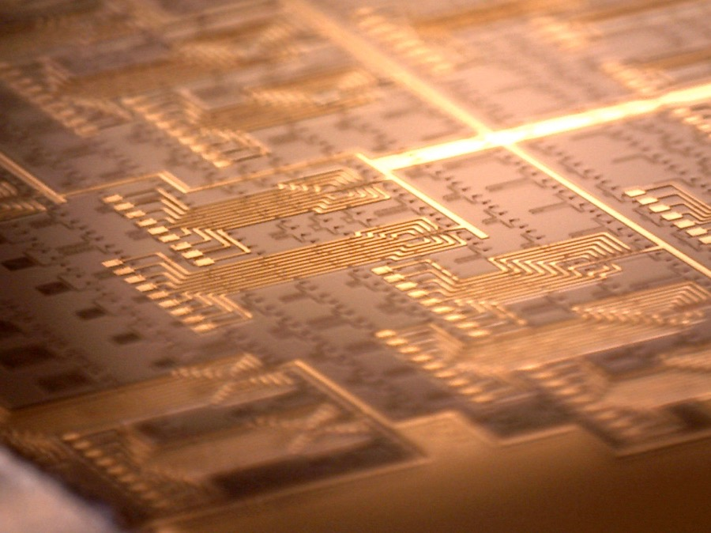
Superconducting Optoelectronics for
Quantum and Neuromorphic Processing
Alex Tait
Faint Photonics Group Sae Woo Nam
Quantum Nanophotonics Group Rich Mirin
Photonics for Quantum Workshop – January 25, 2019
Rochester Institute of Technology

Slide 2
Is nature predictable, in theory?
  Copenhagen interpretation
  Probably not, and
  in either case, the math is elegant
  - Bohr, Heisenberg
  Local realistic interpretation
  Yes, there is a deterministic theory beneath quantum mechanics
  - Einstein:
  “God does not play dice”
Notes:
If you learned quantum mechanincs after 1930, you learned the Copenhagen interpretation, but it has never really been proven

Slide 3
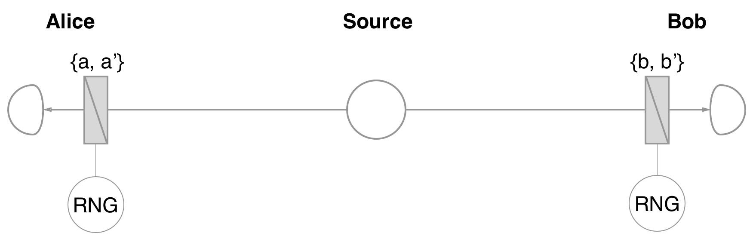
disproving local realism
Local realism is testable
  John Bell, 1975
Local realism is false
  Hensen et al., 2015
  Giustina et al., 2015
  Shalm et al., 2015 (NIST)
Bell test can generate provably unpredictable random numbers
  Bierhorst et al., 2018
entangled photons
Boulder campus
B. Hensen et al., “Loophole-free Bell Inequality Violation Using Electron Spins Separated by 1.3 Kilometres,” Nature 526, 682 (2015).
M. Giustina et al., “Significant-Loophole-Free Test of Bell's Theorem with Entangled Photons,” Phys. Rev. Lett. 115, 250401 (2015).
L. K. Shalm et al., “Strong Loophole-Free Test of Local Realism,” Phys. Rev. Lett. 115, 250402 (2015).
Bierhorst et al., “Experimentally generated randomness certified by the impossibility of superluminal signals,” Nature 556, 7700 (2018).
Notes:
A bell tests involves making entangled particles, separating them far enough so they cannot conspire in some way, then measuring their states’ correlation over many trials.
Local realism predicts that there is a maximum correlation possible. Demonstrating a higher correlation violates local realism.
It also means that we live in a world where there is true randomness.
The data you measure could not have been predicted, even given complete knowledge of the state and history of the universe
It turns out a lot of quantum communication/computing protocols rely on some minimum detection efficiency

Slide 4
God’s Dice
Random key generation is central to
  Cybersecurity
  E-commerce
  Voting machines
http://beacon.nist.gov

Slide 5
neeDs for single Photon detection
Bell test
  >67% detection efficiency
Linear quantum computing
  >99% detection efficiency
Quantum communication
  Photon loss -> redundancy -> vulnerability
This is not comprehensive...
Notes:
.9^10 = 35%

Slide 6
outline
Single photon detectors and quantum information
Cryogenic silicon photonic integration
Superconducting Optoelectronic Networks platform
Neuromorphic photonics and quantum photonics

Slide 7
Single photon detectors
Notes:
Foundation of our particular group at NIST

Slide 8
single photon detection at NIST
Advance science of measuring single photons
Characterize single-photon sources
Transfer detector technology to the public
Investigate new applications
Collaborate
Sae Woo Nam
Contact
saewoo.nam@nist.gov
rich.mirin@nist.gov
jeffrey.shainline@nist.gov
alexander.tait@nist.gov
Notes:
Point 2: All of the components in the characterization setup must be characterized precisely. This is active research
Point 4: Ultimately our mission is to bring the impacts of science and technology to public society, not just conduct science. We want to share our stuff

Slide 9
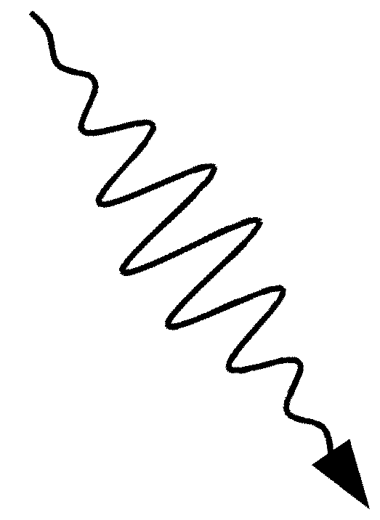

Transition Edge Sensor (TES)
Calorimetric detection
UV/visible/IR photons
Superconducting
transition edge
Energy
deposition
Thermometer
~1 mK
R_{n}
R
Absorber, C
~8 Ω
~0.2 Ω
Weak thermal link, g
T
~0.2 mK
Thermal sink
(50 mK)

Slide 10

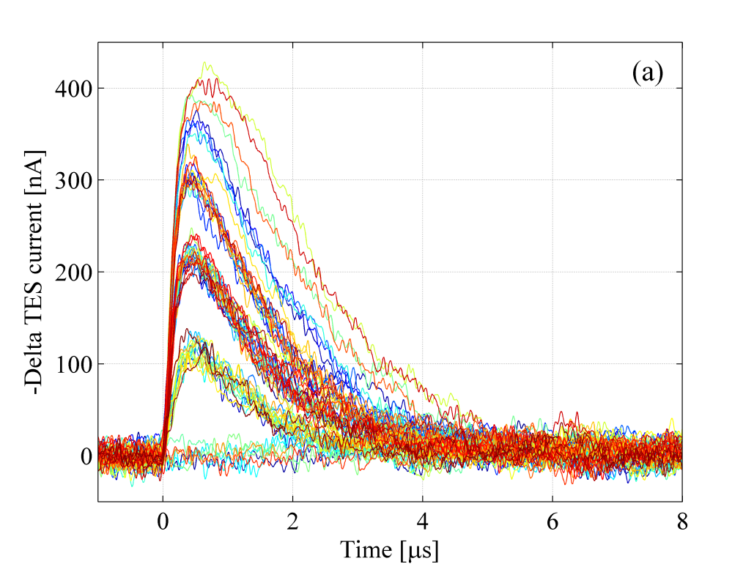
Transition Edge Sensor (TES)
25 μm
Tungsten
(W)
Nb wires
805 nm: η_{System} = 97.7 ± 1.5 %
Goal 1: increase this number
Goal 2: decrease this number
Notes:
Very clear difference between 1 photon and 0 photons
We are trying to get that to 99.9%.
Measurement accuracy is something we are trying to improve.
Imagine instead of detecting 2 photons, your QI protocol needs to detect 10 photons at a time.

Slide 11
superconducting nanowire Single-photon detector
(SNSPD)

Slide 12
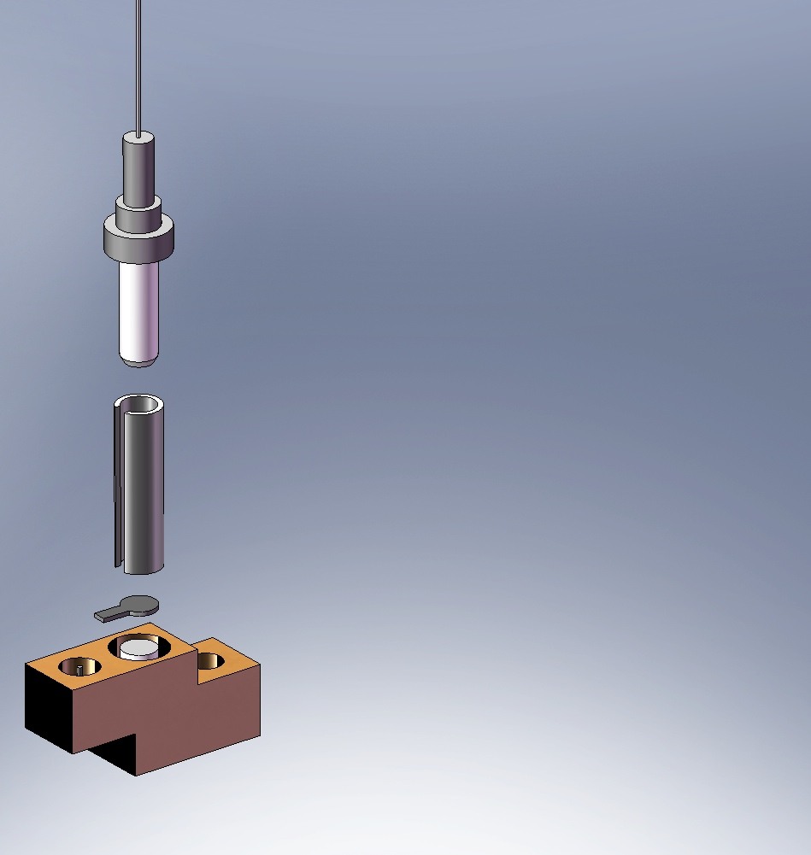
system detection efficiency
Optical fiber
Fiber ferrule
Zirconia sleeve
Device chip
Sapphire rod
Coaxial connector pin
Miller et al., Opt. Express (2011)
Notes:
If you want to buy, contact them.
If you want to learn, contact us.
there is no secret

Slide 13
Cryogenic silicon photonics

Slide 14
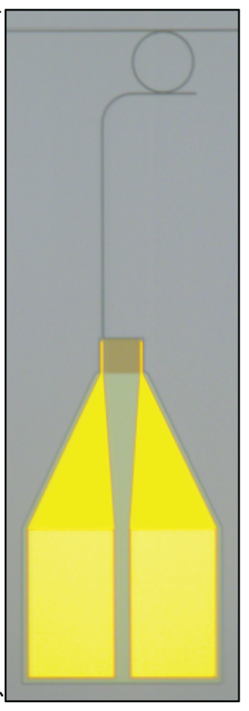
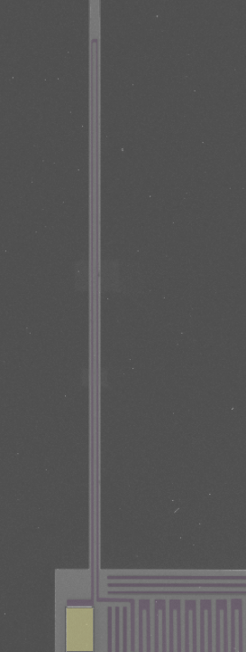
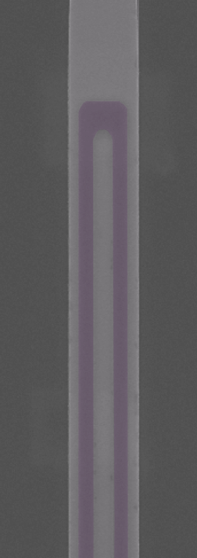
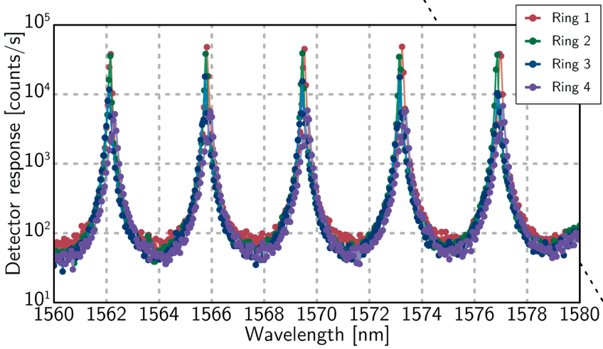
Co-integration: waveguides + SNSPDs
1 um
Jeff Shainline
Shainline et al. ” Room-temperature-deposited dielectrics and superconductors for...” Op. Ex. 25 10322 (2017).
Notes:
No dark counts
High yield
Photonic routing

Slide 15
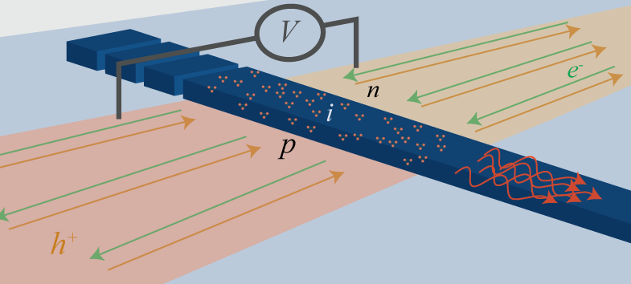
All-silicon light emitting diodes
Some Si defects have an optical transition
Low temp. inhibits non-radiative decay
Electrical pumping with PN junction
Sonia Buckley
S. M. Buckley et al. “All-silicon light-emitting diodes waveguide-integrated with superconducting single- photon detectors ” Applied Physics Letters, 111 (14). 2017.
Notes:
Describe the fabrication briefly

Slide 16
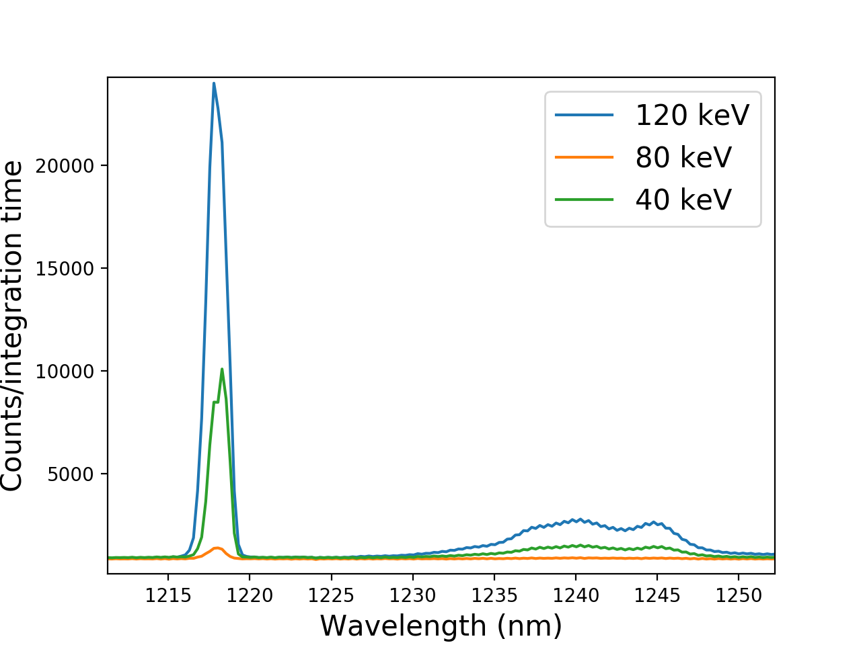
optimizing emission on 12 inch wafers
Implanted at SUNY Poly
Measured at NIST
Photoluminescence
Consistent (±10%)
up to 35 Kelvin
Si⁺
300mm
Recent results
50x enhancement from prior runs
Evidence of localization in device layer, not handle layer
Pops
Notes:
Just verbally talk about etch away tests

Slide 17
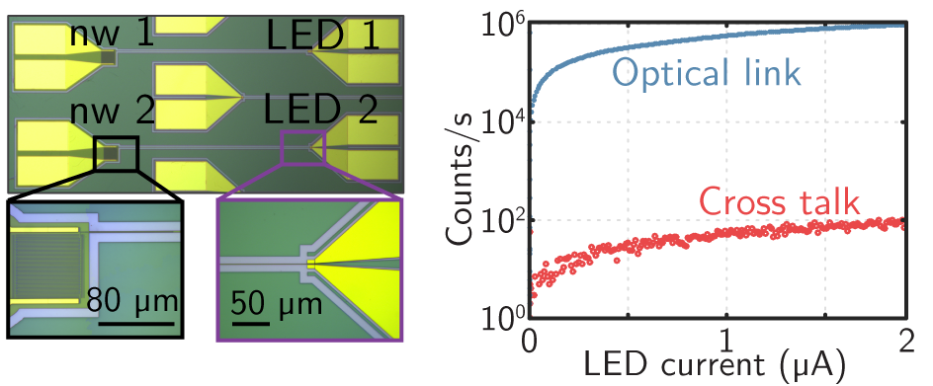
Co-integration: Silicon LEDS + SNSPDS
S. M. Buckley et al. “All-silicon light-emitting diodes waveguide-integrated with superconducting single- photon detectors ” Applied Physics Letters, 111 (14). 2017.

Slide 18
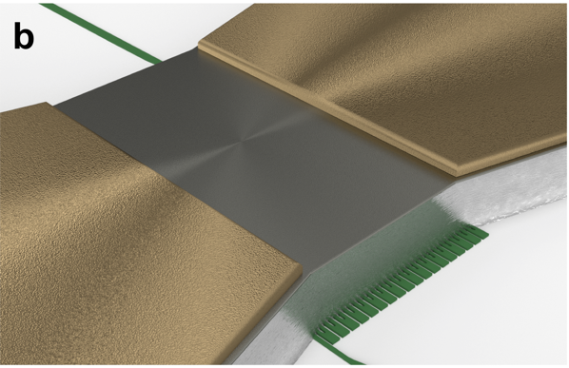
Superconducting amplifiers
Interface: superconductor signals to semiconductor readout
millivolt input -> Volt output
No Josephson Junctions
Adam McCaughan
A. McCaughan et al. “A compact, ultrahigh impedance superconducting thermal switch for interfacing superconductors with semiconductors and optoelectronics,” Submission pending government reopen. 2019

Slide 19
The SOEN platform
Superconducting OptoElectronic Networks

Slide 20
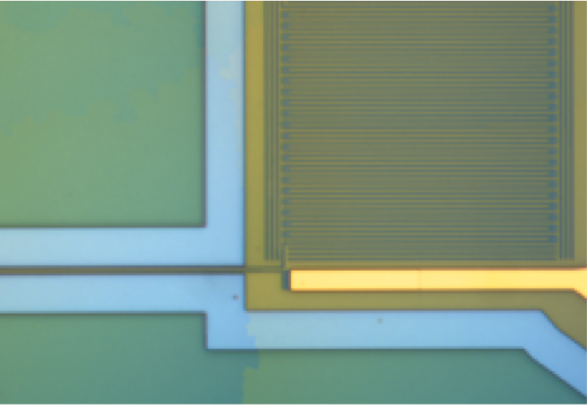
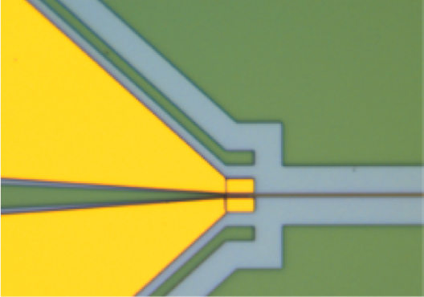
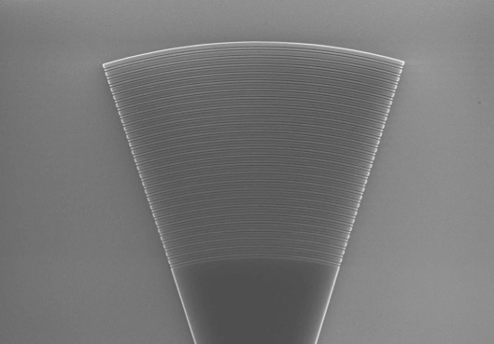
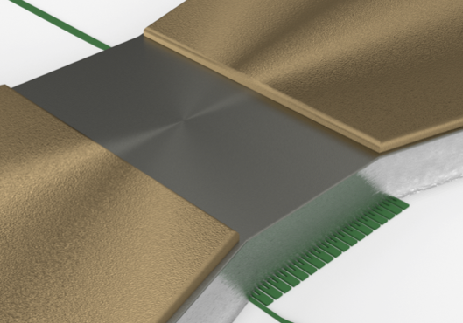
Single-photon detectors
Silicon light sources
Silicon passives
Superconducting amplifiers
NIST is opening this process to the public

Slide 21
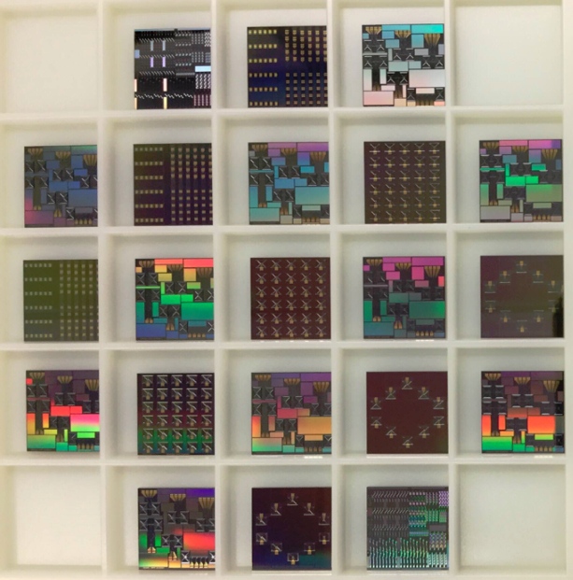
Multi-project wafer format
Fabricated in NIST cleanroom
  3” wafers, 1x1 cm die
  220nm SOI device layer
Process design kit
  Open-access, open-source
  Online (pending govt. reopen)
Preferred design tools
  KLayout (free software)
  phidl (open-source)
3”
www.klayout.de
github.com/amccaugh/phidl
Notes:
You can use other design tools of your choice. Maybe “supported” should be “preferred.
Make a point: we want academics and small companies to be on equal footing with large companies. Hence the way we are releasing it.

Slide 22
More complex systems
LED
Complex systems are enabled by
  High yield
  Electrical-in/Electrical-out
High Dynamic Range Detector Array [1]
  Consistent splitting and efficiency
  No discrete optics or fibers
Fit lines
Nanowire response
Nanowire index
S. M. Buckley et al. “All-silicon light-emitting diodes waveguide-integrated with superconducting single- photon detectors ” Applied Physics Letters, 111 (14). 2017.
Notes:
36 SNSPDs working of 36 tested

Slide 23
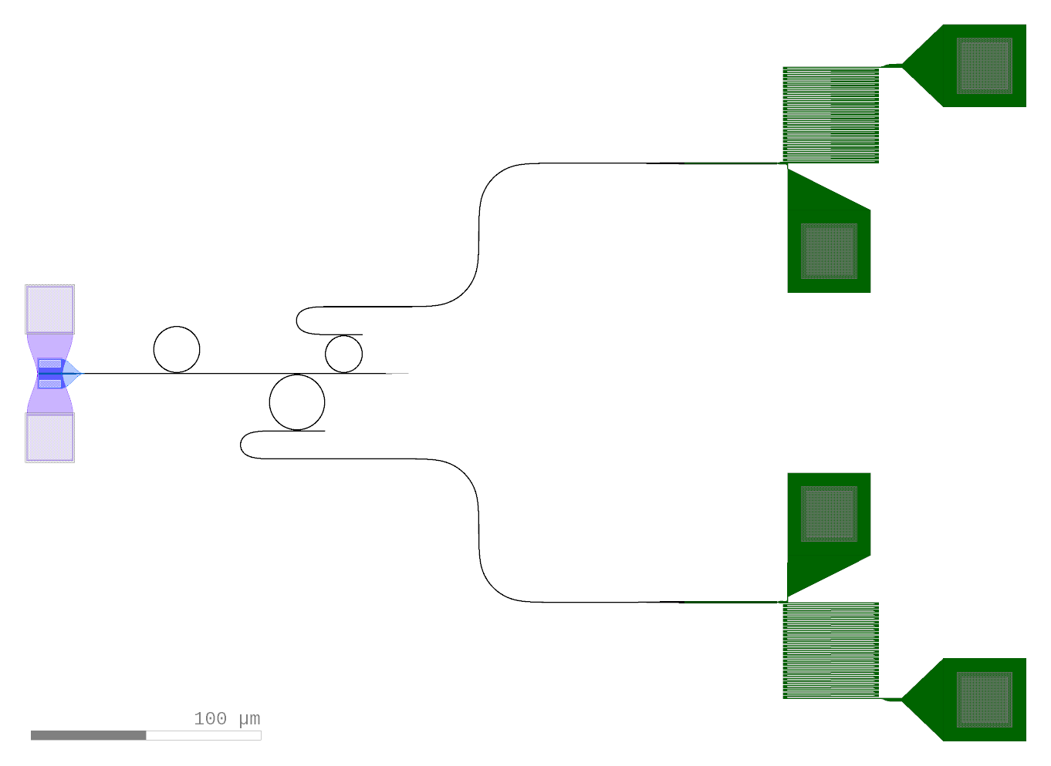
example: photon pair generation
Sources
[1, 2, 3]
Detectors
Buffers
[1] Cale M. Gentry et al. “Quantum-correlated photon pairs generated in a commercial 45nm complementary metal-oxide semiconductor microelectronic chip,” Optica, vol. 2, pp. 1065–1071, 2015.
[2] Marc Savanier, Ranjeet Kumar, and Shayan Mookherjea, “Photon pair generation from compact silicon microring resonators using microwatt-level pump powers,” Op. Ex, vol. 24, pp. 3313–3328, 2016.
[3] Xiyuan Lu et al., “Chip-integrated visible-telecom photon pair sources for quantum communication,” arXiv: 1805.04011, 2018.
Notes:
SAY: Our group makes a lot of single photon sources.
We are very interested in single photon sources.
Thinking about quantum dots

Slide 24
What can you come up with?
Silicon Photonic
Quantum Information
Circuit
Sources
Detectors
Buffers
Notes:
SAY: Our group makes a lot of single photon sources.
We are very interested in single photon sources.
Thinking about quantum dots

Slide 25
We are looking for collaborators
With expertise in integrated photonic device measurement
  Cryogenic temperatures
  High speed
Have new ideas for applications in
  Quantum information science
  Measurement science
  Neuromorphic Photonics
Willing to design characterization structures and report findings
  Detectors
  Sources (esp. single photon)
  Passives
Contact
jeffrey.shainline@nist.gov
alexander.tait@nist.gov
saewoo.nam@nist.gov
rich.mirin@nist.gov
Notes:
Is it accurate to say public access will be 2020?

Slide 26
Neuromorphic Photonics

Slide 27
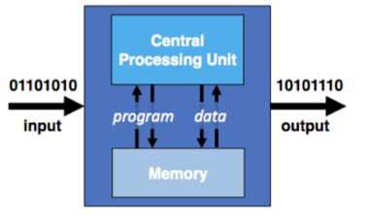
Neural networks in computing
Today, there is large demand to perform neural network operations
Conventional computers are inefficient at doing these operations
Neural network: distributed
argmax
. . .
Conventional computer: centralized
Notes:
Blow through this slide

Slide 28
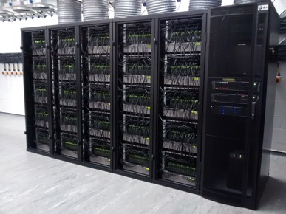
Neuromorphic hardware
Broadcast
Weights
Sum
Nonlinearity
Based on synaptic cross-bars
∑
. . .
∑
Specialized distributed hardware
Does neural network operations
High communication cost
  Energy
  Time
Robotics, supercomputing
[1] F. Akopyan et al, “TrueNorth: Design and tool flow of a 65 mW 1 million neuron programmable neurosynaptic chip,” 2015.
[2] S. B. Furber et al. “The SpiNNaker project,” May 2014.
Notes:
At the end: Make the argument: connectivity -> photons; efficiency -> single photons

Slide 29
Superconducting optoelectronic networks
Weights
Sum
SOEN neuron
Broadcast
Nonlinearity
∑
Detect
Amplify
Transmit
. . .
∑
Cryogenic temperatures
Extremely low power dissipation
Goal: Maximum scalability
beam tap
Jeff Chiles
J. M. Shainline et al., “Superconducting optoelectronic circuits for neuromorphic computing,” Phys. Rev. Applied, vol. 7, p. 034013, Mar 2017.
J. Chiles et al., “Design, fabrication, and metrology of 10x100 multi-planar integrated photonic routing manifolds for neural networks,” APL Photonics, vol. 3, p. 106101, 2018/08/08 2018.

Slide 30

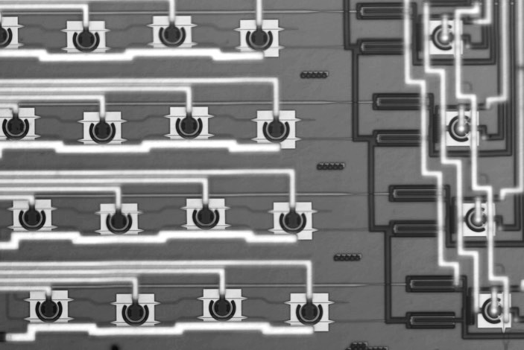
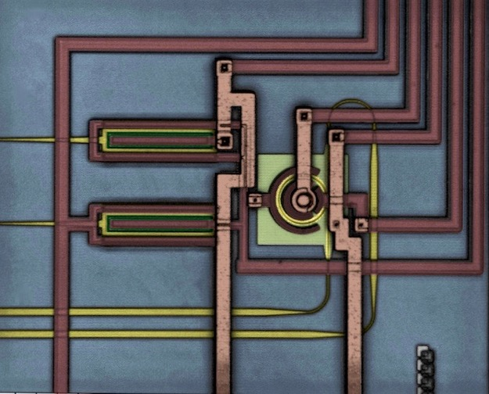
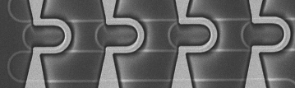
silicon photonic neural networks
weight matrix
neurons
Silicon photonic neuron
[1]
[3]
MRR modulator
V–
V⁺
GND
I_{h}
I_{b}
IN+
photodetector (PD+)
MRR weight bank
Heater
Ge
photodetector (PD–)
IN–
Pump
Si WGs
Al wires
Out
50µm
d)
Electro-optic nonlinearity
10 – 40 GHz operation
Foundry compatible
[2]
IN
THRU
25 µm
DROP
[1] A. Tait, M. A. Nahmias, B. J. Shastri, and P. R. Prucnal, “Broadcast and Weight: an Integrated Network for Scalable Photonic Spike Processing,” J. Lightwave Technol., 32(21), 2014.
[2] A. Tait, T. Ferreira de Lima, E. Zhou, A. X. Wu, M. A. Nahmias, B. J. Shastri, and P. R. Prucnal, “Neuromorphic Photonic Networks Using Silicon Photonic Weight Banks.” Scientific Reports, 7(1). 2017.
[3] A. Tait, T. Ferreira de Lima, M. A. Nahmias, H. B. Miller, H.-T. Peng, B. J. Shastri, and P. R. Prucnal
“A silicon photonic modulator neuron.” arXiv preprint:1812.11898. Dec. 2018.

Slide 31
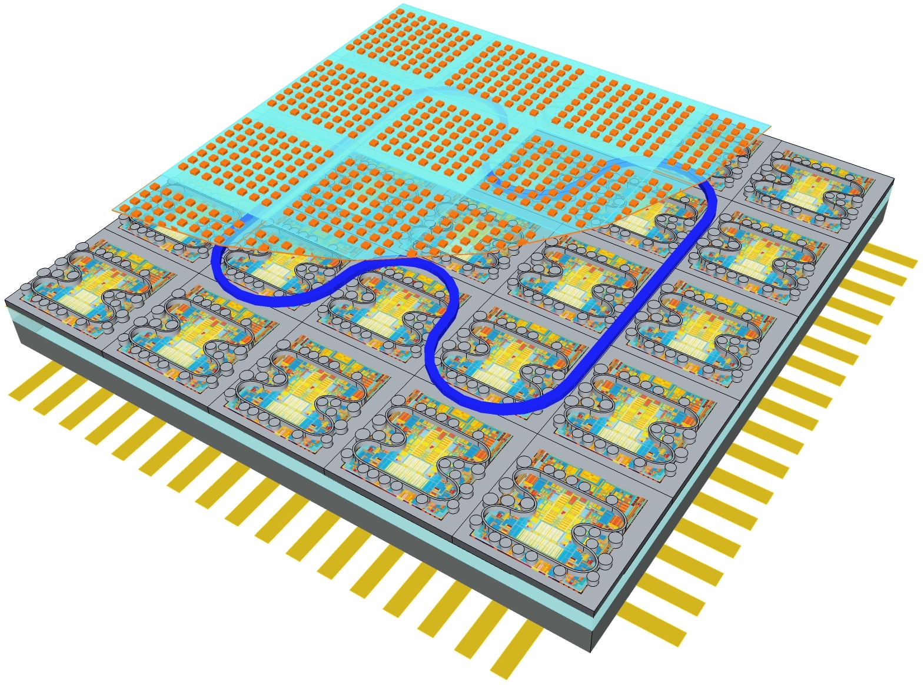
Next steps: hierarchical Networks
Large neural networks are hierarchical
Photonics does well with long-range communication
How do we design chip-scale systems? wafer scale? datacenter scale?
layout rendering
connection matrix
[2]
[1]
Neuron # (x 10⁻³)
region
module
Neuron # (x 10⁻³)
[1] Paul Prucnal and Bhavin Shastri. Neuromorphic Photonics. CRC Press, 2017.
[2] J. M. Shainline et al. “Superconducting Optoelectronic Neurons V: Networks and Scaling,” arXiv:1805:01942, 2018.
Notes:
The “how do” leads into the next slide

Slide 32
large-scale silicon photonic systems
Challenges to quantum and neuromorphic computing are shared
Basic component quality
Large-volume manufacturability
Small-volume research prototyping
Notes:
Why is silicon photonics the way it is?
Demand for quantum computers? No

Slide 33
large-scale silicon photonic systems
Challenges to quantum and neuromorphic computing are shared
Basic component quality
Large-volume manufacturability
Small-volume research prototyping
Externalized technological risk
(thanks to Datacomm.)
[1] The Cattington Post
Notes:
It’s demand for cat videos.
Datacenters need fiber optics and lots of cheap optical receivers and transmitters
That industry invested in silicon photonics. The demand is not going away
That is externalized technological risk.
It is unprecedented in the history of optics to have a stable platform technology

Slide 34
large-scale silicon photonic systems
Challenges to quantum and neuromorphic computing are shared
Basic component quality
Large-volume manufacturability
Small-volume research prototyping
Externalized technological risks
(thanks to Datacomm.)
I/O, packaging
System-level design tools
Process variation
Control complexity
Heat dissipation density
Semi-externalized
Specific to large-scale systems
Notes:
BUT, where it gets hard is where the needs of large-scale depart from those of data communication.
That’s where we need to work together
"Going to make a sentence point on each one”

Slide 35
summary
Quantum and Neuromorphic share platform technologies
Co-integrated passives, sources, amplifiers, SPDs
This platform will become available to the public
NIST trying to advance single photon devices, metrology, and applications

Slide 36
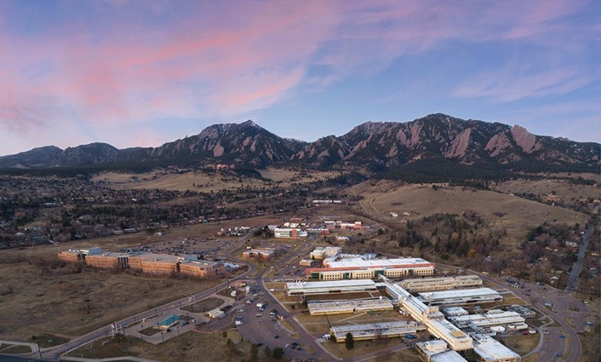
NIST team
Sae Woo Nam
Rich Mirin
Jeff Shainline
Sonia Buckley
Adam McCaughan
Jeff Chiles
Alex Tait
Saeed Khan
Krister Shalm
Marty Stevens
Adriana Lita
Varun Verma
Nima Nader
Mike Mazurek
Dileep Reddy
Eric Stanton
Galen Moody
Kevin Silverman
Thomas Gerrits
Contact
saewoo.nam@nist.gov
rich.mirin@nist.gov
jeffrey.shainline@nist.gov
alexander.tait@nist.gov
atait@ieee.org
Postdoctoral
opportunities
Boulder Labs

