Slide 1
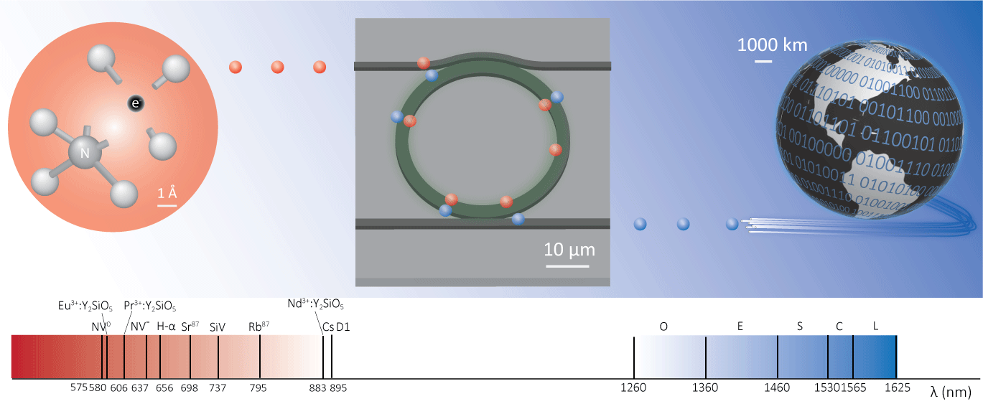




Chip-integrated visible-telecom entangled
photon pair source for quantum communication
X. Lu et al., Nat. Phys., Jan, 2019. doi:10.1038/s41567-018-0394-3
3 dB attenuation distance
in single mode fiber
370 nm (Yb⁺ ion): < 50 m
637 nm (NV⁻): 300 m
780 nm (Rb): 750 m
940 nm (QD): 1.5 km
1300 nm (O-band): 10 km
1550 nm (C-band): 15 km
Xiyuan Lu,^{1, 2} Qing Li,^{1, 2} Daron A. Westly,² Gregory Moille,^{1, 2} Anshuman Singh,^{1, 2} Vikas Anant,³ and Kartik Srinivasan²
1 2 3
Notes:
Challenge of interfacing visible wavelength quantum systems, with the telecom band.
We want to use nanophotonics because of the scalability, but also because the nonlinear nanophotonic systems are suited for this application.
One commonly thought approach now is nanophotonic frequency conversion.

Slide 2
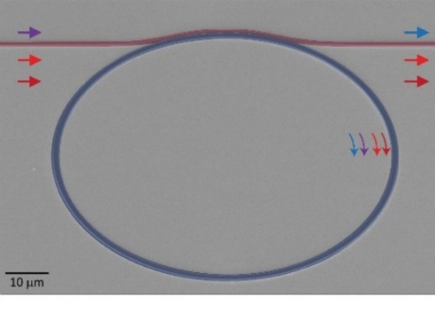
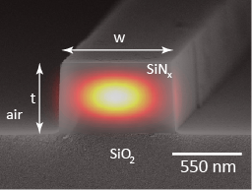
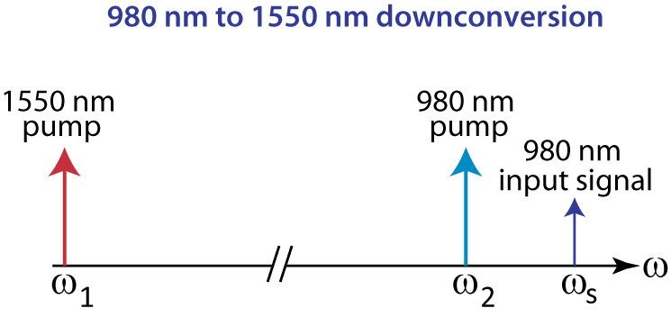
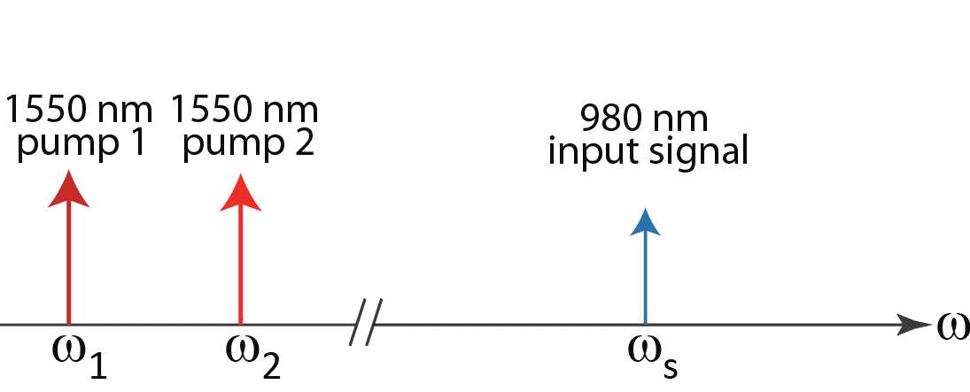
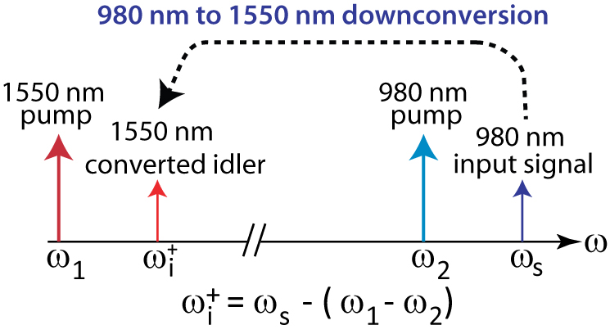
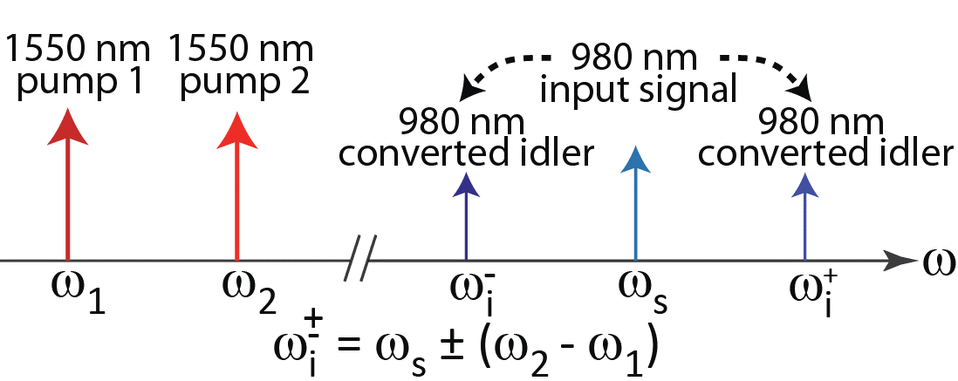




Nanophotonic frequency conversion
Four-wave-mixing Bragg scattering Two pumps at ω₁ and ω₂ induce an effective grating in the nonlinearity => sets spectral translation range as ±(ω₂-ω₁)
Q. Li et al., Nat. Photon. 10, 406-414 (2016)
Air/SiO₂ Cladding ($n≈1.0/1.5$)
SiN_{x} ($n≈2.0)$
SiO₂ ($n≈1.5)$
Si ($n≈3.5)$

Slide 3
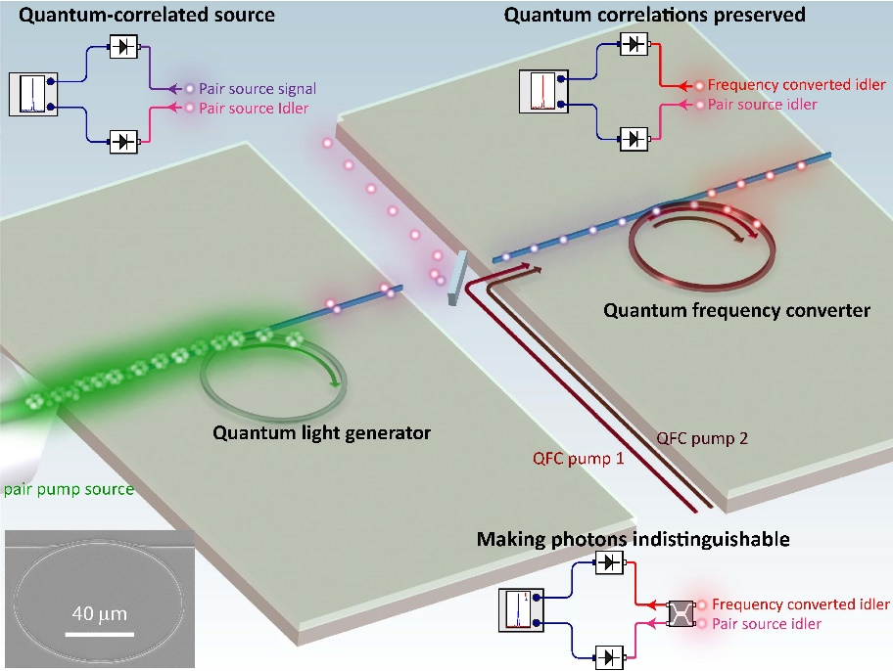
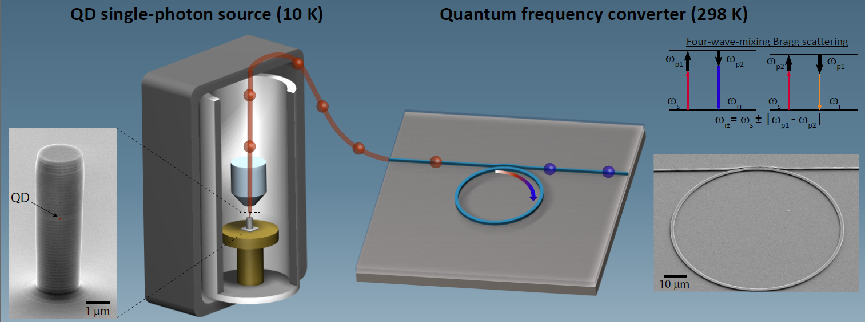
Quantum frequency conversion (QFC)
QFC of photon pair source
QFC of quantum dot
Q. Li et al., under review
A. Singh et al., under review
Both 980 nm intraband conversion
Nontrivial for visible-telecom QFC
Pump noise, dispersion, pump laser etc.
Visible
pump
Visible
pump
Visible
input signal

Slide 4
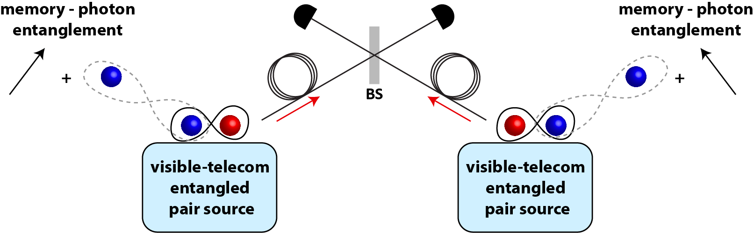
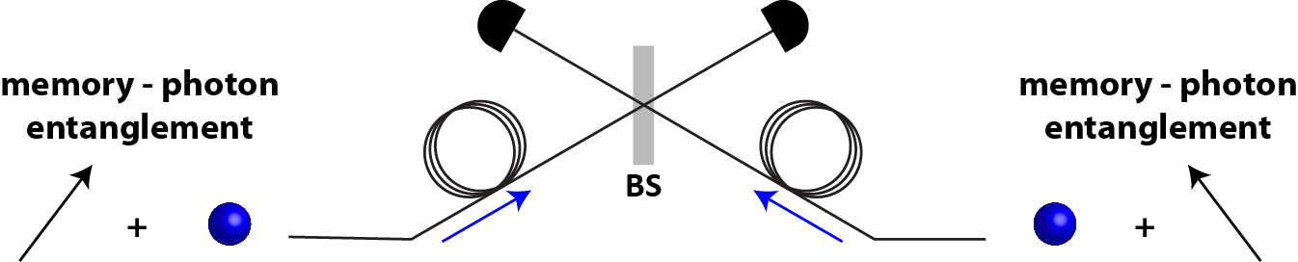
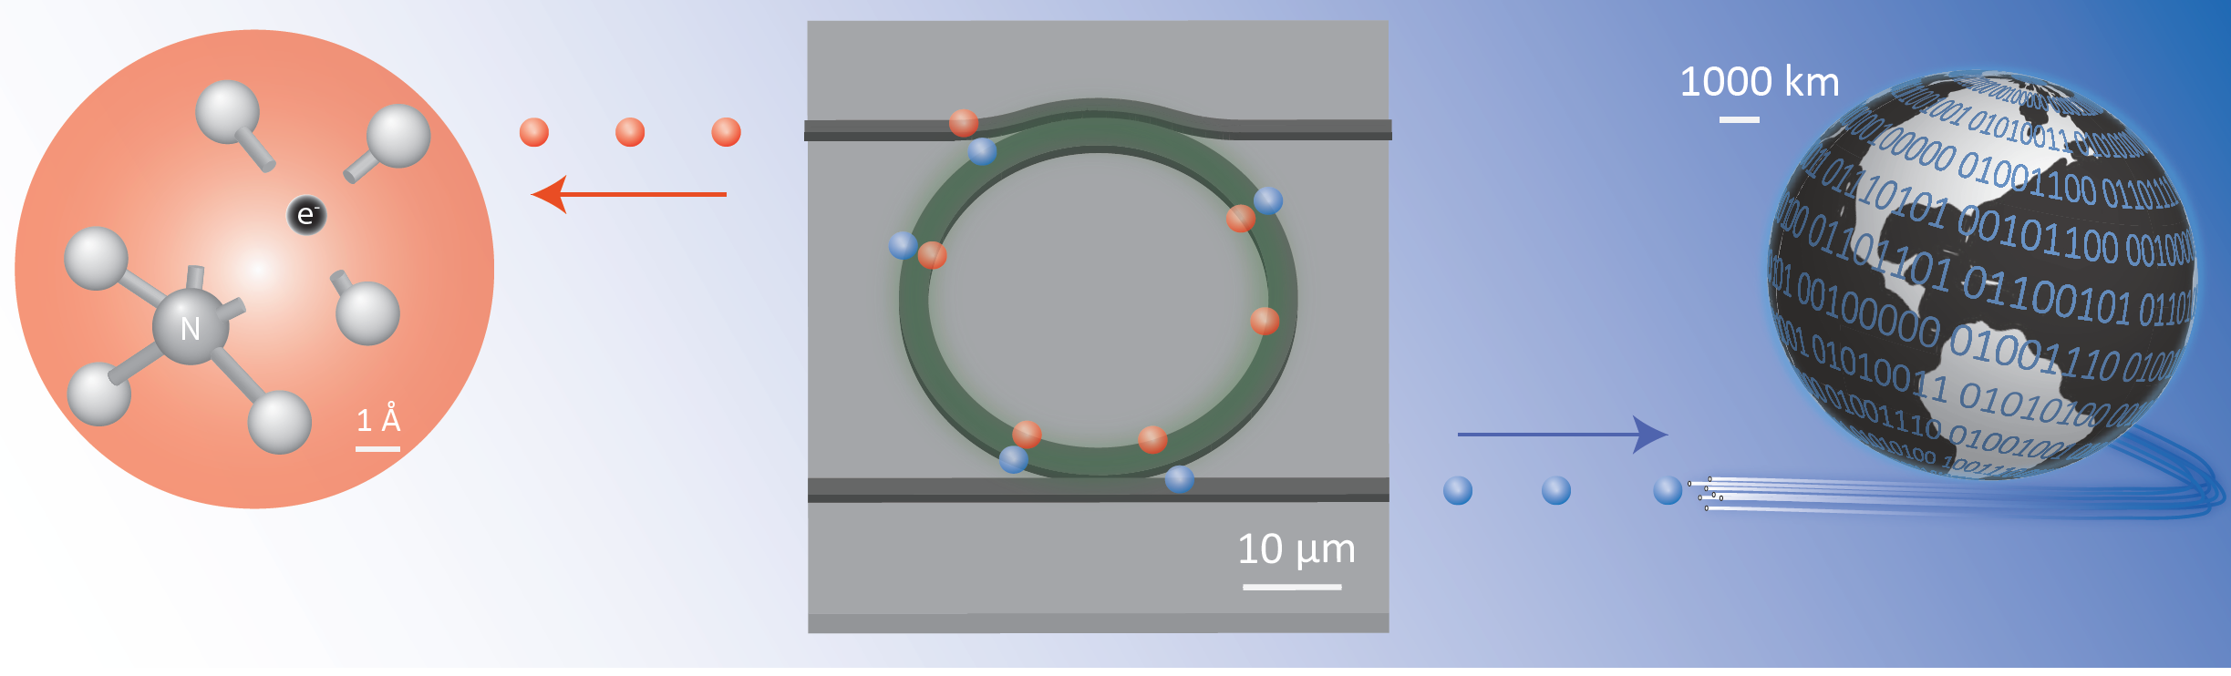
Visible-telecom photon pair source
Motivation: entanglement swapping
Entangle remote quantum memories using visible-telecom entangled photon pair sources
Motivation: entanglement swapping
Most quantum memories are in the visible
Visible photons have limited travel range in optical fibers
Requirements
Wide-band (visible/telecom)
Narrow-linewidth (MHz~GHz)
Pure (CAR > 100)
Bright (high photon flux)
Efficient (sub-mW power)
Integrable (on-chip)
3 dB attenuation distance
in single mode fiber
370 nm (Yb⁺ ion): < 50 m
637 nm (NV⁻): 300 m
780 nm (Rb): 750 m
940 nm (QD): 1.5 km
1300 nm (O-band): 10 km
1550 nm (C-band): 15 km
Entanglement swapping by time measurement:
M. Halder et al. Nat. Phys. 3, 692-696 (2007)
A review for photon source:
M. D. Eisaman et al., Rev. Sci. Instr. 82, 071101 (2011)

Slide 5
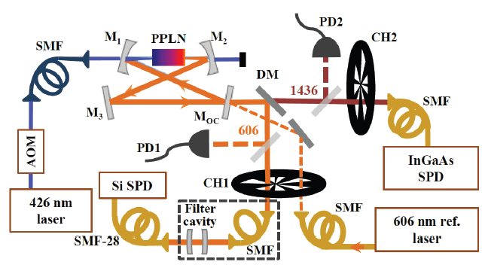
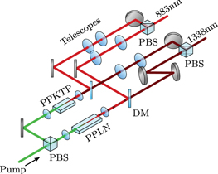
Visible-telecom photon pair source
PPLN/PPKTP & filtering/cavity
J. Fekete et al., Phys. Rev. Lett.110, 220 502 (2013)
C. Clausen et al., New J. Phys. 16, 093058 (2014)
O. Slattery et al., Appl. Phys. B 121, 413–419 (2015)
D. Rieländer et al., New J. Phys. 18, 123 013 (2016)
PPLN/PPKTP
Wide-band (visible/telecom)
Broadband, external filtering/cavity
Pure (CAR > 100)
Bright (high photon flux)
Power efficient (if cavity is used)
Cavity ~ 1 meter, not integrable yet

Slide 6
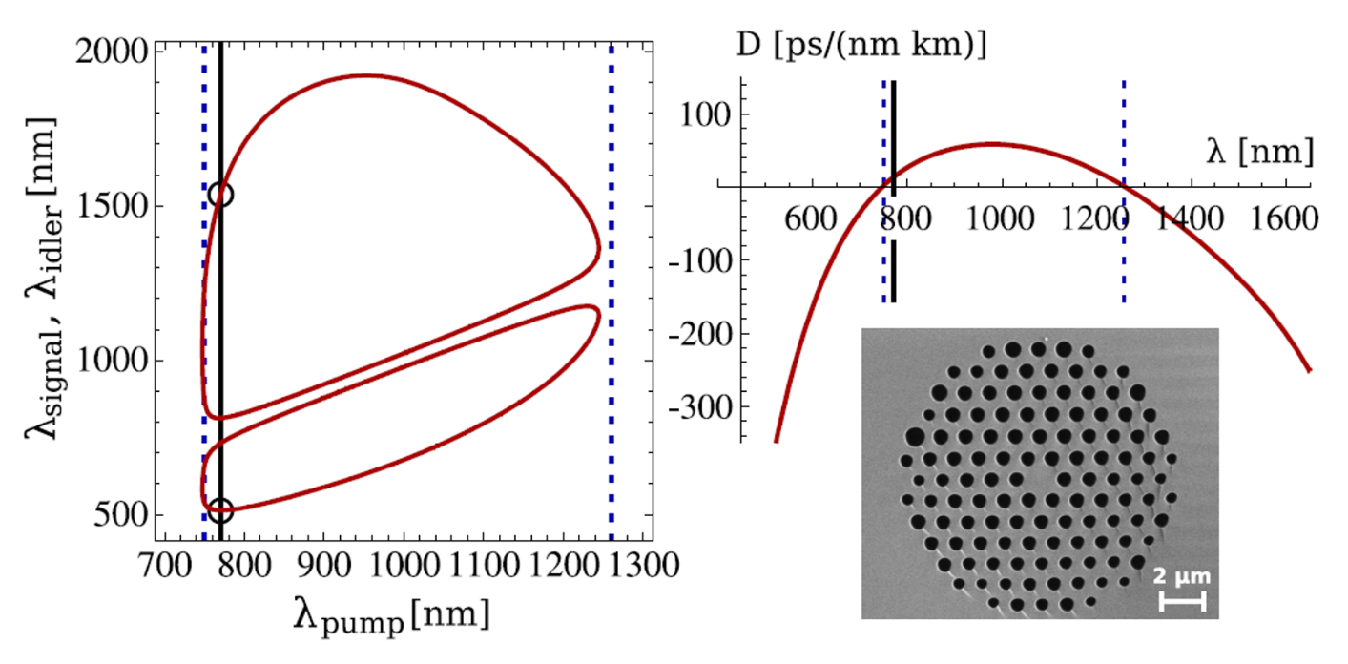
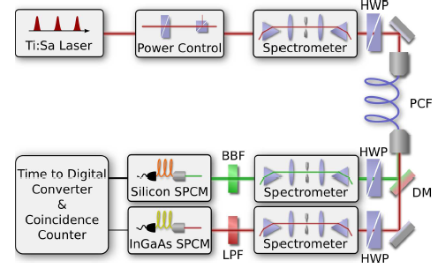
Visible-telecom photon pair source
PPLN/PPKTP & filtering/cavity
J. Fekete et al., Phys. Rev. Lett.110, 220 502 (2013)
C. Clausen et al., New J. Phys. 16, 093058 (2014)
O. Slattery et al., Appl. Phys. B 121, 413–419 (2015)
D. Rieländer et al., New J. Phys. 18, 123 013 (2016)
PhC fiber
C. Söller et al., Phys. Rev. A 81, 031 801 (2010)
PhC fiber
Wide-band (visible/telecom)
Broadband, ~ 1nm
CAR low, typical a few 10s
Bright (high photon flux)
fs laser pulse needed
Length ~ 10 cm, already in fiber

Slide 7
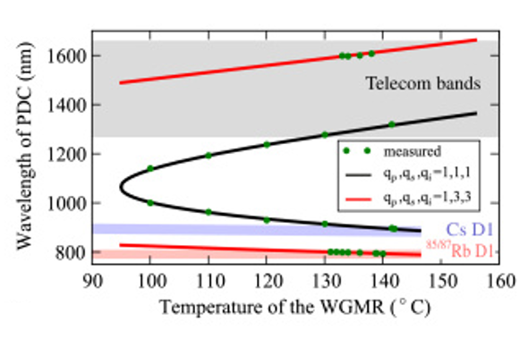
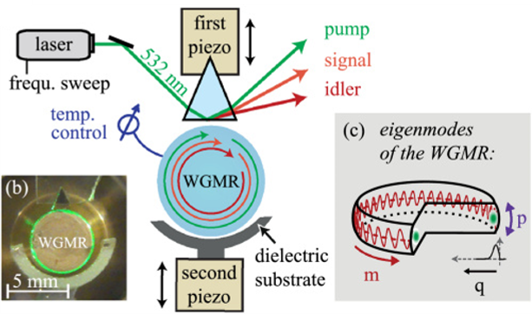
Visible-telecom photon pair source
PPLN/PPKTP & filtering/cavity
J. Fekete et al., Phys. Rev. Lett.110, 220 502 (2013)
C. Clausen et al., New J. Phys. 16, 093058 (2014)
O. Slattery et al., Appl. Phys. B 121, 413–419 (2015)
D. Rieländer et al., New J. Phys. 18, 123 013 (2016)
PhC fiber
C. Söller et al., Phys. Rev. A 81, 031 801 (2010)
Lithium Niobate mm-resonator
G. Schunk et al., Optica 2, 773–778 (2015)
LiNbO3 mm-resonator
Wide-band (visible/telecom)
Narrow-band (17 MHz)
CAR low, < 20
Bright (high photon flux)
Efficient (a few microwatt)
Length ~ a few mm, not integrable yet

Slide 8
Visible-telecom photon pair source
PPLN/PPKTP & filtering/cavity
J. Fekete et al., Phys. Rev. Lett.110, 220 502 (2013)
C. Clausen et al., New J. Phys. 16, 093058 (2014)
O. Slattery et al., Appl. Phys. B 121, 413–419 (2015)
D. Rieländer et al., New J. Phys. 18, 123 013 (2016)
PhC fiber
C. Söller et al., Phys. Rev. A 81, 031 801 (2010)
LiNbO3 mm-resonator
G. Schunk et al., Optica 2, 773–778 (2015)
PhC fiber
Wide-band (visible/telecom)
Broadband, need filtering/cavity
CAR low, typical a few 10s
Bright (high photon flux)
High power pump/pulse needed
Length ~ 10 cm
No nanophotonic source for our intended applications yet!
PPLN/PPKTP
Wide-band (visible/telecom)
Broadband, need filtering/cavity
Pure (CAR > 100)
Bright (high photon flux)
Efficient (sub-mW power)
Cavity ~ 1 meter, not integrable yet
LiNbO3 mm-resonator
Wide-band (visible/telecom)
Narrow-band
CAR low, typical a few 10s
Bright (high photon flux)
Efficient (sub-mW power)
Length ~ a few mm, not integrable yet

Slide 9
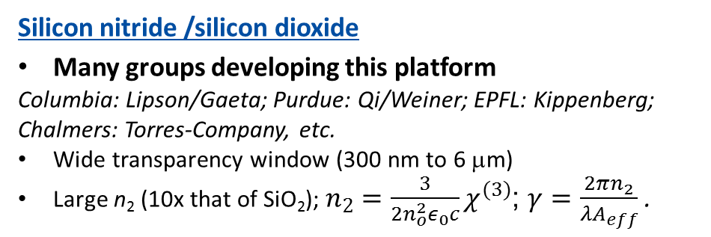
Silicon nitride nanophotonics/photon pair source
Silicon nitride /silicon dioxide
Many groups developing this platform
Columbia: Lipson/Gaeta; Purdue: Qi/Weiner; EPFL: Kippenberg; Chalmers: Torres-Company, etc.
Wide transparency window (300 nm to 6 μm)
Large n₂ (10x that of SiO₂); $n_{2}=\frac{3}{2n_{o}^{2}ε_{0}c}χ^{(3)}$; $γ=\frac{2πn_{2}}{λA_{eff}}$ .
Review: D. J. Moss et al., Nat. Photon. 7, 597-607 (2013)
Air/SiO₂ Cladding ($n≈1.0/1.5$)
SiN_{x} ($n≈2.0)$
SiO₂ ($n≈1.5)$
Silicon nitride nanophotonics
Frequency comb
T. J. Kippenberg, et al., Science, 332, 555 (2011)
Y. Okawachi et al., Opt. Lett. 36, 3398–3400 (2011)
Q. Li et al, Optica 4, 193–203 (2017)
M. Karpov, Nat. Commun. 9,1146 (2018)
D. T. Spencer et al., Nature, 557, 81-85 (2018)
High dimensional frequency-bin
M. Kues et al., Nature, 546, 622-626 (2017)
P. Imany et al., Opt. Express, 26, 1825-1840 (2018)
Harmonic generation, QFC etc.
Q. Li et al., Nat. Photon. 10, 406-414 (2016)
J. S. Levy et al., Opt. Express, 19, 11415-11421 (2011)
Si ($n≈3.5)$
Silicon nitride photon pair source
S. Ramelow et al., arXiv:1508.04358 (2015)
J. A. Jaramilllo-Villegas et al., IPRSN, IW3A.2 (2016)
Limited to telecom band and inferior to Si
Not very pure (CAR < 100)
Q. Li et al., under review (980 nm Pair + QFC)
Wide-band pair source surpassing Si!
This CAR has room to improve!

Slide 10
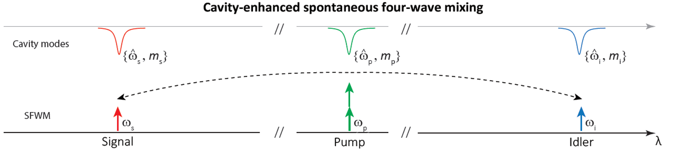
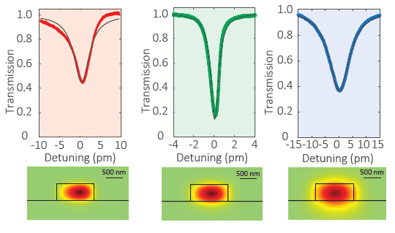
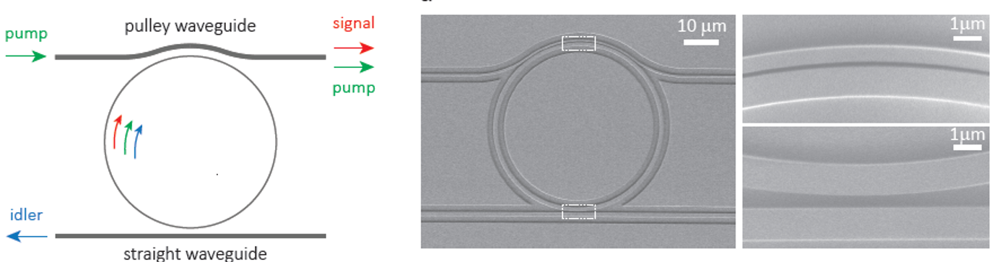
Device scheme
Single Fundamental Mode Family (SFMF) engineering
Dispersion
Coupling
X. Lu et al., Nat. Phys., Jan, 2019. doi:10.1038/s41567-018-0394-3

Slide 11
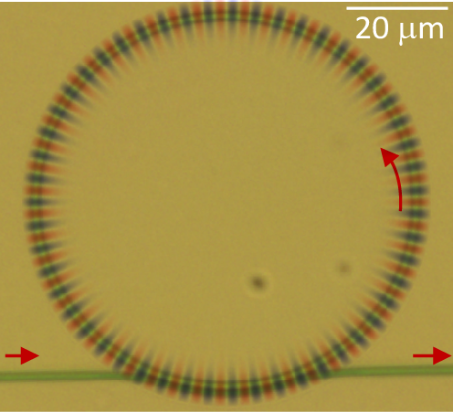
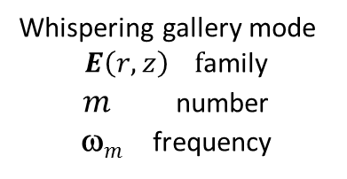


Efficient four-wave mixing in a microresonator
Frequency-matching
Interacting modes need to be frequency matched
  2ω_{p}=ω_{i} + ω_{s}
  Dispersion engineering so that overall mismatch is within a cavity linewidth
Phase-matching
For single mode family operation, interacting modes are phase matched when
  2β_{p}=β_{i} + β_{s} => 2m_{p}=m_{i} + m_{s}
Resonator enhancement
  High loaded Q for the three modes
  Mode overlap for the three modes
Resonator-waveguide coupling
  Efficient injection of pump mode
  Efficient extraction of signal and idler mode
Single fundamental mode family (TE1)
Selective mode splitting
Frequency-matching
Interacting modes need to be frequency matched
  2ω_{p}=ω_{i} + ω_{s}
  Dispersion engineering so that overall mismatch is within a cavity linewidth
Phase-matching
For single mode family operation, interacting modes are phase matched when
  2β_{p}=β_{i} + β_{s} => 2m_{p}=m_{i} + m_{s}
Resonator enhancement
  High loaded Q for the three modes
  Mode overlap for the three modes
Resonator-waveguide coupling
  Efficient injection of pump mode
  Efficient extraction of signal and idler mode
Single fundamental mode family (TE1)
Selective mode splitting
Whispering gallery mode
$$E\left(r,z\right) \text{f}\text{amily}$$
$m$ number
ω$m$ frequency
$$E\left(r,φ,z\right)=E\left(r,z\right)e^{imφ}$$
$E\left(r,z\right)$ | TE1 mode family

Slide 12
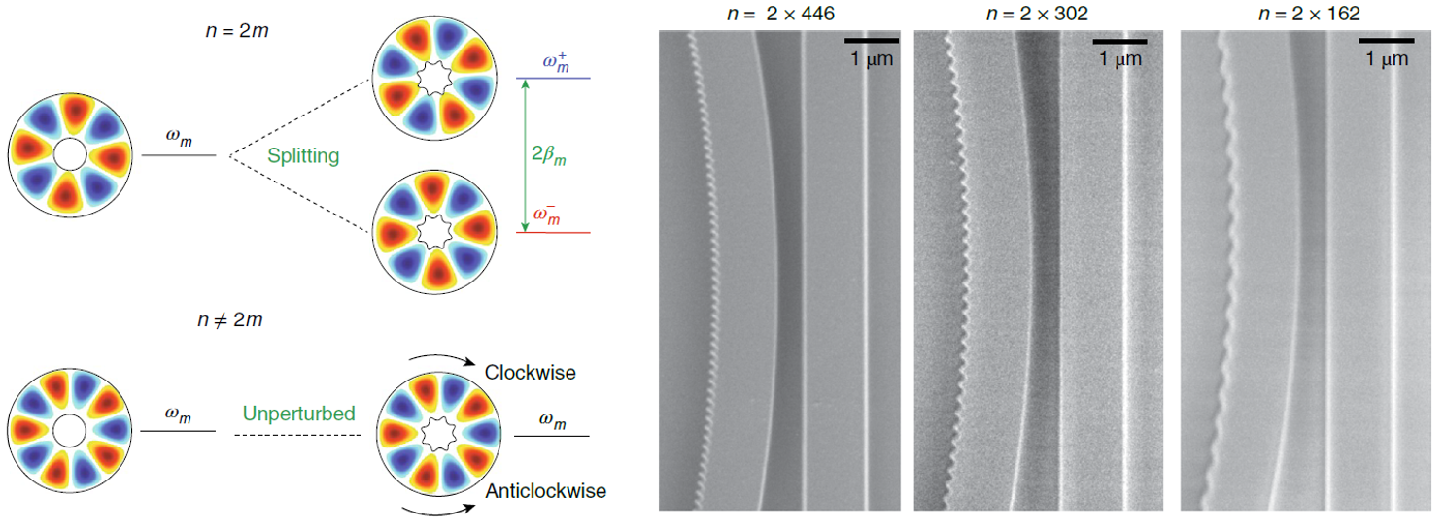


Selective mode splitting
X. Lu et al., Appl. Phys. Lett. 105, 151104 (2014)
Coherent geometric modulation to split and only split targeted modes
For example, the inside ring radius is modulated by
Coherent geometric modulation to split targeted modes only
For example, the inside ring radius is modulated by
$r\left(ϕ\right)=r+ αn cos⁡(nϕ)$ $0$
$r\left(ϕ\right)=r+ αn cos⁡(nϕ)$ $0$
The mode splitting is orthonormal and can be estimated by
The mode splitting is orthonormal and can be estimated by
$$βm=g αn δ(n,2m)$$
$$βm=g αn δ(n,2m)$$

Slide 13
Selective mode splitting

Slide 14
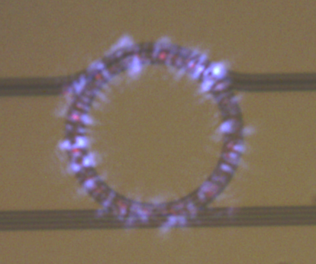
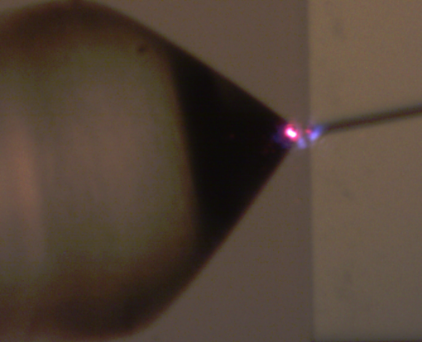
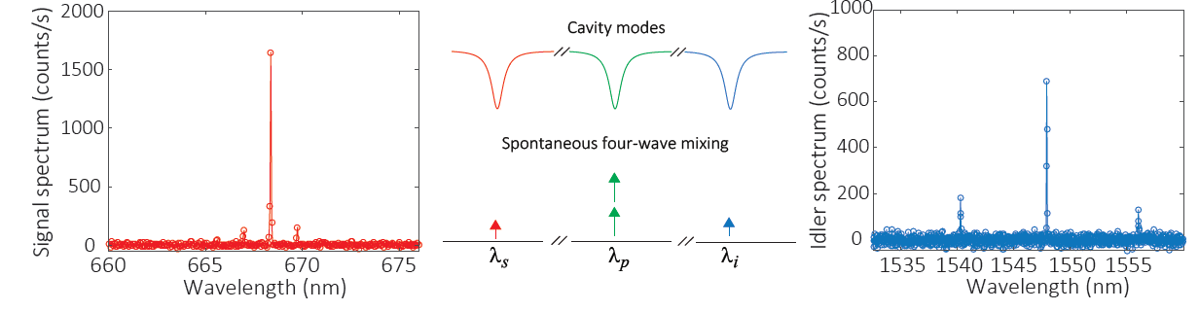


Frequency-/Phase-matching, StFWM, and SpFWM
m_{s} = 443
λ_{s} = 668.3789 nm
m_{p} = 303
λ_{p} = 933.6211 nm
m_{i} = 163
λ_{i} = 1547.8960 nm
Phase-matching Choose modes with
$$Δm=2m_{p}−\left(m_{s}+m_{i}\right)=0$$
Frequency-matching Adjust geometry for
$$Δω=2ω_{p}−\left(ω_{s}+ω_{i}\right)≪ω/Q$$
Δω/2π = (0.16 ± 0.04) GHz < 1 GHz
Q = 1.52 x 10⁵
Q = 1.04 x 10⁶
Q = 1.93 x 10⁵
StFWM Pump/telecom input, visible out
SpFWM photon spectra
Δω/2π = 3.86 GHz
m_{s} = 443
m_{i} = 163
m_{s} = 444
m_{i} = 162

Slide 15
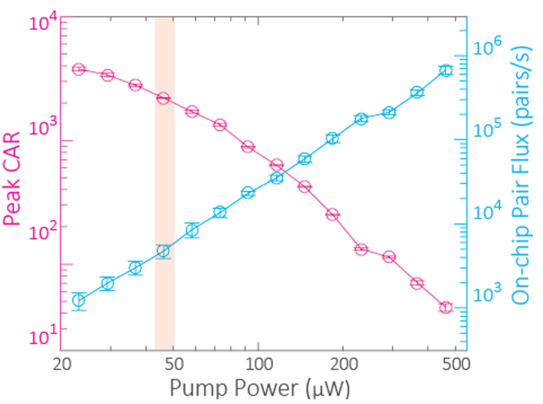
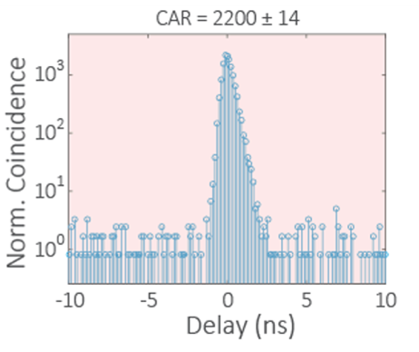
Pair flux and CAR, power dependence
Photon pair characteristics
Wide-band: Over an octave, 668/1548 nm
Narrow-linewidth: < 1 GHz
Pure (CAR > 100)
Bright (high photon flux)
Efficient (sub-mW power)
Integrable (on-chip)
P(μW) N(Pairs/s) CAR
46 4800 2200
146 62000 423
~22 1200 3780

Slide 16
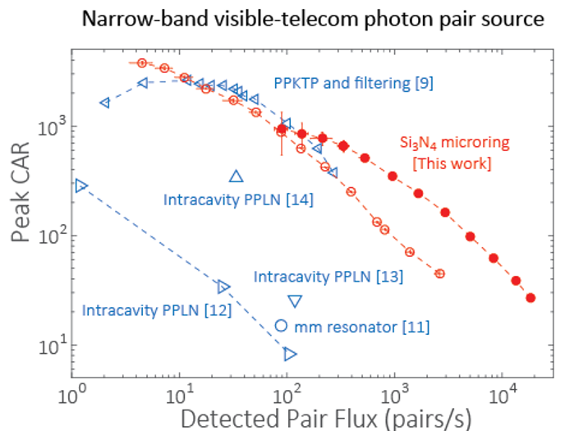

Pair flux and CAR, a comparison
A comparison to previous sources
Detected pair flux versus CAR
Power is not the most critical measure
Comparison
Among the best for overall performance considering both flux and CAR
Record CAR = 3780 at ~N = 5 pairs/s
Record N = 18400 pairs/s, with CAR = 27
The high flux regime is perhaps more useful!
The first nanophotonic device for narrow-band visible-telecom photon pair source
Visible-telecom photon pair source
PPLN/PPKTP & filtering/cavity
[12] J. Fekete et al., Phys. Rev. Lett.110, 220 502 (2013)
[9] C. Clausen et al., New J. Phys. 16, 093058 (2014)
[13] O. Slattery et al., Appl. Phys. B 121, 413–419 (2015)
[14] D. Rieländer et al., New J. Phys. 18, 123 013 (2016)
PhC fiber
[10] C. Söller et al., Phys. Rev. A 81, 031 801 (2010)
LiNbO₃ mm-resonator
[11] G. Schunk et al., Optica 2, 773–778 (2015)

Slide 17
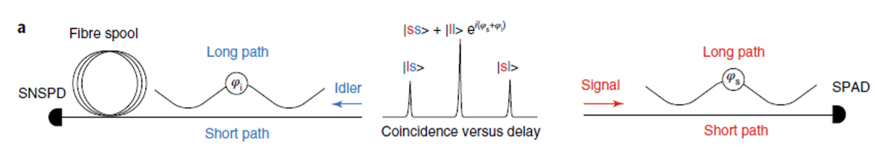
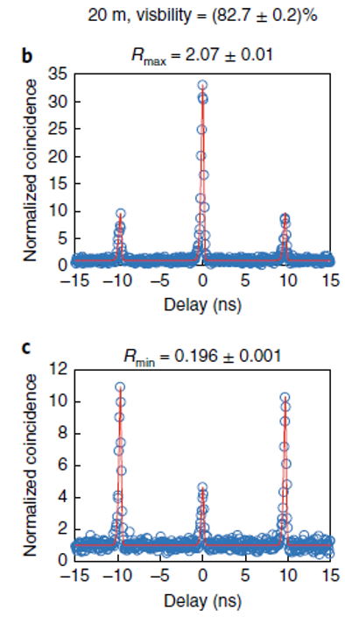
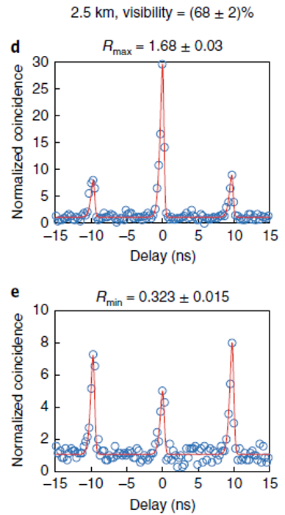
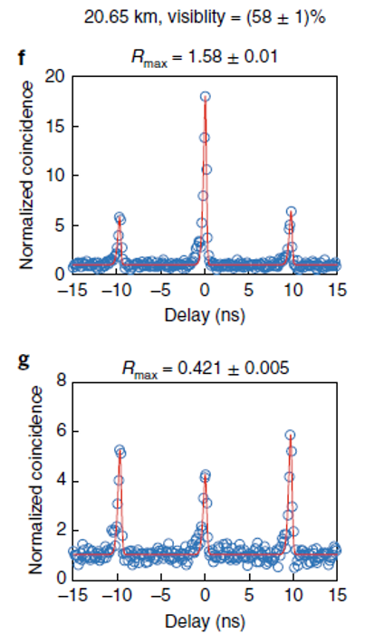
Visible-telecom time-energy entanglement

Slide 18
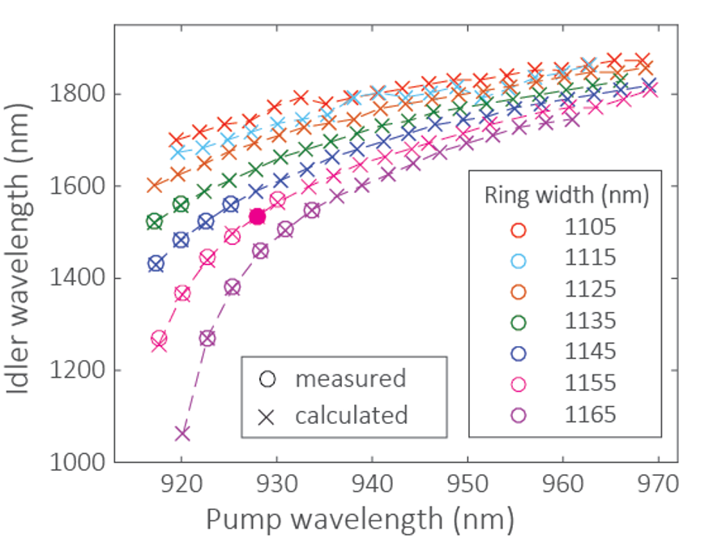
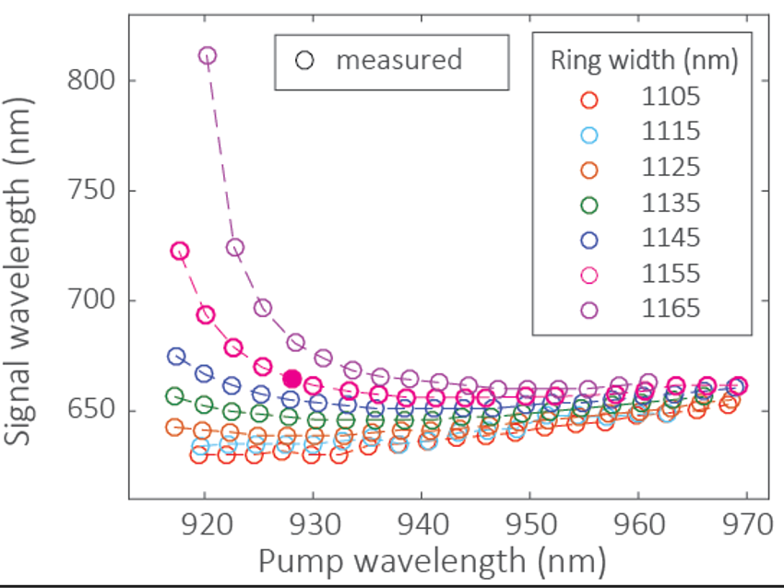
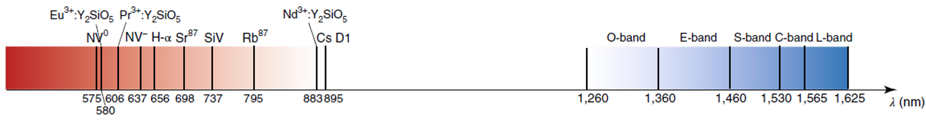
Tailoring the source for different systems
Ability to tune the visible wavelength to match different systems
by changing the parameters in the nanophotonic device
Change the device ring width (colors)
Change the pump mode (x-axis)
Change the device thickness (635/740 nm plato, not shown here)

Slide 19
Future work
Entanglement swapping between two pair sources
Two sources identical at telecom photon spectrum
Connection to visible quantum memory (need collaboration)
Photon pair source for Pr^{3+:}YSO (606 nm)
Photon pair source for NV⁻ (637 nm) and SiV (737 nm)

Slide 20
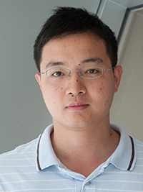

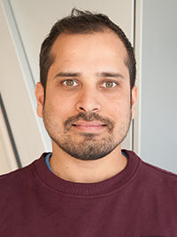
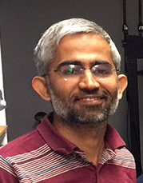
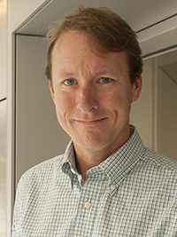
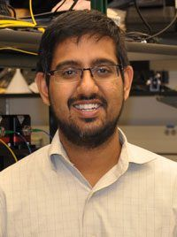

Acknowledgements
Qing Li
Postdoc
Prof. at CMU now
Gregory Moille
Postdoc
Anshuman Singh
Postdoc
NIST on a chip
Vikas Anant
Photon Spot
Daron Westly
Research scientist
Kartik Srinivasan
Project leader

