Slide 1
Efficiently Certifying Large Amounts of Entanglement in High-Dimensional Quantum Systems
Gregory A. Howland
Rochester Institute of Technology
James Schneeloch, Chris Tison, Mike Fanto, Paul Alsing
Air Force Research Laboratory
Photonics for Quantum Workshop
Jan 2019

Slide 2
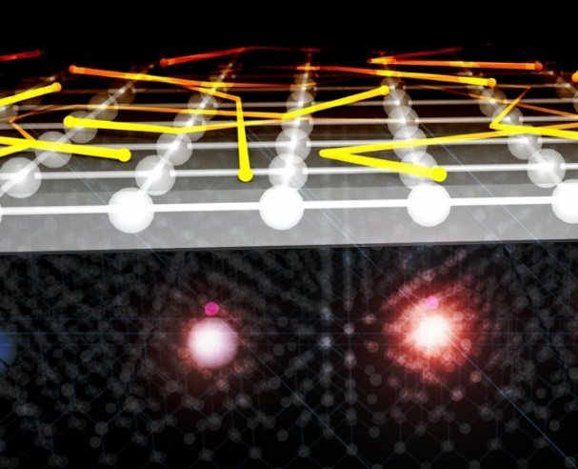
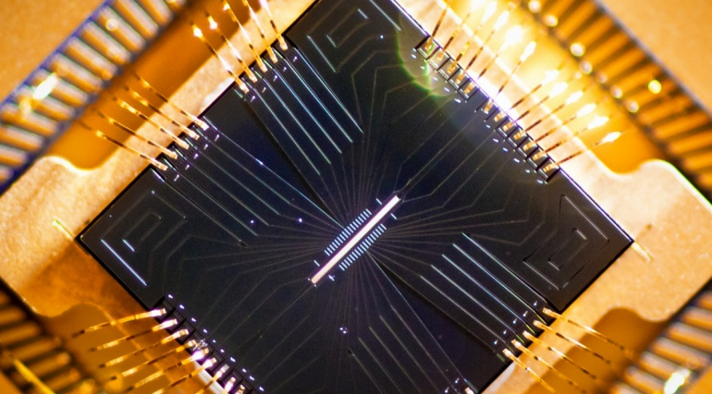
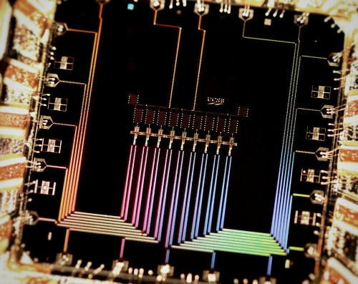
Big Picture
Logical Layer
Sensing Protocols (e.g. Cramer-Rao Bound/Quantum Limit)
Algorithms (e.g. Shor/Grover)
Secure Communication Protocols
Middle “Interface” Layer
Platform Layer
NV Centers
Trapped Ions
Photonic Circuits
Superconductors
https://jqi.umd.edu/news/quantum-sensor-nanoscale-electron-transport
https://jqi.umd.edu/news/future-ion-traps
AFRL/RIT
http://web.physics.ucsb.edu/~martinisgroup/

Slide 3
Big Picture
Platforms are varied and imperfect.
We need practical tools for characterizing large-scale quantum systems and the resources they provide.

Slide 4
Quantify Entanglement in High Dimensions
Alice
Source
Bob
What do I mean by high-dimensions?
Quantum system divided into two parts (for now)
Each party has n local measurement outcomes where n is big (100,1000,10000,512^2……)
Measuring a joint-distribution is $n^{2}$ measurements
Hilbert space can be continuous or discrete
Examples
Photon pairs entangled in spatial variables (position/momentum, orbital angular momentum)
Photons entangled in energy-time (or time bins/frequency bins)
Path entangled qudits on chip
Divide atomic/superconducting systems in two (may be separate, may not be)

Slide 5
Quantifying Entanglement Overview
Quantifying Entanglement
Most general way is to compute an entanglement monotone
Entanglement of Formation: The number of two-qubit Bell pairs required on average to synthesize the desired quantum state
Distillable Entanglement: The number of two-qubit Bell pairs on average that can be synthesized from a given quantum state
Measured in units of ebits. 1 ebit is the quantity of entanglement in a perfect, two qubit Bell State.
Computing these requires the density matrix which is difficult to acquire at large dimension
Entanglement-Dimensionality (Schmidt Rank)
Usually we can only witness entanglement in large quantum systems or use application-specific metrics
Quantitative Entanglement Witnesses
lower-bounds for entanglement monotones that can be computed from limited data (e.g. do not require a density matrix)

Slide 6
Quantifying Entanglement
The Hard Way
Perform a full experimental unbiased quantum tomography
Scales exponentially with added particles and at least quadratically with added dimensions
Compute an entanglement monotone (e.g. ebits)
NP-Hard in general
The Easy Way?
Invent a quantitative entanglement witness that…
Works with very limited data
Measurements are easy and “smart”
Results not contingent on any assumptions
Easy error analysis
Avoid numerical inversion/optimization

Slide 7
Uncertainty Relations
Variance-Based
$$σ_{x}σ_{k}≥1/2$$
Variance captures localization or clustering
Information-Based (Entropic)
$$h(x)+h\left(k\right)≥πe$$
h is Shannon Entropy (bits)
Entropy captures the number of questions you have to ask? (1 bit = 1 yes/no question)
The more information a measurement tells you about position statistics, the less information a subsequent measurement can tell you about momentum statistics.

Slide 8
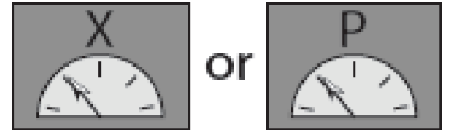
Witnessing the EPR Paradox
Alice
Source
Bob
EPR Paradox is seen when $σ_{x_{A}|x_{B}}σ_{k_{A}|k_{B}}≤1/2$
Entropic Witness of the EPR Paradox
$$d\log_{2}\left(\frac{πe}{Δ_{x}Δ_{k}}\right)−\left[H\left(X_{A} | X_{B}\right)+H\left(K_{A} | K_{B}\right)\right]≤R_{secret}$$
secret key rate
$H\left(X_{A} | X_{B}\right)$ is the conditional Shannon Entropy
(Small when knowledge about system “A” specifies system “B)
Only requires measuring $P\left(X_{A},X_{B}\right)$ and $P(K_{A},K_{B})$

Slide 9
EPR to Ebits
$$d\log_{2}\left(\frac{2π}{Δ_{x}Δ_{k}}\right)−\left[H\left(X_{A} | X_{B}\right)+H\left(K_{A} | K_{B}\right)\right]≤−S\left(A | B\right)≤E_{f}$$
d --- number of dimensions in vector space
$Δ_{x}$--- discretization pixel physical dimension dimension
Need to measure $P(X_{A},X_{B})$ and $P(K_{A},K_{B})$
Note: bold indicates vector space observable
$S(A|B)$ is the quantum conditional entropy
Entanglement of Formation (how many ebits you have)
Not doing a tomography anymore, but
still a lot of measurements!

Slide 10
Scaling to Many Dimensions
“One can regard the possibility of digital compression as a failure of sensor design. If it is possible to compress measured data, one might argue too many measurements were taken” – David Brady (via EJ Candes)
How can we measure just the “important part” of a signal?
How can we go “Analog to Information”? (DARPA)
Can we replace the “Nyquist Rate” with the “Information Rate”?
Measurements are questions. What are the right questions to ask our system?

Slide 11
Scaling: How do we use prior knowledge
Prior Knowledge
Usually expect some for of structure in a system of interest
Structure = Compression
Abstract
Low rank density matrix, nearly pure state, EPR-type, compressible
Technical
Knowledge/model of particular system or hardware

Slide 12
Estimation vs Certification
Estimation is your Best Guess
Maximum Likelihood Estimation
Compressive Sensing
Bayesian Inference
Assumption-based tomography
Fidelity to a target state
Numerical/Computational Techniques
Noise Reduction
Background Subtraction
Any of your favorite
Certification is a Guarantee
For limited measurements, the result is the worst case possibility consistent with the measurements
Essential for quantum security and foundational issues (e.g. closing loopholes)
Can we still certify entanglement if we exploit prior knowledge?

Slide 13
How to exploit expectations to improve our Quantitative Entanglement Witness
Assumptions → Estimation
Result is contingent on assumptions
Expectations → Certification
Result is valid whether or not expectation is met
Expectation helps guide you to “asking good questions”
Outcome will confirm whether you had “great expectations”
$$d\log\left(\frac{2π}{Δ_{x}Δ_{k}}\right)−\left[H\left(X_{A} | X_{B}\right)+H\left(K_{A} | K_{B}\right)\right]≤E_{f}$$
For certification, any approximations we make must never decrease the conditional entropy (e.g. decrease the uncertainty)
Good news! When you mess around with conditional entropies you tend to increase them

Slide 14
Improvement 1
Exploit the expectation of local separability
A property of conditional entropies is
$$H\left(X_{A} | X_{B}\right)=H\left(X_{A1},…,X_{An} | X_{B1},…,X_{Bn}\right)≤H\left(X_{A1} | X_{B1}\right)+…+H(X_{An}|X_{Bn})$$
Inequality becomes = when $P\left(X_{A},X_{B}\right)$ is separable
Example: 2-D Spatial Coordinates
$$X=(X,Y)$$
$$then$$
$$H\left(X_{A}\right|X_{B})≤H\left(X_{A} | X_{b}\right)+H\left(Y_{A} | Y_{b}\right)$$
Instead of measuring $P\left(X_{A},X_{B}\right)$, measure $P\left(X_{A},X_{B}\right)$ and $P(Y_{A},Y_{B})$ separately $(n^{4}→2n^{2})$
Inequality is always true even if the distribution isn’t actually separable.

Slide 15
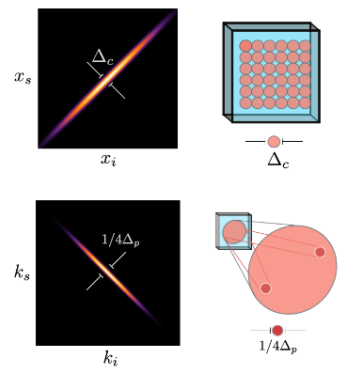
Improvement 2
Exploit the expectation of Sparsity/Compression
If our system is highly entangled, we will probably choose to measure observables that are highly correlated
Highly correlated probability distributions are very sparse
Want to scan at high-resolution where the correlations are strong and low-resolution elsewhere

Slide 16
Improvement 2: Multi-Level Approximation
Replace $P(X_{A},X_{B})$ with $\tilde{P}(X_{A},X_{B})$ which is an arbitrarily coarse grained estimate of $P$
Coarse Graining = replace collections of elements with their average value
This can only increase the conditional entropy (good)
$H\left(X_{A} | X_{B}\right)≤\tilde{H}\left(X_{A} | X_{B}\right)$ so we can use it!
$$P(X_{A},X_{B})$$
$$\tilde{P}(X_{A},X_{B})$$

Slide 17
Improved Quantitative Entanglement Witness
In two suggestive dimensions (x,y)…
$2\log\left(\frac{2π}{Δ_{x}Δ_{k}}\right)−\tilde{H}\left(X_{A} | X_{b}\right)+\tilde{H}\left(Y_{A} | Y_{b}\right)$ + $\tilde{H}\left(K_{A}^{(x)} | K_{b}^{(x)}\right)+\tilde{H}\left(K_{A}^{(Y)} | K_{b}^{(y)}\right)≤E_{f}$
Constant that comes from uncertainty relations
Horizontal Position Correlations
(multilevel)
Vertical Position Correlations
(multilevel)
Horizontal Momentum Correlations
(multilevel)
Vertical Momentum Correlations
(multilevel)
How many ebits we certify
Only assumptions are how probability distributions are found
None are added by the witness

Slide 18
The talk could end here...

Slide 19
https://arxiv.org/abs/1804.04515 (in review)
Quantify 7.1 ebits between spatially entangled photon pairs (512 x 512 pixels per photon)
Use 20 million times fewer measurements than uncompressed inequality

Slide 20
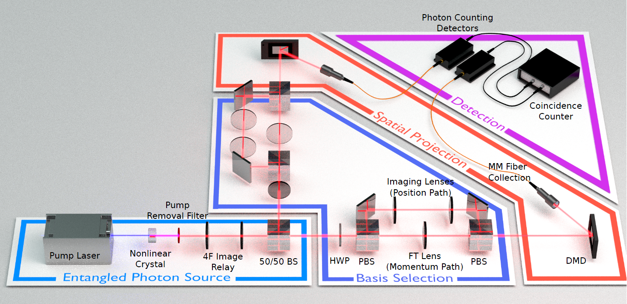
Spatial entanglement testbed
Easily generated via Spontaneous Parametric Down-Conversion (SPDC) and manipulated with DMDs or SLMs.
Serves as a proxy-system for energy-time, OAM, other HD bipartite entangled systems.
Very large entanglement because X and K are continuous variables
Produces an entangled state very similar to that described in the original EPR paradox.
Positive position correlations
Negative momentum correlations
Good for testing new characterization protocols.

Slide 21
Adaptive, quad-tree sampling
In an entangled system, we expect distributions of certain observables to be very sparse (e.g. $P(x_{1},x_{2})$, $P(k_{1},k_{2})$) due to high intensity correlations
Want to scan at high-resolution in highly-correlated regions and low-res elsewhere
Use an adaptive quad-tree sampling technique. Split a block when intensity (coincidence count rate) is greater than a chosen threshold.
Commonly used in computer graphics for collision detection
Node
Decreasing pixel size as we go down the tree.
Leaf

Slide 22
Adaptive Sampling Demo

Slide 23
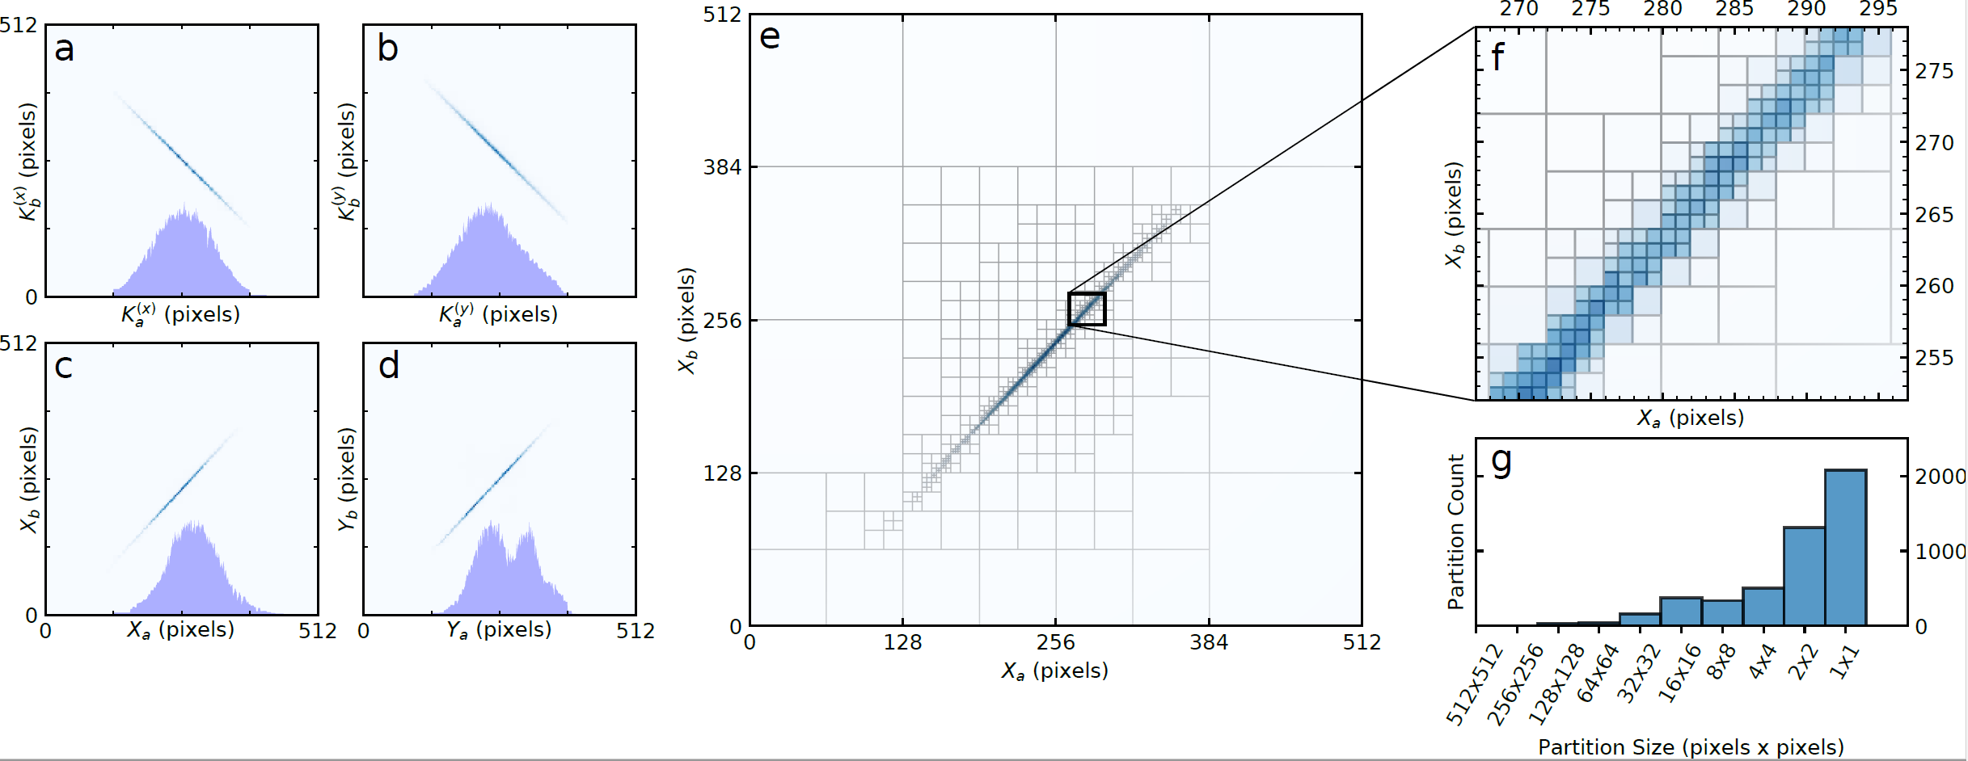
Results: Compressed Distributions
Separately measure $\tilde{P}(X_{A},X_{B})$, $\tilde{P}\left(Y_{A},Y_{B}\right),\tilde{P}\left(K_{A}^{(x)},K_{B}^{(x)}\right),\tilde{P}(K_{A}^{(y)},K_{B}^{(y)})$
512 x 512 pixels-per-photon for each distribution
6456 total partitions required (Factor of 20-million fewer than joint-scan)
Large partitions require fewer than 1 coincidence count-per-pixel

Slide 24
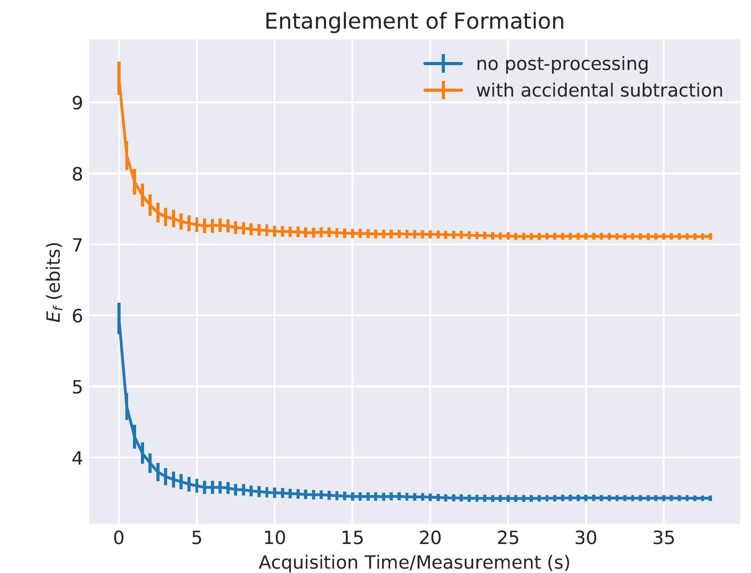
Results: Entanglement vs acquisition time
Error bars enclose two standard deviations
Early region is before statistical significance is reached
6,456 total measurements
$7.11±.04$ ebits
$3.43±.02$ ebits

Slide 25
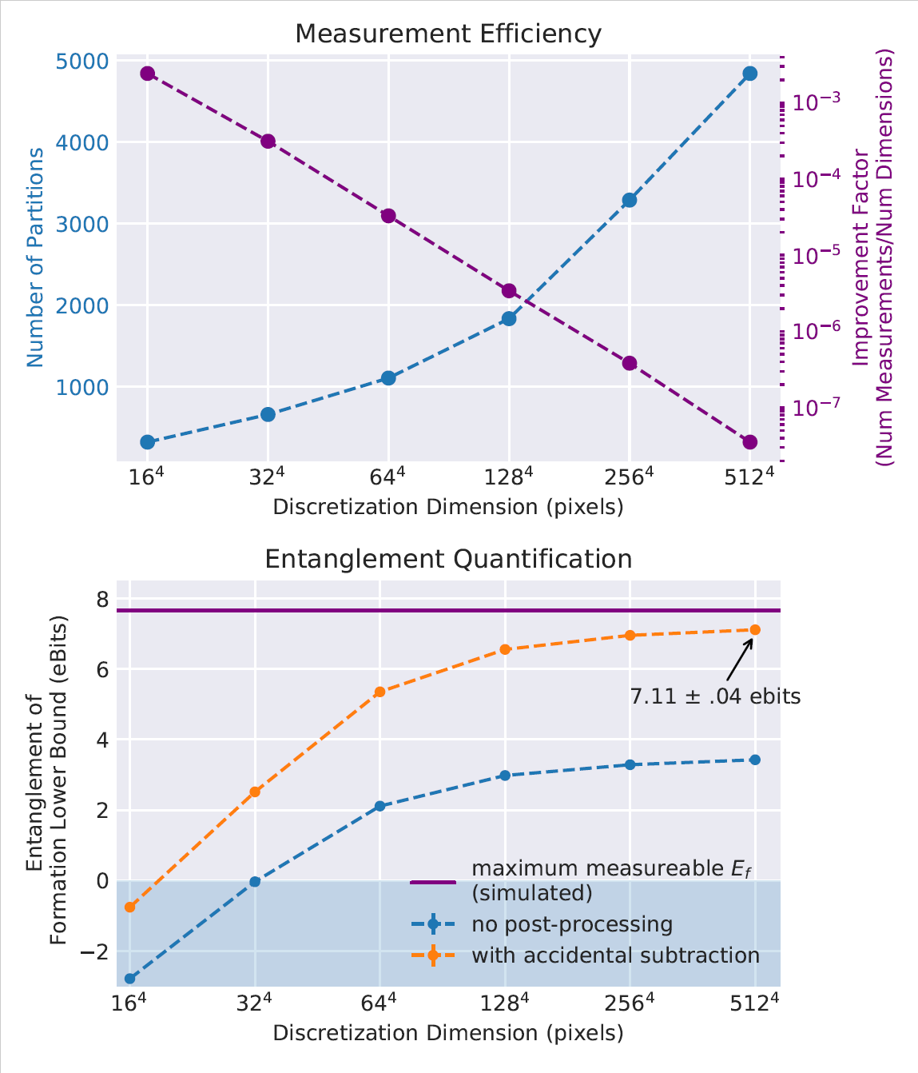
Results: $E_{f}$ vs maximum resolution
Record 7.1 ebits certified
20 million times more efficient than uncompressed version
10^18 times more efficient than tomography
Progressive use few measurements to witness entanglement, refine to accurately quantify
Error bars present but scarcely visible
No numerical inversion or optimization codes

Slide 26
Full disclosure --- we did make some assumptions in the demo
Post-selected on coincidence detections
Did background subtraction (sometimes)
Have a finite detection window
Have a finite quantum efficiency of our detectors and other losses
But this is not the fault of our witness

Slide 27
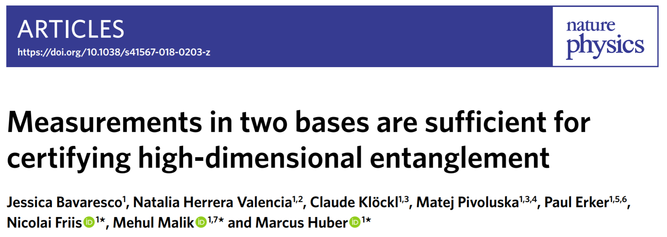
Other groups are working in this space too

Slide 28
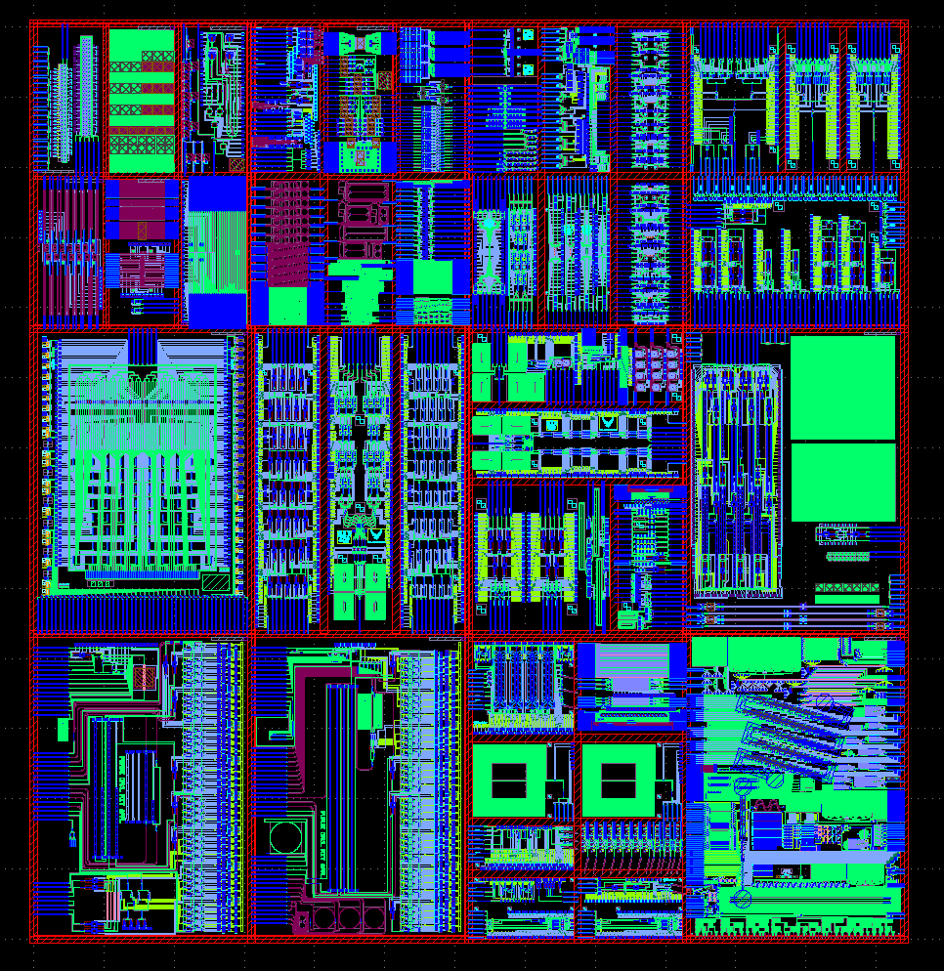
Future Work
Adapt to many-body systems
Resource-based analysis
Instead of how many measurements do we need, how many copies of the quantum system do we consume
Other ways to use prior knowledge?
Use multi-channel detection
Photon counting cameras
Many-channel SNSPD arrays
Use on interesting platforms (e.g. integrated photonic circuits)
DISTRIBUTION A. Approved for public release: distribution unlimited. (88ABW-2019-0221)

Slide 29
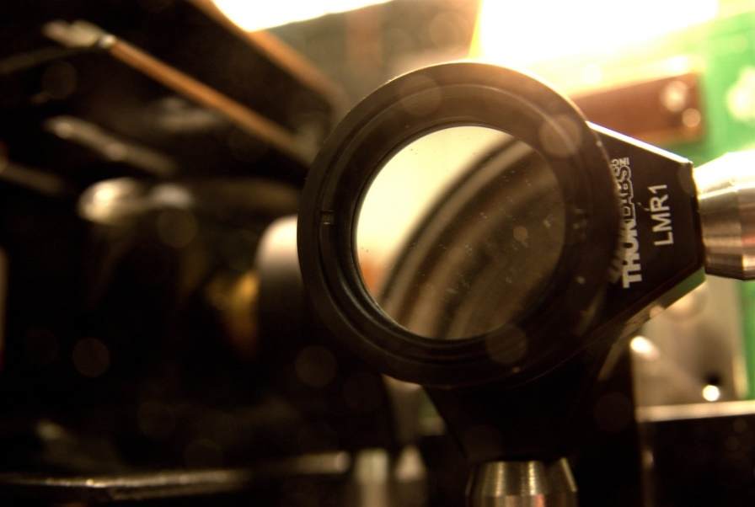
Acknowledgments
Thanks to:
AFRL Quantum Group
James Schneeloch
Mike Fanto
Chris Tison
Paul Alsing
Stefan Preble’s Group (RIT)
Thank you for listening! Questions? gaheen@rit.edu

