Slide 1
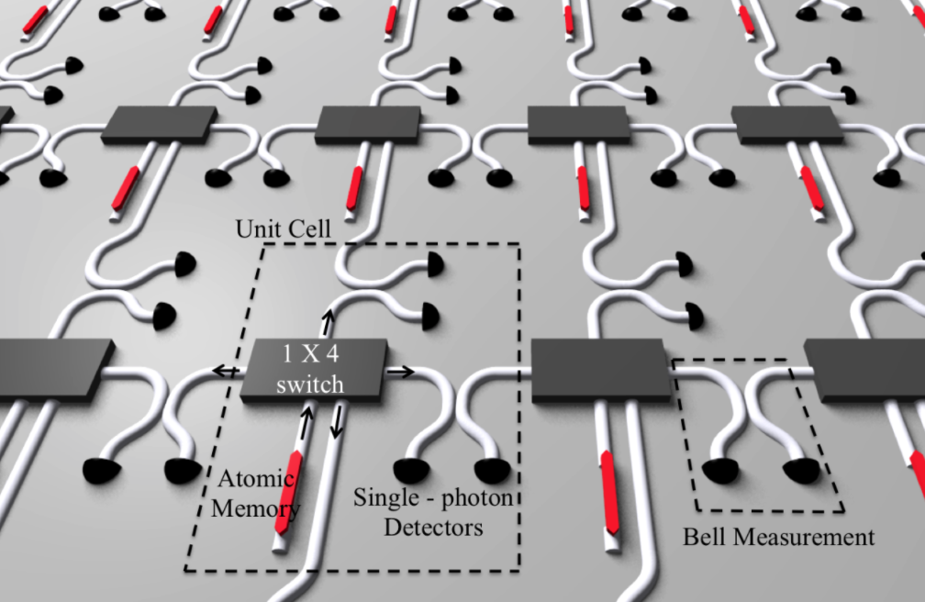
Large-Scale Photonic Circuits for Quantum Information Processing
Dirk Englund
Electrical Engineering and Computer Science, MIT
Photonics for Quantum (PfQ) Workshop
Rochester Institute of Technology | Rochester, NY
Jan 25, 2019
Notes:
.. exploit the opto-electronic properties of graphene as the active material in optical interconnects for high-speed, efficient optical modulation and detection. Explore possible advantages over present-day architectures.
Abstract: There has been increasing interest in developing opto-electronic devices based on graphene, whose tunable optical and electronic properties make it applicable for both high-speed and broadband modulators and photodetectors. The flexibility and robustness of graphene makes it compatible with various devices geometries. In this chapter, we describe chip-integrated graphene optoelectronics with nanophotonic cavities and waveguides. By depositing graphene onto photonic crystal nanocavities, it is possible to reach near-unity ab- sorption into graphene. The graphene-photonic crystal cavity system enables a high-contrast electro-optic modulation by electrically tuning the Fermi level of graphene. In addition, high- speed operation is possible using capacitive gating, such as through a double layer graphene stack. The cavity also enables dramatically enhanced and spectrally selective photodetection on graphene. A similar scheme of graphene integration on nanophotonic waveguides greatly increases the interaction time of graphene with light and enables efficient, broadband, and high-speed photodetectors. Such graphene photodetectors are compatible with photonic in- tegrated circuits and promise an alternative to traditional on-chip photodetectors. Thus, the combination of graphene optoelectronic devices with photonic chips promises a new route for ultrafast and broadband on-chip optical interconnects.
Session 7:
Novel Nanophotonic Devices, Sensors, and Concepts Based on 2D Materials
Tuesday 21 April 2015
4:00 PM - 5:20 PM
Location: Conv. Ctr. Room 336
Session Chair: Ertugrul Cubukcu, Univ. of Pennsylvania (United States)
2D materials and heterostructures for applications in optoelectronics (Invited Paper)
Paper 9467-38
Time: 4:00 PM - 4:20 PM
Author(s): Thomas Mueller, Technische Univ. Wien (Austria)
Show Abstract Add To My Schedule
Plasmon excitations in low dimensional graphitic materials (Invited Paper)
Paper 9467-39
Time: 4:20 PM - 4:40 PM
Author(s): Feng Wang, Univ. of California, Berkeley (United States)
Show Abstract Add To My Schedule
Optics and optoelectronics of 2D atomic membranes (Invited Paper)
Paper 9467-40
Time: 4:40 PM - 5:00 PM
Author(s): Xiaobo Yin, Univ. of Colorado at Boulder (United States)
Show Abstract Add To My Schedule
Graphene optoelectronic devices for optical communications and imaging (Invited Paper)
Paper 9467-41
Time: 5:00 PM - 5:20 PM
Author(s): Dirk R. Englund, Ren-Jye Shiue, Massachusetts Institute of Technology (United States); Yuanda Gao, James Hone, Columbia Univ. (United States)

Slide 2
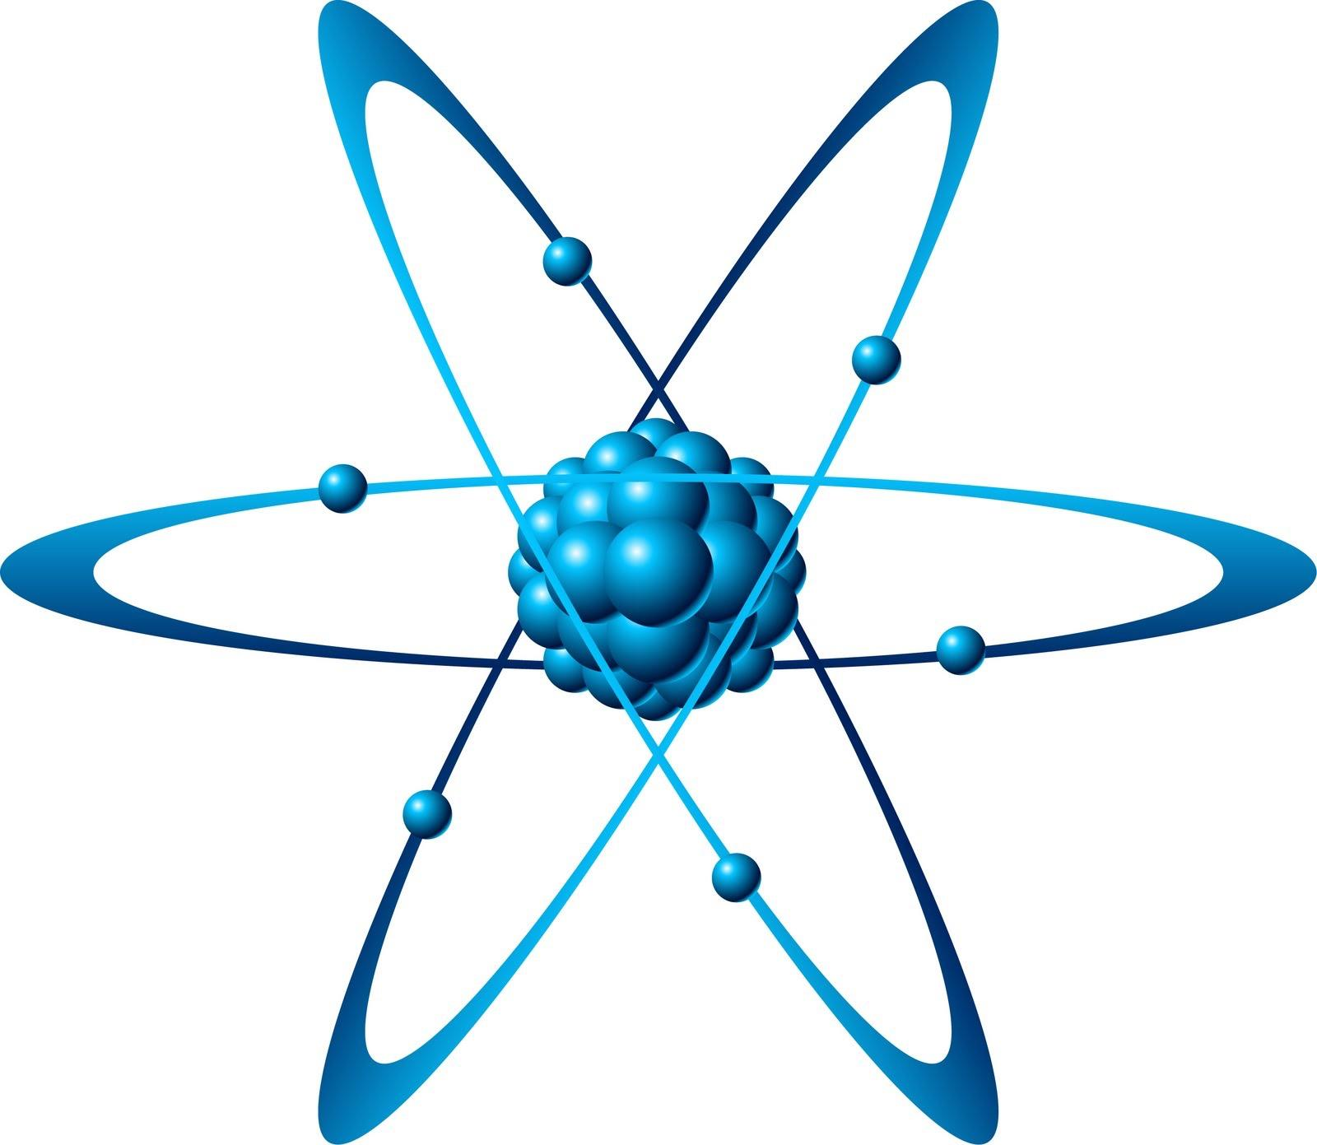
Quantum networks
Alice
Bob
Alice
Bob
Entangled state: 0_{A} 0_{B}+1_{A} 1_{B}
Alice
Bob
trunk line> 1000 km
Quantum Network Applications
Secure Comm,
Quantum foundations
Networked
quantum comp., blind QC
Sensing, Timing, GPS, ..
?
Undis-
covered
app’s
?

Slide 3
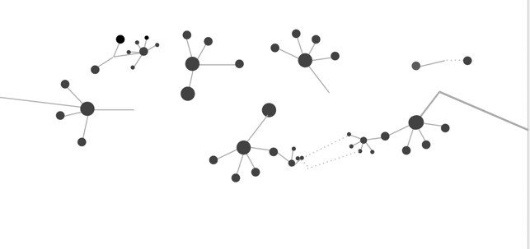
Quantum repeater networks
Alice
Bob
10 km
50 km
trunk line ~ 1000s of km
Requirements per repeater:
> 2 qubits
Efficient 2-qubit logic gate + efficient detection
H. Briegel et al, PRL 81 (1998)

Slide 4
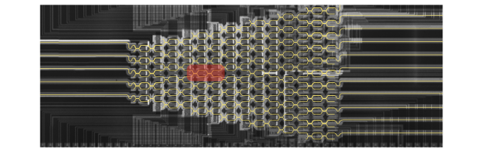
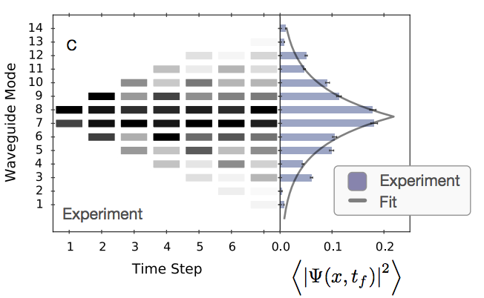
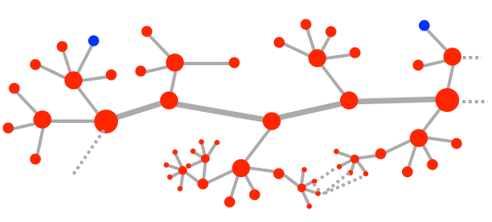
Outline
Technology
Photonic Integrated Circuits
Optoelectronic control
artificial atoms
photon resolving detectors
optical nonlinearities
Applications
00+11
Quantum simulation & machine learning
Quantum Networking
Modular quantum computers
N. Harris .. N Photonics 11, 447–452 (2017)
Y. Shen .. N Photonics 11, 441–446 (2017)
Notes:
This was clumsy

Slide 5
Acknowledgements
MIT Quantum Photonics Group :
Graduate Students: Sara Mouradian, Noel Wan, Michael Walsh, Eric Bersin, Tsung-Ju Lu, Donggyu Kim, Chris Foy, Mohammad Ibrahim
Postdocs: Tim Schroeder (-> Niels Bohr Institute, Copenhagen), Matt Trusheim, Lorenzo De Santis
Collaborators:
MIT: Prof. Karl Berggren, Prof. Ruonan Han
Harvard: Prof. Mikhail Lukin, Prof. Marko Loncar
Air Force Research Laboratory: Michael Fanto, Dr Paul Alsing
Rochester Institute of Technology: Prof Stefan Preble
Sandia National Laboratory: J Urayama, N Boynton, N Martinez, C DeRose, A Lentine, P Davids, E. Edward S. Bielejec, R Camacho
U. of Arizona: Prof Saikat Guha
BBN Technologies: Dr Mohammad Soltani
Funding
Notes:
thank you for your attention and i’m happy to take more of your questions

Slide 6
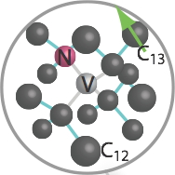
NV⁻ center in diamond
λ~ 637 nm
±1
Spin-dependent photon emission → spin-photon entanglement
0
±1
1
2gµB_{z}
-1
s=1
0
2.88 GHz
NV⁻: ion ‘trapped’ in a 99% ¹²C lattice¹
Electron T₂>100 ms²
Nuclear spin qubits
Two-qubit gates & error correction³
¹A. Gruber et al, Science 276 1997
² N. Bar-Gill et al (Walsworth, Harvard), N. Comm. 4 (2013); see also Stuttgart (Wrachtrup) & Delft (Hanson)
³ G. Waldherr et al, (Wrachtrup, Stuttgart), Nature (2014)
Early work: Wrachtrup, Jelezko (U. Stuttgart), Lukin (Harvard), Awschalom (UCSB), Manson (ANU), ..
Notes:
The NV consists of a nitrogen atom substituting a carbon atom in diamond, adjacent to a lattice vacancy.
In the negatively charged states, it has two unpaired electrons which can form a spin triplet and spin singlet. The triplet state is the lower energy ground state with the magnetic sublevels shown here: The spins are aligned (same energy) or anti-aligned. Just as you’d expect for two bar magnets, the aligned states are slightly higher in energy, due to the magnetic dipole interaction, by about 3GHz. We can split their degeneracy with a magnetic field and then use just two of these levels as our qubit. Now, because the diamond lattice does not interact much with the NV (mostly spin-neutral isotope of ¹²C), and because of low spin-phonon coupling, the spin state can have a long coherence time: ~ 1sec. The electron spin also couples to nuclear spins (the occasional ¹²C or the N nuclear spin), and these states can have seconds-long coherence time even at room temperature.
If the NV is pumped with green light, largely spin-preserving transitions produce red fluorescence (shown here for single NVs in a scanning confocal scan). The fluorescence shows a characteristic ZPL at 637 nm and a broad phonon side-band, which accounts for the majority (~97%) of the photoluminescence. This is actually a problem for coherent optical interactions between NVs is in fact one of motivations for coupling the NV to a cavity.

Slide 7
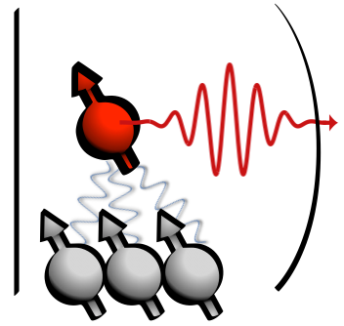
Quantum networks with diamond NV centers
efficiency η
Bell-state measurement
Cavity interface
e⁻ spins
T₂ ~ second
00+11
e⁻ spins, T₂ ~ second
✖️
loss to
environment
Leading experiments (Delft):
Two-photon protocol R∝ η² , ~1/10 sec
Single-photon protocol, R∝ η, ~35 Hz
P. C. Humphreys, N. Kalb, et al (R. Hanson, Delft), Nature 558 (2018)
See also trapped ions (Monroe, Blatt, ..); InAs quantum dots (Imamoglu, Vuckovic, Waks, Atature, ..)
Nuclear spins
T₂ ~ second
Entanglement rate R∝ η² R₁ R₂
Heralded entanglement:
L. Childress et al, PRA 72, 052330
S. D. Barrett & P. Kok, PRA 71, 060310 (2005)

Slide 8
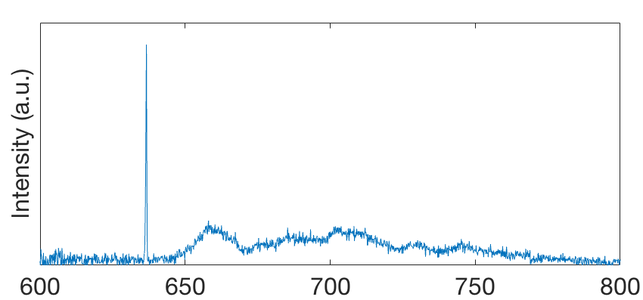
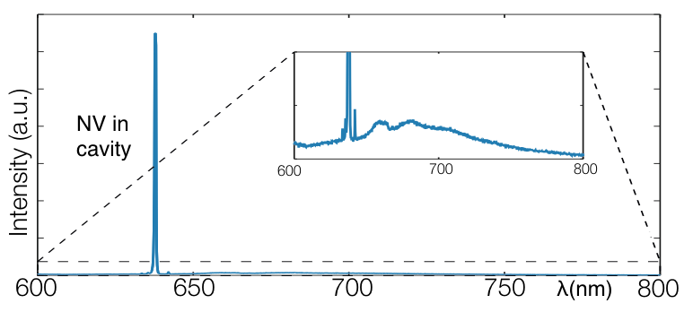
“Fixing” the NV
NV diamond spectrum (5K)
NV⁻: ion ‘trapped’ in a 99% ¹²C lattice
Electron T₂>100 ms
Zero-Phonon Line (ZPL) ☺
Phonon side-band ☹
±1
s=1
0
2.88 GHz
Outstanding challenges:
Spectral stability
Photon interfaces
Device yield
L. Li, T. Schroeder, E. Chen, et al, NCOMM 6, 6173 (2015)
Early NV work: Wrachtrup(U. Stuttgart), Jelezko (Ulm) , Lukin (Harvard), Awschalom (UCSB), Manson (ANU), ..
See also: Harvard, Vienna, Saarland, Delft, HP, Basel

Slide 9
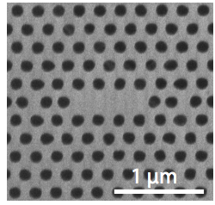
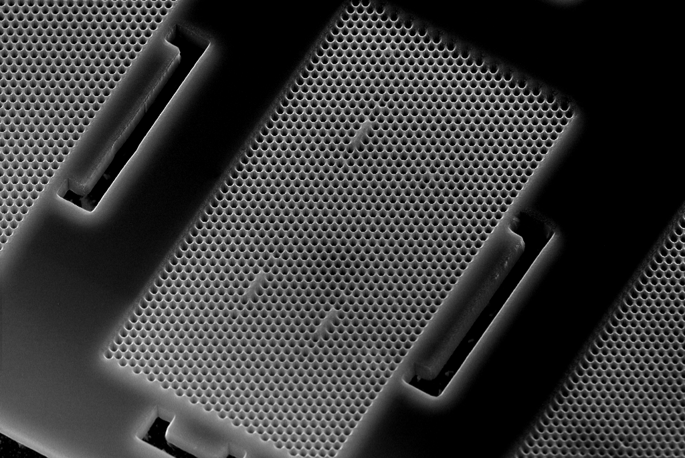
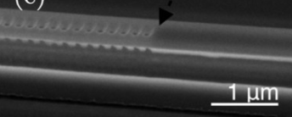
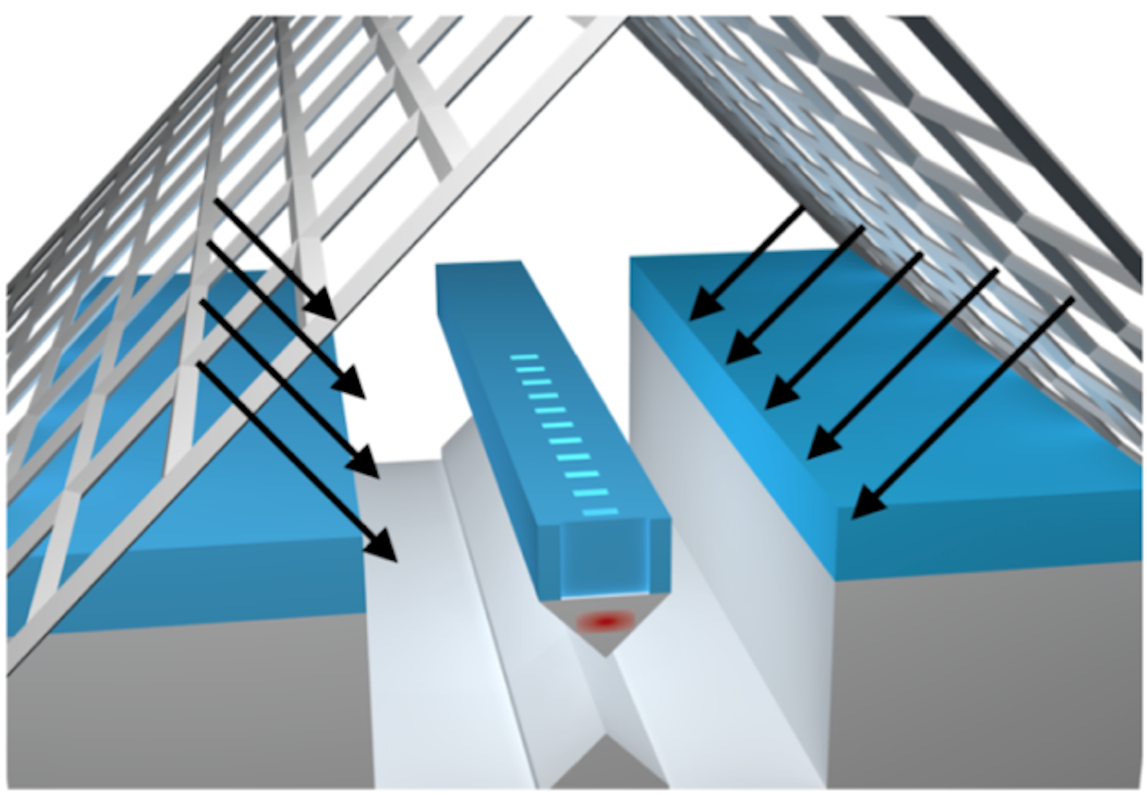
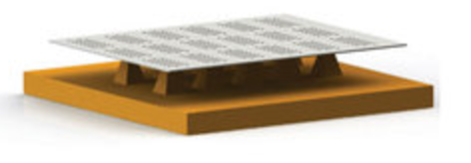
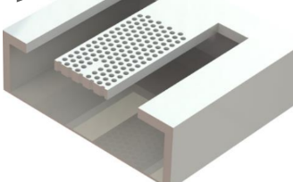
Diamond PhC Patterning
1 µm
Q < 10,000
NV: λ_{ZPL} ~ 10s GHz
L. Li, T. Schroeder, E. Chen, et al, NCOMM 6, 6173 (2015)
Q > 8,000
NV: λ_{ZPL} < 5 GHz
Aligned emitters✔
# yielding cavities>10³
Q > 14,000
NV: λ_{ZPL} < 1 GHz
Aligned emitters✔
Chip Size: 4x4 mm✔
# yielding cavities>10⁴
L. Li et al Sci Rep 5 (2015)
M. Schukraft et al, APL Photonics 1, 020801 (2016)
T. Schroeder et al, Material Optics Express 7, 5 (2017)
I. Bayn et al, Applied Physics Letters 105, 21 (2014)
1D : S. Mouradian, N. Wan et al, APL 111 (2017)
2D: Noel Wan et al, APL 112 (2018)

Slide 10
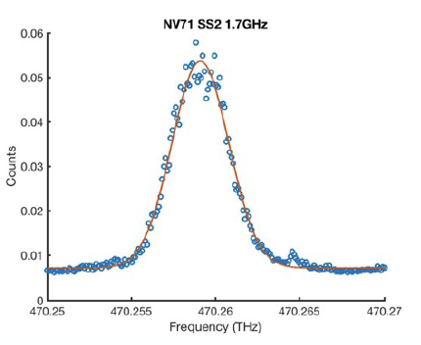
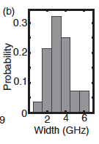
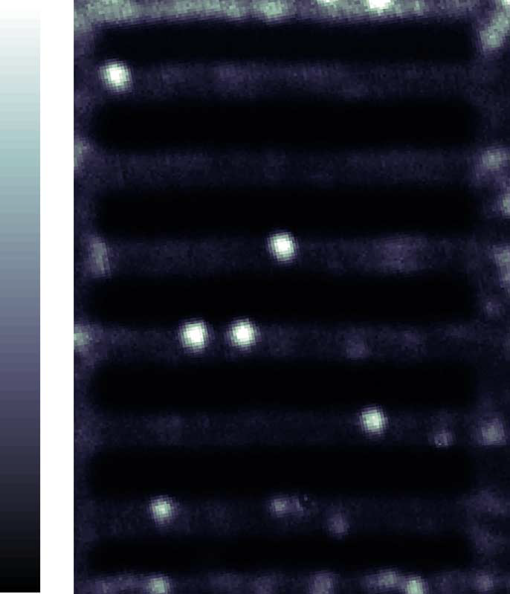
High Yield and Scalable
NV in cavity
Noel Wan, Kevin Chen / MIT
The catch: NV spectral broadening

Slide 11
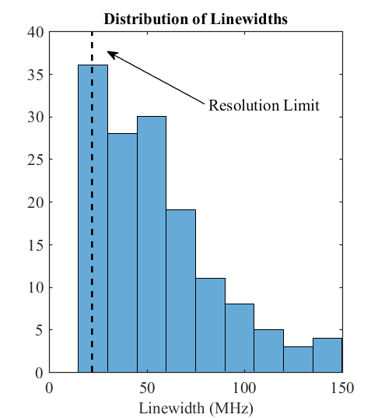
Properties of NVs produced by implantation
Implanted, before fabrication
Linewidths to <1 GHz: more work needed to get to ~ 100 MHz
Preliminary measurements indicate < 300 MHz linewidths of NVs in nanobeams

Slide 12
Reliable spin-photon interfaces
Spectrally stable NVs in nanocavities?
Still a challenge: best result are ~ 500 MHz - 1 GHz in nanostructures
Implantation: narrow (<100 MHz) NVs, but not from the N atoms implanted: S B. van Dam, M Walsh, et al (Taminiau - Hanson - Englund), arXiv:1812.11523 (2018)
SiV-, GeV-, SnV-, PbV-: inversion-symmetry → stable optical lines
Stable, narrow ZPL, DWF~0.8
Narrow lines by FIB:
T. Schroeder et al, N Comm 8 (2017)
> 10 ms spin coherence: D. D. Sukachev et al ( Lukin) PRL 119 (2017)
2-qubit interactions demo’d in cavity (Harvard)
Review: M Atatüre, D Englund, N Vamivakas, SY Lee, and J Wrachtrup, Nature Reviews Materials (2018)

Slide 13
Silicon Vacancy (SiV) center by focused ion beam
FIB
Collaboration with Lukin group (Harvard) and Sandia Nat’l Laboratory
T. Schroeder et al, Nature Communications 8, 15376 (2017)
See also A Sipahigil, Science 354 (2016)

Slide 14
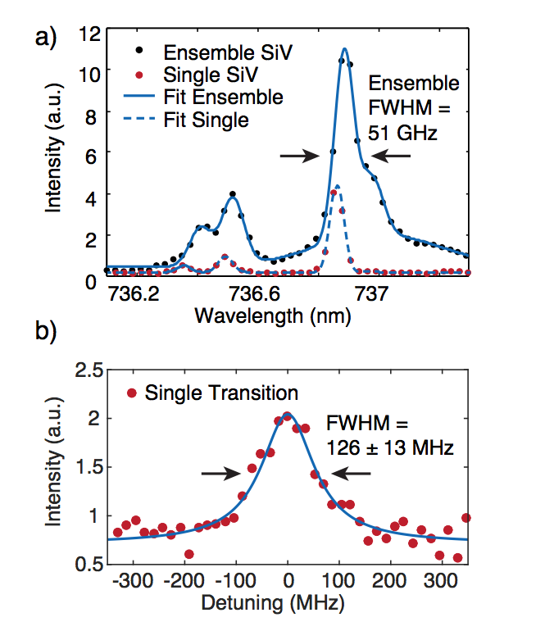
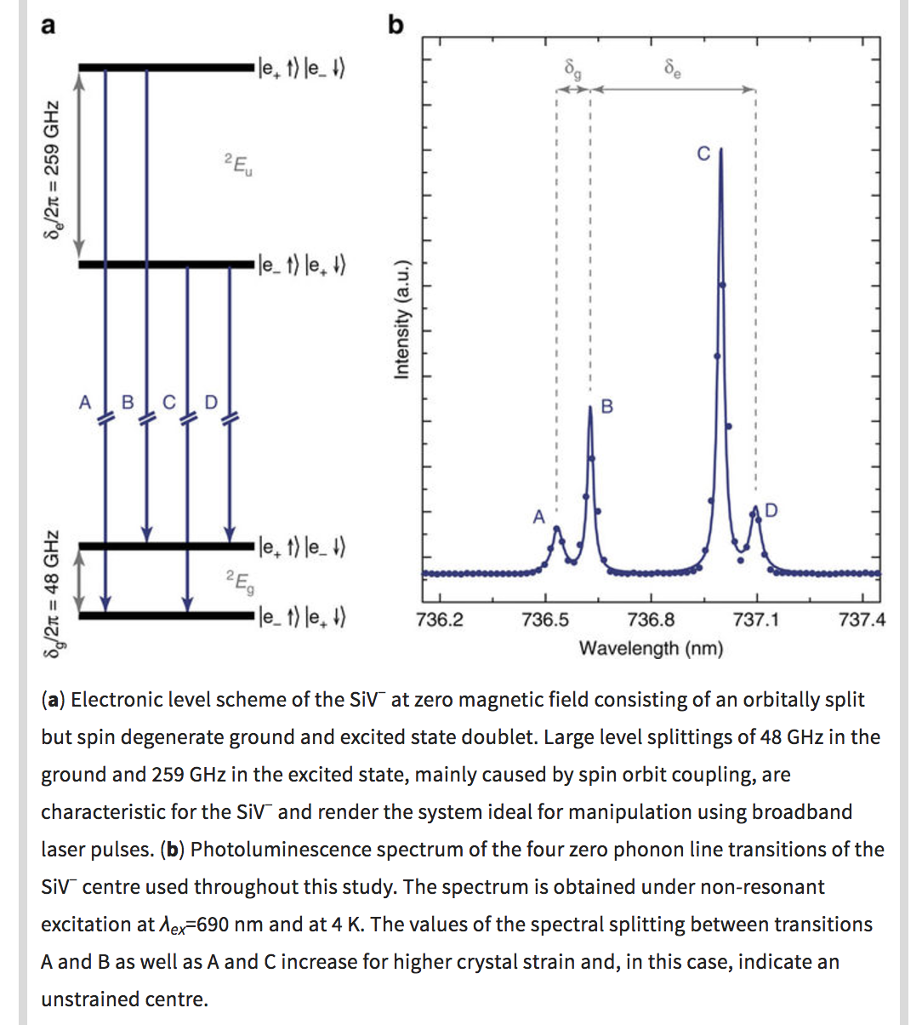
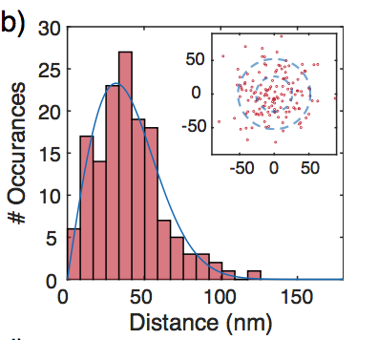
How good is the Si FIB implantation?
Spectral properties
Placement accuracy
σ~32 nm
T. Schroeder et al, Nature Communications 8, 15376 (2017)
See also A Sipahigil, Science 354 (2016)

Slide 15
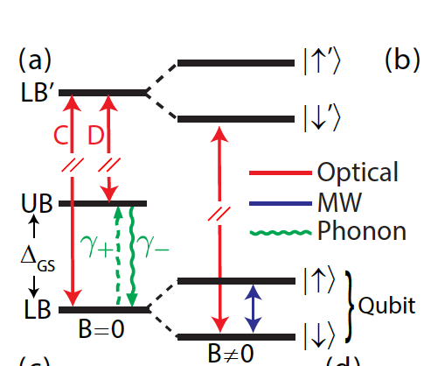
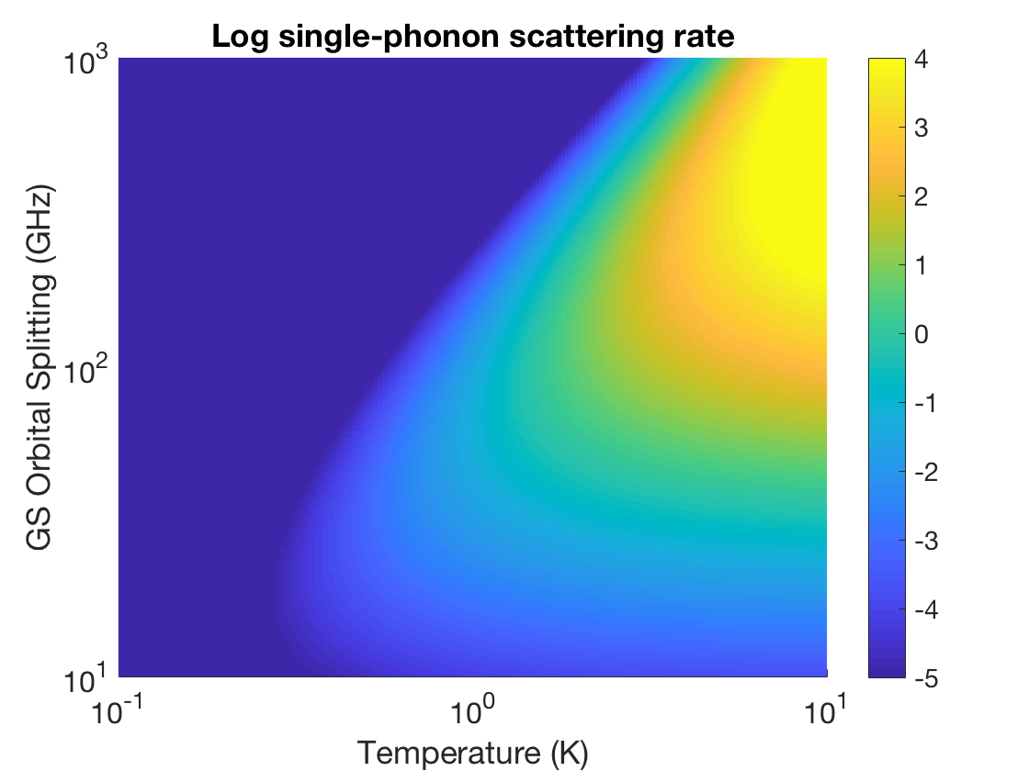
Spin dephasing in inversion-symmetric centers
Single-phonon scattering
Limits coherence
Iwasaki PRL 2017
Siyushev PRB 2017
Meesala PRB 2018
Sukachev PRL 2017
SiV ~ 100 ns⁻¹
Pingault Nat. Comm.
2017
Sukachev PRL 2017, Jahnke NJP 2014
Notes:
Rest of talk will discuss first tin, then pb

Slide 16
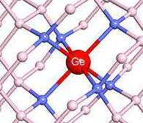
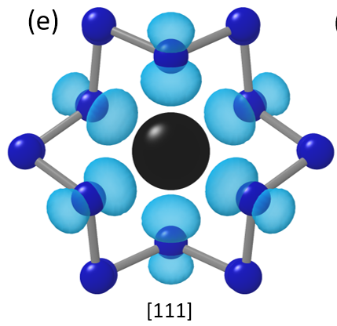
Frequency-stable artificial atoms in diamond
Silicon Vacancy
λ_{ZPL}=737 nm, DWF~0.8
Stable, narrow ZPL
Promising spin-½ and spin-1 qubits
GeV & SnV..
Stable, narrow ZPL, DWF~0.8
Promising spin-½ qubit & spin-1 qubits
Promise for high decoupling of spin ground state from phonons
SnV: T. Iwasaki et al, Phys. Rev. Lett. 119, 253601 (2017)
GeV: Nonlinear optics : M. K. Bhaskar et al (Harvard), PRL 118 (2017)
SnV: Observed T1 > 50 µs at 4 K: Trusheim, Pingault et. al. arXiv:1811.07777
PbV centers
M Trusheim et al, ”Lead-Related Quantum Emitters in Diamond,” arXiv:1805.12202 [quant-ph
PbV center

Slide 17
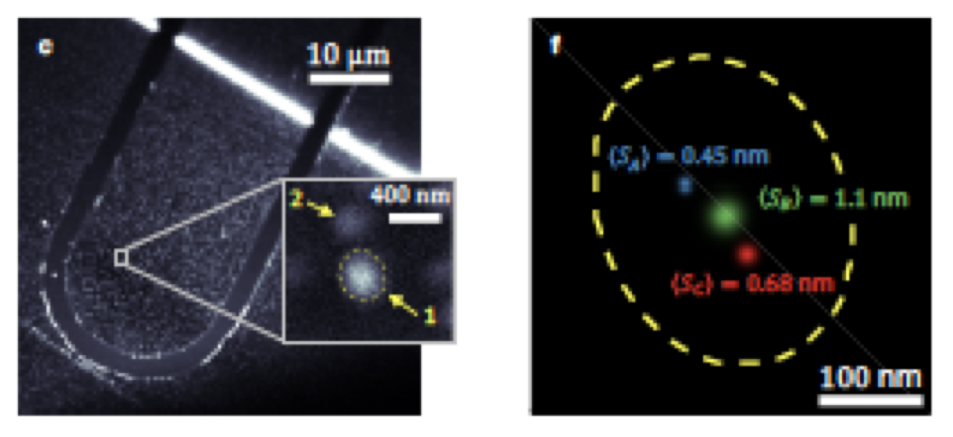
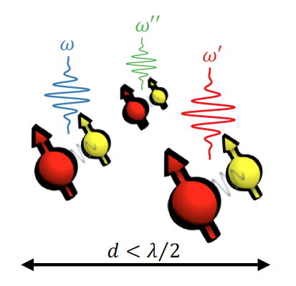
Spectrally multiplexed quantum memories
Multi-qubit registers:
Frequency multiplexing
Error correction
Spectrally selective single-NV readout in cluster of 3 NVs
E Bersin, M Walsh, S Mouradian, M E. Trusheim, T Schröder, DE, ArXiv:1805.06884 (2018)
NV centers
~ 10 kHz coupling rate at ~ 5-10 nm separation

Slide 18
Spatially multiplexed quantum memories
Faster entanglement rates
Error Correction
Greater connectivity
Multiplexed NV quantum repeater

Slide 19
Multiplexed Quantum Repeater Concept
Why? Minimize photon loss; Reduce latency; Phase stability; Scaling
NV Electron spin
Nuclear spins
Mach Zehnder Interferometer
excitation laser
electrical control
quantum register
cavity interface
QR1
…
~4 mm
Detector
QR8
Couplers
Photonic Routing
Quantum registers
Notes:
9 data qubits + 3 ancillas for Shor code or Bacon-Shor subsystem code, surface codes will also be explored

Slide 20
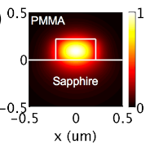
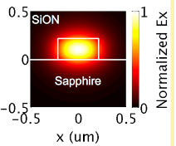
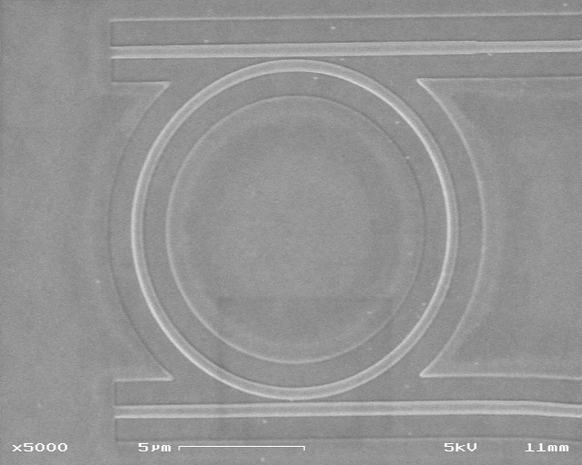
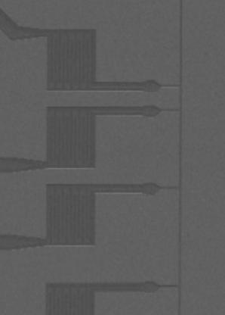
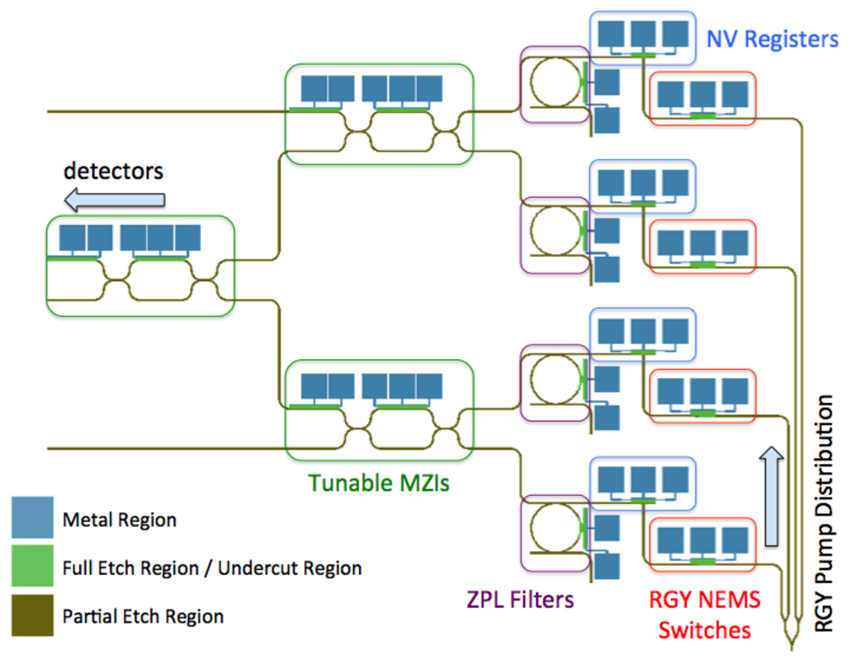
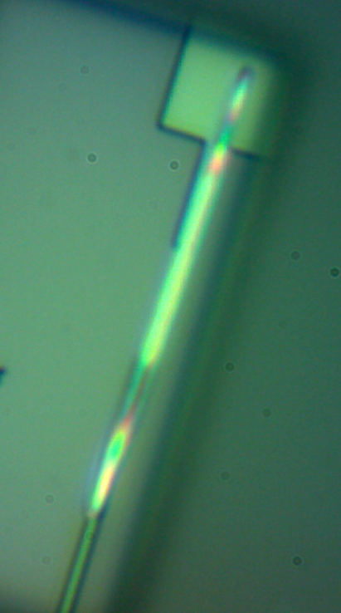
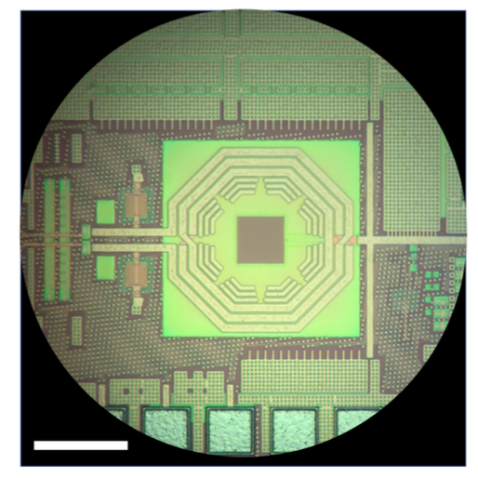
Aluminum Nitride Photonic Integrated Circuit
Distributed Bragg Filter
Ring filter
Diamond Nanobeam
S. Mouradian et al, PRX (2015)
superconducting detectors*
200 µm
CMOS
Tsung-Ju Lu*, Michael Fanto*, et al, Optics Express (2018). *equal contributors
Di Zhu, Qing-Yuan Zhao, Hyeongrak Choi, Tsung-Ju Lu, Andrew E. Dane, Dirk R. Englund, Karl K. Berggren, ”A scalable multi-photon coincidence detector based on superconducting nanowires,” Nature Nanotechnology (2018)
AlGaN/AlN PICs: M Soltani, R Soref, T Palacios, and D Englund, Opt. Express 24 (2016)
Ring Resonator

Slide 21
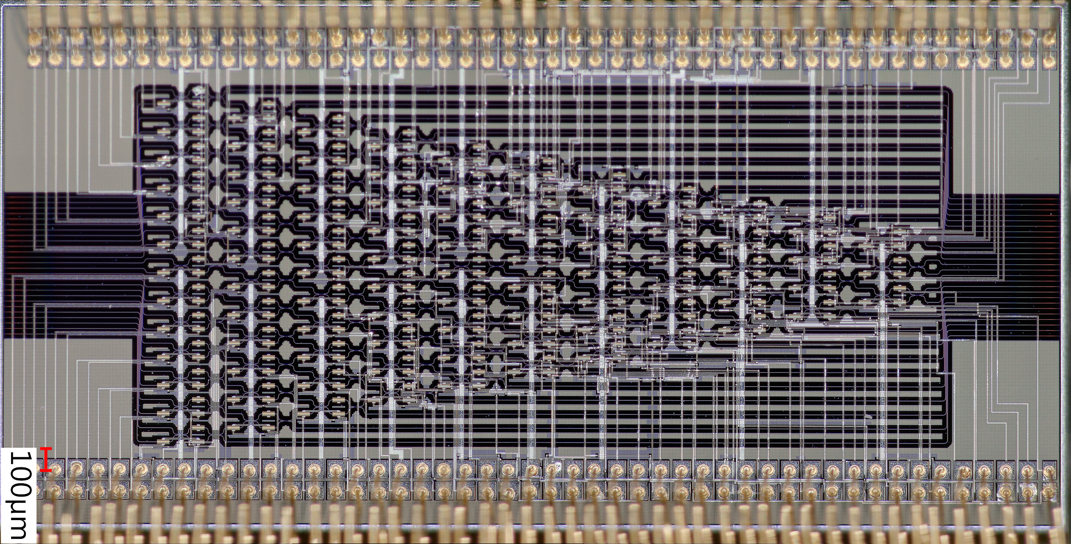
Programmable circuits in silicon photonics
Programmable PIC
88 MZIs, 26 input modes, 26 output modes, 176 phase shifters
References:
N. Harris et al, Nanophotonics 5 (3) (2016)
N. Harris et al, Nature Photonics 11 (2017)
Y. Shen*, N. C. Harris*, et al [with Prof. Marin Soljacic, MIT], Nature Photonics 11 (2017)
OPSIS Foundry
Collaborators: Michael Hochberg, Michael Fanto, Paul Alsing (AFRL), Stefan Preble (RIT), Philip Walther (U. Vienna)
See also D.A.B.M Miller, “Sorting out Light” , Science 347 (2017)

Slide 22
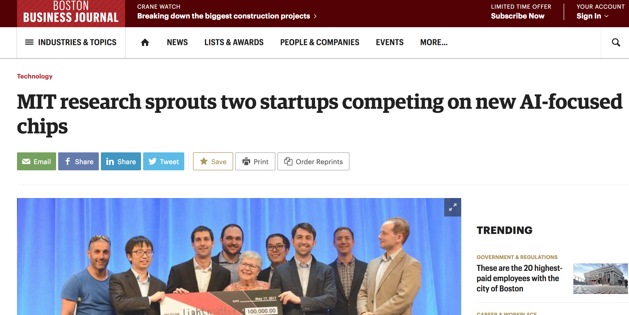
Positions available

Slide 23
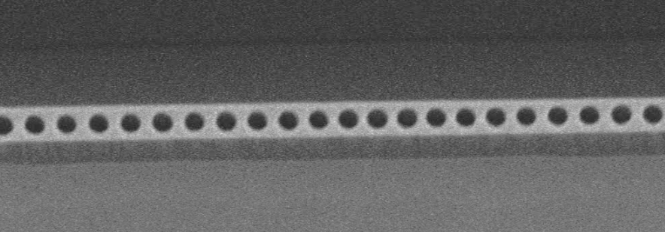
CMOS & VIS-UV photonics integration for large-scale modular quantum architectures
Diamond spins coupled to photons
Photonic integrated circuit
Microwave spin control
+
+
200 µm
CMOS: D Kim, M Ibrahim, C. Foy, R Han, & D.E., arXiv:1810.01056 (2018)
M I. Ibrahimet al, ISSCC (2018)
IEEE VLSI Circuits Symposium (2018)
AlN waveguide PICs:
Tsung-Ju Lu*, Michael Fanto*, et al, Optics Express (2018)
See also Tang group (Yale)
Review on programmable switch arrays: N. Harris et al, Optica 5, 12, pp. 1623-1631 (2018)

Slide 24
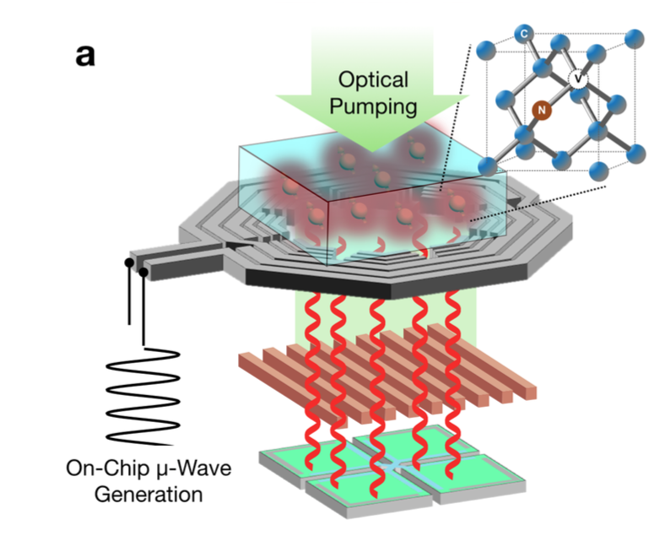
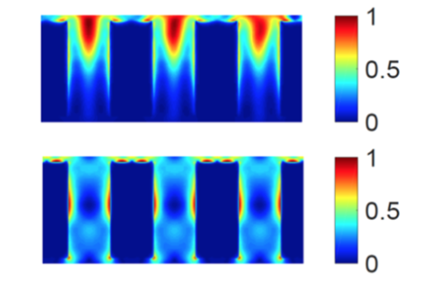
CMOS Electronics for large-scale switching, spin control, detection
Ronald slide
Green T< 10%
200 μm
Red T>90%
Photodetector
Notes:
Schematic of our chip integrated NV magnetometer. NV ensembles in diamond form quantum magnetic field sensors. An off-chip green optical pump beam excites the NV ensemble for optical detection of their spin magnetic resonance. A on-chip MW inductor delivers the on-chip generated MW driving field. Periodic metal/dioxide nanostructures reject the green optical pump beam. On-chip photodiode detects the red spin-dependent fluorescence emitted from the NV centers. Inset is a simplified atomic structure of the NV. b and c, Optical photography of our fabricated chip (top view) without and with the diamond, respectively.

Slide 25
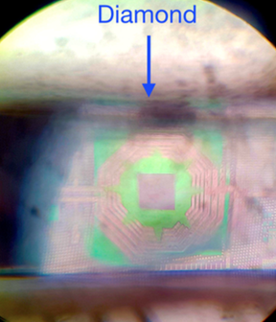
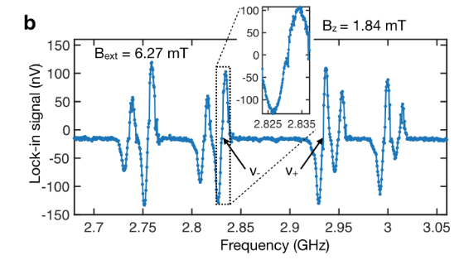
CMOS Integration
65 nm TSMC CMOS process, 9 IC layers.
On-chip VCO, Bz ~ 10 G at 8 mA @ 3 GHz
Allows for field-tracking magnetometry
H. Clevenson et al, APL 112, 252406 (2018)
3D multiturn ring achieves 4% B-field homogeneity across R/2~100 µm
200 µm
D Kim, M Ibrahim, C. Foy, R Han, & D.E., arXiv:1810.01056 (2018)

Slide 26
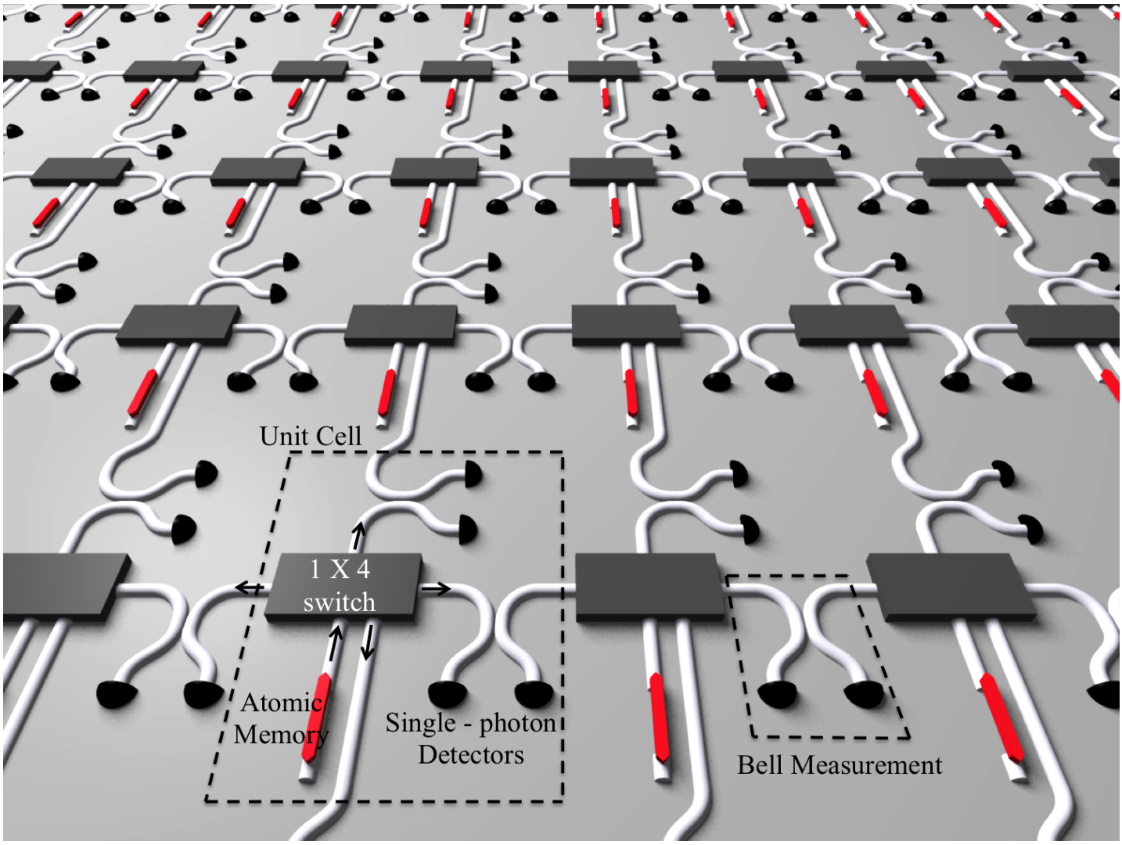
Quantum Repeater / Mod. Quantum Computer Architecture
M. Pant et al, arXiv:1704.07292 (2017)

Slide 27
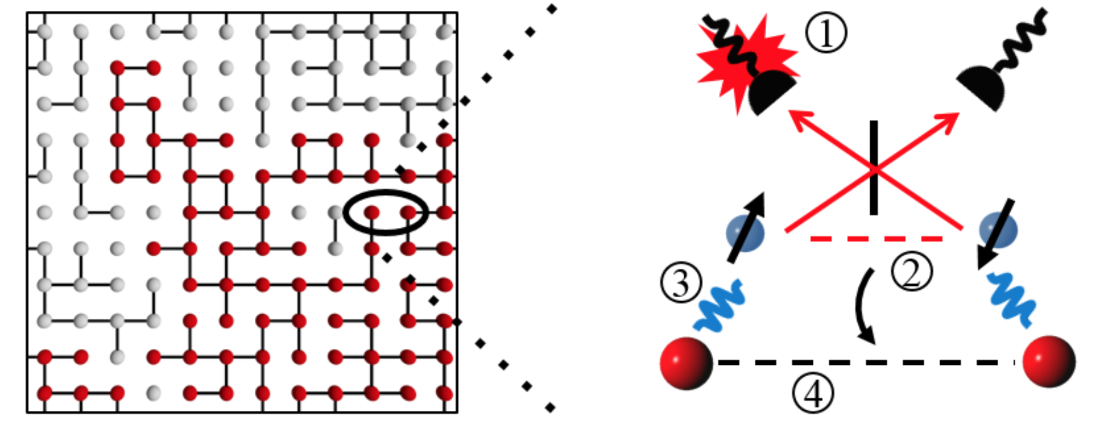
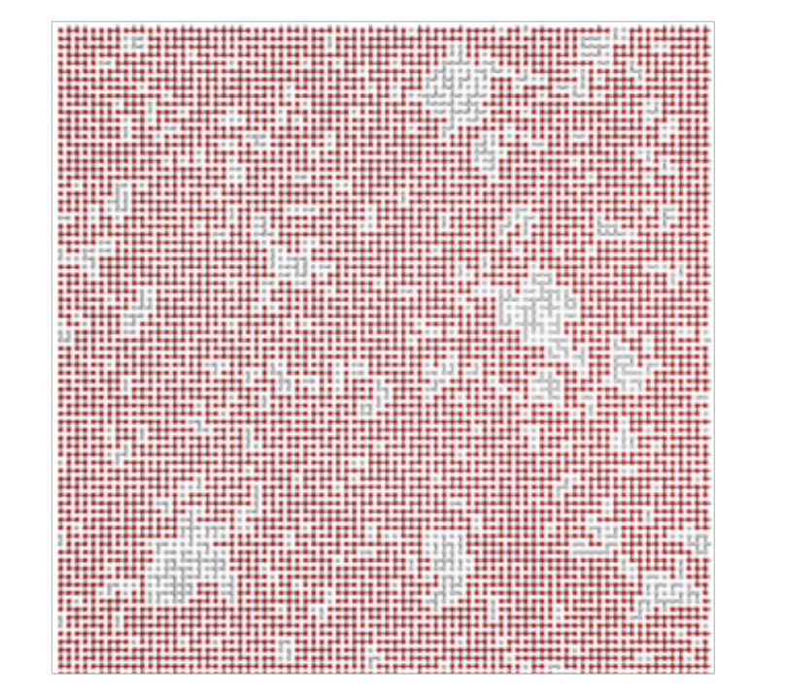
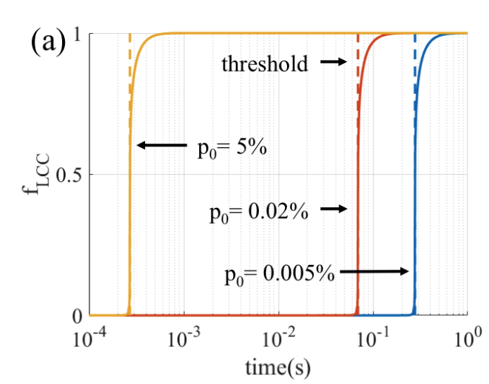
Modular quantum computing with atom-like emitters
General-purpose quantum computers will require lots of qubits. Here’s one scheme for generation large NV cluster states in perhaps <1 ms by percolation:
Entanglement probability p₀ on each attempt, total probability p
Store entangled qubits in NV nuclear spin
p=0.6
Entanglement distribution in the quantum internet
Cluster state of nuclear spins for general-purpose quantum computing.
Possibility for fault-tolerance by surface code.
Pant et al. ArXiv: 1708.07142 (lead: S. Guha)
M. Pant et al, arXiv:1704.07292 - under review (2019)

Slide 28
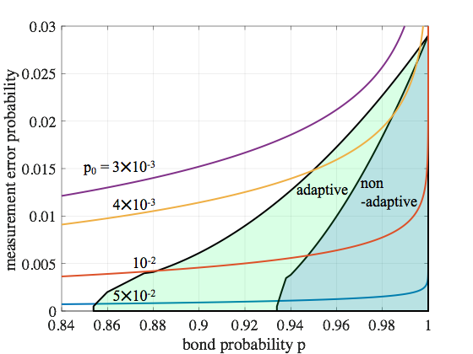
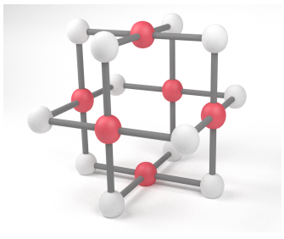
Fault tolerant error correction?
Raussendorf et al. (2006)
Auger et al. (2017)
Herr et al. (2017)
P_{error} = 1 - exp(-t/t_{coh}), t_{coh} = 1s
Areas of fault tolerance: J. M. Auger, et al (D Browne) PRA 97 (2018)
Coupling efficiency needs to be > 10 % for two-photon probabilistic entangling gates
Pant, M., Choi, H., Guha, S., & Englund, D. (2017). Percolation based architecture for cluster state quantum computation using photon-mediated entanglement between atomic memories. arXiv preprint arXiv:1704.07292v2.
Notes:
Finally, using recent result on fault-tolerance in lattices with missing bonds, we were able to look at the requirements for fault-tolerance in our architecture, and we found that with a coupling efficiency of ~9% we can use our architecture for fault-tolerant quantum computing

Slide 29
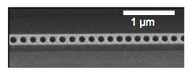
Things are coming together
Quantum memory-integrated PICs
High-speed HD-QKD & photonic integrated circuits
Diamond cavities working well:
S. Mouradian et al, APL (2017); N. Wan et al, APL (2018)
Quantum emitters getting close to “repeatable and good”:
NVs need more work: S B. van Dam, M Walsh, et al (Taminiau - Hanson - Englund), arXiv:1812.11523 (2018)
Spectrally multiplexed NV clusters: E Bersin, M Walsh, S Mouradian, M E. Trusheim, T Schröder, DE, ArXiv:1805.06884 (2018)
New kinds of emitter systems: PbV, SnV,: See Trusheim talk this Friday at PQE
CMOS electronics for large-scale spin control:
D Kim, M Ibrahim, C. Foy, R Han, & D.E., arXiv:1810.01056 (2018)
Photonic network:
Tsung-Ju Lu*, Michael Fanto*, et al, Optics Express (2018). *equal contributors
Review: N. Harris et al, Optica 5, 12, pp. 1623-1631 (2018)
~ Mbit/sec PIC field test:
D. Bunandar et al, Phys. Rev. X 8, 021009 (2018) ; with Sandia National Laboratory
Outlook: Multiplexing.
1 µm
200 µm
Extensions to large-scale quantum networks and modular qu. computing
NV-percolation thresholds: M. Pant et al, arXiv:1704.07292 (2017)
Photonic percolation thresholds: M. Pant et a, arXiv:1701.03775v1, to appear in Nature Communications (2019)

Slide 30
Acknowledgements
MIT Quantum Photonics Group :
Graduate Students: Sara Mouradian, Noel Wan, Michael Walsh, Eric Bersin, Tsung-Ju Lu, Donggyu Kim, Chris Foy, Mohammad Ibrahim
Postdocs: Tim Schroeder (-> Niels Bohr Institute, Copenhagen), Matt Trusheim, Lorenzo De Santis
Collaborators:
MIT: Prof. Karl Berggren, Prof. Ruonan Han
Harvard: Prof. Mikhail Lukin, Prof. Marko Loncar
Air Force Research Laboratory: Michael Fanto, Dr Paul Alsing
Rochester Institute of Technology: Prof Stefan Preble
Sandia National Laboratory: J Urayama, N Boynton, N Martinez, C DeRose, A Lentine, P Davids, E. Edward S. Bielejec, R Camacho
U. of Arizona: Prof Saikat Guha
BBN Technologies: Dr Mohammad Soltani
Funding
Notes:
thank you for your attention and i’m happy to take more of your questions

Slide 31
Extra slides

Slide 32
Measuring an individual NV in an NV ensemble
NV resonances in single diamond sample
Sub-diffraction NV cluster
Distinguishable transitions
Goal: Ensembles of coupled qubits with individual addressability
Applications: Error-corrected registers, entangled sensors, many-body physics, etc.
E Bersin, M Walsh, S Mouradian, M E. Trusheim, T Schröder, DE, ArXiv:1805.06884 (2018)

Slide 33
NV ensemble addressing
Nanometer-scale localization
Super-resolution readout preserves states of nearby NV qubits
Rabi on NV A
Preserved
Ramsey for B and C
Original spot size
E Bersin, M Walsh, S Mouradian, M E. Trusheim, T Schröder, DE, ArXiv:1805.06884 (2018)

Slide 34
CMOS-integrated diamond quantum magnetometry
CMOS-integrated microwave circuit for NV spin control
CMOS-integrated optical readout
Magnetic field sensitivity (~30 µT/Hz^{1/2} limited by imperfect pump filtering before photodiode); improved design in production
External spin pump light source

Slide 35
Properties of NVs produced by implantation
Implanted, before fabrication
Linewidths to <1 GHz: more work needed to get to ~ 100 MHz
Preliminary measurements indicate < 300 MHz linewidths of NVs in nanobeams

