Slide 1

Technology Development and the 2020 Nobel Prize in Physics
Don F. Figer
Future Photon Initiative
Center for Detectors
Rochester Institute of Technology, Rochester, NY
January 21, 2020

Slide 2
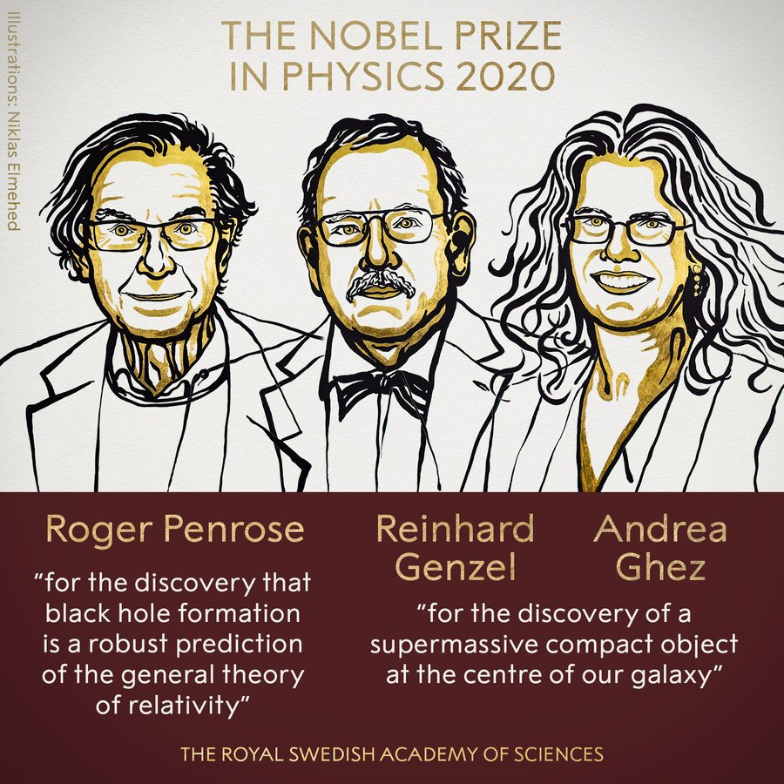
2020 Nobel Prize in Physics

Slide 3
Outline
Historical context
How to measure the mass of a black hole
The Galactic center black hole experiment
A digression
Big telescope mirrors
Adaptive optics
Infrared detectors
Instruments
Future detector technologies
Some content in this presentation is from Genzel, Eisenhauer, & Gillessen 2010, Rev. Mod. Phys. 82, 3121

Slide 4
Historical context

Slide 5
Historical Context
1931, Jansky, Sgr A
1968, Becklin & Neugebauer, IR
1973, Rieke & Low, IR
1974, Balick & Brown, Sgr A*
1980-1985, Serabyn & Lacy, gas - M_{BH}=3-4(10⁶) M_{Sun}
1996, Eckart & Genzel, stars - M_{BH}=3(10⁶) M_{Sun}
1998, Ghez et al., stars - M_{BH}=2.6(10⁶) M_{Sun}
2002, Schoedel et al., S2, M_{BH}=4.1(10⁶) M_{Sun}
2003, Ghez et al., S2, M_{BH}=4.6(10⁶) M_{sun}
2009, Gillessen et al., M_{BH}=4.3(10⁶) M_{Sun}
2018, Genzel et al., S2 gravitational redshift
2019, Ghez et al., S2 gravitational redshift
2020, Abuter et al., S2 orbit precession
2020, Nobel Prize

Slide 6
how to measure the mass of a black hole

Slide 7
Measuring Mass
Find “test particles” orbiting another object.
Measure position and velocity.
Infer mass using Kepler and Newton.

Slide 8
Kepler and Newton
Kepler (1610)
  orbits are ellipses
  equal areas are swept in equal time
  square of the period is cube of the radius
Newton (1687)
  objects remain in motion unless there is a force
  force equals mass times acceleration
  force exerted by one body is equal to force on that body
  gravity is proportional to the product of the masses divided by the square of the distance

Slide 9



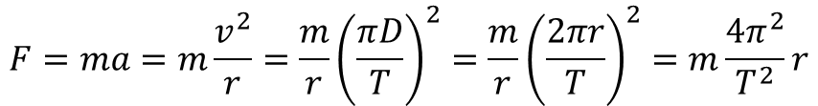
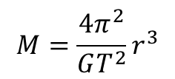
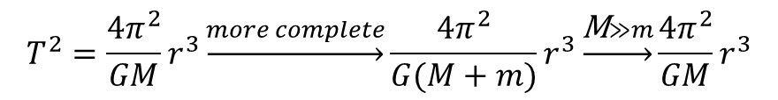

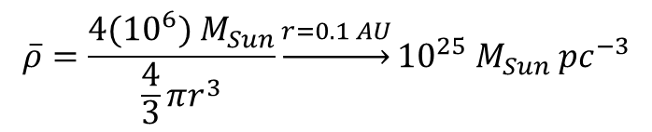
High School Math
$$F=ma=m\frac{v^{2}}{r}=\frac{m}{r}{\left(\frac{πD}{T}\right)}^{2}=\frac{m}{r}{\left(\frac{2πr}{T}\right)}^{2}=m\frac{4π^{2}}{T^{2}}r$$
$$F=G\frac{Mm}{r^{2}}$$
$$m\frac{4π^{2}}{T^{2}}r=G\frac{Mm}{r^{2}}$$
$$T^{2}=\frac{4π^{2}}{GM}r^{3}\underset{→}{more complete}\frac{4π^{2}}{G(M+m)}r^{3}\underset{→}{\text{M}≫m}\frac{4π^{2}}{GM}r^{3}$$
$$M=\frac{4π^{2}}{GT^{2}}r^{3}$$
$$M\underset{→}{r=1 AU, T=1 year}=1 M_{Sun}$$
$$M\underset{→}{r=1000 AU, T=16 years}=4({10}^{6}) M_{Sun}$$
$$\overline{ρ}=\frac{4({10}^{6}) M_{Sun}}{\frac{4}{3}πr^{3}}\underset{→}{r=0.1 AU}{10}^{25} M_{Sun} {pc}^{−3}$$

Slide 10
The Galactic center black hole experiment

Slide 11
The Experiment
Take pictures of stars near the Galactic center (GC).
Repeat this for 20 years.
Supplement data with spectra.
Measure distance to GC.
Determine orbital parameters for some stars.
Estimate mass inside orbit.
Convert to density.
Compare density to that of black hole.

Slide 12
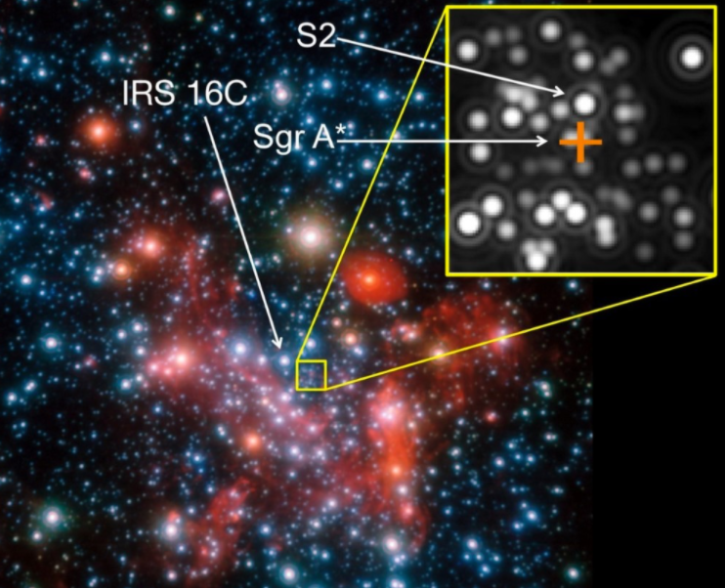
The Central Parsec

Slide 13
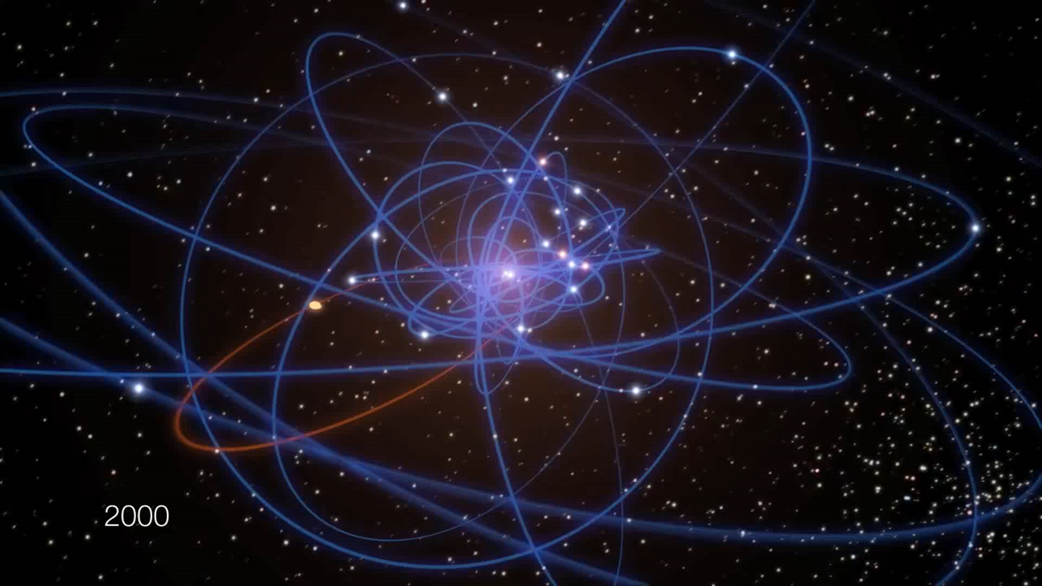
Stellar Orbits Near the GC
Credit: ESO/MPE/M. Schartmann/L. Calçada

Slide 14
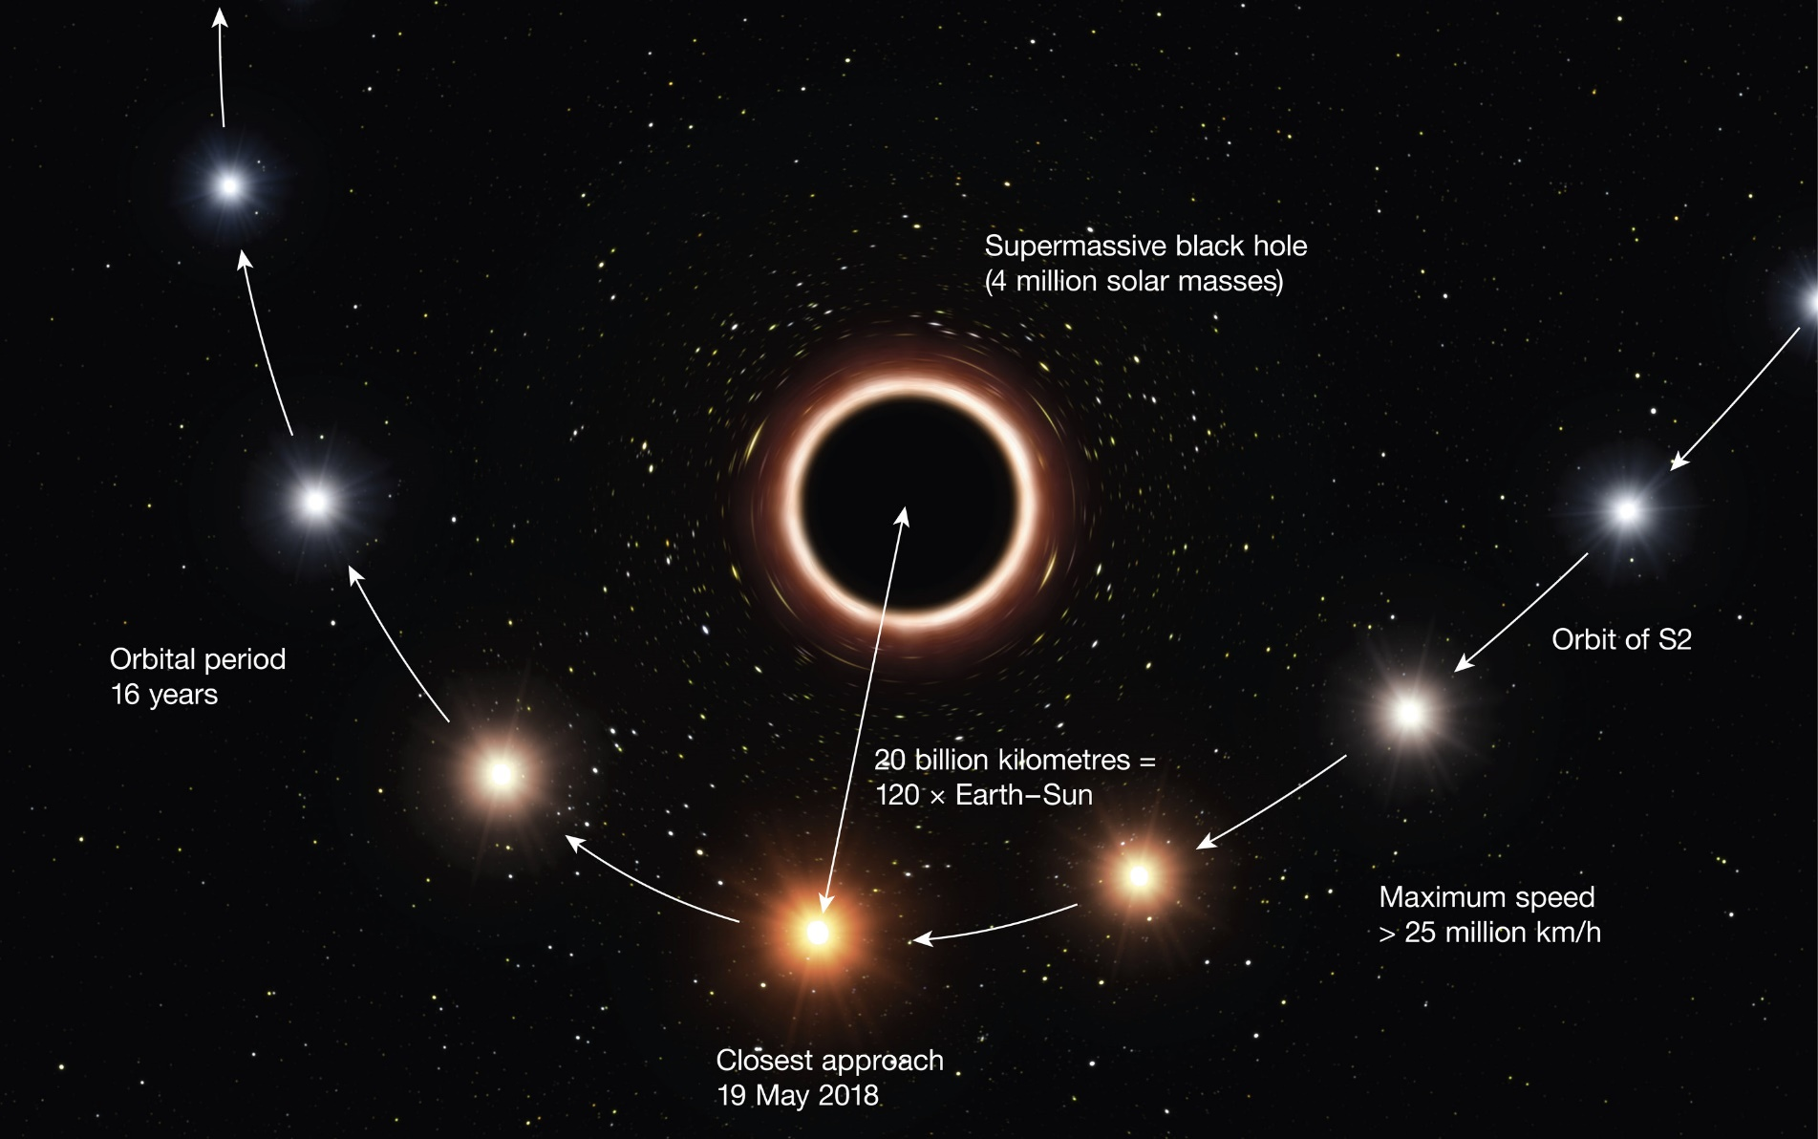
Relativistic Redshift

Slide 15
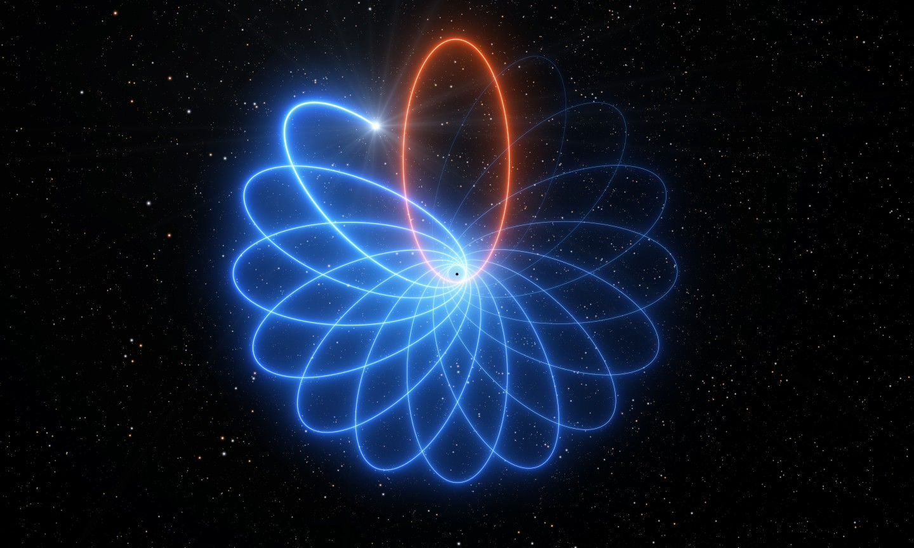
Relativistic Precession

Slide 16
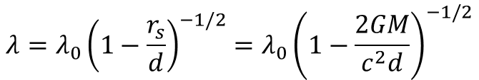
Gravitational Redshift
A photon shifts to longer wavelengths when it propagates into a region of stronger gravitational field.
The new wavelength is given by,
$$λ=λ_{0}{\left(1−\frac{r_{s}}{d}\right)}^{−1/2}=λ_{0}{\left(1−\frac{2GM}{c^{2}d}\right)}^{−1/2}$$
where r_{s} is the Schwarzchild radius and d is the distance between where the photon is emitted and the center of the black hole.

Slide 17
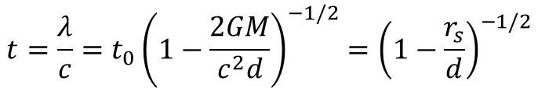
Gravitational Time Dilation
Consider the time between waves as measured at the point of photon emission and also at the point of a distant observer.
The gravitational redshift tells us that it will take more time for a wave to propagate one full wavelength at the location of the distant observer as compared to at the point of emission because the wavelength has been stretched.
Notice what happens at d=r_{s}.
The wavelength becomes infinite. The light never arrives. It appears that time becomes infinite.
$$t=\frac{λ}{c}=t_{0}{\left(1−\frac{2GM}{c^{2}d}\right)}^{−1/2}{=\left(1−\frac{r_{s}}{d}\right)}^{−1/2}$$

Slide 18


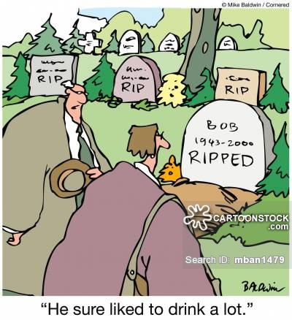

Getting Ripped!
Notes:
2

Slide 19
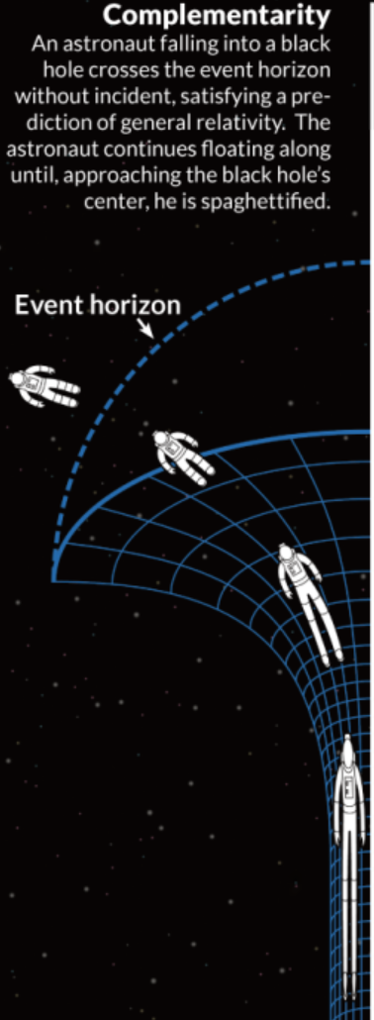
Spaghettification
Spaghettification is the technical term when a black hole rips you apart.
This can happen when the tidal force across your body exceeds the force required to keep your body together.
The force on the part of your body nearest the black hole will exceed that on your body furthest from the black hole.
This will stretch your body along a direction toward the black hole.

Slide 20

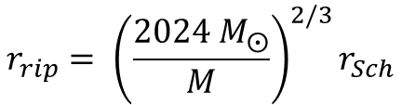
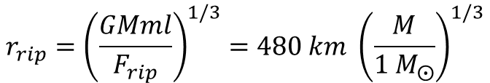
Getting Ripped
We can calculate the point of getting ripped through the tidal force equation.
$$ΔF=\frac{GMm}{r^{3}}l$$
Inverting this equation, and guessing at the differential force that will rip your body apart, we find:
$$r_{rip}={\left(\frac{GMml}{F_{rip}}\right)}^{1/3}=480 km {\left(\frac{M}{1 M_{⨀}}\right)}^{1/3}$$
Recalling that r_{Sch}=$3 km \left(\frac{M}{{1 M}_{⨀}}\right)$,
$$r_{rip}= {\left(\frac{{2024 M}_{⨀}}{M}\right)}^{2/3}r_{Sch}$$
So, r_{rip} is inside event horizon for M>2,000 M_{Sun}.
Notes:
2

Slide 21
Combined Effects
As an object approaches the event horizon,
  Light would get redshifted to larger and larger wavelengths.
  Redder and redder IR, to radio, to undetectable.
  Time would appear to slow down.
  Would freeze at the event horizon.
What would the astronaut see looking back at us?
  For them, time proceeds normally.
  Would see time running fast for us.
  Light from us would be blueshifted.

Slide 22
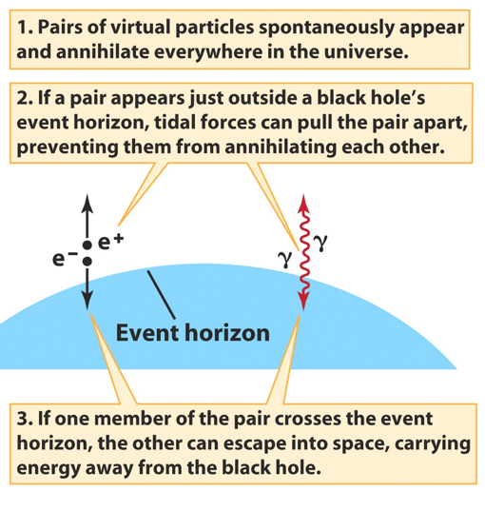
Hawking Radiation
Hawking radiation is the radiation that the region around a black hole emits due to particle-antiparticle creation.
It is generated just outside the event horizon.
The antiparticle falls into the black hole, whereas the particle is emitted.
The particle has positive energy, so the antiparticle has negative energy.
The antiparticle reduces the energy of the black hole.
Ultimately, the black hole will end up with no energy. That is, it will “evaporate.” This takes a long time, ~10¹⁰⁰ yr.
Notes:
2
Stellar Spectra
Comparison of spectra observed for seven different stars having a range of surface temperatures. The hottest stars, at the top, show lines of helium and multiply ionized heavy elements. In the coolest stars, at the bottom, helium lines are not seen, but lines of neutral atoms and molecules are plentiful. At intermediate temperatures, hydrogen lines are strongest. The actual compositions of all seven stars are about the same. ><*Recently, some astronomers have proposed the addition of two new spectral classes—L and T—for low-mass, low-temperature stars whose odd spectra distinguish them from the M-class stars in the current scheme. For now, at least, the new classification has not been widely adopted. Astronomers are still uncertain whether these new objects are “true” stars, fusing hydrogen into helium in their cores, or if they are “brown dwarfs” that never achieved high enough central temperatures for fusion to begin.

Slide 23
Supermassive Black Holes
There is evidence for black holes that have masses that far exceed what would be expected if they formed from a single star.
These are called supermassive black holes.
They have been found in the centers of many galaxies.
They have masses of ~10⁶ to 10¹⁰ M_{Sun}.
The Galaxy has a supermassive black hole with M=4(10⁶) M_{Sun}.
There is a controversy as to whether these objects accrete their mass steadily over long time-scales or if they were created with such large masses during the time of galaxy formation.
Notes:
2
Stellar Spectra
Comparison of spectra observed for seven different stars having a range of surface temperatures. The hottest stars, at the top, show lines of helium and multiply ionized heavy elements. In the coolest stars, at the bottom, helium lines are not seen, but lines of neutral atoms and molecules are plentiful. At intermediate temperatures, hydrogen lines are strongest. The actual compositions of all seven stars are about the same. ><*Recently, some astronomers have proposed the addition of two new spectral classes—L and T—for low-mass, low-temperature stars whose odd spectra distinguish them from the M-class stars in the current scheme. For now, at least, the new classification has not been widely adopted. Astronomers are still uncertain whether these new objects are “true” stars, fusing hydrogen into helium in their cores, or if they are “brown dwarfs” that never achieved high enough central temperatures for fusion to begin.

Slide 24
A digression

Slide 25
Practical Problem
The stellar images were too blurry as observed from the ground (pre-AO).
The telescopes in space produce sharp images but are too small.
One solution was to observe stars further away from the black hole, but those do not move very quickly.
Instead, measure their velocities, not their changing positions with time.
Use Doppler shift.

Slide 26
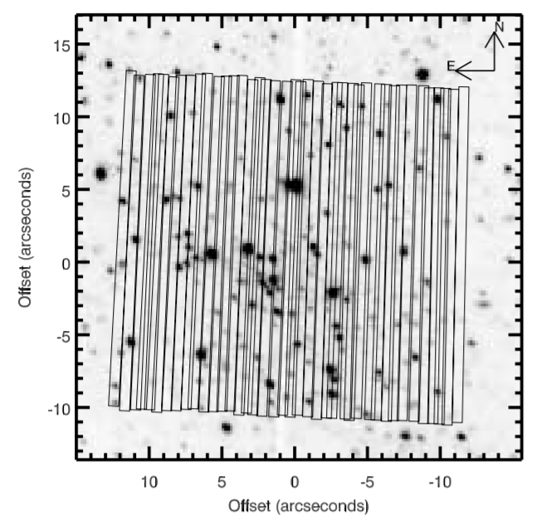
Spectral Scan

Slide 27
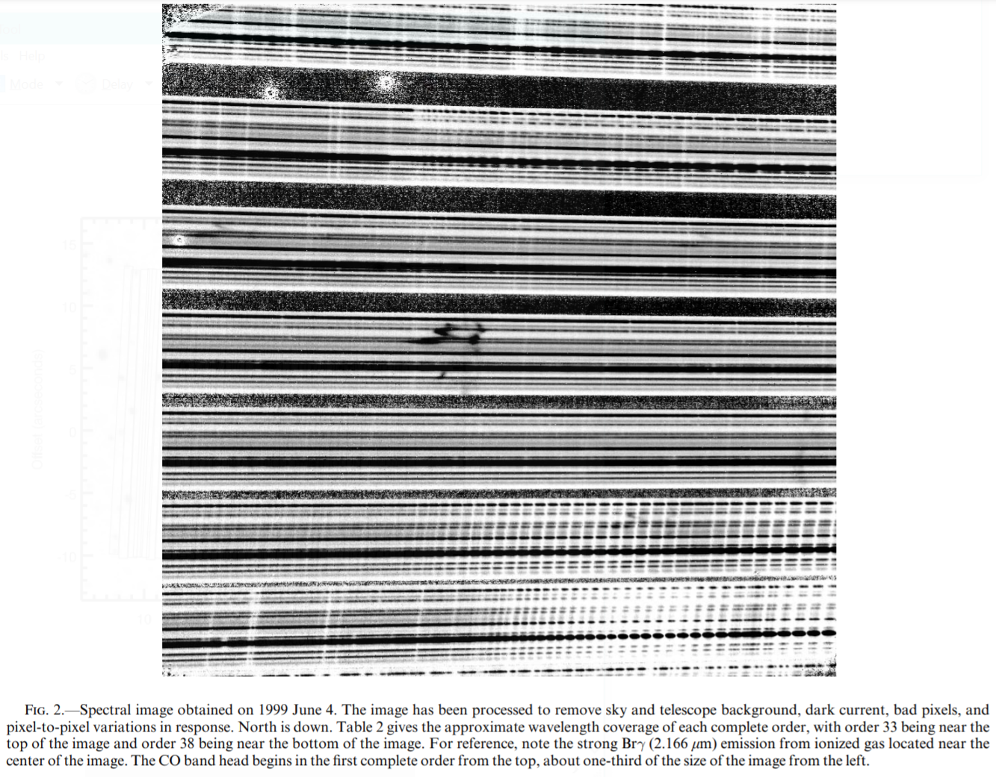
Raw Spectral Image

Slide 28
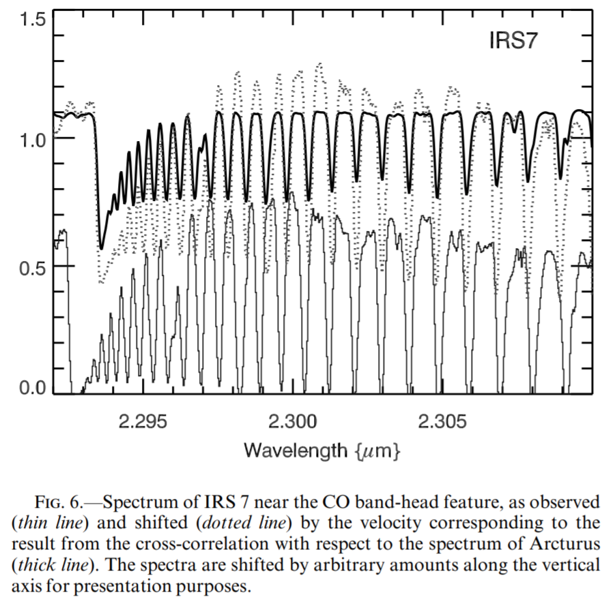
Extracted Spectrum

Slide 29
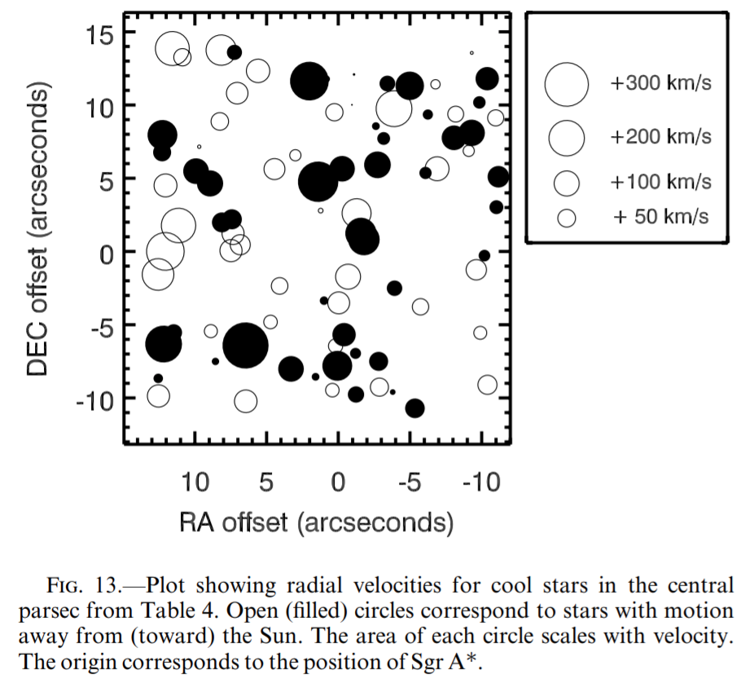
Velocities

Slide 30
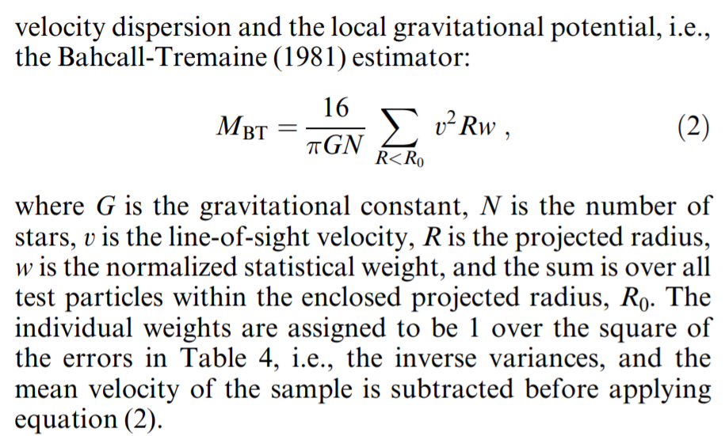
Mass from Velocities

Slide 31
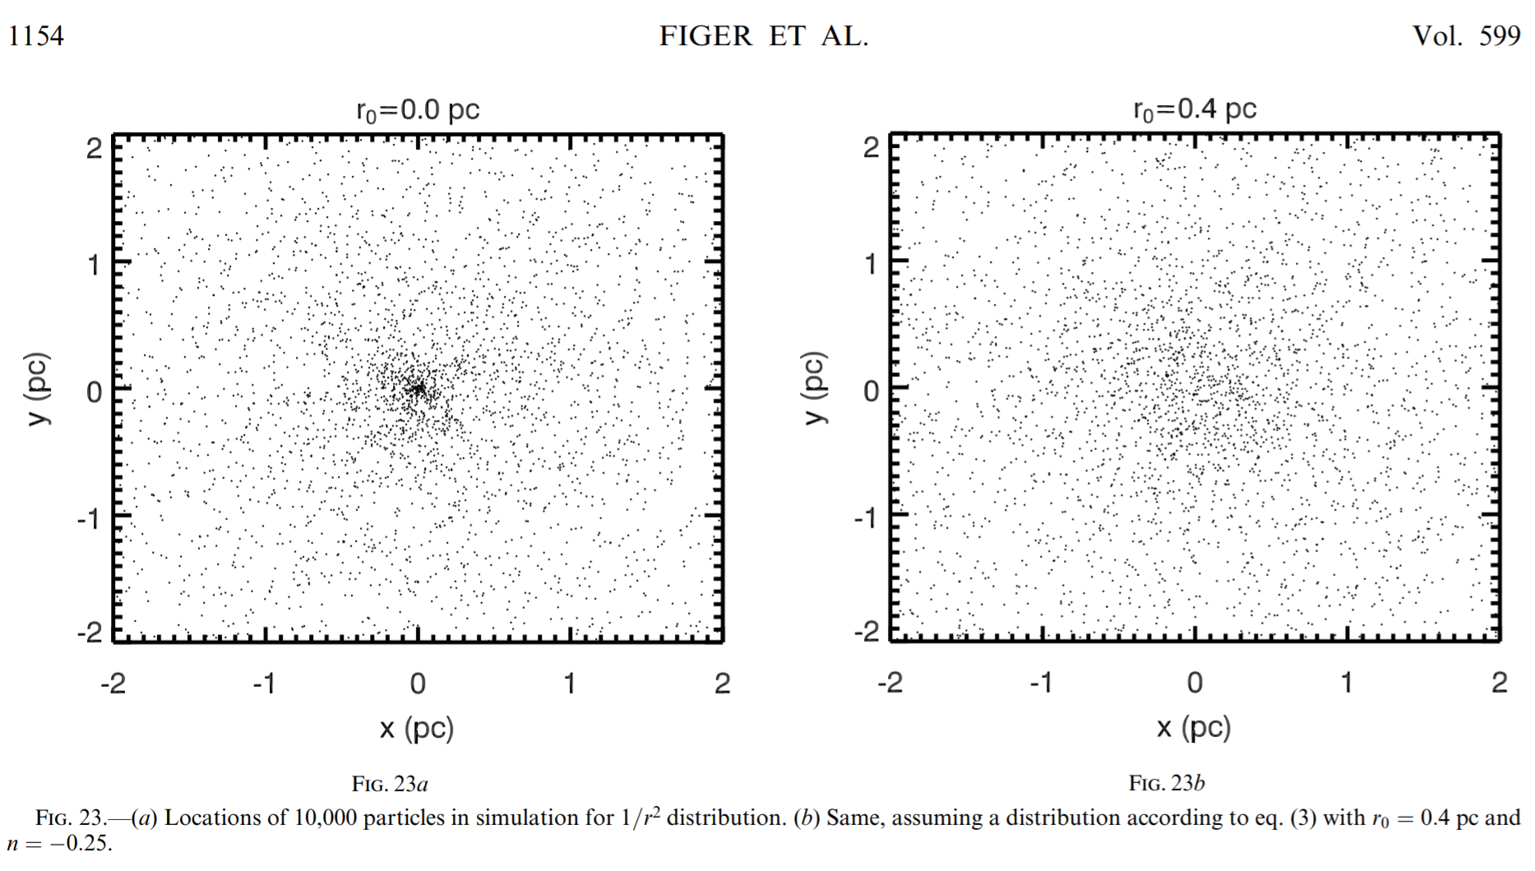
A Hole in the Stellar Mass Distribution

Slide 32
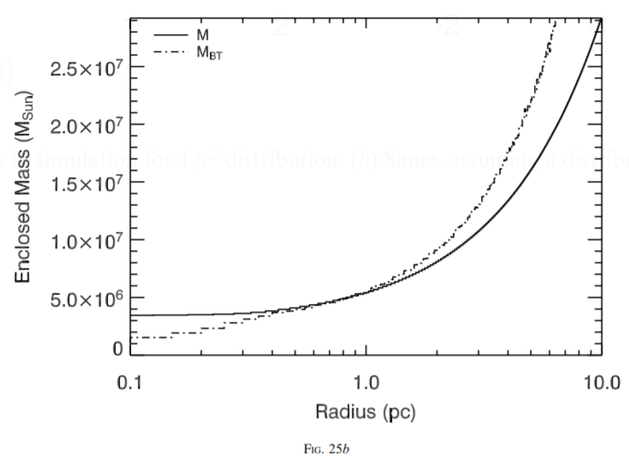
Corrected Enclosed Mass

Slide 33
Red Giant Hole

Slide 34
technologies

Slide 35
Technologies
Big telescope mirrors
  Jerry Nelson (Keck)
  Roger Angel (VLT)
Adaptive optics
  Peter Wizinowich (Caltech)
  Claire Max (UCSC)
Infrared detectors
  Don Hall (HgCdTe, UH)
  Al Fowler, Judy Pipher, Bill Forrest (InSb, U of R)
Instruments

Slide 36
big telescope mirrors

Slide 37
Big Telescope Mirrors
Jerry Nelson (Keck)
Roger Angel (VLT)

Slide 38
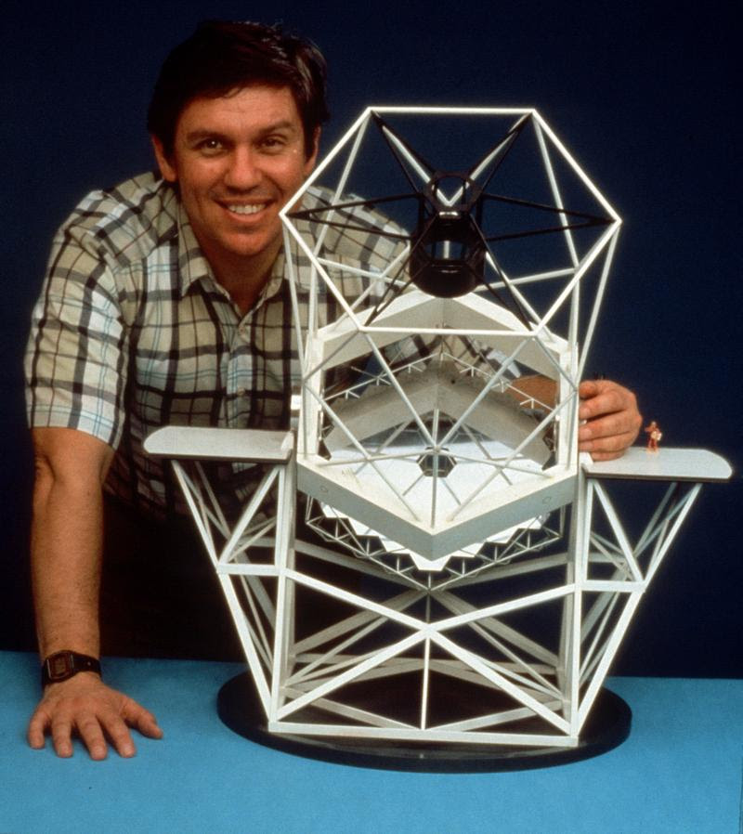
Jerry Nelson

Slide 39
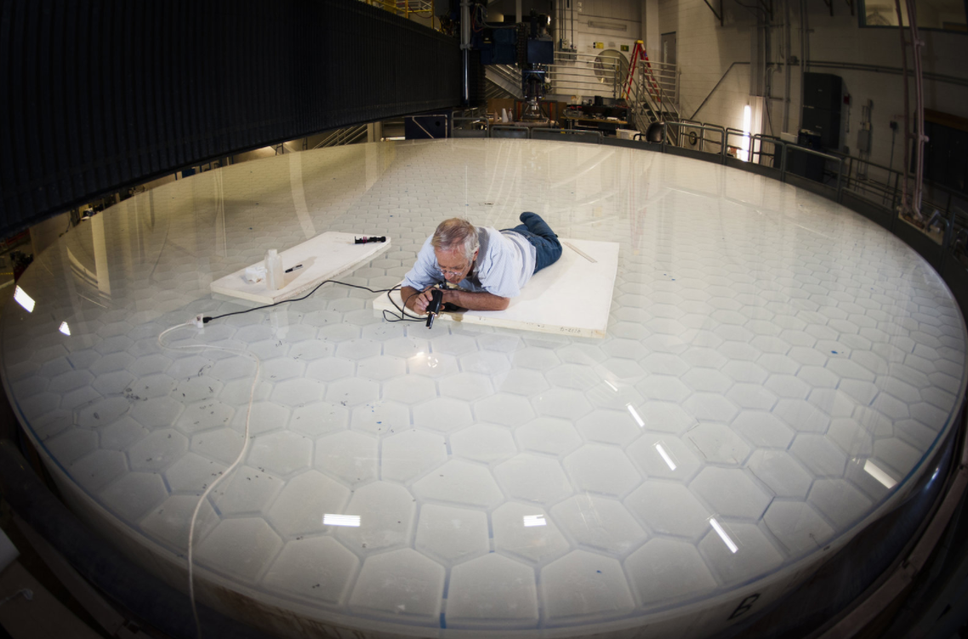
Roger Angel

Slide 40
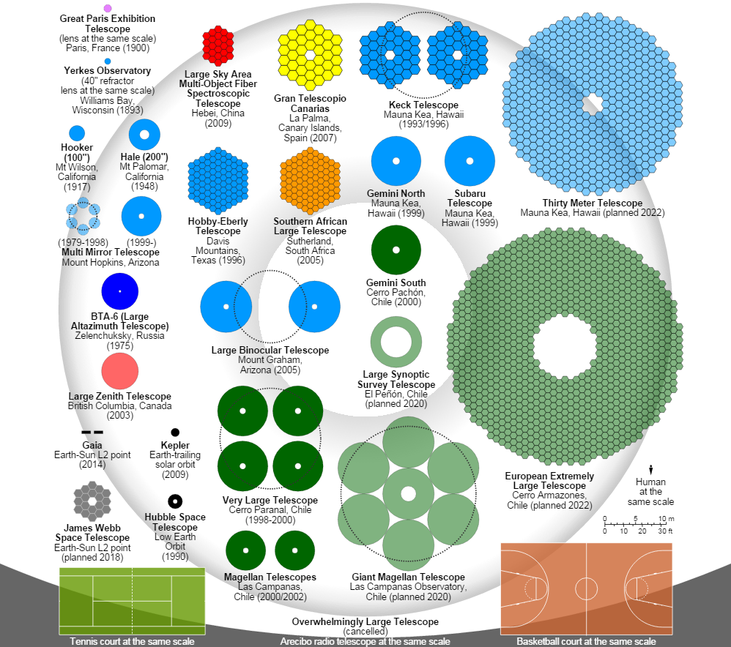
Telescope Primary Sizes
Notes:
ORM is now the Gran Canary Telescope (GTC).

Slide 41
adaptive optics

Slide 42
Adaptive Optics
Peter Wizinowich (Caltech)
Claire Max (UCSC)

Slide 43
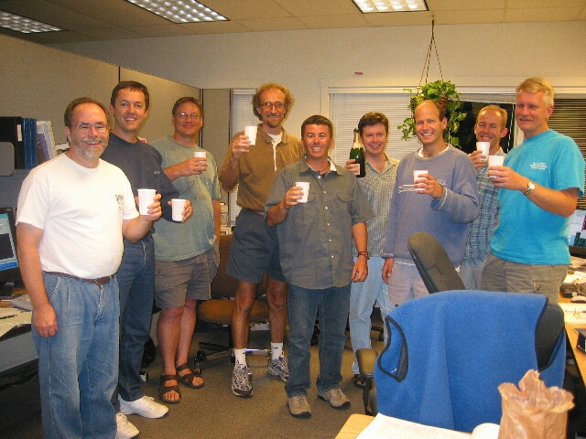
Peter Wizinowich

Slide 44
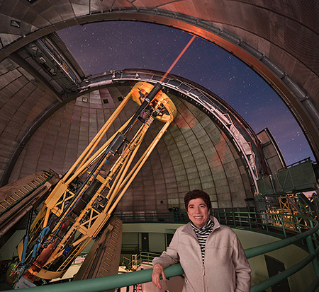
Claire Max

Slide 45
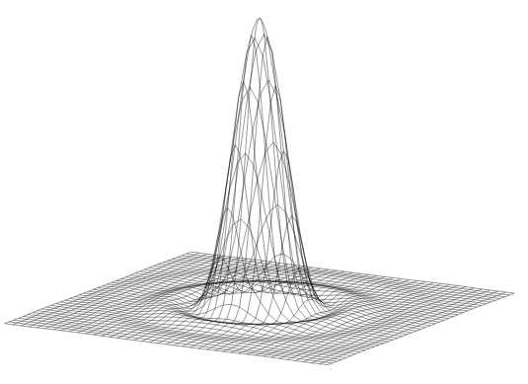
Airy Pattern
An Airy pattern is the image intensity pattern at a focal plane for an optical system that has a circular aperture.
It looks like a central peak surrounded by rings.
A central obscuration has the effect of moving some of the light from the central peak into the outer rings.

Slide 46
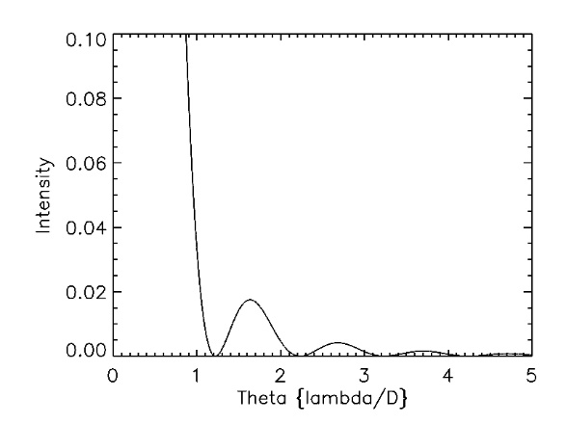
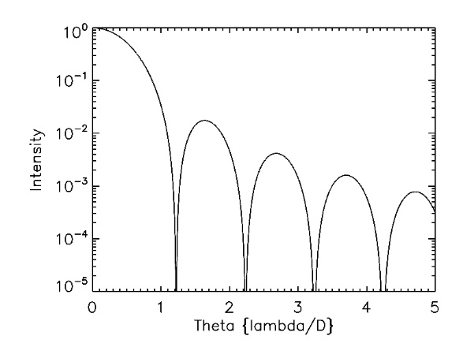
Airy Pattern
The Airy pattern is one type of point spread function (PSF) at the focal plane of an instrument for a point source.
The intensity pattern is given by the order 1 Bessel function of the first kind.
The radius of the first dark ring is 1.22 and the FWHM is at 1.028 (all in units of lambda/D).

Slide 47
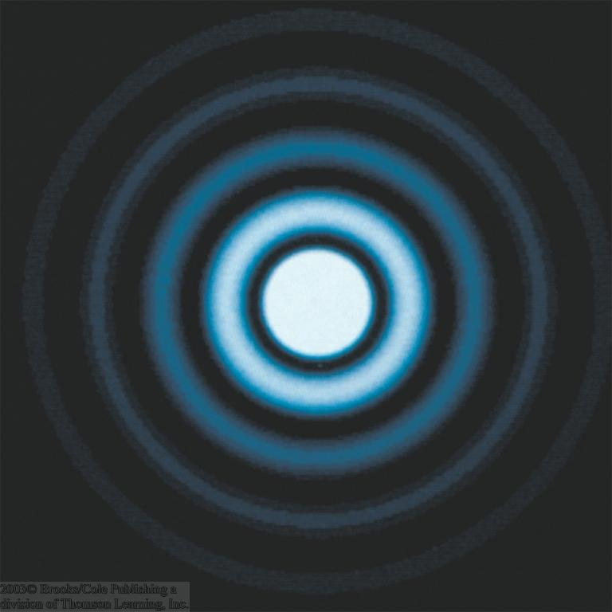
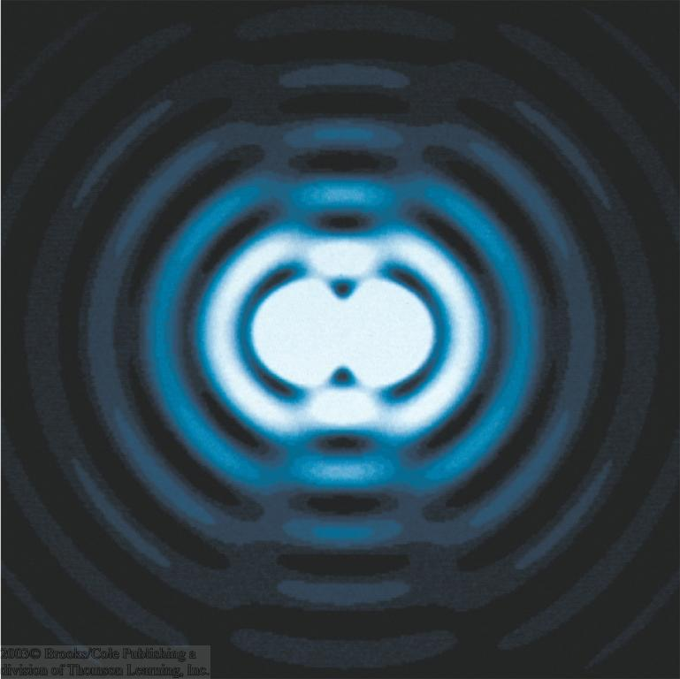
Diffraction: Rayleigh Criterion
The telescope aperture produces fringes (Airy disc) that set a limit to the resolution of the telescope.
Angular resolution is minimum angular distance between two objects that can be separated.
Rayleigh criterion is satisfied when first dark ring produced by one star is coincident with peak of nearby star.
α_{min}

Slide 48
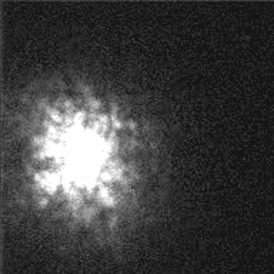
Atmospheric Turbulence

Slide 49

Gemini AO Animation

Slide 50
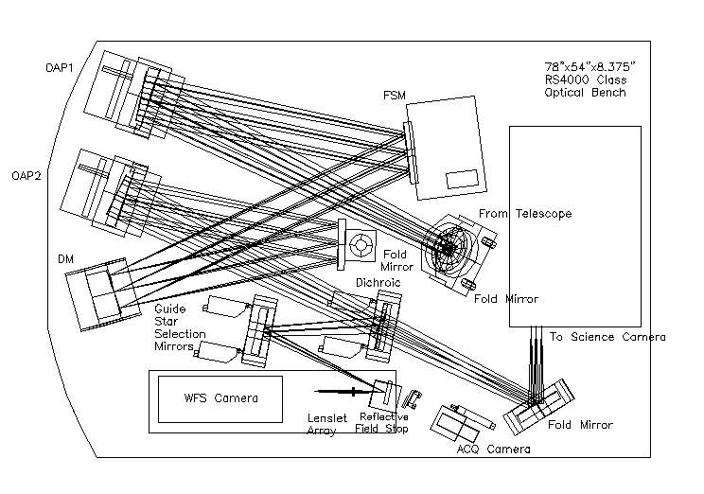
Adaptive Optics System
Notes:
OAP1 produces an image of the pupil at the DM. OAP2 focuses the beam onto the science and WFS cameras.

Slide 51
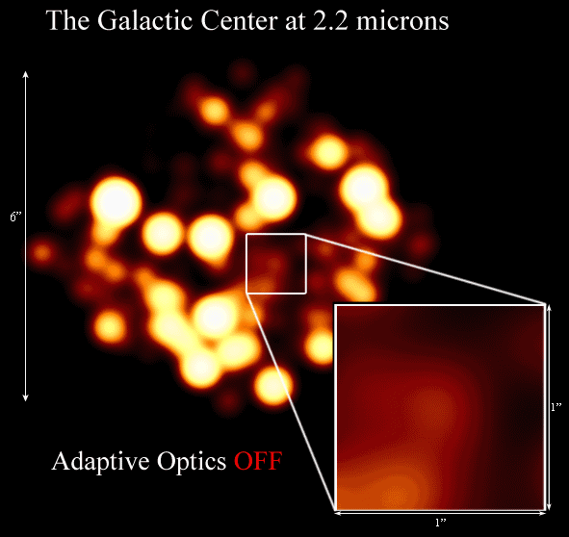
GC with AO

Slide 52
infrared detectors

Slide 53
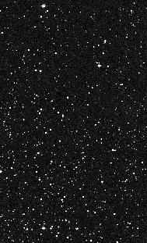
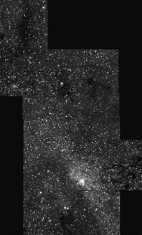
Why Near-infrared?
V band
K band
60 pc
Digitized Sky Survey
Figer 1995

Slide 54
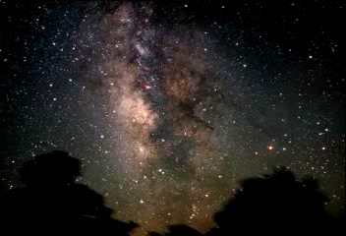
Infrared

Slide 55
Infrared Detectors
Don Hall (HgCdTe, UH)
Al Fowler (InSb, UA)
Judy Pipher, Bill Forrest (InSb, UR)
Kadri Vural (Rockwell/Teledyne)
Alan Hoffman (Hughes SBRC/Raytheon)

Slide 56
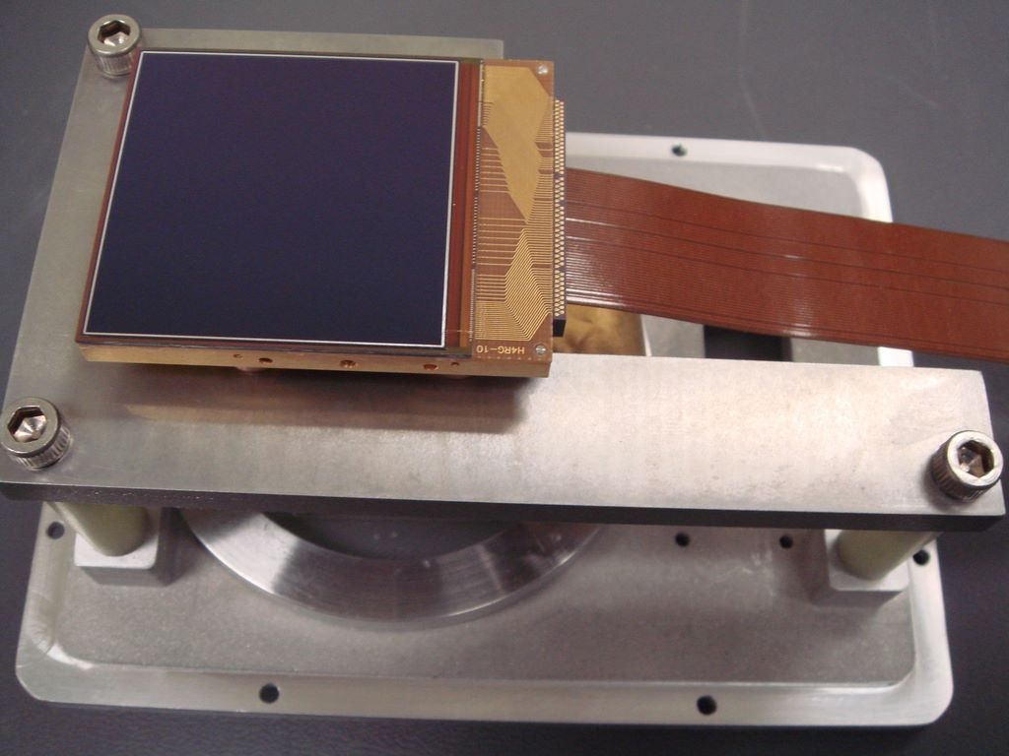
Infrared Detectors

Slide 57
instruments

Slide 58
Instruments
GRAVITY (4 UT VLT interferometric K-band imager: Eisenhauer)
ISAAC (Infrared Spectrometer And Array Camera)
NACO (Nasmyth Adaptive Optics System, NAOS & Near-Infrared Imager and Spectrograph, CONICA)
NIRC/NIRC2 (Near-Infrared Camera: Matthews)
NIRSPEC (Near-Infrared Spectrograph: McLean)
OSIRIS (OH-Suppressing Infra-Red Imaging Spectrograph: Larkin)
SHARP (System for High Angular Resolution Pictures)
SINFONI (Spectrograph for Integral Field Observations in the Near Infrared)

Slide 59
NIRSPEC on Keck

Slide 60
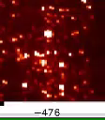
Bracket-gamma Data Cube

Slide 61
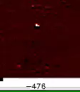
Stars Removed

Slide 62
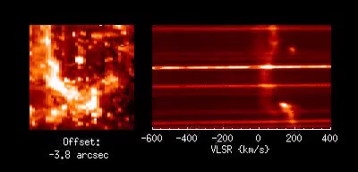
Data Cube Alternate View

Slide 63
conclusions

Slide 64
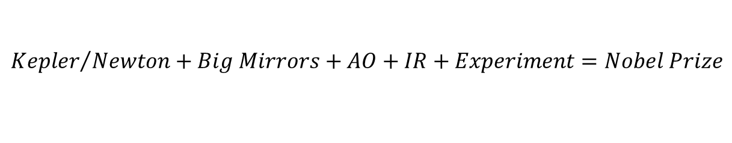
A Few Conclusions
It took 400 years after Kepler/Newton for the necessary technology to be developed.
There was no “Eureka” moment.
Many (100s) of people participated.
What new experiments can you do with technologies coming online?
No, we don’t know everything. What is dark matter, dark energy?
$${Kepler}/{Newton}+Big Mirrors+AO+IR+Experiment=Nobel Prize$$

Slide 65
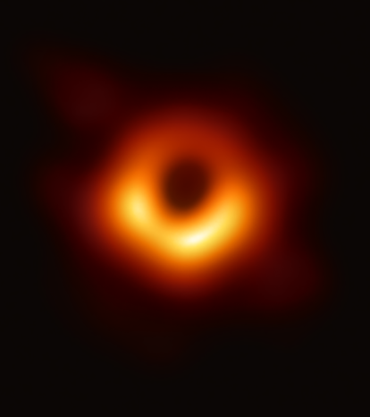
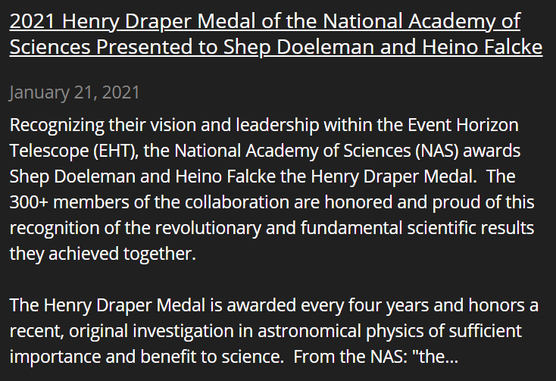
Why? Technology!

Slide 66
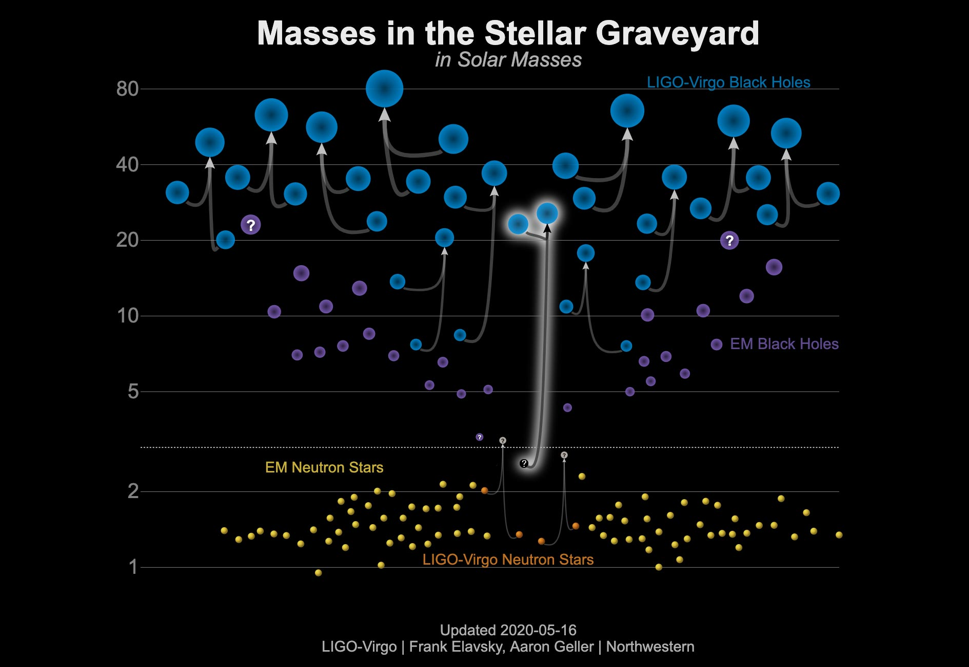
Why? Technology!

