Slide 1
Velocity distribution of NGC 205 from its optical spectrum
Alexander Rasskazov

Slide 2
Goals of the project
To determine the velocity distribution of a galaxy at different points using its spectrum
Observed
spectrum
Velocity distribution
to be found
Template spectrum
(spectrum of a single star assumed to be representative of the whole stellar population)

Slide 3
Goals of the project
To find σ(r), V(r) profiles from the velocity distribution at different points in the galaxy
If possible, to determine the central black hole mass

Slide 4
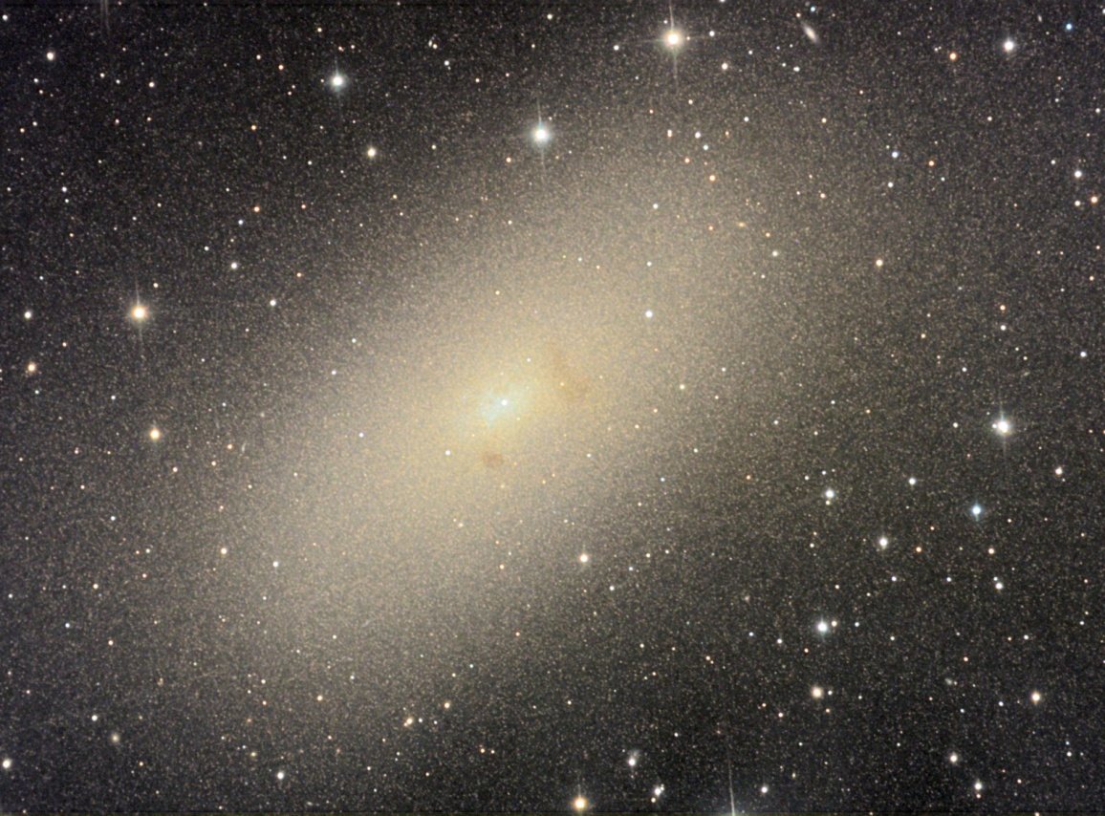
Data
Galaxy: NGC 205, dwarf elliptical companion of Andromeda

Slide 5
Data
Template star: HD115617, main-sequence G5 star
Instrument: HST’s Space Telescope Imaging Spectrograph (STIS), 52’’ x 0.1’’slit

Slide 6
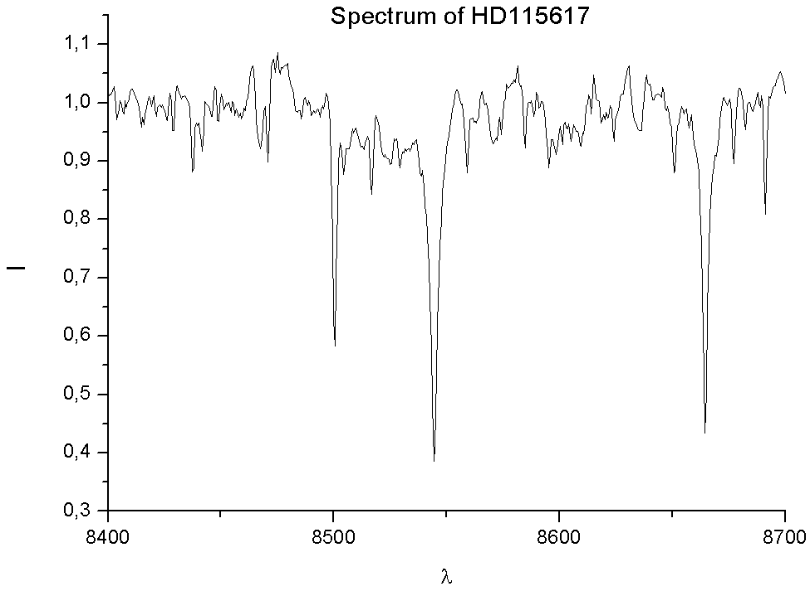
Spectral lines: Ca II absorption triplet (λ = 8498.06, 8542.14 and 8662.17 Å)

Slide 7
Hidden difficulties
There exists a wide class of problems where completely different theories can lead to very similar predictions in terms of measurable quantities
These problems are particularly abundant in astronomy due to remote-sensing nature of measurements (e. g., inevitable convolution along the line of sight)

Slide 8
Hidden difficulties
Convolution problems in astronomy:
  1) Instrumental response:
  Measurement = incident signal *
  * point-spread function
  2) Non-instrumental integral transform
  Measurement = initial signal * source response

Slide 9
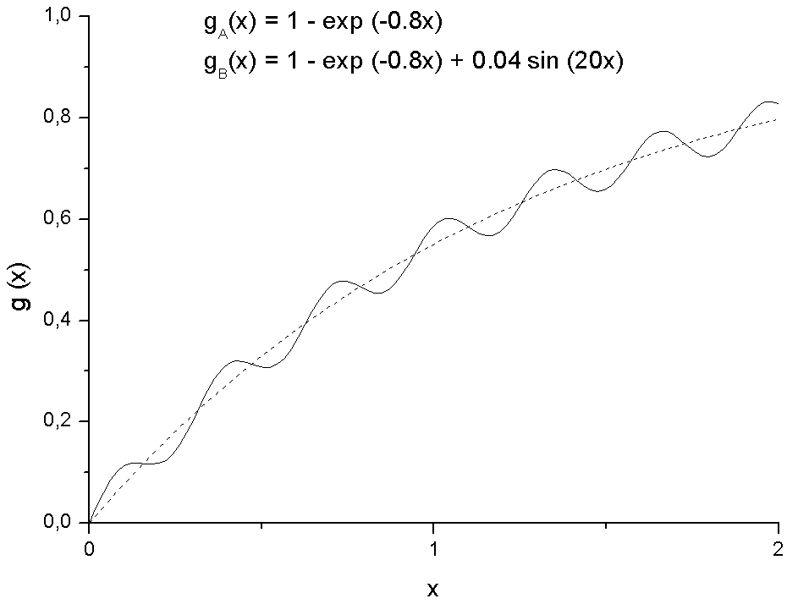
Hidden difficulties

Slide 10
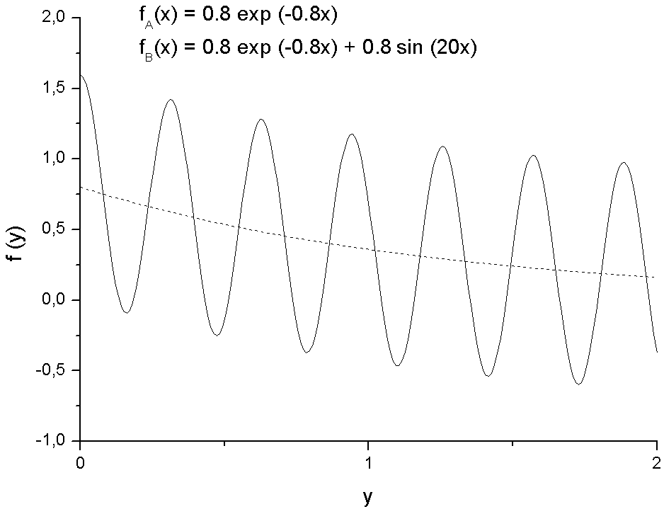
Hidden difficulties

Slide 11
Hidden difficulties
High-order harmonics are inevitably “quenched” by noise:

Slide 12
Hidden difficulties
Domain of f (y)
Domain of g(y)

Slide 13
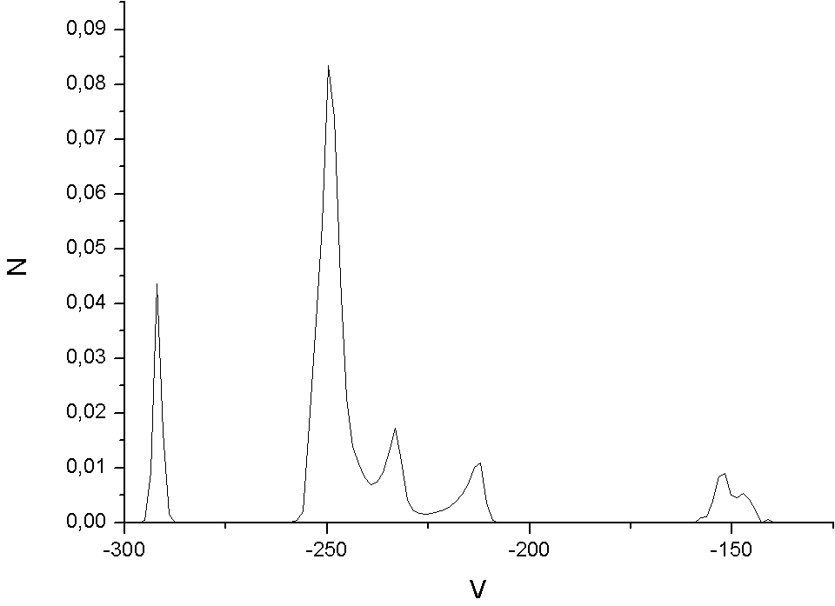
Hidden difficulties
Velocity distribution that provides the best-fitting spectrum fits all the noise in the observed spectrum

Slide 14
Different smoothing methods
Parametric form of N(V) (e. g., gaussian)
Series expansion of N(V):
Penalized likelihood method:

Slide 15
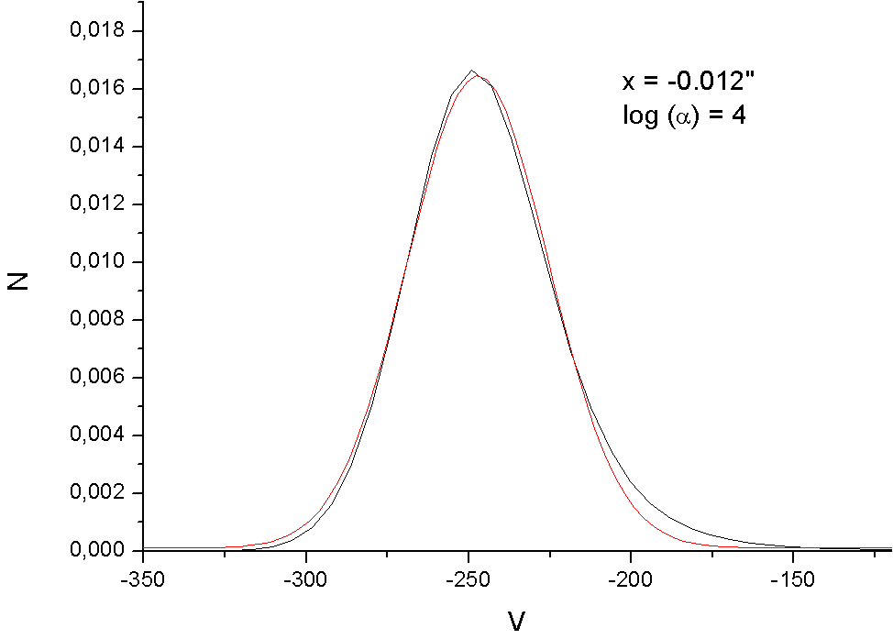
Results

Slide 16
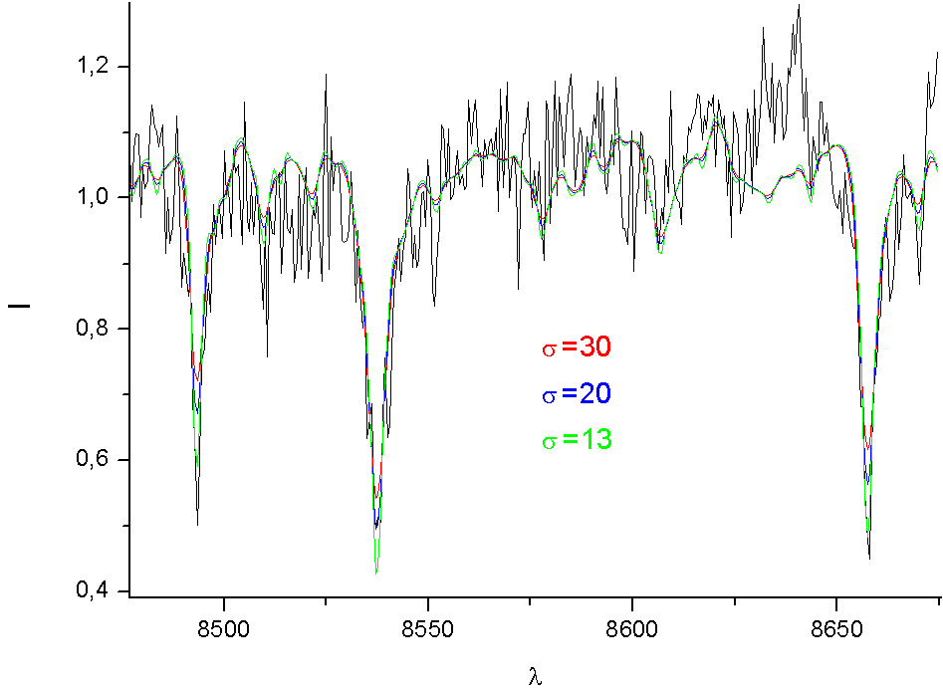
Results

Slide 17
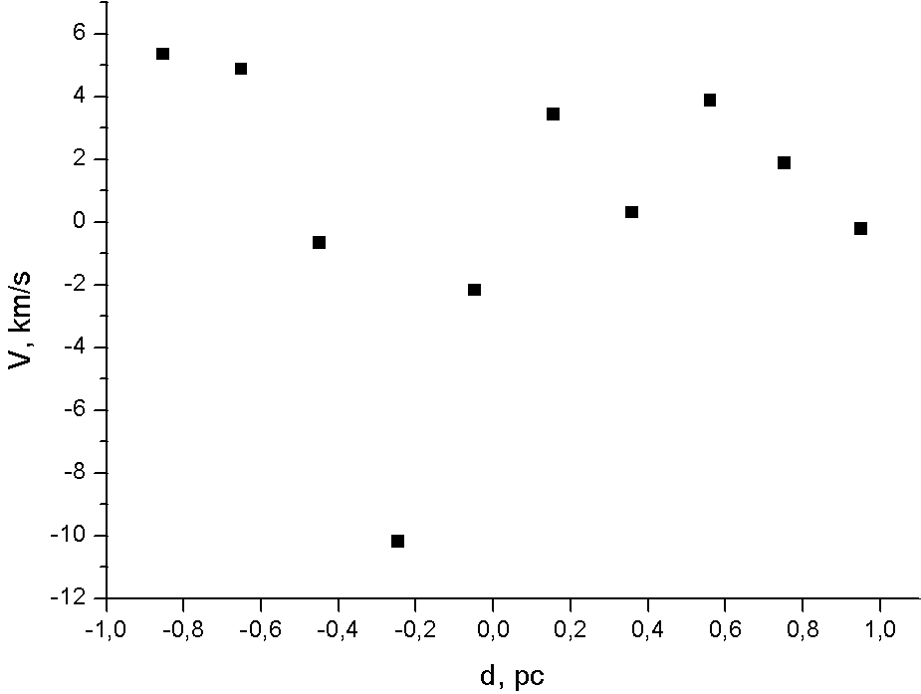
Results

Slide 18
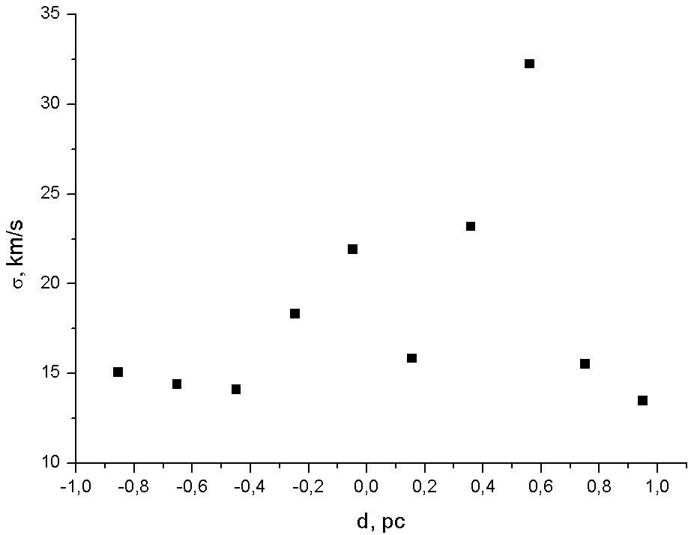
Results

Slide 19
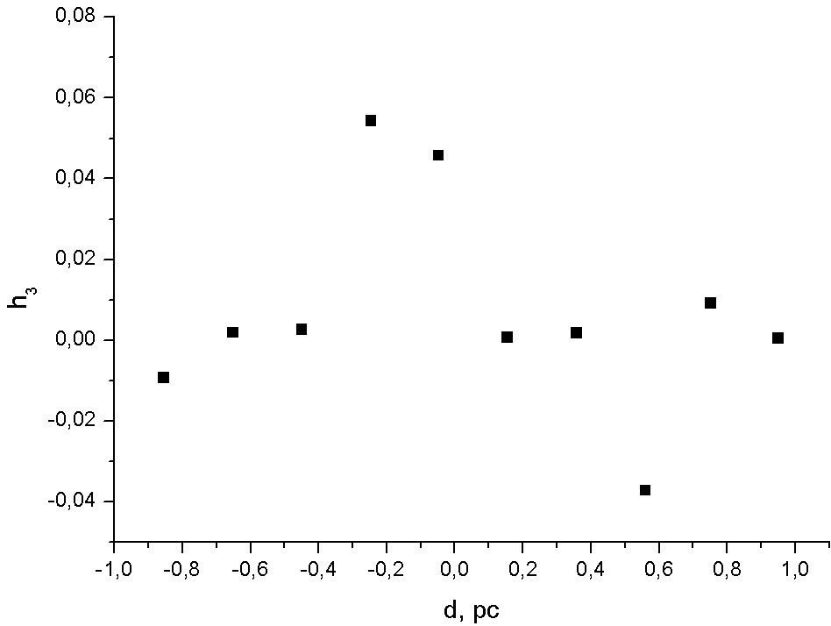
Results

Slide 20
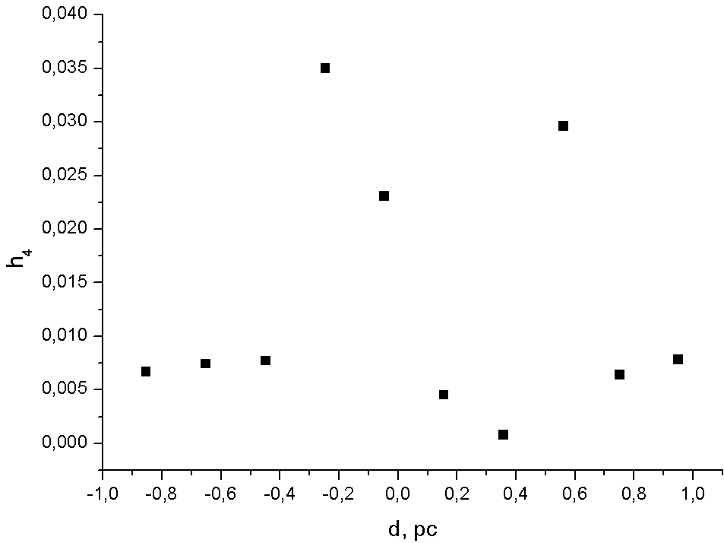
Results

Slide 21
Conclusions
Velocity dispersion profile suggests
Profiles of all the parameters seem to be rather unreliable, with possible errors being of the order of parameter value itself.

Slide 22
Conclusions
Possible sources of error:
  Fundamental difficulties of the deconvolution problem
  Template mismatch
  High noise level in galaxy spectrum

Slide 23
Thank you!

