Slide 1


Red Clump Distance Measurements
Andrew Lipnicky
Astronomy Observational Techniques and Instrumentation
May 9, 2013

Slide 2
Outline
Goals
Observations
Photometry
Color Magnitude Diagrams
Distances
Conclusions
Notes:
This slide gives the outline of the whole talk.

Slide 3
Goal
Answer the most fundamental question in Astronomy: “How far away is it?”
Use archival 2MASS data to make Color Magnitude Diagrams (CMDs) of star clusters and use the “Red Clump” method
Find the distance to Berkeley 29

Slide 4
Why Be 29?
Furthest open cluster in the Milky Way
Coincident with the Sagittarius Stream
Current distance calculations vary between ~10-15 kpc

Slide 5

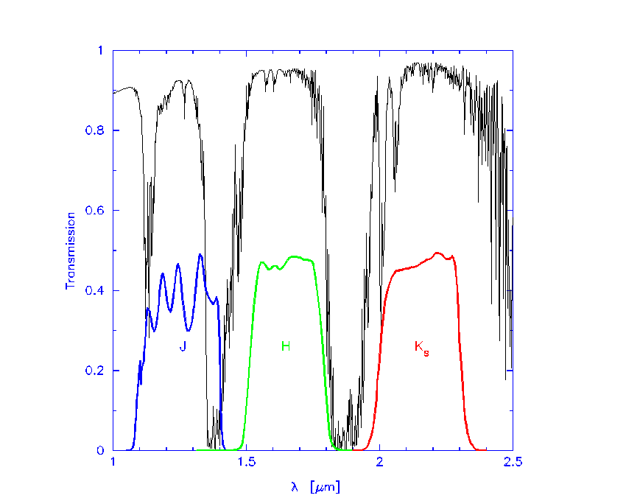
Observations
Two Micron All-Sky Survey
All sky map in J (1.3μm), H(1.6μm), K_{S}(2.2μm)

Slide 6
Feasibility
If d=15 kpc, RC at k=14.3
d=10 kpc, RC at k=13.4
Can observe red clump to k~14

Slide 7
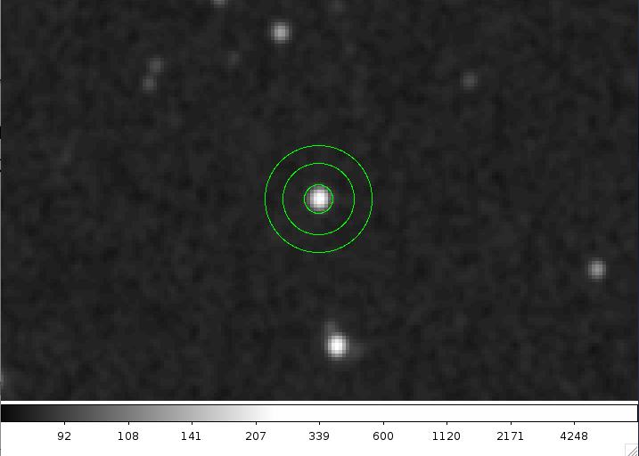
Photometry
Obtained reduced images of star clusters (IRSA)
Performed aperture photometry after finding each star

Slide 8
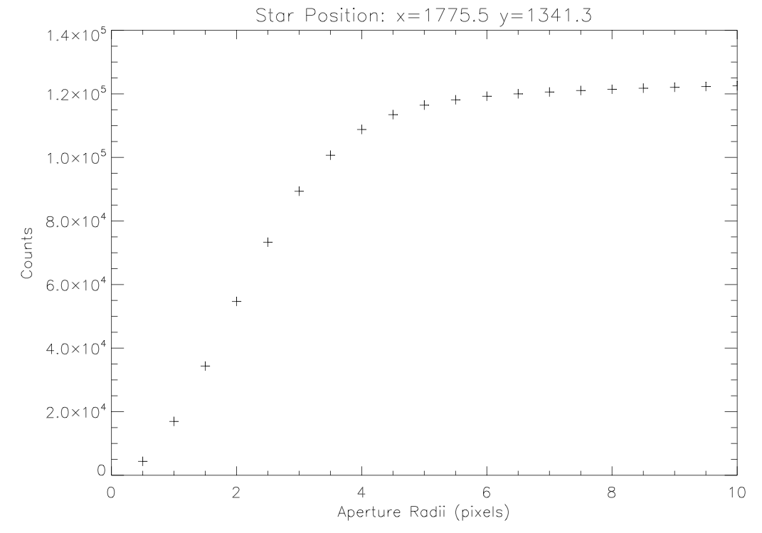
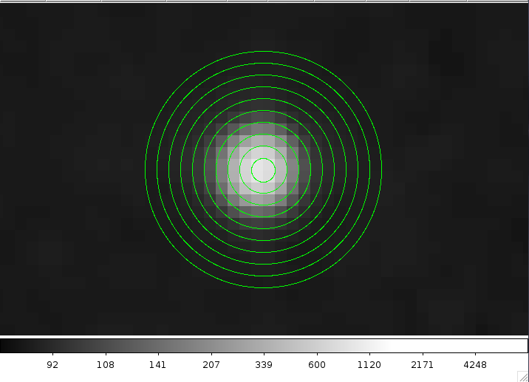
Photometry
Due to dense populations, an aperture correction was used

Slide 9
Red Clump Method
Red Giants in the Horizontal Branch on CMDs
Almost no dependence on metallicity and constant absolute magnitude
M_{K,RC}=-1.61±0.03 (Alves, D. R., 2000, ApJ, 539, 732)

Slide 10
List of Objects
M67
NGC 6791
M13
M30
Berkeley 29

Slide 11
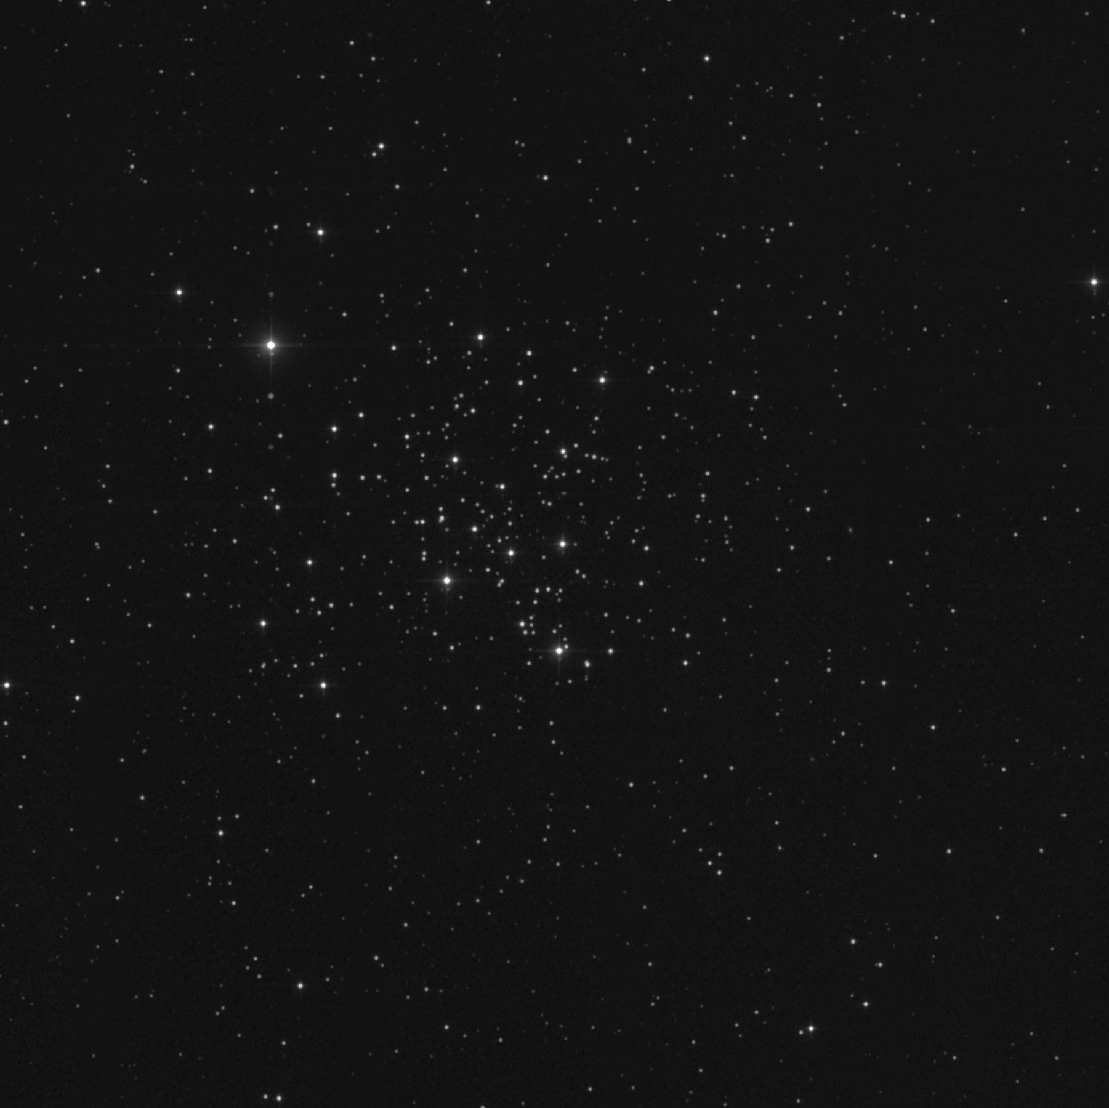
Observations
M67

Slide 12
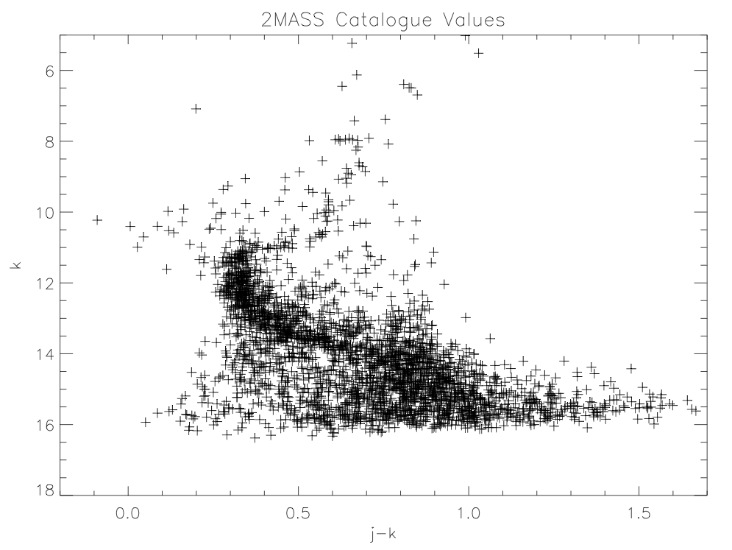
CMDs

Slide 13
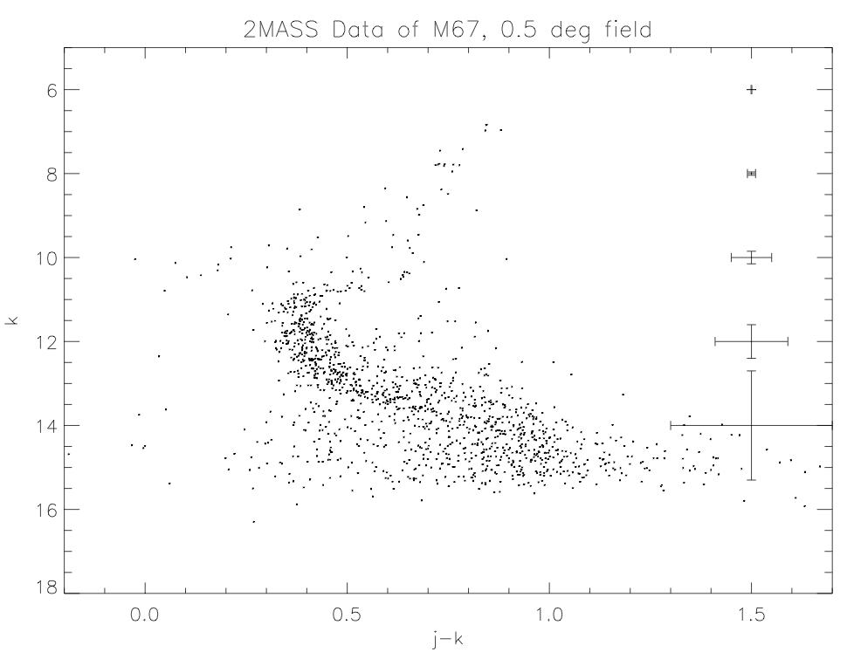
CMDs

Slide 14
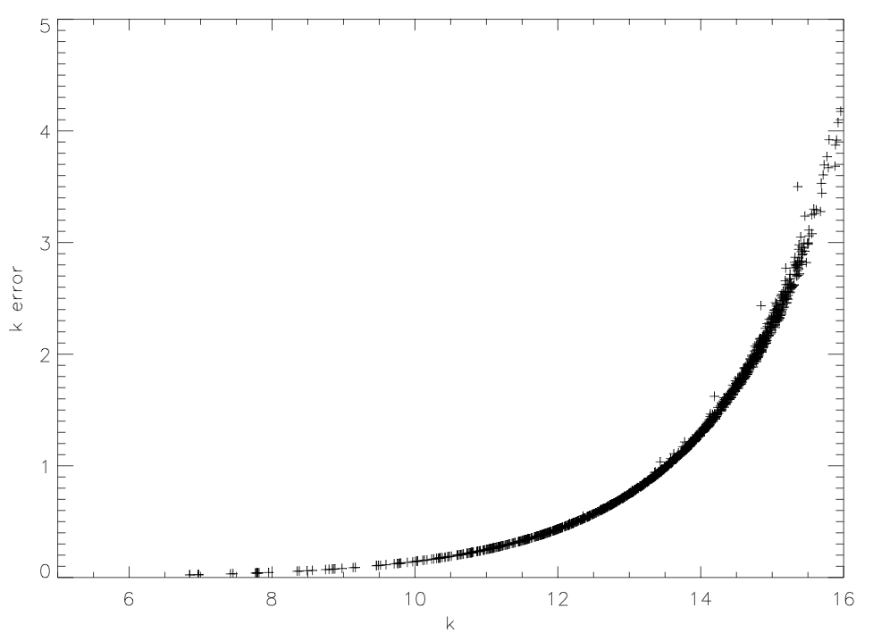
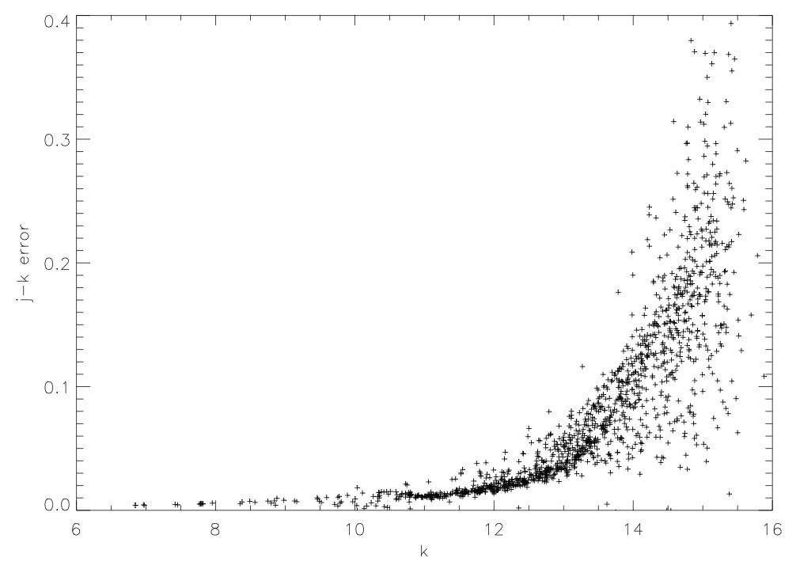
Errors

Slide 15
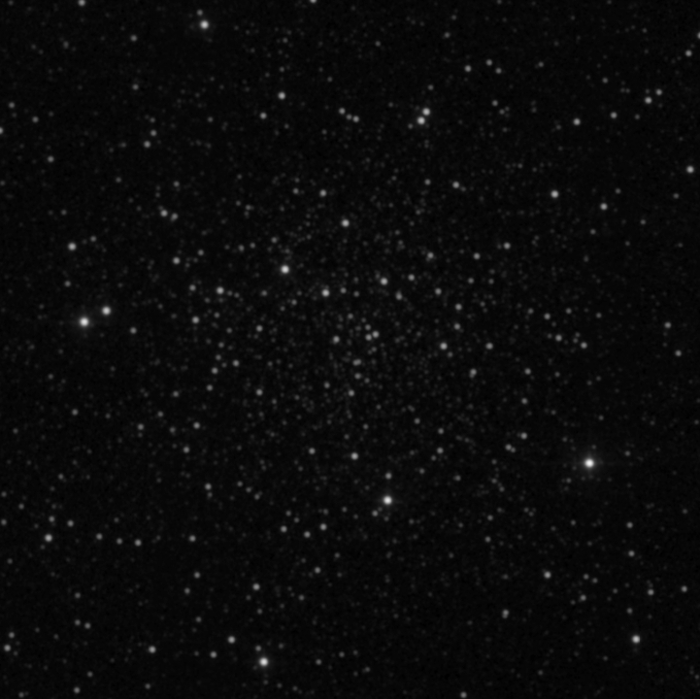
CMDs
-NGC 6791

Slide 16
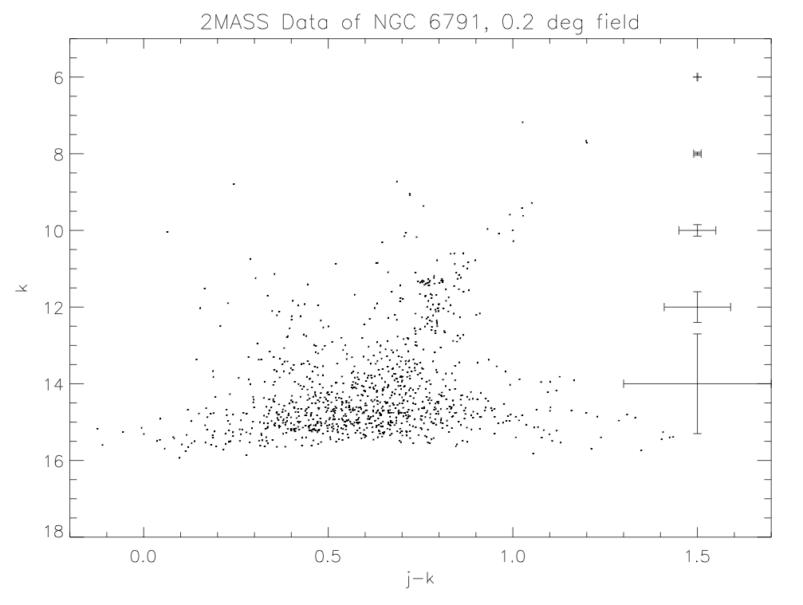
CMDs

Slide 17
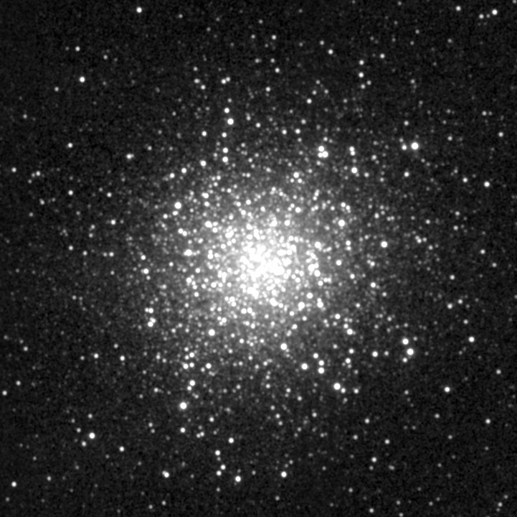
CMDs
-M 13

Slide 18
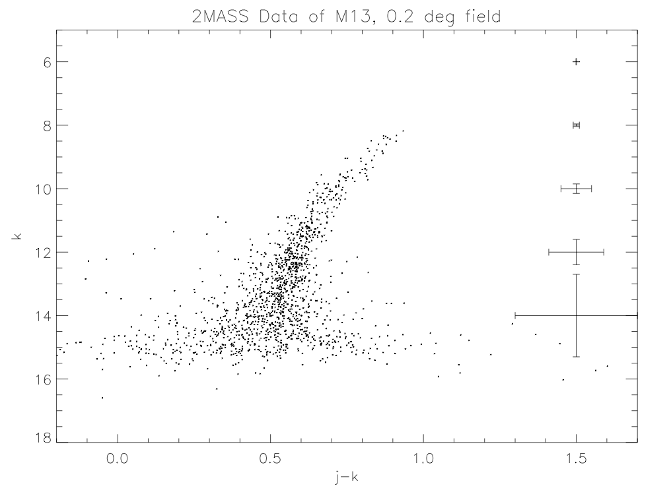
CMDs

Slide 19
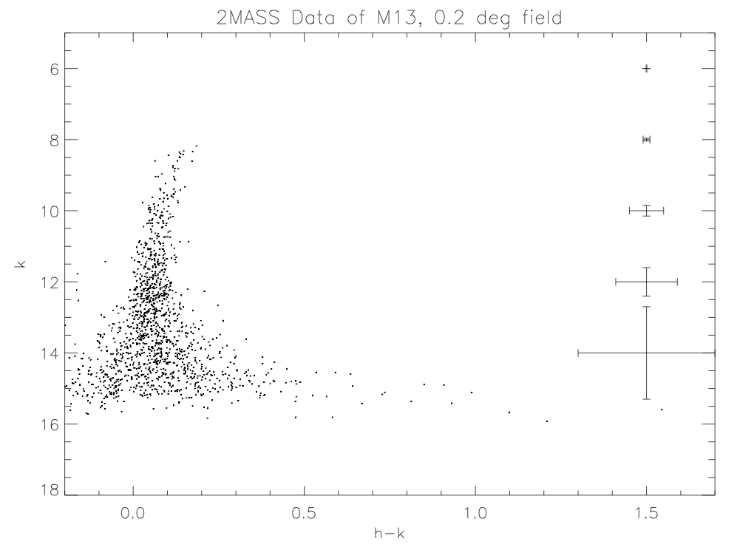
CMDs

Slide 20
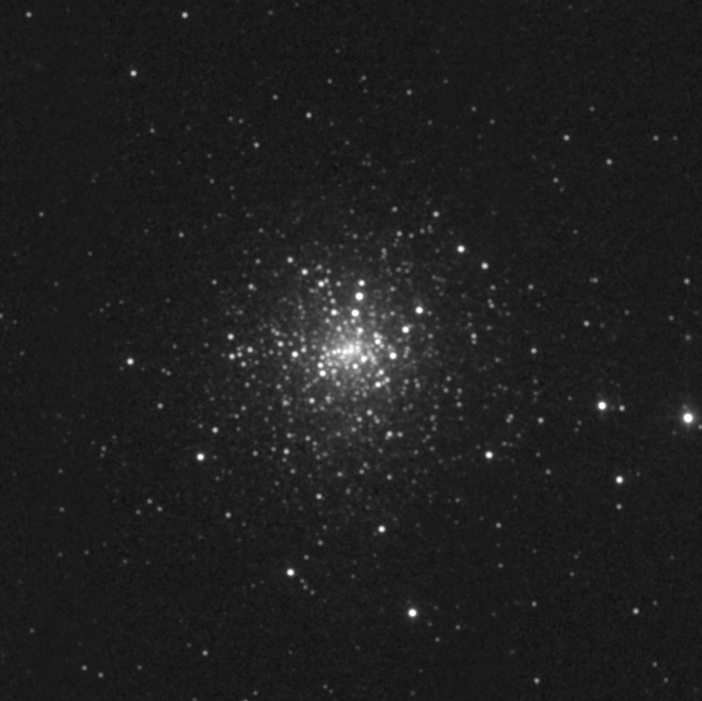
CMDs
-M 30

Slide 21
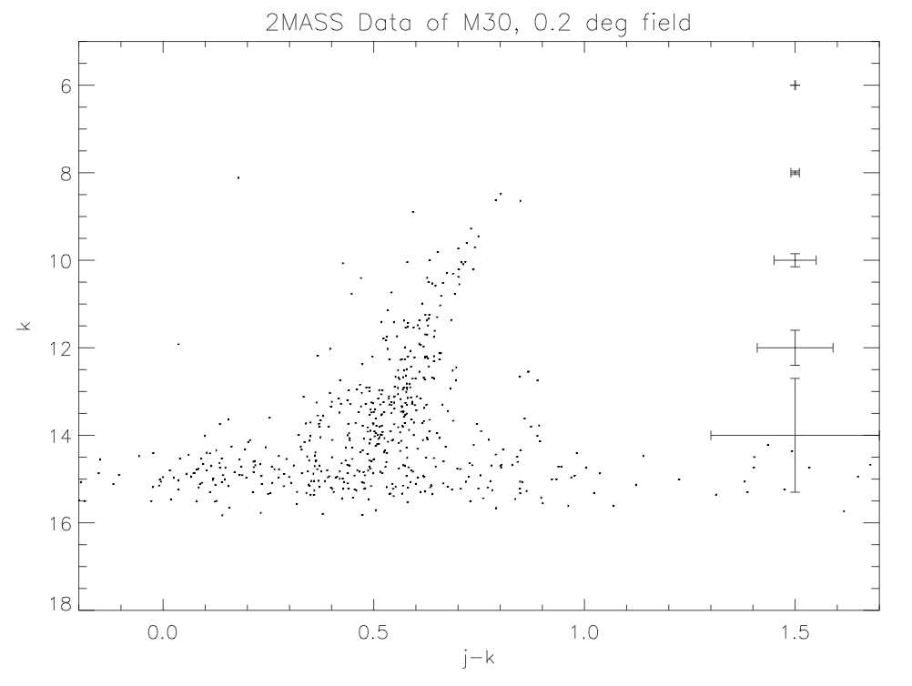
CMDs

Slide 22
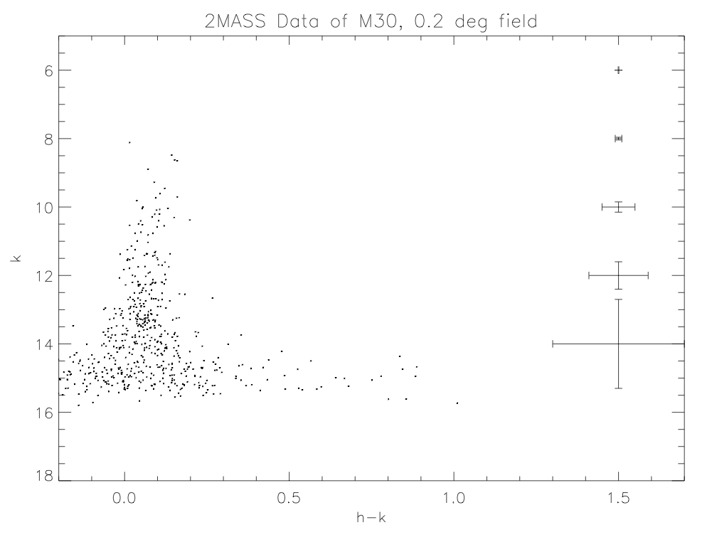
CMDs

Slide 23
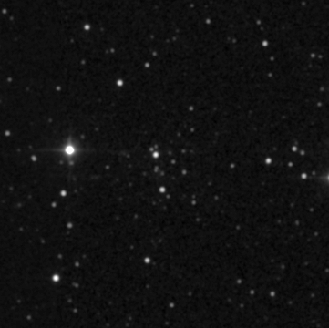
CMDs
-Be 29
±

Slide 24
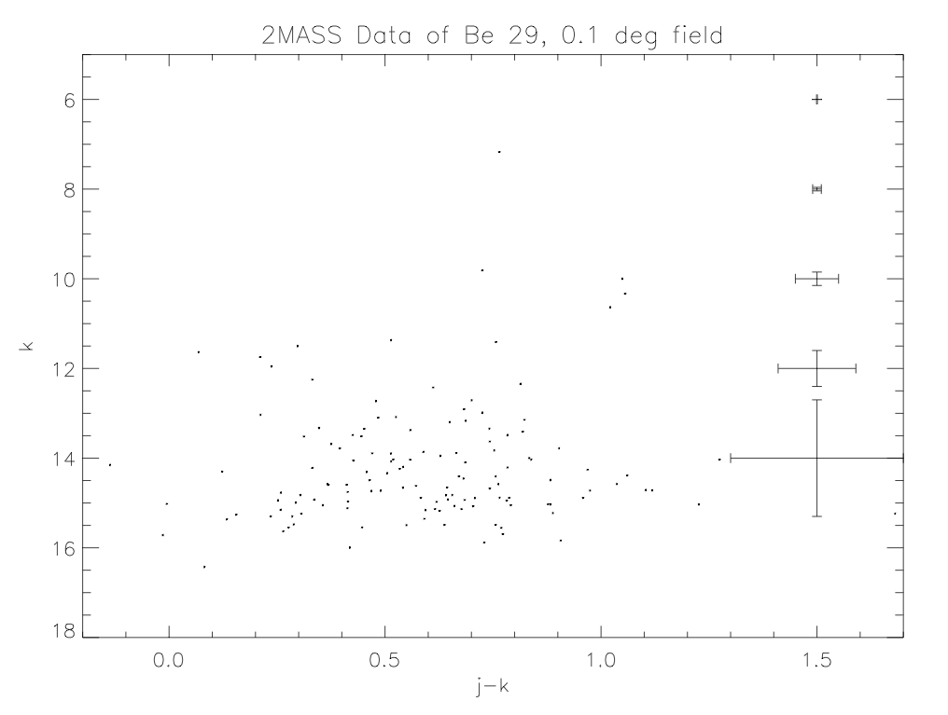
CMDs

Slide 25
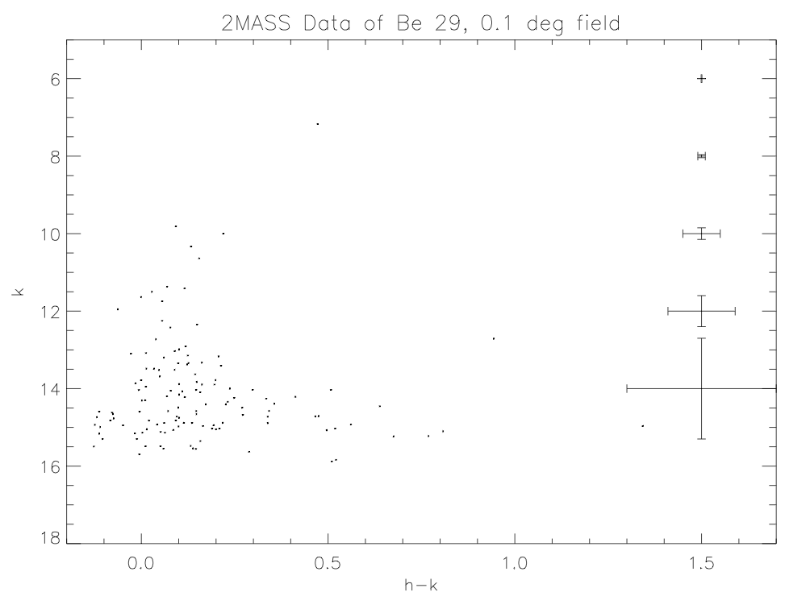
CMDs

Slide 26
Distances
-M67 RC at k=8.0 ± 0.04
Calculated: (k-M_{K})=9.61±0.05 => 830 ± 19 pc
Actual: (k-M_{K})=9.72±0.05 => 880 ± 20 pc (Sarajedini et al., 2009, ApJ, 698, 1872)
-NGC 6791 RC at k=11.5 ± 0.3
Calculated: (k-M_{K})=13.1±0.3 => 4.2 ± 0.6 kpc
Actual: (m-M)_{V}=13.42 => 4.8 kpc (Chaboyer et al. 1999, 117, 1360)
-M13 RC at k=12.5 ± 0.5
Calculated: (k-M_{K})=14.1±0.5 => 6.6 ± 1.7 kpc
Actual: 6.8 kpc (Paust et al. 2010, ApJ, 139, 476)
-M30 RC at k=13.25 ± 1.0
Calculated: (k-M_{K})=15.0±1.0 => 10 ± 6 kpc
Actual: 9.0 ± 0.5 kpc (Carretta et al. 2000, ApJ, 533, 215)

Slide 27
Distances
Object | Red Clump (k band) | Observed Distance (kpc) | Literature Distance
M67 | 8.0 | 0.83 ± 0.2 | 0.88 ± 0.2 ¹
NGC 6791 | 11.5 | 4.2 ± 0.6 | 4.8 ²
M13 | 12.5 | 6.6 ± 1.7 | 6.8 ³
M30 | 13.25 | 10 ± 6 | 9.0 ± 0.5 ⁴
Be 29 | Not Visible | - | ~13 ⁵
(1) Sarajedini et al., 2009, ApJ, 698, 1872, (2) Chaboyer et al. 1999, 117, 1360, (3) Paust et al. 2010, ApJ, 139, 476, (4) Carretta et al. 2000, ApJ, 533, 215, (5) Tosi et al. 2004, MNRAS, 354, 225

Slide 28
Distances
Be 29 too distant for 2MASS survey
Distance limit: d >10 kpc

Slide 29
Summary
Performed aperture photometry of 5 clusters
Successfully found distances to 4 clusters but goal cluster Be 29 was beyond 2MASS limit
In the future, isochrones could be fit to MS to find age and metallicity

Slide 30
(Suggestions)
Know your audience
Know what you want the audience to learn from your talk
Plan the talk
Start by defining sections and subsections
Don’t use: too many colors, animations, fonts
Face the audience at all times
Make eye contact with the audience now and then
Speak at a good pace, but not in monotone
Give credit and references
Highlight what is new
Double check for spelling
Use parallel construction
For plots
  say what the plot demonstrates
  describe the axes
  include a legend
  ensure that text is legible
  give references
  say why the plot makes the point
Take a short-course on technical presentation (or read a book)
Notes:
This slide provides the motivation for photon-counting detectors in low light applications.

