Slide 1
The sdss galaxies at redshift 0.1
What can we learn from the luminosity function
and color studies?

Slide 2
OUTline
Scientific Questions
SDSS
  Basic Information
My Data Set
Methods of Analysis
  Introduction to theory
  Practically how is it performed?
Results and Conclusions
Notes:
Scientific Questions: what can we learn from luminosity functions and colors etc
Sdss: What is sdss? What does it do? How can we use it?
Data set: describe what exactly my data is
Analysis: Brief overview to the theory of LF and a condense recipe to produce one. How I did fits etc
Results: What can we infer from the data

Slide 3
Scientific Questions
How does the galaxy luminosity function behave at redshift 0.1?
  How accurate does the Schechter function model the entire distribution?
Do galaxies have a clear split between red and blue?
  What can we learn from galaxy optical color plots?
    Can we infer information about the stellar populations?
Notes:
Is LF dominated by a particular feature or type of galaxy?
Schechter normally fits only bright end…can we fit entire function? What about selection effects?
Optical light is mostly star light

Slide 4
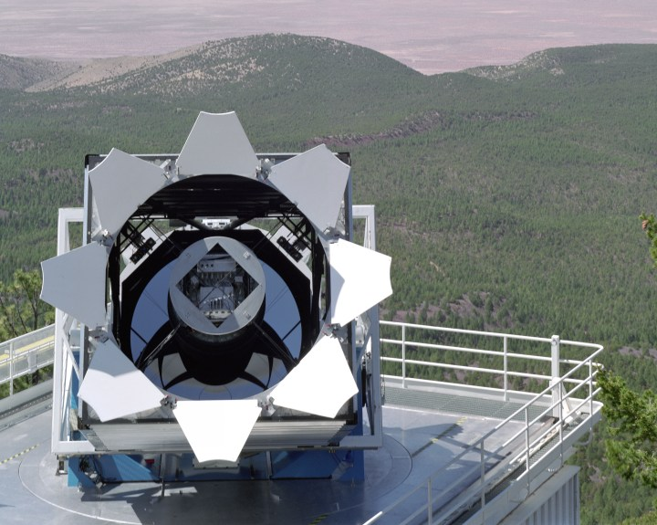
SDSS Instruments
2.5m Telescope at Apache Point Observatory, NM
120 Mpixel camera
  1.5 square degrees of sky in each shot
2 spectrographs fed by optical fibers can measure spectra of 600+ galaxies per observation
Covers the entire optical spectrum and parts of the NUV and NIR with 5 non-overlapping filters
DR8 contains images of over 500 million stars and galaxies with spectra of ~2 million
Data publicly available
http://www.sdss.org/
http://www.sdss.org/photos/00_509.72dpi.jpg
Notes:
Some “fun facts” about SDSS from their website

Slide 5
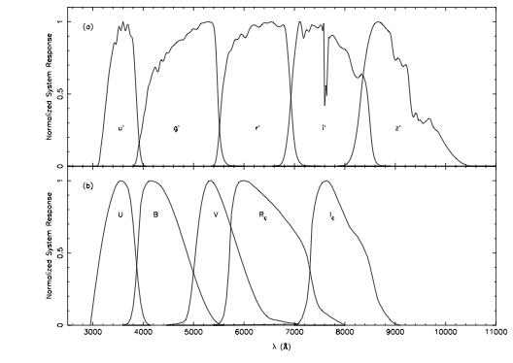
SDSS Filters compared to
Johnson-Morgan-Cousins
u’
peak 350 nm , width 60nm
g’
480nm width 140nm
r’
625nm width
i’
770nm width 150nm
z’
910nm width 120nm
The u’,g’,r’,I’,z’ Standard-Star System
Smith et al 2002
Notes:
The bands are intended to be similar to the UBV system
Improved performance in g over BV
Less overlap
----- Meeting Notes (5/9/13 10:03) -----
Dip in between u and g important for LF later

Slide 6
My Data Set
Obtained corrected PSF magnitudes from the SDSS Spec Photo database
  Used the first 10,000 galaxies between redshift 0.10 and 0.11
Spec Photo only contains magnitudes in the u’,g’,r’,i’ bands.
Spec Photo was selected over Galaxies for the ability to specify a small redshift band.
  Small redshift band avoids unusual results by studying potentially different galaxy systems at different Universe ages.
Notes:
Wanted redshifts to be in narrow population to tell about a given redshift. Avoid different galaxy sets of different redshifts.
In order to restrict redshift had to sacrifice the z’ band

Slide 7
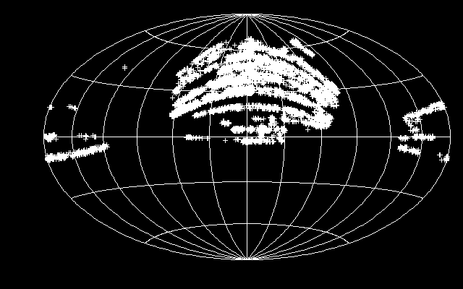
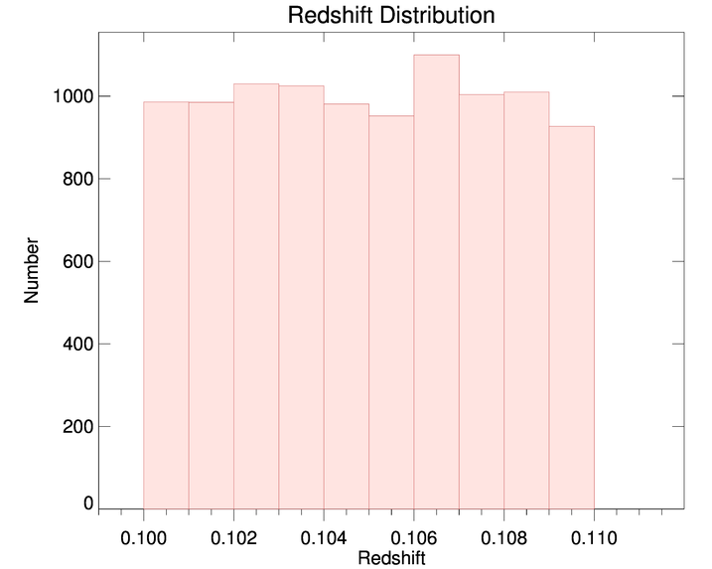
The Data set
Notes:
Note that most of the galaxies of the survey are otuside of the plane. (circle through points on edges and over points in middle)

Slide 8
The Schechter Luminosity function
An empirical relation for the number of galaxies between L and L + dL
Commonly recast into magnitudes to use with observed data
Phi star controls the Normalization
Alpha controls the slope in power law regime
Lstar and Mstar control the location of the bend
Notes:
Explain the parts of the function. What each does and how to transform from lum to mag using jacobian

Slide 9
Analysis
Need number density as a function of absolute magnitude for Schechter function
We can use Redshift to find the distance to the galaxies.
  Assume z << 1
    Note that 0.1 is at the limit of where this estimate is valid. Even at 0.13 large errors can be present. (See Introduction to Modern Astrophysics)
Combine the above to produce absolute magnitudes
Note that raw data would require corrections to the apparent magnitude
Additionally it is often beneficial to reduce one’s own data
Planck 2013 results. I. Overview of products and scientific results
arXiv:1303.5062
Notes:
Need absolute magnitude because apparent magnitude cannot be used to infer intrinsic properties….
Helps to remove selection effect
Explain rough nature of distance estimate (better estimates are highly dependent on cosmological parameters (omegas and hubble const))
The instrument pipelines are to be taken with a grain of salt

Slide 10
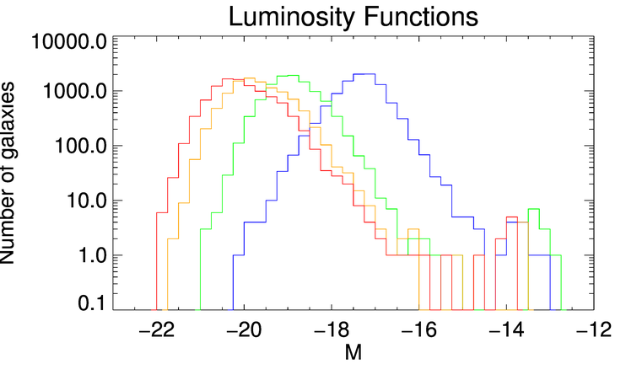
Producing the Luminosity Function
Read in apparent magnitudes
If not already corrected for extinction, evolution, K correct do so.
Convert apparent magnitude to absolute magnitude using the distance modulus.
Bin up the magnitudes
Plot the number in each bin against the magnitude bins
Note that redder bands are more luminous.
Notes:
Explain how to get LF
K correction tells how an observed band would actually be another shorter band instrinsicly due to redshift
Evolution corrects for change in system while light travelling
Extinction loss of light from dust (important in optical measurements…IR reprocessing)
Redder bands more luminous?

Slide 11
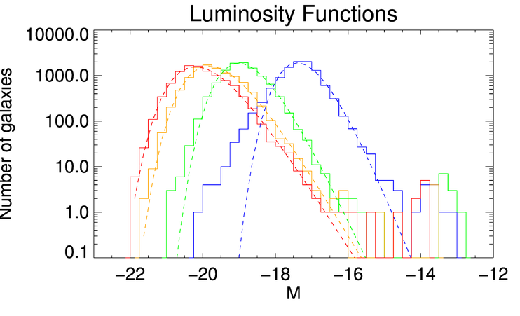
Fitting to the Schechter Function
When fitting the function need to be careful in how one attempts to fit.
Dim outliers can easily through off a fit.
The u band appears to be poorly fit
Band | Phistar | alpha | Mstar
u | 85.881346 | 4.0909369 | -15.630381
g | 256.55132 | 3.3632489 | -17.408042
r | 870.11282 | 2.3562895 | -18.517338
i | 1066.0481 | 2.1568930 | -18.958874
The fits were made using Anthony Smith’s IDL routines
Notes:
The whole fit.
Talk about u poor fitting
Talk about dim bumps to right throwing off fits and issues with that
Explain visually how each of the parameters controls the fit curve
How does the error look?

Slide 12
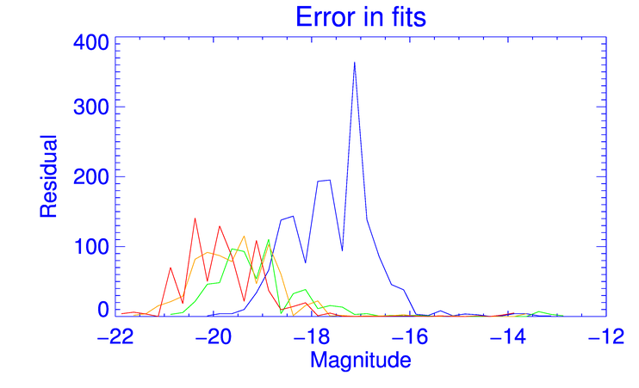
Quality of the Fit
The residual is the absolute value of the difference between the value computed in the histogram and the fitted function.
Better fits for longer wavelengths.
Notes:
Show the poor fit of U
Peak in residual is nearest peaks in the curve (obvious as values are larger easier to have large diff)

Slide 13
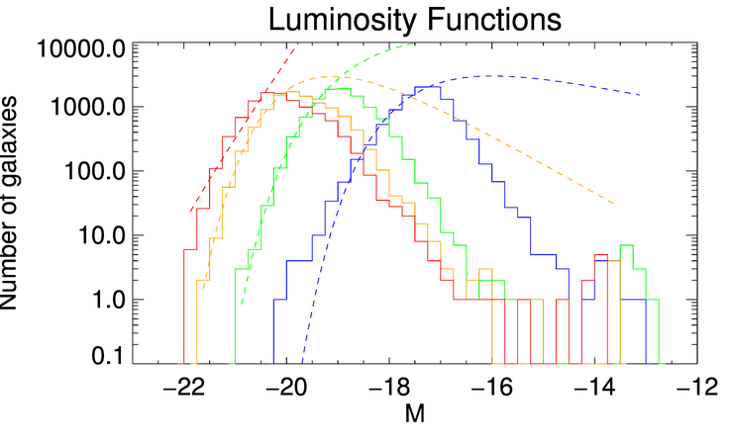
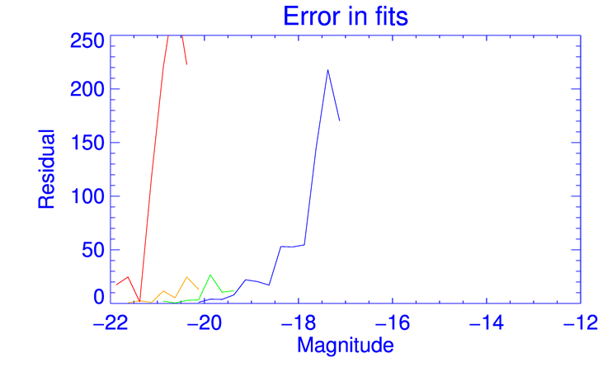
Fitting only the bright end of the curve
These values can be compared more directly with literature sources which typically only fit to the bright end.
However, this function can wildly over estimate the number of dim galaxies
Band | Nstar | Mstar | alpha
u | 4.16 | -17.79 | -1.01
g | 1.40 | -19.53 | -1.1
r | 0.90 | -20.73 | -1.23
i | 1.09 | -20.97 | -1.16
band | Mstar | alpha | Nstar
u | -17.001823 | -0.60343009 | 6997.4038
g | -18.390041 | -0.97937758 | 16826.371
r | -18.988563 | 0.122265854 | 8683.5567
i | -22.526628 | -3.8784816 | 7.7910135
arXiv:0806.4930v1
Notes:
Literature usually fits bright end. How does this perform?
Compare my fits to a reference source.
Over predicts the dim galaxies
How do 2 forms match up in error?

Slide 14
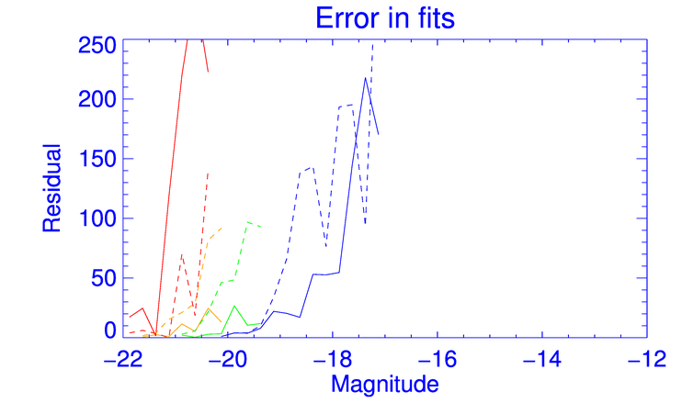
Error in different fitting methods
Dashed lines are fits to full function
Solid lines fit only to bright tail
With the exception of r band this appears to be a better for to the bright tail of the LF
However, the partial fits fail entirely to fit the dim portion.
Notes:
Dashed full
Solid half
Half is better fit for the bright portion but can tell you nothing about the dim portion.
Now we know about LF, what about the galaxy colors?

Slide 15
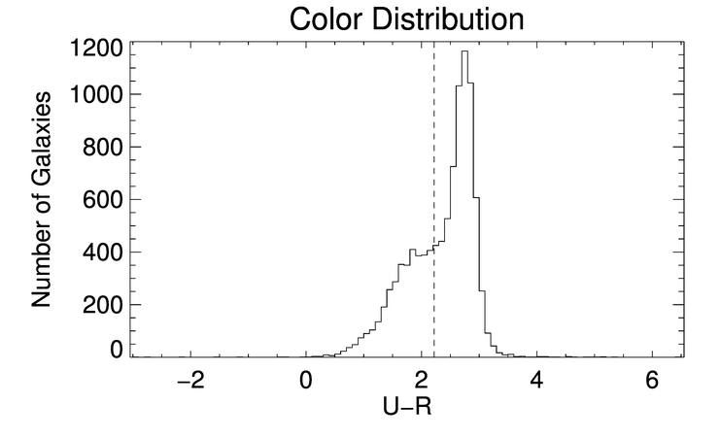
Galaxies have color
Sample color U-R is dominated by a large peak between 2.4 and 2.6
Smaller feature to the left of this in the plateau around 1.9
Some sources claim a split between red and blue galaxies occurs at U-R of 2.22
  arXiv:0806.4930v1
  Strateva et al 2001
    APJ,122:1861-1874 Oct
Notes:
Selected the two furthest bands so large scale color change would be most apparent.
Explain literature claim of 2.2 as split. Is this valid? Does data set really portay a bimodal set?

Slide 16
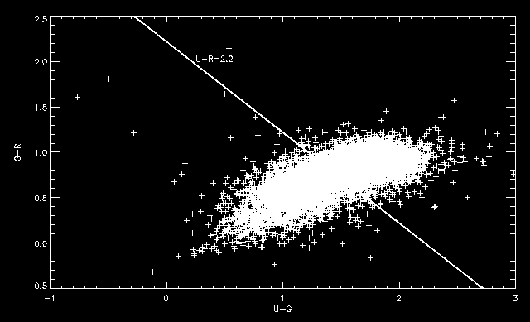
Color-Color plot
The galaxy sample appears to be bimodal in our definition of blue versus red
Left of the line is blue
  3656
Right of the line is red
  6331
The blue side is shifted towards the red.
Therefore, the light appears to be predominantly red.
Red galaxies are less diverse than the blue
Notes:
Discuss the deceptive nature of this plot. Looks like more blue than red because of diversity.
Also, notice blue things are still redder than they are blue

Slide 17
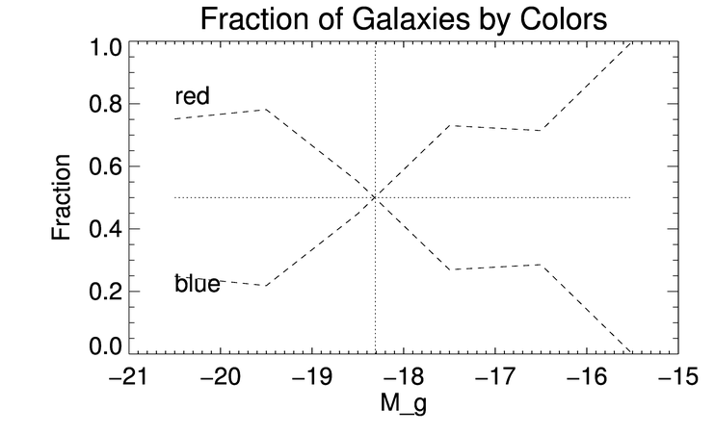
Quantitative measure of Redness as a function of magnitude
The galaxies are evenly split between red and blue at magnitude -18.3 in the g band
At -15.5 there are no longer any red galaxies
Dim magnitudes are dominated by blue galaxies while bright ones by red galaxies
Blue galaxies are typically smaller than ellipticals (Spirals merge to form ellipticals)
Blue stars (O,B) are rare thus, spirals dimmer
Notes:
Why can we not have bright blue( too small)
Why no bright red (too large)
mergers

Slide 18
Conclusions
The Schechter function can be used to fit the LF either fully or in part. However, the choice in fitting method can drastically change the functional form of the fit.
  By fitting only the bright tail one the function produces a fit that predicts infinite galaxies.
The redder portions of galaxies tend to be more luminous
  Elliptical galaxies typically large
  Spirals are typically smaller than Ellipticals

