Slide 1

Determining the size of the Dusty Torus in NGC 6418
Triana Almeyda
Observational Techniques
May 9, 2013

Slide 2
Outline
Introduction/Motivation for Talk
  Goal: To observe the time lag predicted by reverberation mapping from the torus of NGC 6418
  Background on reverberation mapping
Data/Observations
Analysis
Results
Conclusions
Future Work

Slide 3
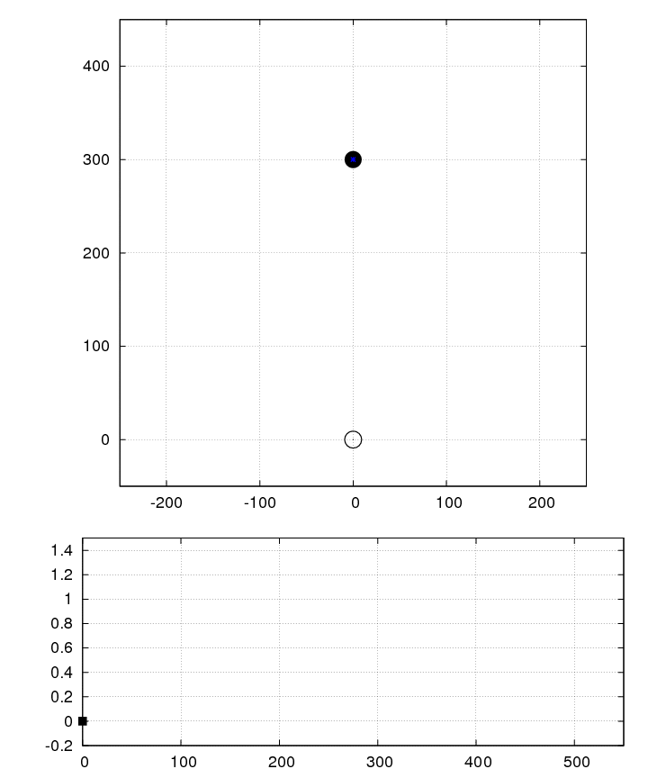

Reverberation Mapping
Credit: Michael Richmond

Slide 4
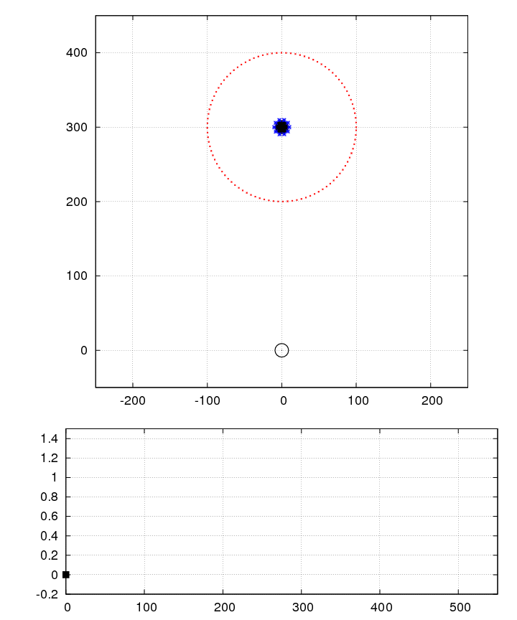

Reverberation Mapping continued
Credit: Michael Richmond

Slide 5
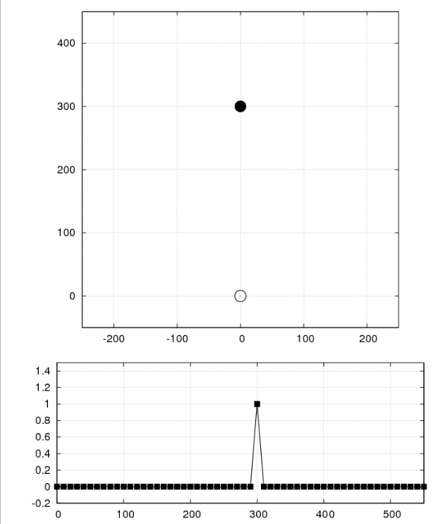
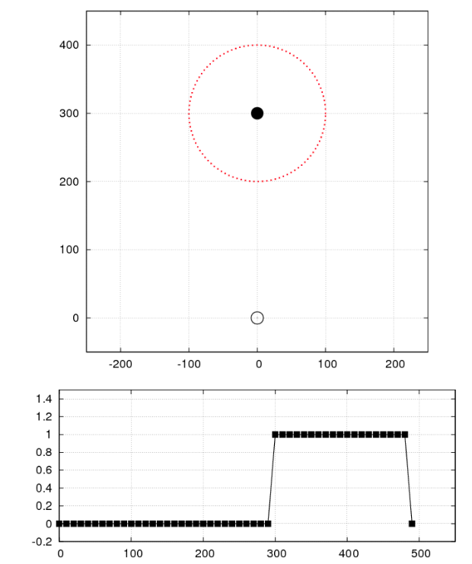
Reverberation Mapping continued
Credit: Michael Richmond

Slide 6
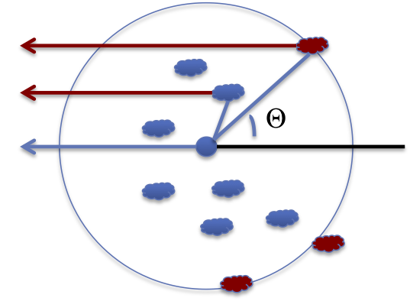
Reverberation Mapping continued
τ=(1-cosθ)r/c
For simplicity:
  Assume non-clumpy torus but a thin ring of dust
  Will use τ=r/c, to solve for the radius of the torus.
Credit: Billy Vazquez

Slide 7
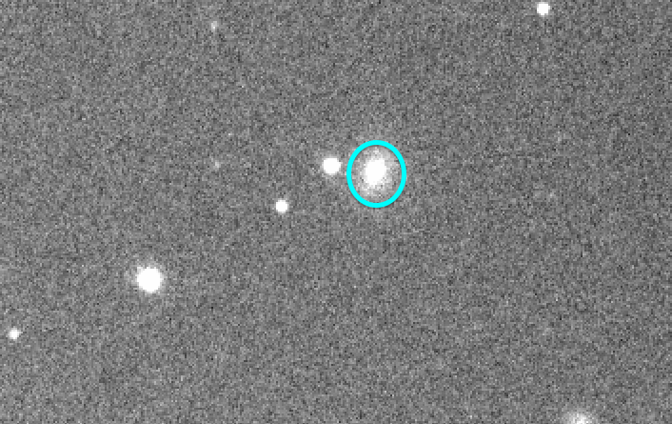
NGC 6418
Notes:
Seyfert 1
Z=0.029
About 119Mpc away

Slide 8
Data/Observations
Optical (B band)
  Liverpool Telescope (2.0m)
    Previously calibrated
  Southwestern (0.41m)
    Previously calibrated
Infrared
  Spitzer Space Telescope (0.85m)
    Channel 1 and Channel 2 (3.6 and 4.5 microns respectively)
    Used Post-BCD

Slide 9
Analysis
Make light curves
Determine time lag centroid and its error
  Run flux redistribution code
    Interpolates the optical data to Spitzer data
    Uses Monte Carlo technique to determine the mean magnitude at each time lag
    Calculates linear correlation factor
Make cross correlation plot
  Determine the centroid time lag

Slide 10
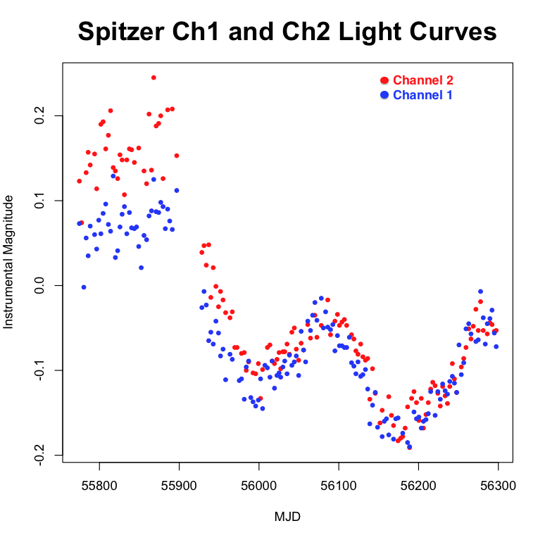
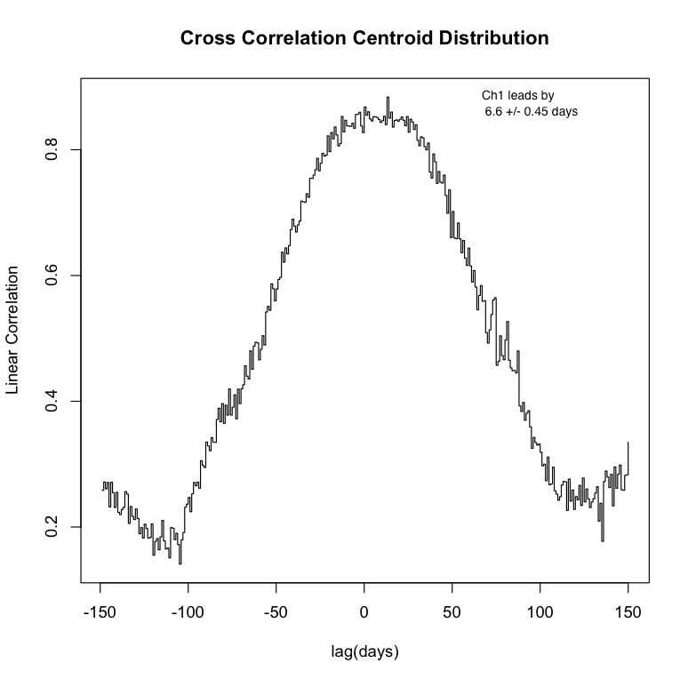
Results

Slide 11
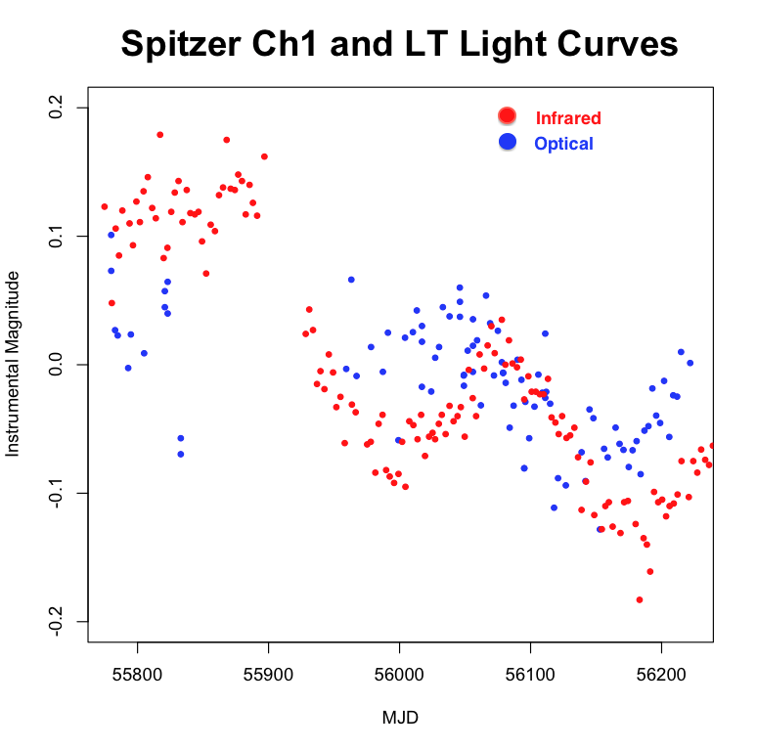
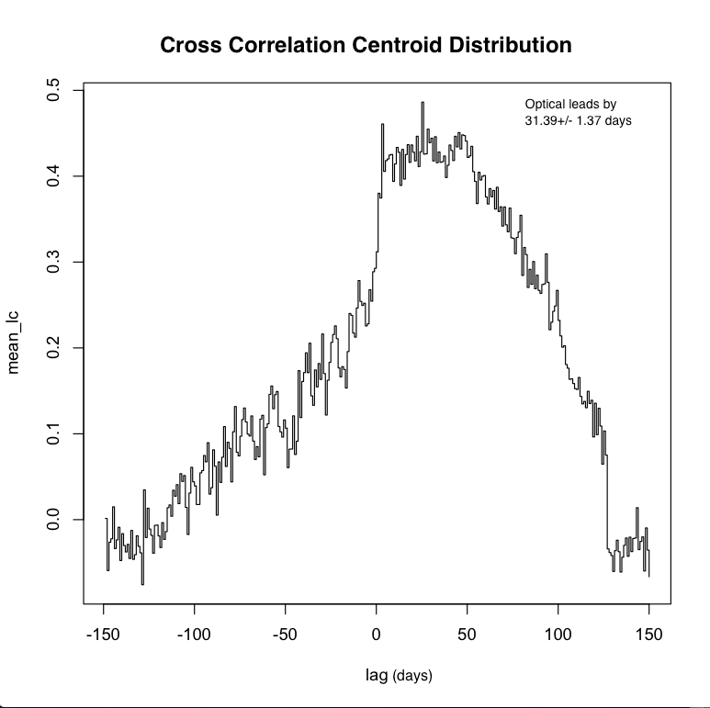
Results

Slide 12
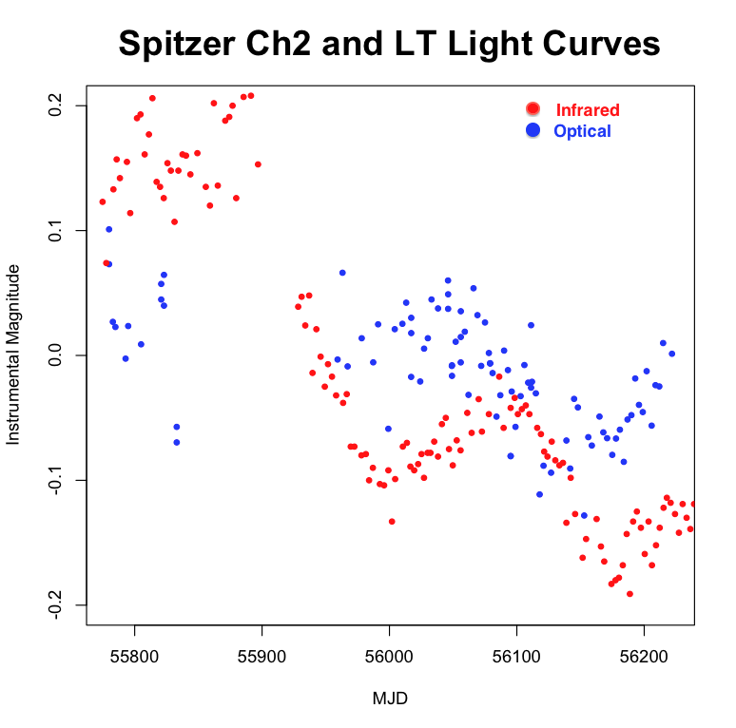
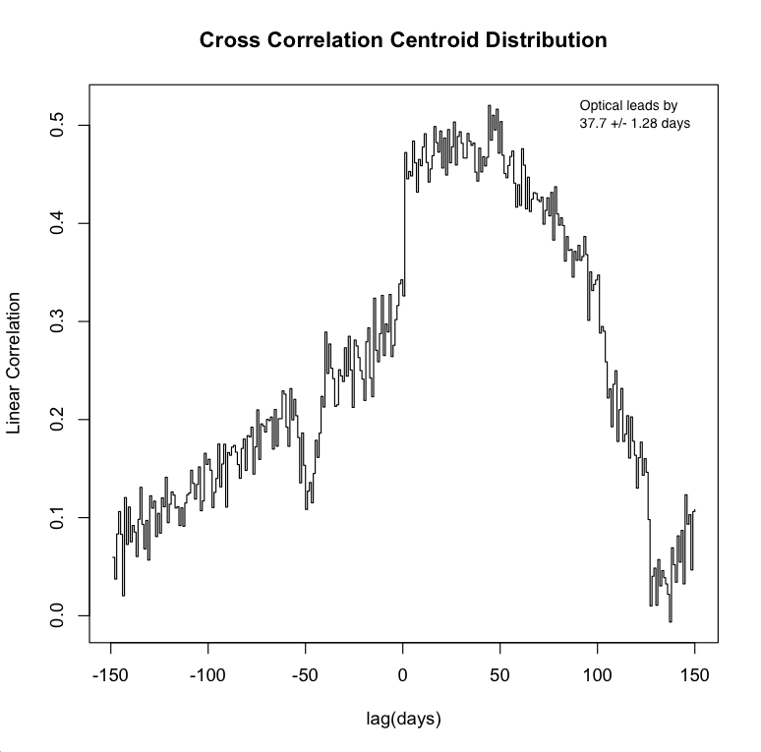
Results

Slide 13
Conclusions
Time lag between Spitzer Ch1 and Ch2 data 6.6 +/- 0.45 days and Δr=0.0055 +/- 0.0004 pc.
  Consistent with determined value from Twadelle et al. 2012 of 8.2 +/- 7.3 days and Δr=0.007 +/- 0.006 pc.
Time lag between Spitzer Ch1 and Liverpool
  31.4+/- 1.37 days, r=0.026 +/- 0.0012 pc
Time lag between Spitzer Ch2 and Liverpool
  37.7 +/- 1.28 days, r=0.032 +/- 0.0011 pc

Slide 14
Future Work
Obtain better optical data
Run longer simulations
Redo analysis for Southwestern data
Apply same analysis to already obtained datasets of other AGN

