Slide 1
Design Considerations for Directly Imaging Earth-like Exoplanets
Garreth Ruane
gjr8334@rit.edu
Chester F. Carlson Center for Imaging Science
Rochester Institute of Technology

Slide 2
Question: What telescope specifications are necessary to directly image and characterize planets in the “habitable zone” of nearby stars?

Slide 3
Outline
Introduction
Exoplanetary Science
Short history of direct imaging
High-contrast imaging technology
Candidate stars
Hipparcos
Design specification
Conclusions

Slide 4
Exoplanetary Science
Detections
Methods
770 confirmed
More than 2300 candidates
Radial velocities
Planetary transits
Transit timing variation
Gravitational microlensing
Astrometry
Pulsar timing
Features in circumstellar disks
Direct imaging
Missions
Current
MOST (Canada)
COROT (France)
Kepler (NASA)
Under Development
Gaia (ESA)
JWST (NASA)

Slide 5
History of Direct imaging

Slide 6
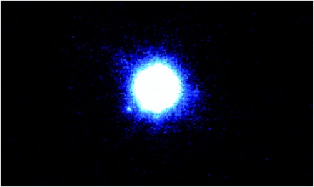
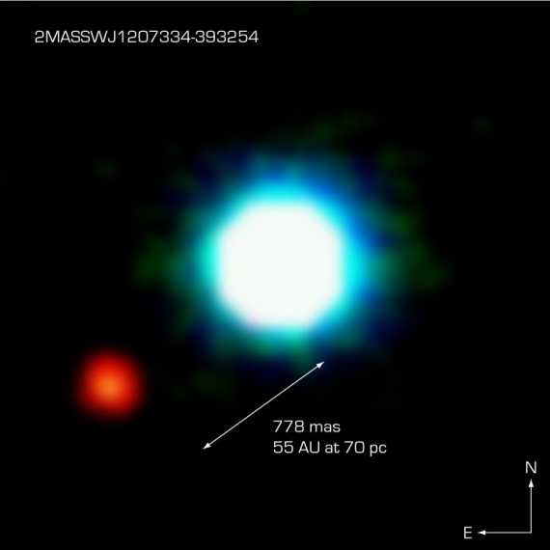
History of Direct Imaging
2004: First direct image, 2M1207b
27 planetary systems have been imaged since 2004.
VLT NACO (8 m) J-band image of 2M1207 [Mohanty et. al. 2006]
VLT NACO (8 m) NIR image of 2M1207 [ESO]
Notes:
This composite image shows an exoplanet (the red spot on the lower left), orbiting the brown dwarf 2M1207 (centre). 2M1207b is the first exoplanet directly imaged and the first discovered orbiting a brown dwarf. It was imaged the first time by the VLT in 2004. Its planetary identity and characteristics were confirmed after one year of observations in 2005. 2M1207b is a Jupiter-like planet, 5 times more massive than Jupiter. It orbits the brown dwarf at a distance 55 times larger than the Earth to the Sun, nearly twice as far as Neptune is from the Sun. The system 2M1207 lies at a distance of 230 light-years, in the constellation of Hydra. The photo is based on three near-infrared exposures (in the H, K and L wavebands) with the NACO adaptive-optics facility at the 8.2-m VLT Yepun telescope at the ESO Paranal Observatory.

Slide 7
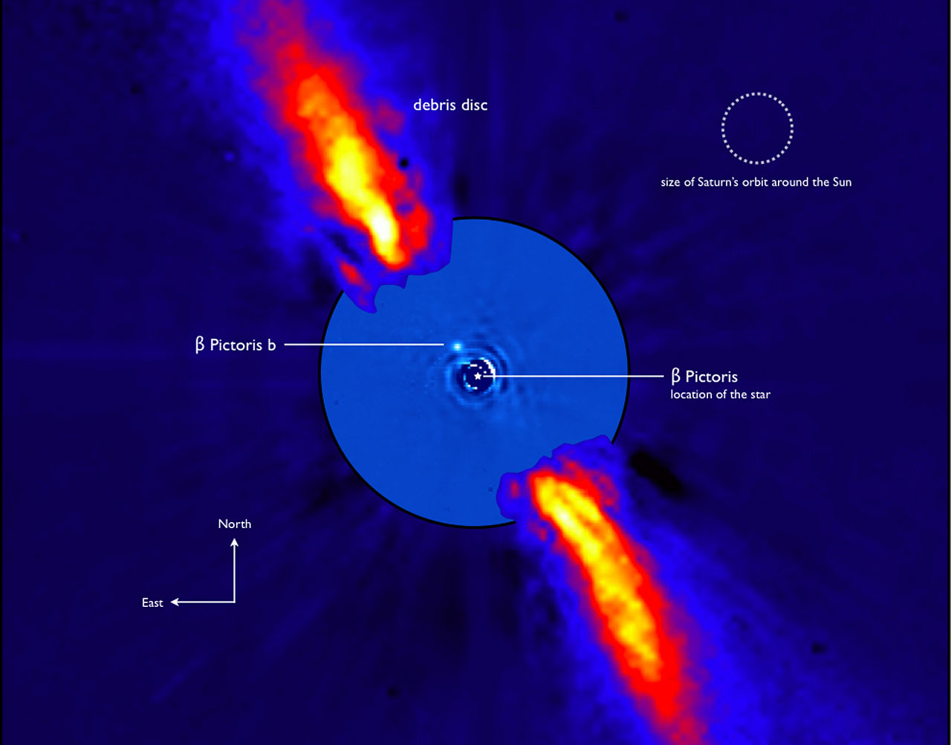
Beta Pictoris b (2008)
[ESO/A.-M. Lagrange et al. 2009]
Notes:
This composite image represents the close environment of Beta Pictoris as seen in near infrared light. This very faint environment is revealed after a very careful subtraction of the much brighter stellar halo. The outer part of the image shows the reflected light on the dust disc, as observed in 1996 with the ADONIS instrument on ESO's 3.6 m telescope; the inner part is the innermost part of the system, as seen at 3.6 microns with NACO on the Very Large Telescope. The newly detected source is more than 1000 times fainter than Beta Pictoris, aligned with the disc, at a projected distance of 8 times the Earth-Sun distance. Both parts of the image were obtained on ESO telescopes equipped with adaptive optics.

Slide 8
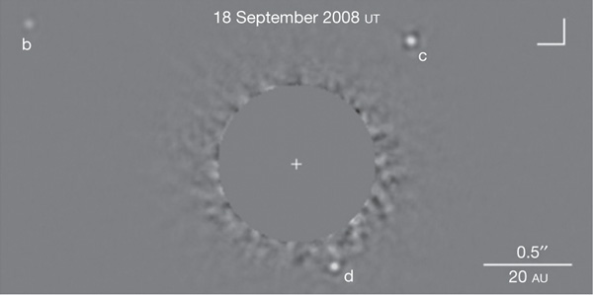
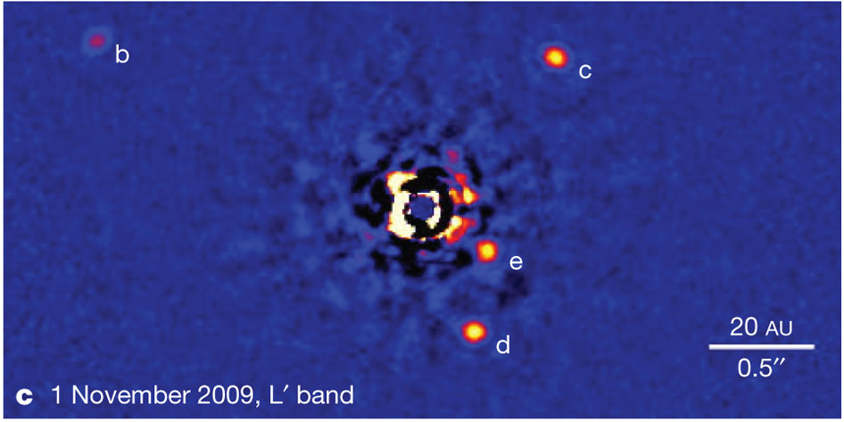
HR 8799 (2008/2010)
Keck K_{s}-band image of HR 8799 [Marois et. al. 2008]
Keck L’-band image of HR 8799 [Marois et. al. 2010]
Notes:
K-band 2 to 2.4 (coronagraph)
L-band 3-4microns (Angular Differential Imaging technique)

Slide 9
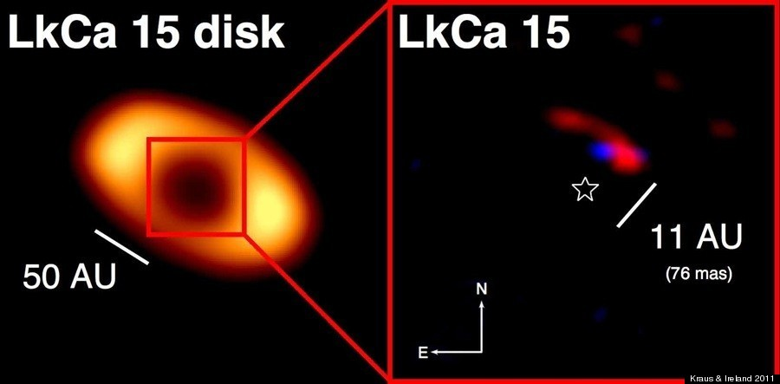
LkCa 15 b (2011)
[Kraus and Ireland 2011]
Notes:
keck

Slide 10
What do these systems have in common?
Large planets
Large separation
Low contrast
Hot Jupiters/Young?
Emit in infrared
High contrast astronomical imaging seeks to resolve cool planets very close to bright stars.

Slide 11
High contrast imaging

Slide 12
High-contrast imaging terminology
Contrast
Inner working angle
Outer working angle
Discovery space

Slide 13
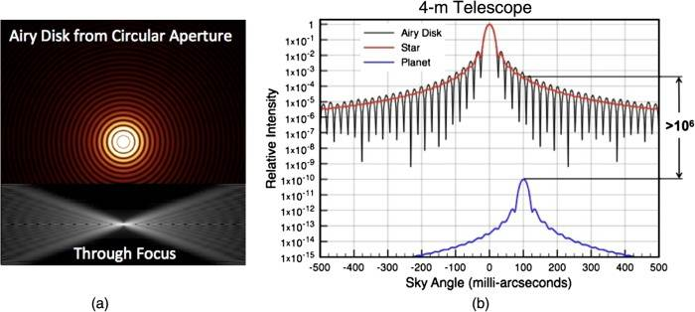
Contrast
10¹⁰
[Lyon and Clampin 2012]
Notes:
Contrast and focal plane diffraction. (a) Example of a 4-m circular aperture telescope’s ideal diffraction pattern at λ = 500 nm. (b) The star’s Airy disk normalized to unity at the peak (red) and a planet with a luminosity of 10^−10 of the star separated by 100mas would appear only 10^6 times dimmer due to the angular separation.

Slide 14
Inner Working Angle
$$IWA=100 mas$$
[Lyon and Clampin 2012]
Notes:
Contrast and focal plane diffraction. (a) Example of a 4-m circular aperture telescope’s ideal diffraction pattern at λ = 500 nm. (b) The star’s Airy disk normalized to unity at the peak (red) and a planet with a luminosity of 10^−10 of the star separated by 100mas would appear only 10^6 times dimmer due to the angular separation.

Slide 15
Outer Working Angle
Limited by the field of view of the optics
Can be limited by actuators

Slide 16
Discovery Space
Field of view
IWA
Sky Angle
OWA

Slide 17
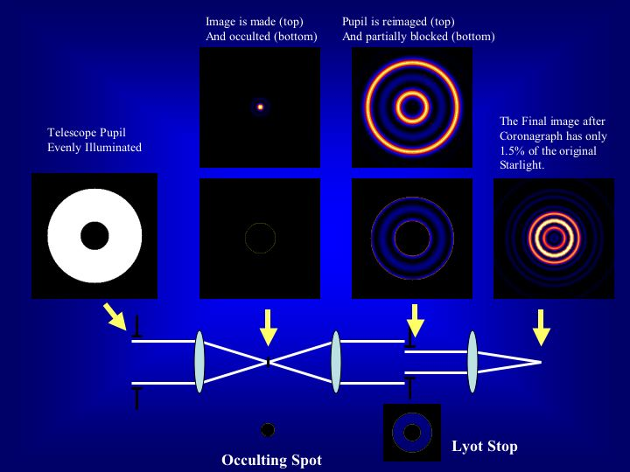
High-contrast imaging technology
Lyot coronagraph
[Sivaramakrishnan et al. 2001]

Slide 18
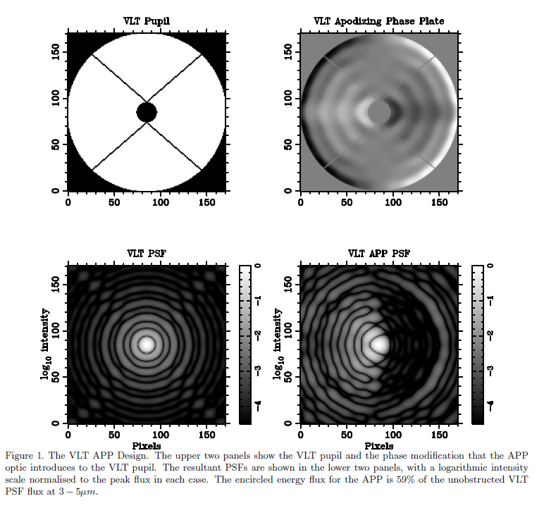
High-contrast imaging technology
Apodizing phase plate coronagraph
[Kenworthy et al. 2010]

Slide 19
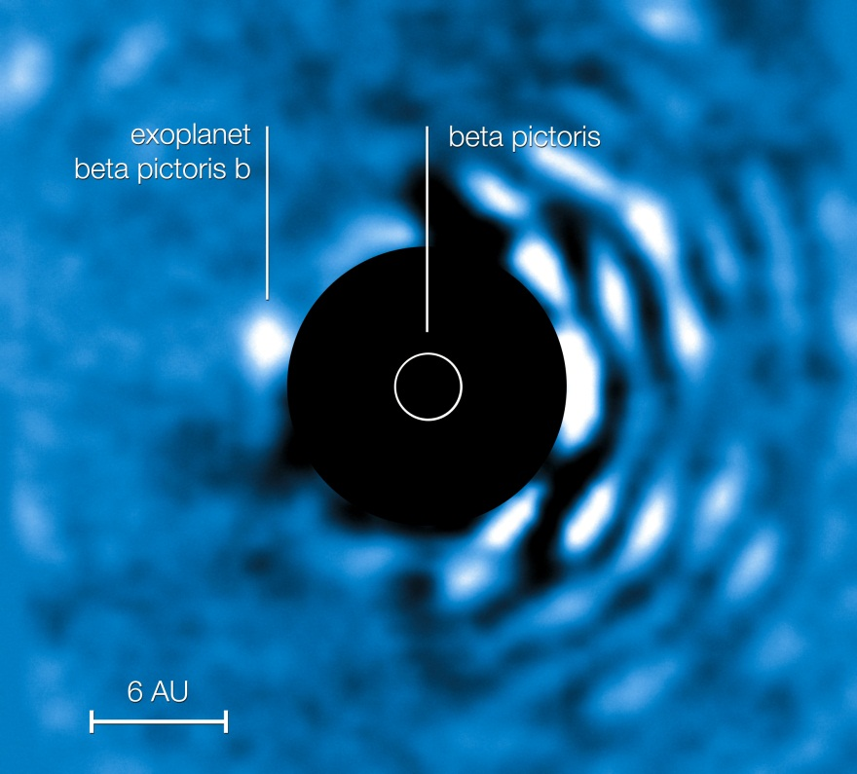
Instruments in use
VLT
NACO/APP coronagraph
Keck
NIRC-2
Gemini
NICI/Lyot coronagraph
HST
NICMOS
STIS
ACS/HCR
JWST
NIRCam
Image credit: ESO
Notes:
Blanks just have occulting spots
The planet Beta Pic b imaged at a wavelength of 4.05 micrometres with the VLT’s NACO instrument using the Apodising Phase Plate (APP) coronagraph on 3 April 2010. The “bad” (bright) side of the image is visible to the right while the central bright regions of the central star (Beta Pictoris) have been masked out to enable the viewer to see clearly the planet to the left of the star. At its current projected position the planet is roughly 6.5 AU away from its host star (1 AU being the distance Earth–Sun). The planet’s mass is estimated to be roughly nine times that of Jupiter.

Slide 20
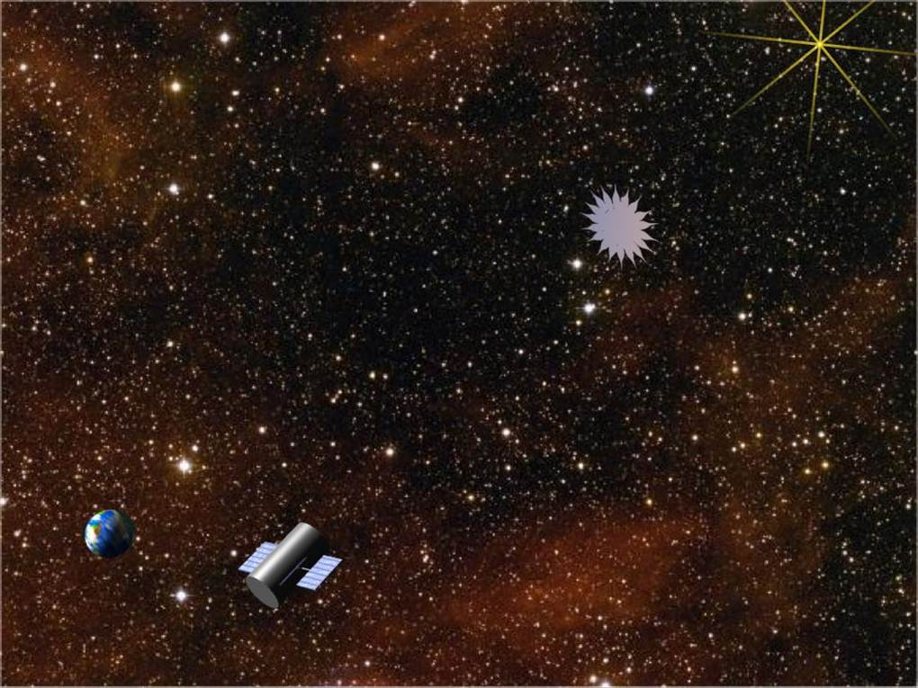
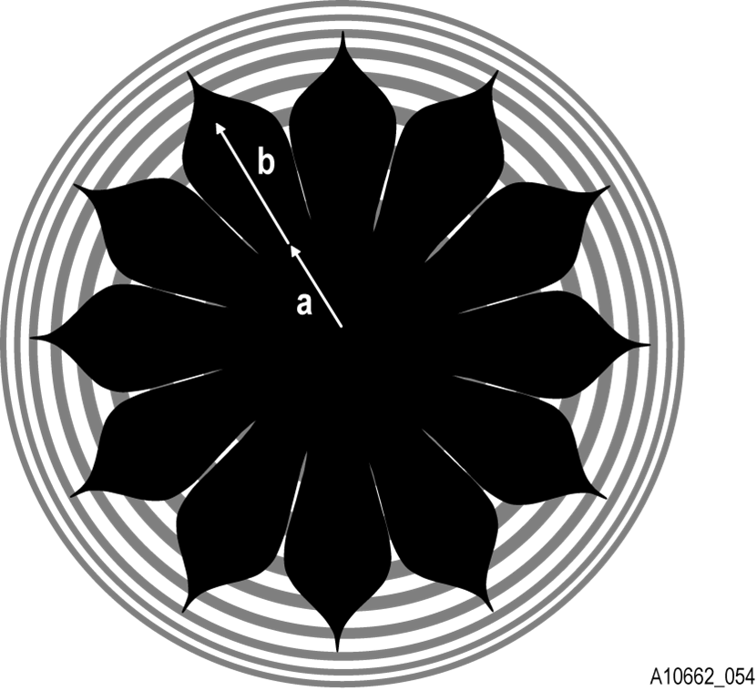
Next generation technology
NASA’s New Worlds Observer
4-m telescope plus starshade has star:planet limiting contrast of 10⁻¹¹ at IWA = 50 mas
[http://newworlds.colorado.edu]

Slide 21
Next generation technology
Optical vortex coronagraph
PP1
Mask
Lyot Stop
Detector
r, θ
ρ, φ
ρ’, φ’
O₁
z
L1
L2
L3
f
f
$$e^{i2θ}$$

Slide 22
Next generation technology
Optical vortex coronagraph
PP1
Mask
Lyot Stop
Detector
r, θ
ρ, φ
ρ’, φ’
O₁
O₂
z
α₂
L1
L2
L3
f
f
$$e^{i2θ}$$

Slide 23
Next generation technology
Vortex coronagraph
Keck (10 m) K_{s}-band image of HR 8799
Hale (1.5 m) K_{s}-band image obtained with vortex coronagraph
[Serabyn et al. 2010]

Slide 24
Candidate stars

Slide 25
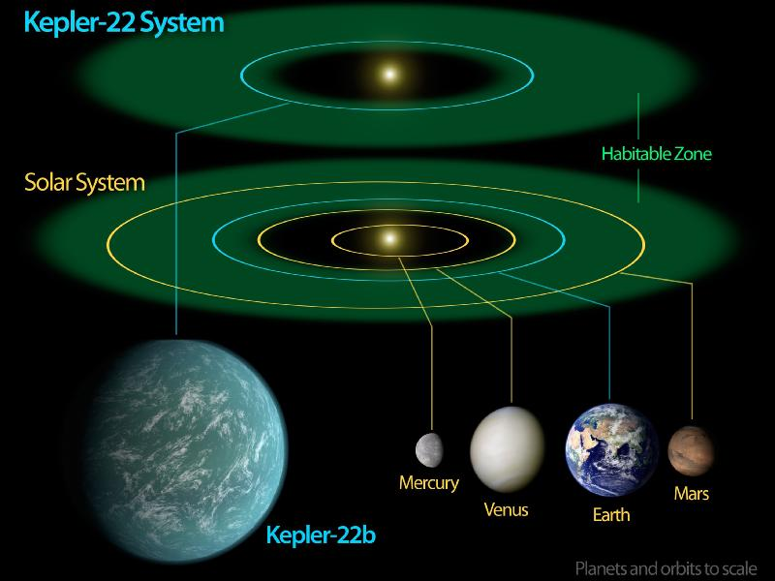
“Habitable” Zone
Image credit: NASA/Ames/JPL-Caltech

Slide 26
HabCat: A catalog of nearby “habitable” systems
Originally targets selected for SETI
Derived from the Hipparcos catalog
17,129 stars out of about 118,218
Criteria for HabCat Candidates
Stars must be at least 3 Gyr old.
Stars must be non-variable.
Stars must be capable of harboring terrestrial planets (measured by [Fe/H]).
Stars must support a dynamically stable habitable zone.
[Turnbull et al. 2003]
Notes:
The Catalogue of Nearby Habitable Stars (known as HabCat) is a list of star systems that could conceivably host habitable planets. Developed by Margaret Turnbull and Jill Tarter, the HabCat list was created by taking data from the Hipparcos Catalogue (which contains approximately 120,000 nearby stars) and eliminating those stars that have no possibility* of hosting a habitable planet, bringing the number of possible "HabStars" down to 17,129.

Slide 27
The HabCat catalog

Slide 28
Size of habitable zone
We can calculate the star-planet distance necessary to receive the same energy as earth.
$$I_{planet}=I_{earth}$$
$$\frac{L_{star}}{4πr_{}^{2}}=\frac{L_{sun}}{4π{\left(1AU\right)}_{}^{2}}$$
$$r_{HZ}[AU]=1AU×\sqrt{\frac{L_{star}}{L_{sun}}}$$
$$θ_{HZ}["]=\frac{r_{HZ}[AU]}{d[pc]}=\frac{1}{d[pc]}\sqrt{\frac{L_{star}}{L_{sun}}}=\frac{1}{d[pc]}\sqrt{{10}^{({4.8−M}_{BOL})/2.5}}$$
where $M_{BOL}≈M_{V}$ and $M_{V}=V−5log\left(d\left[pc\right]\right)+5.$
[Turnbull et al. 2004]

Slide 29
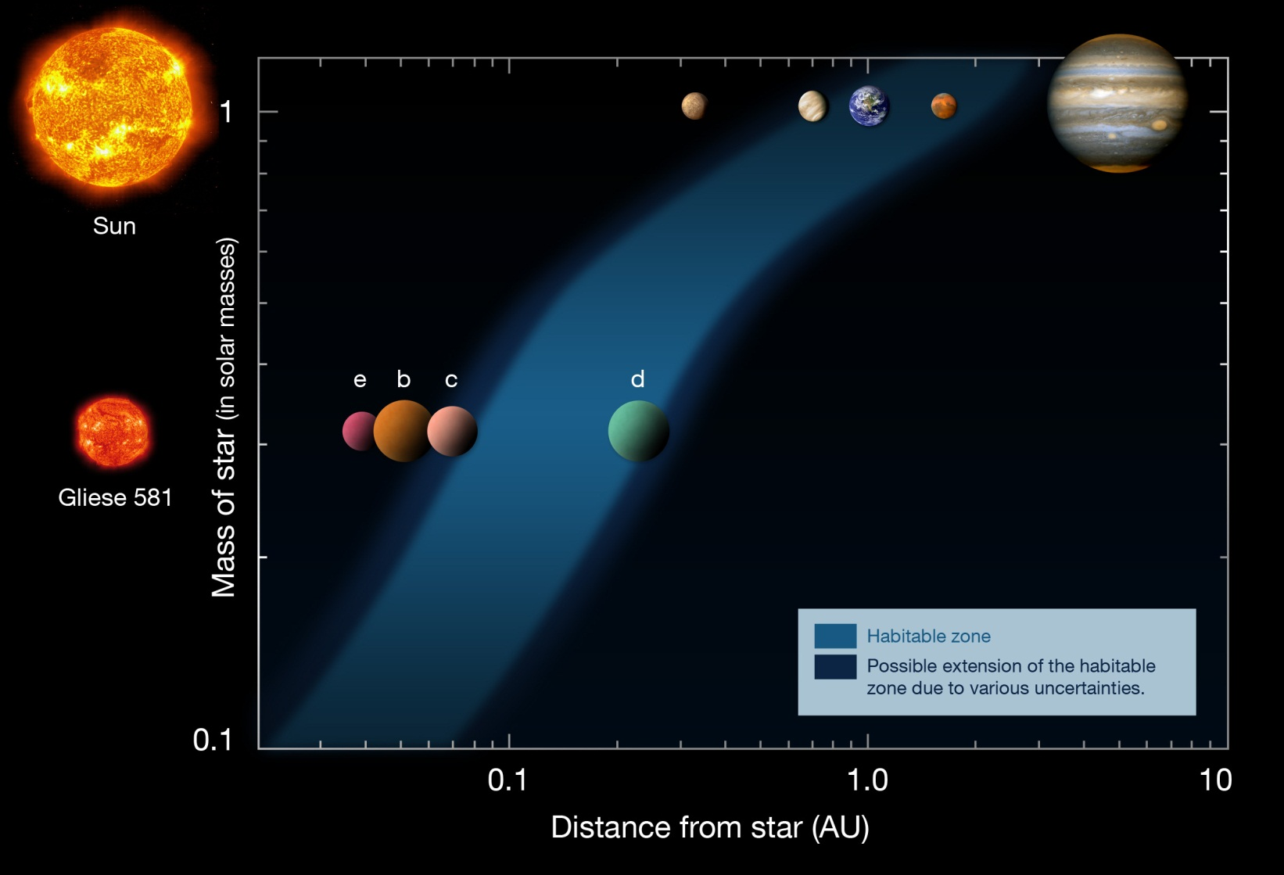
Habitable Zone
$$θ_{HZ}["]d[pc]$$
$$IWA["]d[pc]$$
[Image Credit: ESO]

Slide 30
Can we resolve planets in the HZ?
$$\frac{2λ}{D}$$
Hale (1.5 m) K_{s}-band image obtained with vortex coronagraph
[Serabyn et al. 2010]
Number of HabCat planets whose $θ_{HZ}$ is outside of an IWA of ${2λ}/D$at $λ=550 nm$.
Diameter [m] | IWA [mas] | # of HabCat Stars
1 | 226.9 | 1
2 | 113.4 | 9
4 | 56.7 | 86
8 | 28.4 | 1167
16 | 14.2 | 9092

Slide 31
Planet-Star Contrast
How much reflected light will we see?
Depends on distance to star, planet radius, and planet albedo.
$$Luminosity Ratio=\frac{L_{P}}{L_{S}}=α{\left(\frac{R_{planet}}{R_{star−planet}}\right)}^{2}φ\left(β\right)$$
We can use the Earth/Sun luminosity to scale the planet/star luminosity. Assuming best viewing conditions,
$$\frac{L_{P}}{L_{S}}={2.2×10}^{−10}{\left(\frac{1AU}{R_{star−planet}}\right)}^{2}$$
where $R_{star−planet}[AU]=θ_{HZ}["]d[pc]$
[Lyon and Clampin 2012]
Notes:
Phi is orbital phase function

Slide 32
Luminosity Ratio of Earth-like planet
1 m
2 m
@ ${2λ}/D$ where $λ=550 nm$
4 m
8 m
16 m
Plot of luminosity ratio of a terrestrial planet in the HZ of HabCat stars.

Slide 33
Aperture Flux
The photon rate is given by
$$F_{star}=F_{0,λ}{10}^{−\frac{m_{V}}{2.5}}AΔλ\left[\frac{photons}{sec}\right]$$
$$F_{planet}=\left(\frac{L_{p}}{L_{s}}\right)F_{star}$$
where $F_{0,λ}={10}^{8}\left[\frac{photons}{sec m^{2} nm}\right]$.
[Lyon and Clampin 2012]

Slide 34
Aperture Flux of an Earth-like planet
$${2λ}/D$$
Plot of aperture flux for a 6.5 m (JWST) aperture in the J-band due to a terrestrial planet in the HZ of HabCat stars.

Slide 35
Detector Signal
Electrons per second per pixel due to the star:
$$S_{star}=𝒮 η QE F_{star}PSF\left(θ\right)$$
$𝒮$ = starlight suppression factor of the coronagraph
$η$ = total transmission
$QE$ = quantum efficiency
Electrons per second per pixel due to the planet:
$$S_{planet}=η QE F_{planet} PSF(θ−θ_{p})$$
$PSF\left(θ\right)=π{\left[\frac{J_{1}(πθ)}{πθ}\right]}^{2}$ where $θ$ is the sky angle in units of $\frac{λ}{D}$
$θ_{p}$ is the sky angle of the planet in units of $\frac{λ}{D}$
[Lyon and Clampin 2012]

Slide 36
Noise Sources
Noise sources:
Shot noise of planet and star
Zodiacal light
Exozodiacal light
Background
Dark current
Read noise

Slide 37
Noise Sources
Zodiacal Light
$$M_{Z}=22\frac{magnitudes}{{arcsec}^{2}}$$
The irradiance at the aperture
$$I_{Z}≅0.15 \frac{photons}{\sec{m^{2}pixel}}$$
[Lyon and Clampin 2012]

Slide 38
Noise Sources
Exozodiacal Light
Subtraction will be necessary.
Preliminary studies will allow better subtraction.
Subtraction may cause significant noise.
May be important for orbital determination.
[Lyon and Clampin 2012]

Slide 39
Background Sources
Photometric measurements rule out background sources

Slide 40
Signal-to-Noise Ratio
$$SNR=\frac{S_{planet}Δt}{\sqrt{S_{planet}Δt+S_{star}Δt+S_{Zodi}Δt+S_{exoZodi}Δt+i_{dark}Δt+σ_{}^{2}}}$$
where $S$ is the signal [photoelectrons/sec]
and $σ$ is the detector read noise.
Lets say there exists a zero read-noise detector with no dark current,
$$SNR=\frac{S_{planet}\sqrt{Δt}}{\sqrt{S_{planet}+S_{star}+S_{Zodi}+S_{exoZodi}}}$$
$$Δt={SNR}^{2}\left(\frac{S_{planet}+S_{star}+S_{Zodi}+S_{exoZodi}}{{Splanet}_{}^{2}}\right)$$
[Lyon and Clampin 2012]

Slide 41
Integration Time
Assuming $𝒮={10}^{−8}$, Zodi and exoZodi are equal with solid angle ${\left(λ/D\right)}^{2}$, $η=0.9$, $QE=0.9$, ideal PSF, the integration time for an SNR of 5 is…
${2λ}/D$ where $J−Band$
$$D=6.5 m$$
Many HZ planets could be imaged at SNR = 5 under ideal conditions and minimal noise.

Slide 42
Other performance considerations
Aperture obstructions
Optical surface quality
Polychromatic effects
Pointing
Postprocessing

Slide 43
Mission specifications

Slide 44
Mission design
Consider a space telescope with a 6.5m mirror operating at 1μm,
The HZ of 799 HabCat stars have an angular separation greater than an IWA of ${2λ}/D$.
At a contrast floor of ${10}^{−10}$, 232 of these stars would be viable targets.
By calculating the integration time to reach SNR = 5, we find that the total integration time to image each HZ once is $\sim$200 days.
In less than 5 years each HZ could be searched 5 times to SNR = 5.

Slide 45
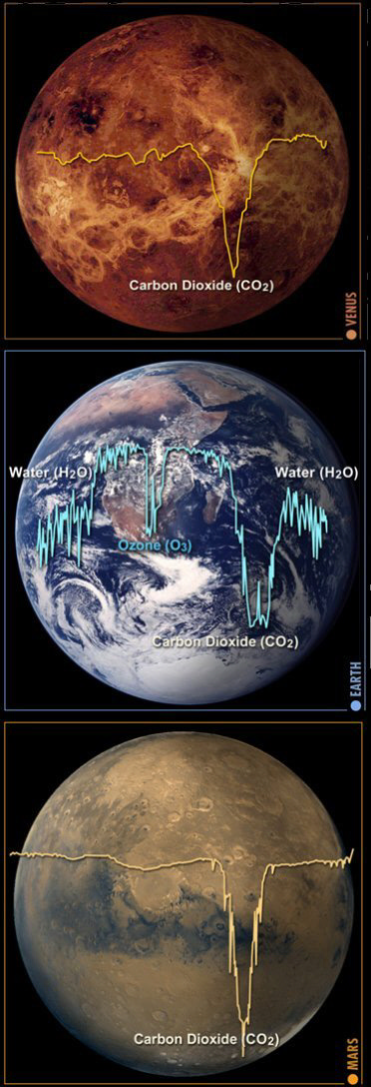
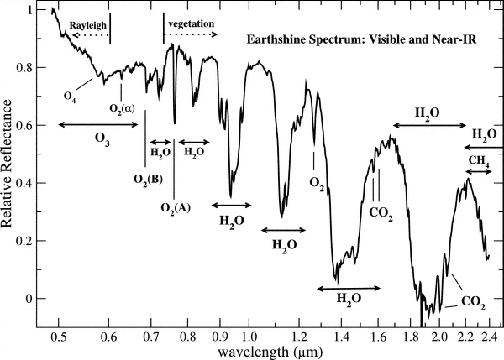
Future missions
Photometric measurements
Broadband (Spitzer: HD 189733b)
Spectroscopy
Atmosphere, biomarkers
Polarimetry
Oceans?
Image credit: (left)Turnbull et. al. 2006 (right) ESO

Slide 46
Conclusions
It is possible to design a mission with current technology that is likely to directly image at least one earth-like planet.
With state-of-the-art starlight suppression JWST would have over 200 viable HZ targets.
Such a mission would be capable of imaging most planets outside of the HZ.
Later spectral types are favored for contrast. These types have very small HZs.
Direct imaging opens doors to photometric, spectroscopic, polarimetric studies of exoplanets.

Slide 47
References
Kenworthy, M.A., Quanz, S.P., Meyer, M.R., Kasper, M.E., Lenzen, R., Codona, J.L., Girard, J.H.V., Hinz, P.M., 2010. An apodizing phase plate coronagraph for VLT/NACO. arXiv:1007.3448.
Kraus, A.L., Ireland, M.J., 2011. LkCa 15: A Young Exoplanet Caught at Formation? arXiv:1110.3808.
Lafrenière, D., Jayawardhana, R., van Kerkwijk, M.H., 2008. Direct Imaging and Spectroscopy of a Planetary-Mass Candidate Companion to a Young Solar Analog. The Astrophysical Journal 689, L153–L156.
Lagrange, A.-M., Gratadour, D., Chauvin, G., Fusco, T., Ehrenreich, D., Mouillet, D., Rousset, G., Rouan, D., Allard, F., Gendron, é., Charton, J., Mugnier, L., Rabou, P., Montri, J., Lacombe, F., 2009. A probable giant planet imaged in the β Pictoris disk. Astronomy and Astrophysics 493, L21–L25.
Lyon, R.G., Clampin, M., 2012. Space telescope sensitivity and controls for exoplanet imaging. Optical Engineering 51, 011002– 011002–15.
Marois, C., Macintosh, B., Barman, T., Zuckerman, B., Song, I.S., Patience, J., Lafreniere, D., Doyon, R., 2008. Direct Imaging of Multiple Planets Orbiting the Star HR 8799. Science 322, 1348–1352.
Marois, C., Zuckerman, B., Konopacky, Q.M., Macintosh, B., Barman, T., 2010. Images of a fourth planet orbiting HR 8799. Nature 468, 1080–1083.
Mohanty, S., Jayawardhana, R., Huélamo, N., Mamajek, E., 2007. The Planetary Mass Companion 2MASS 1207-3932B: Temperature, Mass, and Evidence for an Edge-on Disk. The Astrophysical Journal 657, 1064–1091.
Serabyn, E., Mawet, D., Burruss, R., 2010. An image of an exoplanet separated by two diffraction beamwidths from a star. Nature 464, 1018–1020.
Sivaramakrishnan, A., Koresko, C.D., Makidon, R.B., Berkefeld, T., Kuchner, M.J., 2001. Ground‐based Coronagraphy with High‐Order Adaptive Optics. The Astrophysical Journal 552, 397–408.
Swartzlander, G.A., 2009. The optical vortex coronagraph. Journal of Optics a-Pure and Applied Optics 11.
Turnbull, M., Glassman, T., Roberge, A., Lo, A., Cash, W., 2009. Looking for New Earth in the Coming Decade with Direct Imaging, in: Astro2010: The Astronomy and Astrophysics Decadal Survey. Presented at the astro2010: The Astronomy and Astrophysics Decadal Survey, p. 299.
Turnbull, M.C., Tarter, J.C., 2003a. Target Selection for SETI. I. A Catalog of Nearby Habitable Stellar Systems. The Astrophysical Journal Supplement Series 145, 181–198.
Turnbull, M.C., Tarter, J.C., 2003b. Target Selection for SETI. II. Tycho‐2 Dwarfs, Old Open Clusters, and the Nearest 100 Stars. The Astrophysical Journal Supplement Series 149, 423–436.

