Slide 1
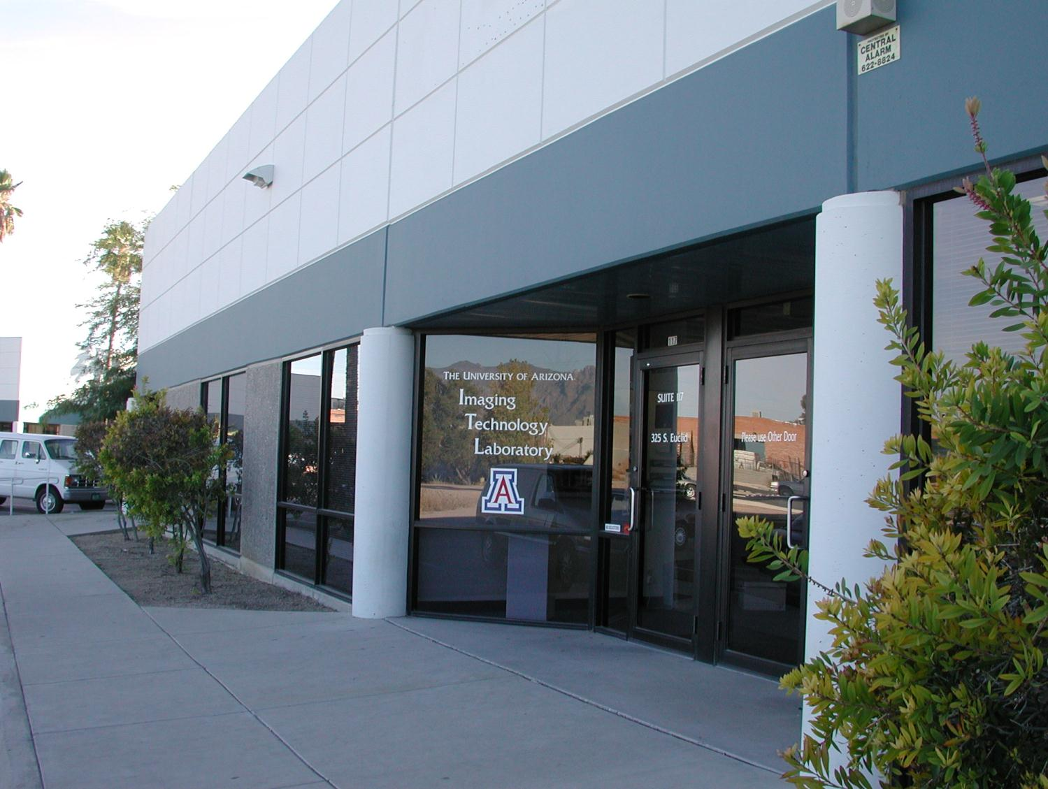

UA Imaging Technology Laboratory
Production of Back Illuminated CCD and CMOS Sensors
for Scientific and Industrial Imaging
Michael Lesser
University of Arizona
Steward Observatory
UA Imaging Technology Laboratory

Slide 2
Outline
Recent back illuminated detector trends for scientific and industrial imaging
Back illuminated detectors overview
Novel backside detectors
Detector processing at the UAITL
Custom detector packaging
Future directions ⇒ scientific CMOS imagers

Slide 3
Visible/UV Detector Developments
Bigger and bigger devices – 10kx10k devices
  Current limits are 150 mm wafers for CCDs,
  200 mm wafers for CMOS
Extended spectral response
  UV (193 nm), X-ray, direct electron bombardment
  800 – 1000 nm QE > 80%, reduced fringing
Orthogonal Transfer Arrays (OTA)
  Split large format devices into cells
  Utilize cells independently (guiding, imaging)
  Correct for atmospheric “seeing” on-chip with
  OT pixels

Slide 4
Visible/UV Detector Developments
Highly parallel outputs
  8, 16, 32, 128, 256 amplifiers
  3+ GB/sec data output per detector
Extremely tight mechanical specifications
  5 μm peak-valley flatness
  -120 C operation
Large Mosaics
  Up to hundreds of devices per focal plane
CMOS imagers
  On-chip logic, low power, radiation hardened
  More manufacturing options than CCDs

Slide 5
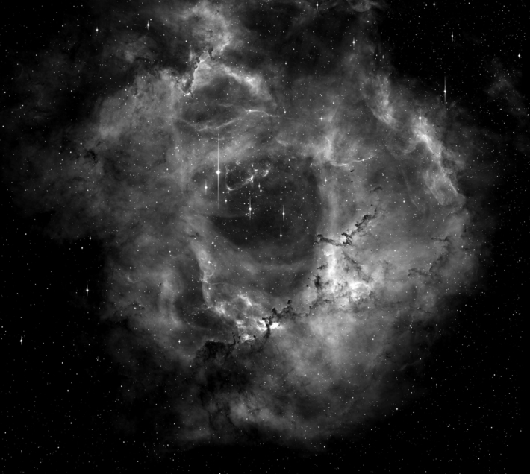
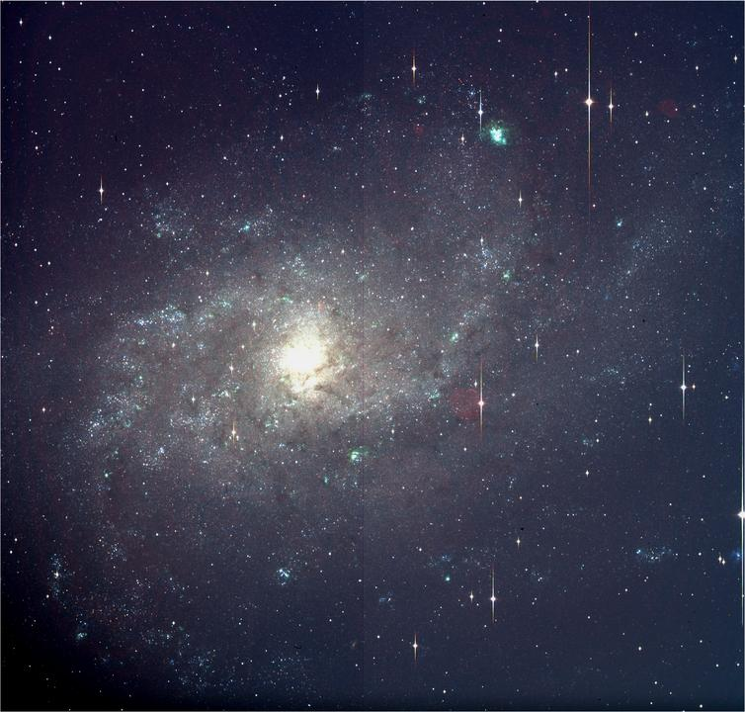
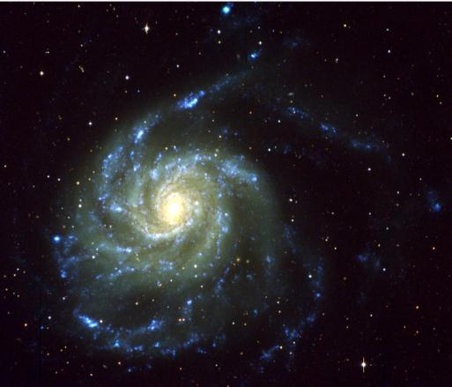
CCD Imaging
2x2 mosaic of 4kx4k CCDs

Slide 6
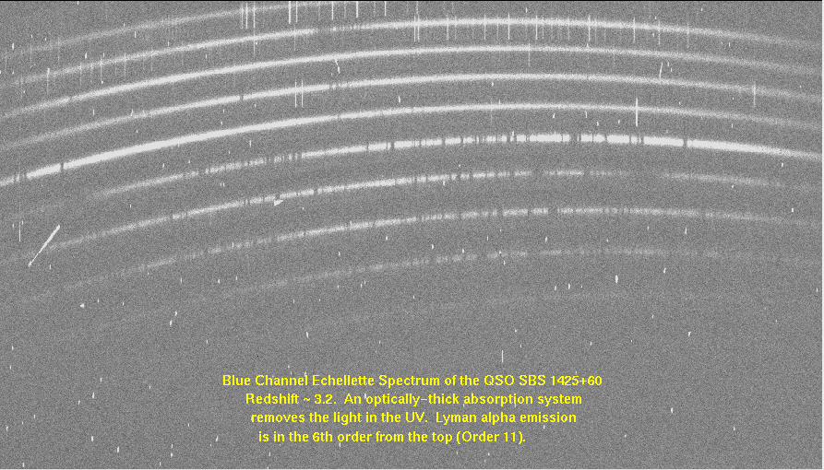
CCD Spectroscopy
long exposures, requires very low dark current and very low noise

Slide 7
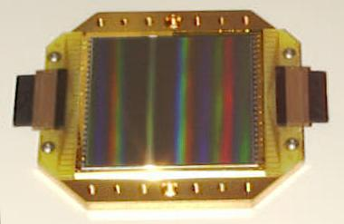
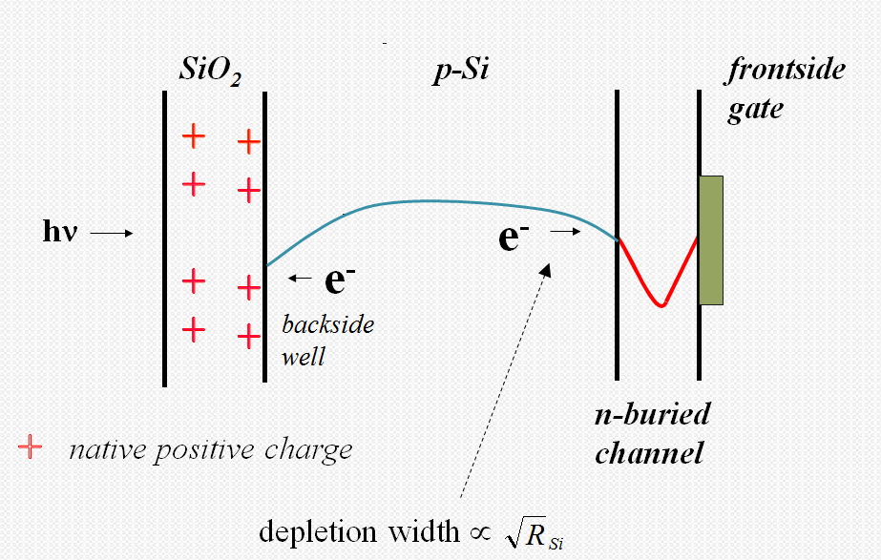
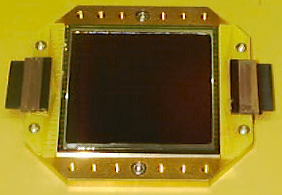
Back Illuminated Detectors
Illuminate silicon from backside
of detector rather than through
frontside electronic structures
front
illuminated
back
illuminated
CCD cross section

Slide 8
Back Illuminated Detectors
Why fabricate backside (expensive) devices?
  Increase quantum efficiency (QE)
    no frontside absorption/reflection
    reflection limited response is possible with appropriate
    backside processing
    may apply a variety of antireflection coatings for
    application specific optimization
  Broad spectral response
    silicon detectors are capable of excellent response
    from X-ray through near-IR
  Commercial backside processing
    Reduce pixel aspect ratio for very small (~1 μm) pixels

Slide 9
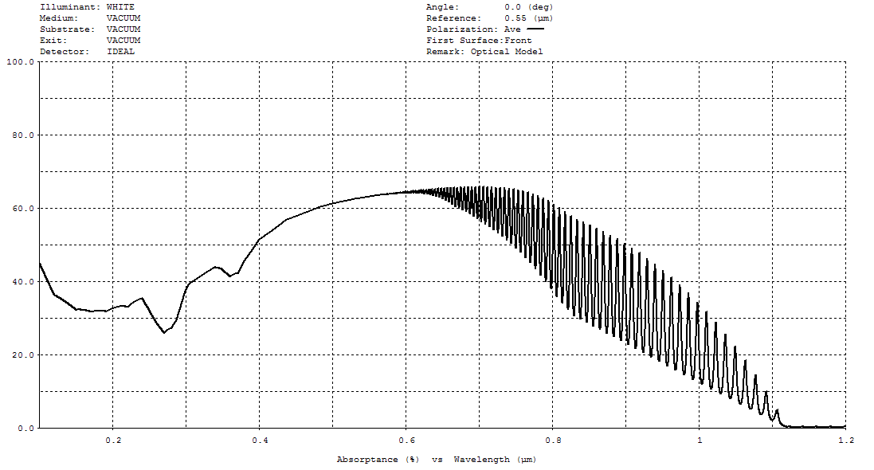
Ideal QE - 10 μm Thick Silicon
no AR coatings

Slide 10
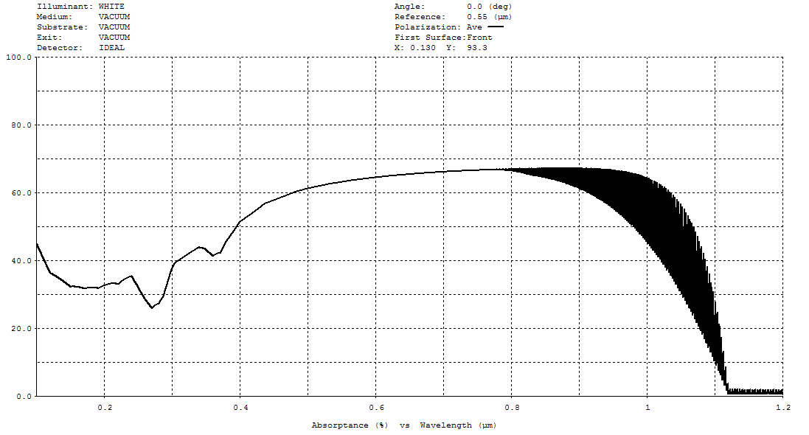
Ideal QE - 50 μm Thick Silicon
no AR coatings
interference fringing

Slide 11
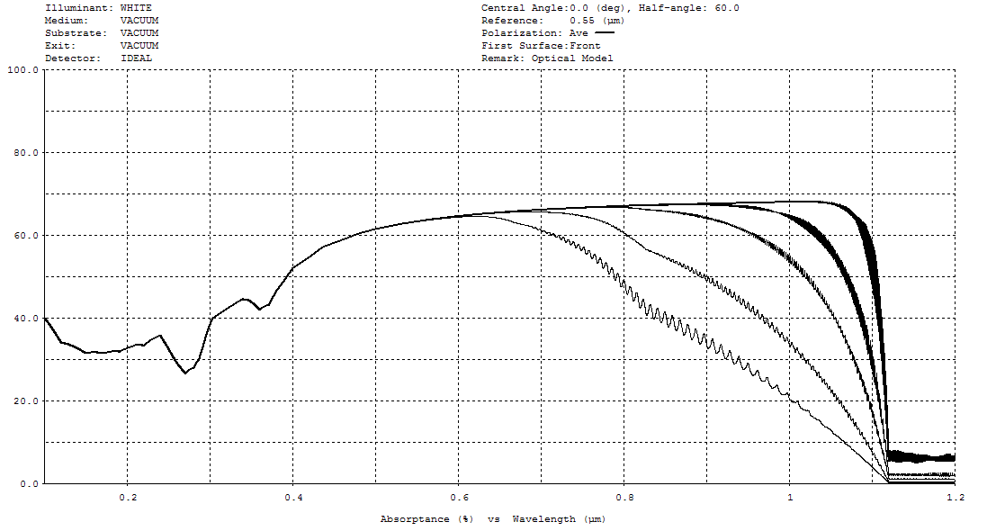
Ideal QE -
10, 20, 50, 100, 300 μm Silicon
no AR coatings
300 μm
10 μm
fringing reduced for clarity

Slide 12
Typical Visible QE

Slide 13
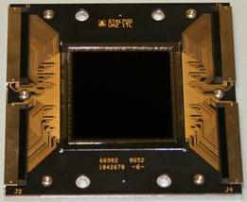
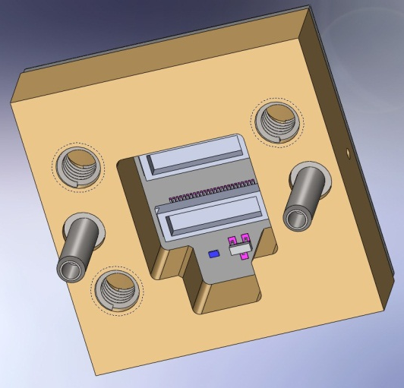
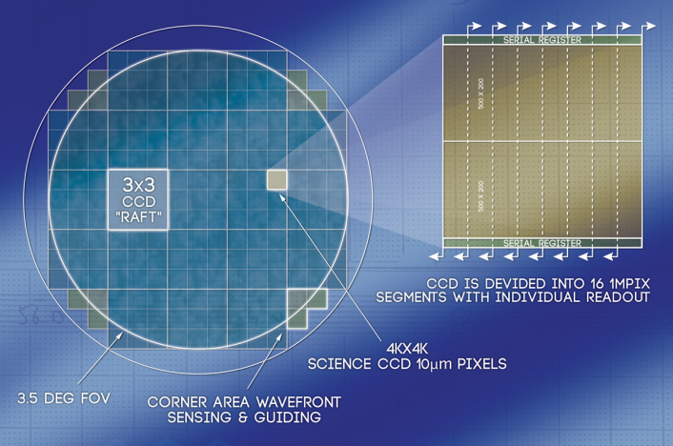
Novel BI CCD Examples
STA1920A 4kx4k 16 output CCD
  ~ 100 μm thick detector for LSST project
  (STA is Semiconductor Technology Associates, Inc.)
Transparent and conductive backside contact
applied to backside for full depletion
Backside bias from guard rings
around die (STA design)
Coatings optimized for near IR
prototype detector
New LSST version of package
LSST focal plane concept
3.2 Gpixels, ~200 CCDs

Slide 14
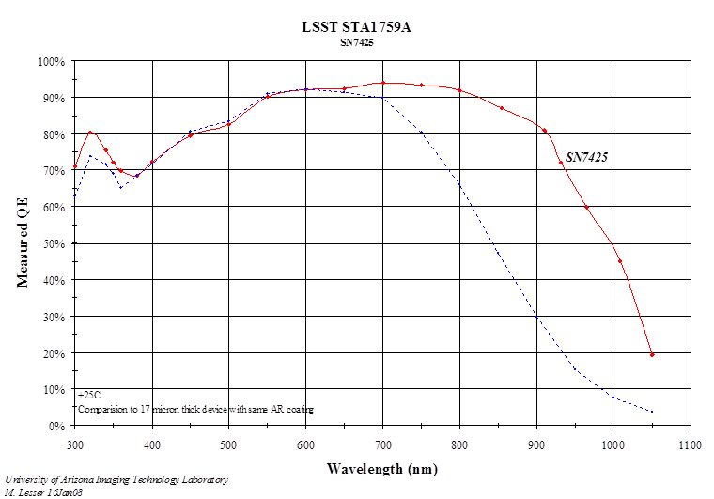
LSST Prototype CCD
93 um thick

Slide 15
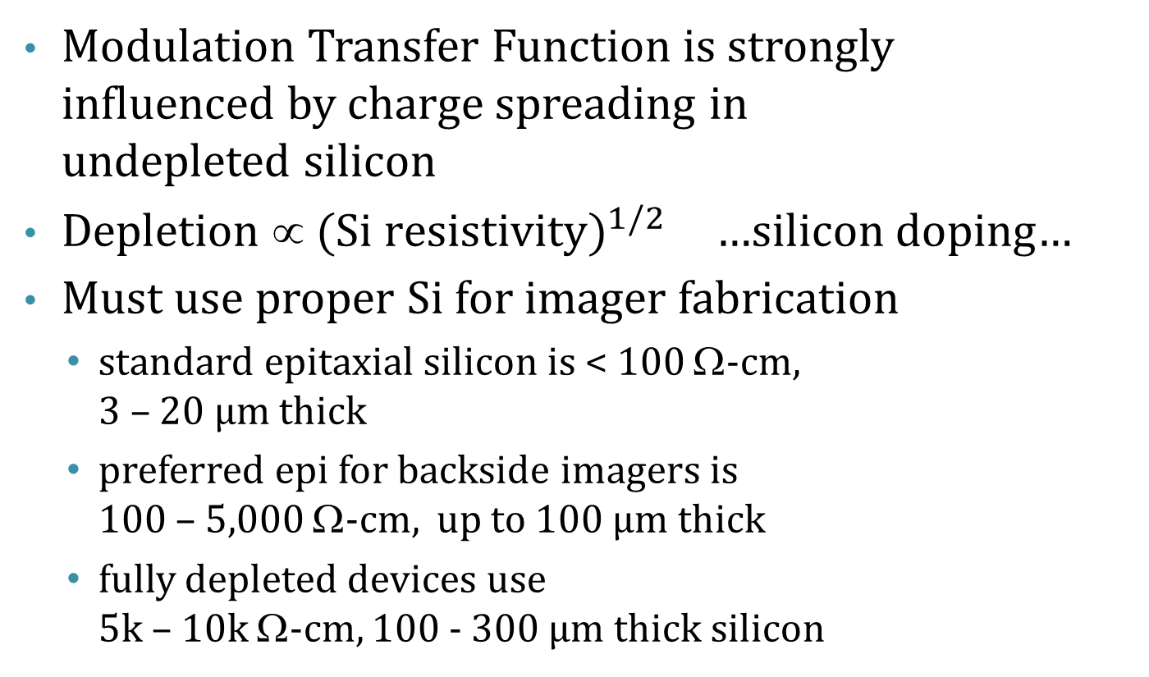
Maintaining Good Resolution
Modulation Transfer Function is strongly
influenced by charge spreading in
undepleted silicon
Depletion ∝ ${\text{(}\text{Si} \text{resistivity})}^{1/2}$ …silicon doping…
Must use proper Si for imager fabrication
  standard epitaxial silicon is < 100 Ω-cm,
  3 – 20 µm thick
  preferred epi for backside imagers is
  100 – 5,000 Ω-cm, up to 100 µm thick
  fully depleted devices use
  5k – 10k Ω-cm, 100 - 300 µm thick silicon

Slide 16
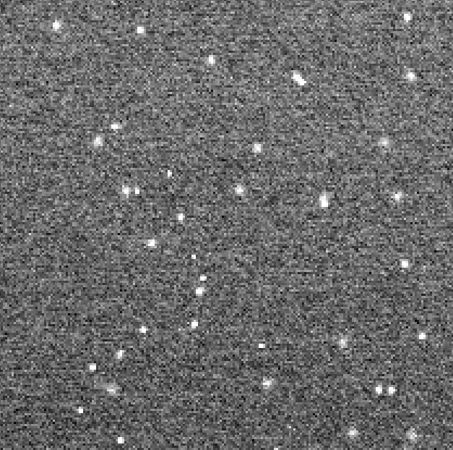
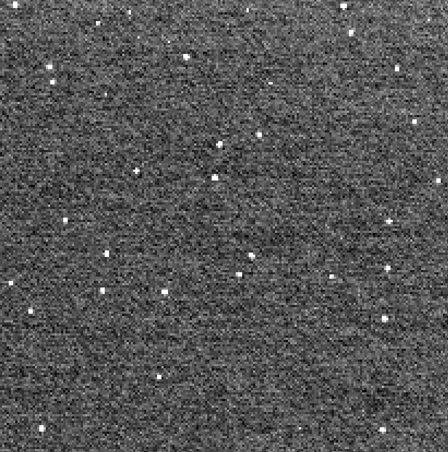
Depletion – MTF
Fe-55 X-ray events
⇒ point sources
-50 V backside bias
no backside bias
LSST prototype device

Slide 17
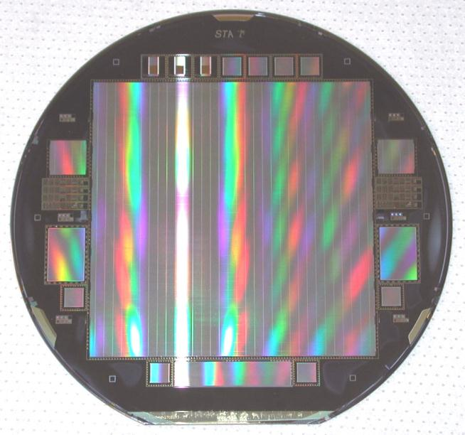
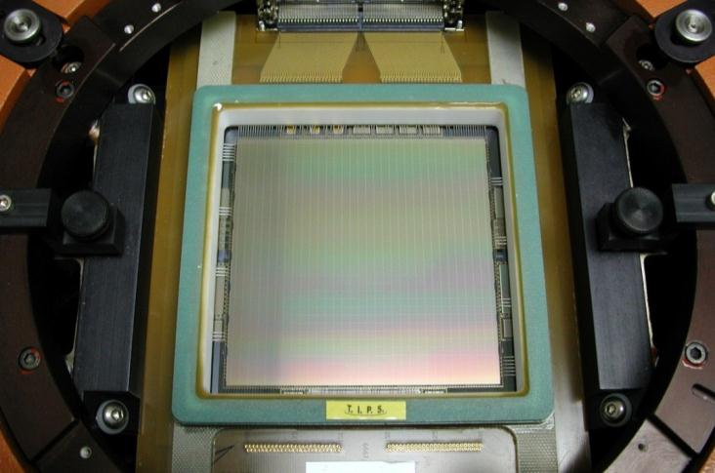
STA1600A 10kx10k CCD
1 die per 150 mm wafer
9 µm pixels
16 high speed outputs
~1 fps readout possible
Largest semiconductor device when first fabricated
Designed and sold by Semiconductor Technology Associates, Inc.

Slide 18
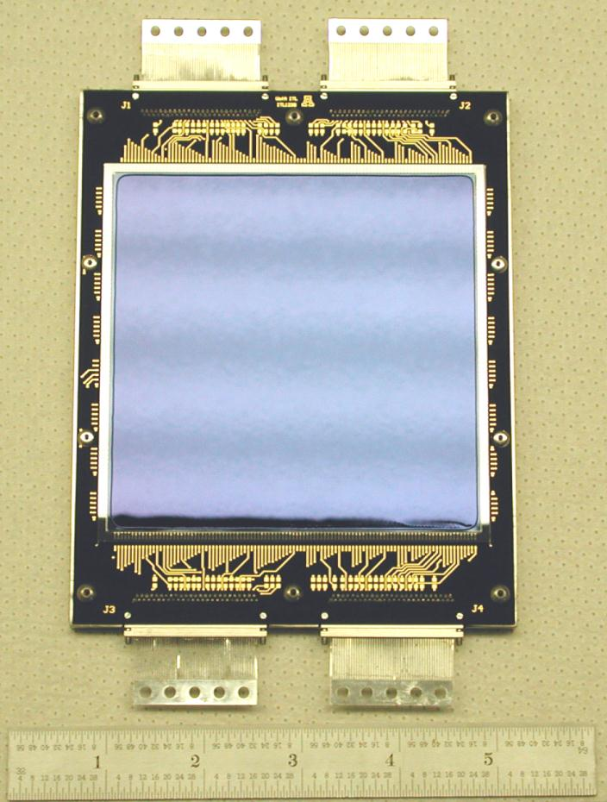
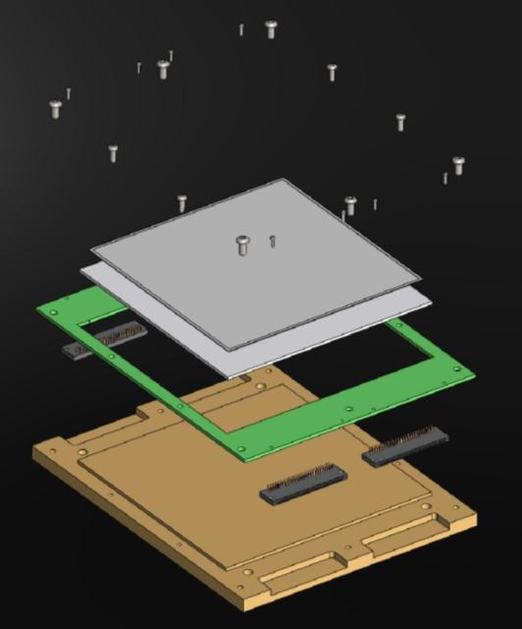
STA1600 10kx10k CCD
<15 µm peak-valley flatness
silicon substrate
Invar package
4 cable connectors
typical operating temp. -120 C

Slide 19
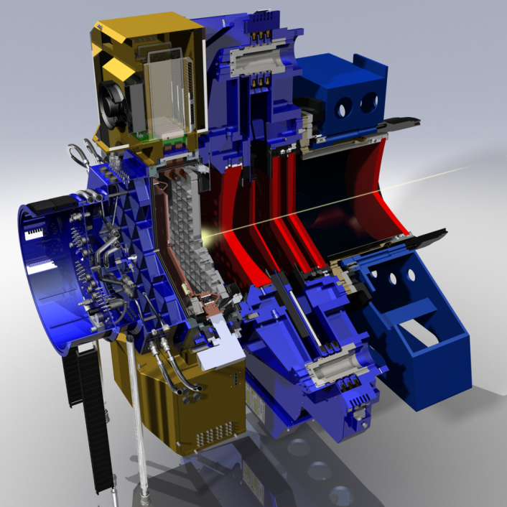
WIYN One Degree Imager
64 Orthogonal Transfer CCD focal plane to be installed on
Kitt Peak next year
~ 1 Gpixel camera
SiC focal plate
ITL fully buttable package
http://www.noao.edu/wiyn/ODI/

Slide 20
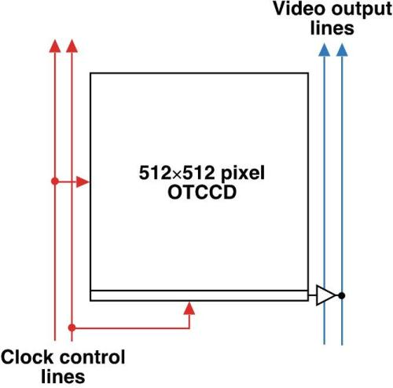
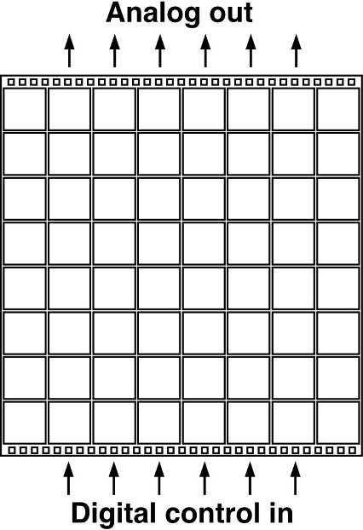
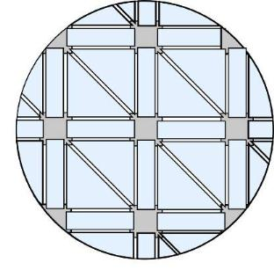
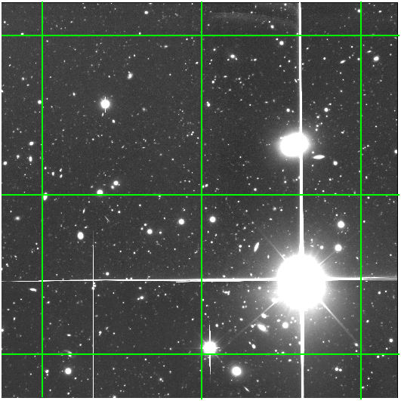
Orthogonal Transfer Arrays
Partition a conventional large-area CCD imager into an array of independently addressable cells
OT pixel
OTA:
8x8 Array of Cells
Independently
addressable cell
reduce bleed effect
OT CCDs developed at MIT/LL

Slide 21
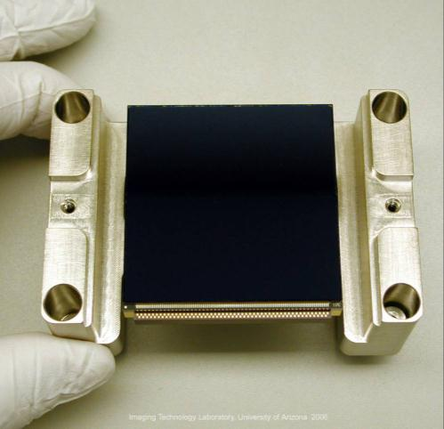
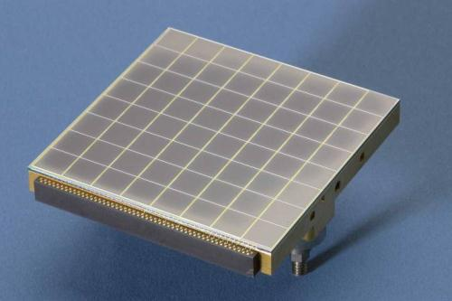
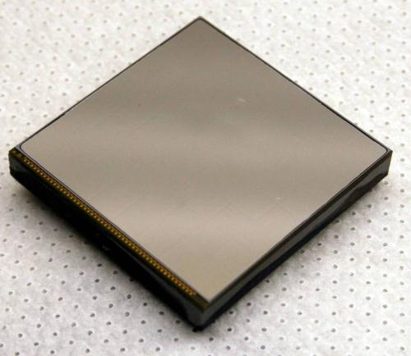
OTA CCD for WIYN ODI
Prototype
backside device
frontside showing 64 cells
Final buttable
backside device

Slide 22
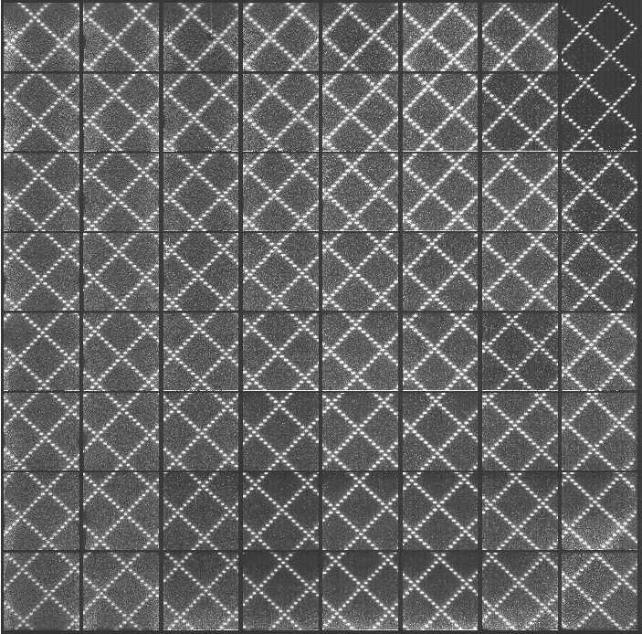
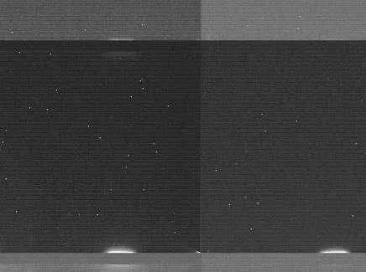
WIYN ODI – STA2200A Backside
Fe55
image
logic glow
grid projection

Slide 23
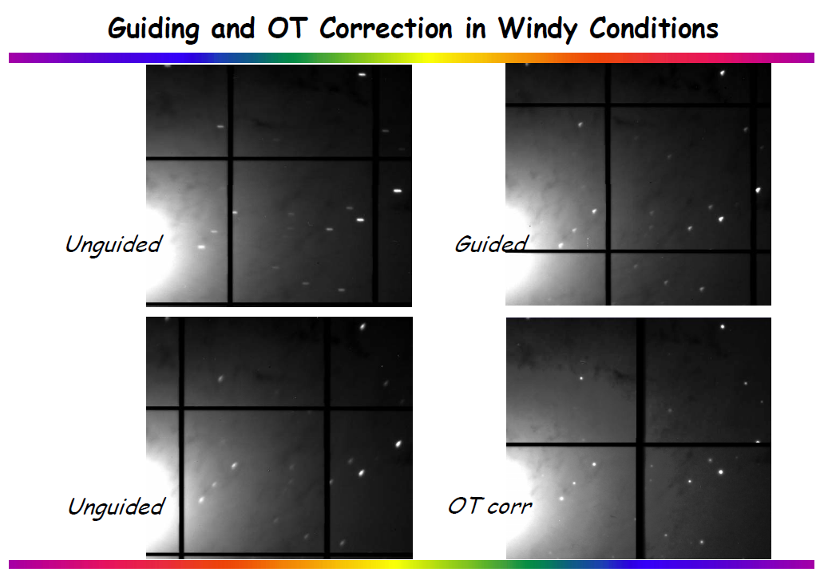
OTAs in Action

Slide 24
UV Semiconductor Inspection
UV laser illumination required for imaging
submicron line widths
  Back illumination required for spectra response
Typical laser wavelengths
  193.5 nm, 198.5 nm, 257 nm, and 266 nm
Long-term stability difficult
  Extended UV irradiation degrades oxide and
  possibly backside charging mechanism

Slide 25
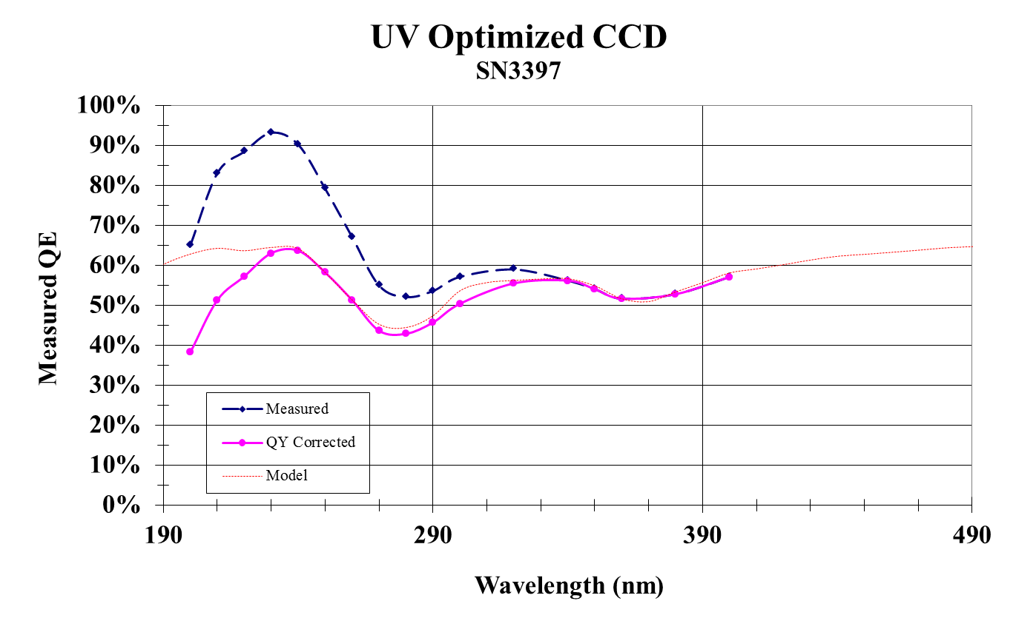
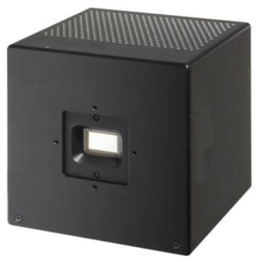
BI CCDs: UV Laser imaging
UV optimized camera
for industrial imaging

Slide 26
Typical CCD Process Flow at ITL
Receive wafers from foundries
DC wafer probe (for shorts)
Image devices @ -60 C
Identify good die
Backside grind (vendor)
Gold stud bump application
Dice
Hybridize to silicon or ceramic
Epoxy underfill
Acid protection
Selective acid etch
Epitaxial acid etch
Oxidize back surface
Apply thin film coatings
Package
Characterize
Assemble focal plane

Slide 27
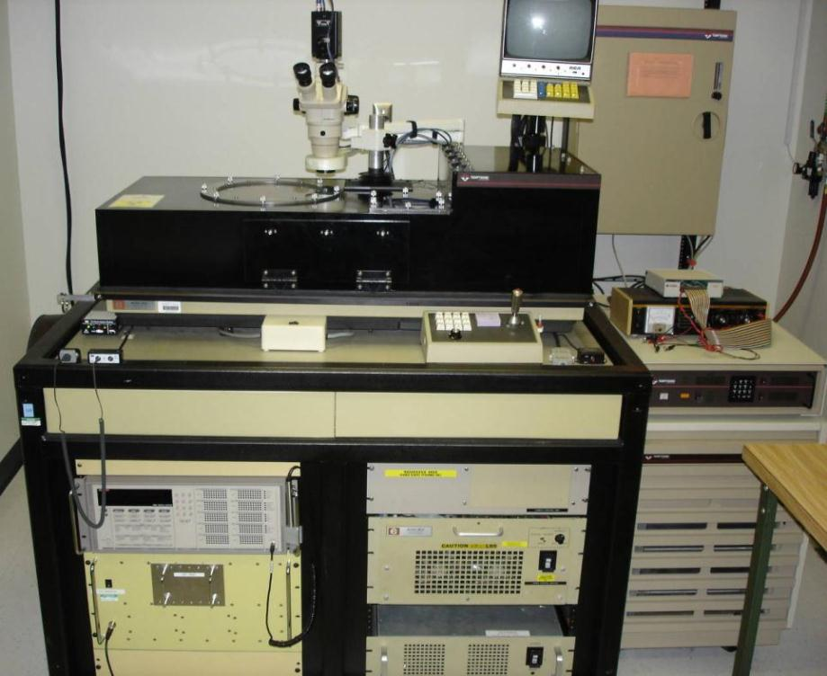
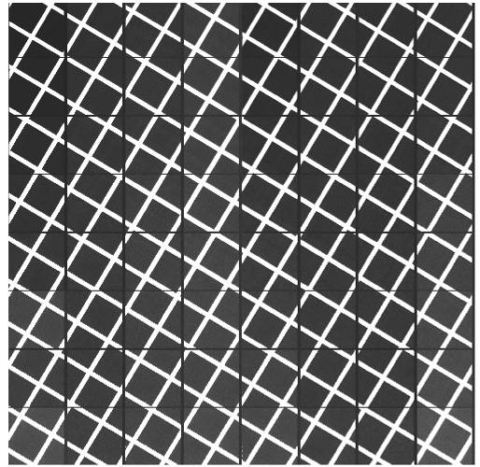
Wafer Probing Detectors
Which devices are good
enough to go through the
effort and expense of
backside processing?
OTA CCD @ -60 C
ITL Cold Prober

Slide 28
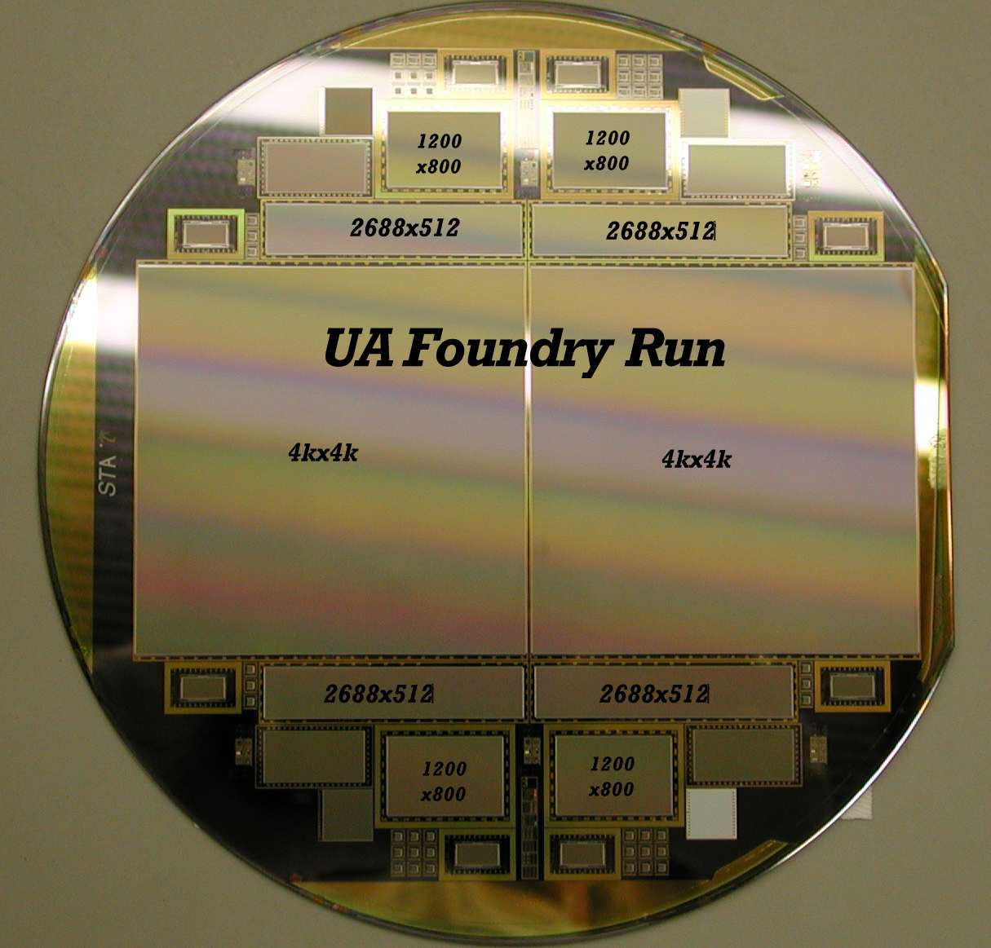
Wafer Probing
wafer level characterization can be complex and time consuming
UA “Foundry Run”
2 4kx4k CCDs
4 2688x512 CCDs
4 1200x800 CCDs
512x1024 FT guiders
128x128 AO devices
“FBI” test devices

Slide 29
Wafer Probing
Data from 100+ lots show yield is mainly
determined on a lot to lot basis
  yield does NOT scale well with device size
Average DC yields for ‘good’ lots is > 50%
(20 MΩ criterion)
‘Bad lots’ have global issues, not just low yield
  fabrication/process problems (etching, alignments)
  silicon issues (traps, CTE, dark current)
  design problems
Very, very seldom do we see a low yield
‘good’ lot
  use multiple lots to work out issues

Slide 30
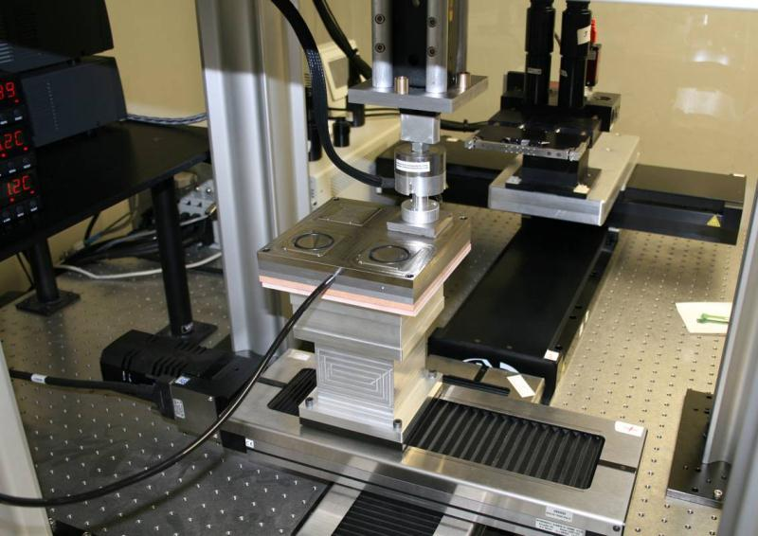
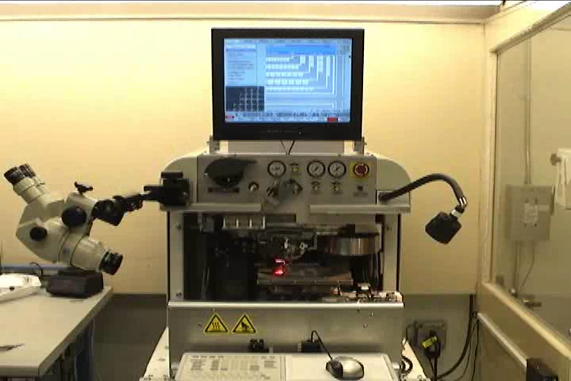
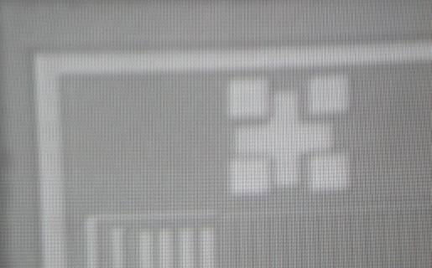
Hybridization
bond CCD to silicon or ceramic substrate/pinned package
indium bumps mated to gold stud bumps
sizes from small 5 mm die to 250 mm focal plane
heat and pressure bonding
NASA hybridization bonder
Fiducials useful on detector and substrate
Automated wafer stud bumper

Slide 31
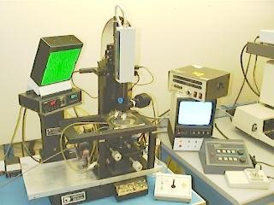
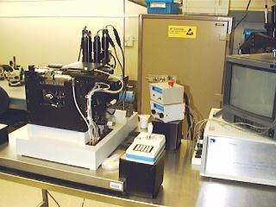
Hybridization
Various flip chip bonders used to align and bond detector and substrate
Infrared aligner for
silicon substrates
Split field aligner for
ceramic substrates
All use heat, pressure, and/or ultrasonics

Slide 32
Hybridization to Silicon
Silicon substrate used for majority of projects
Substrate wafer is indium bumped by electroplating
Typically hybridize a 250 µm thick detector (CCD or CMOS) to a 1400 µm thick silicon substrate
  exact thermal expansion match
  flatness spec on Si substrate is < 5 µm over 150 mm
Individual (diced) substrate die are typically
flat to ~2 µm

Slide 33
Hybridization to Ceramic
Aluminum nitride (AlN) replaces silicon
as substrate material
  1-2 mm thick
Multilayer metals, vias, polished surfaces
Traces metallized and indium bumps applied
Fabricated for die or wafer level
Standard backside processing follows
Mechanical/cooling frame and connectors
attached to underside
Allows combination of hybridization and packaging

Slide 34
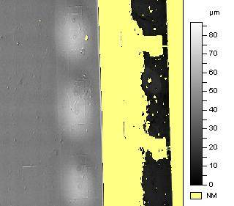
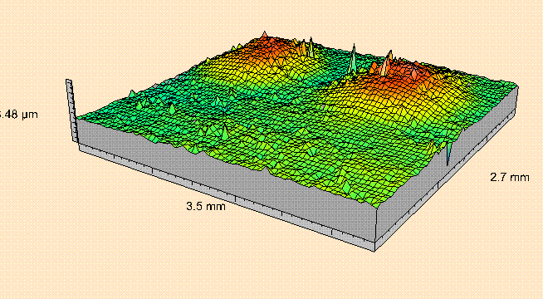
Hybridization Bumps
Bumps placed on wire bond pads,
not in imaging area (pixels)
Regions around bumps (welts) may affect imaging, depending on geometry
Experimentally bumps have been placed under
pixels for enhanced fill factor
~ 3 microns tall

Slide 35
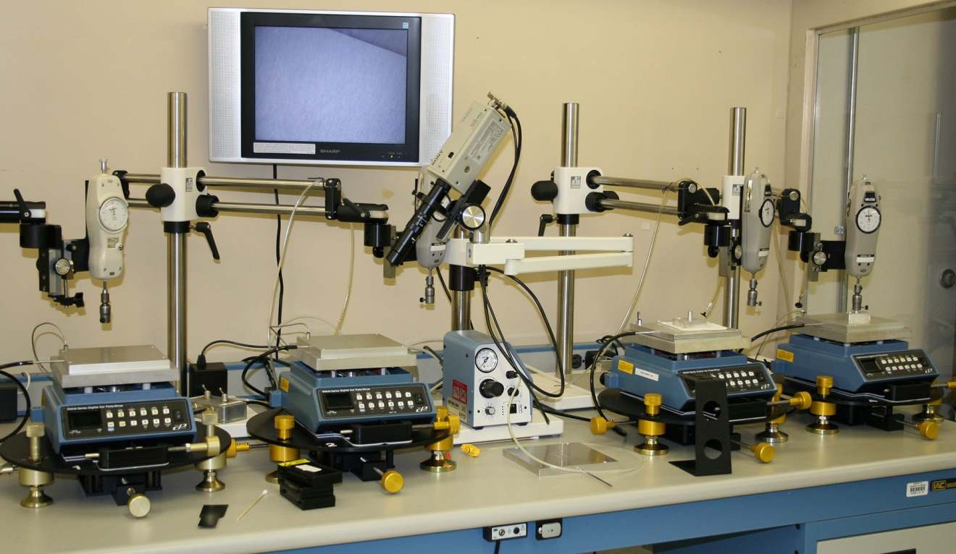
Epoxy Underfill
Epoxy underfill used to mechanically bond
CCD and substrate after bump bonding
Heat used for viscosity control
Chip Flatteners hold device surface shape
during epoxy
cure
underfill stations

Slide 36
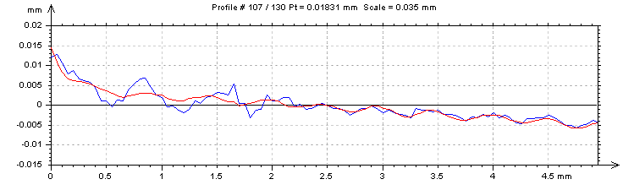
Epoxy Underfill Ripples
We sometimes see ‘ripples’ in underfill material associated with edges of device and layout of bumps
  stress related
  ~5 μm variations
  can cause issues with fiber optic bonding

Slide 37
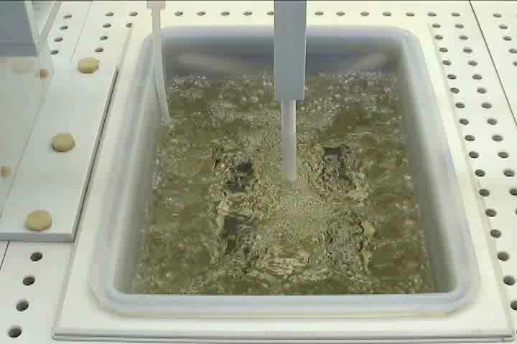
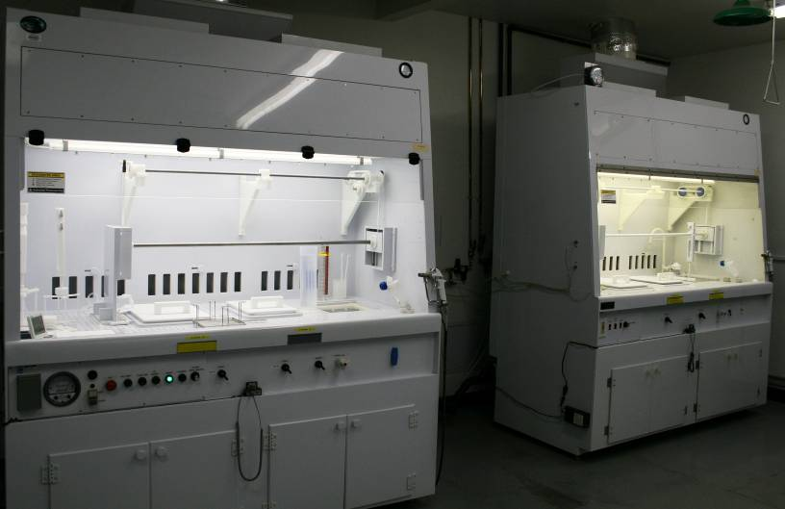
Silicon Etching
1:3:8 HF:HNO₃:CH₃COOH acid solution used to etch p⁺ substrate to epitaxial interface
Etch selectivity critical to achieve uniform
final device thickness
Typical doping levels
  p⁺ = 10¹⁸ cm⁻³, p = 10¹⁵ cm⁻³
  10 – 10,000 Ω-cm
Etch time ~2 hours

Slide 38
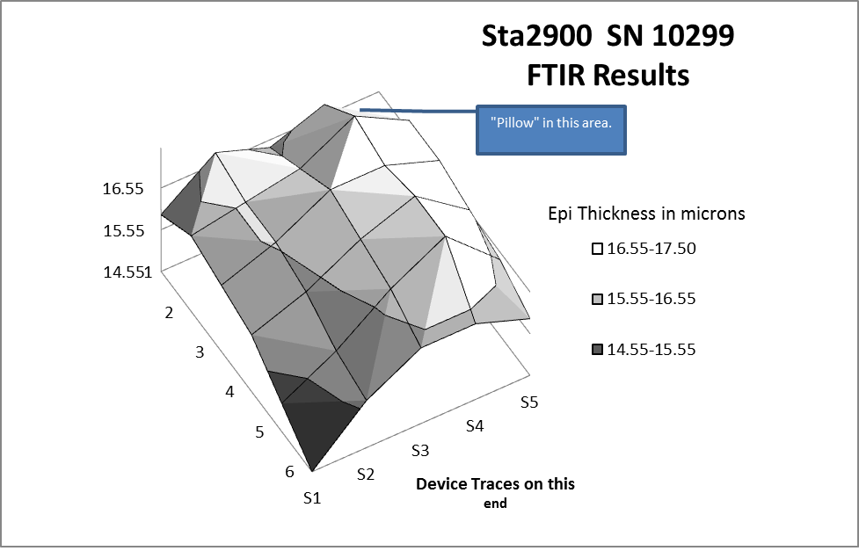

Epitaxial Acid Etch
Second etch of epitaxial material to clear all
p⁺ residual
Tailor device thickness for MTF optimization
Excessive etching decreases yield and
increases cosmetic problems
Removes surface stains generated during
selective etch
KMnO₄ based
acid solution

Slide 39

Bulk Silicon Etching
Bulk (non-epitaxial) high resistivity silicon is used for some detectors
Improved MTF with thick devices (100-300 μm)
  5k – 10k Ω-cm silicon is typical
No epitaxial “etch stop” so 1:3:8 acid mixture
does not work
Timed etch used with thickness measurements
  Hf:HNO₃ mixtures
FTIR microscope for
thickness measurements

Slide 40



Acid Protection
Die/wafer edges and support substrate must be protected from etching
Wax is used as an acid resist
as other materials do not
survive chemistry
waxed stencils
automated wax jetter
manual
waxing

Slide 41




Custom Backside Processing
10k CCD no shutter for Antarctica
thick region
thin region
Non-thinned frame store regions for improved high speed clocking
custom space applications

Slide 42
Backside QE Enhancement Physics
Several techniques are used to produce
high QE with backside devices
Surface Charging techniques
  Chemisorption Charging (ITL)
  Flash gates (high work function materials) and
  UV flooding (Janesick/JPL)
Internal Charging techniques
  Implant and anneal (most common commercially)
  Delta Doping (MBE) (JPL)

Slide 43
Backside Illumination Potentials
SiO₂
p-Si
frontside
gate
hν
e⁻
e⁻
backside
well
n-buried
channel
native positive charge

Slide 44
Surface Charging
SiO₂
p-Si
frontside
gate
-
-
-
hν
e⁻
-
e⁻
-
backside
well
n-buried
channel
native positive charge
-
desired negative charge

Slide 45
Internal Charging – most common
SiO₂
p-Si
frontside
gate
-
-
-
hν
e⁻
-
e⁻
-
SiO₂
not required
backside
well
n-buried
channel
native positive charge
-
desired implant

Slide 46



Chemisorption Charging
oxidation
chamber
ITL’s Chemisorption Coating for enhanced QE
Oxidize backside of thinned CCD to reduce
interface trap density
Apply thin metal film to promote negative
backside charge by Chemisorption (Ag)
Apply antireflection coating optimized
for application
thin films coating chamber

Slide 47
QE Stability Critical
QE stability should be tested for all backside processes
QE vs. time, environment, and temperature

Slide 48
Antireflection Coatings
Optimize QE for application
Broadband applications require multiple layers
UV difficult as need high index,
low absorbing materials
Some common AR materials are radioactive
(avoid thorium)
Common silicon BSI AR materials
  HfO₂, MgF₂, SiO, SiO₂, Ta₂O₅
Use thin films design program as indices change rapidly in blue/UV

Slide 49

Ideal QE with AR Coatings
50 μm silicon
1 layer
HfO₂
2 layer
HfO₂+MgF₂
uncoated

Slide 50
Measured Visible QE

Slide 51


Detector Packaging
Commercial packages
  usually not flat (~100 µm)
  not buttable
  ~$50 (Kovar, Al₂O₃)
Custom ceramic, invar, molybdenum,
aluminum nitride
  very flat (<5 µm peak-valley)
  more stable with temperature
  better thermal transfer
  $500 - $5,000

Slide 52


Detector Packaging
structures under
CCD may appear
when imaging
400 nm
epoxy void
900 nm
fringing
frontside metal areas
traces under CCD

Slide 53

Ultra Flat Packaging
Static dissipating ceramic vacuum chuck holds CCD on upper stage
Polished to ~1 um
on both chucks
~5 um tolerance
from part to part
No adjustments
in focal plane assembly
Packaging jig for SNAP, ODI, Pan-STARRS
Flattest devices ±2.5 µm @ -100 C

Slide 54



Custom BSI Packaging
Customer required backside pinout to match an existing frontside pinout
(Kodak KAF-16801E 4kx4k CCD)
Multilayer aluminum nitride packages to swap signals underneath detector
CCD
top
bottom

Slide 55



Buttable Imager Example
AlN
CE5 frame
packaged CCD
indium bumps
top
bottom
package for WIYN One Degree Imager 64 CCD focal plane mosaic

Slide 56

Detector Flatness
Flatness at operating temperature is critical for
many scientific applications
Stress reduction in processing and packaging processes are critical to achieve < 20 um flatness
WIYN ODI SN8105
Internal stresses in wafer affect device flatness (-100 C)

Slide 57

VIEW Summit 600 CMM
WIYN ODI
SiC focal plane
baseplate
Coordinate Measuring Machine in ESD safe clean room
with 18”x24” measuring area, 2-3 μm accuracy

Slide 58



MicroMeasure 3D Profilometry
300 mm XY travel
non-contact
10 nm accuracy possible
24 mm max work. dist.
referenced to optical flat
Optical pens (interchangeable) use white
light chromatic aberration technique

Slide 59


CryoScanner for Low Temperature
ITL built scanning system measures flatness while detectors operate cold
+25 to -150 C
CryoScanner on isolation frame
optical pen is down looking into dewar
view through
dewar window

Slide 60

Back Illuminated CMOS
Early ITL CMOS thinning was 1998
Early devices used very thin epi, difficult to
back illuminate without damage and
latch-up issues
Typical “CCD silicon” can be used for CMOS devices which may be back illuminated without
serious issues
QE is similar to backside CCDs
backside CMOS
imager

Slide 61
BI CMOS – Sarnoff/ITL
on going QE enhancements
low noise backside CMOS
data from Jim Janesick/Sarnoff

Slide 62





Detector Characterization

Slide 63
QE Characterization
Calibrated photodiode at detector location
Photo feedback power supply
Monochrometer (Oriel 257)
Dual filter wheels
  order blocking filters
  quartz ND filters
Integrating sphere and baffled tube
Custom UDT photodiodes
  613 mm², UV enhanced

Slide 64

Optical Bench One
dedicated to
uniform illumination
imaging
light sources
dewar on cart
integrating sphere
baffled tube

Slide 65
Photodiode Calibration Change
yearly calibration performed (by manufacturer – UDT)

Slide 66

UV QE Characterization
D₂ source
3 filter wheels
UV integrating cube
photodiode

Slide 67
UV QE

Slide 68
Summary
Backside detector processing technologies are well established and well characterized
Many scientific applications require backside devices for enhanced QE and spectral coverage
Project often have custom, cutting edge
detector requirements which lead to
interesting advancements
Backside CMOS processing is developing along similar path as backside CCDs and will continue to expand as enhanced CMOS imagers are fabricated
Thank you!

