Slide 1
THE DETECTOR
Donald Figer
Rochester Institute of Technology
Center for Detectors

Slide 2
Cancer is the leading cause of death worldwide.

Slide 3
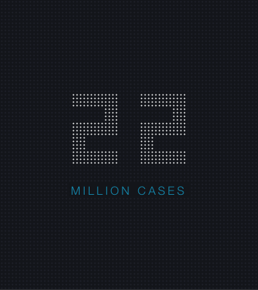
Cases are expected to increase by 70% to more than 22 million people in the next two decades.
Statistic according to World Health Organization

Slide 4
How can we beat cancer? With early detection.

Slide 5
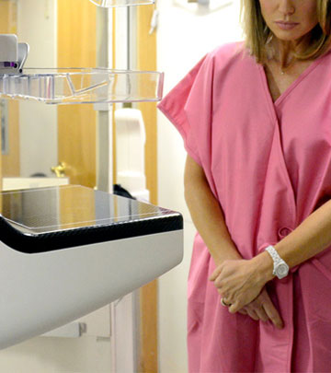
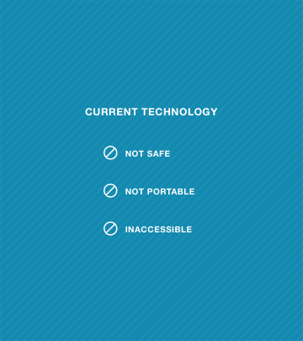
Photo of ABC News Anchor Amy Robach’s 2013 televised breast cancer scan courtesy of ABC

Slide 6
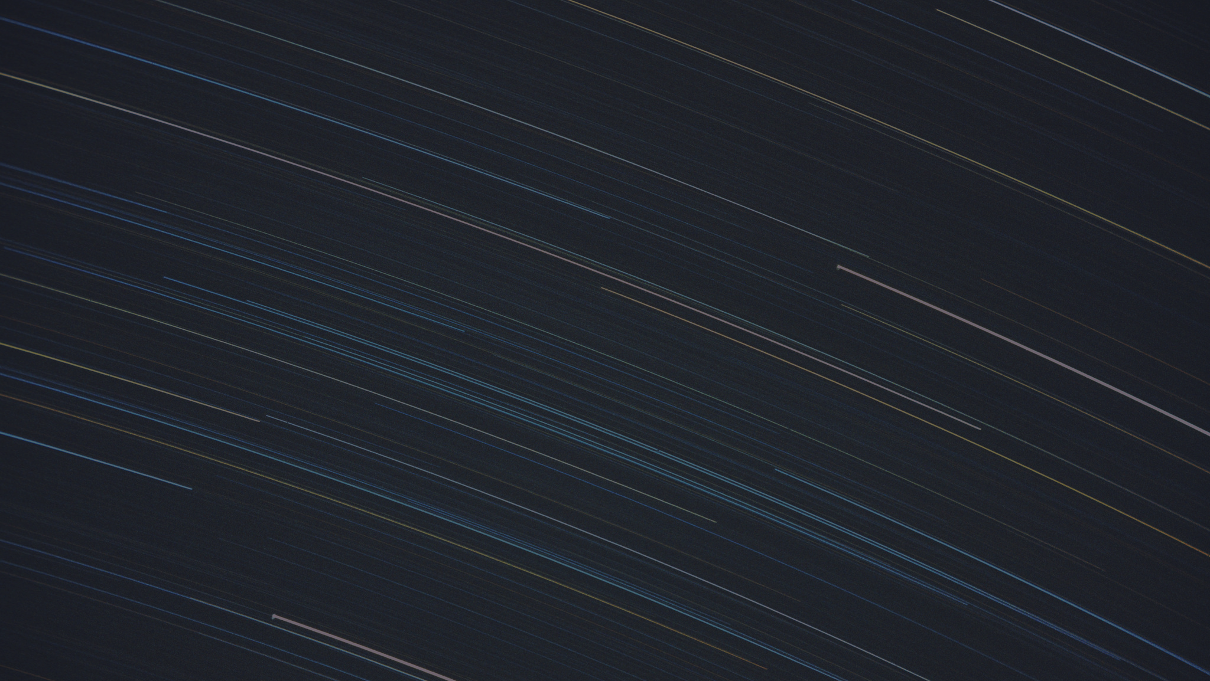
Let’s use a simple, hand-held scanning device
that uses safe visible light to probe the breast.
Photo courtesy of Ian Abbott/Star Trails, September 1980

Slide 7
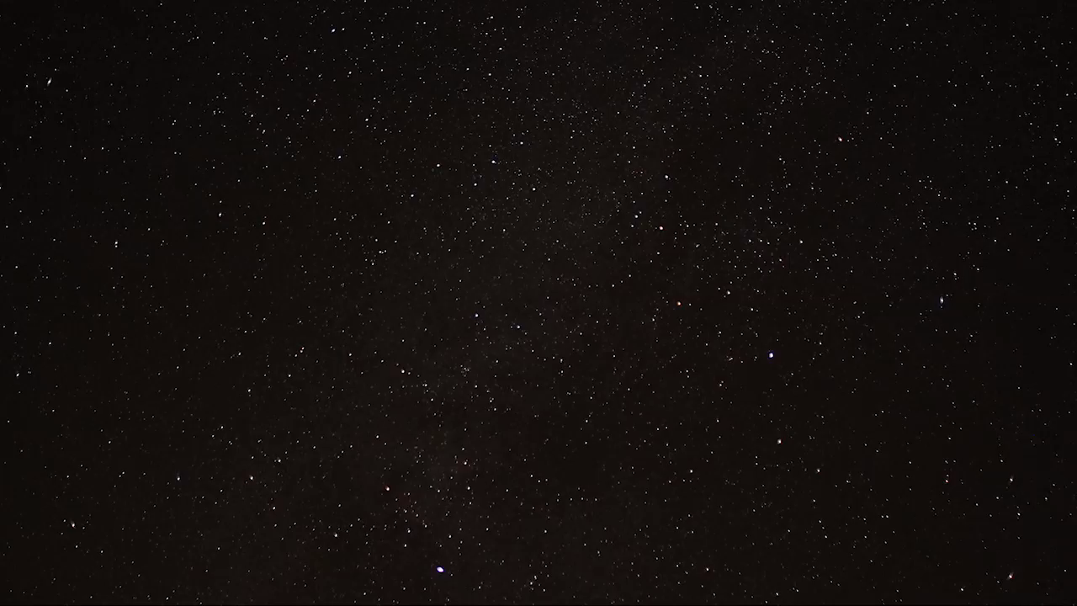

Slide 8
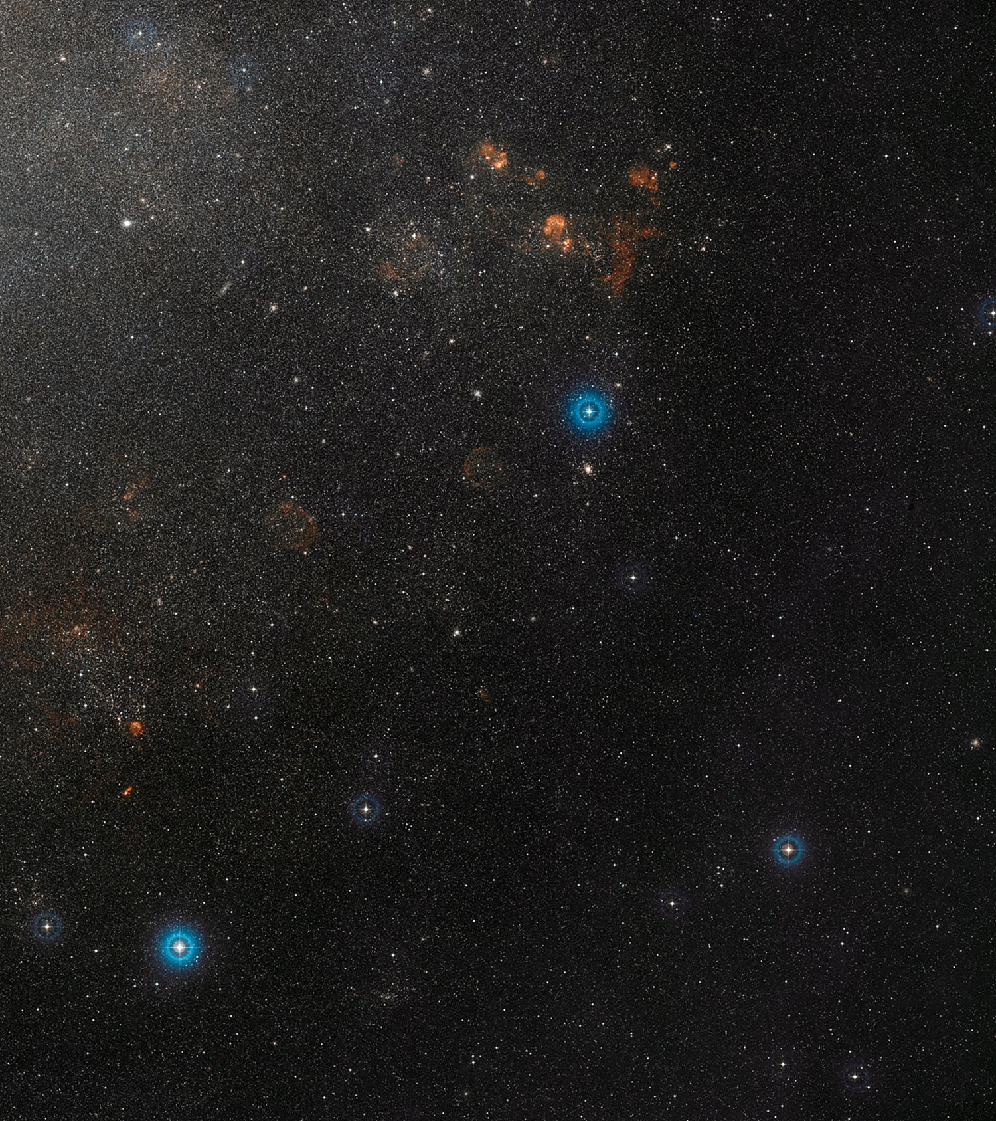
Childhood dreams turned into research that measured the distance to pulsating variable stars, and more.
On right: Wide field view of the Large Magellanic Cloud courtesy of ESO (European Southern Observatory)

Slide 9
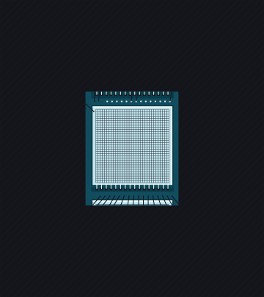
THE DETECTOR
is critical to discovery

Slide 10
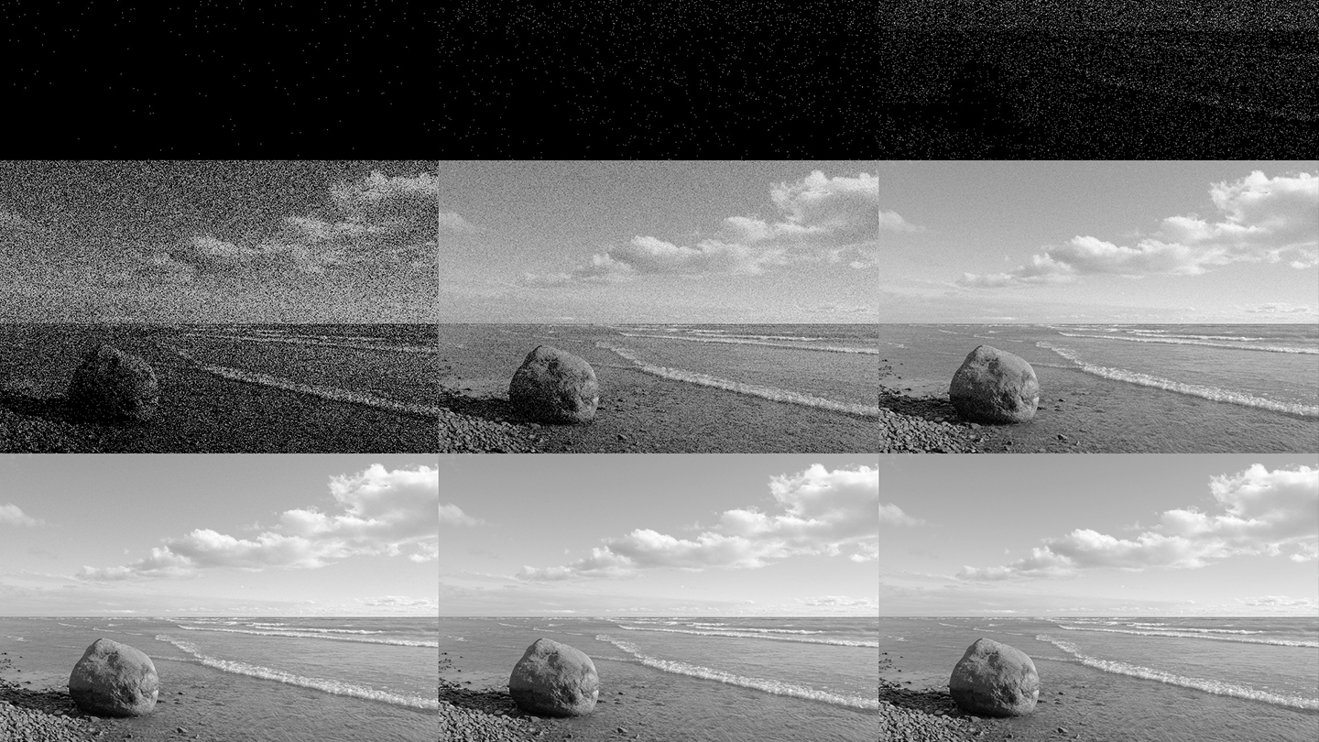
Photo courtesy of Eric Bajart, displaying a photon noise simulation

Slide 11
We know how to tackle these challenges.

Slide 12
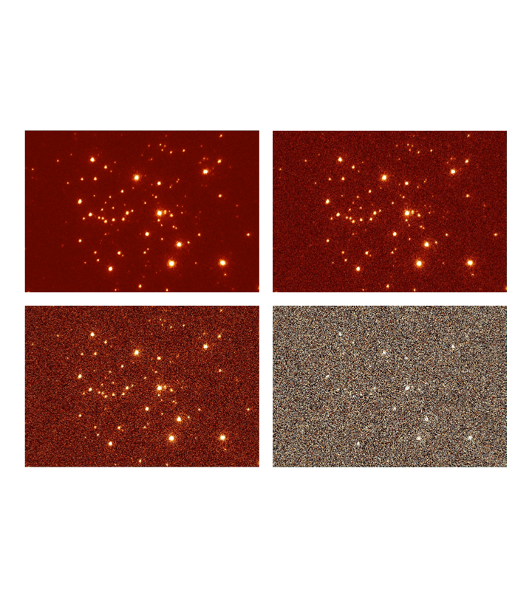
The development of the zero read noise detector is essential for our discoveries to be made.
On right: Images of the Arches cluster near the Galactic center, obtained with Keck/LGSAO. Each image has synthetic shot noise and increasing read noise (left and right, top to bottom: 0, 5, 10, 100 electrons)

Slide 13
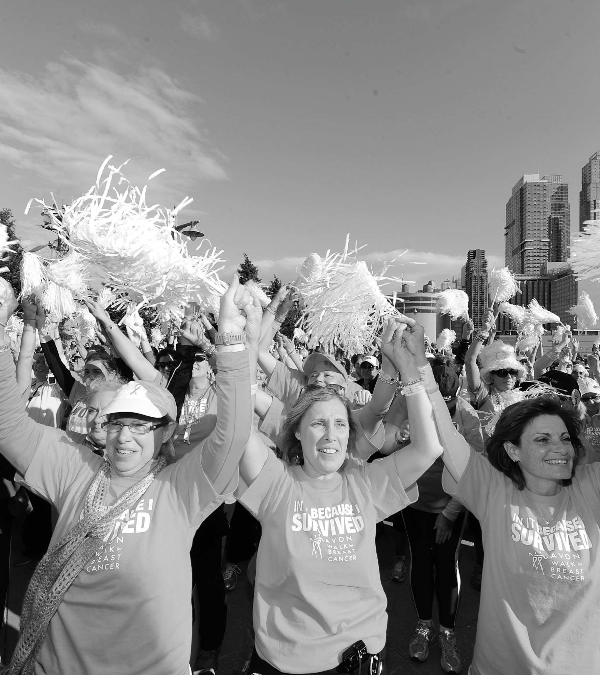
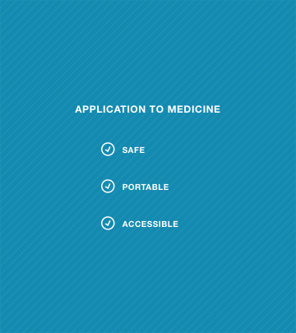
Photograph courtesy of Dimitrios Kambouris/Getty Images for Avon

Slide 15
OTHER APPLICATIONS

Slide 16
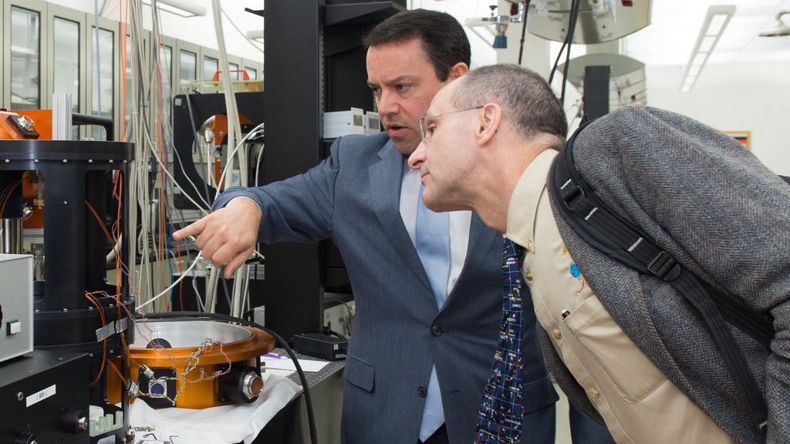
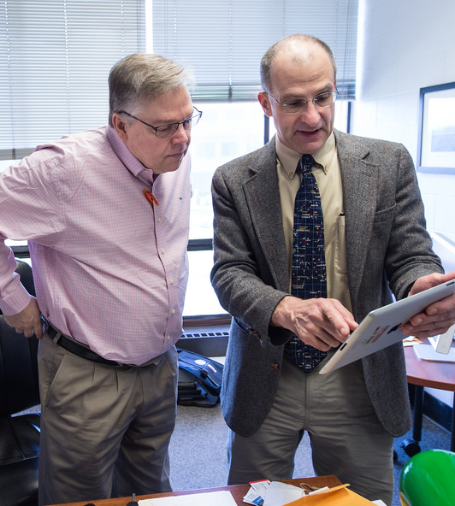
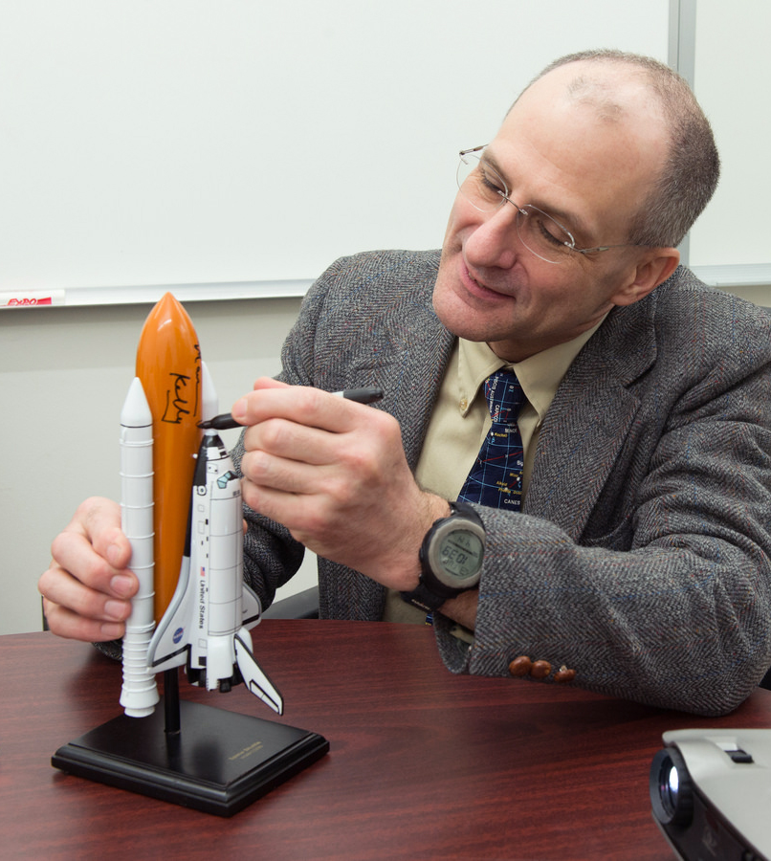
NASA Astronaut Donald Pettit toured RIT’s campus and the Center for Detectors, collaborating with students on a challenge proposed by the International Space Station.
On right: Image series courtesy of RIT alumnus Peter A. Blacksberg ’75 of the Photography Department

Slide 17
In order to lead the efforts in developing this technology, we need your help.

Slide 18
Questions?

Slide 19
Thank You
Donald Figer
Rochester Institute of Technology
Center for Detectors

