Slide 1
HgCdTe Infrared Imaging Focal Plane Arrays
Today’s King of the Hill for
Single and Dual Band Sensors
Jim Bangs
Raytheon Vision Systems
4 June, 2012
Detector Virtual Workshop
Center for Detectors at the Rochester Institute of Technology

Slide 2
Outline
Infrared FPA Figures of Merit
Performance capabilities of HgCdTe (review open literature info)
  Single color
    HgCdTe/CdZnTe
    HgCdTe/Si
  Dual band
Future Directions
Notes:
Abstract:
For applications demanding focal plane arrays with the best possible infrared sensitivity in the visible through 14µm wavelength regimes, HgCdTe detectors have unsurpassed performance and technology and manufacturing maturity (TRL & MRL) and likely to retain this leadership for at least the next 10 years. This talk will review infrared focal plane array figures of merit, detector technology considerations that factor into designing a detector array for a given application, state of the art performance capabilities of HgCdTe for single and dual band detector arrays and future directions for HgCdTe as well as other infrared imaging focal plane arrays.

Slide 3

Definition: King of the Hill
Web definitions: King of the Hill is an American animated
series created by Mike Judge and Greg Daniels that
ran from Jan 1997, to May 2010, on Fox network
  en.wikipedia.org/wiki/King_of_the_Hill
From Dictionary.com: king of the hill
noun
1. a game in which each player attempts to climb to
the top of some point, as a mound of earth, and to
prevent all others from pushing or pulling him or her off the top.
2. an undisputed leader or champion.
For EO/IR systems demanding a near perfect detector (high QE across full spectral range of interest with noise dominated by nature’s limit)-
HgCdTe remains the undisputed detector performance leader

Slide 4
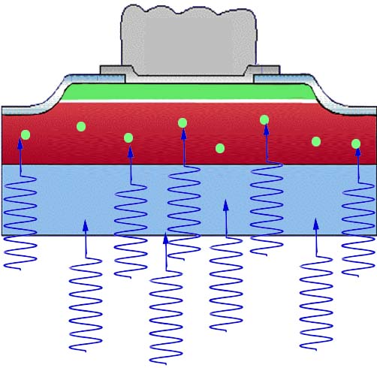
Photo-voltaic FPA photon detection Process
I_{det}
ROIC outputs Voltage proportional to number of electrons collected from detector
N_{ph} = A_{opt}*QE*Q_{b}* Tint-
    AKA “Signal”
ROIC
V_{out}=Z*N_{e-}
Z=(V_{sat}-V_{starve})/N_{Max}
N_{e-}=Nph_{e-} + Ndark_{e-}
Hybrid Interconnect
Detector
Transparent substrate (E_{g}>E_{ph})
Incident photons
Photons with energy greater than detector “Bandgap” generate photo-excited minority carriers in the absorber layer
Minority carriers arise from sources other than photo generation
User wants to know how many photons hit a given pixel and detector’s “Sensitivity” capability

Slide 5
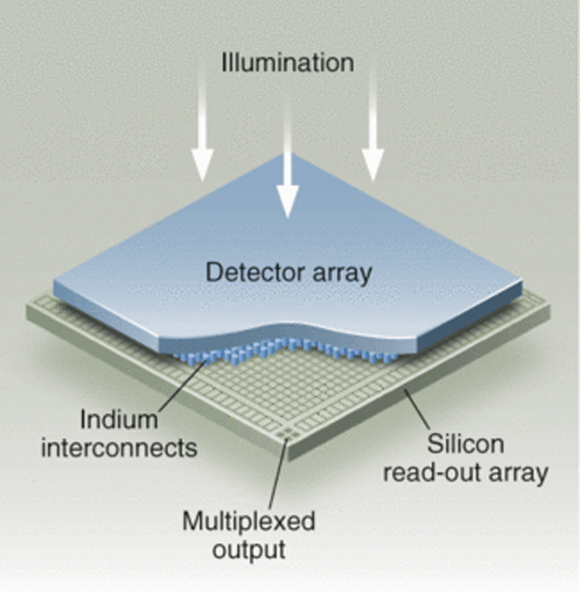
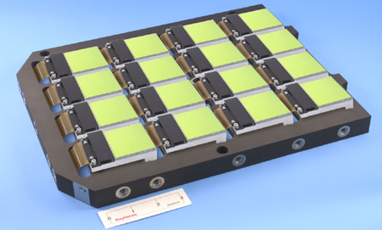
Definition – Focal Plane Array (aka Sensor Chip Assembly)
3 components to SCA
  Detector array
    Array of detector pixels to collect photons across image plane
  Readout Integrated Circuit
    Hold detector bias, Collect and integrate charge at pixel level, and multiplex signal out to system electronics
  Hybrid Interconnect
    Holds detector to ROIC and conducts electrons from detector to ROIC
In the system- the Focal Plane Array is located at the image
focus point
  An FPA may consist of multiple
  SCAs
From: images.pennnet.com-articles-lfw-thm.jpg

Slide 6
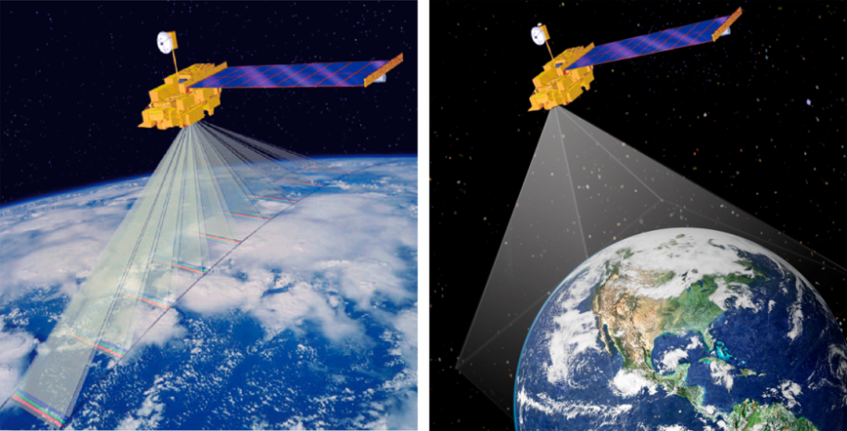
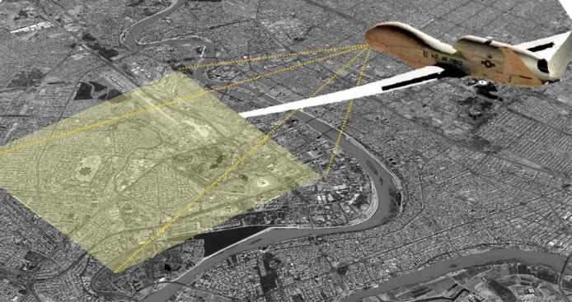
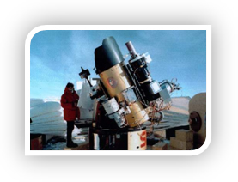
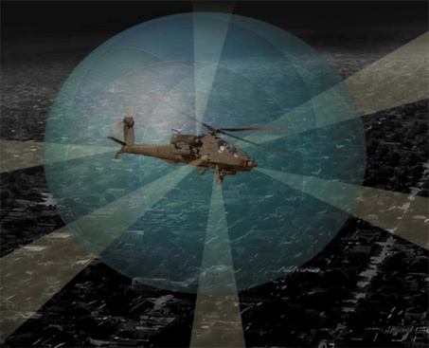
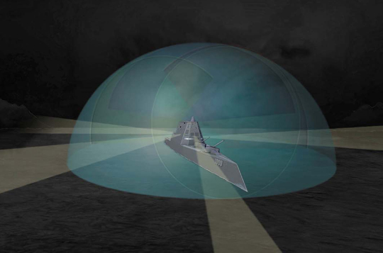
Large Format IR FPAs Enable Enhanced Mission Utility
Large Format FPAs enable high resolution wide FOV Persistent Surveillance
  Wide Area Persistent Surveillance
  Distributed Aperture Systems
  Infrared Astronomy

Slide 7

Definition of Terms- Perfect Detector
A “Perfect” photon detector will generate 1 electron per incident photon
  This detector’s “quantum efficiency” (QE) would be 100% across the spectral band of interest
A Perfect detector also contributes no noise to signal.
  Not possible- but useful to determine theoretical best performance
Incident Photon
100% Transmission
& Collection
Perfect Detector
Spectral
Band of Interest
QE for Perfect Detector 100% Across Spectral band of interest
100%
QE
Wavelength (µm)

Slide 8
Simplified ROIC Calculations
ROIC required to convert photo-generated electrons to useful signal
ROIC Collects detector signal for specified period of time, Tint
  Both photo generated & detector dark current, N_{e-} electrons
ROIC Outputs over a range from Starvation (Vstarve), no electrons to Saturation (Vsat) representing N_{Max} Electrons
Transimpedance, Z with units V/electron is the incremental change in output voltage
Z=(V_{sat}-V_{starve})/N_{Max}
V_{out}=Z*N_{e-}
ROIC noise is a fixed term, independent of Tint
  N_{noise_ROIC}
I_{det}
ROIC
Detector

Slide 9
The Scene Background Irradiance and it’s Noise
Mother Nature’s Brick Wall
Background Irradiance
Q_{bkg} background irradiance is defined at first optical surface of detector
  Units ph/(cm²-s)
There is a characteristic noise associated with the background irradiance due to randomness in photon emission from the background
The dominant background irradiance can originate from background scene temp and/or optics
Background Limited detector Performance (BLIP) describes an operating condition where the noise is dominated by photon noise, and is absolute best that can be built.
  All other noise mechanisms are negligible (detector, ROIC, electronics)
Detector
n_{det}
For Noise due solely to background irradiance in terms of electrons:
Tint=integration time
Aopt=detector optical collection area
QE= detector Quantum Efficiency

Slide 10
One Key SCA Figure of Merit: Responsivity
Responsivity= change in output/change in scene input
V_{out}=Z*N_{e-}
I_{det}
ROIC
Volts
Ph/cm²*s
Detector
n_{det}
Responsivity- Bigger is better
Determine optimum Tint for system (motion jitter, smearing, etc)
Optimize Z by ROIC design
  Tradeoff with bucket size, which limits Tint
Only Detector Factors are QE and Optical Area

Slide 11
Sensitivity is the Most Significant Pixel Level Figure of Merit
Calculated from Noise and Responsivity
NEQ=Noise Equivalent Irradiance is most useful figure of merit for photon detectors
Units ph/(cm²-s) aka “Flux”
Lower is better
RSS Noise Terms Together
Nnoise_Ph = Scene Noise
Nnoise_ROIC= Read Noise from ROIC
Nnoise_Det= Detector dark noise
May need to consider 1/f noise and electronics noise that reads signal from ROIC
For photon dominated sensor (AKA BLIP)
NEdT=Noise Equivalent Temperature Difference is another common Figure of Merit
Kelvins
dQ/dT is scene dependent

Slide 12
Case Examples:
Photons Collected from Unresolved Target vs Distance
Emission from Star Emission from human
noise limits range with terrestial background
Assume no loss in distance from star to detector and no background noise
Background noise is constant-

Slide 13
NEQ Sensitivity to RoA, Read Noise, & QE
Examine case 78K det, Vary N_{noise_Read}, Detector RoA (N_{noise_det})
  RoA is detector figure of merit- zero bias impedance*Area product
  Relate Jdark= k*T/RoA
  N_{noise_Det}=Sqrt(Jdark*Aopt*Tint/q)
Photon Limited
Photon Limited
Photon Limited
Vary Det RoA
Vary Read Noise N_{noise-Read}
Vary QE

Slide 14
Why HgCdTe

Slide 15
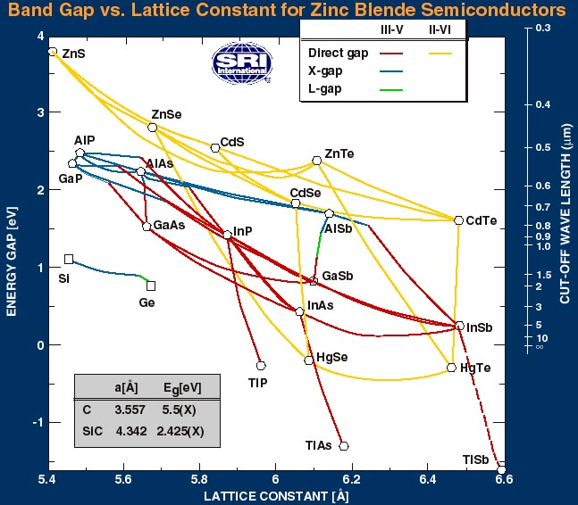
Why HgCdTe
Varying stoichiometric ratios of Cd/Hg (x), bandgap can be varied from 1.4eV for CdTe down to semi-metal for HgTe,
  Eg remains direct bandgap over entire range
  Little variation in lattice constant
SCA Manufacturing commonality
  Detector wafer growth machines
    Same MBE for single & dual color & all cutoffs
  Array fabrication processes
    Similar processes
  Hybrid assembly processes
Best producible Sensitivity for high operability SCAs
  Near 100% QE (with Anti-reflection (AR) coating)
  Lowest dark current and noise for any infrared detector material used to fabricate
From SRI International Website www.sri.com
“Achieving Manufacturing Readiness for 6-Inch HgCdTe on Silicon “, L Paden et al, Journal of Electronic Materials, Volume 39, Number 7 (2010),
2007 “MBE Growth of HgCdTe on Large-Area Si and CdZnTe Wafers for SWIR, MWIR and LWIR Detection”, M. Reddy, et al, Journ Elect Mtrl, Vol 37, No 9, 2008
2007 “MBE Growth of HgCdTe on Large-Area Si and CdZnTe Wafers for SWIR, MWIR and LWIR Detection”, M. Reddy, et al, Journ Elect Mtrl, Vol 37, No 9, 2008

Slide 16
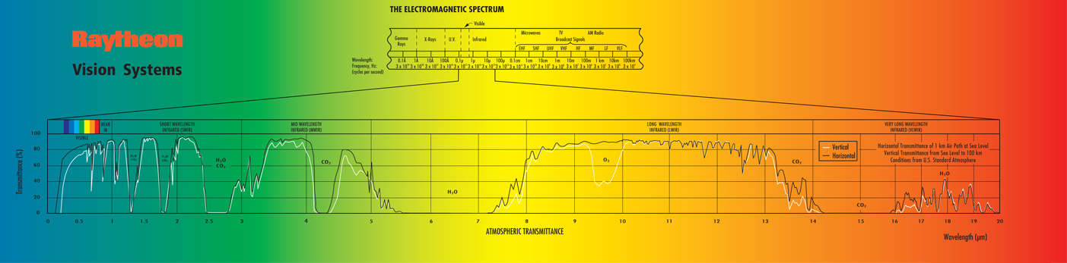
HgCdTe Covers Key Spectral Windows in Atmospheric Transmission
Infrared Windows in the Atmosphere
Downloaded from http://coolcosmos.ipac.caltech.edu/cosmic_classroom/ ir_tutorial/irwindows.html
Wavelength Range | Band | Sky Transparency | Sky Brightness
1.1 - 1.4 microns | J | high | low at night
1.5 - 1.8 microns | H | high | very low
2.0 - 2.4 microns | K | high | very low
3.0 - 4.0 microns | L | 3.0 - 3.5 microns: fair 3.5 - 4.0 microns: high | low
4.6 - 5.0 microns | M | low | high
7.5 - 14.5 microns | N | 8 - 9 microns and 10 -12 microns: fair others: low | very high
17 - 40 microns | 17 - 25 microns: Q 28 - 40 microns: Z | very low | very high
330 - 370 microns |  | very low | low
HgCdTe Capability

Slide 17
HgCdTe Performance and
Detector Architecture

Slide 18
RVS Single Color p-on-n HgCdTe Detector Structure
RVS grown lattice matched CdZnTe substrate
n-type absorber and p-type cap are grown by Liquid Phase Epitaxy (LPE) or Molecular Beam Epitaxy (MBE)
  LPE growth requires CdZnTe substrate but allows meltback of surface layer for extremely low defect densities
  MBE growth on CdZnTe or Si substrate
  Layers grown with wider bandgap cap for heterojunction dark current suppression **
Delineate individual pixels with mesa etch through p-n junction
  Provides 100% Optical Fill Factor
  Low Crosstalk
  High QE across spectral band
P-type HgCdTe Cap Layer
n-type HgCdTe IR absorber Layer
Transparent
Substrate
P-type Cap
n-type absorber
Substrate
SEM
of mesa
delineated
pixels
“Current voltage modeling of current limiting mechanisms in HgCdTe focal plane array photodetectors”, Angelo Scotty Gilmore et al, Journal of Electronic Materials Vol 34, # 6 (2005), 913-921
*DLHJ described in1992 SPIE paper “State of the art of Hg-melt LPE HgCdTe at Santa Barbara Research Center” by Tse Tung et al, Proc. SPIE Vol. 1735, p. 109-134, Infrared Detectors: State of the Art, Wagih H. Makky; Ed.

Slide 19
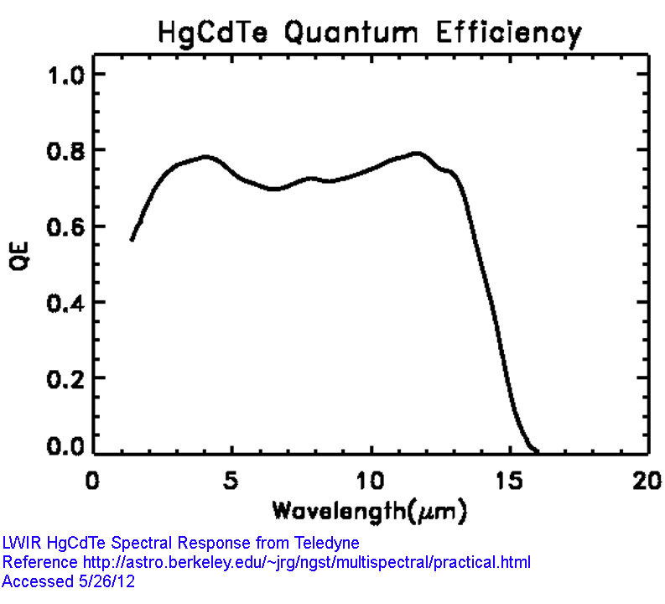
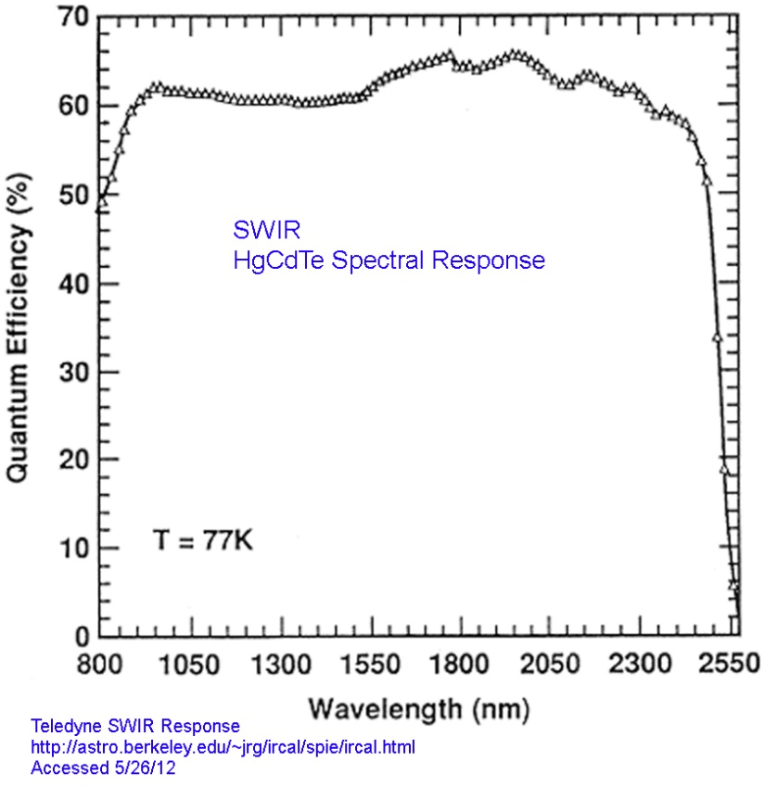
HgCdTe has high QE across spectral band
Excellent Spectral Response
  High QE across spectral band
VLWIR Rel. Response
1
543972 V7
0.8
0.6
Relative Response per Photon
0.4
78K 15.6 um cutoff
0.2
40K 18.7 um cutoff
0
4
6
8
10
12
14
16
18
20
Wavelength (µm)
“Current voltage modeling of current limiting mechanisms in HgCdTe focal plane array photodetectors”, Angelo Scotty Gilmore et al, Journal of Electronic Materials Vol 34, # 6 (2005), 913-921, DOI: 10.1007/s11664-005-0042-4

Slide 20
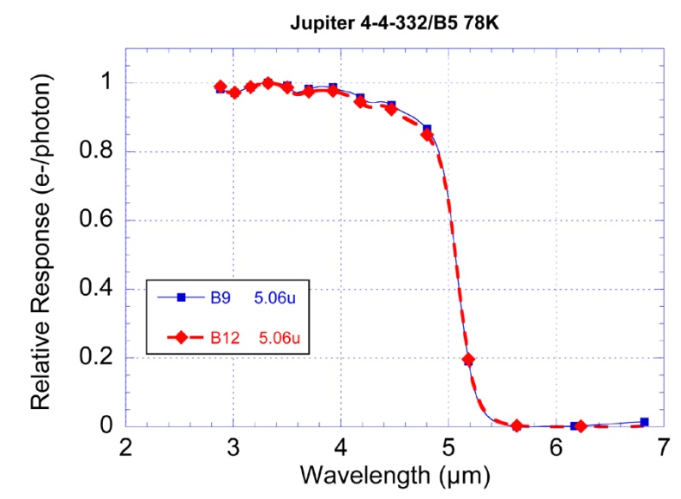
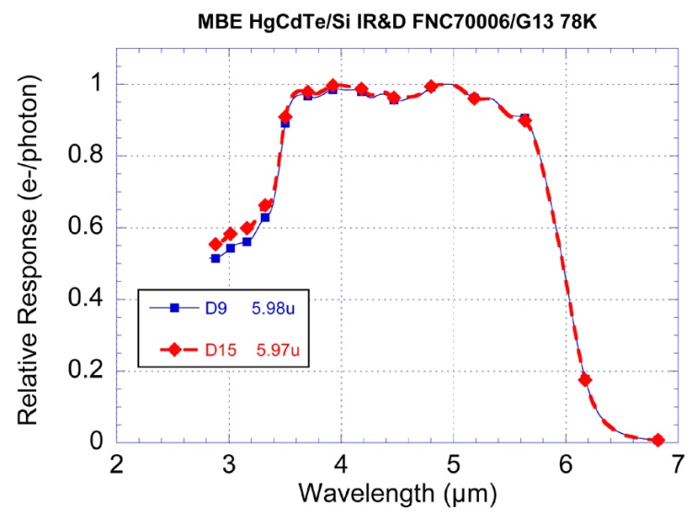
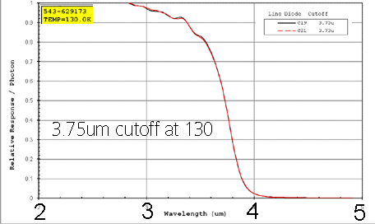
Flexible Spectral Tuning via adjustment of Cd composition during HgCdTe layer growth
SPIE DSS 2011
5.06µm Cutoff at 78K
3.7µm Cutoff at 130K
6.0µm Cutoff at 78K
Easily tuned cutoff with detectors processed in common line
Excellent QE Exemplified in 256×256 30µm pitch SCA data for single-color LWIR FPA.
Ref: HgCdTe focal plane arrays for dual-color mid- and long-wavelength infrared detection
by E P G Smith, et al Journal of Electronic Materials (2004)
Volume: 33, Issue: 6, Publisher: Springer, Pages: 509-516, ISSN: 03615235, DOI: 10.1007/s11664-004-0039-4

Slide 21
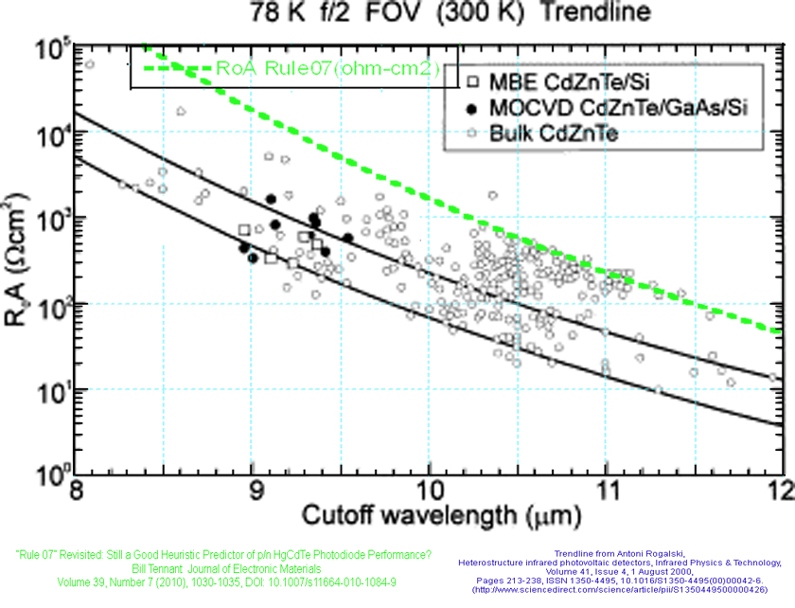
HgCdTe Trendlines- Adjust RoA by Varying Cd composition
RoA 78K Trendline from Rogalski Publications
  Similar performance various growth techniques
Bill Tennant’s “Rule 07” superimposed

Slide 22
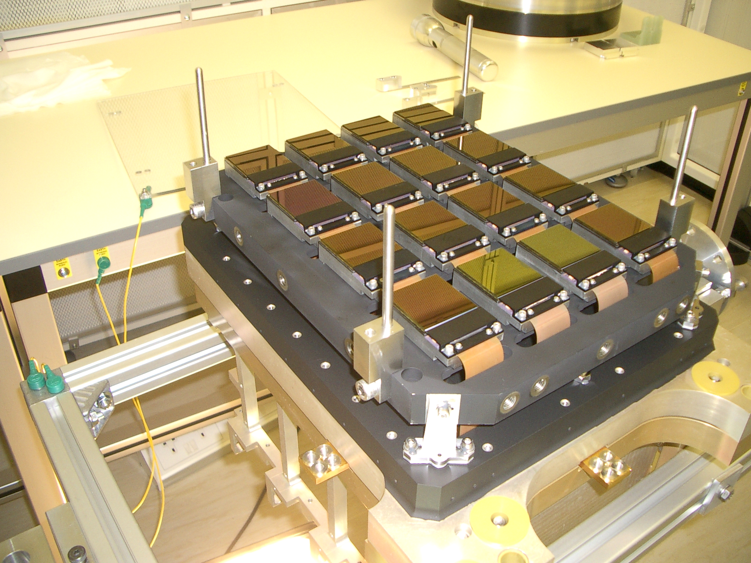
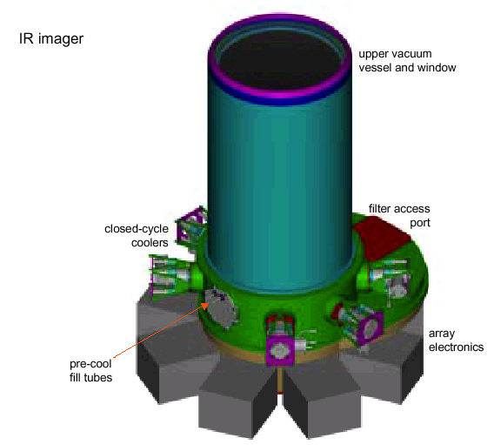
VISTA Focal Plane:
Sixteen 2k × 2k SWIR LPE HgCdTe Modules
Large Format SWIR FPAs for United Kingdom Astronomy Technology Centre (UK ATC)
4-meter telescope to survey southern sky from Cerro Paranal (Chile) at the European Southern Observatory (ESO)
Demanding FPA performance achieved
  High ~1-2.5μm QE (>70%)
  Low dark current (<1e⁻/sec at 77K)
  High operability (>99%)
2k × 2k 20µm unit-cell FPAs fabricated from
p-on-n DLHJ LPE on CdZnTe wafers
Maturing MBE HgCdTe/Si technology will
result in increased capability for fabricating
large format astronomy FPAs
Largest IR focal plane – 16 2k × 2k FPAs (67million pixels)
12 µm focus accuracy over entire focal plane
Status of Two-Color and Large Format HgCdTe FPA Technology at Raytheon Vision Systems, EPG Smith et al, Proc. of SPIE Vol. 6127, 61271F, (2006) ·
Ground-based Astronomy

Slide 23
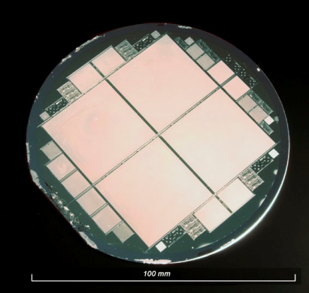
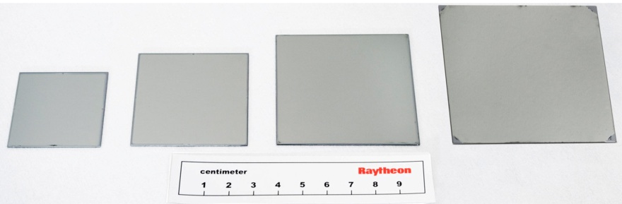
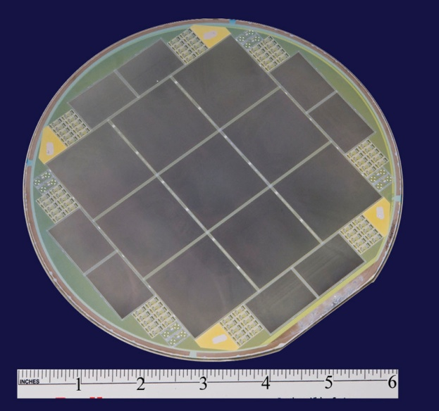
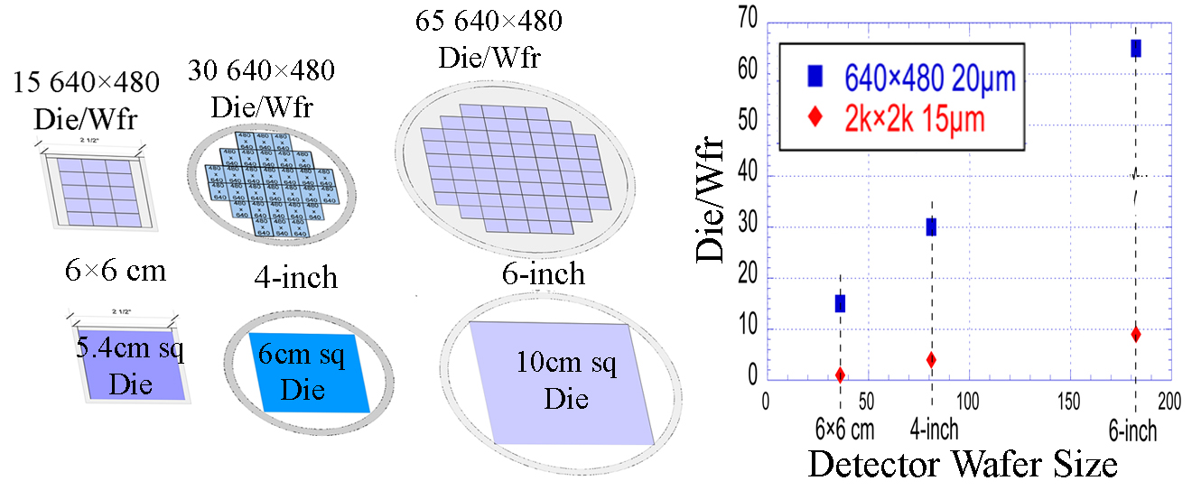
MBE Growth HgCdTe
Larger Wafers → Lower Cost or Bigger Detector Arrays
Available CdZnTe substrate sizes for MBE HgCdTe
50 x 50 mm
60 x 60 mm
70 x 70 mm
4-inch HgCdTe/Si
40 x 40 mm
Wafers drawn to scale
6-inch HgCdTe/Si
6-inch HgCdTe/Si Has 5X the Printable Area as 6×6cm HgCdTe/CdZnTe
Largest wafer reported for any IR detector Technology

Slide 24
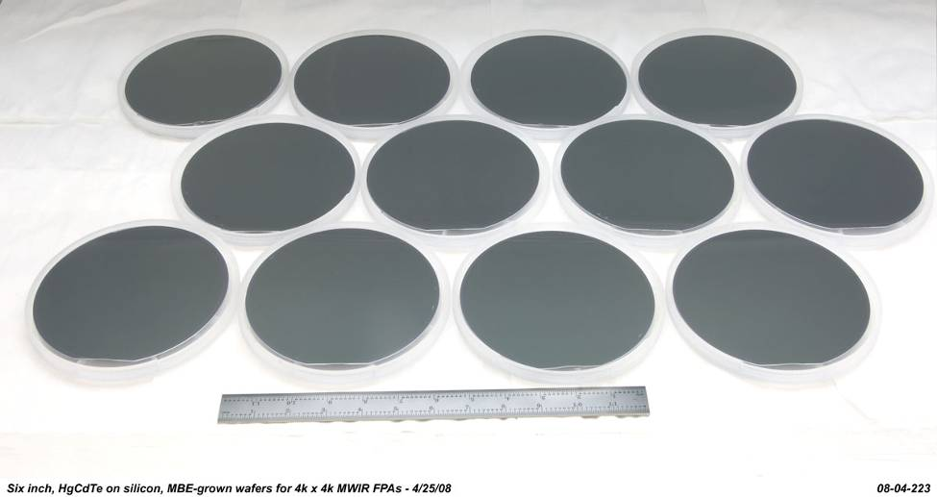
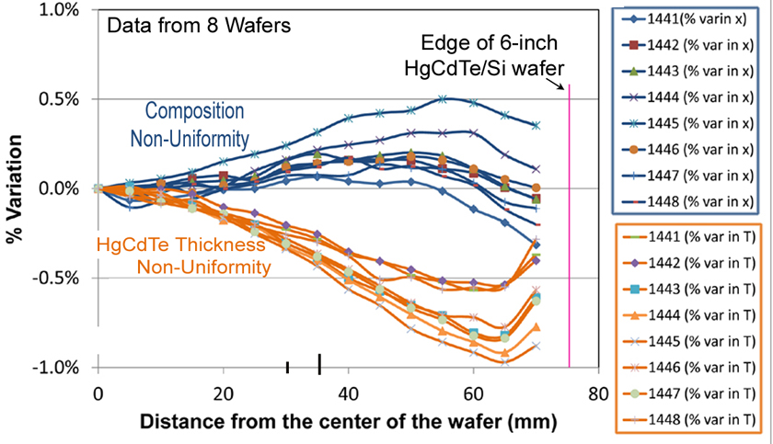
6-inch HgCdTe/Si in production at RVS
Repeatable Cutoff Wafer to Wafer
4.9µm Cutoff at 110K
SPIE DSS 8012-97
Notes:
Current TRL Capability:
Excellent spectral response
Uniformity across wafer (ADAS responsivity wafer map)
RoA Trend line, position of 6-inch MBE/Si on it
High quality diodes to larger area on 6-inch wafer

Slide 25
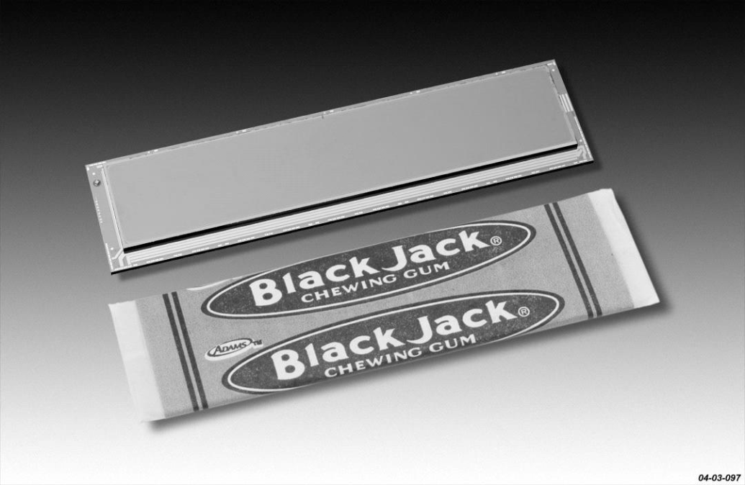
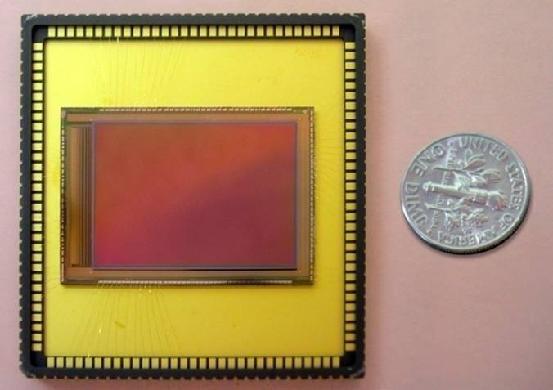
Overview RVS’ HgCdTe/Si SWIR and MWIR Focal Plane Array Developments
2001- 1024×1024 SWIR HgCdTe/Si
SPIE's 46th Annual Meeting and International Symposium on Optical Science and Technology
  “Large-format infrared arrays for future space and ground-based astronomy applications ”, P.J. Love, et al, RVS, Proc. SPIE Vol. 4486, 373 (2002).
2004- 2560×512 MWIR HgCdTe/Si
SPIE Defense, Security, and Sensing
  “Navy DAS FNC program overview: SBIRST for DD(X)” (Invited Paper), E. H. Takken, J. R. Waterman, R. Priest, Naval Research Lab. [5406-28]
  “Wide FOV FPAs for a shipboard distributed aperture system”, D. J. Gulbransen, et al, RVS; E. H. Takken, Naval Research Lab. [5406-29]
2010- 1536×1024 SWIR and MWIR on 6-inch HgCdTe/Si wafers
SPIE Defense, Security, and Sensing
  “Performance of MWIR and SWIR HgCdTe-based focal plane arrays at high operating temperatures”, Leon Melkonian; et al, RVS, SPIE Vol. 7660
2011- High operability 2k × 2k 15µm pitch MWIR
SPIE DSS
  “Large Format High Operability SWIR and MWIR Focal Plane Array Performance and Capabilities”, J Bangs et al, SPIE, Volume 8012, pp. 801234-801234-12 (2011)
1k×1k 27µm FPA
2560×512 25µm FPA
1.5×1k 15µm FPA

Slide 26
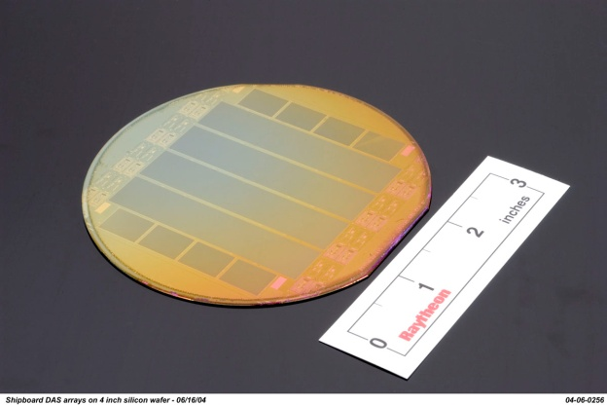
MBE HgCdTe/Si Performance
MWIR 2560x512, SWIR 2048×2048
Die Size 69.1 X 17.9mm
SWIR 2048x2048 20µm unit-cell
MWIR 2560x512 25µm unit-cell
Uniform large format FPA performance
Operability >99% (0.7*Mean<pixel<1.4*Mean)
Quantum efficiency > 60% with ARC
Comparable to SWIR LPE/CdZnTe
Increased fabrication of large format FPAs
Routine large wafer MBE growth
Proven fabrication procedures
Mega pixel FPA/ROIC hybridization
Quantum Efficiency (QE)
no AR coating
“Fabrication and Characterization of Small Unit-Cell Molecular Beam Epitaxy Grown HgCdTe-on-Si Mid-Wavelength Infrared Detectors” by E. P. G. Smith et al, Journal of Electronic Materials Volume 36, Number 8 (2007), 1045-1051

Slide 27
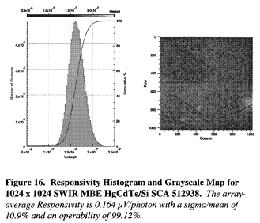
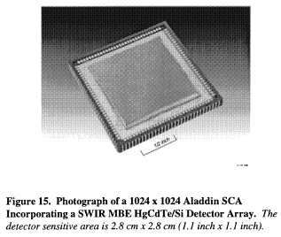
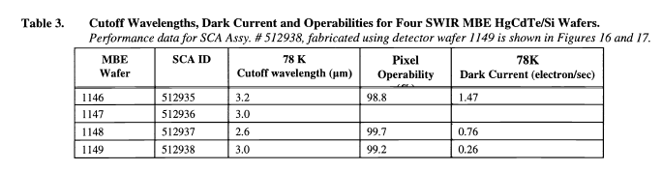
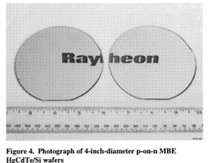
HgCdTe/Si SWIR Astronomy Arrays Demonstrated 2002
27µm Opt Area
SFD ROIC
Demonstrated low leakage current SWIR HgCdTe/Si
Large-Format Infrared Arrays for Future Space and Ground-Based Astronomy Applications, P.J. Love et al, Infrared Spaceborne Remote Sensing IX, Marija Strojnik, Bjørn F. Andresen, Editors, Proceedings of SPIE Vol. 4486 (2002) © 2002 SPIE · 0277-786X/02/

Slide 28
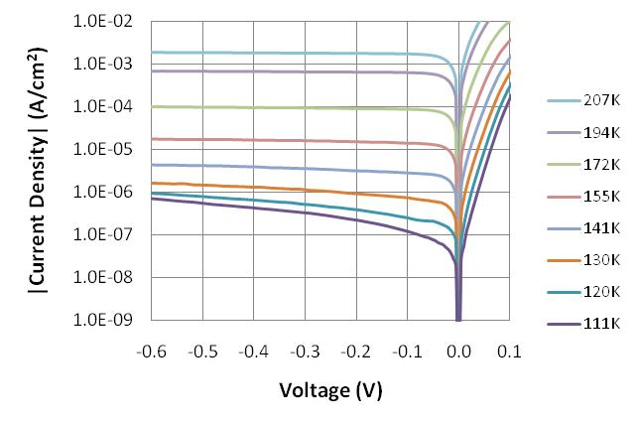
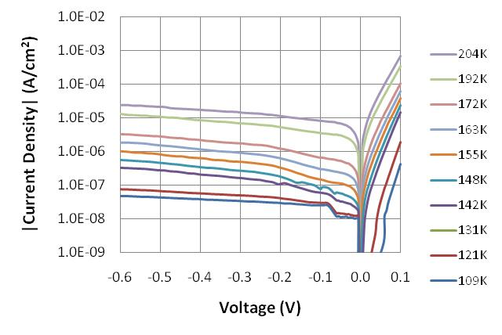
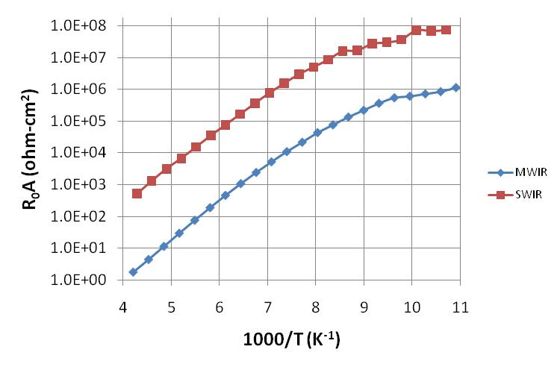
MWIR & SWIR HgCdTe/Si Exhibit excellent diode qualities
MWIR (4.8µm cutoff)
SWIR (3.7µm cutoff)
Breakdown voltage is greater than 600 mV, far higher than the bias at which these detectors are operated.
“Performance of MWIR and SWIR HgCdTe-based focal plane arrays at high operating temperatures”, Leon Melkonian; et al, RVS, SPIE Vol. 7660
Notes:
I-V curves were also generated on the detector test structures.
Here we show I-V curves for the two detectors taken at a wide range of temperatures, and also plots of R₀A vs temperature for the two detectors.
These HgCdTe detectors on Si substrates are showing excellent diode qualities.
The breakdown voltage is greater than 600 mV, far higher than the bias that these detectors are operated at.

Slide 29
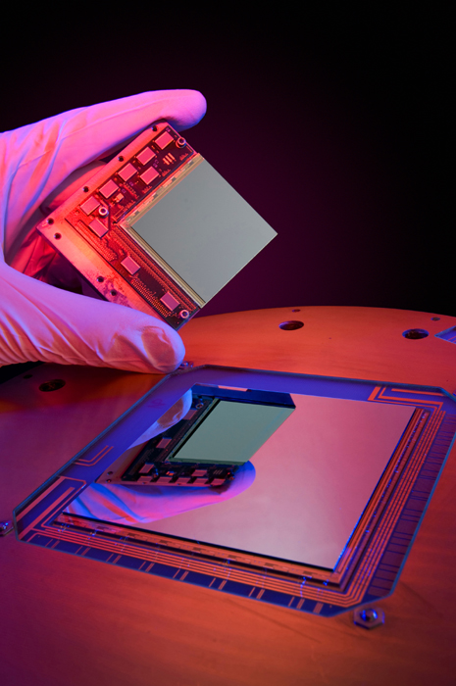
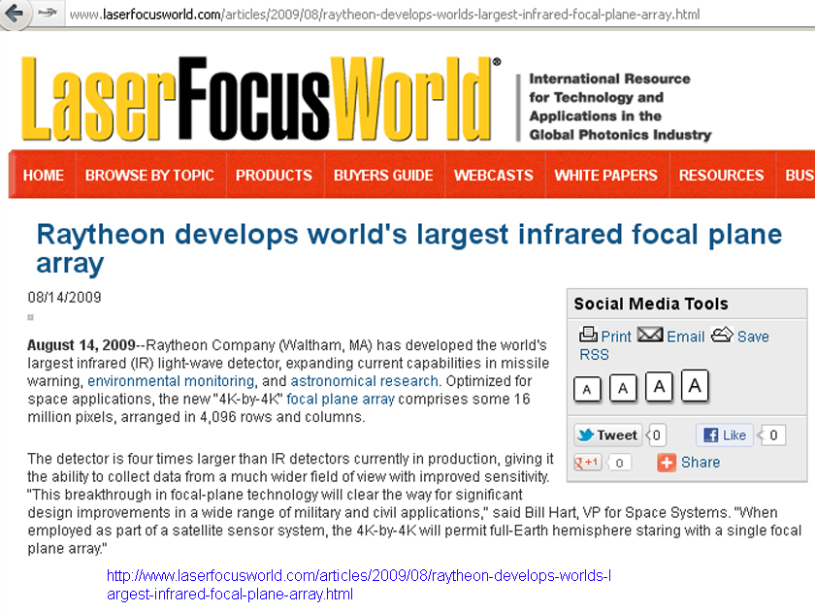
4k×4k 20µm pitch HgCdTe MWIR SCA Demonstrated in 2009
Leveraged 6-inch MWIR HgCdTe/Si wafer to fabricate world’s largest single piece infrared detector array

Slide 30
Ref: 2 HgCdTe focal plane arrays for dual-color mid- and long-wavelength infrared detection by E P G Smith, et al Journal of Electronic Materials (2004) Volume: 33, Issue: 6, Publisher: Springer, Pages: 509-516, ISSN: 03615235, DOI: 10.1007/s11664-004-0039-4
RVS Dual Band Detector Architecture
Pixel
Contact
  Band 1
  operating bias
  Band 2 operating
  bias
Band 2
n-type
Array
Common
Current (A)
p-type
Band 1
n-type
CdZnTe Substrate
Voltage (V)
Ref 2
MBE TLHJ Architecture
MWIR/LWIR 1280x720 20µm unit-cell
Spatially co-located dual band detection with stacked diode approach
Ref 1 “Fabrication and Characterization of Small Unit-Cell Molecular Beam Epitaxy Grown HgCdTe-on-Si Mid-Wavelength Infrared Detectors” by E. P. G. Smith et al, Journal of Electronic Materials, Volume 36, Number 8 (2007), 1045-1051, DOI: 10.1007/s11664-007-0169-6
Notes:
2

Slide 31
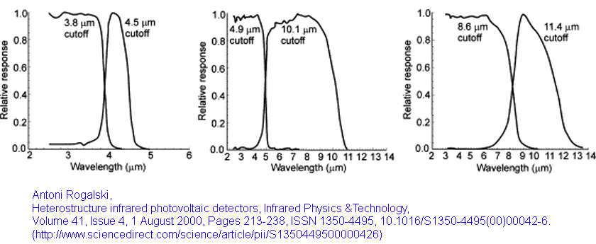
Dual Band HgCdTe Detectors Provide Similar Excellent Spectral Response as Single Color
Maintain excellent QE Spectral Response with flexibility to tune for mission

Slide 32
Dual Band MWIR/LWIR 1280×720
HgCdTe/CdZnTe Performance
MWIR/LWIR 1280x720 20µm unit-cell
LWIR
F/2.8, 50 mm EFL, 60 Hz
MWIR
Wide FOV and High Resolution Dual Band Imaging Realized
“Fabrication and Characterization of Small Unit-Cell Molecular Beam Epitaxy Grown HgCdTe-on-Si Mid-Wavelength Infrared Detectors” by E. P. G. Smith et al, Journal of Electronic Materials Volume 36, Number 8 (2007), 1045-1051, DOI: 10.1007/s11664-007-0169-6
Notes:
2

Slide 33


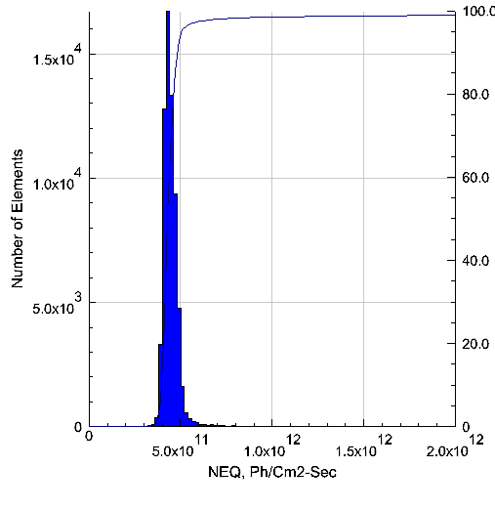
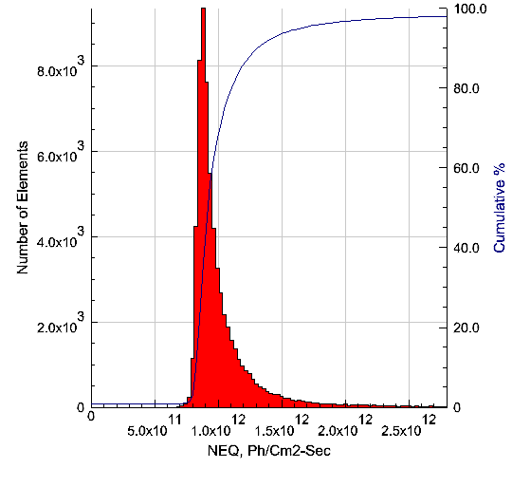
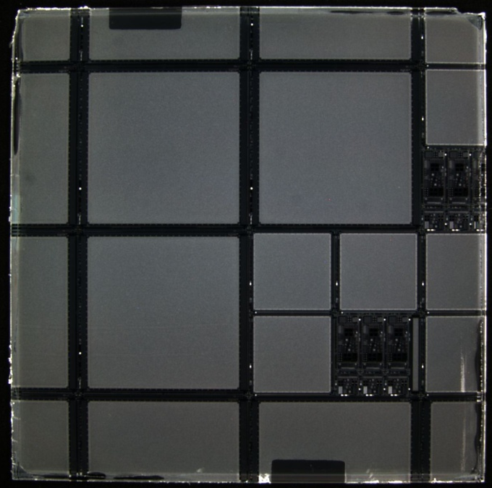
Dual Band LWIR/LWIR 256×256
HgCdTe/CdZnTe Performance
256 x 256 30µm unit-cell (SB172 ROIC)
512 x 512 30µm unit-cell (SB410 ROIC)
Deliverable FPA for Dewar Integration
FPA level characterization
S/N 7632146 (Wafer 4189) NEQ Histogram Data
Band LW1
Band LW2
Test Structure Assembly (Direct Fanout)
Detector level characterization
5cm x 5cm
HgCdTe/CdZnTe wafer
“Large Format HgCdTe Focal Plane Arrays for Dual-Band Long-Wavelength Infrared Detection”, EPG Smith et al, physica status solidi c, Special Issue: 36th International Symposium on Compound Semiconductors (ISCS 2009) Vol 7, Issue 10, pages 2522–2525, Oct 2010

Slide 34
RVS 512×512 L/LWIR SCA Development First Test Lab Video Capture (2009)
LWIR Band 1
LWIR Band 2
Full SB-410 512 x 512 L/LWIR FPA Functionality Demonstrated
“Large Format HgCdTe Focal Plane Arrays for Dual-Band Long-Wavelength Infrared Detection”, EPG Smith et al, physica status solidi c, Special Issue: 36th International Symposium on Compound Semiconductors (ISCS 2009) Vol 7, Issue 10, pages 2522–2525, Oct 2010

Slide 35
Dual Band LWIR/LWIR 512×512
HgCdTe/CdZnTe Performance
High Operability and Uniform L/L FPA Performance Demonstrated
“Large Format HgCdTe Focal Plane Arrays for Dual-Band Long-Wavelength Infrared Detection”, EPG Smith et al, physica status solidi c, Special Issue: 36th International Symposium on Compound Semiconductors (ISCS 2009) Vol 7, Issue 10, pages 2522–2525, Oct 2010

Slide 36
Dual Band HgCdTe Exhibits Excellent QE
Histogram plots of effective QE for dual-band HgCdTe triple-layer-heterojunction (TLHJ) 256×256 30μm unit-cell focal plane arrays (FPAs)
(MWIR)/MWIR
(LWIR)/LWIR
Ref: HgCdTe focal plane arrays for dual-color mid- and long-wavelength infrared detection
by E P G Smith, et al Journal of Electronic Materials (2004) Volume: 33, Issue: 6, Publisher: Springer, Pages: 509-516,

Slide 37
Future Directions- Large Format SCA Technology
Demonstrate capability SWIR & MWIR HgCdTe/Si meet astronomy requirements
  Up to 10×10cm detector array possible with 6-inch wafer
High operability SWIR and/or MWIR FPAs with > 6×6cm image plane area
  Small pitch
Increase on-chip logic processing of scene information
Dual Band HgCdTe/Si

Slide 38
Conclusion
For Photon Detectors, Noise Equivalent Irradiance (NEQ) is the most significant pixel level Figure of Merit independent of scene temp and optics config
  Operability is most significant SCA FoM
Detector specific factors affecting SCA sensitivity are detector QE and Noise
  HgCdTe provides best possible QE and spectral coverage of sensor’s band of interest
  Low leakage current HgCdTe offers the highest operating temperature
  These 2 factors give HgCdTe best sensitivity currently reported for any detector material used to manufacture an SCA
HgCdTe FPAs are in production for wide range of formats and spectral coverage
  Presented data on single and dual band SCAs in formats from 256×256 to 4k×4k
While other detector technologies are working to replace HgCdTe, the hybrid and Large Area ROIC processes will be nearly identical to those required for HgCdTe

Slide 39
3 Questions
HgCdTe Infrared Technology

Slide 40
HgCdTe FPAs: Question 1
What are the most interesting developments that you would like to see for your topic over the next ten years?
High Operability 8k×8k MWIR HgCdTe/Si FPA
On-FPA decision/ data management - Critical for wide area surveillance systems.
  Find ways to provide intelligent and relevant scene information of interest from the FPA’s imagery vs massive bulk data stream
Pixel level digitization linear to the 13th bit and beyond that spans the different dynamic ranges
  Ongoing development at MIT LL
Curved FPAs
Access to 12-inch Si foundries for large area ROIC fabrication
  The more ROIC die printed per wafer the lower batch processing costs
  Better equipment provides lower defect densities (higher yields)
  ITAR regulates access to offshore foundries, domestic foundry cost prohibitive

Slide 41
HgCdTe FPAs: Question 2
What are the biggest challenges for developing relevant technology over the next ten years?
Development costs to demonstrate TRL 5, which provides the FPA to assess TRL 6+
  Large Area ROIC Costs
    Designing ROIC for mission is major expense
    When ROIC die count/wafer <10, cost and yields can be a deal breaker
  In addition to ROIC, Large area detectors require full size detector wafers in development (can’t use “scraps” to demo TRL5)
For smaller pixels, ROIC bucket capacity is limiting factor
  Digital pixel has potential to overcome this limit

Slide 42
HgCdTe FPAs: Question 3
What science breakthroughs could be enabled by this technology over the next ten years?
Large area FPAs →
  Increased image resolution per frame
    Increase capabilities for surveillance systems
    Increase coverage for IR astronomy
  See all the photons, everywhere in FOV, all the time
    Wide area persistent surveillance
    Infrared Astronomy

Slide 43
In Closing – Quote relevant to retaining “King of the Hill” Leadership
From article titled “King of the Hill: Can Established Tech Companies Be Bested?”
  Quote by Kartik Hosanagar, an operations and information management professor at Wharton, Published: April 25, 2012 in Knowledge@Wharton
"Companies often talk about how a competitor is just one click away [from overtaking them].... It's not that straightforward,
People have inertia and also incur learning costs to switch to a new product or provider. So, to get consumers to switch, you cannot be as good or slightly better.
You have to be much, much better along dimensions that matter to consumers."

