Slide 1
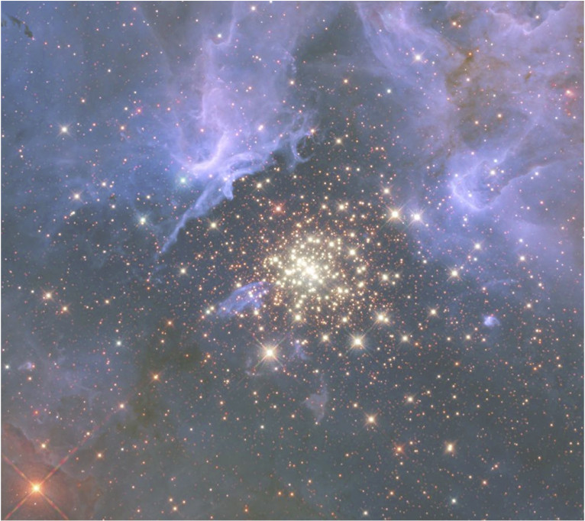




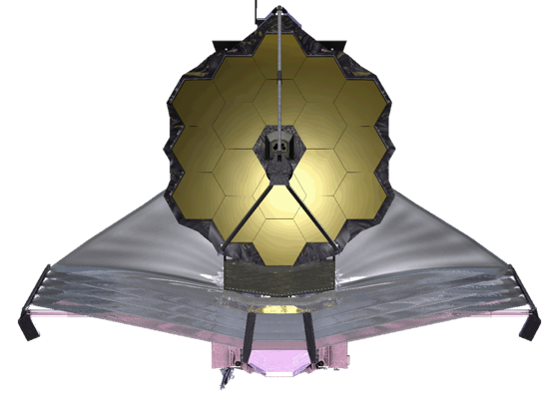
Reducing the Read Noise of JWST NIRSpec Detectors with Improved Reference Sampling and Subtraction (IRS²)
Bernard J. Rauscherª, Richard G. Arendt^{b}, D.J. Fixsen^{c}, Matthew Lander^{f}, Don Lindler^{d}, Markus Loose^{e}, S.H. Moseleyª, Donna V. Wilson^{f}, and Christos Xenophontos^{f}
ªCode 665, NASA Goddard Space Flight Center, Greenbelt, MD
^{b}CRESST/UMBC/GSFC,Greenbelt, MD
^{c}CRESST/UMd/GSFC, Greenbelt, MD
^{d}Sigma Space Corporation/GSFC, Greenbelt, MD
^{e}Markury Scientific, Inc., 518 Oakhampton Street, Thousand Oaks, CA
^{f}Code 582, Goddard Space Flight Center, Greenbelt, MD
Notes:
Thanks to Don Figer for the invitation to speak today. I will be telling you mostly about a new, lower noise readout mode that we have developed for JWST NIRSpec. We’ll start with an introduction to JWST, to provide context, before getting into the details of the Improved Reference Sampling and Subtraction (IRS²) readout.

Slide 2
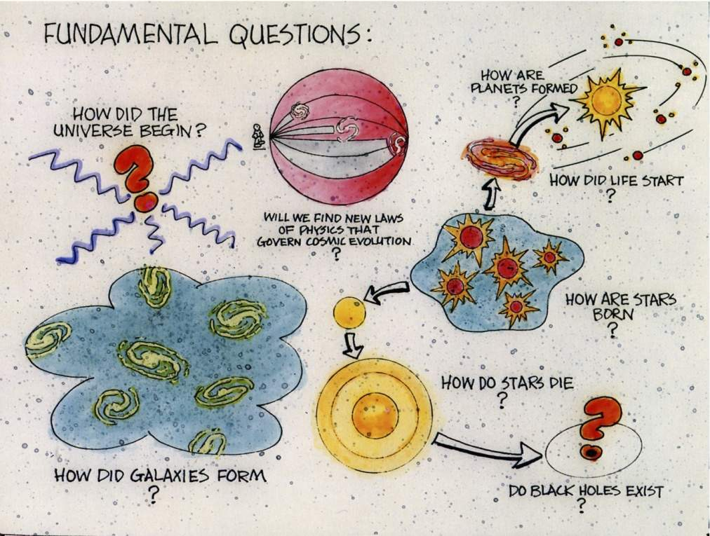
Notes:
In the spirit of many great musicians, here is a chart that I borrowed from John Mather that he borrowed from Charlie Pellerin. It comes from the Great Observatories brochure of mid 1980’s, to describe a unified program to Congress, with HST (1990), CGRO (1991), Chandra (1999), Spitzer (2003). It worked: we built all four!
The great questions then! Some are partially answered: COBE, WMAP, Planck, and intense ground-based effort on CMB. Inflation (Guth 1980), dark matter (Zwicky 1934), dark energy (1998, High z team), Black holes exist (Cyg X-1 1972, etc.)
Galaxy formation: very different, much earlier than we thought before HST could reach high z, now approaching 10!
Star formation and death still very mysterious: quick, violent, and often hidden. Like planet formation. Supercomputer simulations magnificent, not yet very predictive.
Big surprise to some: planets are abundant, like gravel! Now, possibility to detect life elsewhere!
So the Great Observatories proved immensely important, rewrote all the textbooks! Truly extraordinary impact on science and on public, not just astronomy departments.
But what are we going to do for an encore? Well, that would be JWST –top priority in the 2000 Decadal Survey.

Slide 3

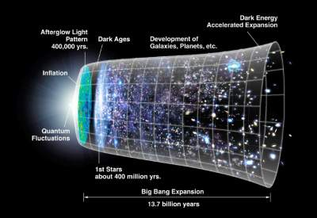
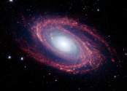
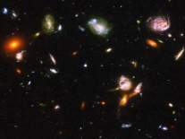
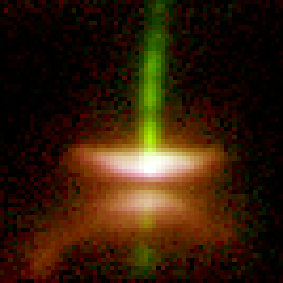
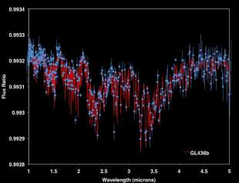
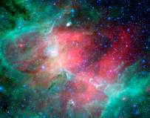
Decadal 2000 & 2010 Science with JWST
M81
HST-UDF
First Light and Re-Ionization
Assembly of Galaxies
HH-30
GL146
M-16
Birth of stars and
proto-planetary systems
Planetary systems and the
origin of life
Notes:
Fast forward to 1995, and Alan Dressler and the HST and beyond committee. They took on the challenge of saying what ought to be done and they said 2 things: a large IR optimized telescope, and a search for terrestrial planets. You should get the book, it will give you goose bumps to read about the wonderful things that can be done. It did me! That’s John speaking, but this book was the thing that motivated me to change from a career in a university to NASA. Alan wrote about all these topics and said the new telescope would be very very helpful. These four themes form the backbone of JWST’s planned science program.
Amazing new technologies enable real answers to these questions. 4 themes chosen to guide choice of JWST parameters – the hardest is the first light, so faint and so red-shifted. But the real discoveries will come from you, the users! Of course every piece of equipment everywhere, including the new giant ground-based telescopes from optical to radio wavelengths will all give unique and complementary information.
Of course, we chose the JWST parameters to avoid duplication; its capabilities are unique.
This is the science endorsed by the Decadal Survey in 2000, and is the basis for the recommendations of 2010. it is key to everything. Not to mention, the key to Canadian and European science priorities.
Our detectors are key to all of this. In the near-IR, that would be Teledyne H2RGs and SIDECAR ASICs. NIRSpec is detector noise limited for most of what it does, so we were interested in developing better readout methods to get the noise down.

Slide 4

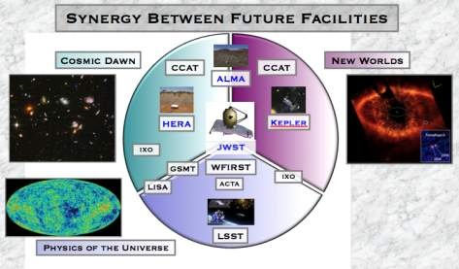

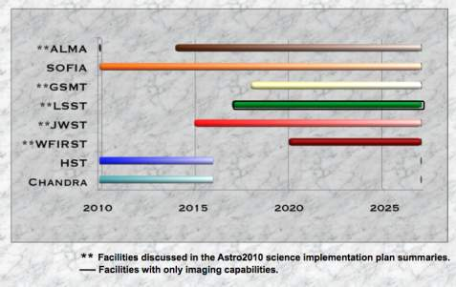
JWST and its H2RG detector arrays were an integral part of Astro2010’s planning. The H2RG also appears as an important component of WFIRST.
Notes:
And it continues, JWST was assumed to exist for Astro2010. And there is a new priority, WFIRST.
Both JWST and WFIRST will fly a lot of H2RG detectors and SIDECAR ASICs. This is the point of the talk. IRS2 readout improves on classical readout in that there are many more reference pixels in each integration, reference pixels are sampled much more frequently, and both the reference pixels and reference output are applied in a Wiener-optimal way. That is to say, the reference correction is the best that can be done in a least-squares sense.

Slide 5


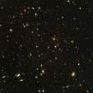

JWST and its Precursors
HUBBLE
JWST
SPITZER
0.8-meter
T ~ 5.5 K
2.4-meter
T ~ 270 K
6.5-meter
T ~ 40 K
123” x 136”
λ/D1.6μm~ 0.14”
312” x 312”
λ/D5.6μm~ 2.22”
324” x 324”
λ/D24μm~ 6.2”
114” x 84”
λ/D20μm~ 0.64”
132” x 264”
λ/D2μm~ 0.06”
Wavelength Coverage
1 μm
10 μm
100 μm
HST
JWST
Spitzer
Notes:
1) Lets put JWST in Context
- aperture
- wavelength
trade between sampling and Field of View
This is just to show you how far we are going to improve upon our parents. We have spectacular collecting area, excellent angular resolution, and very wide wavelength coverage.

Slide 6
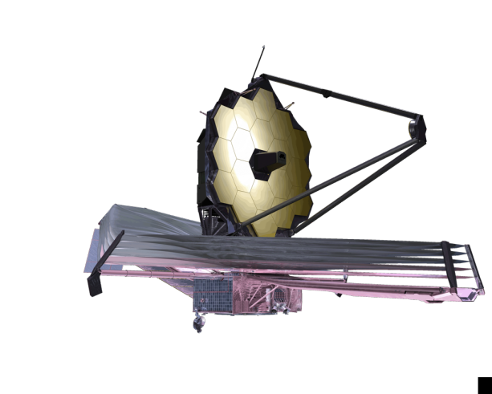


James Webb Space Telescope
Organization
Mission Lead: Goddard Space Flight Center
Senior Project Scientist: Dr John Mather
International collaboration: ESA & CSA
Prime Contractor: Northrop Grumman Aerospace Systems
Instruments:
Near Infrared Camera (NIRCam) – Univ. of Arizona
Near Infrared Spectrograph (NIRSpec) – ESA
Mid-Infrared Instrument (MIRI) – JPL/ESA
Fine Guidance Sensor (FGS) & Tunable Filter
  Imager – CSA
Operations: Space Telescope Science Institute
Description
Deployable infrared telescope with 6.5 meter diameter segmented adjustable primary mirror
Cryogenic temperature telescope and instruments for infrared performance
Launch on an ESA-supplied Ariane 5 rocket to Sun-Earth L2
5-year science mission requirement (10-year propellant lifetime)
Notes:
So this is it, the magnificent machine! It’s international and it’s working.

Slide 7
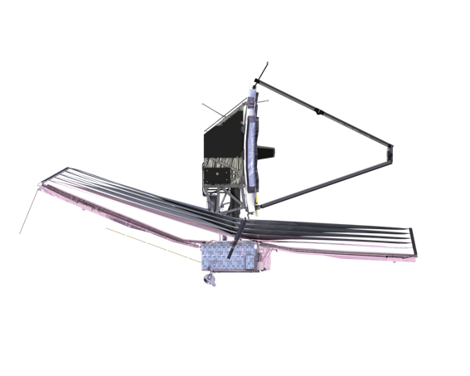
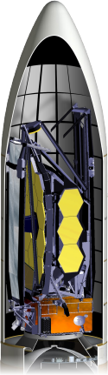


HOW JWST WORKS
Integrated Science
Instrument Module (ISIM)
Cold Side: ~40K
Primary Mirror
JWST is folded
and stowed for launch
5 Layer
Sunshield
Observatory is deployed after launch
Solar Array
Secondary
Mirror
Spacecraft Bus
Hot Side
Sun
JWST Orbits the 2nd Lagrange Point (L2)
384,000km
1.5 million km
Earth
Moon
L2

Slide 8
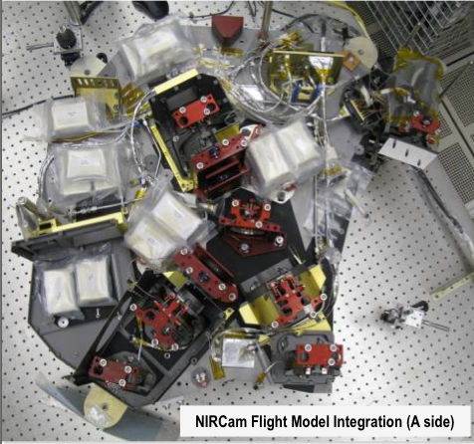
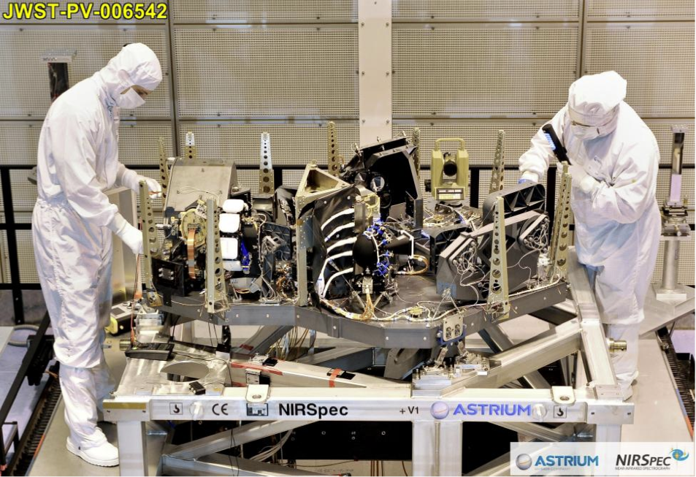
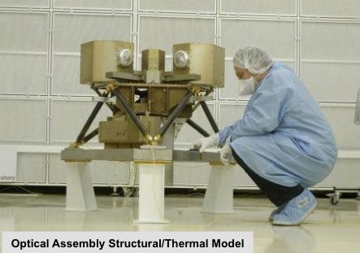
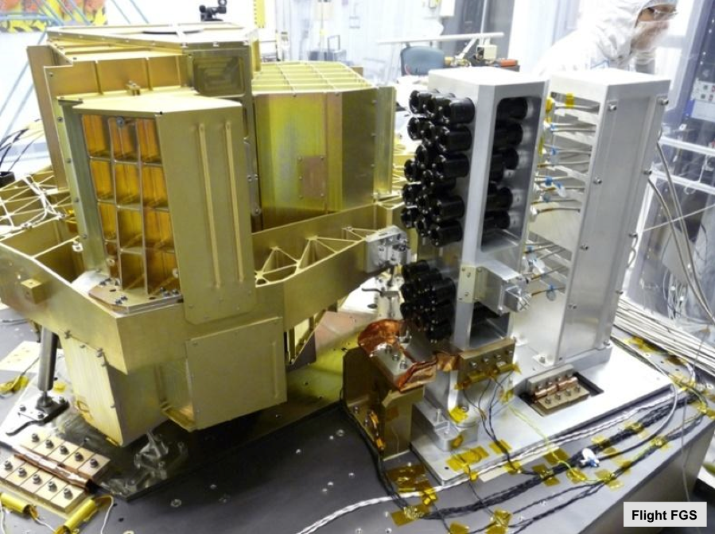
JWST Instrumentation
Instrument | Science Requirement | Capability
NIRCam Univ. Az/LMATC | Wide field, deep imaging 0.6 μm - 2.3 μm (SW) 2.4 μm - 5.0 μm (LW) | Two 2.2’ x 2.2’ SW Two 2.2’ x 2.2’ LW Coronagraph
NIRSpec ESA/Astrium | Multi-object spectroscopy 0.6 μm - 5.0 μm | 9.7 Sq arcmin Ω + IFU + slits 100 selectable targets: MSA R=100, 1000, 3000
MIRI ESA/UKATC/JPL | Mid-infrared imaging 5 μm - 27 μm Mid-infrared spectroscopy 4.9 μm - 28.8 μm | 1.9’ x1.4’ with coronagraph 3.7”x3.7” – 7.1”x7.7” IFU R=3000 - 2250
FGS-NIRSS CSA | Fine Guidance Sensor 0.8 μm - 5.0 μm Slitless (grism) spectroscopy | Two 2.3’ x 2.3’ 2.2’ x 2.2’ R=100 with coronagraph
Notes:
Core instrument package recommended by ISWG and divvied up for the international partnership. 0.6 to 28 µm, diffraction limited imaging at 2 µm, zodi limited sensitivity < 10 µm. Note complementary to ground: spectroscopic R < ~ 3000, and wide field cameras. So at near IR we get nJy senstitivity, and 1 nJy = 31.4 mag AB.
Getting this package was a huge technology effort: detectors far better than before, a cooler for MIRI down to 7 K, and 250000 microshutters for NIRSpec. But it’s worth it! Instrument technology has the highest benefit/cost ratio of all parts of the observatory – and you can’t make the mirror any bigger than this without some really radical new concept.

Slide 9
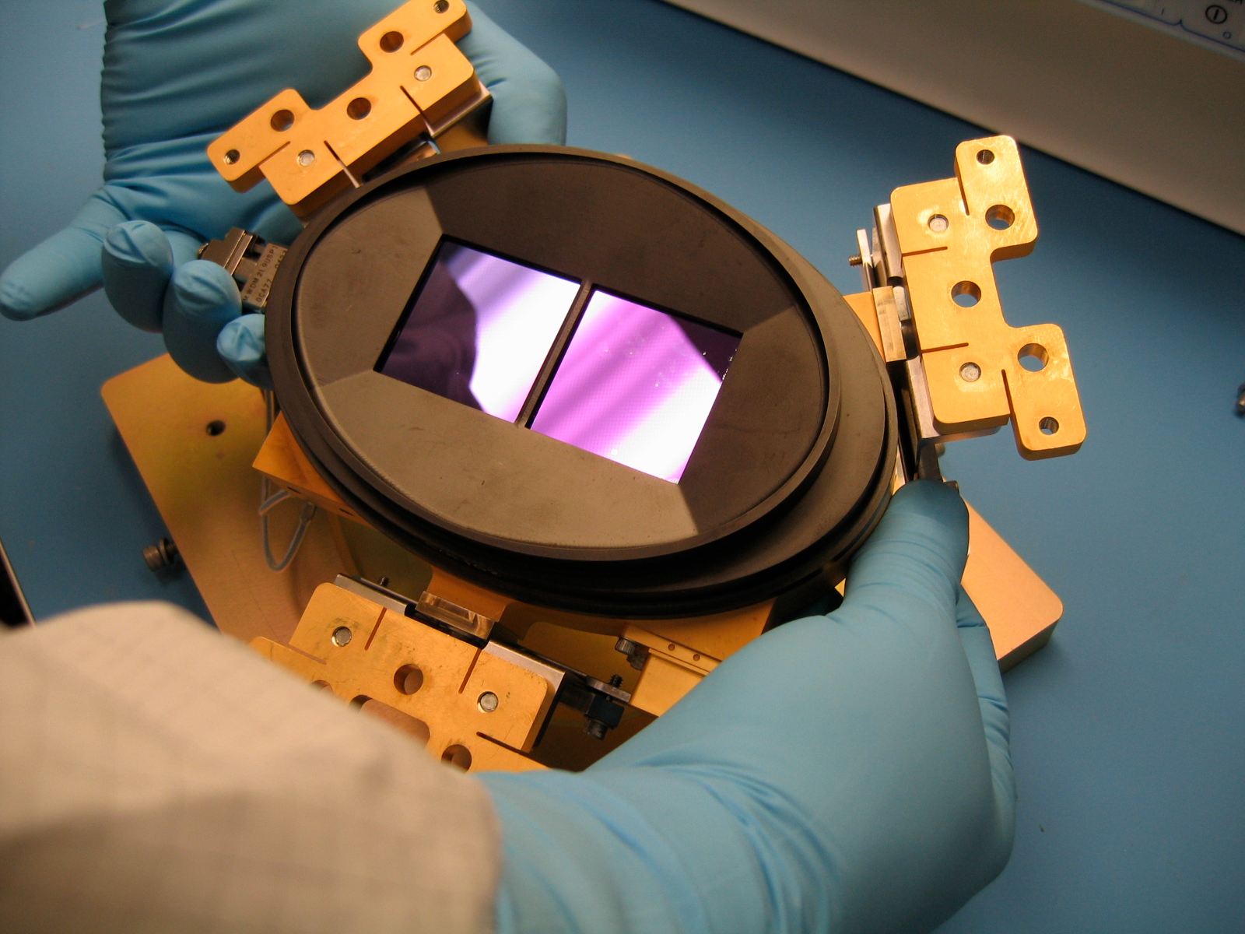
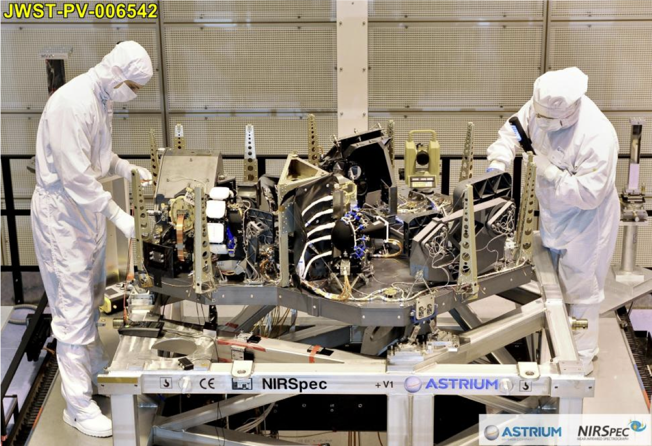

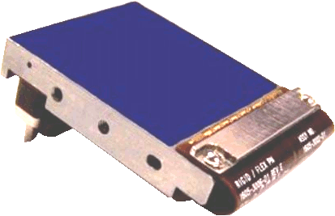
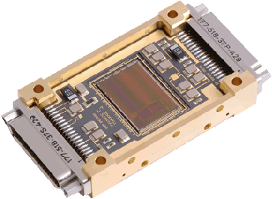
NIRSpec uses a pair of
Teledyne HAWAII-2RG sensor chip assemblies
NIRSpec FPA
NIRSpec is detector noise limited for most observations. This is why JWST developed IRS². Traditional readout is planned for the other two JWST NIR instruments, NIRCam and FGS.
Two HAWAII-2RGs
Two SIDECAR ASICs
Notes:
Here we see NIRSpec at the ESA prime contractor’s facility in Ottobrunn, Germany. It uses a pair of Teledyne H2RG detectors and SIDECAR ASICs.

Slide 10
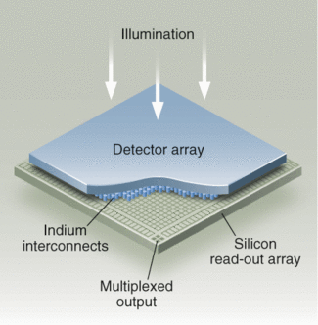
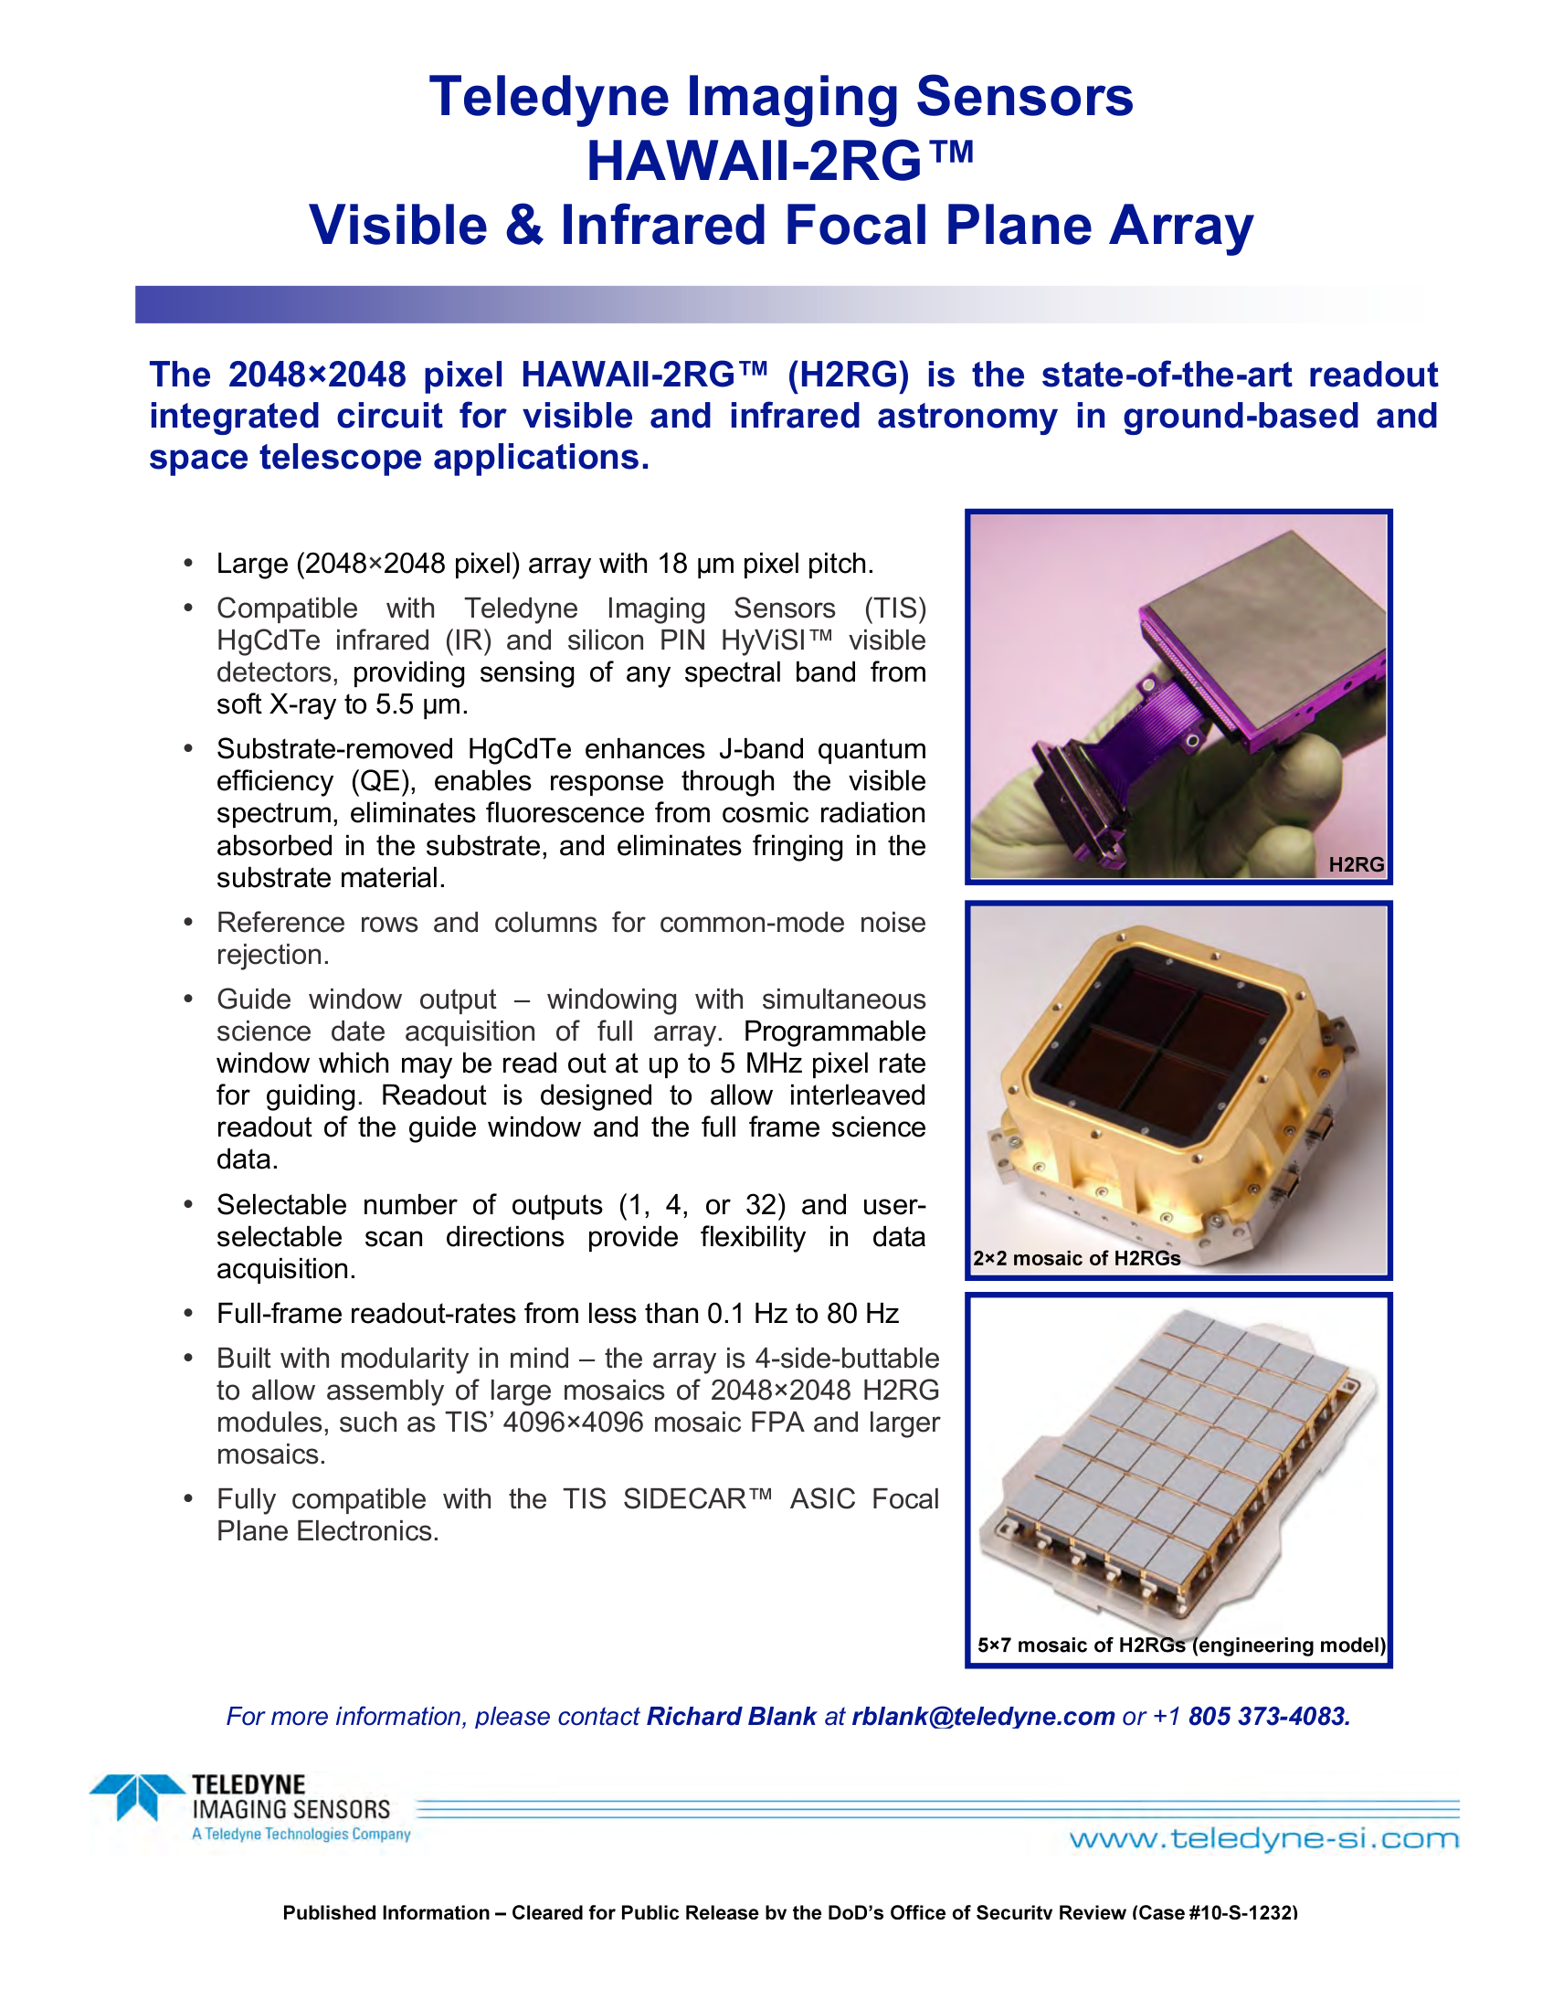
NIRSpec’s H2RGs are near-IR hybrids
Light is collected in the HgCdTe detector array. By varying the mole fraction of cadmium, the cutoff is tunable from ~1.7 µm to at least 5 µm
The HgCdTe detector array is read out by a silicon readout integrated circuit (ROIC)
The two are hybridized together using indium bumps with an epoxy backfill
Not all near-IR arrays use the epoxy backfill, but JWST does
Notes:
Here we see NIRSpec at the ESA prime contractor’s facility in Ottobrunn, Germany. It uses a pair of Teledyne H2RG detectors and SIDECAR ASICs.

Slide 11
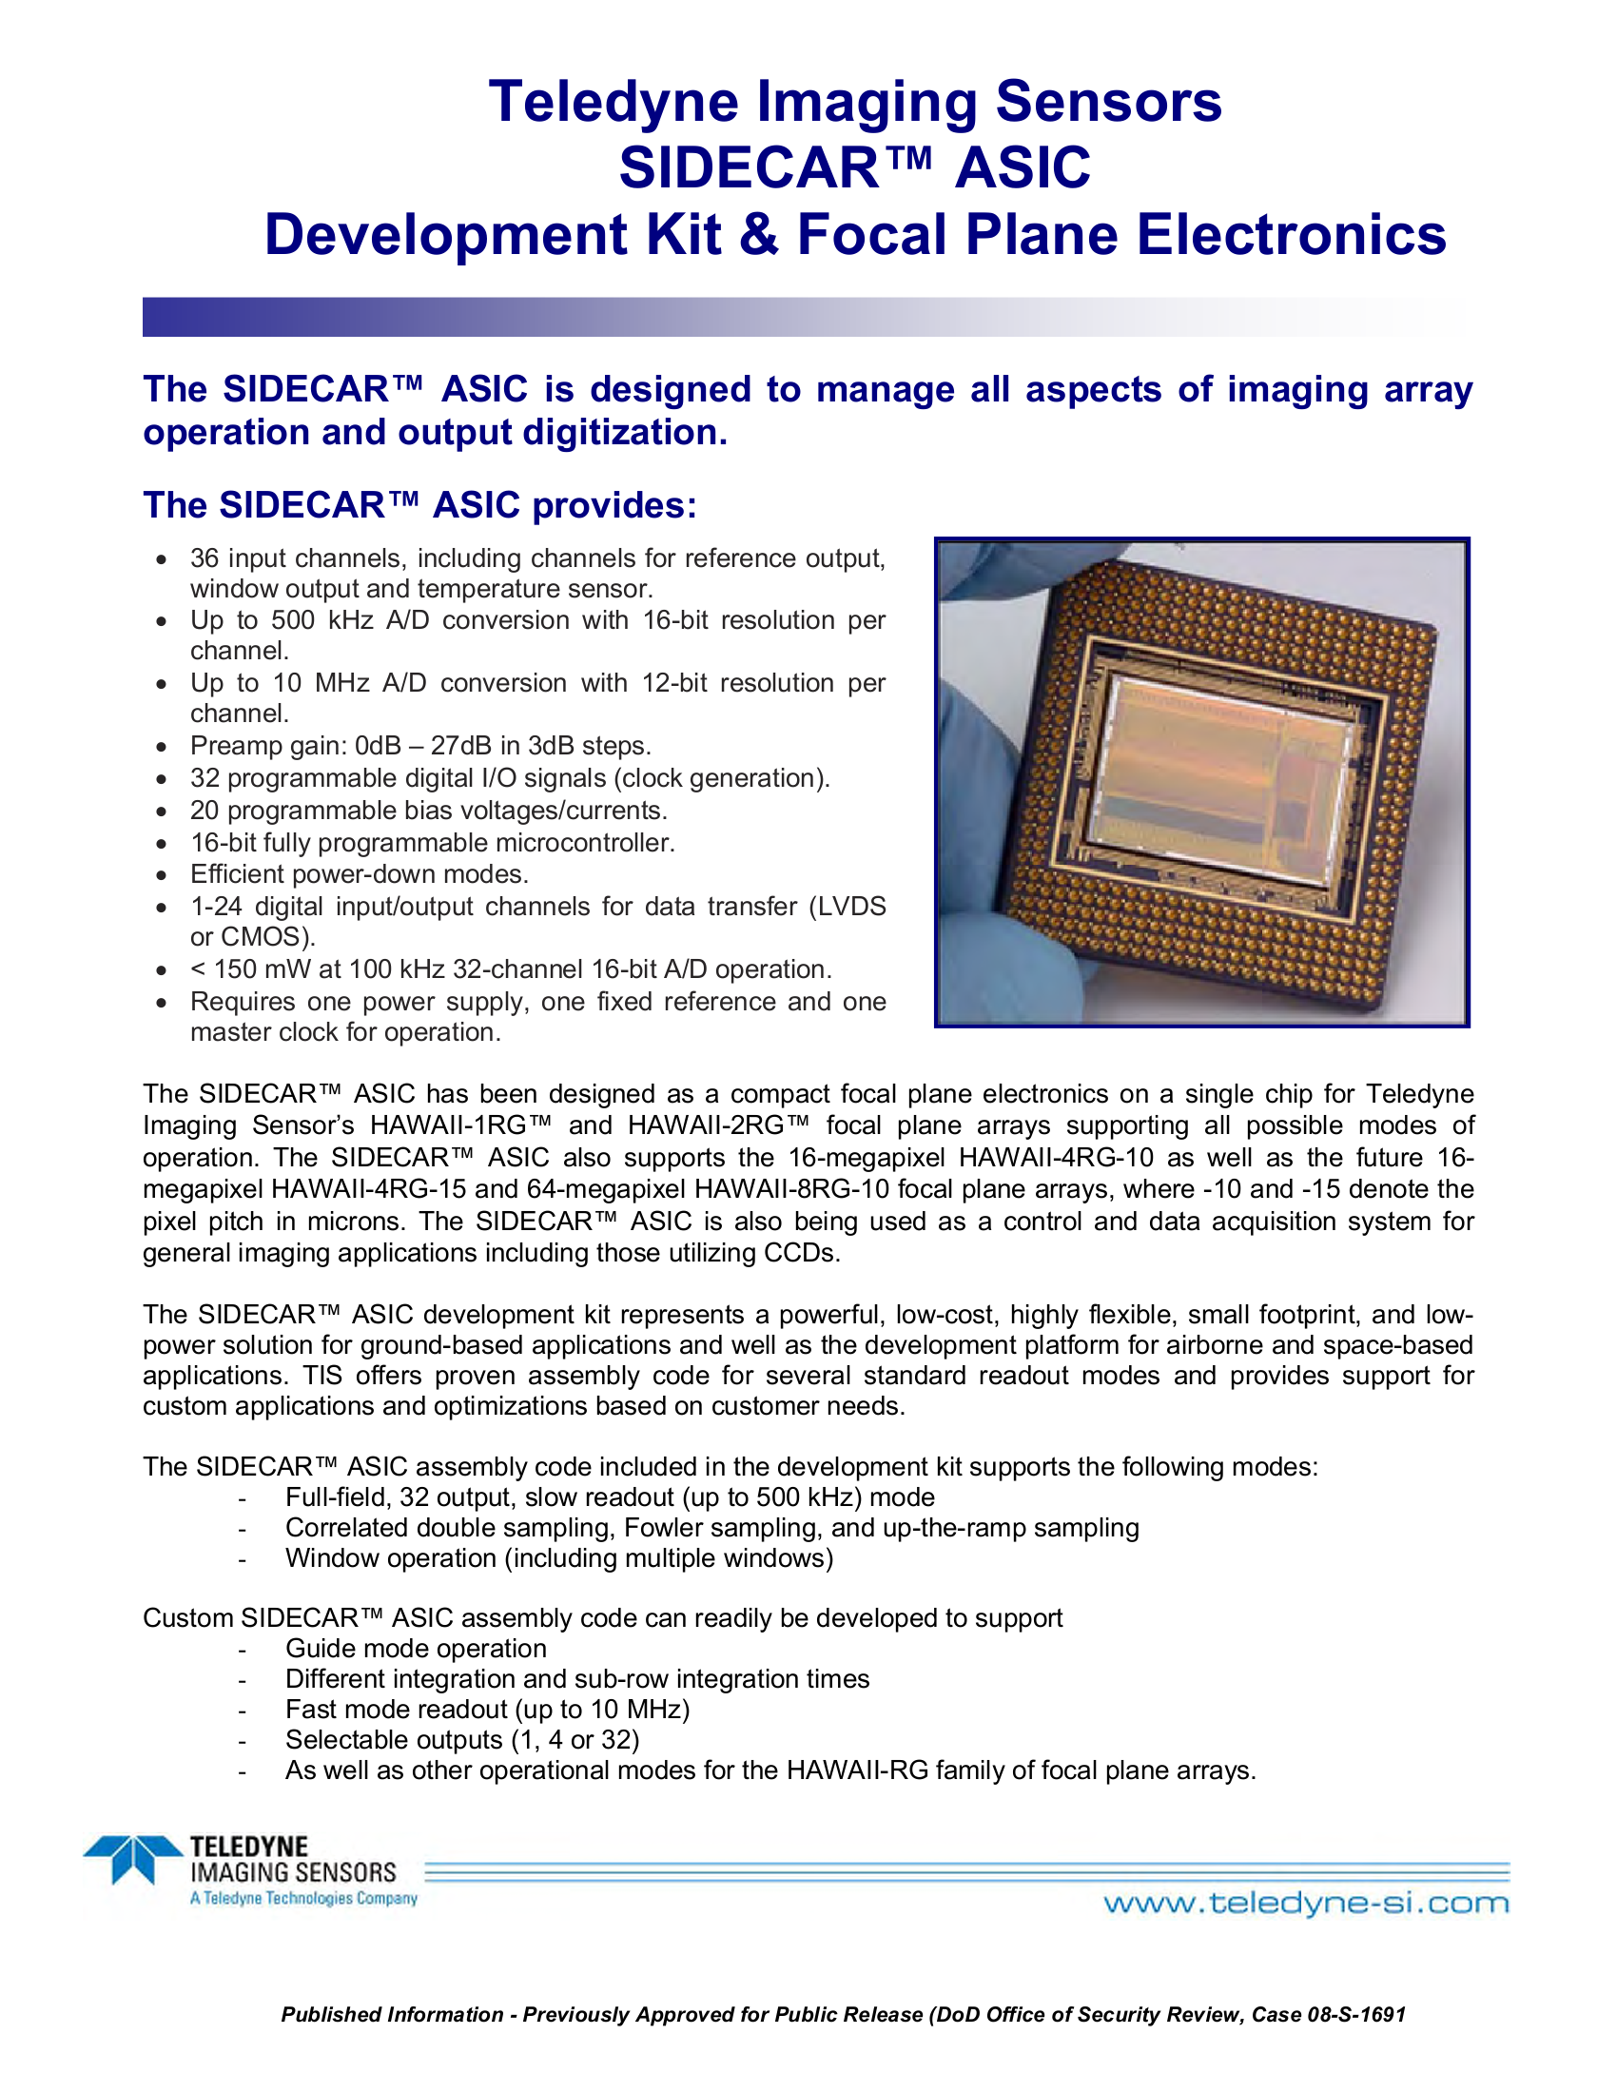
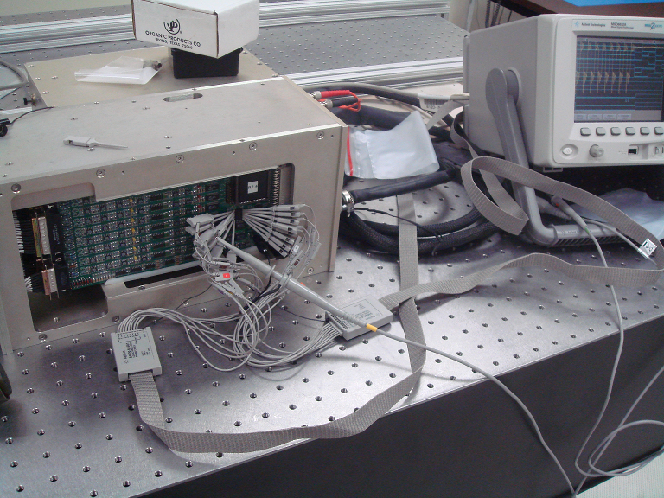
SIDECAR ASIC = Infrared Array Controller on a Chip
The SIDECAR ASIC is essentially a near-infrared array controller on a single microchip (in JWST there is one SIDECAR paired with each H2RG)
Provides biases, clocks, analog to digital conversion, and a flexible CPU with memory in a single package that can be operated at the same temperature as the H2RG
Hugely simplifies system engineering for space applications
Orders of magnitude less mass and power required than a traditional implementation
Outstanding performance when controlling mass, power, and volume are paramount
Notes:
Here we see NIRSpec at the ESA prime contractor’s facility in Ottobrunn, Germany. It uses a pair of Teledyne H2RG detectors and SIDECAR ASICs.

Slide 12
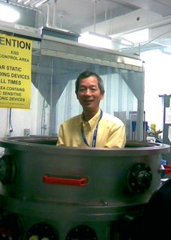
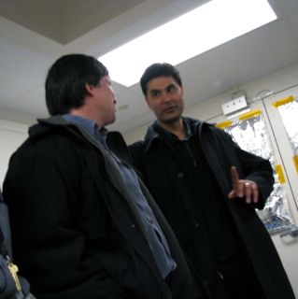
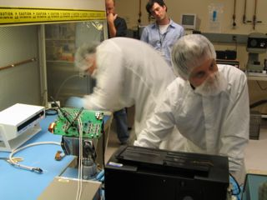
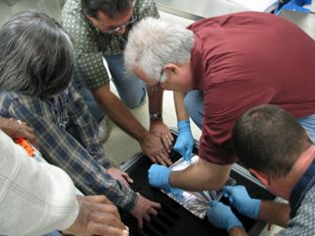
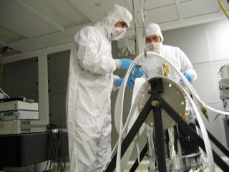
Key Detector Subsystem Requirements
It’s a team effort!
A few Key NIRSpec Requirements
Parameter | Value
Median total noise | < 6 e⁻ rms per 1000 s exposure (88 up-the-ramp samples allowed)
Operating temperature | T ~ 40 K
Median dark current | < 0.01 e⁻/s
Pixel rate | 100 kHz
# of detector array outputs | 4
Detector format | 2040 x 2040 pixels
QE | > 70%, 0.6 µm ≤ λ< 1 µm > 80%, 1 µm ≤ λ ≤ 5 µm
Operability for science | > 89%
Yiting Wen tries on a new dewar for size.
Sridhar Manthripragada and Bob Hill discuss the finer points…
Craig Cabelli and Greg Delo work while NASA/GSRP student Ori Fox “manages” the action
Brent Mott in action!
a) All requirements are end of life (i.e. after I&T, storage until launch, and ≥ 5 years of use in the L2 radiation environment).
Kamdin Shakoorzadeh and Ali Feizi inspect their handiwork!
And a big Thank You to all the others who worked hard to make it possible!
Notes:
Here we see a few of the key requirements. In practice, we think the parts are coming in low for QE and total noise using SIDECARs is 6.5 e- rms. This results in an 11% sensitivity non-compliance at 2.x microns. This is the reason why we undertook the IRS2 study.
Because this chart was not full enough, I added in some pictures of a few (only a very few!) of the many of the people who built the NIRSpec detector subsystem.

Slide 13
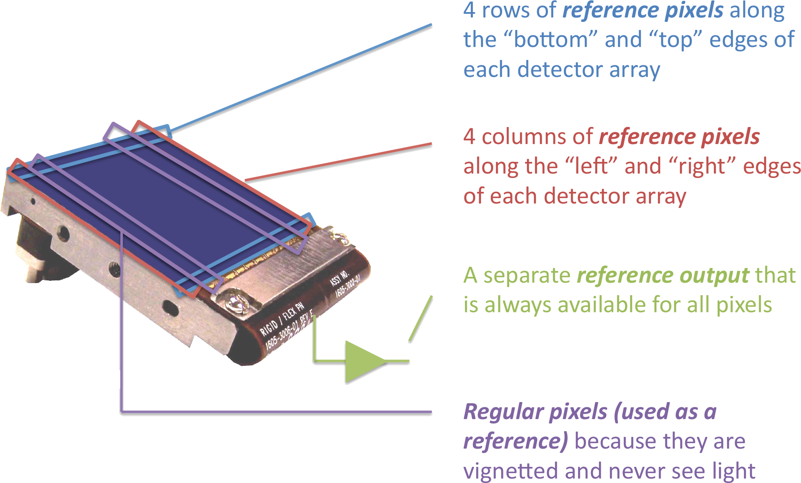
Introduction to References
A reference is any signal that mimics a normal pixel, but that does not respond to light
The H2RG has been engineered to include reference pixels and a reference output
Depending on the instrument, other references may be available

Slide 14
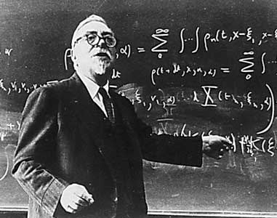
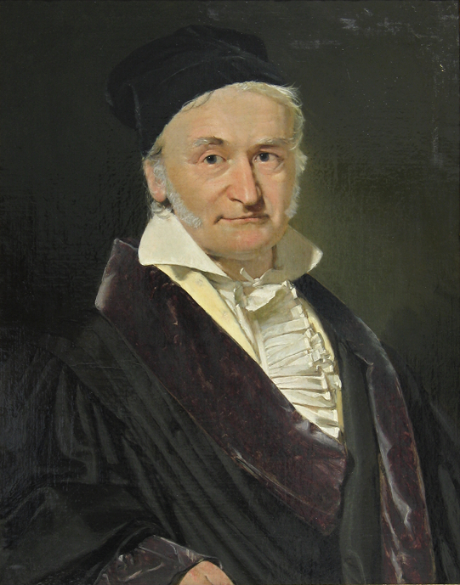
Optimal use of References
Norbert Wiener circa 1960
IRS² is Wiener-optimal. The detector system is highly linear by design, and reference information is applied in a way that is optimal, in a least squares sense.
Carl Friedrich Gauss circa 1850
We are using frequentist inference, we’d be interested in hearing about other ways…
Notes:
The least squares method was pioneered by Carl F. Gauss in the 19th century. Norbert Wiener systematically applied these techniques to linear systems early in the 20th century.

Slide 15
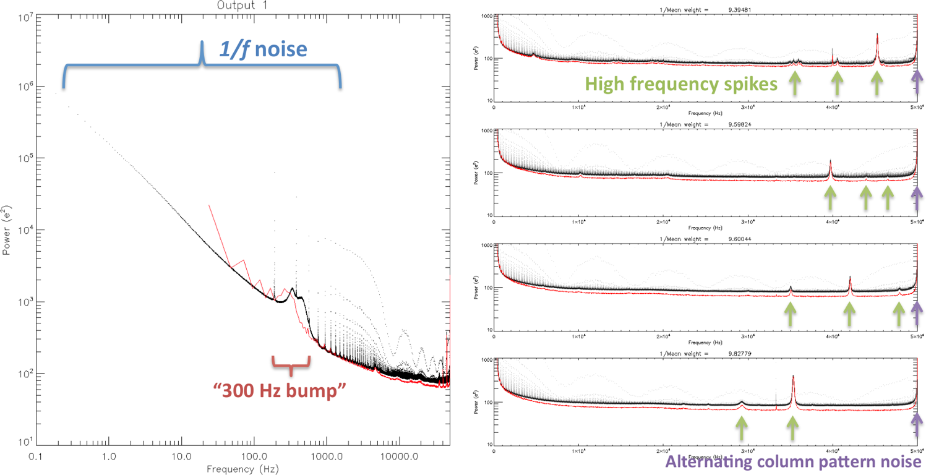
NIRSpec Read Noise
Traditional readout noise power spectra
We reduce the high frequency spikes by tuning the SIDECAR ASICs
IRS² addresses remaining noise components as follows
  Using measured frequency correlation between normal outputs and reference output
    Cuts white noise power approximately in half
    facilitates removal of 1/f noise
    facilitates removal of 300 Hz bump
  More frequent sampling of reference pixels + frequency dependent weighting facilitates more complete removal of 1/f noise up to a ~few kHz
  More frequent sampling of reference pixels + sampling even numbered and odd numbered columns separately + frequency dependent weighting facilitates removal of alternating column noise
Please ignore the red curves. This is an archival chart and they are not relevant to the current discussion.

Slide 16
Principal Components Analysis (PCA)
Pixels were sorted into time-ordered vectors (important to interpolate over all gaps due to e.g. new line overheads and hot pixels, etc.)
PCA was performed on long sets of dark ramps (100 ramps, 88 up-the-ramp frames per ramp)
  For frequencies faster than the frame rate, the noise is stationary
    Eigenvectors are sines and cosines
    Eigenvalues are 1/f
    Most natural basis for working with references is Fourier space!
  Non-stationary components enter around the frame rate (~0.1 Hz)

Slide 17
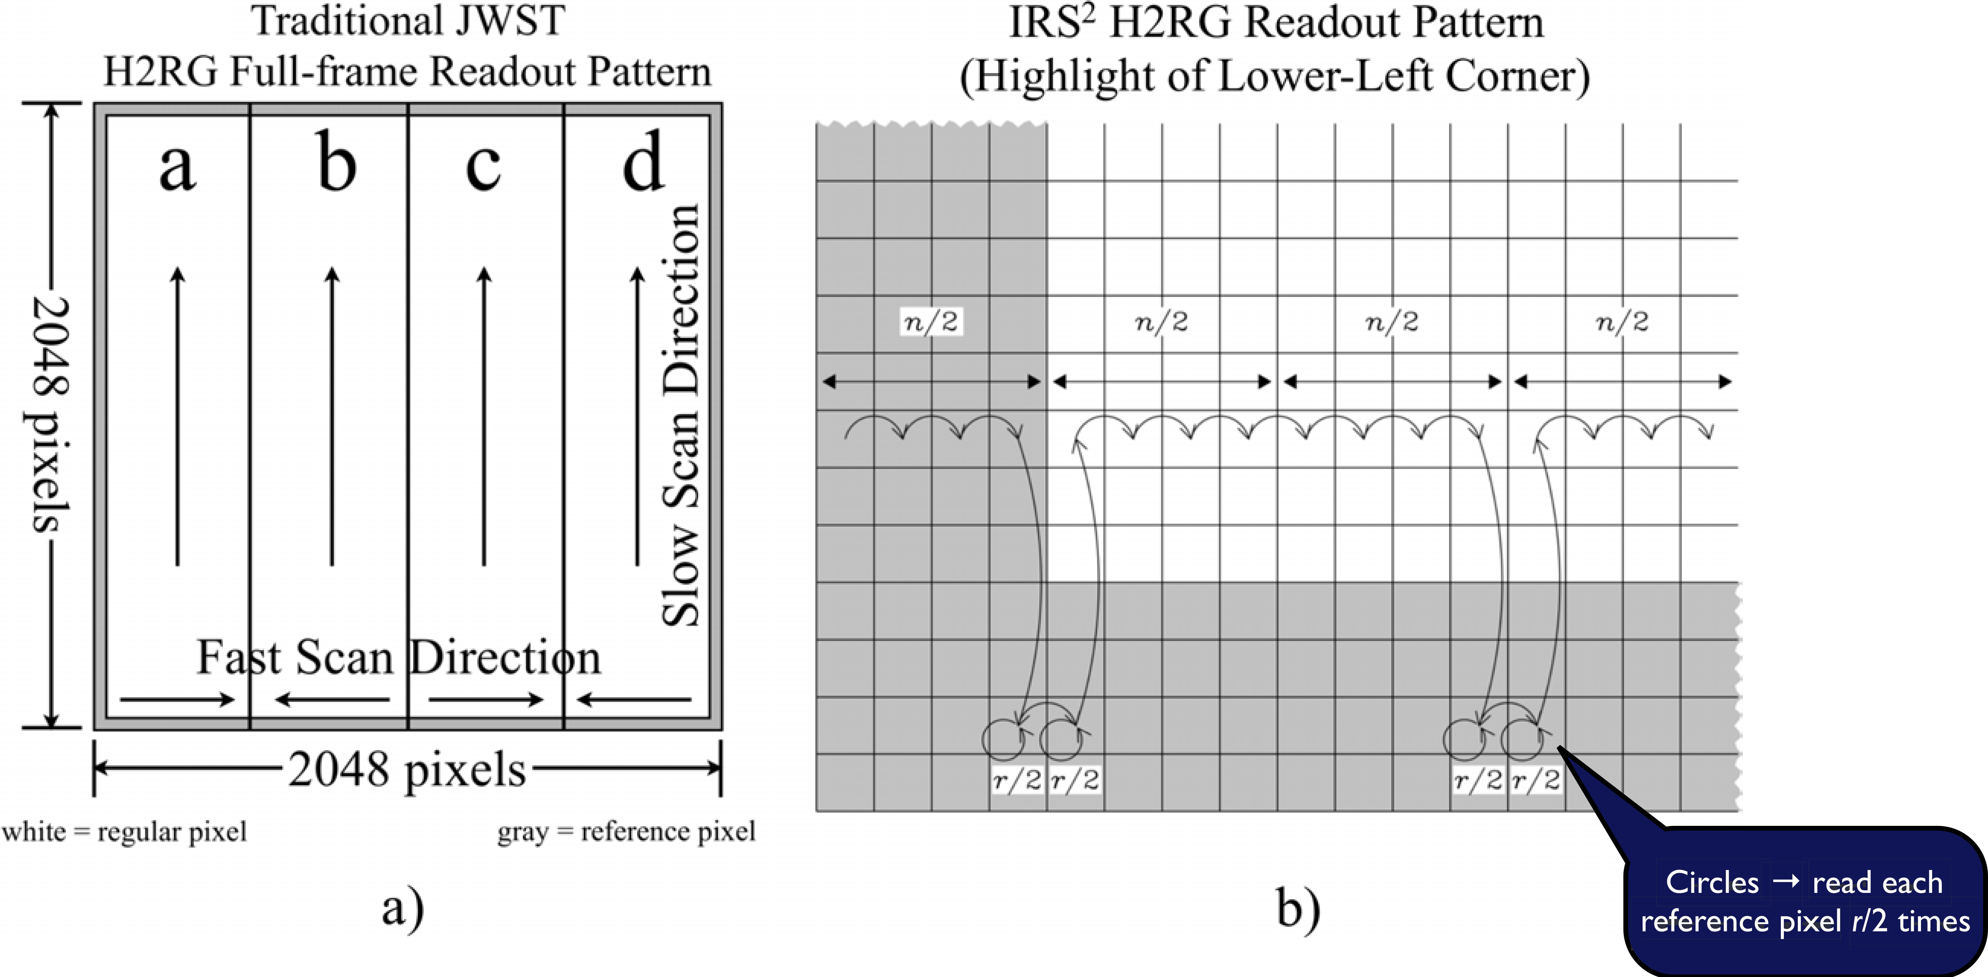
Improved Reference Sampling
In (a) traditional H2RG readout, the time ordering of pixels follows their physical layout on the detector
  Reference rows sampled only at the beginning and end of each frame
  Reference columns only available for two of the four outputs, and only sampled once per row
  Readout includes too few reference pixels, and they are too far apart
In (b) IRS², sampling r reference pixels is interleaved with sampling n normal pixels throughout the frame
  Enables sampling many more reference pixels and ensures that there is always a nearby reference pixel
IRS² differs from traditional H2RG readout in that there are many more reference pixels and the reference pixels are sampled much more frequently.

Slide 18
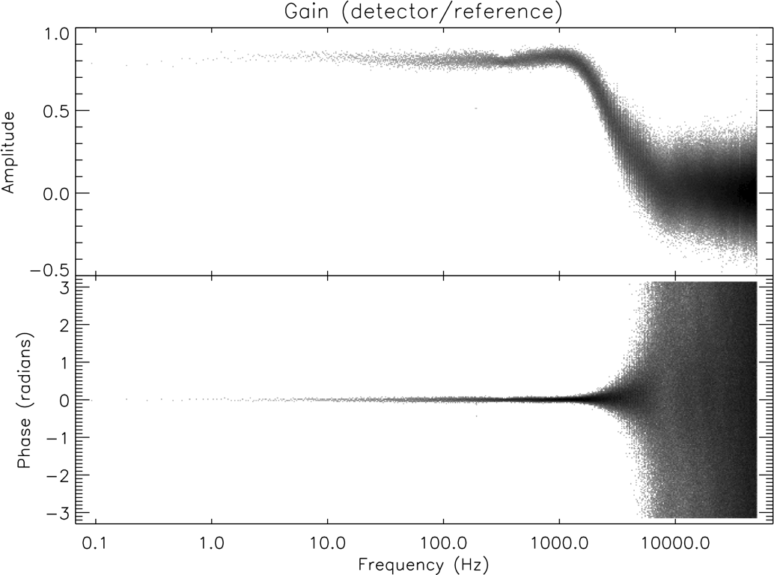
Improved Reference Subtraction
In an earlier paper,ª we showed that the correlation between: (1) the reference output and the normal outputs and (2) the reference pixels and the regular pixels, are best studied in Fourier space
  There is a frequency dependent gain difference between the normal pixels and either the reference output or the reference pixels
  For the three JWST NIRSpec systems that we have looked at so far, any phase differences are very small
Amplitude of the ratio of Fourier transforms is ~0.8 for low frequencies, dropping to small values at ~few kHz
Fig. The amplitude and phase of the ratio of the normal and reference outputs F(n(t))/F(r(t)) is shown. Surprisingly, even at low frequencies, the ratio is not unity. As expected, it is consistent with zero for frequencies higher than ~3 kHz. The relative phase is consistent with zero at low frequencies, and is essentially unconstrained at higher frequencies since the ratio is near zero.
The same approach is used to measure the frequency dependent gain between normal pixels and reference pixels
a) Mosely, S.H. et al. 2010, Proc SPIE, 7742, 77421B-1

Slide 19
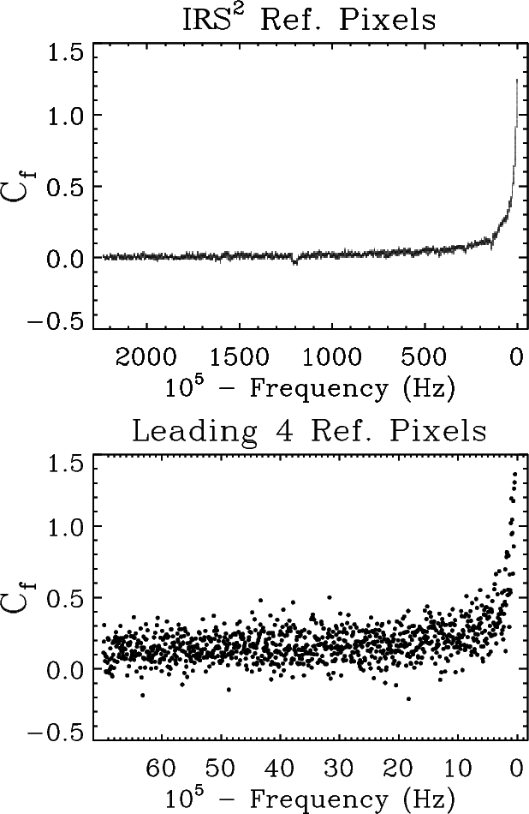
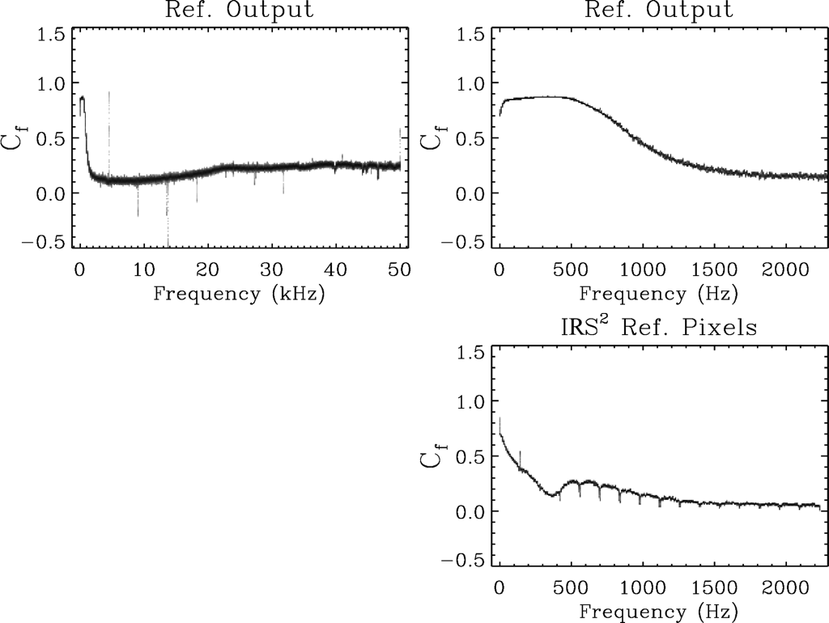
Measured Weights
d)
a)
b)
c)
e)
The reference output is weakly correlated with data at high frequencies, >10 kHz. Enables a slight reduction in white noise. (Less correlation and less benefit for better systems.)
Strong correlation at low frequency, <2 KHz, allows substantial reduction of 1/f noise.
Remaining correlation with well-sampled reference pixels, enables further reduction of 1/f and artifacts (e.g. 300 Hz bump)
Well-sampled reference pixels can also reduce noise found at and near the Nyquist frequency. Further reduction can be made by similarly employing the lead 4 reference pixels in each row, but only for the two outputs that have them.
19

Slide 20

IRS² using reference pixel & reference output
The previous charts reflected the situation as of about six months ago. We now have the software to simultaneously correct using both the interleaved reference pixels and the reference output.
Track these sums in your dark ramps
They are used to compute frequency dependent weights
And ultimately apply the reference correction
20
Notes:
I don’t intend to speak to this eye chart in detail. It is here for completeness. Eq. 1 shows that we are using a simple linear model that is least-squares fitted to a “training” data set. This results in a set of sums, Eq. 3-8. The quality of the correction improves as more and more data are fed into these sume. Eqs. 11-12 show the frequency dependent weights and Eq. 13 shows the reference correction being applied to the data. In pipeline processing, there is no need to Fourier transform the science data. Indeed, once the weights are known, one could implement the reference processing as two simple convolutions in the time domain.

Slide 21
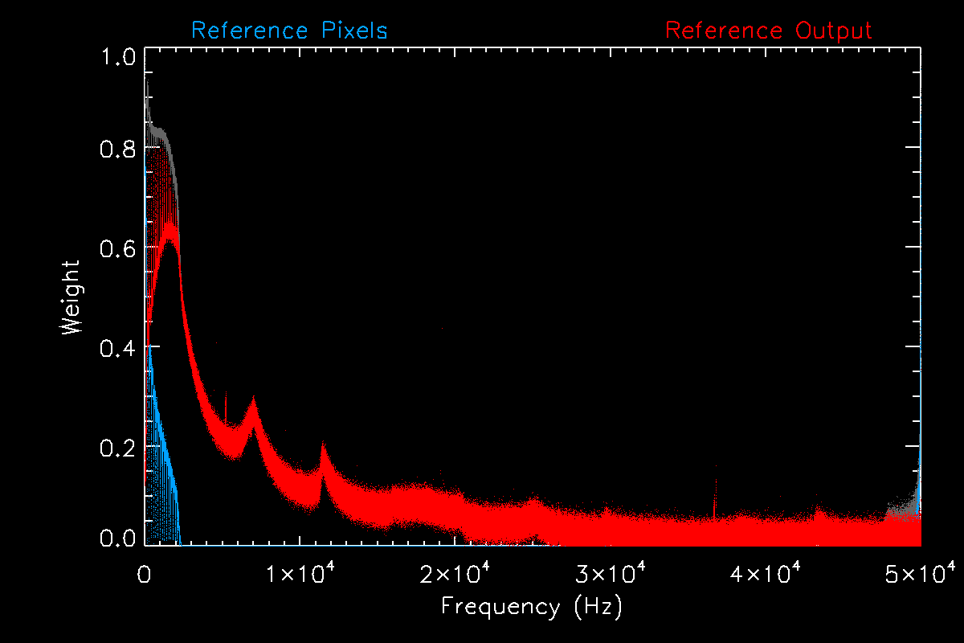
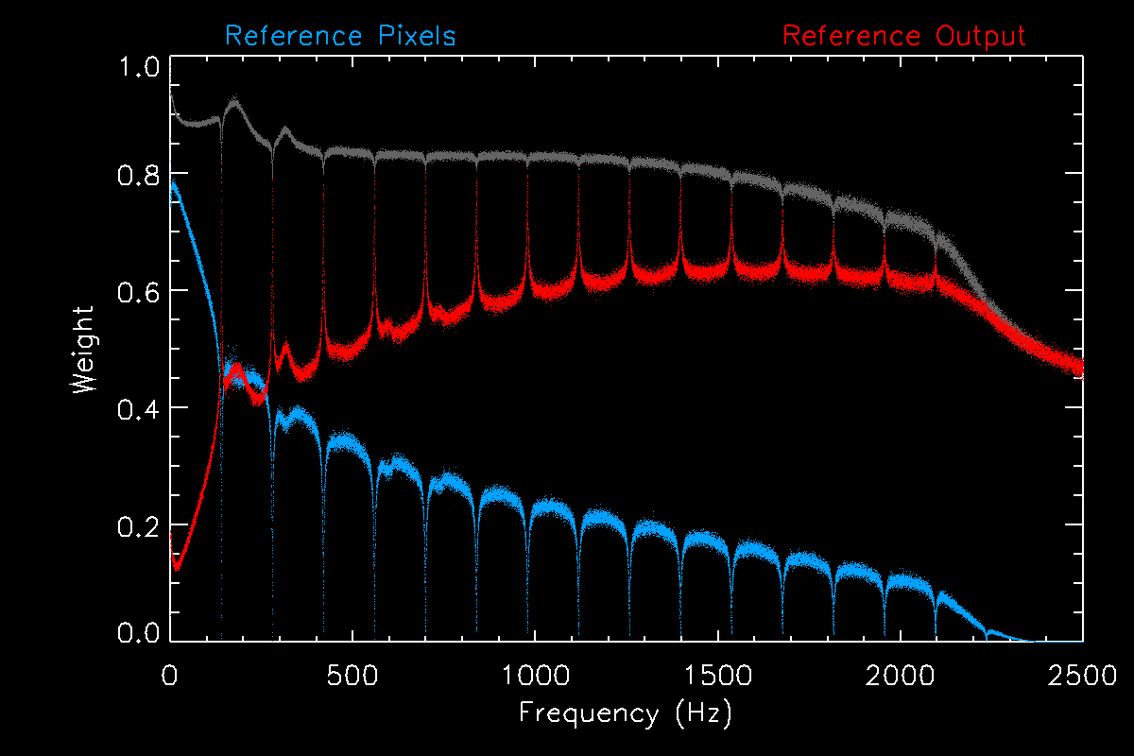
It is better to simultaneously fit for all weights
This reveals that the reference output and reference pixels do different things
  Frame frequency is ~0.1 Hz
  Reference output corrects high frequencies
  Interleaved reference pixels correct low frequencies
Notes:
When we simultaneously do a least squares fit of the reference output and reference pixels to the data, we see that the reference output and reference pixels do different things. The reference output preferentially corrects high frequency (except near the Nyquist frequency). The interleaved reference pixels get the very low frequencies and also the peak at the Nyquist frequency (alternating column noise).

Slide 22
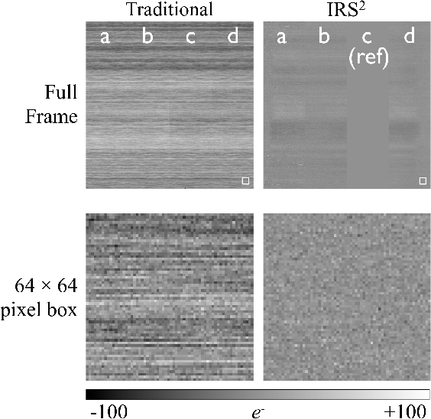
Benefit of IRS² Viewed in the Time Domain
In traditional readout (at left), faint horizontal banding caused by 1/f noise is obvious
  Because the bands go all the way across, we know that this component is highly correlated across outputs
IRS² (at right) cleans most of this (and other correlated noise) up
There is still room for improvement in the reference subtraction of this enginering grade hardware
With flight grade components, the suppression of banding is comparable, but there is relatively less overall reduction in noise because non-stationary low frequency components become dominant sooner
σread = 25 e⁻ rms
σread = 10 e⁻ rms
For this demonstration, output c in IRS² has been configured to return the signal from the reference output.

Slide 23
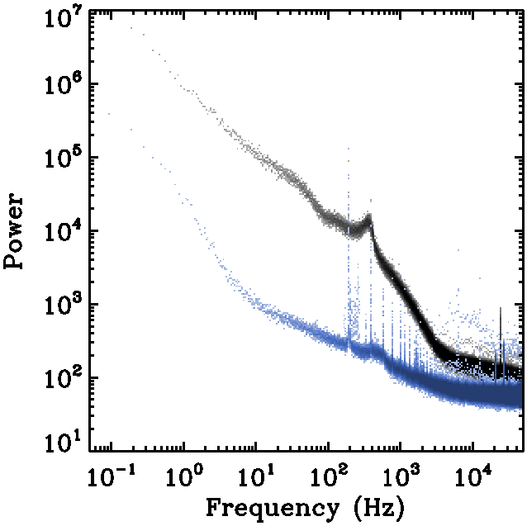
Benefit of IRS² Viewed in the Fourier Domain
(this example is with an engineering grade detector)
Improvement using IRS²
  factor of 2 at high freqs.,
  a factor of 80 near 20 Hz & 400 Hz, and
  a factor of 25 at <1 Hz
Traditional
IRS²

Slide 24
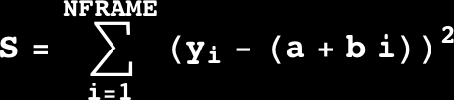
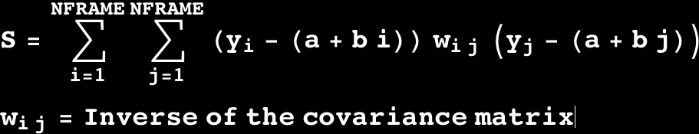
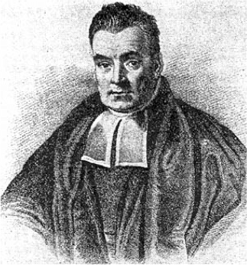
A word about up-the-ramp fitting
Good old fashioned 2-parameter least squares is a best linear unbiased estimator (BLUE) if,
  All data points have equal uncertainty, &
  The uncertainties are uncorrelated.
Both of these conditions are generally FALSE for near-IR detector data
  Unweighted least squares is unbiased, but
  It is not optimal
Generalized least squares is BLUE and improves noise by a few percent for our system
It would be interesting to know if some other definition of optimal is better…
Don’t minimize this…
2-parameter least-squares fit
Minimize this!
Generalized 2-parameter least-squares fit
Thomas Bayes?
Notes:
IRS² uses a generalized least squares fit. This is optimal for gauss random uncertainties. Of course, our uncertainties may not be gauss random, and it would be useful to know if some other interpretation of optimal is better. The little picture is Thomas Bayes. IRS² uses frequentist inference, and it is optimal in a least squares sense for Gauss normal uncertainties. It would be very interesting to know how/if Bayesian inference would change any of our formalism.

Slide 25
Total Noise Improvement
Good old fashioned 2-parameter least squares is a best linear unbiased estimator (BLUE) if,
  All data points have equal uncertainty, &
  The uncertainties are uncorrelated.
Both of these conditions are generally FALSE for near-IR detector data
  Unweighted least squares is unbiased, but
  It is not optimal
Generalized least squares is BLUE and improves noise by a few percent for our system
It would be interesting to know if some other definition of optimal is better…
Notes:
IRS² uses a generalized least squares fit. This is optimal for gauss random uncertainties. Of course, our uncertainties may not be gauss random, and it would be useful to know if some other interpretation of optimal is better. The little picture is Thomas Bayes. IRS² uses frequentist inference, and it is optimal in a least squares sense for Gauss normal uncertainties. It would be very interesting to know how/if Bayesian inference would change any of our formalism.

Slide 26
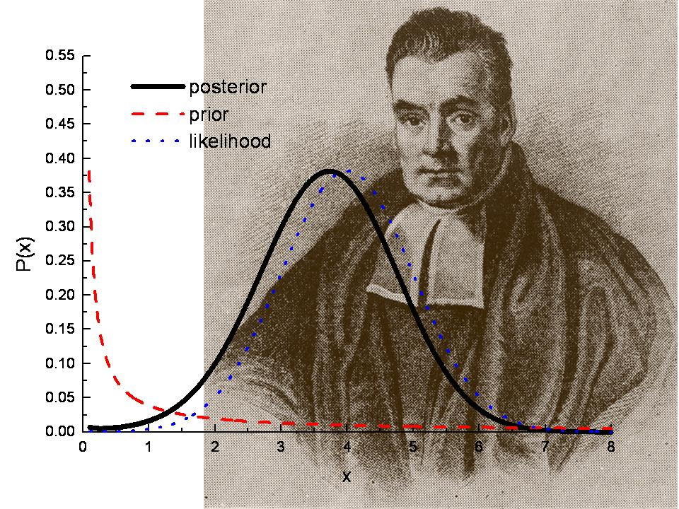
Might we still do better?
IRS² is Wiener-optimal
  Frequentist approach, it’s “what Gauss would have done” (to quote Dale Fixsen)
  Assumes distributions are Gauss-normal, which is debatable for our near-IR detector data
  Would be interested in knowing what Thomas Bayes would have done…

Slide 27
How to build better detector systems
The IRS² study has progressed to the point where we are arguably starting to see the limitations of the H2RG design
If I were in a position to design new detector arrays & ASICs for low background astronomy, here are a few of the simple things that I would do (specific hardware changes are in blue)
  The reference output is very useful for rejecting noise within a frame, but its spectral characteristics are poorly matched to the regular pixels. In the ASIC package, I would include a handful of passive components (~4) to filter the reference signal before passing it to the differential amplifiers
  Only the reference pixels that are built into each output can see the noise that is specific to that output. “But, there are too few of them, and they are too far apart.”
    I would engineer in reference pixels that can be flexibly interleaved with the regular pixels without disturbing the clocking (i.e. no impact on guide windows, etc.)
    I would ensure that these engineered-in pixels are available on both the even and odd numbered column busses (to remove alternating column effects)
  Some noise components, e.g. the picture frame, appear only in the HgCdTe.
    I would engineer in reference pixels that terminate in the HgCdTe
    I would study reset scenarios that deliberately reset a grid of pixels into hard saturation. These would no longer respond to light, but might be useful for tracking position dependent noise in images. IRS²
At some point (I think we’re close), 1/f noise in the unit cell source followers is going to become dominant… If it is straightforward to do, and as a preemptive strike, I would improve the 1/f properties of the unit cell source-follower FETs.

Slide 28
Summary
We are working on a Wiener-optimal approach to using the reference output and reference pixels that are built into the H2RG
Improved reference sampling and subtraction (IRS²) is optimal in a least-squares sense
  We are very interested in hearing about other statistical approaches that you think might be better for…
    Applying reference corrections
    Up-the-ramp fitting
    Stacking calibrated images
IRS² noise reduction to date
  6.5 e- rms: Traditional readout, 88 up-the-ramp frames
  6.1 e- rms: IRS² readout, 65 up-the-ramp frames
  5.5 e- rms: IRS² readout, 65 up-the-ramp frames, + blanked off columns as references
  Images are significantly cleaner with much less banding and visible correlated noise
We are still working to understand the non-stationary noise at very low frequencies and residual covariance

