Slide 1

IR Instrumentation & AGN: Revealing Inner Secrets
Chris Packham
University of Florida
13th December, 2010

Slide 2
Presentation Outline
Instrumentation now and in the near future
  INGRID
  MMT-POL
  T-ReCS, CanariCam
  MICHI
  SOFIA
  SPICA
AGN research: the driving force of my instrumentation direction
  AGN science team
    Driving goals
    Results
Conclusions
λ
Time

Slide 3
Why Use and Build IR Instruments?
IR ideal
Requires deep observations at diffraction limit
Distant objects are redshifted from optical to IR band
Objects commonly shrouded in dust

Slide 4
Instrument Development
4 intertwined elements for optimal & sustained instrument development

Slide 5
MMT-POL

Slide 6
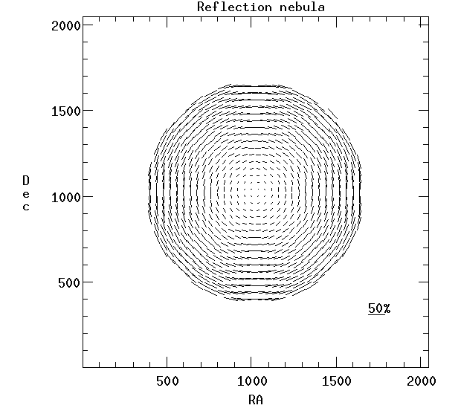
Resolution & Polarimetry
Model reflection nebula
  Individual polarization vectors up to 50%
  Integrated polarization = 0%
    Crossed (unresolved)
    polarization vectors
    add to null (zero)

Slide 7
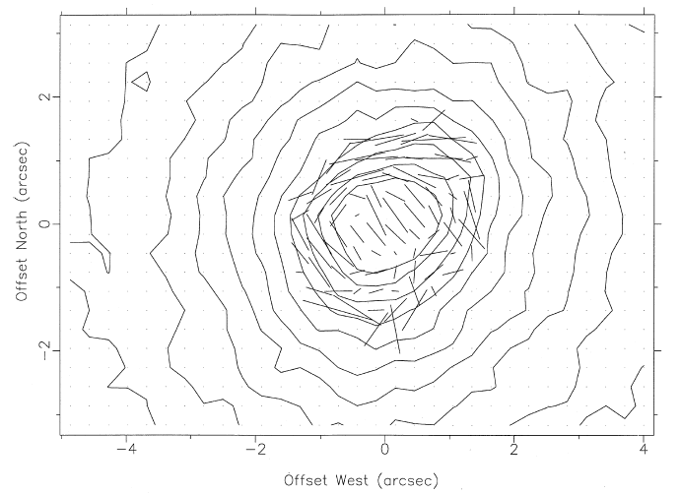
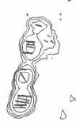
Resolution & Polarimetry
Natural seeing vs. HST observations find startlingly different polarization values
  UKIRT 1.0” ~ 4%
  HST 0.2” ~ 28%

Slide 8
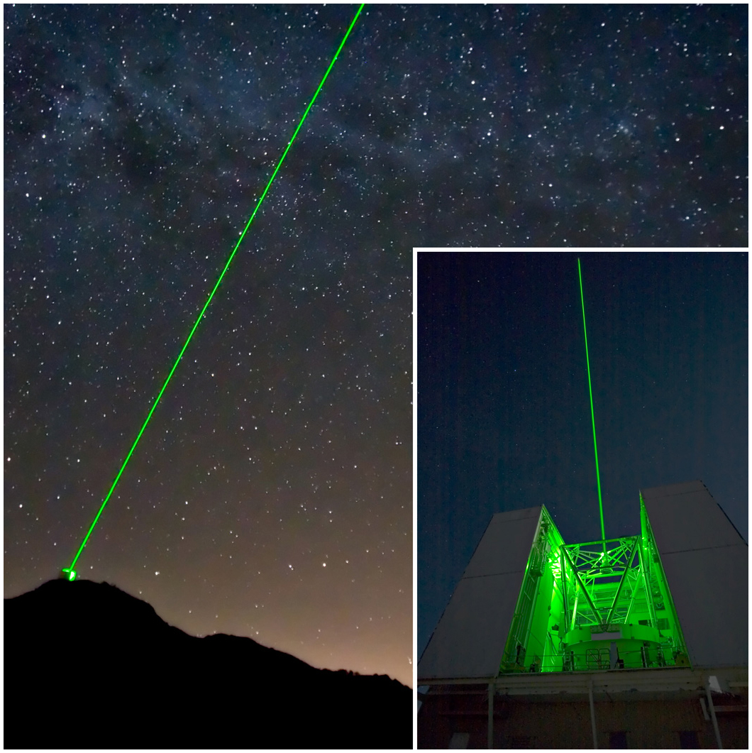
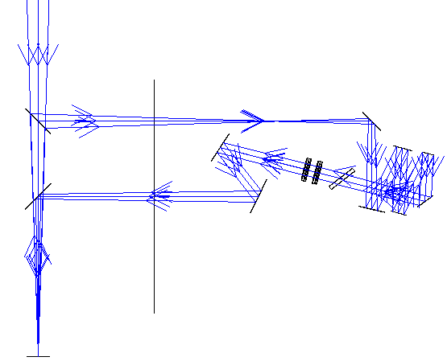
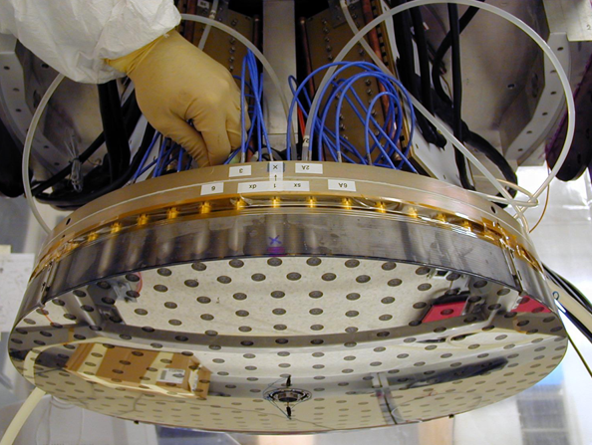
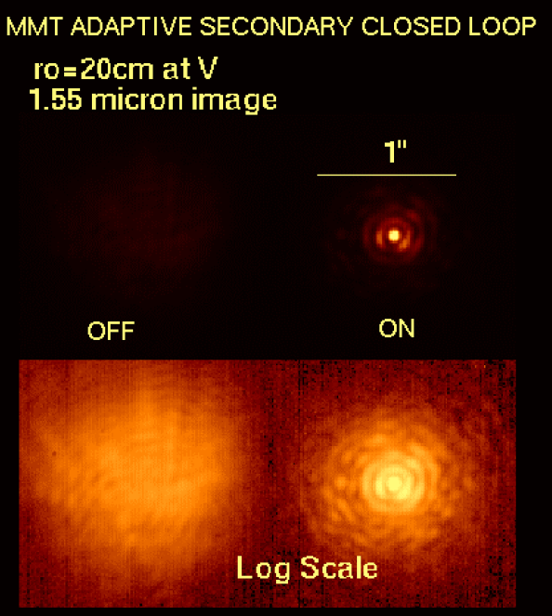
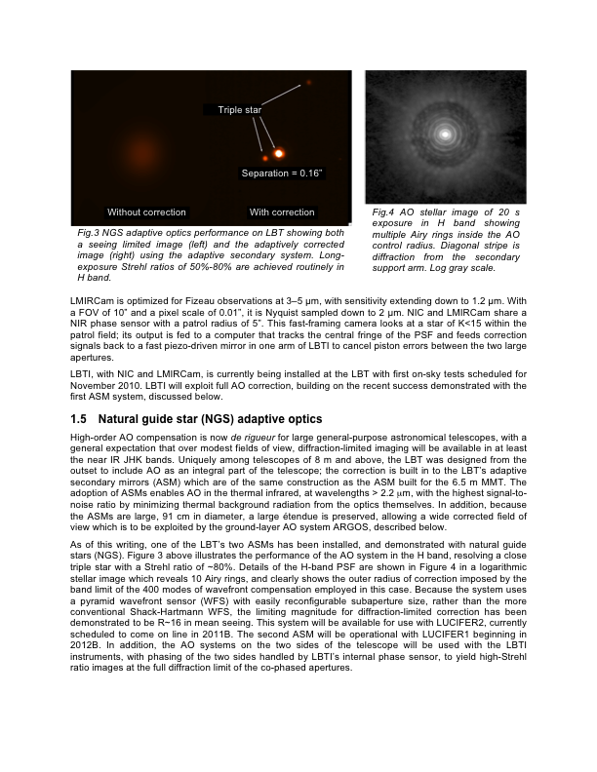
AO Polarimetry
Extremely difficult for high accuracy NIR polarimetry with standard AO systems
  Multiple reflections, dichroics, etc. scramble the polarization signature
6.5m MMT in Arizona with AO secondary
  Laser guide star deployed
  Implementation offers very low instrumental polarization & minimal IR background
ASMs to revolutionize 8m class telescopes

Slide 9
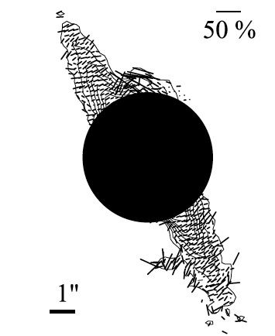
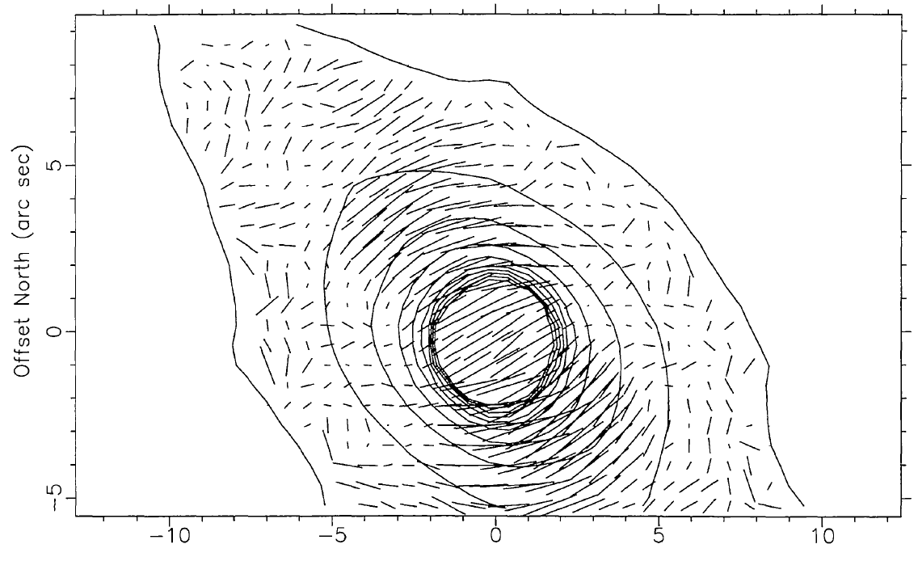
Selected MMT-POL Science Cases
Young stars
  Investigations of planet-spawning debris discs
  Star formation sites and the role of magnetic fields
AGN & galaxies
  Magnetic field structure in AGN & interaction with the host galaxy
  Fuelling processes in nucleus

Slide 10
Polarization & λ Coverage
(Illustrative only)
Dust Scattering
P ∝ λ⁻⁴ or λ⁻¹
Dichroic Emission
P ∝ ?
Efficiency
Dichroic Absorption
P ∝ exp(ln²(λ⁻¹))
Electron Scattering
P ∝ λ⁰
λ
0.5μm
5μm
15μm

Slide 11
Flow-down to Instrument Goals

Slide 12
MMT-POL (Packham & Jones, 2008, SPIE, 7014)
1-5µm dual-beam imaging polarimeter for the 6.5m MMT (Co-PIs: Packham & Jones)
$1M funding provided by NSF in 2007
  Student involvement in all aspects crucial
    Smaller scale projects ideal for students as lifetimes shorter
  Jones: Optics, mechanical
  Packham: Electronics, array & software

Slide 13
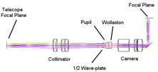
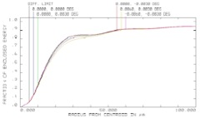
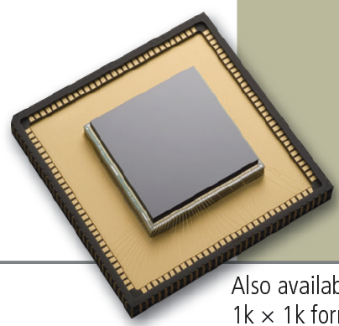
Instrument Design
Optics
  Dual-beam using Wollaston & HWP
    High polarimetric accuracy and avoids PSF variability problem
  Simple transmissive imaging optics
    Maximal throughput and minimal instrumental polarization
Mechanical
  Dewar and cryo-motors in-house
Array & Electronics
  Using Raytheon’s 1024² Virgo array
  Read-out electronics also produced with Raytheon
Software
  Adapted UF developed software already used on Gemini/GTC
Commissioning planned March 2011
RVS Virgo array

Slide 14
Instrument Progress
All components in house
  Integration & optimization in progress
Array optimization occurring remotely from FL to MN
  Building experience for geographically distributed instrument development

Slide 15
MMT-POL

Slide 16
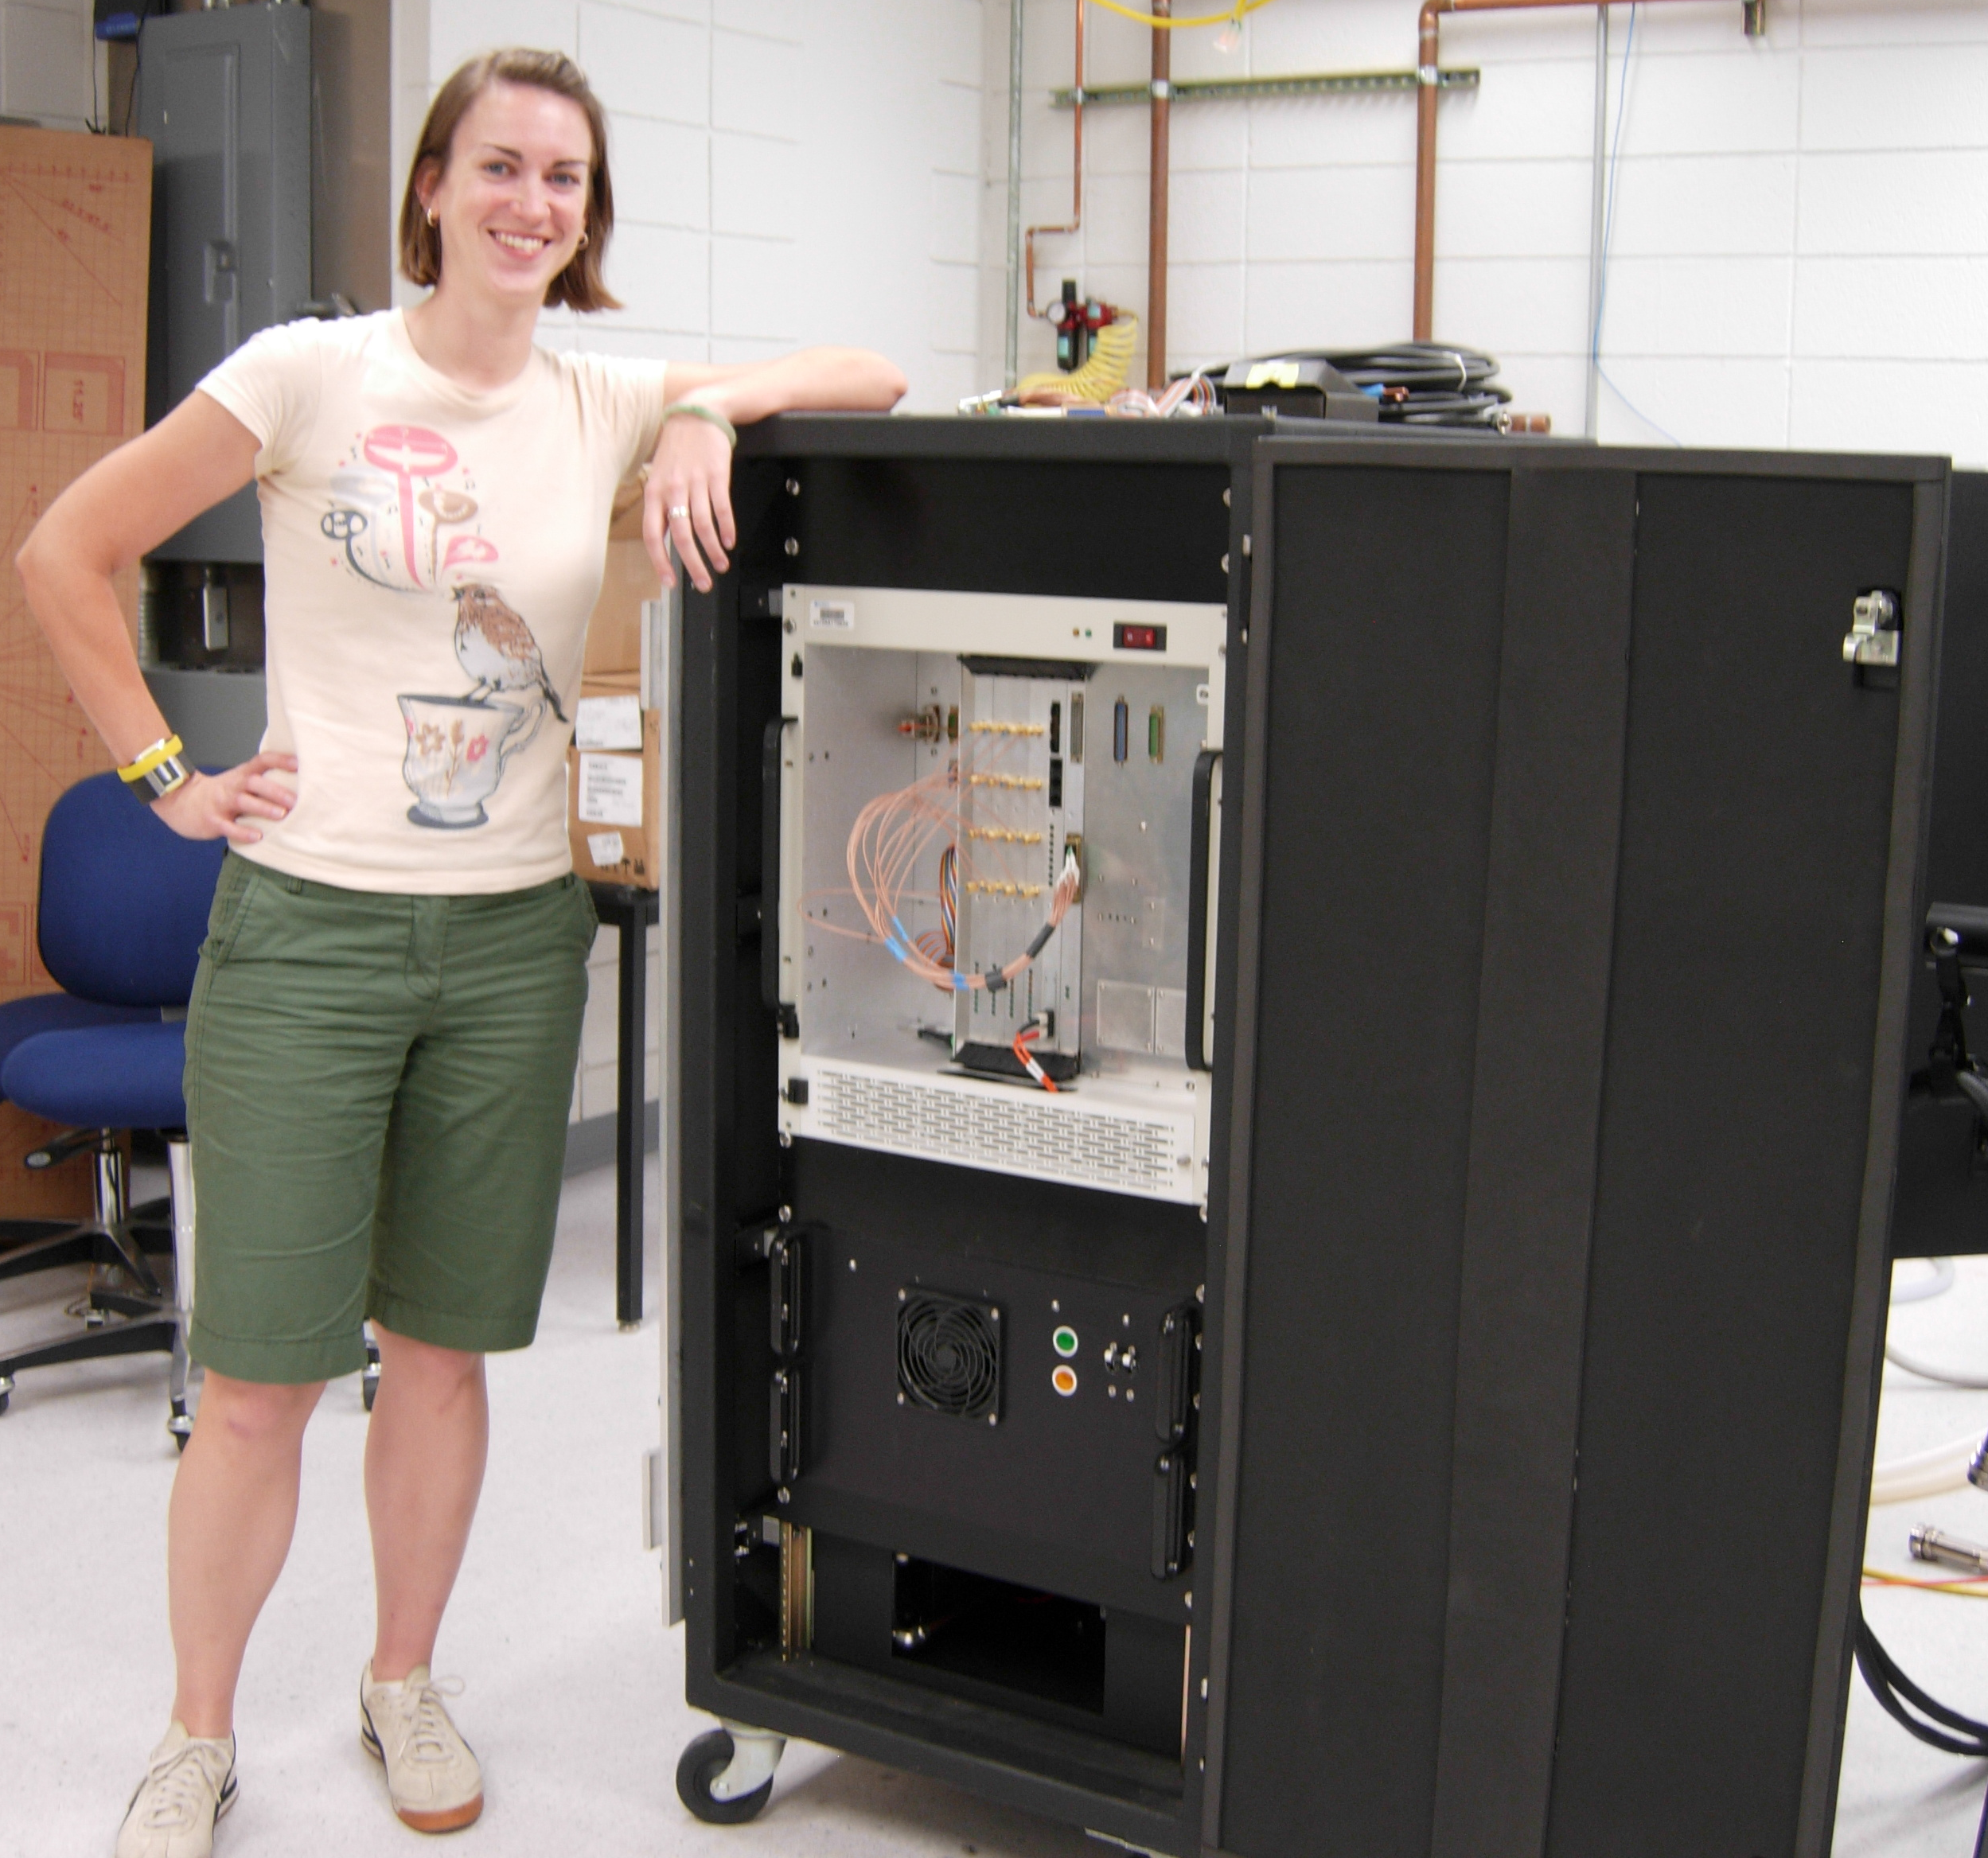
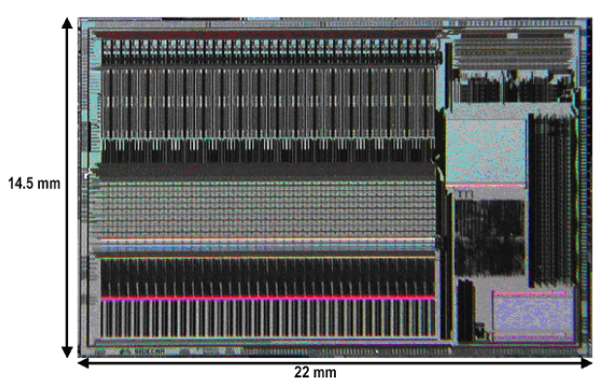
Technology Enablers
1.3m to 22mm!
~$400K to ~$40K
  Output via USB2 cable!

Slide 17
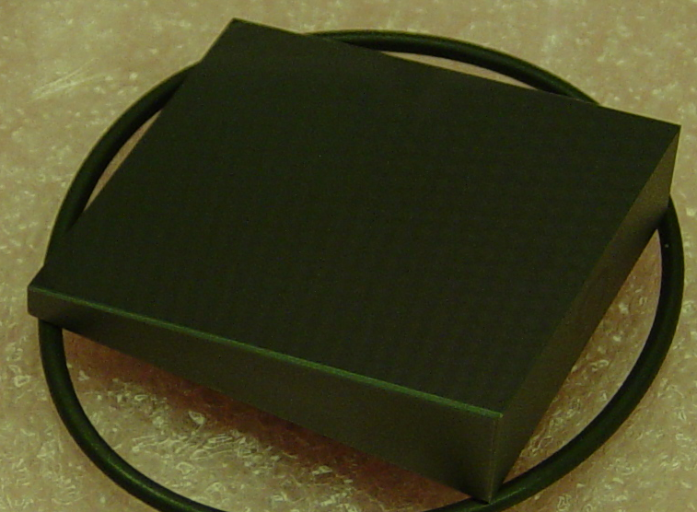
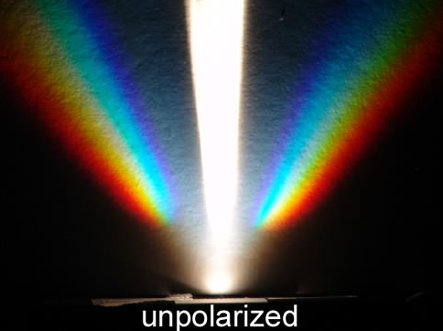
Optics Enablers
$50K to $5K
Spectropolarimetry in one ‘hit’
  Packham et al 2010
Ideal for ground- and space-observatories

Slide 18
T-ReCS & CanariCam

Slide 19
Versatile MIR Instruments
8-26µm facility class instruments
T-ReCS – $2.9M
  Imager & spectrometer
  Deployed on 8.1m Gemini South
  Successfully commissioned 2003
  PI: Telesco, deputy-PI: Packham
CanariCam – $3.2M
  Imager, spectrometer, polarimeter & coronograph
  Deployed on 10.4m GTC
  1st light in Nov. 2009
  PI: Telesco, deputy-PI: Packham

Slide 20
Essential Parameters
Diffraction limited imaging at λ>7.5µm
  T-ReCS = 0.24”
  CanariCam = 0.18”
Diffraction limited spectroscopy at λ>7.5µm
  R~100-1,000
    Entire N (~7.5-13.5µm) and Q (16-26µm) band in one setting or tuned higher spectral resolution
1st dual-beam polarimeter at N band
Coronograph for N band
HST (K) = 0.23” Spitzer (7.5μm) = 2.36”

Slide 21
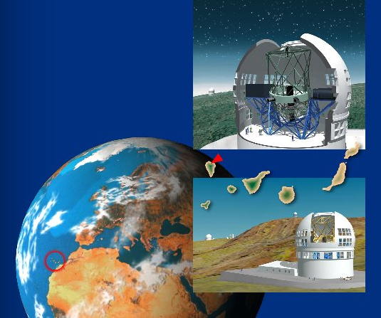
CanariCam
Packham et al., 2005 http://www.astro.ufl.edu/CanariCam/canaricam_home.htm
Mid-IR imager, spectrometer,
polarimeter, coronograph
22 filters, 4 diffraction gratings
Uses 8 gold coated mirrors
  3 OAP provide optical power
1st mid-IR dual beam polarimeter
Array cooled to ~7K
  Optics cooled to ~30K
Engineering modes
  Pupil imaging (to correctly match instrument to telescope pupil)
  Window imaging (to confirm quality of dewar windows)

Slide 22
TMT & MICHI

Slide 23
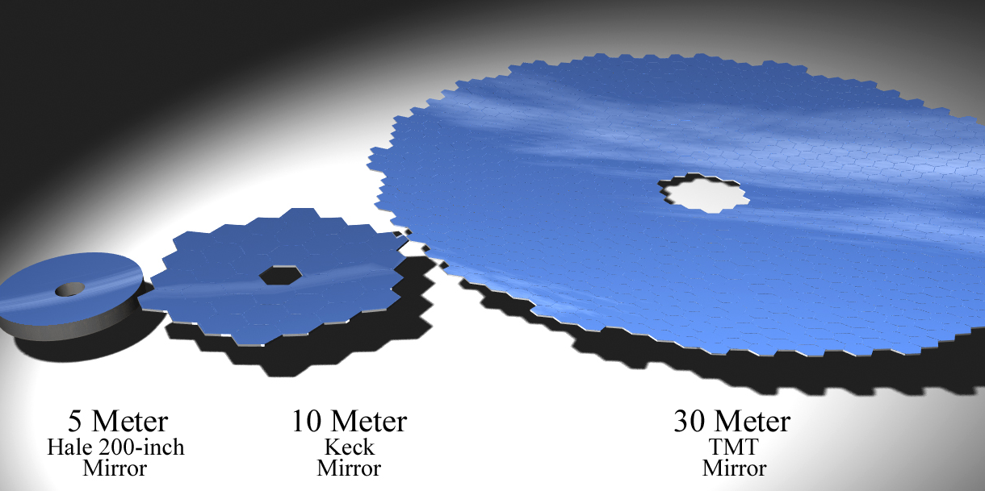
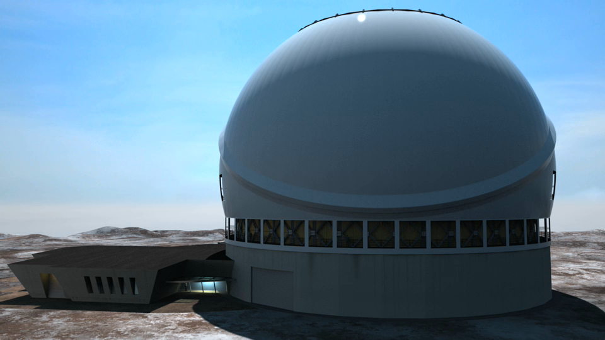
TMT
Revolutionary 492 element
segmented telescope
Key ground based development of 2010’s (?)
AO critical from the outset
  Many gains from 8 - 30m predicated on diffraction limited observations
Optical & 2 NIR
inst. selected
  Each instrument
  cost $10’sM
  MIR instrument
  highly ranked in 1st
  gen. competition

Slide 24
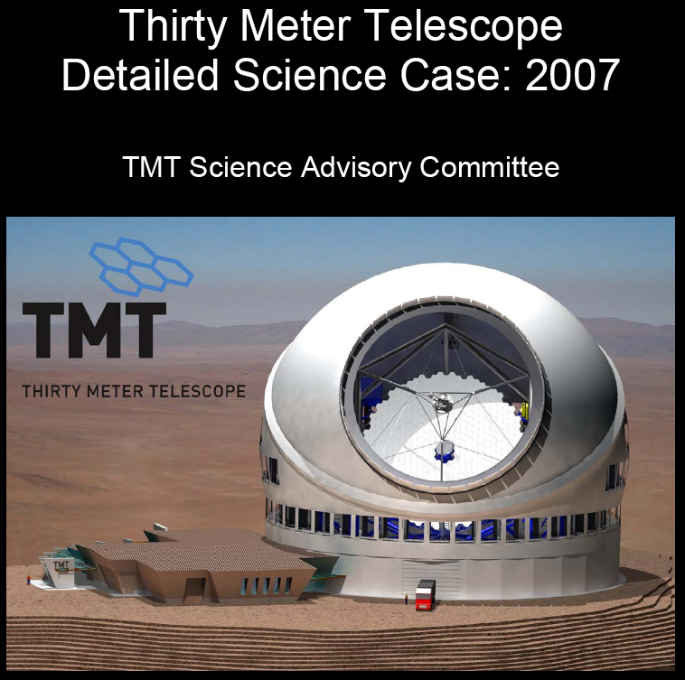
TMT’s Key Science Cases

Slide 25
TMT Science Addressed by MIR

Slide 26
MIR Transformative Science

Slide 27
Science Drivers
Key advantages of a TMT/MIR instrument
  High spatial & spectral resolution
  High sensitivity
Broad science cases (Okamoto, Packham, Tokunaga, et al 2010)
  Star/planet formation & solar system
    Debris disks as early planetary systems
    Properties of solar system bodies
  Galaxies & cosmology
    Properties of AGN & embedded star formation
    Sub-structure of dark matter distribution
  Stars & ISM
    Dust formation/destruction around evolved stars
Multiple cycles of science discovery
  Impossible with limited lifetime missions

Slide 28
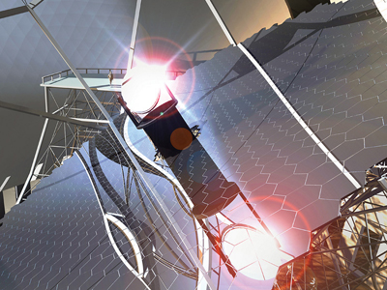
MICHI Concept
MIR TMT instrument to fuse:
  High spectral resolution (R~60-120K)
  MIRES (PI: Tokunaga)
  High spatial resolution (0.063”), low-spectral resolution (R~100), internal chopper, IFU & polarimetry concepts
Japanese initiative by Okamoto & Kataza
  Tokunaga & Packham invited to join 2008
    Strong MIR community interest in Japan/USA
    NSF seed funding ($110K, PI: Packham) to define key science drivers and produce optical design
    NSF R&D funding pending ($163K, PI: Packham)
    Commensurate early funding from Japanese sources

Slide 29
Science Flow-Down
Science cases carefully flowed down into instrument requirements
Requirements addressed by our feasibility level design (Tokunaga, Packham, Okamoto, et al. 2010)
Reference document written and submitted (summer 2010)
Well received by TMT, US and Japanese communities (Okamoto et al. 2010, Packham et al. 2011a, 2011b)
TMT instrument/science workshop expected spring 2011 (HIA?) in preparation for new proposal round
NSF down-select of USA’s 30m proposals in 2011

Slide 30
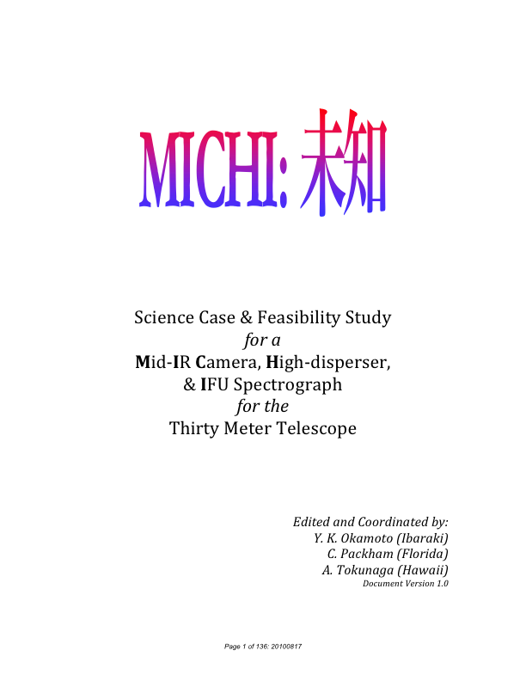
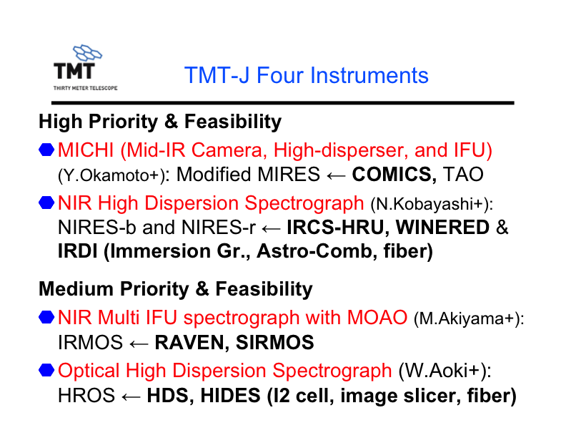


Slide 31
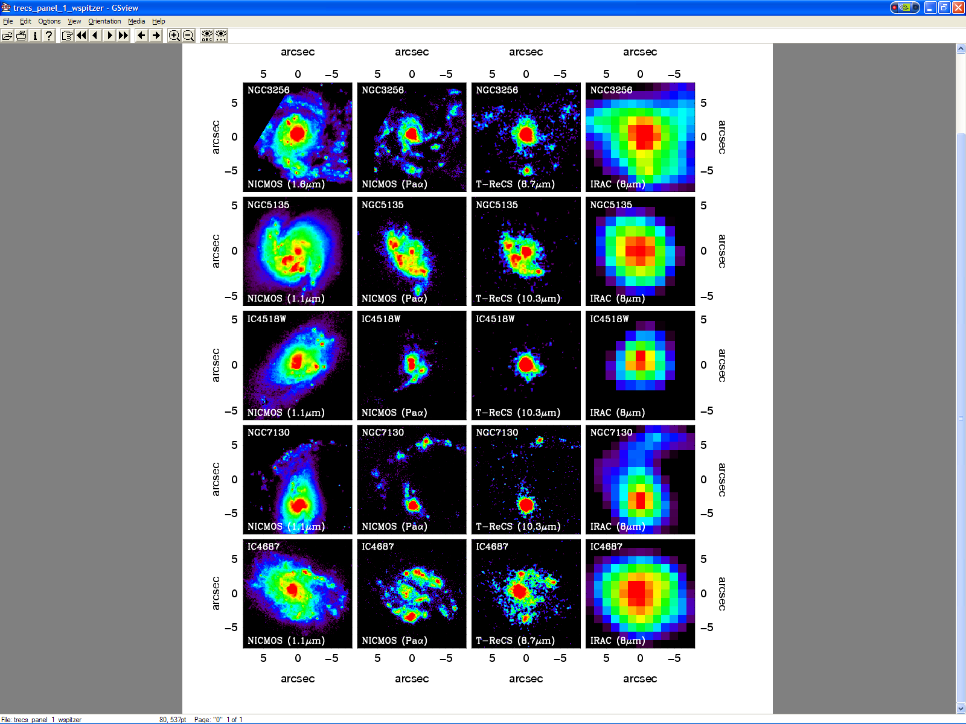
TMT MIR High Spatial Resolution Imaging
Diaz-Santos et al. 2008
Can use the fusion of Spitzer & Gemini as a guide
  But 8m’s rapidly run out of flux, even on bright galaxies
  Only beneficial when Spitzer’s resolution runs out
    Spitzer runs out of resolution very quickly
Crucial to understand the local
universe for application to
distant objects
  Foundation stone of understanding galaxy & AGN formation, where black hole & AGN evolution may be evident
  Necessary to disentangle emission from diffuse, AGN & HII regions

Slide 32
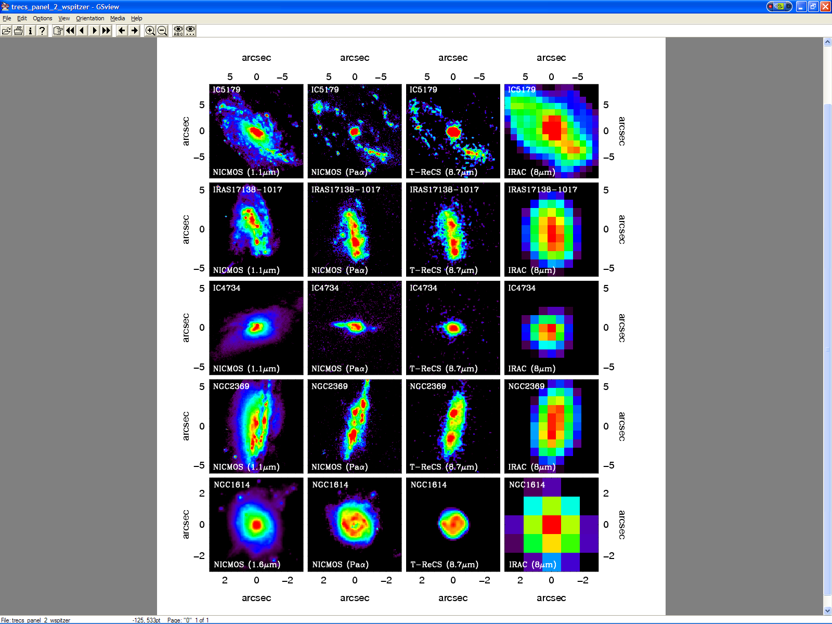
Only with high spatial resolution can constituent parts of AGN & host galaxy be investigated and de-blended
    Resolution at z=0.5
      JWST = 1.5kpc (galactic star forming rings, etc.)
      TMT = 330 pc (nuclear dominated)

Slide 33
Only with high spatial resolution can constituent parts of AGN & host galaxy be investigated and de-blended
    Resolution at z=0.5
      JWST = 1.5kpc (galactic star forming rings, etc.)
      TMT = 330 pc (nuclear dominated)

Slide 34
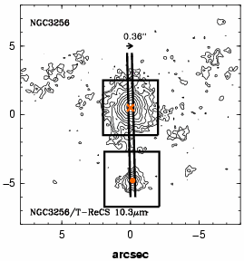
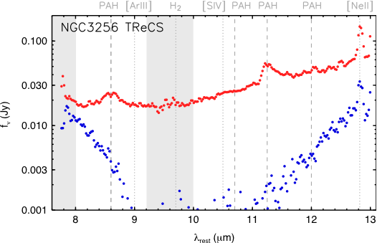
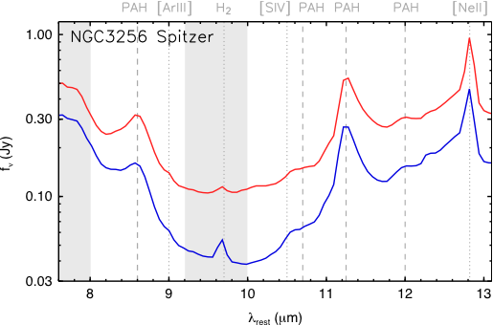
Spatial Resolution & Spectra
Diaz-Santos et al. 2010.
Comparison of Spitzer (~600 pc) and T-ReCS (~60 pc) spectra shows significantly different results
  In this case, silicate absorption is essentially only from southern nucleus whereas PAH dominantly in northern nucleus
    Surrounding diffuse emission can confuse and contaminate the spectra, possibly misdiagnosing the nuclear activity, SFR & torus parameters

Slide 35
Spatial Resolution & Spectra
Diaz-Santos et al. 2010.
Comparison of Spitzer (~600 pc) and T-ReCS (~60 pc) spectra shows significantly different results
  In this case, silicate absorption is essentially only from southern nucleus whereas PAH dominantly in northern nucleus
    Surrounding diffuse emission can confuse and contaminate the spectra, possibly misdiagnosing the nuclear activity, SFR & torus parameters

Slide 36
Science Teams

Slide 37
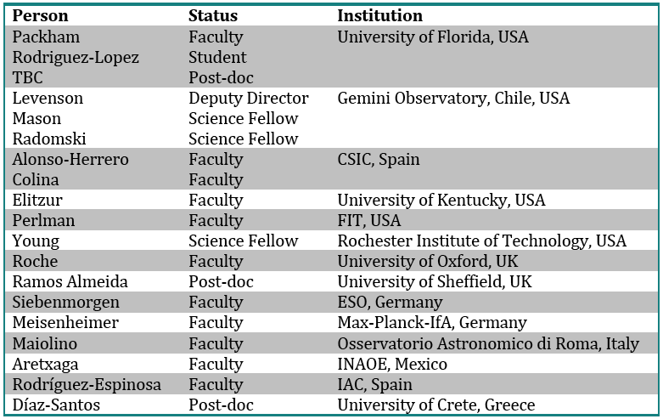
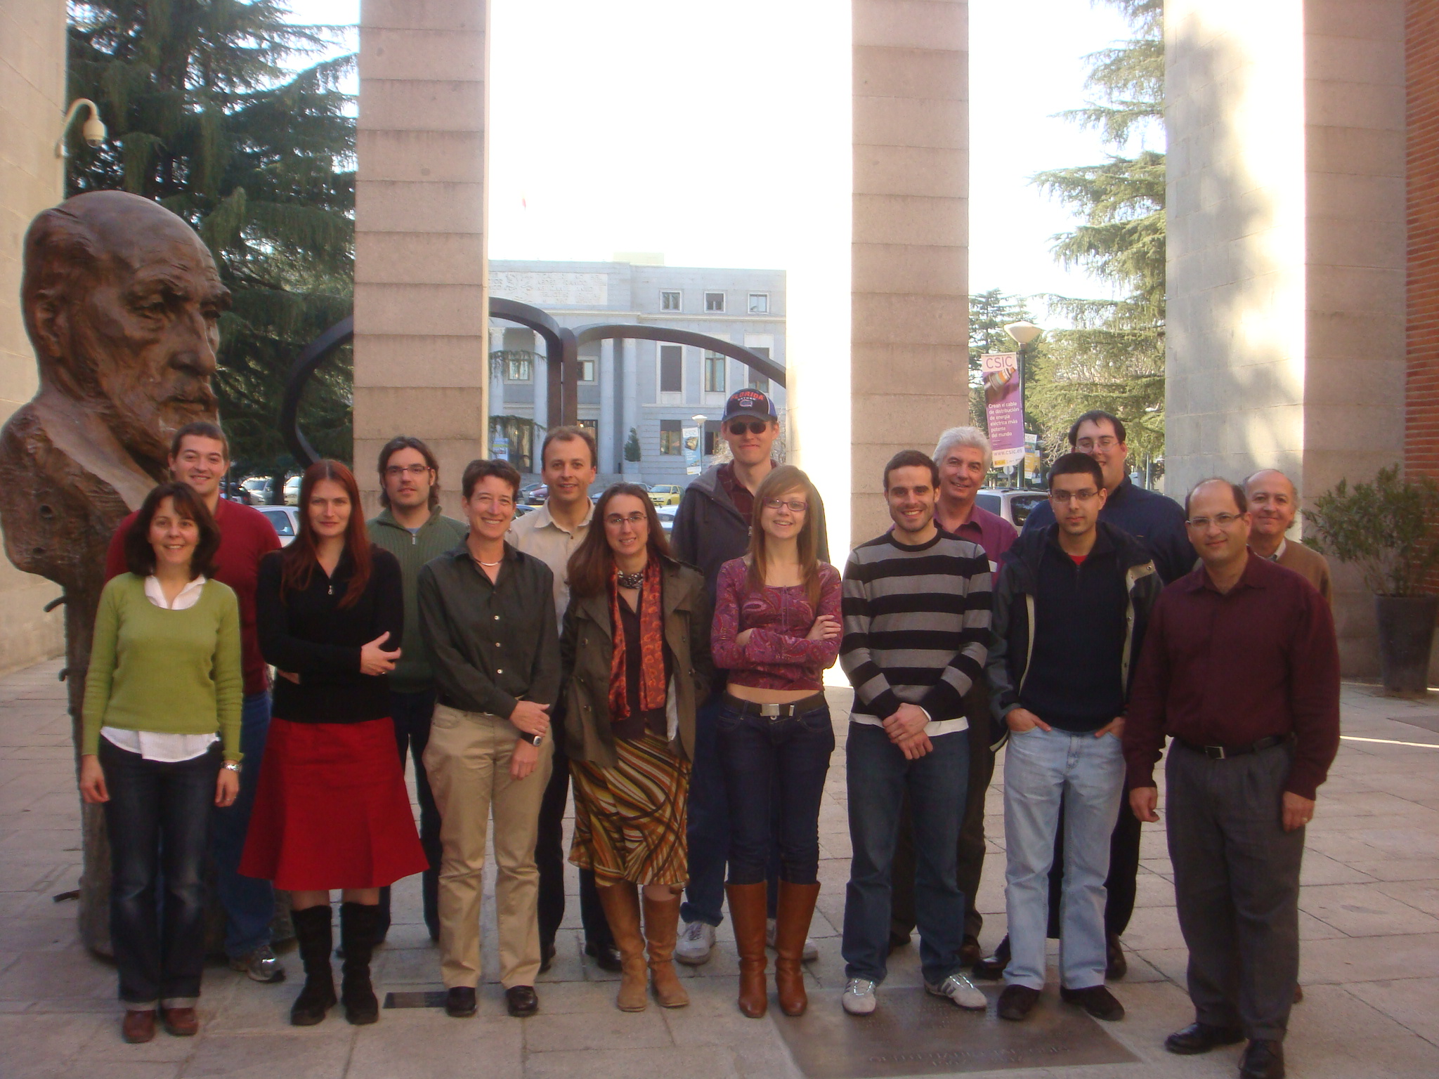
CanariCam Science Teams
3 groups
  AGN (Packham)
  Sub-stellar objects (Telesco)
  Stellar disks (Telesco)
Aims to maximize scientific return from CanariCam GT
Teams crucial to maximize returns
  CCST:AGN has published >35 papers since 2005
  Key data in >5 Ph.D.’s
    US, Spain, Mexico, UK
  Unifies instrument builders, observers & modelers in single coherent team
Madrid, March 2009

Slide 38


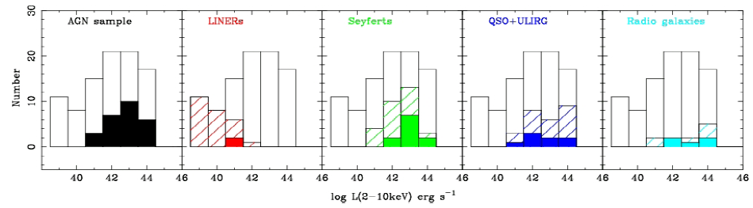
Time Allocation
Awarded 200 hours “ESO-GTC Large Program” status in fall 2008
  Supporting funds (~€0.2M) granted in Spain
Total of >350 hours to probe luminosity function of AGN using
x-ray luminosity as proxy
  Unification of type 1 and II objects
  Unification of radio-loud and radio-quiet objects
  Dust properties in and around the nuclear regions
  Probing the AGN/Starbust connection
  Low-luminosity AGN and the origin of the torus
Homogenous observations using imaging, spectroscopy and polarimetry of ~150 objects
  Legacy-type archive & definitive 8m MIR study of AGN

Slide 39
Time Allocation
Awarded 200 hours “ESO-GTC Large Program” status in fall 2008
  Supporting funds (~€0.2M) granted in Spain
Total of >350 hours to probe luminosity function of AGN using
x-ray luminosity as proxy
  Unification of type 1 and II objects
  Unification of radio-loud and radio-quiet objects
  Dust properties in and around the nuclear regions
  Probing the AGN/Starbust connection
  Low-luminosity AGN and the origin of the torus
Homogenous observations using imaging, spectroscopy and polarimetry of ~150 objects
  Legacy-type archive & definitive 8m MIR study of AGN

Slide 40
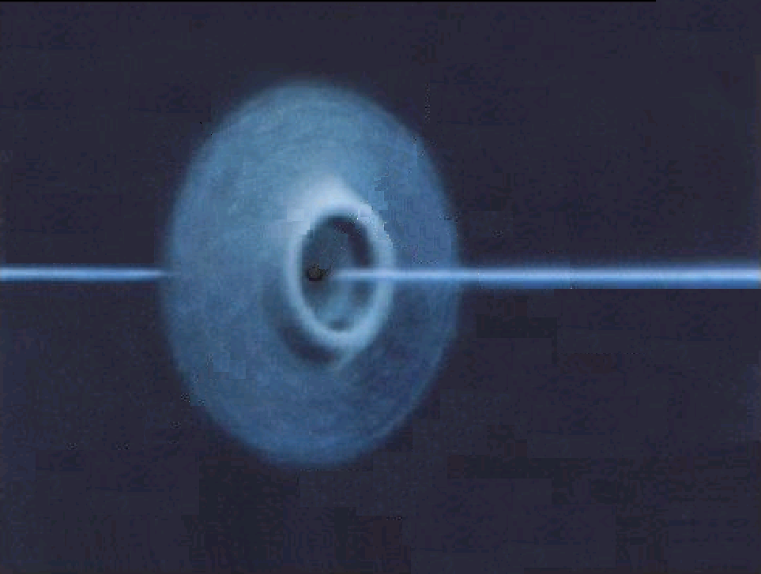
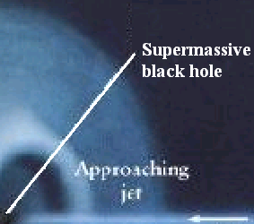

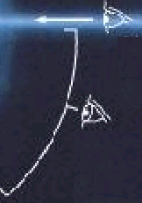

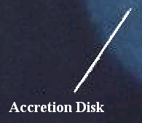
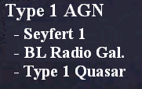
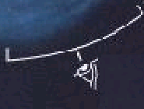
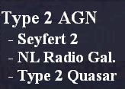
TORUS
STANDARD MODEL

Slide 41
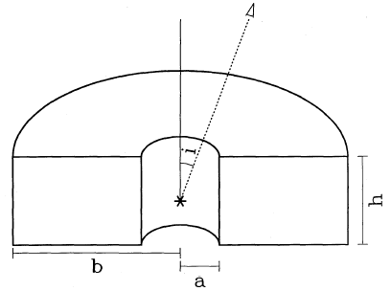
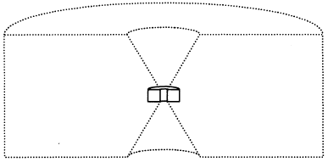
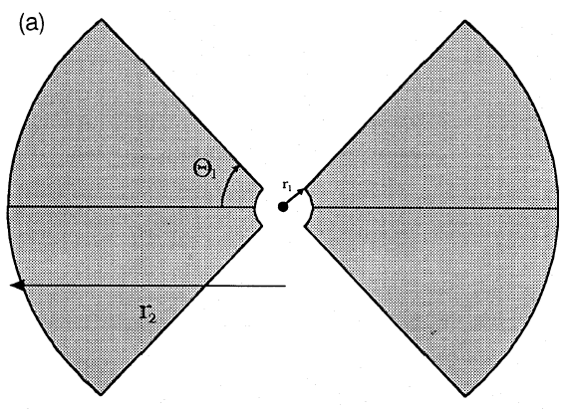
Modeling IR emission
0
Pier & Krolik 92
Pier & Krolik 93
5-10 pc
~100 pc
Efstathiou et al (1996) estimate torus for NGC1068 outer radius = 178pc
Granato et al (1997)
  Uniform density
  R_{out} > 10 – 20 pc

Slide 42
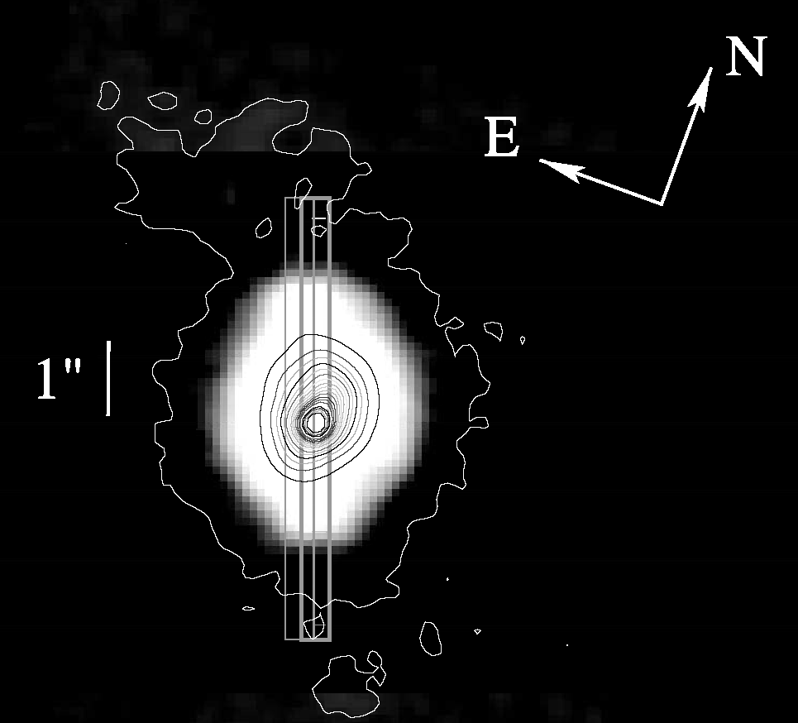
Imaging & Spectroscopy of NGC1068
Mason et al., ApJ, 2006
Archetypal Sy AGN
  Sy 2 in total flux, Sy 1 revealed in polarized flux
If large torus (r>15pc) present in NGC1068, easily resolvable at our 8m MIR resolution
  Image (left) at 9.7μm show no evidence of extension attributable to the torus
Spectra extracted in 0.4” steps along the slit

Slide 43
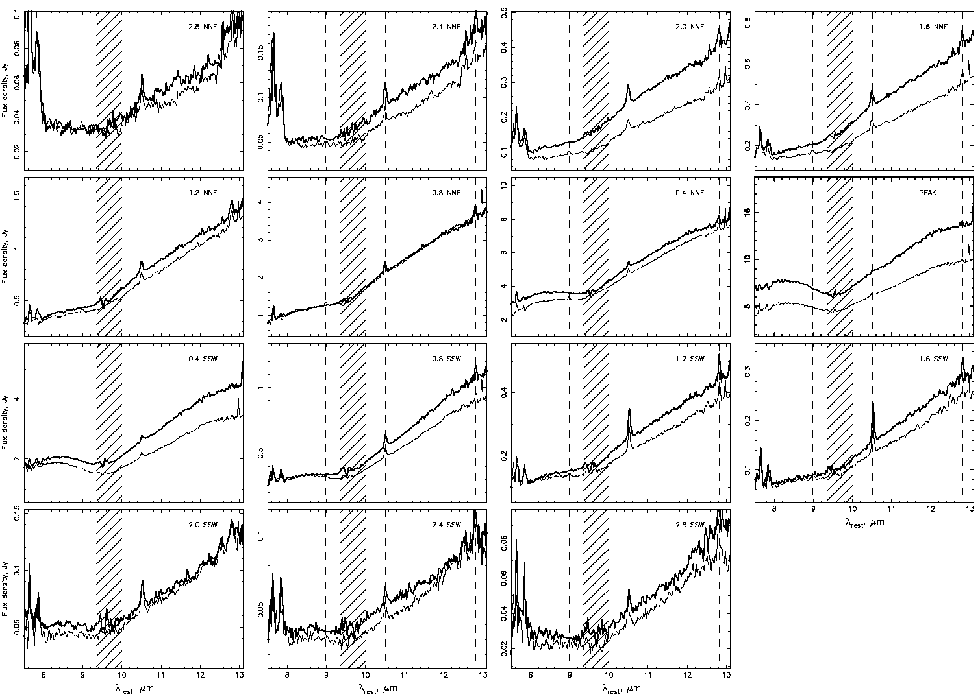
Extracted Spectra:
Variations on Sub-Arcsecond Scales

Slide 44
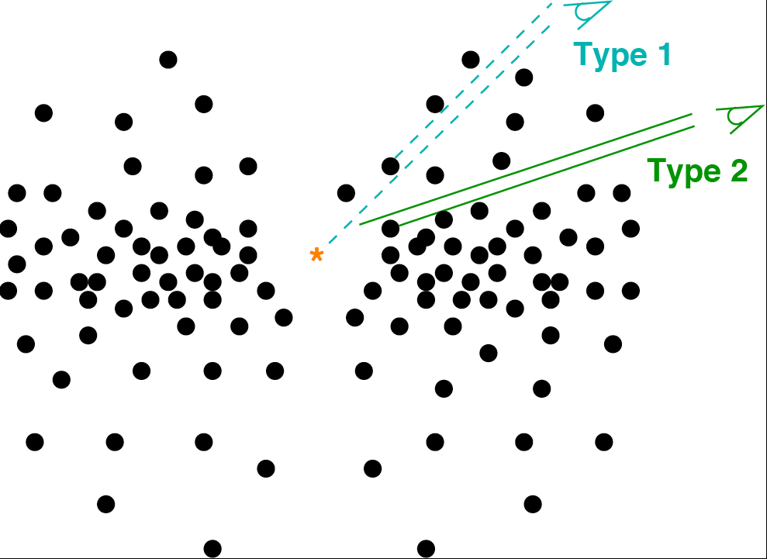
Clumpy Torus Model
Clumpy torus model of Nenkova et al. (2002)
  Clouds follow power law distribution
  Clouds concentrated in equatorial plane
  Distributed with scale height σ
  τ_{v} of each cloud = 40-150
  Number of clouds along pencil-beam line of sight ~10

Slide 45
Clumpy Torus Model Advantages
Clumpy distribution puts cooler dust (on protected side) closer to nucleus than continuous dust distribution
  More compact torus
Strong silicate emission feature rarely observed
  Difficult to replicate result in traditional models
  Readily reproduced in clumpy model

Slide 46
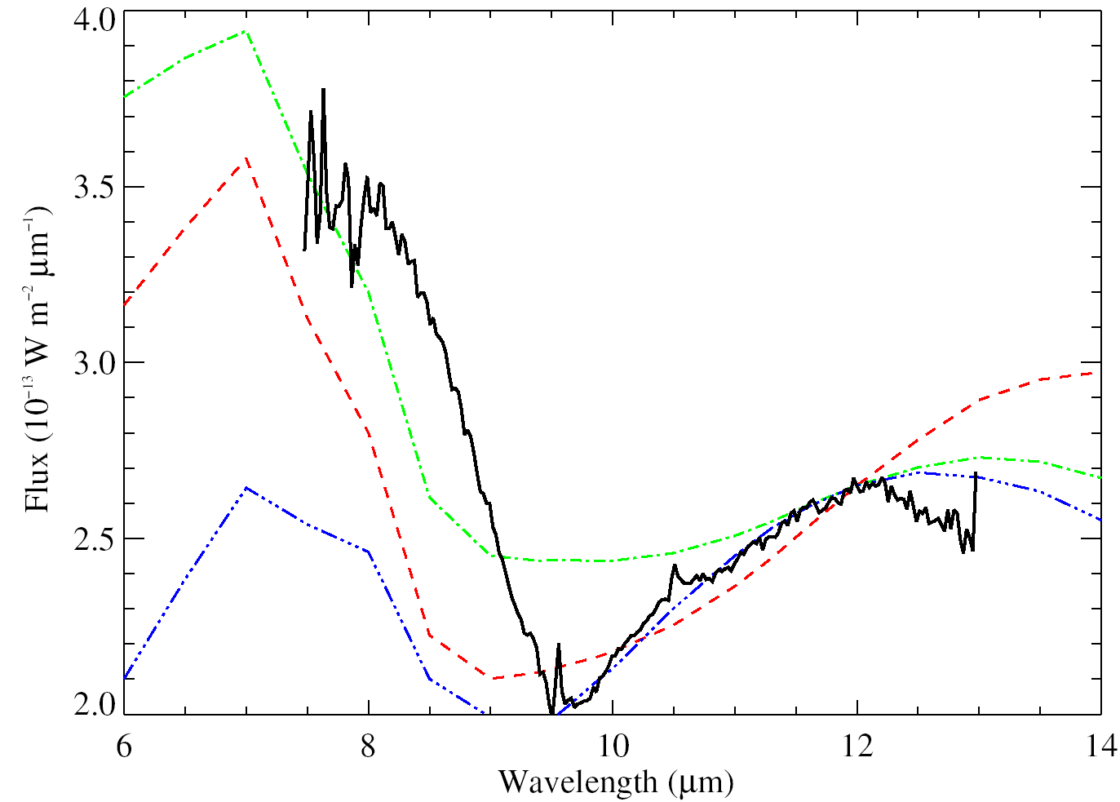
Clumpy Torus Model Spectral Fits
Fits of the clumpy torus model to the 10µm spectrum of NGC 1068 (heavy solid line)
Torus size best fit ~3pc
Entirely consistent with MIR interferometric observational result of Jaffe et al. (2004)

Slide 47
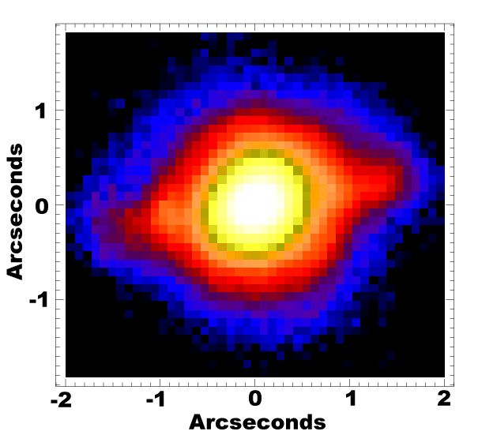
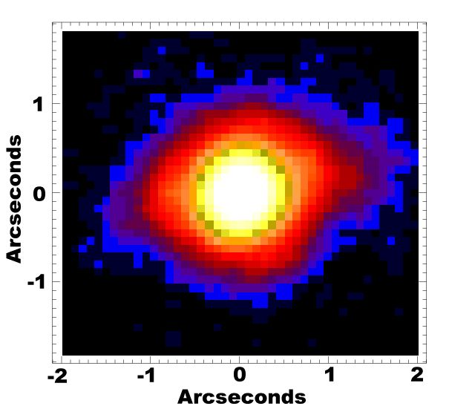
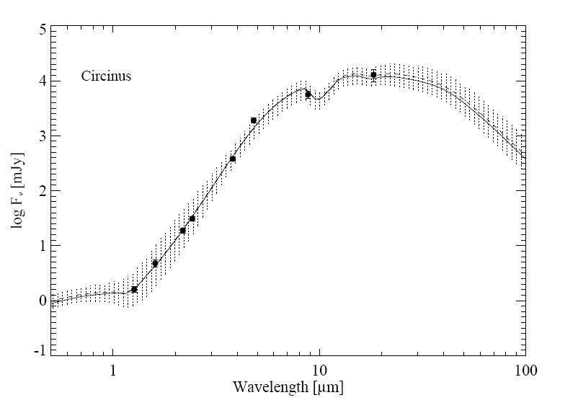
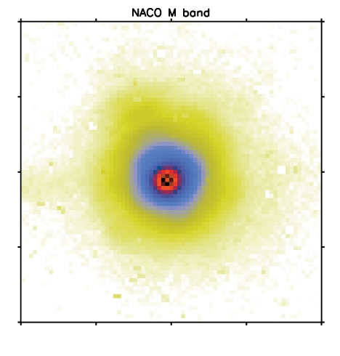


NIR-MIR SED Fitting
Ramos Almeida et al. submitted
T-ReCS N
T-ReCS Q
Mid-IR data from T-ReCS/Gemini (Packham et al. 2005)
NACO M
NACO L
Near-IR data from NACO/VLT (Prieto et al. 2004)
NACO J

Slide 48
Conclusions: The Torus
Centaurus A torus <0.19” (3.1pc) (Radomski et al., 2007)
Circinus torus <0.2” (4pc) (Packham et al., 2005)
NGC1068 torus <0.4” (3pc) (Mason et al., 2006; Jaffe et al. 2004; Packham et al., 2007)
NGC4151 torus <35pc (Radomski et al., 2003)
MIR SED of M87 shows no evidence of torus emission (Perlman et al., 2001, 2007)
Torus is very compact and consistent with a clumpy distribution of obscuring material
  Link between luminosity, accretion & torus presence?
    Elitzur & Shlosman, 2006
  Where the torus ends and the host galaxy dust structure starts is more of a question of semantics rather than a true physical boundary (Young et al. 2007; Packham et al. 2008)
  SED and spectral fitting using Bayesian methods constraining detailed torus parameters (Alonso Herrero et al submitted)
    Tentative detection of difference between type I/II tori

Slide 49
IR Instrument & Science Teams

Slide 50
IR Instrumentation

Slide 51
Expensive Instruments
A new era of instrumentation is upon us
  TMT instruments now costing similar to those of space based (~$50M)
    Space based instruments commonly developed in collaboration with industry
  Partnerships are now possible and desirable
  Geographically distributed instrument development
    Systems engineering and industry approached required
    10% overrun of new instruments is higher than total budget of previous generation!
    Specialization becoming key
      RIDL outstanding example
  Technical schools well placed to leverage these changes

Slide 52
IR Instrument Development
IR arrays are fundamental to the next generation of instruments (TMT, 8m, etc)
  RVS & Teledyne interested in collaborations
Institutes with privileged large telescope access especially well placed for instrument development
  NSF keenly aware that instrument development groups must be nurtured in coming decade to compete with ESO

Slide 53

Multidisciplinary Activities
Necessary for instrument development
  Linking with university engineering departments
An exciting and dynamic environment for young scientists
  Involvement of students in sections of large projects
  Center for Detectors is an excellent example
Leading to astronomical research
  Science/development in its own right
  Collaborating institute with others
    E.g. Cornell, NOAO, UCLA, Gemini,
    Subaru, RVS, Acumen, Teledyne
Essential training for 21st century
workforce

Slide 54
Final Conclusions
IR instruments key now, and in the future
  AO, TMT, JWST, SPICA, SOFIA, etc.
Need balanced approach to instrument development for the long-term
  New ground-based era is upon us
  Heavily reliant on project management & system engineering
Observations of AGN at MIR wavelengths changing the scales and structure of the torus
The next generation of telescopes will probe the distant universe to explore galaxy and AGN formation
  Black hole and AGN evolution may be evident
  Understanding local objects is essential preparation
RIT optimally placed to leverage from the research staff & Center for Detectors

Slide 56
IR Instrument Development
IR arrays are fundamental to the next generation of instruments (TMT, 8m, etc)
  RVS & Teledyne interested in collaborations
Institutes with privileged large telescope access especially well placed for instrument development
  NSF keenly aware that instrument development groups must be nurtured in coming decade to compete with ESO

Slide 57
INGRID

Slide 58


INGRID
1-2.5μm imager for 4.2m
WHT (PI: Packham)
  Wide field of view (4.2’x4.2’)
  Diffraction limited imaging (with AO system)
Commissioned 2000
  ~$1.5M, array was new and expensive 10 yrs ago!
Provided UK astronomers with greatest survey power facility NIR imager
  Most requested WHT instrument for several semesters
  Simple and quick development to fill an open niche
    Ideal preparation for 8m era
  Agile instrument development essential to exploit new technologies

Slide 59
SOFIA

Slide 60


SMIRPh
Instrument concept for
NASA’s airborne 2.5m SOFIA
SOFIA MIR Polarimeter: simultaneous 5-25 & 25-40µm imaging- and spectro-polarimetry
  PI: Packham, science advisory board formed
    Advancement from FORCAST
  Science drivers and instrument concept complete
    Papers presented at SPIE & interest from military
  Awaiting 2nd generation instruments on SOFIA
    Expected 2010 (?)
No polarimetry on future space-based observatories
  Ideal niche for SOFIA
  Warmly welcomed by SOFIA community
  Offers a unique legacy for
    Star formation
    Debris discs
    AGN
    Dust grain chemistry

Slide 61
SPICA

Slide 62


SPICA
Planned JAXA-ESA 3.5m
5-200µm satellite
Launch planned ~2017
More sensitive than JWST at MIR wavelengths due to active cooling
4 instruments likely
  MIR will be the primary
  science instrument
Will probe birth & evolution
of galaxies, stars, and planets

Slide 63
SPICA Collaborations
Initial discussions indicate a desire to collaborate on array development & testing
  Could include software work too
SPICA could be the premier MIR space telescope for a decade to come
  But spatial resolution limited to 0.54” at 7.5µm
  Sensitivity unrivalled
  Time for initiating collaborations is now
    Enthusiasm from all sides

