Slide 1


Massive star formation in the Galactic Center
Don Figer
¹Director, Center for Detectors, Rochester Imaging Detector Laboratory
Professor, College of Science, Astrophysical Sciences and Technology PhD Program, Microsystems PhD Program, Imaging Science Program
CfD

Slide 2
Outline
Galactic center star formation environment
Products of star formation
  embedded protostars
  young clusters
  young dispersed population
  intermediate age population
Global characteristics
Conclusions
Notes:
This slide gives the outline of the whole talk.

Slide 3
Galactic center star formation environment

Slide 4
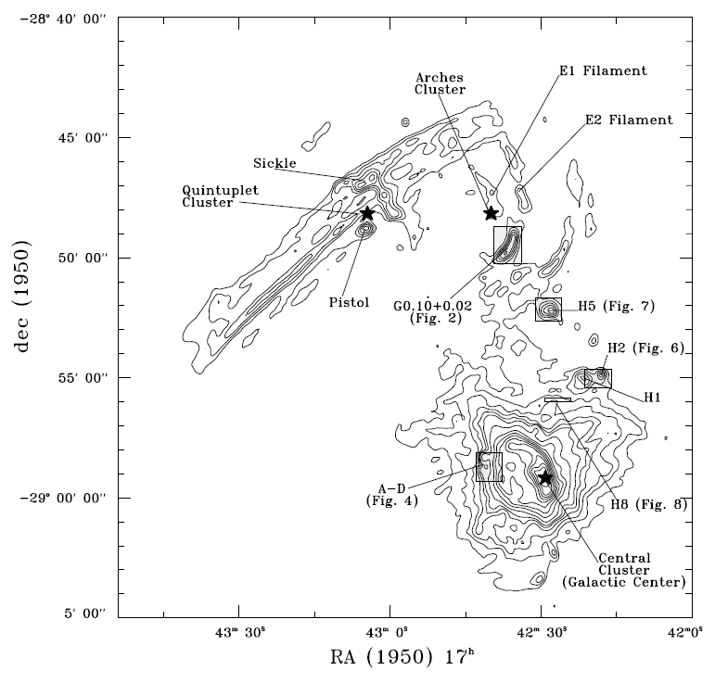
Map of star formation sites
Notes:
ISOLATED HOT STARS IN THE GALACTIC CENTER VICINITY
ANGELA S. COTERA1 JANET P. SIMPSON,1 EDWIN F. ERICKSON, AND SEAN W. J. COLGAN
NASA/Ames Research Center, MS 245-6, Mo.ett Field, CA 94035
MICHAEL G. BURTON
University of New South Wales, School of Physics, Department of Astrophysics, 2052 Sydney, NSW, Australia
AND
DAVID A. ALLEN2
Anglo-Australian Observatory, P.O. Box 296, Epping, NSW 2121, Australia
Received 1997 October 30; accepted 1998 August 3
ABSTRACT
Using near-infrared imaging and spectroscopy, we discuss the discovery of six emission-line sources
within D20 pc of Sgr A West but outside of the central parsec. The objects are coincident with stars
seen in the J, H, and K@ images; all have Brc (2.166 km) in emission, several also have He I (2.058 and
2.112/3 km), and some have He II (2.189 km) emission lines. Comparison of the H- and K-band spectra
of the newly discovered stars with recently published infrared spectral atlases of optically classiÐed stars
suggests that most of these stars are similar to massive stars in transition (e.g., Ofpe/WN9, B[e], and
LBV), although one is deÐnitely a WN6 star. Two of the potential stars are associated with the radio
emission regions AÈD near Sgr A East, three are near or within the radio emission regions H1ÈH8
(nomenclature from Yusef-Zadeh & Morris), the last is near G0.10]0.02 and is likely to be associated
with the G0.12]0.02 (Arches) cluster of stars, discussed in a previous paper. The stars are shown to be
signiÐcant sources of ionization for their associated radio emission regions, with several capable of completely
ionizing the regions. These results provide additional support for the idea that these thermal
radio regions, and similar such regions in the Galactic center, are indeed photoionized by hot young
stars.

Slide 5
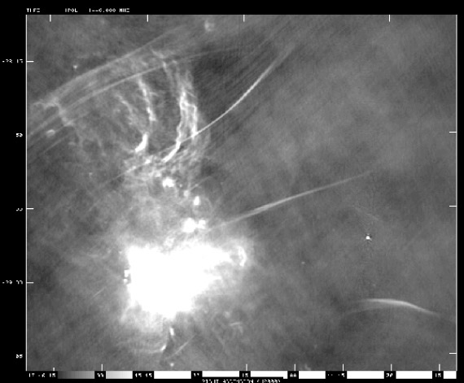
The GC in Radio - Wide View
20 cm
big clusters
UCHII regions
N
E
Lang, Morris, Echevarria 1999

Slide 6
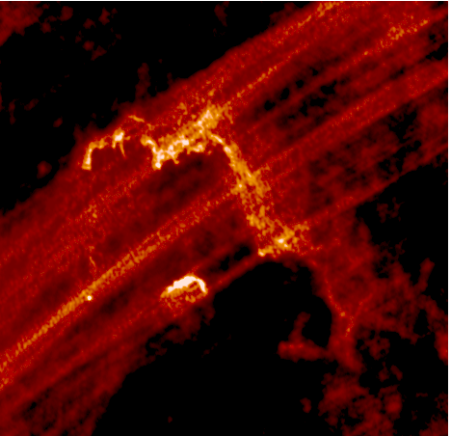
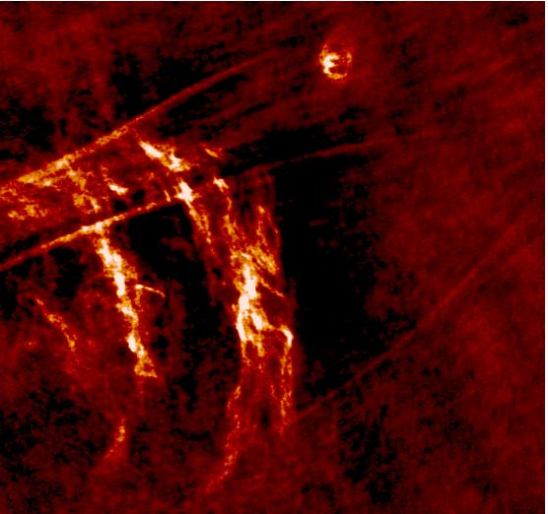
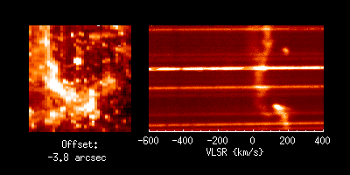

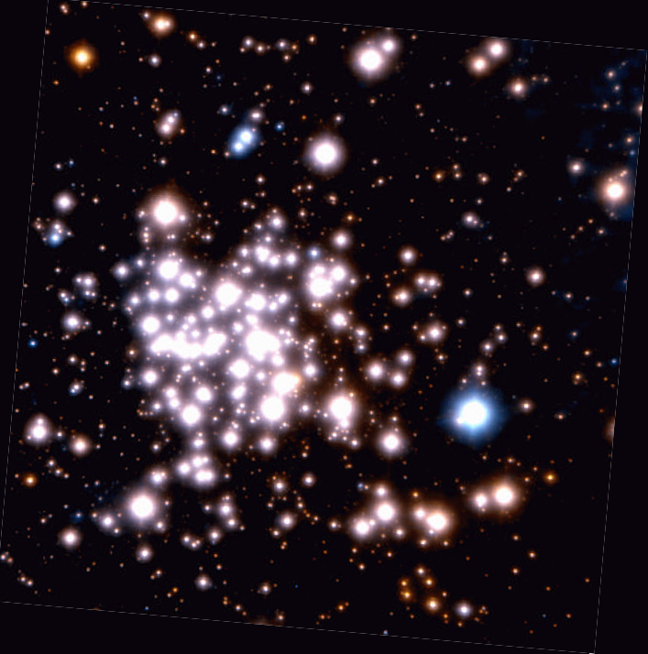
Giant HII Regions: Massive Star Signposts
Quintuplet 6 cm
Arches 6 cm
Center Br-γ
N
E

Slide 7
Products of star formation: embedded protostars

Slide 8
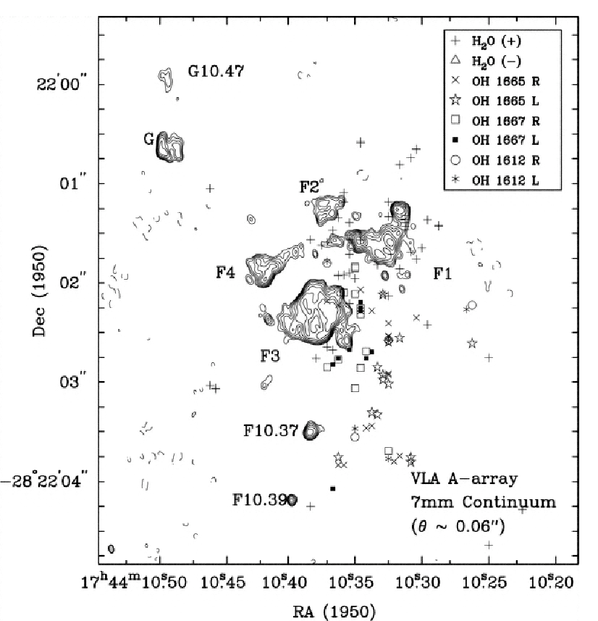
Protostars: Sgr B2 (VLA)
Notes:
Figure 3 from McGrath, Goss, & De Pree (2004) showing H2O and OH masers
overplotted on 7 mm contours for a small portion of the Sgr B2 cloud. The activity in this
region is typical of that found near the fifty or so ultra-compact HII regions in Sgr B2.

Slide 9
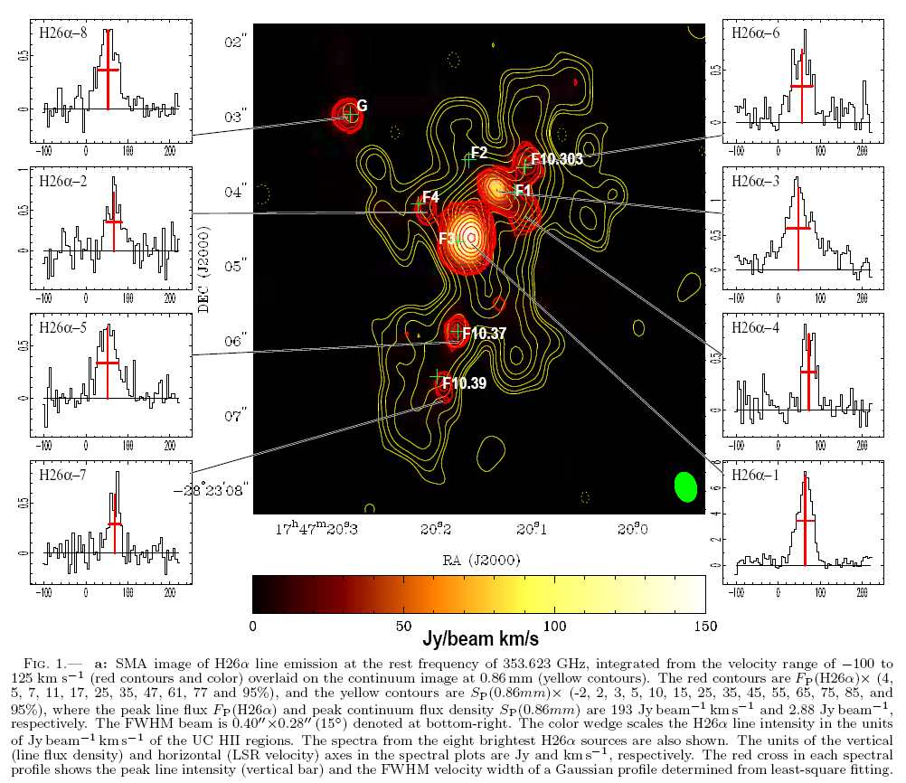
Protostars: Sgr B2 (SMA)
Notes:
Sagittarius B2 Main: A Cluster of Ultra-Compact HII Regions and Massive Protostellar Cores
Zhao, Jun-Hui; Wright, M. C. H.
The ionized core in the Sgr B2 Main star-forming region was imaged using the Submillimeter Array archival data observed for the H26$\alpha$ line and continuum emission at 0.86 millimeter with an angular resolution 0.3\arcsec. Eight hyper-compact H26$\alpha$ emission sources were detected with a typical size in the range of 1.6--20$\times10^2$ AU and electron density of 0.3--3$\times10^7$ cm$^{-3}$, corresponding to the emission measure 0.4--8.4$\times10^{10}$ cm$^{-6}$ pc. The H26$\alpha$ line fluxes from the eight hyper-compact HII sources imply that the ionization for each of the sources must be powered by a Lyman continuum flux from an O star or a cluster of B stars. The most luminous H26$\alpha$ source among the eight detected requires an O6 star that appears to be embedded in the ultra-compact HII region F3. In addition, $\sim$ 23 compact continuum emission sources were also detected within the central 5\arcsec$\times$3\arcsec\,($\sim0.2$ pc) region. In the assumption of a power-law distribution for the dust temperature, with the observed brightness temperature of the dust emission we determined the physical properties of the submillimeter emission sources showing that the molecular densities are in the range of 1--10$\times10^8$ cm$^{-3}$, surface densities between 13 to 150 $g$ cm$^{-2}$, and total gas masses in the range from 5 to $\gtrsim$ 200 $M_\odot$ which are 1 or 2 orders of magnitude greater than the corresponding values of the Bonnor-Ebert mass. With a mean free-fall time scale of 2$\times10^3$ y, each of the massive protostellar cores are undergoing gravitational collapse to form new massive stars in the Sgr B2 Main core.

Slide 10
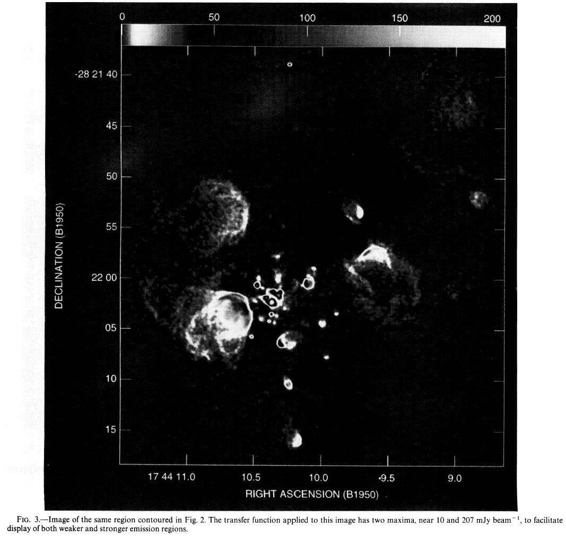
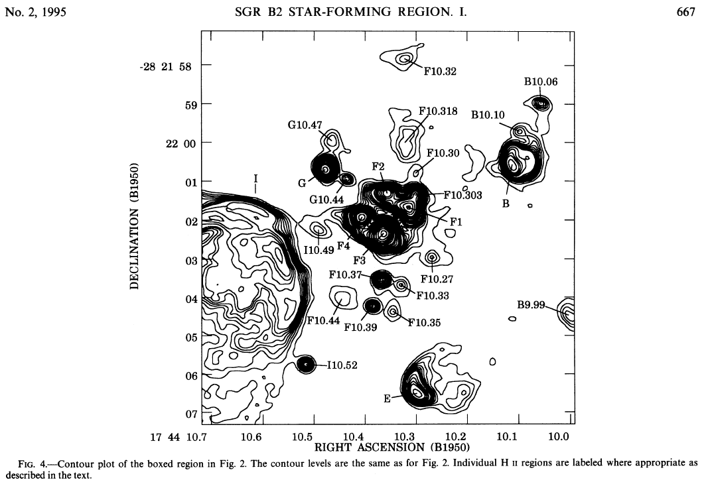
HCHII Regions in Sgr B2 (Gaume et al. 1995)
There are ~100 HCHII regions in Sgr B2.

Slide 11
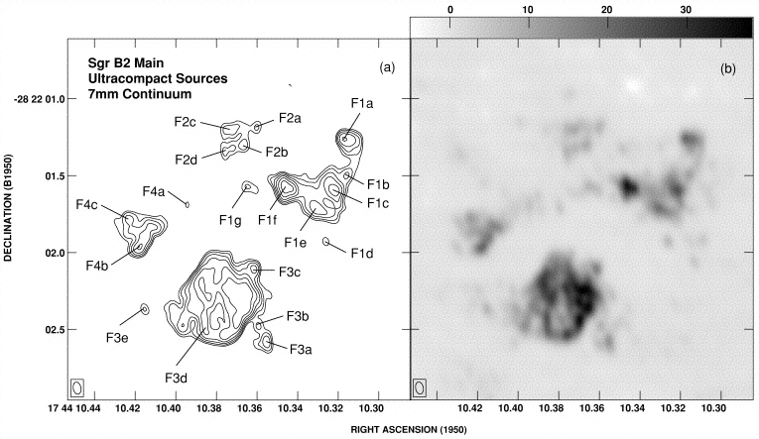
HCHII Regions in Sgr B2 (De Pree et al. 1998)
The clumps break up into even smaller clumps with sizes ~100 AU and densities >10⁷ cm⁻³.
Each clump contains an OB star.

Slide 12
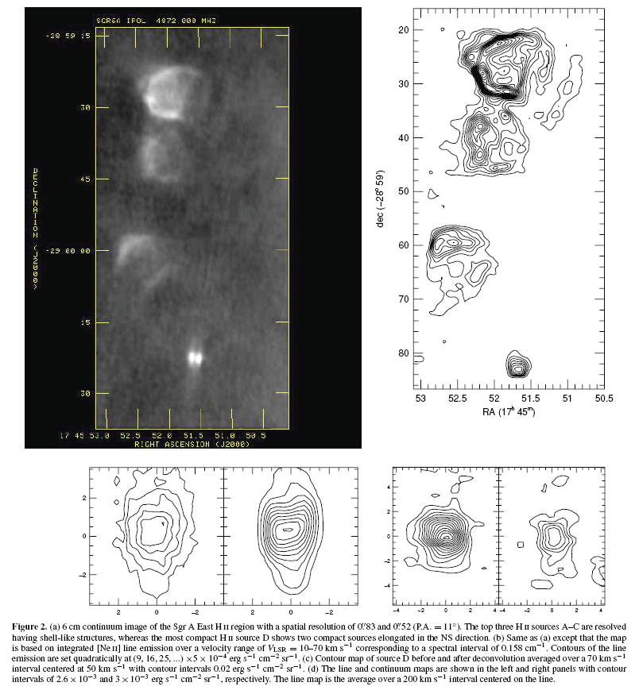
Protostars: A-D (VLA)
Notes:
MASSIVE STAR FORMATION OF THE SGR A EAST Hii REGIONS NEAR THE GALACTIC CENTER
F. Yusef-Zadeh1,8, J. H. Lacy2,8, M. Wardle3, B. Whitney4, H. Bushouse5, D. A. Roberts6, and R. G. Arendt7
1 Department of Physics and Astronomy, Northwestern University, Evanston, IL 60208, USA
2 Department of Astronomy, University of Texas, Austin, TX 78712, USA
3 Department of Physics and Astronomy, Macquarie University, Sydney, NSW 2109, Australia
4 Space Science Institute, 4750 Walnut Street, Suite 205, Boulder, CO 80301, USA
5 STScI, 3700 San Martin Drive, Baltimore, MD 21218, USA
6 Adler Planetarium and Astronomy Museum, 1300 South Lake Shore Drive, Chicago, IL 60605, USA
7 University of Maryland, Baltimore County, GSFC, Code 665, Greenbelt, MD 20771, USA
Received 2010 July 13; accepted 2010 October 9; published 2010 November 29
ABSTRACT
A group of four compact Hii regions associated with the well-known 50 km s−1 molecular cloud is the closest site
of on-going star formation to the dynamical center of the Galaxy, at a projected distance of ∼6 pc. We present a
study of ionized gas based on the [Ne ii] (12.8 μm) line, as well as multi-frequency radio continuum, Hubble Space
Telescope Paα, and Spitzer Infrared Array Camera observations of the most compact member of the Hii group,
Sgr A East Hii D. The radio continuum image at 6 cm shows that this source breaks up into two equally bright
ionized features, D1 and D2. The spectral energy distribution of the D source is consistent with it being due to a
25±3M star with a luminosity of 8±3×104 L. The inferred mass, effective temperature of the UV source, and
the ionization rate are compatible with a young O9-B0 star. The ionized features D1 and D2 are considered to be
ionized by UV radiation collimated by an accretion disk.We consider that the central massive star photoevaporates
its circumstellar disk on a timescale of 3×104 years giving a mass flux ∼3 × 10−5 M yr−1 and producing the
ionized material in D1 and D2 expanding in an inhomogeneous medium. The ionized gas kinematics, as traced by the
[Ne ii] emission, is difficult to interpret, but it could be explained by the interaction of a bipolar jet with surrounding
gas along with what appears to be a conical wall of lower velocity gas. The other Hii regions, Sgr A East A-C,
have morphologies and kinematics that more closely resemble cometary flows seen in other compact Hii regions,
where gas moves along a paraboloidal surface formed by the interaction of a stellar wind with a molecular cloud.

Slide 13
Products of star formation: young clusters

Slide 14
Young Clusters in the Galactic Center
There are three massive young clusters in the Galactic center.
They each have about 10⁴ M in stars.
They are about 2 to 5 Myr old.
The are the Quintuplet, Arches, and Central clusters.

Slide 15

Lick 3-m (1994)
Notes:
This series of images shows the Arches cluster at progressively better spatial resolution.

Slide 16
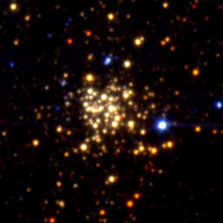
Keck 10-m (1997)

Slide 17
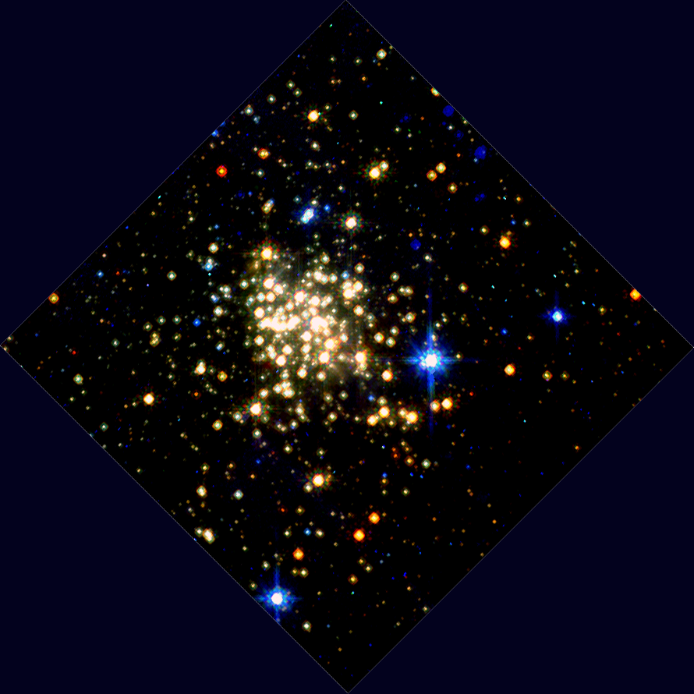
HST/NICMOS (1997)

Slide 18
VLT/AO (2002)

Slide 19
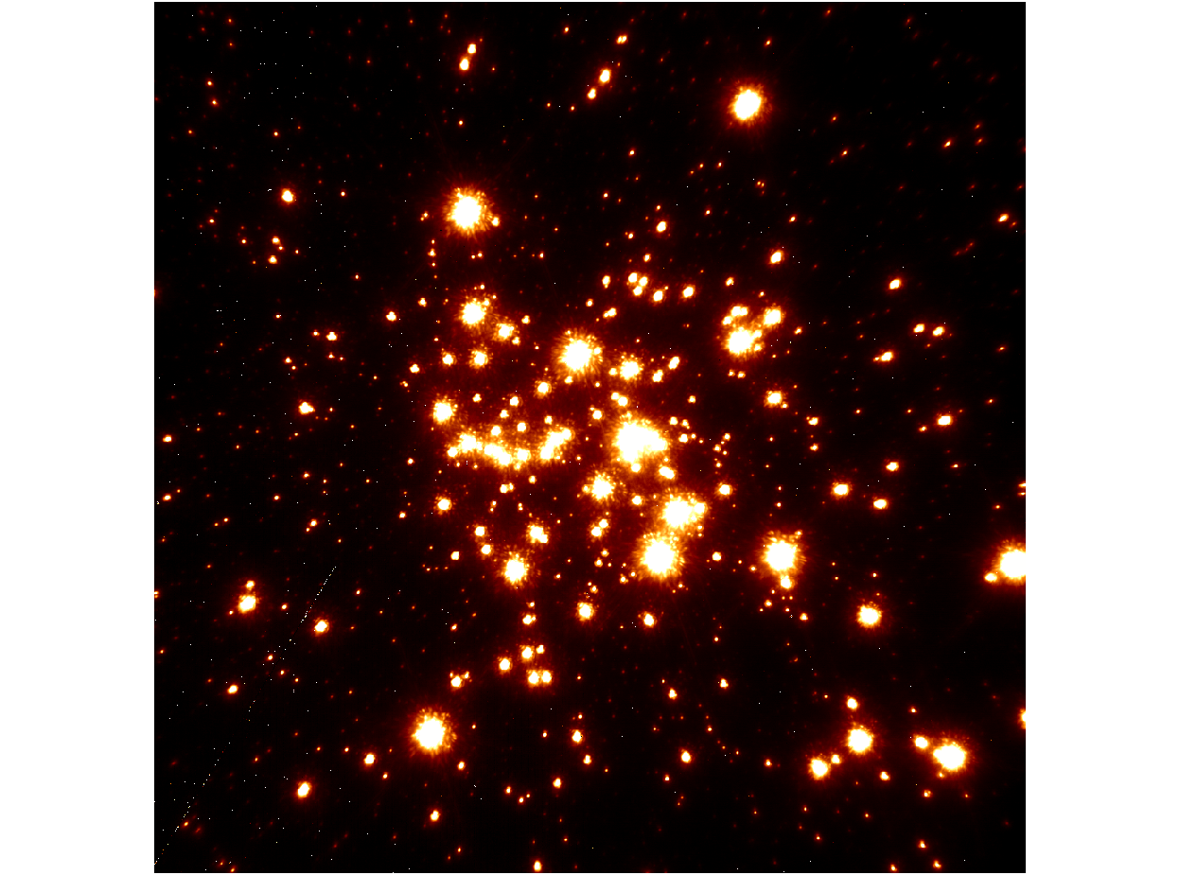
Keck/LGSAO (2006)

Slide 20
Spatial resolution
Notes:
This figure shows the dramatic improvement in the spatial resolution of one of the most massive young star clusters in the Galaxy obtained over a ten year period, leading to the determination of the full mass function from 130 Msun down to 2 Msun.
20

Slide 21
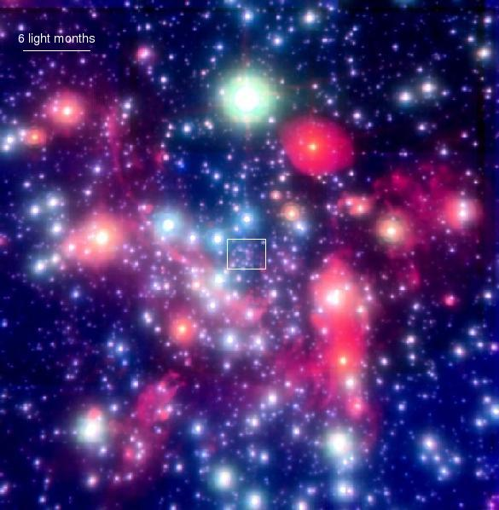
The Central Cluster
Genzel, Eckart et al.

Slide 22
Quintuplet cluster

Slide 23
Products of star formation: young dispersed population

Slide 24
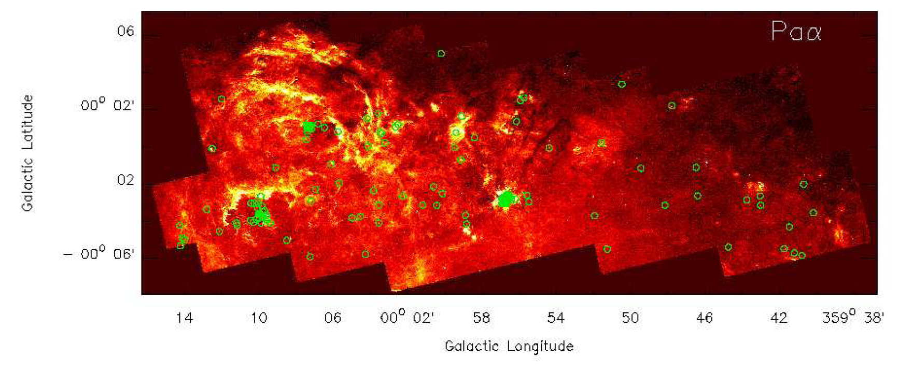
Paschen-alpha survey
Notes:
HST Pa Survey of the Galactic Center – Searching the
missing young stellar populations within the Galactic Center
H. Dong1, Q. D. Wang1, A. Cotera2, S. Stolovy3, M. R. Morris4, J.
Mauerhan3, E. A. Mills4, G. Schneider5, C. Lang6

Slide 25
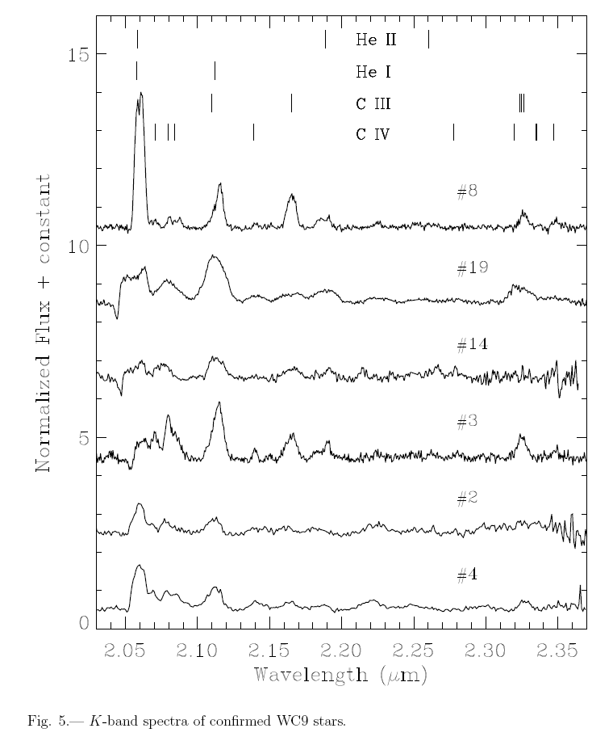
Spectra of WC stars
Notes:
Isolated Wolf-Rayet Stars and O Supergiants in the Galactic
Center Region Identified via Paschen- Excess
J. C. Mauerhan1, A. Cotera2, H. Dong3, M. R. Morris4, Q. D. Wang3, S. R. Stolovy1, C.
Lang5
We report the discovery of 19 hot, evolved, massive stars near the Galactic
center region (GCR). These objects were selected for spectroscopy owing to
their detection as strong sources of Paschen- emission-line excess, following a
narrowband imaging survey of the central 0.◦65 × 0.◦25 (l, b) around Sgr A∗ with
the Hubble Space Telescope. Discoveries include six carbon-type (WC) and five
nitrogen-type (WN) Wolf-Rayet stars, six O supergiants, and two B supergiants.
Two of the O supergiants have X-ray counterparts having properties consistent
with solitary O stars and colliding-wind binaries. The infrared photometry of 17
stars is consistent with the Galactic center distance, but two of them are located
in the foreground. Several WC stars exhibit a relatively large infrared excess,
which is possibly thermal emission from hot dust. Most of the stars appear
scattered throughout the GCR, with no relation to the three known massive
young clusters; several others lie near the Arches and Quintuplet clusters and
may have originated within one of these systems. The results of this work bring
the total sample of Wolf-Rayet stars in the GCR to 92. All sources of strong P
excess have been identified in the area surveyed with HST, which implies that
the sample of WN stars in this region is near completion, and is dominated by
late (WNL) subtypes. The current WC sample, although probably not complete,
is almost exclusively dominated by late (WCL) subtypes. The observed Wolf-
Rayet subtype distribution in the GCR is a reflection of the intrinsic rarity of
early subtypes (WNE and WCE) in the inner Galaxy, an effect that is driven by
metallicity.

Slide 26
Products of star formation: intermediate age population

Slide 27
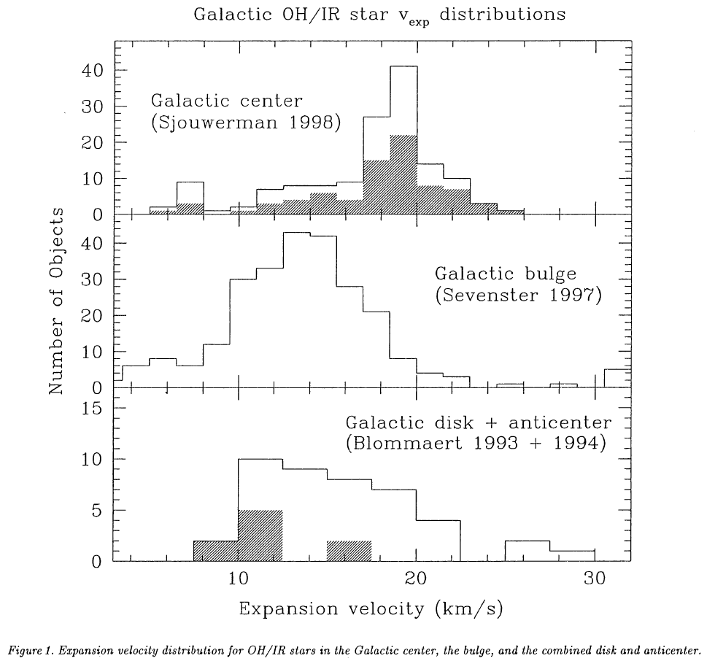
2 Gyr population

Slide 28
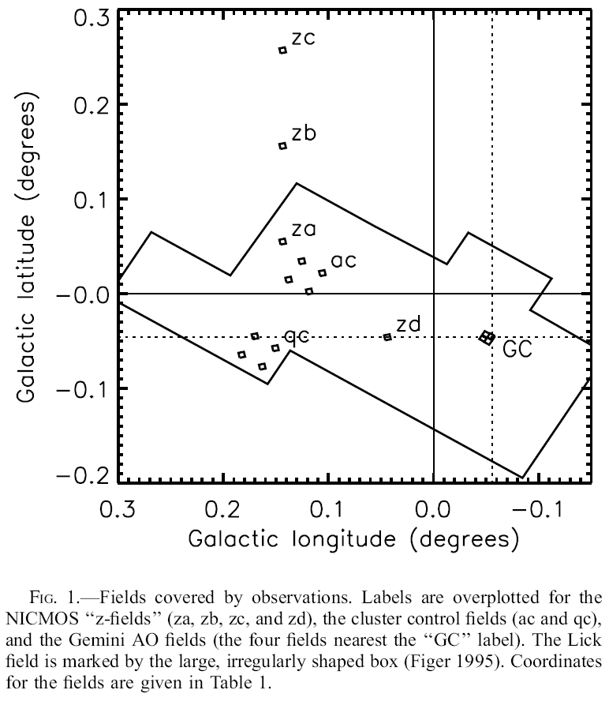
Star formation map
Notes:
AN EXTENDED STAR FORMATION HISTORY FOR THE GALACTIC CENTER FROM HUBBLE SPACE
TELESCOPE NICMOS OBSERVATIONS1
Donald F. Figer,2,3 R. Michael Rich,4 Sungsoo S. Kim,5 Mark Morris,4 and Eugene Serabyn6
Received 2003 July 19; accepted 2003 September 18
ABSTRACT
We present Hubble Space Telescope (HST ) Near-Infrared Camera and Multiobject Spectrometer (NICMOS)
observations as evidence that continuous star formation has created much of the central stellar cusp of the
Galaxy. The data are the deepest ever obtained for a Galactic center population, being more than 50% complete
for mF205W < 19:3, or initial stellar masses k2 M. We use Geneva and Padova stellar evolution models to
produce synthetic luminosity functions for burst and continuous star formation scenarios, finding that the
observations are fitted best by continuous star formation at a rate that is consistent with the recent star formation
activity that produced the three massive young clusters in the central 50 pc. Further, it is not possible to fit the
observations with ancient burst models, such as would be appropriate for an old population like that in Baade’s
window or NGC 6528.

Slide 29
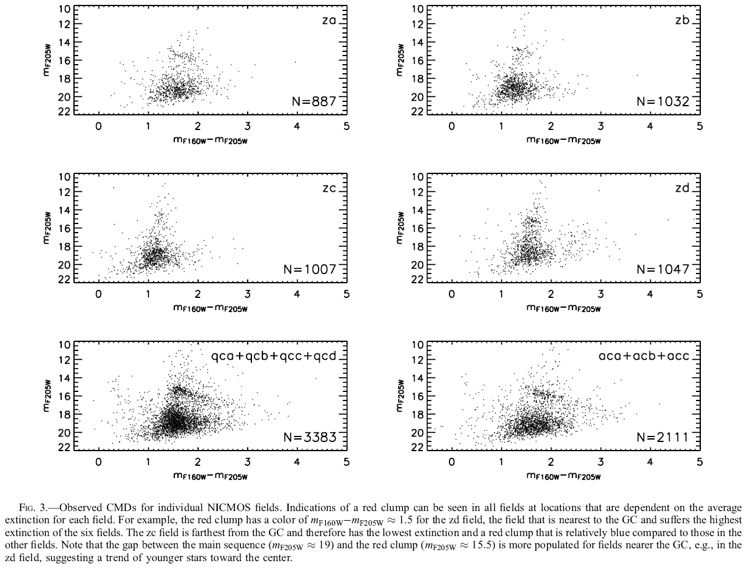
Color-magnitude diagrams
Notes:
AN EXTENDED STAR FORMATION HISTORY FOR THE GALACTIC CENTER FROM HUBBLE SPACE
TELESCOPE NICMOS OBSERVATIONS1
Donald F. Figer,2,3 R. Michael Rich,4 Sungsoo S. Kim,5 Mark Morris,4 and Eugene Serabyn6
Received 2003 July 19; accepted 2003 September 18
ABSTRACT
We present Hubble Space Telescope (HST ) Near-Infrared Camera and Multiobject Spectrometer (NICMOS)
observations as evidence that continuous star formation has created much of the central stellar cusp of the
Galaxy. The data are the deepest ever obtained for a Galactic center population, being more than 50% complete
for mF205W < 19:3, or initial stellar masses k2 M. We use Geneva and Padova stellar evolution models to
produce synthetic luminosity functions for burst and continuous star formation scenarios, finding that the
observations are fitted best by continuous star formation at a rate that is consistent with the recent star formation
activity that produced the three massive young clusters in the central 50 pc. Further, it is not possible to fit the
observations with ancient burst models, such as would be appropriate for an old population like that in Baade’s
window or NGC 6528.

Slide 30
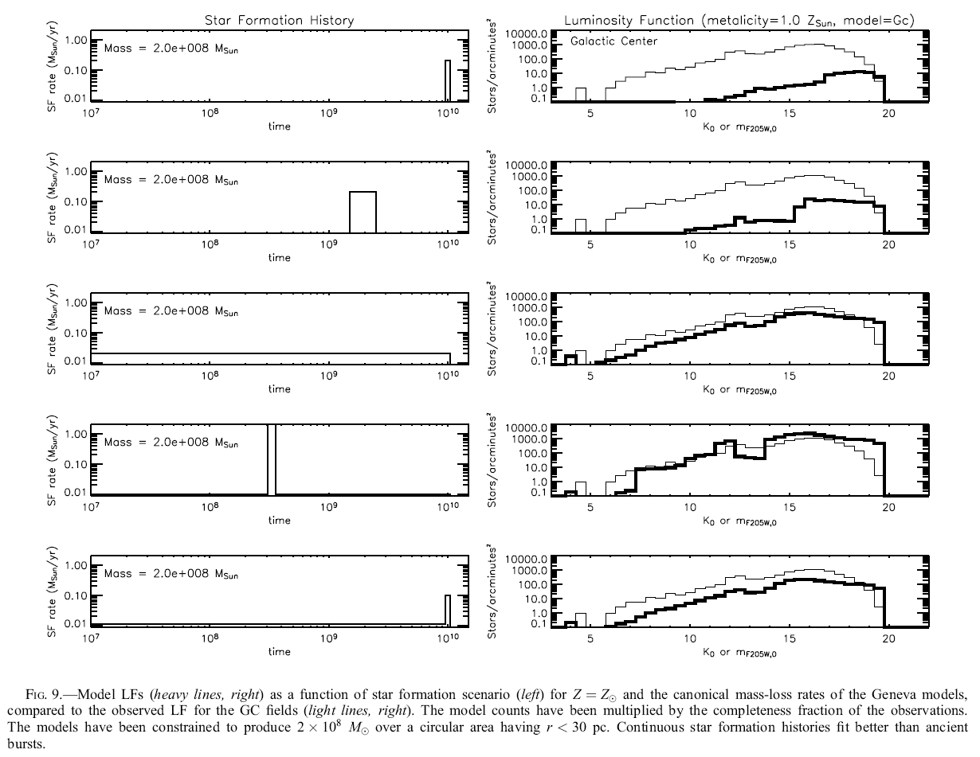
Luminosity functions
Notes:
AN EXTENDED STAR FORMATION HISTORY FOR THE GALACTIC CENTER FROM HUBBLE SPACE
TELESCOPE NICMOS OBSERVATIONS1
Donald F. Figer,2,3 R. Michael Rich,4 Sungsoo S. Kim,5 Mark Morris,4 and Eugene Serabyn6
Received 2003 July 19; accepted 2003 September 18
ABSTRACT
We present Hubble Space Telescope (HST ) Near-Infrared Camera and Multiobject Spectrometer (NICMOS)
observations as evidence that continuous star formation has created much of the central stellar cusp of the
Galaxy. The data are the deepest ever obtained for a Galactic center population, being more than 50% complete
for mF205W < 19:3, or initial stellar masses k2 M. We use Geneva and Padova stellar evolution models to
produce synthetic luminosity functions for burst and continuous star formation scenarios, finding that the
observations are fitted best by continuous star formation at a rate that is consistent with the recent star formation
activity that produced the three massive young clusters in the central 50 pc. Further, it is not possible to fit the
observations with ancient burst models, such as would be appropriate for an old population like that in Baade’s
window or NGC 6528.

Slide 31
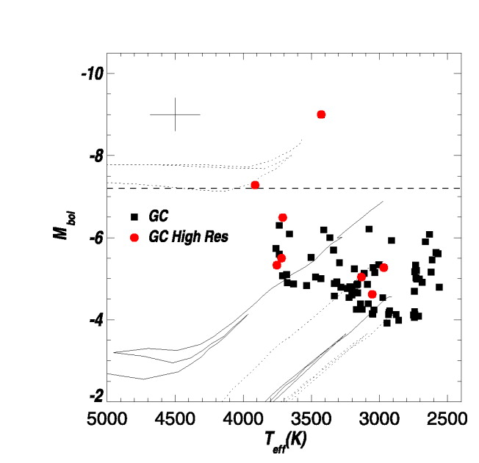
Intermediate age giants
Notes:
Estimates of absolute magnitude versus temperature for stars in the GC from Blum
et al. (2003). The lines correspond to model isochrones having ages of 10 Myr, 100 Myr, 1 Gyr,
5 Gyr, and 12 Gyr. The supergiants (above the horizontal line) are descendant from stars having
M≈15-25 M, whereas fainter stars are descendant from lower mass main sequence stars having
a few to 15 M. The presence of these stars in the GC demonstrates intermediate age star
formation of massive stars.

Slide 32
Crocker
explaining the diffuse, broad-band (radio continuum to TeV g-ray), non-thermal signal detected
from this region. Our modelling pins down the ISM parameters for the environment wherein
cosmic ray (CR) electrons and ions reside in the Galactic centre (GC). We find that the magnetic
field in this region is 100-300 mG, the gas density . 60 cm􀀀3, and that a powerful (> 200 km/s)
‘super’-wind acts to remove > 95% of the cosmic rays accelerated in the region before they have
time to lose their energy in situ. The 1039 erg/s carried away by the GC cosmic ray protons is
precisely enough to energise the GeV g-ray emission from the Fermi ‘bubbles’ recently found to
extend north and south of the GC out to distances of 10 kpc, provided that the bubbles constitute
thick targets to the GC protons and that the situation has reached steady state. In such a situation
of ‘saturation’ the hard,
Notes:
Roland Crocker
Max-Planck-Institut für Kernphsik, Heidelberg, Germany
We have modelled the high-energy astrophysics of the inner 200 pc of the Galaxy with a view to
explaining the diffuse, broad-band (radio continuum to TeV g-ray), non-thermal signal detected
from this region. Our modelling pins down the ISM parameters for the environment wherein
cosmic ray (CR) electrons and ions reside in the Galactic centre (GC). We find that the magnetic
field in this region is 100-300 mG, the gas density . 60 cm􀀀3, and that a powerful (> 200 km/s)
‘super’-wind acts to remove > 95% of the cosmic rays accelerated in the region before they have
time to lose their energy in situ. The 1039 erg/s carried away by the GC cosmic ray protons is
precisely enough to energise the GeV g-ray emission from the Fermi ‘bubbles’ recently found to
extend north and south of the GC out to distances of 10 kpc, provided that the bubbles constitute
thick targets to the GC protons and that the situation has reached steady state. In such a situation
of ‘saturation’ the hard, uniform spectrum of the bubbles are explained and secondary electron
synchrotron explains the non-thermal microwave emission found in WMAP data mirroring the
bubbles. Given the very low density of the bubble plasma (<0.01 cm􀀀3), the pp loss time in the
Bubbles is > 5 Gyr. Our scenario thus has the startling implication that a GC source of nonthermal
particles of time-averaged power 1039 erg/s has persisted since the youth of the Galaxy.

Slide 33
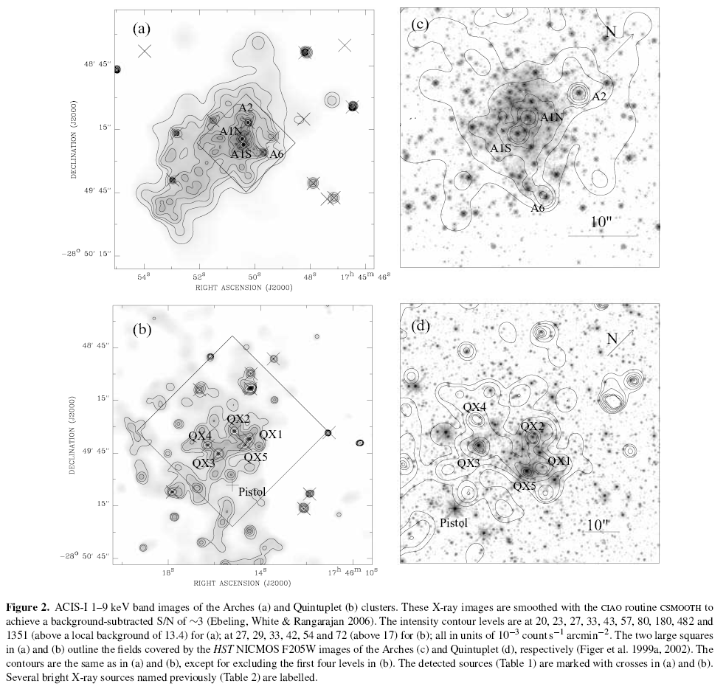
Cluster x-ray observations
Notes:
The interplay between star formation and the nuclear environment
of our Galaxy: deep X-ray observations of the Galactic centre Arches
and Quintuplet clusters
Q. Daniel Wang,1⋆ Hui Dong1⋆ and Cornelia Lang2⋆
1Department of Astronomy, B619E-LGRT, University of Massachusetts, Amherst, MA 01003, USA
2Department of Physics and Astronomy, University of Iowa, Iowa City, IA 52245, USA
Accepted 2006 June 6. Received 2006 May 27; in original form 2006 April 30
ABSTRACT
The Galactic centre (GC) provides a unique laboratory for a detailed examination of the interplay
between massive star formation and the nuclear environment of our Galaxy. Here,
we present a 100-ks Chandra Advanced CCD Imaging Spectrometer (ACIS) observation of
the Arches and Quintuplet star clusters. We also report on a complementary mapping of
the dense molecular gas near the Arches cluster made with the Owens Valley Millimeter
Array. We present a catalogue of 244 point-like X-ray sources detected in the observation.
Their number–flux relation indicates an overpopulation of relatively bright X-ray sources,
which are apparently associated with the clusters. The sources in the core of the Arches and
Quintuplet clusters are most likely extreme colliding wind massive star binaries. The diffuse
X-ray emission from the core of the Arches cluster has a spectrum showing a 6.7-keV
emission line and a surface intensity profile declining steeply with radius, indicating an origin
in a cluster wind. In the outer regions near the Arches cluster, the overall diffuse X-ray enhancement
demonstrates a bow shock morphology and is prominent in the Fe Kα 6.4-keV line
emission with an equivalent width of ∼1.4 keV. Much of this enhancement may result from an
ongoing collision between the cluster and the adjacent molecular cloud, which have a relative
velocity 120 km−1. The older and less-compact Quintuplet cluster contains much weaker
X-ray sources and diffuse emission, probably originating from low-mass stellar objects as well
as a cluster wind. However, the overall population of these objects, constrained by the observed
total diffuse X-ray luminosities, is substantially smaller than expected for both clusters, if they
have normal Miller & Scalo initial mass functions. This deficiency of low-mass objects may
be a manifestation of the unique star formation environment of the GC, where high-velocity
cloud–cloud and cloud–cluster collisions are frequent.

Slide 34
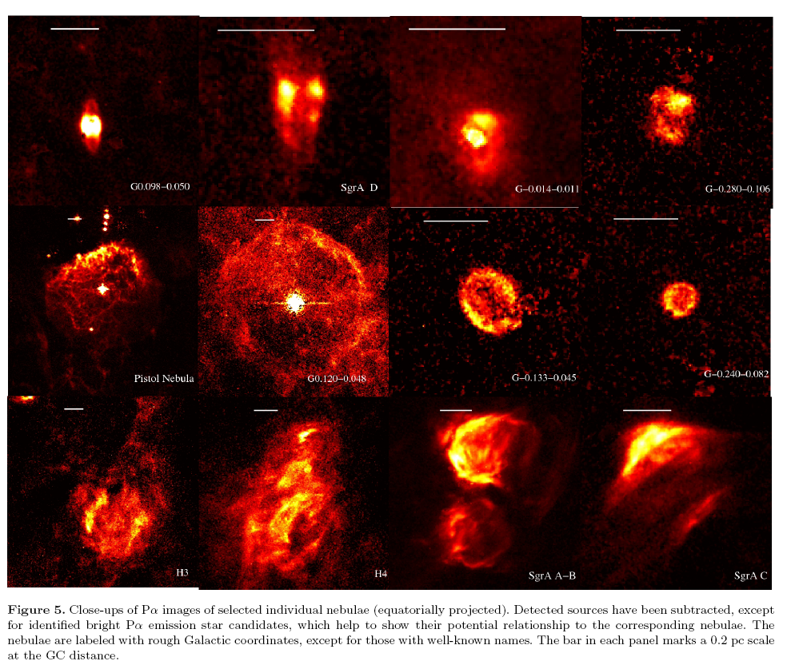
Paschen-alpha nebulae
Notes:
HST/NICMOS Paschen- Survey of the Galactic Center:
Overview
Q. D. Wang1?, H. Dong1, A. Cotera,2 S. Stolovy,3 M. Morris,4 C. C. Lang,5
M. P. Muno,6 G. Schneider,7 and D. Calzetti1
1Department of Astronomy, University of Massachusetts, Amherst, MA 01003, USA
2SETI Institute, 515 North Whisman Road, Mountain View, CA 94043, USA
3Spitzer Science Center, California Institute of Technology, Mail Code 220-6, 1200 East California Boulevard, Pasadena, CA 91125, USA
4Department of Physics and Astronomy, University of California, Los Angeles, CA 90095, USA
5Department of Physics and Astronomy, University of Iowa, Iowa City, IA 52245, USA
6Space Radiation Laboratory, California Institute of Technology, Pasadena, CA 91125, USA
7Steward Observatory, The University of Arizona, Tucson, AZ 85721, USA
Accepted 2009 November 2; Received 2009 October 29; in original form 2009 September 22
ABSTRACT
We have recently carried out the rst wide-eld hydrogen Paschen- line imaging
survey of the Galactic Center (GC), using the NICMOS instrument aboard the Hubble
Space Telescope. The survey maps out a region of 2253 pc2 (416 arcmin2) around
the central supermassive black hole (Sgr A*) in the 1.87 and 1.90 m narrow bands
with a spatial resolution of 0:01 pc (0:002 FWHM) at a distance of 8 kpc. Here
we present an overview of the observations, data reduction, preliminary results, and
potential scientic implications, as well as a description of the rationale and design
of the survey. We have produced mosaic maps of the Paschen- line and continuum
emission, giving an unprecedentedly high resolution and high sensitivity panoramic
view of stars and photo-ionized gas in the nuclear environment of the Galaxy.We detect
a signicant number of previously undetected stars with Paschen- in emission. They
are most likely massive stars with strong winds, as conrmed by our initial follow-
up spectroscopic observations. About half of the newly detected massive stars are
found outside the known clusters (Arches, Quintuplet, and Central). Many previously
known diuse thermal features are now resolved into arrays of intriguingly ne linear
laments indicating a profound role of magnetic elds in sculpting the gas. The bright
spiral-like Paschen- emission around Sgr A* is seen to be well conned within the
known dusty torus. In the directions roughly perpendicular to it, we further detect
faint, diuse Paschen- emission features, which, like earlier radio images, suggest an
outow from the structure. In addition, we detect various compact Paschen- nebulae,
probably tracing the accretion and/or ejection of stars at various evolutionary stages.
Multi-wavelength comparisons together with follow-up observations are helping us to
address such questions as where and how massive stars form, how stellar clusters are
disrupted, how massive stars shape and heat the surrounding medium, how various
phases of this medium are interspersed, and how the supermassive black hole interacts
with its environment.

Slide 35
Global characteristics

Slide 36
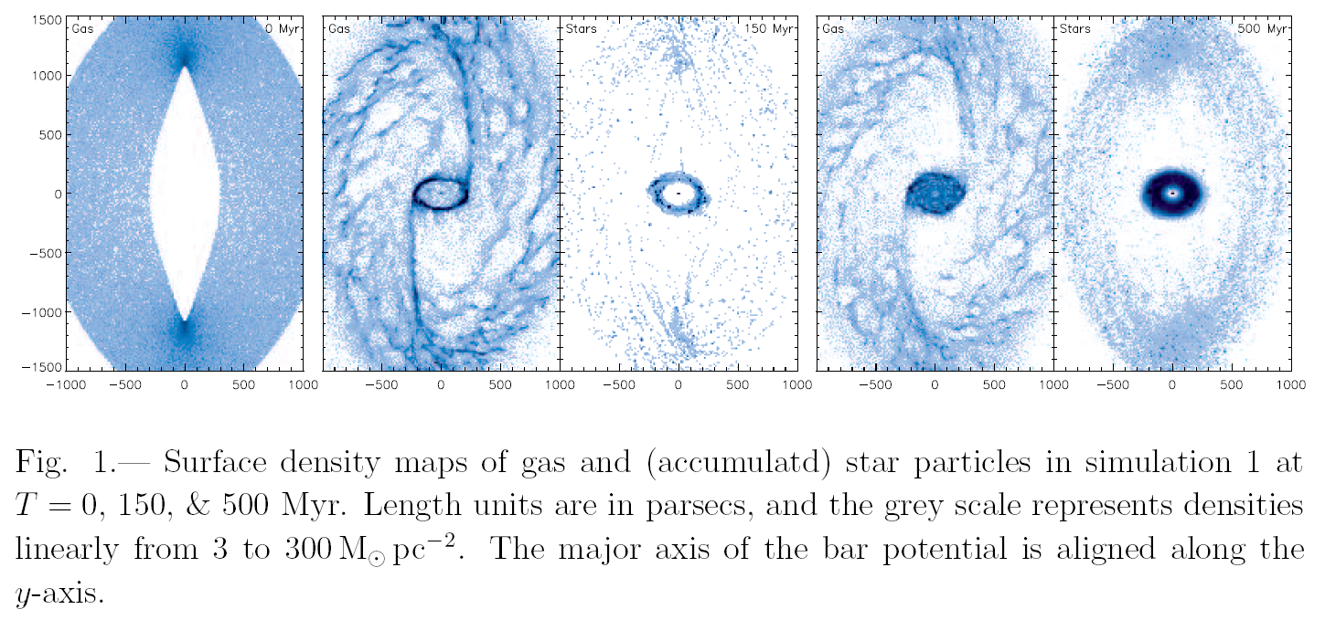
Gas in central molecular zone
Notes:
Nuclear Star-Forming Ring of the Milky Way: Simulations
Sungsoo S. Kim,1,2,3 Takayuki R. Saitoh,4 Myoungwon Jeon,1,5 Donald F. Figer,3
David Merritt,6 and Keiichi Wada7
ABSTRACT
We present hydrodynamic simulations of gas clouds in the central kpc region
of the Milky Way that is modeled with a three-dimensional bar potential. Our
simulations consider realistic gas cooling and heating, star formation, and supernova
feedback. A ring of dense gas clouds forms as a result of X1–X2 orbit
transfer, and our potential model results in a ring radius of ∼ 200 pc, which
coincides with the extraordinary reservoir of dense molecular clouds in the inner
bulge, the Central Molecular Zone (CMZ). The gas clouds accumulated in
the CMZ can reach high enough densities to form stars, and with an appropriate
choice of simulation parameters, we successfully reproduce the observed gas mass
and the star formation rate in the CMZ, ∼ 2 × 107M⊙ and ∼ 0.1M⊙ yr−1. Star
formation in our simulations takes place mostly in the outermost X2 orbits, and
the star formation rate per unit surface area outside the CMZ is much lower.
These facts suggest that the inner Galactic bulge may harbor a mild version of
the nuclear star-forming rings seen in some external disk galaxies. Furthermore,
from the relatively small size of the Milky Way’s nuclear bulge, which is thought
to be a result of sustained star formation in the CMZ, we infer that the Galactic
inner bulge probably had a shallower density profile or stronger bar elongation
in the past.

Slide 37
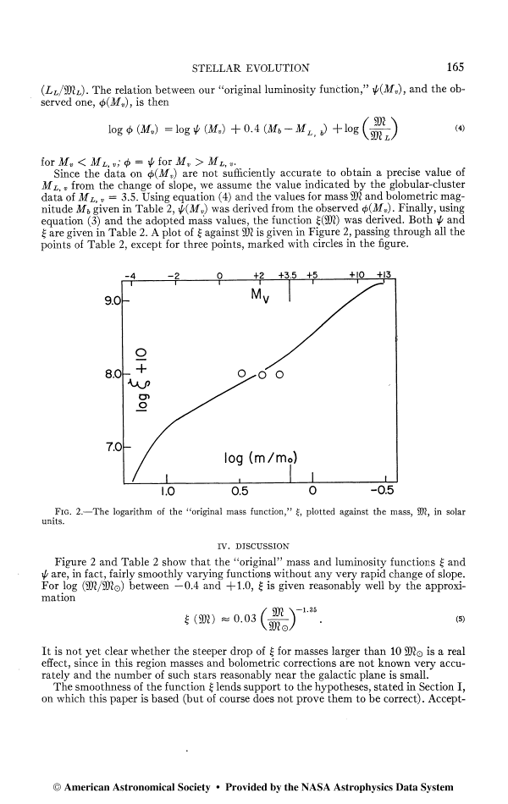
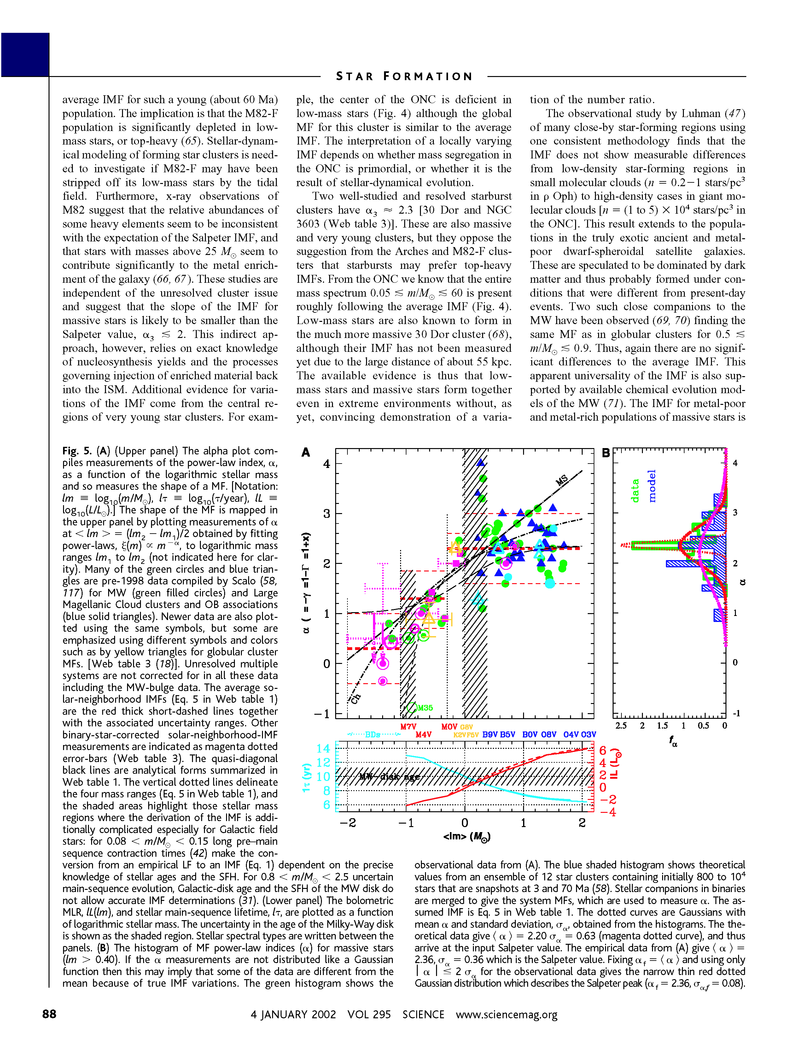
The “Standard” IMF
Γ=−1.35
Γ=−1.35
1-120 M
Salpeter 1955
Kroupa 2002
The IMF slope is usually observed to be the Salpeter value of Γ=−1.35.

Slide 38
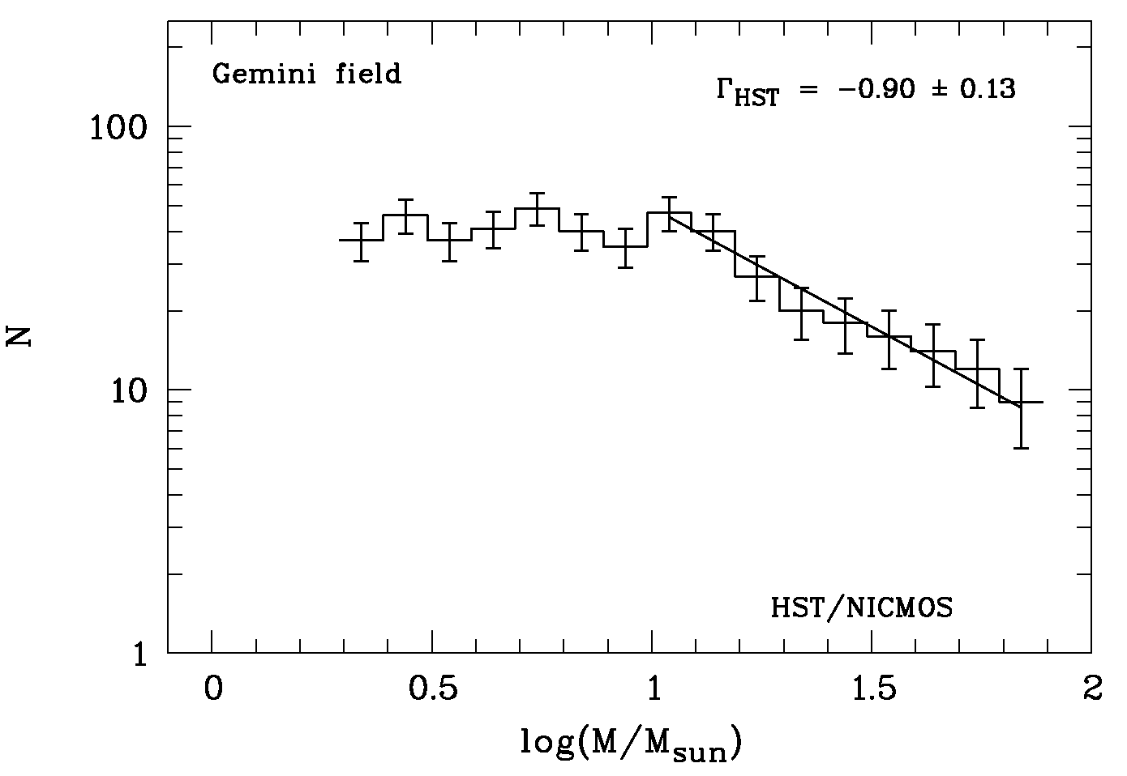
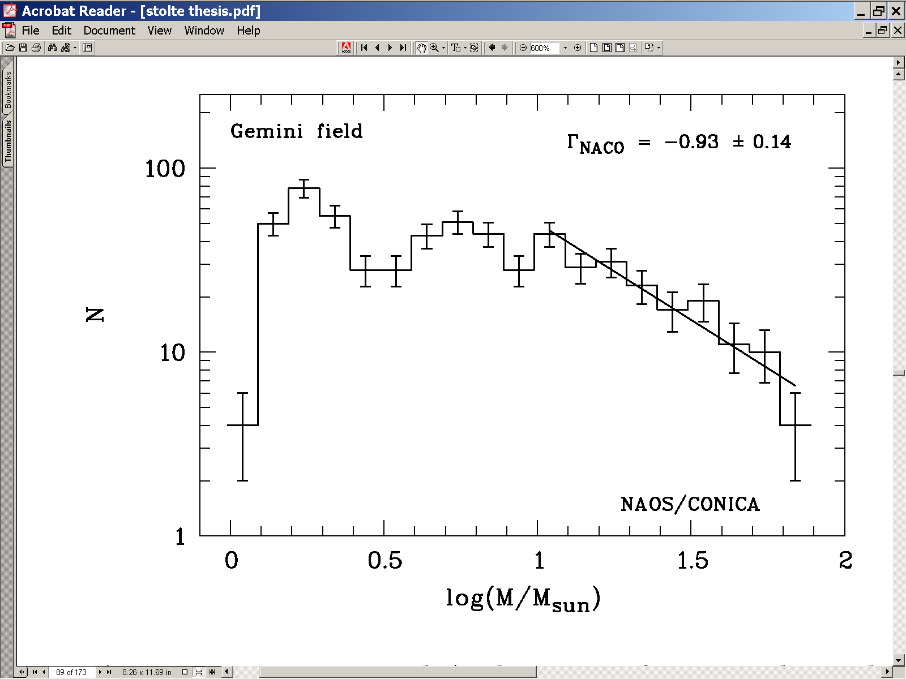
IMF in Arches Cluster
HST•NICMOS
VLT•NAOS•CONICA
Flat Mass Function in the Arches Cluster
Figer et al. 1999; Stolte et al. 2003
The only direct measurement of the IMF in the Galactic Center indicates that it is “shallow.”

Slide 39
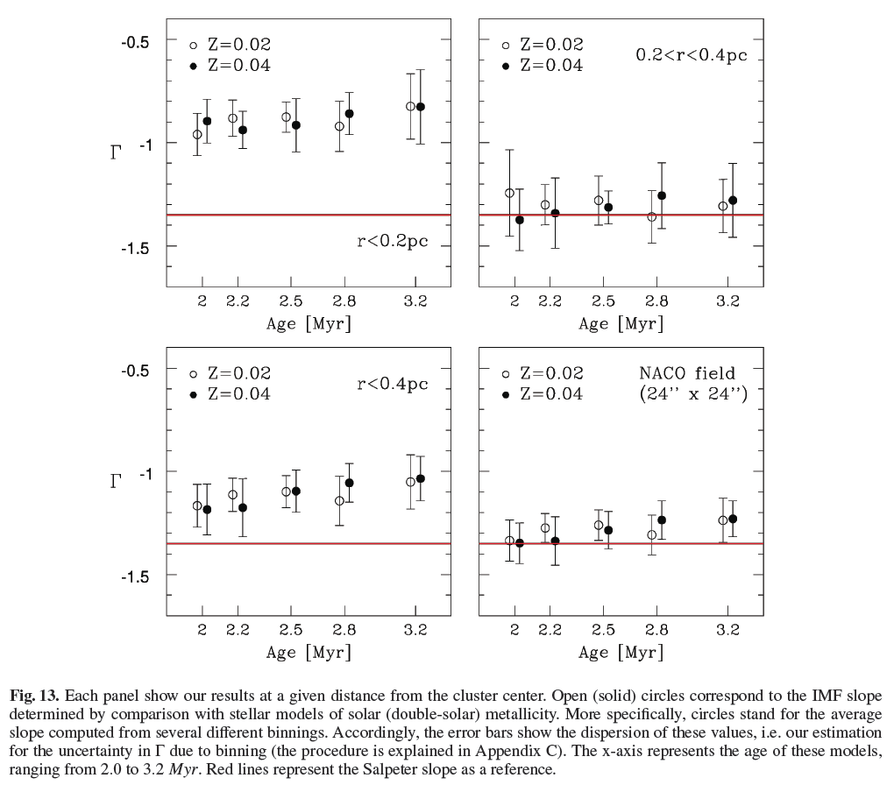
Arches cluster IMF
Notes:
The massive star initial mass function of the Arches cluster?;??
P. Espinoza1;2, F. J. Selman3, and J. Melnick3
1 Steward Observatory, The University of Arizona, 933 North Cherry Avenue, Tucson AZ 85719, USA;
e-mail: pespinoza@as.arizona.edu
2 Previous Address: Departamento de Astronom´ıa y Astrof´ısica, Pontificia Universidad Cat´olica de Chile, Santiago, Chile
3 European Southern Observatory, Alonso de C´ordova 3107, Santiago, Chile
e-mail: [fselman;jmelnick]@eso.org
Received day month / Accepted day month
ABSTRACT
The massive Arches cluster near the Galactic center should be an ideal laboratory for investigating massive star formation under
extreme conditions. But it comes at a high price: the cluster is hidden behind several tens of magnitudes of visual extinction. Severe
crowding requires space or AO-assisted instruments to resolve the stellar populations, and even with the best instruments interpreting
the data is far from direct. Several investigations using NICMOS and the most advanced AO imagers on the ground revealed an overall
top-heavy IMF for the cluster, with a very flat IMF near the center. There are several eects, however, that could potentially bias these
results, in particular the strong dierential extinction and the problem of transforming the observations into a standard photometric
system in the presence of strong reddening. We present new observations obtained with the NAOS-Conica (NACO) AO-imager on
the VLT. The problem of photometric transformation is avoided by working in the natural photometric system of NACO, and we
use a Bayesian approach to determine masses and reddenings from the broad-band IR colors. A global value of 􀀀 = 􀀀1:1 0:2 for
the high-mass end (M > 10M) of the IMF is obtained, and we conclude that a power law of Salpeter slope cannot be discarded
for the Arches cluster. The flattening of the IMF towards the center is confirmed, but is less severe than previously thought. We find
􀀀 = 􀀀0:88 0:20, which is incompatible with previous determinations. Within 0:4 pc we derive a total mass of 2:0(0:6) 104M
for the cluster and a central mass density = 2(0:4) 105 M pc􀀀3 that confirms Arches as the densest known young massive
cluster in the Milky Way.

Slide 40
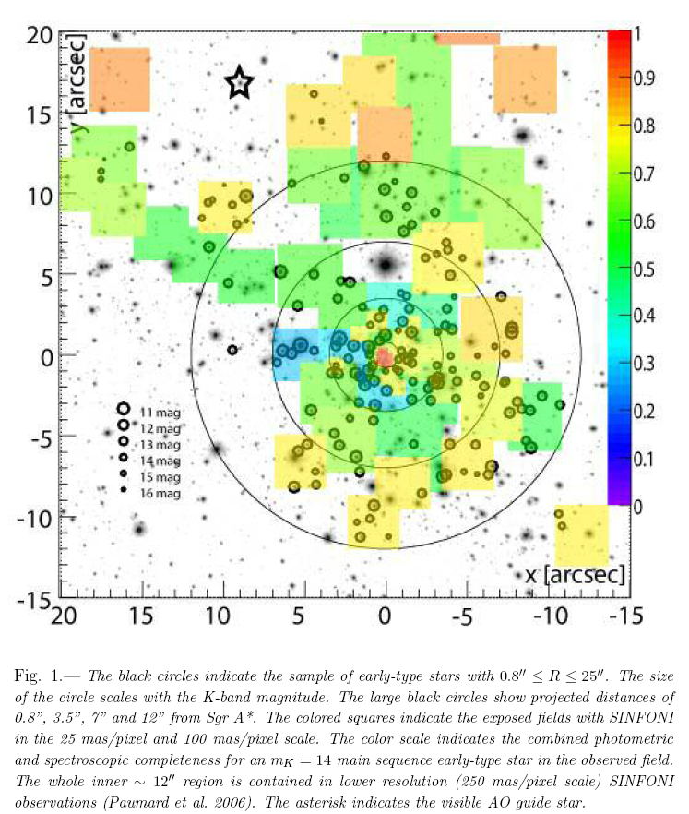
Map of GC for IMF measurement
Notes:
An Extremely Top-Heavy IMF in the Galactic Center Stellar
Disks 1
H. Bartkoa,, F. Martinsa,b,, S. Trippej T. K. Fritza, R. Genzela,c, T. Otta, F. Eisenhauera,
S. Gillessena, T. Paumarde, T. Alexanderf , K. Dodds-Edena, O. Gerharda, Y. Levind,
L. Mascettia, S. Nayakshing, H. B. Peretsf , G. Perrine, O. Pfuhla, M. J. Reidh, D. Rouane,
M. Zilkai, A. Sternbergi,
We present new observations of the nuclear star cluster in the central parsec of
the Galaxy with the adaptive optics assisted, integral field spectrograph SINFONI
on the ESO/VLT. Our work allows the spectroscopic detection of early and late
type stars to mK 16, more than 2 magnitudes deeper than our previous data
sets. Our observations result in a total sample of 177 bona fide early-type stars.
We find that most of these Wolf Rayet (WR), O- and B- stars reside in two
strongly warped disks between 0.8” and 12” from SgrA*, as well as a central
compact concentration (the S-star cluster) centered on SgrA*. The later type B
stars (mK > 15) in the radial interval between 0.8” and 12” seem to be in a more
isotropic distribution outside the disks. The observed dearth of late type stars in
the central few arcseconds is puzzling, even when allowing for stellar collisions.
The stellar mass function of the disk stars is extremely top heavy with a best fit
power law of dN/dm / m−0.45±0.3 in the mass range 7 − 80M. Since at least
the WR/O-stars were formed in situ in a single star formation event 6 Myrs
ago, this mass function probably reflects the initial mass function (IMF). The
mass functions of the S-stars inside 0.8” and of the early-type stars at distances
beyond 12” are compatible with a standard Salpeter/Kroupa IMF (best fit power
law of dN/dm / m−2.15±0.3).

Slide 41
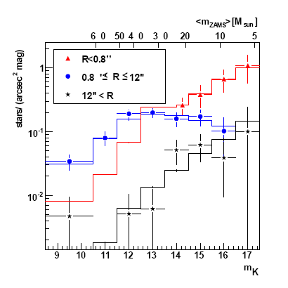
Central parsec IMF
Notes:
An Extremely Top-Heavy IMF in the Galactic Center Stellar
Disks 1
H. Bartkoa,, F. Martinsa,b,, S. Trippej T. K. Fritza, R. Genzela,c, T. Otta, F. Eisenhauera,
S. Gillessena, T. Paumarde, T. Alexanderf , K. Dodds-Edena, O. Gerharda, Y. Levind,
L. Mascettia, S. Nayakshing, H. B. Peretsf , G. Perrine, O. Pfuhla, M. J. Reidh, D. Rouane,
M. Zilkai, A. Sternbergi,

Slide 42
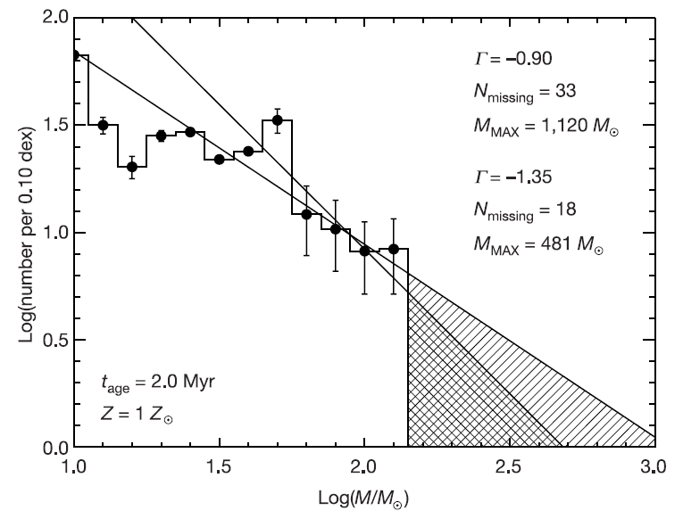
IMF upper mass cutoff
Notes:
Frequency distribution versus mass for stars in the Arches cluster extracted from
data in Fig. 1. The counts in each bin have been reduced by counts in nearby background
fields. Error bars represent the Poisson errors based on the background subtracted
counts. Two lines are drawn through the average counts in the four highest populated
mass bins, with slopes inferred from the data (d(log N)/d(log m) ¼ G ¼ 20.9; ref. 2, 23)
and that of Salpeter (G ¼ 21.35; ref. 15). For both lines, there is a clear deficit of stars
with initial masses greater than ,150M (, as seen in the hatched regions. In addition,
both slopes predict that at least one star in the cluster should have a mass far beyond that
observed if there is no upper mass cut-off. N missing is the difference between the number
of stars expected with M initial . 130M ( and the number observed. M MAX is the initial
mass at which the mass function predicts the existence of one star. t age is the assumed
cluster age. Z is the assumed abundance of metals in the cluster stars.

Slide 43
Massive Galactic Young Clusters: 1997
THIS PAGE INTENTIALLY LEFT BLANK

Slide 44
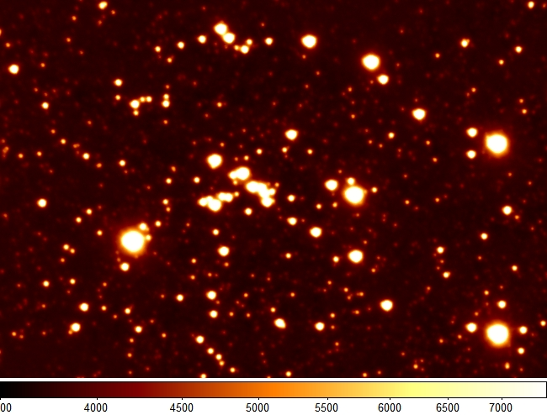
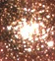
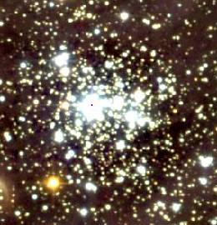
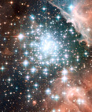
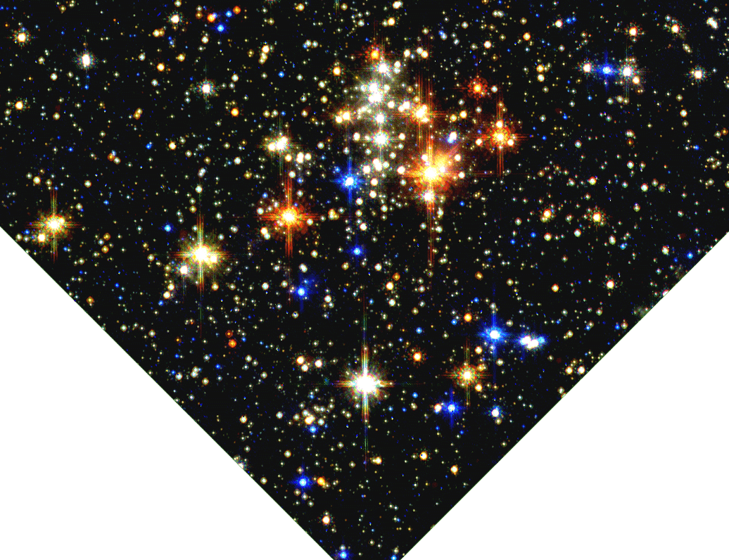
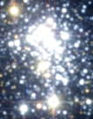
Massive Galactic Young Clusters
Cl 1806-20
NGC3603
Westerlund 2
Trumpler 14
GC
Pistol Star
1 pc
Quintuplet
Arches
Westerlund 1

Slide 45
Massive Galactic Young Clusters: 2010

Slide 46
Conclusions

