Slide 1
Telescope Diameter for HDI Imaging
green – single photon counting detector with UV-enhancement
red – baselined HDI CMOS
2x smaller diameter with single photon counting detector and 3x decrease with UV-enhancement (δ-doping)

Slide 2
Telescope Diameter for Exoplanet Spectroscopy (SNR = 1)
green – single photon counting detector with UV-enhancement
red – baselined HDI CMOS
2x smaller diameter (V-band) with low read noise
2x smaller diameter with single photon counting detector and 3x decrease with UV-enhancement (δ-doping)

Slide 3
Telescope Diameter for Exoplanet Spectroscopy (SNR = 5)
green – single photon counting detector with UV-enhancement
red – baselined HDI CMOS
1.5x smaller diameter (V-band) with low read noise
1.5x smaller diameter with single photon counting detector and 2x decrease with UV-enhancement (δ-doping)

Slide 4
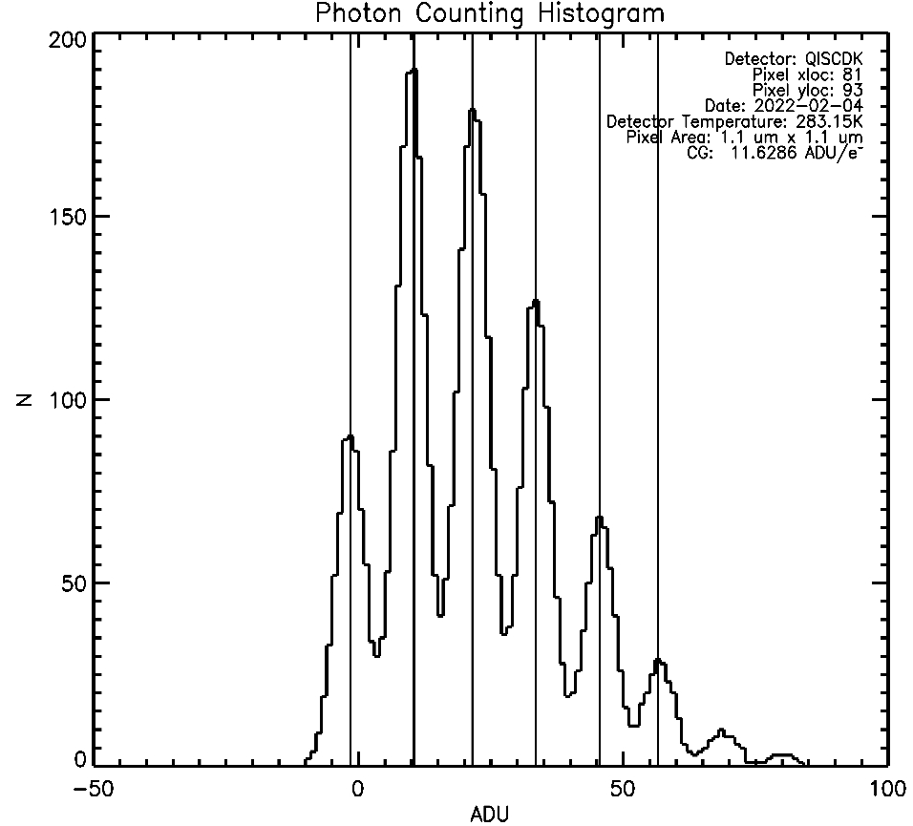
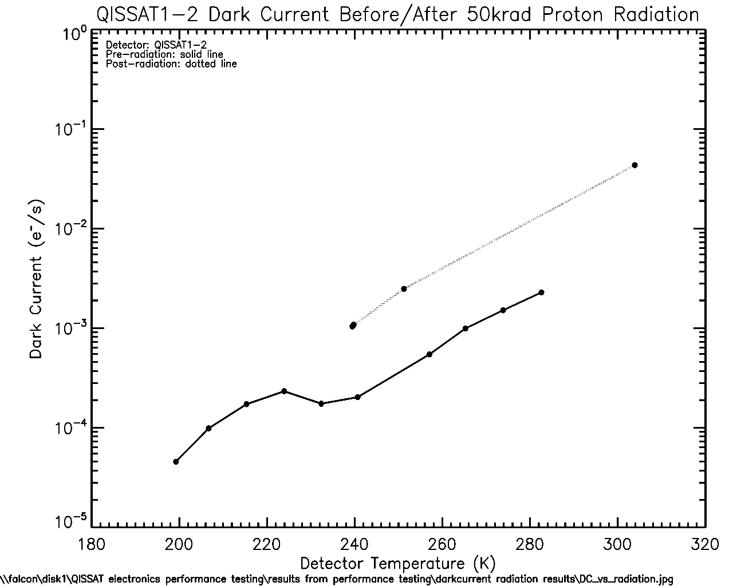
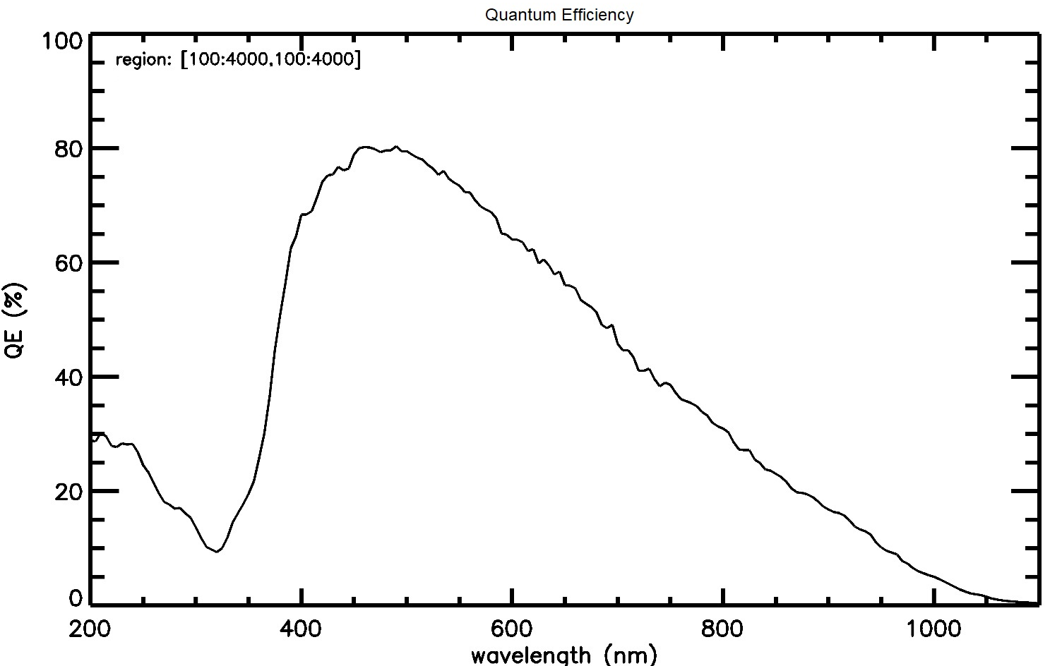
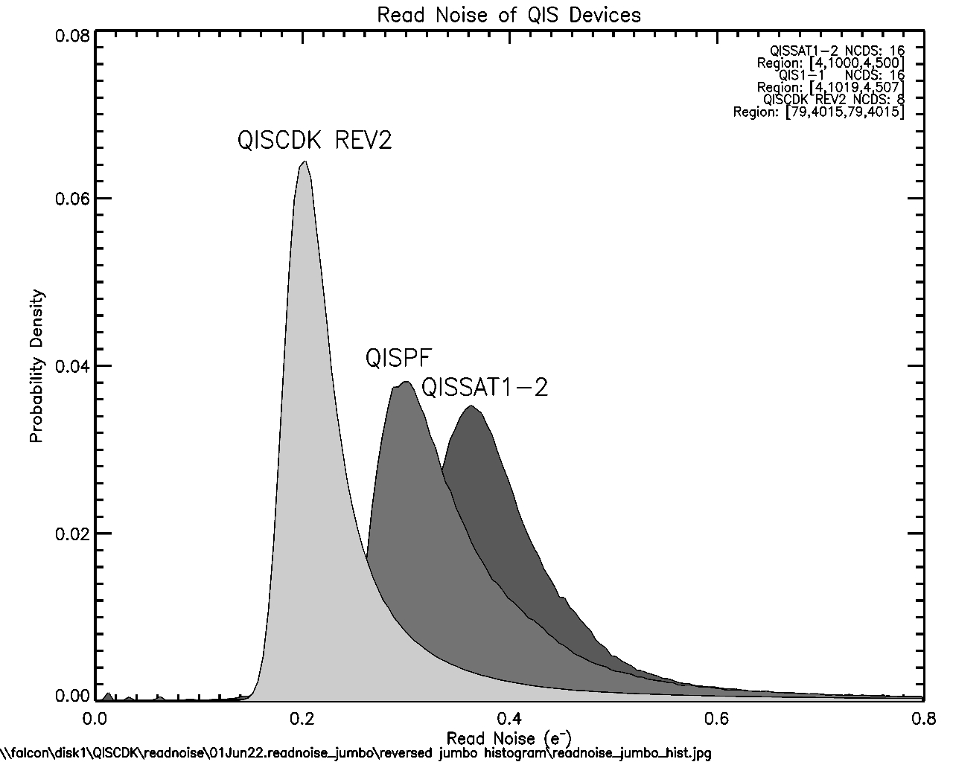
Single-Photon Counting CMOS Image Sensors
Gallagher, J., Buntic, L., Figer, Donald F., and Deng, W. 2022, “Characterization of single-photon sensing and photon-number resolving CMOS image sensors,” SPIE Astronomical Telescopes and Instrumentation, Montreal, Paper 12191-28

Slide 5
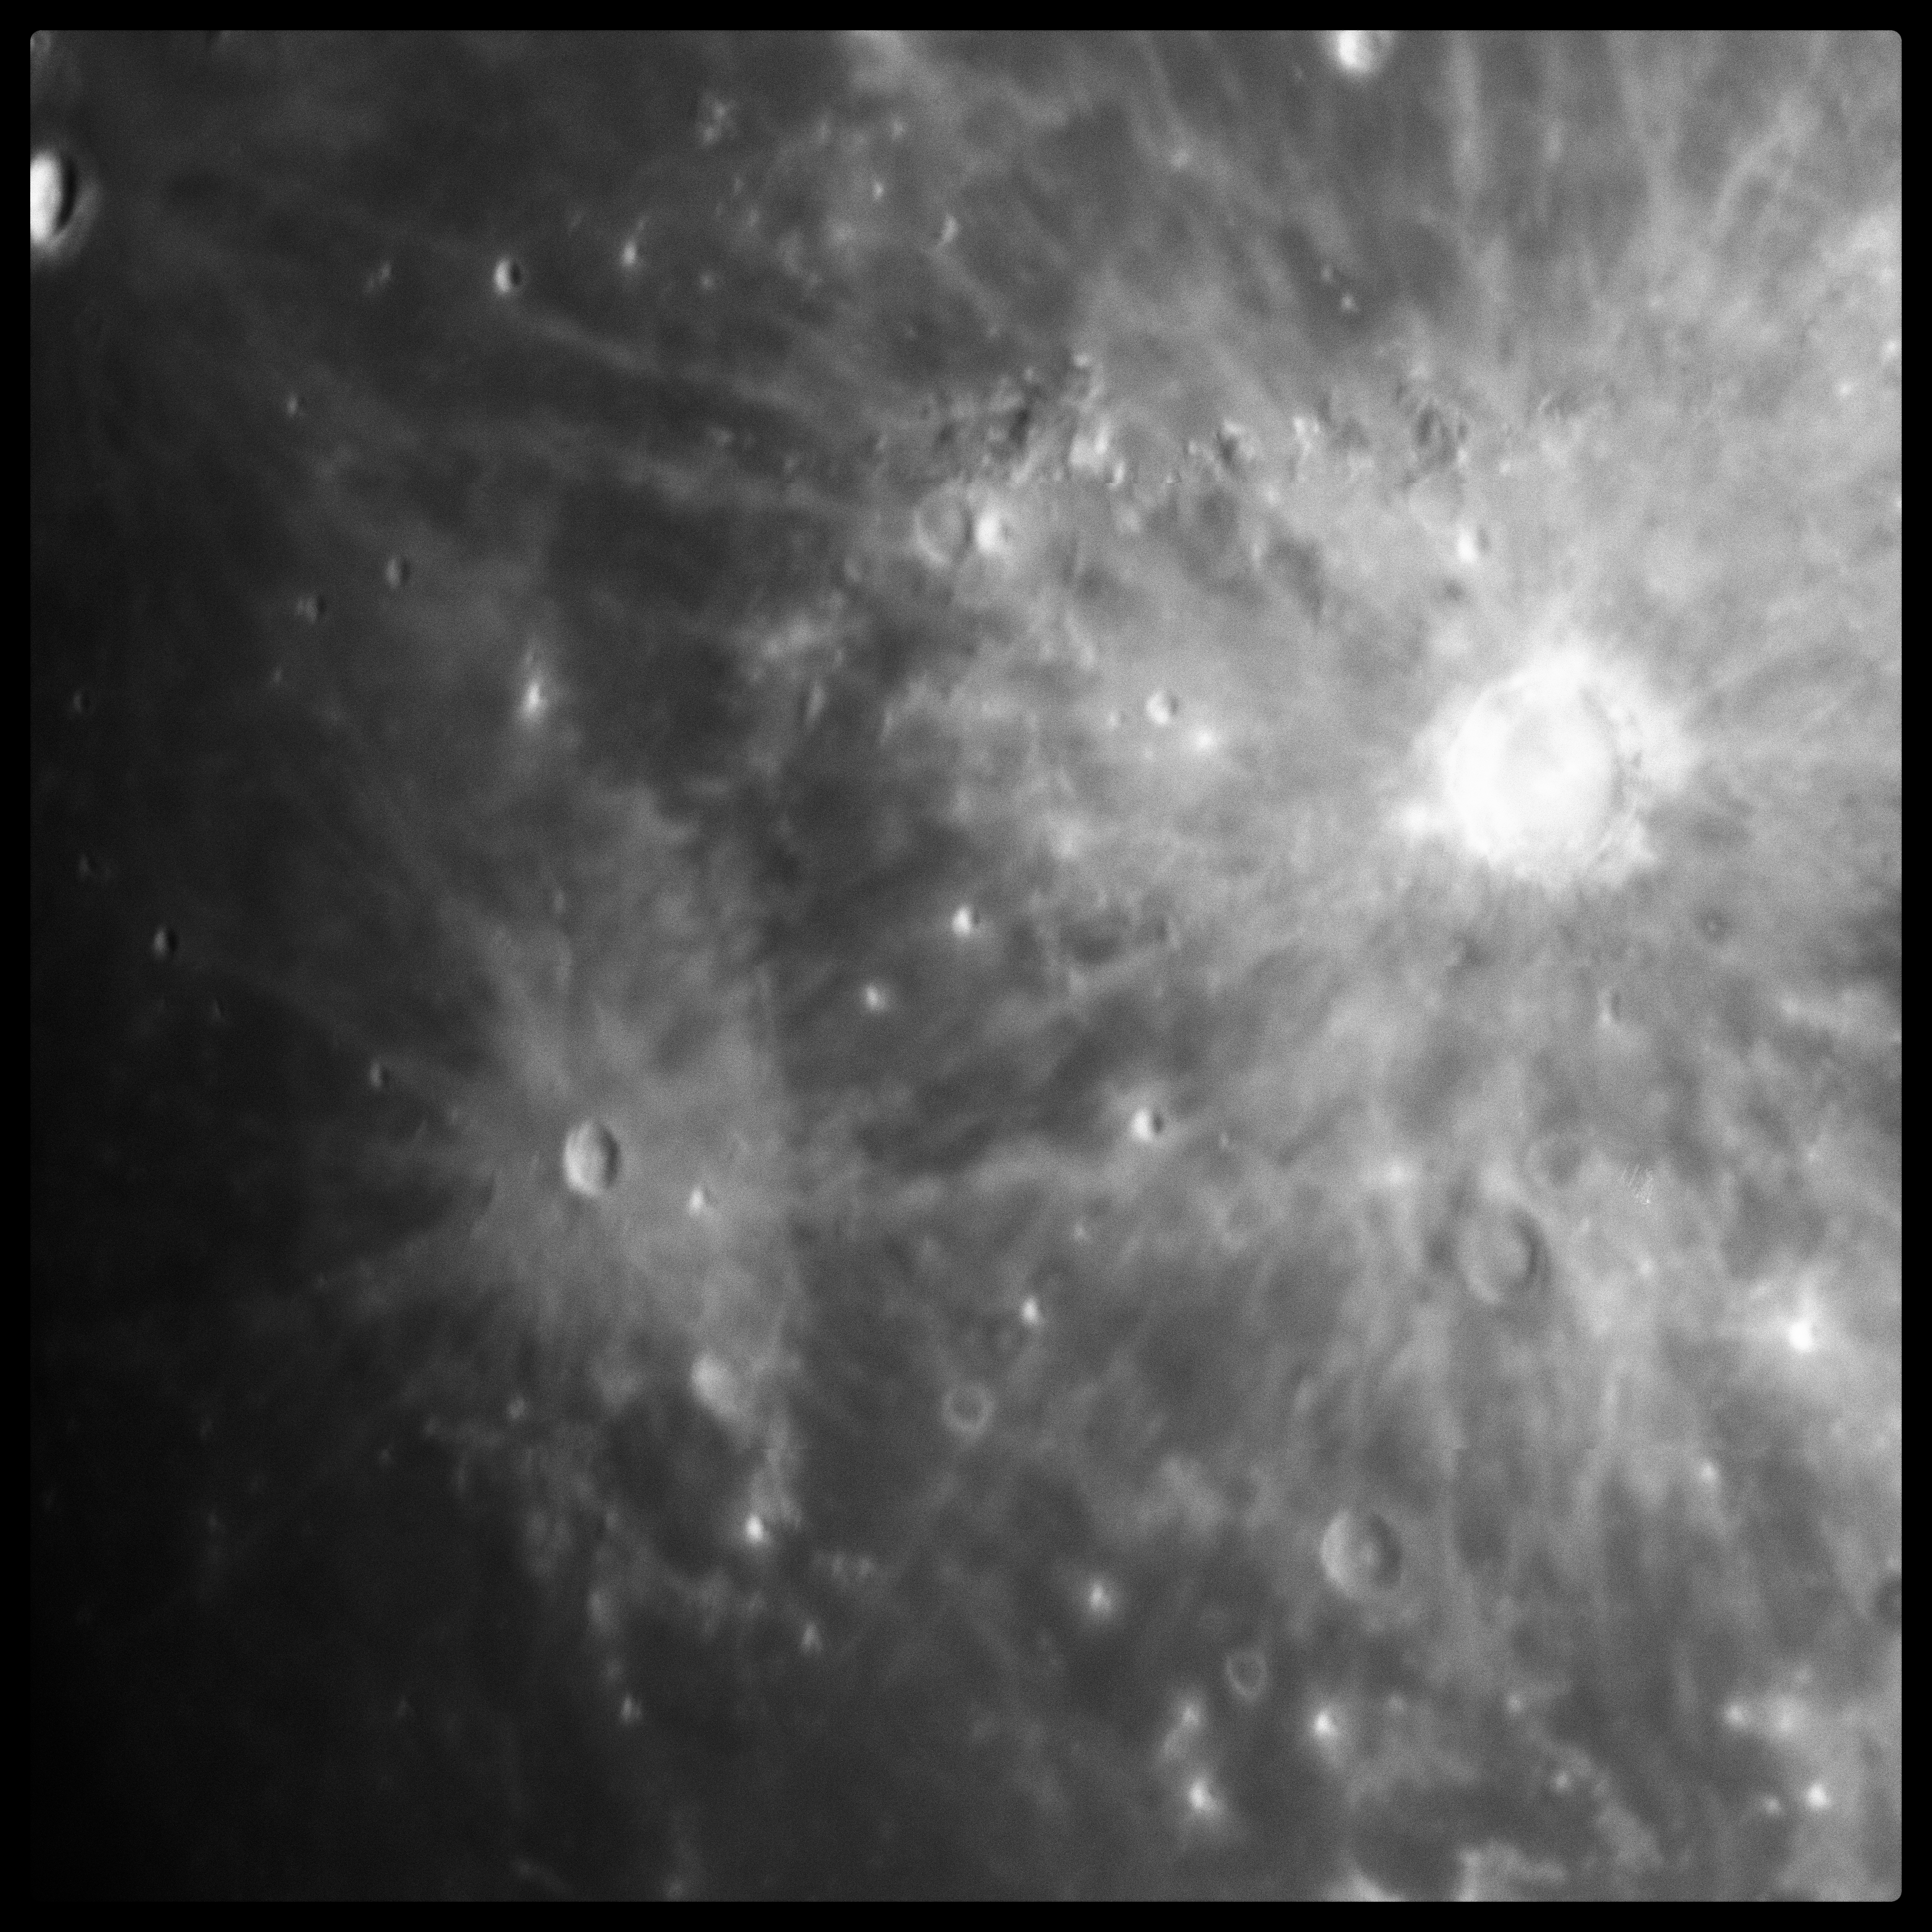
Image of Lunar Terminator using QISCDK

Slide 6
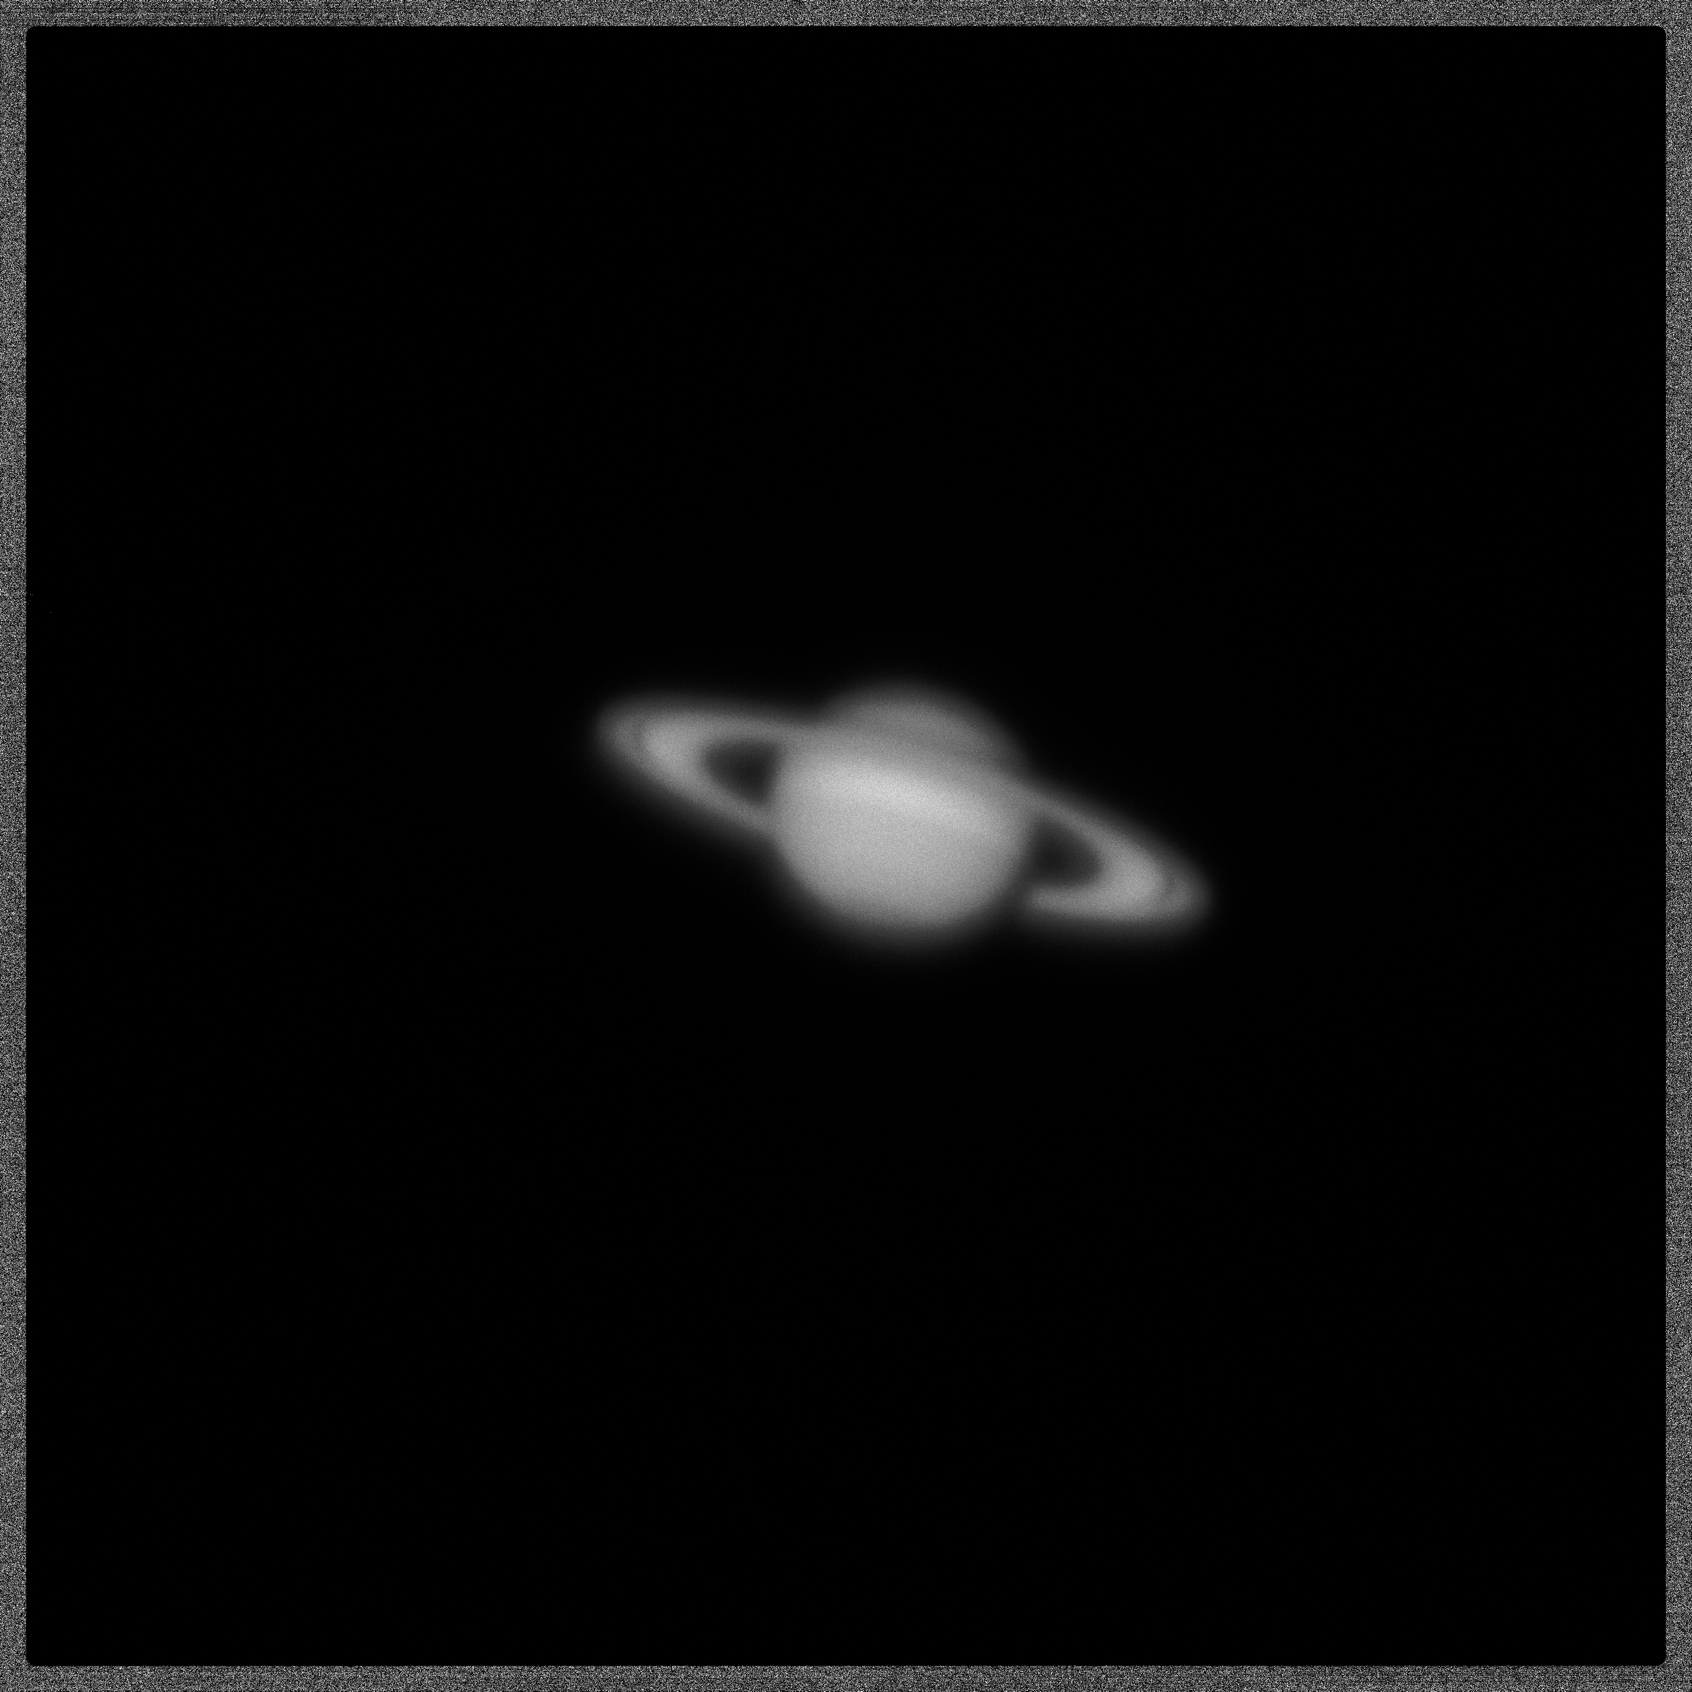
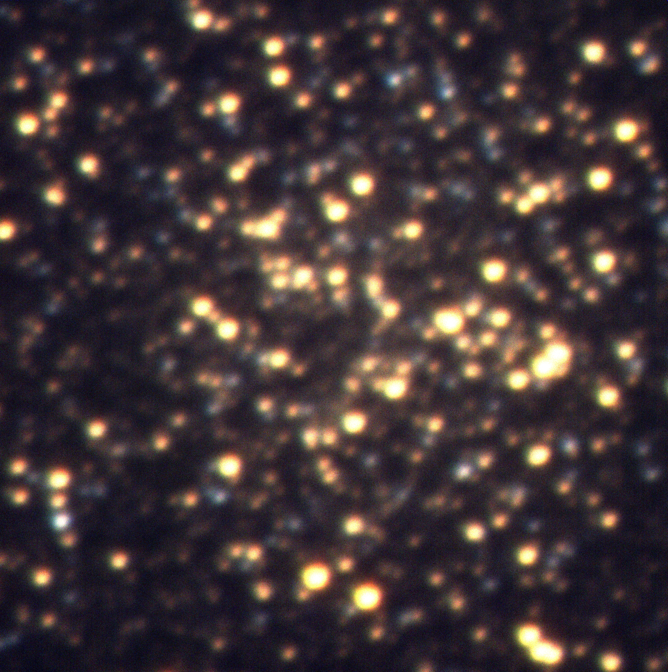
Observations with Single Photon Counting CMOS Image Sensors
Image of Saturn
(integration time = 70 μs)
Image of M13 (BVR)

Slide 7
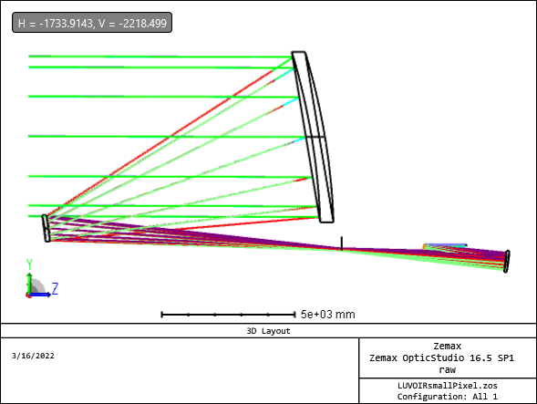
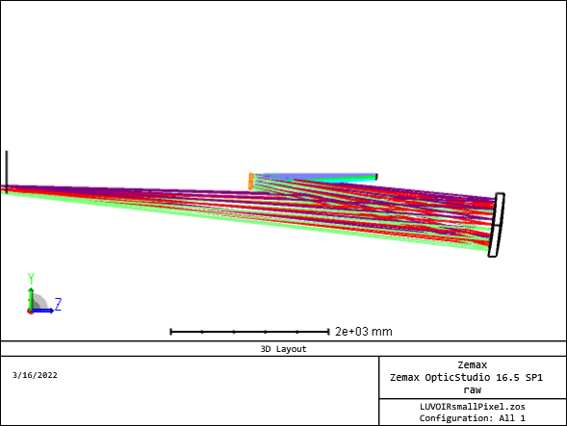
Small Pixels Enable Small Instruments
f/9 matches 2.2 μm (7 mas) pixels for Nyquist-sampling at 500 nm using Bob Woodruff’s TMA design in a 6-meter telescope.
A faster final f/#, enabled by small pixels, implies a factor of 3x smaller instrument in linear dimensions, or a factor of 100x decrease in volume.
FOV is 240 x 240 arc sec with 31.6 K x 31.6 K [10⁹ pixels] focal plane.
Notes:
Faster final f/#, enabled by small pixels, implies factor of three smaller instruments in linear of dimension or factor of 100x in volume.

