Slide 1
Performance of the
Raytheon Aquarius 1K mid-IR Array with the Large Binocular Telescope Interferometer
William F. Hoffmann, Phillip M. Hinz, Denis Defrère,
Jarron M. Leisenring, Andrew J Skemer
Steward Observatory, The University of Arizona
Bertrand Mennesson
Jet Propulsion Lab, California Institute of Technology
Scientific Detector Workshop
Florence, Italy October 7-11, 2013

Slide 2
1. The Context
The Goal of this work
Provide a ground-based astronomical instrument for mid-infrared (8-13 μm) high contrast Imaging of nearby stars
Detect and measure exozodiacal light
Detect and characterize planets
Work supported by NASA through a contract with JPL

Slide 3
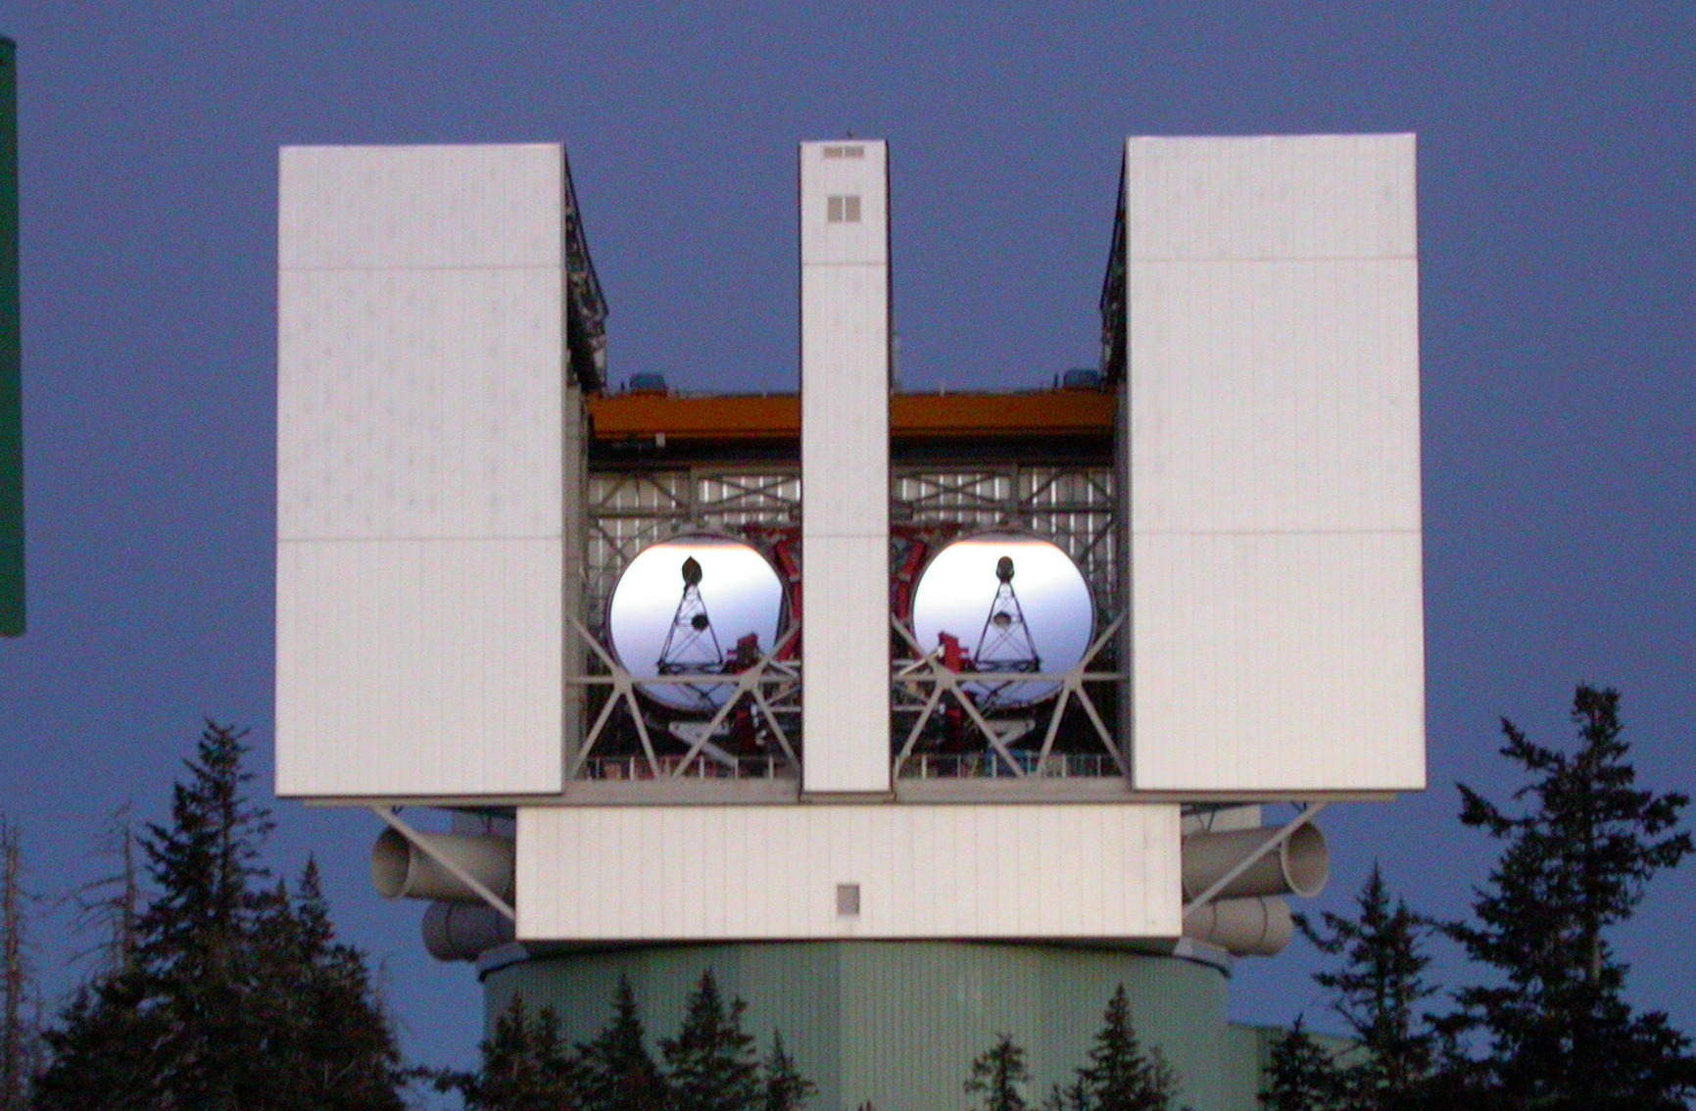
The Large Binocular Telescope (LBT)
Partners: Arizona, Italy, Germany, The Research Corporation, Ohio State University
Location: Mt Graham, Arizona, elevation 10400 feet (3170 meters)
Two 8.4 meter primary mirrors, edge-to-edge 22.7 meters
Adaptive optics thin shell secondaries with Strehl ratio of 0.98 at 11 μm

Slide 4

LBT Interferometer (LBTI)
4.13 m
3.6 m
Cryogenically cooled beam train
Slow alignment mechanisms and atmospheric phase, tip/tilt correction
Rigid external structure

Slide 5
LBTI Components
(2-5 um)
(1-5 um)

Slide 6
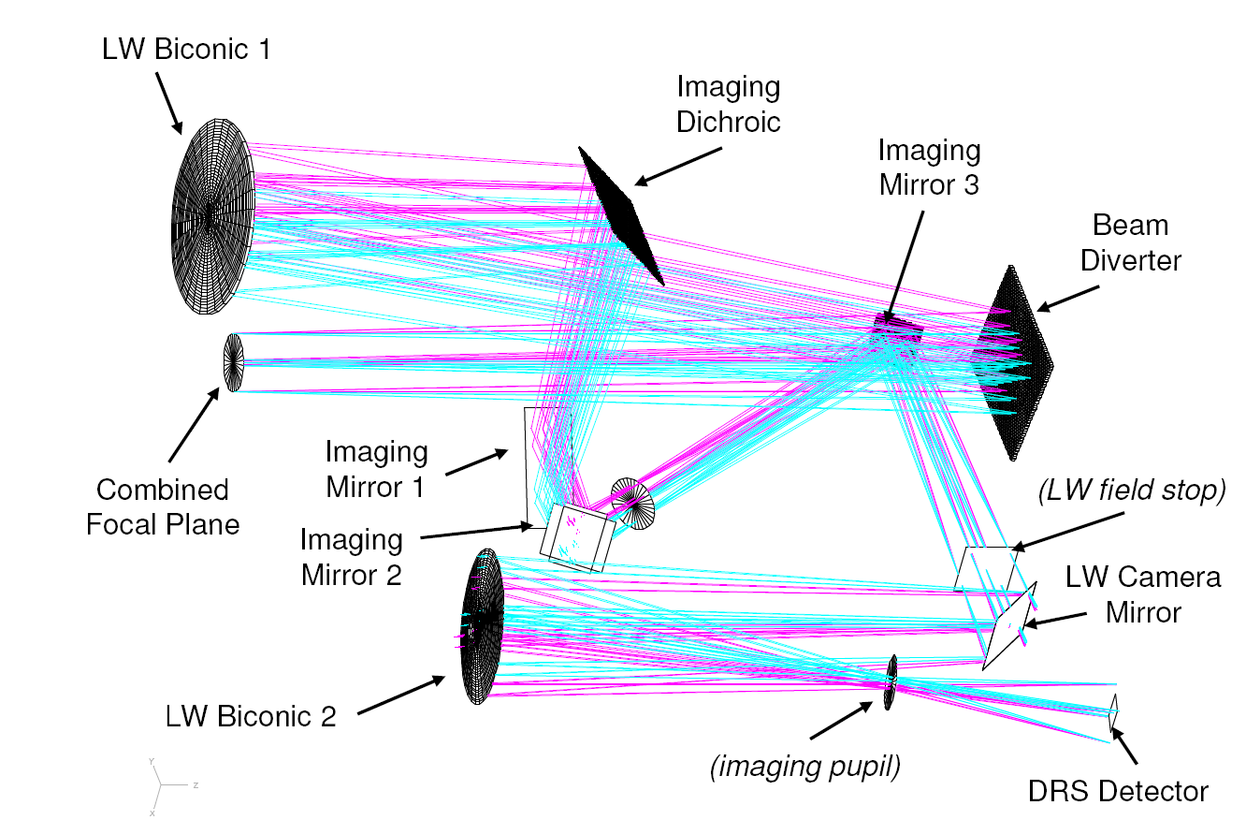
2. The Instrument
Nulling Optimized Mid-Infrared Camera (NOMIC)
Aquarius
Array: Raytheon Aquarius Si:As 1024x1024 with 30 μm pixels
Field of view: 12 arcseconds Pixel scale: 0.018 arcseconds/pixel
λ/D individual aperture at 11 μm: 0.27 arcseconds 15 pixels
λ/D Fizeau interferometry at 11 μm: 0.10 arcseconds 5.5 pixels

Slide 7
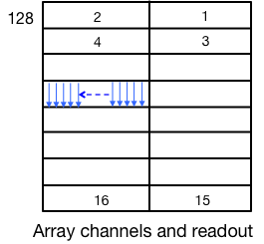
NOMIC Array, Electronics, Controller, and Computer
16 Array output current sources, Preamplifiers.
and A/D Converters
FPGA Formatting
Co-adding
Data Transfer
• • •
PC
De-interlacing
Saving
Quick look display & analysis
Array is read in “rolling mode”. Pixels are reset as they are read
Sub-array allows each channel reduced size, e.g. 128x256 or 128x128 pixels
Pixel read speed 2.4 MHz. Full array 65536 pixels per channel
Full array read 27 msec. Partial array ≥3 msec
A/D converter 14 bit

Slide 8
3. Performance
All Measurements are for “High Gain” (Small integrating Capacitance). Full well ~ 10⁶ electrons
Linearity
Linear from 12% to 84% of saturation

Slide 9
Read and shot noise
Noise is defined to be the standard deviation over a selected portion of the array of the difference between two images.
Noise measurements
Fit to measurements
Fit minus read noise = shot noise
Measured read noise
Raytheon spec for read noise
Conversion = 153 electrons/ADU
Detector Bias = 1.8 V

Slide 10
Array Quantum efficiency at 11 μm ~40%
QE is calculated from the shot noise and well filling in the previous slide.
QE = (shot noise)² / (Well filling)
Calculated QE
Fit to Calculation
Conversion = 153 electrons/ADU
Detector bias = 1.8 V

Slide 11
Image Quality - Point source and noise
Median-combined 11 μm image of 15972 frames at 55 msec each
Subtracting telescope off-source nod beams, single aperture
Part of the image containing Vega, stretched to show diffraction rings
Part of the image away from Vega showing noise, linear stretch

Slide 12
Image Quality - Artifacts
Vega with histogram stretch to show artifact
Single raw frame showing detector artifacts, response variation from left to right, and horizontal lines

Slide 13
4. Low Frequency Excess Noise (ELFN)
ELFN Characteristics
ELFN is not noticeable in a single array read. It requires many coadds to see.
It appears at low frequencies, < 10 Hz
It is not 1/f noise.
It rises above the shot noise approximately a factor of two to five over about a factor of 100 in frequency
The rise starts at a “knee” which is at a higher frequency for higher incident photon flux

Slide 14
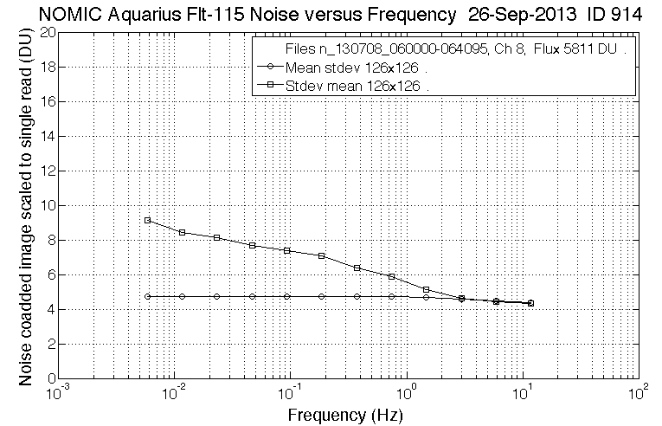
Plot of ELFN Noise
Detector frame
126x126 pixels
Plot of the standard deviation of 126x126 pixel image difference pairs as a function of the frequency calculated from the time interval between pairs. The lower curve is for single pairs. The upper curve is for 2048 co-added pairs

Slide 15
The Challenge
For previous generations of IR telescopes with rapid beam switching ELFN was not a problem.
For current and future generations of large telescopes beam switching is generally much slower than 10 Hz so that observing strategies must be adapted to minimize this effect.

Slide 16
Adding Spatial Filtering to Noise Measurement
The standard deviation of all the pixels over the array is not an appropriate measurement of noise when the energy from a star falls on a number of pixels. The values for these pixels must be added to detect and determine the flux from a star.
In addition, in order to remove the effect of possible variation of the background over the array, a region outside the star is frequently subtracted, such as a neighboring area or an annulus.
These steps are a form of spatial filtering which effects the noise determination and reveals something about its properties.

Slide 17
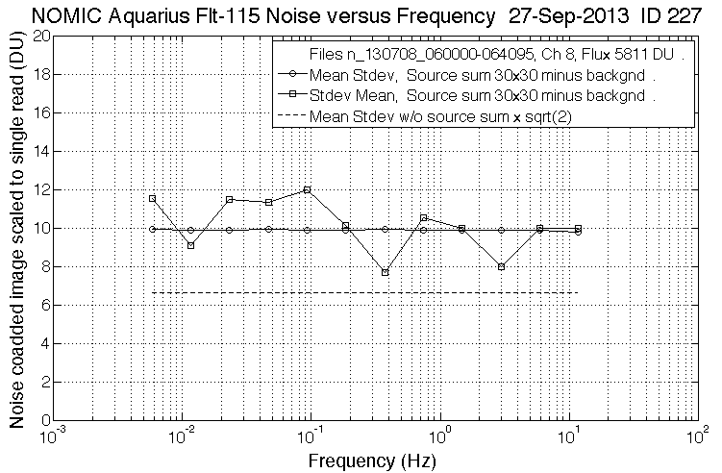

ELFN Noise with Source Sum & Bkgnd Subtract
Detector frame
Background 15x30
Source
30x30
pixels
Background 15x30
Plot of the standard deviation of 2x4 “pixel” difference pairs for source sum and background subtract as a function of the frequency calculated from the time interval between pairs. The flat curve is for single pairs. The irregular curve is for 2048 co-added pairs. The dashed line is the mean standard deviation w/o source sum × sqrt(2).

Slide 18
It appears that
With both temporal and spatial filtering, we can overcome most of the ELFN increase of noise with decreasing frequency for point source measurements
However
The resulting noise with temporal and spatial filtering is about a factor of 1.5 times that without ELFN
This increase appears to be due to spatial and temporal correlation of the array readout noise.
The task remains to understand and eliminate this correlation

Slide 19
References
LBTI web site: lbti.as.arizona.edu

Slide 20
Backup Slides

Slide 21
Two Approaches to Noise Calculation
1. Approach of Previous Slides
We have first subtracted images at various time intervals to remove the fixed pattern and then defined the noise to be the standard deviation over the array. Subsequently we have summed over the source and subtracted the background
2. Alternative Approach
We could first sum over the source and subtract a background to remove bias and then define the noise as the standard deviation of a time sequence of these differences. Subsequently we could difference time separated images to further reduce the noise

Slide 22
Time variation of Sum over Source
Drift with detector blanked-off is ~ 1.2 × 10⁴ ADU in 130 seconds
Temporal drift with background on array is ~ 8 × 10⁴ ADU in 130 seconds
Detector
Detector and Background

Slide 23
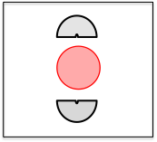
Subtract Nearby Split Background
40-min of sky data nodding every ~1min30 (June 27th 2013)
Background regions
Photometric aperture
(optimized for r=0.64λ/D)
Aperture only
DIT=55ms
Background subtracted
WITHOUT NODDING SUBTRACTION
WITH NODDING SUBTRACTION

Slide 24
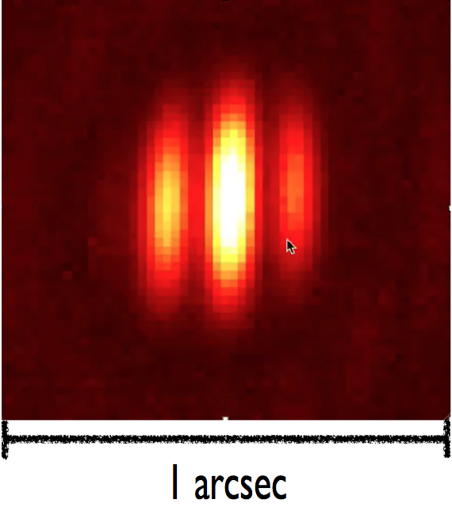
Fizeau Fringes

