Slide 1
SDW 2013
Derek Ives + Gert Finger
E.S.O.

Slide 2
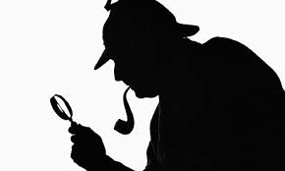
SDW 2013
“A Detective Story”
“Elementary, my dear Watson”

Slide 3
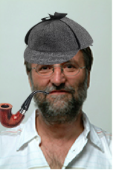
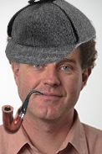
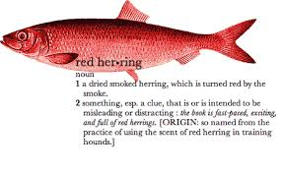
Title :- “The mystery of what killed the instrument sensitivity ?”
A detective story
Characters :-
Derek “ Sherlock Holmes” Ives
Dr. Gert “John Watson” Finger
The elusive Mr. “ELFN”
The Victim :-
VISIR - VLT Imager and Spectrometer for mid InfraRed
“Red Herring” –
a false clue that leads towards a false conclusion
“It is quite a three pipe problem, and I beg that you won't speak to me for twenty minutes”
– The Red-headed League

Slide 4
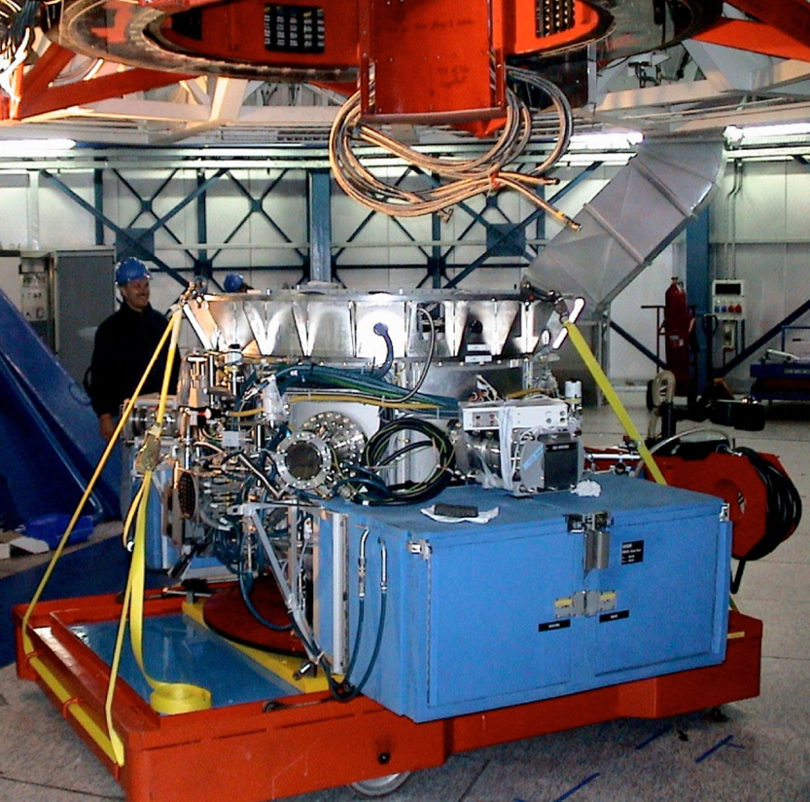
The Prologue – improving instrument performance
VISIR – mid-IR Imager/Spectrometer for VLT
New Water vapour monitor
New Optics – N(10um) and Q(20um) band in one exposure (old system required 4 exposures)
Detector development – AQUARIUS (RVS)
1024 x 1024 device, 30 um square pixels
3 – 28 um wavelength coverage, AR coated
Proven Technology – MIRI heritage – Si:As IBC
Project began ~ 6-7 years ago
First light at telescope – 2012 – rapid deployment to telescope
VISIR at telescope

Slide 5
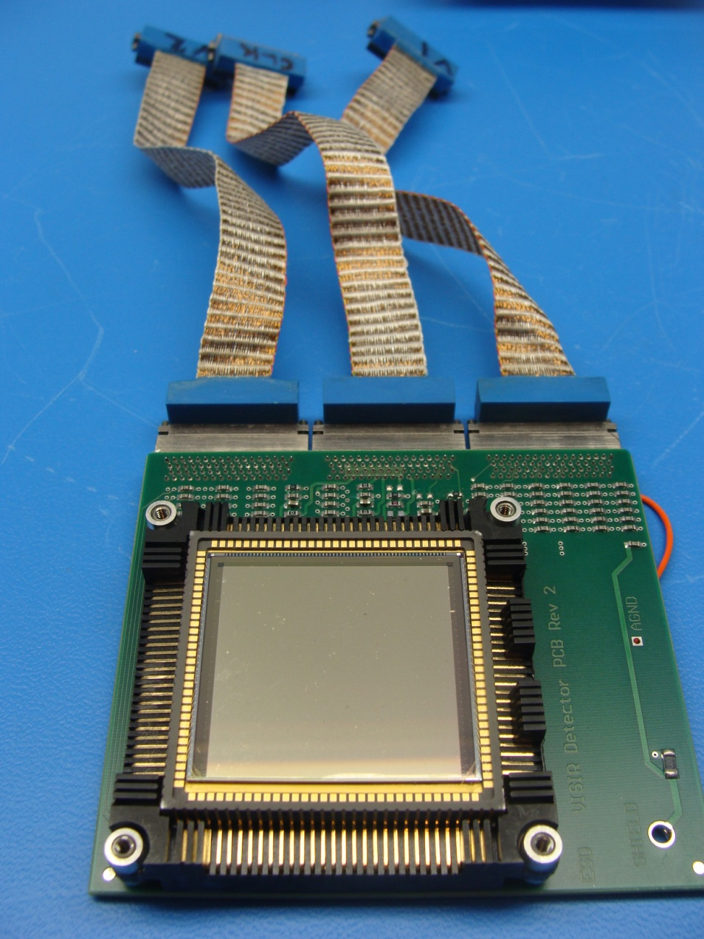
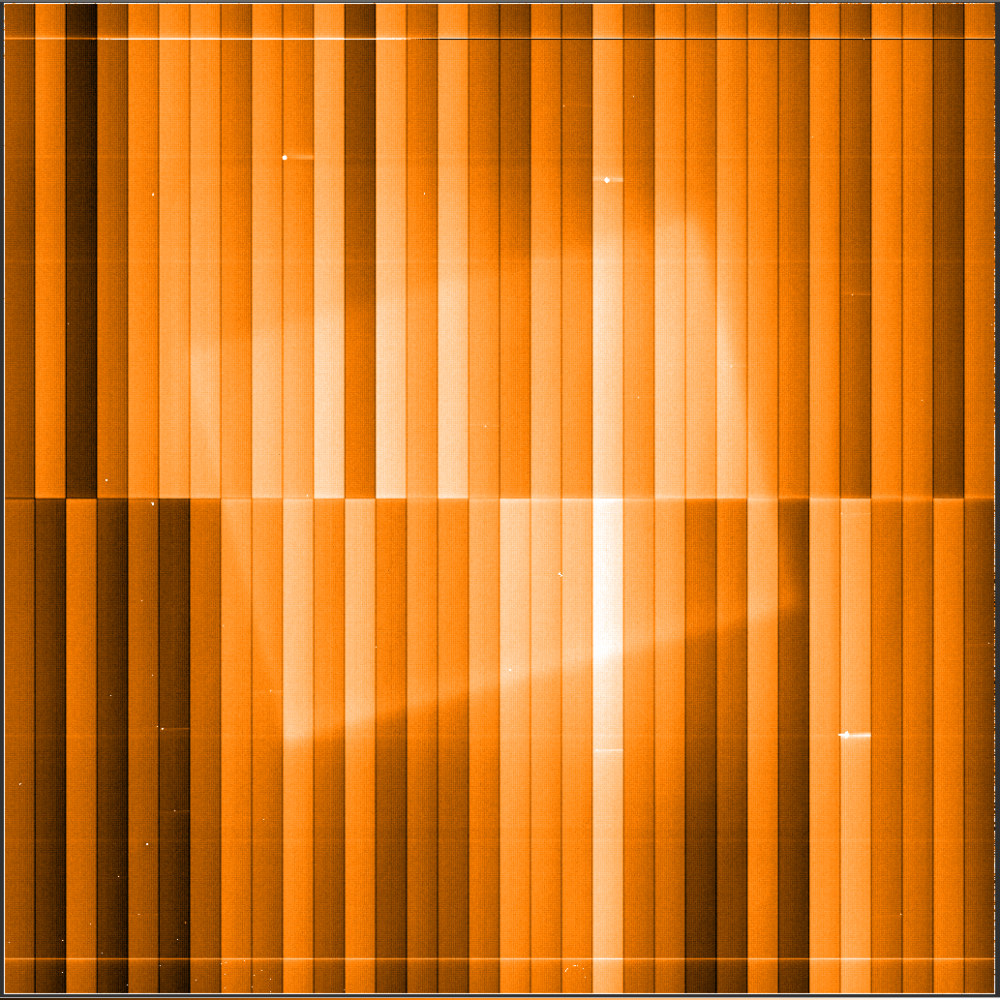
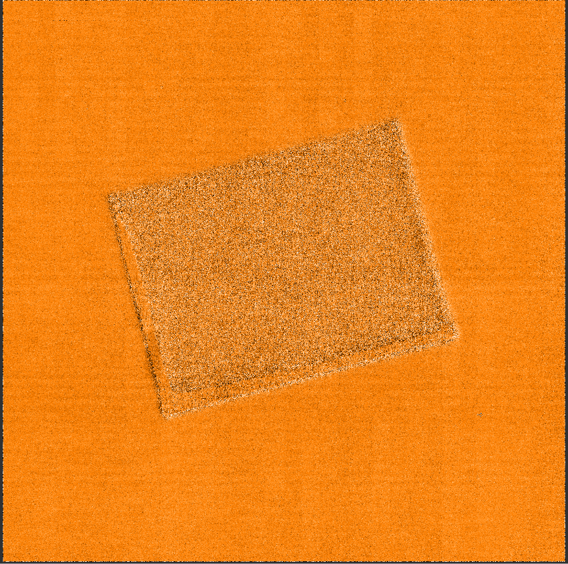
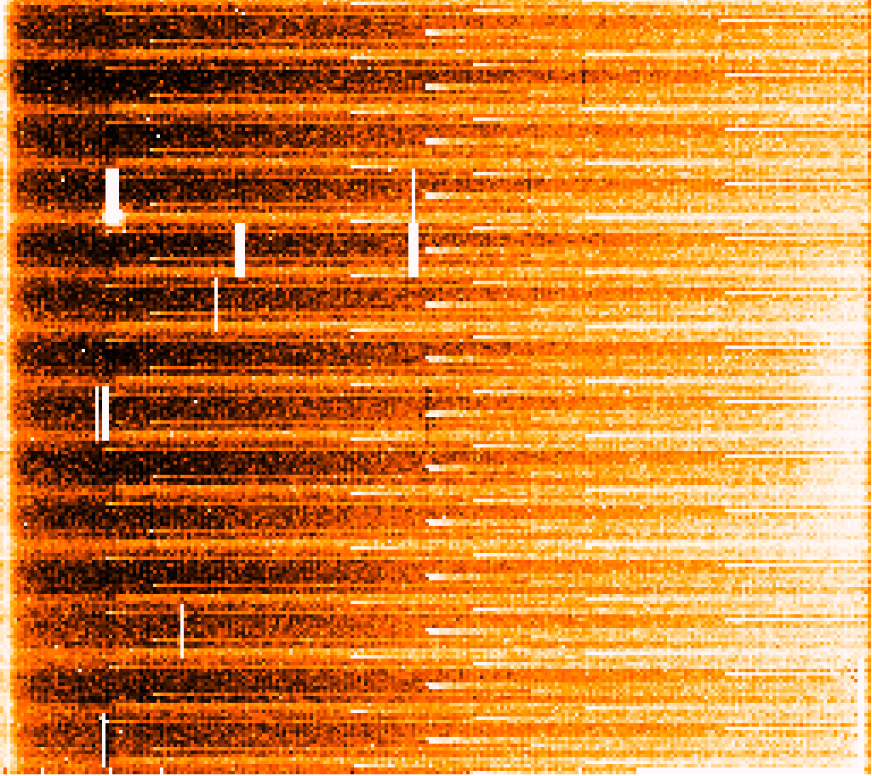
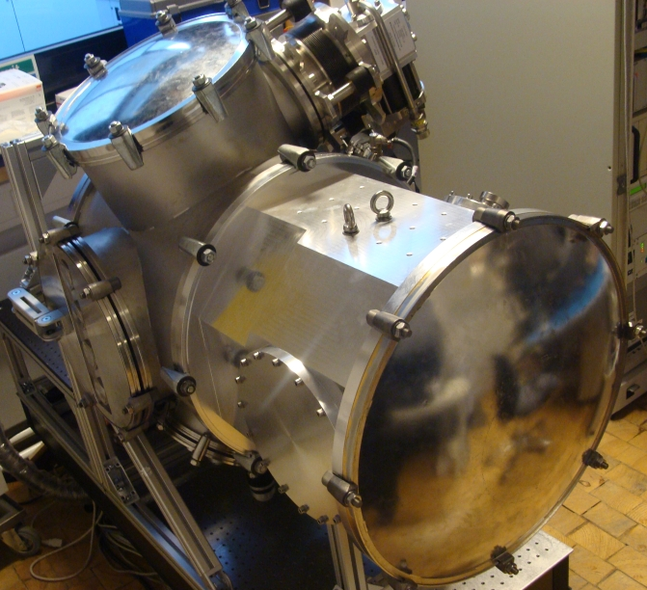
Prologue - ESO Development work
Development of new mid-IR test facility at Garching (reuse of TIMMI instrument)
Filters
Polarimeter (used to change flux)
4K operation
Quick turnaround (4 hours)
Cryogenic Preamplification (50K)
NGC driven, 64 channels, 3 MHz
150 frames/second => > 300 Mbytes/s
RON ~ 200 e rms/1 Me full well
(c.f. 1000 e for last generation)

Slide 6
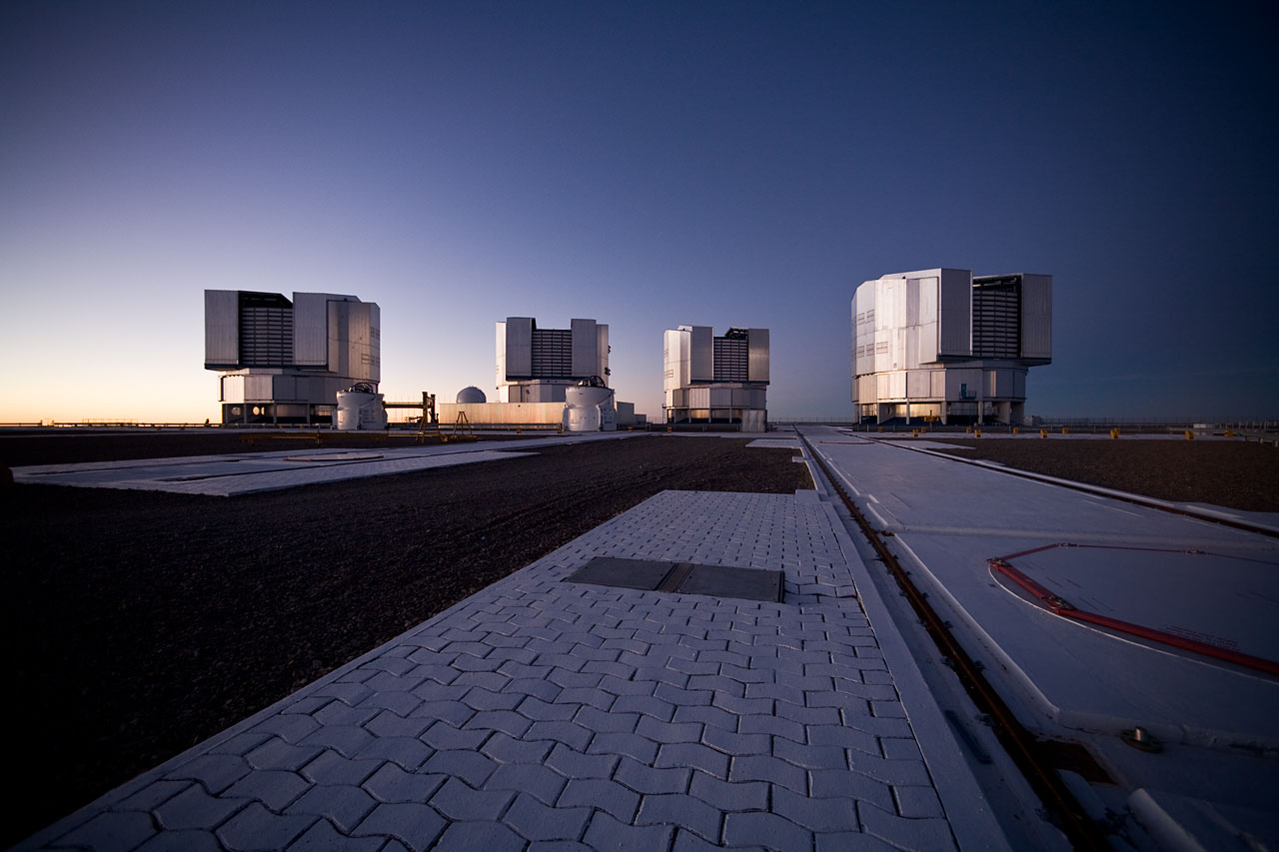
The “crime scene” – Paranal, Chile
Crime Committed – summer 2012
UT3
Scene of “crime”
“Nothing clears up a case so much as stating it to another person” – Silver Blaze
Notes:
1 Jansky = non-SI unit of spectral flux density[ equivalent to 10E−26 watts per square metre per hertz

Slide 7
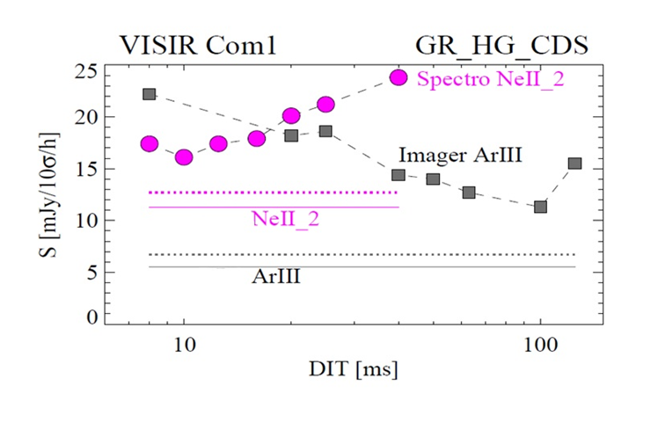
The “crime” – kill the sensitivity
CRIME - Sensitivity is ~2-3 times less than with old detector
“You see, but you do not observe. The distinction is clear.” - A Scandal in Bohemia

Slide 8
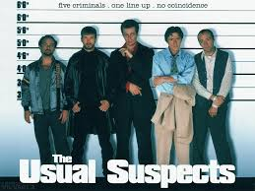
The Usual Suspects ?
The 5 suspects :-
Optics – Suspect 1, Innocent
External Electronics – Suspect 2
Gain, Linearity – Suspect 3
Very Low Q.E. – Suspect 4
Excess Noise – Suspect 5
“Eliminate all other factors, and the one which remains must be the truth” – The Sign of the Four

Slide 9
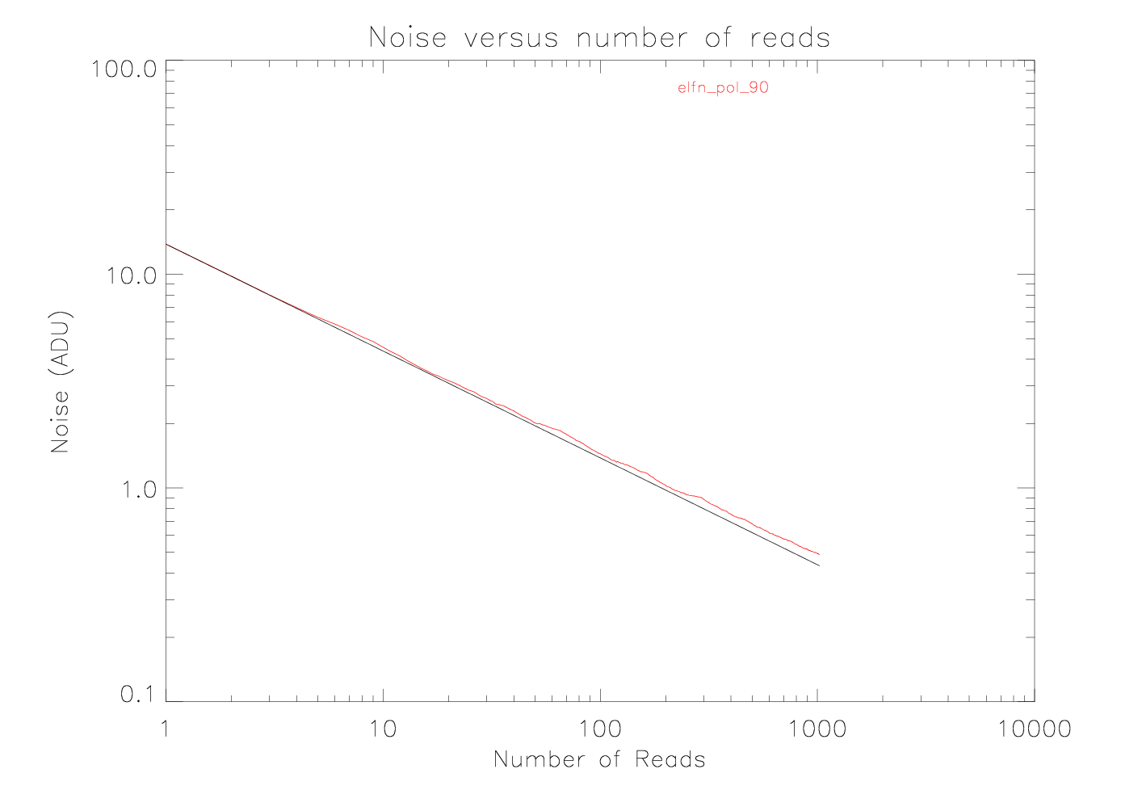
Suspect Numbers 1 & 2 – Optics and Electronics
Signal/Noise α 1/SQRT(Number of Reads) ?
  Innocent - Electronics eliminated
Read Noise Regime
Signal
Actual
Read Noise / low flux regime
Theory
Bias
“There is nothing more deceptive than an obvious fact” – The Boscombe Valley Mystery

Slide 10
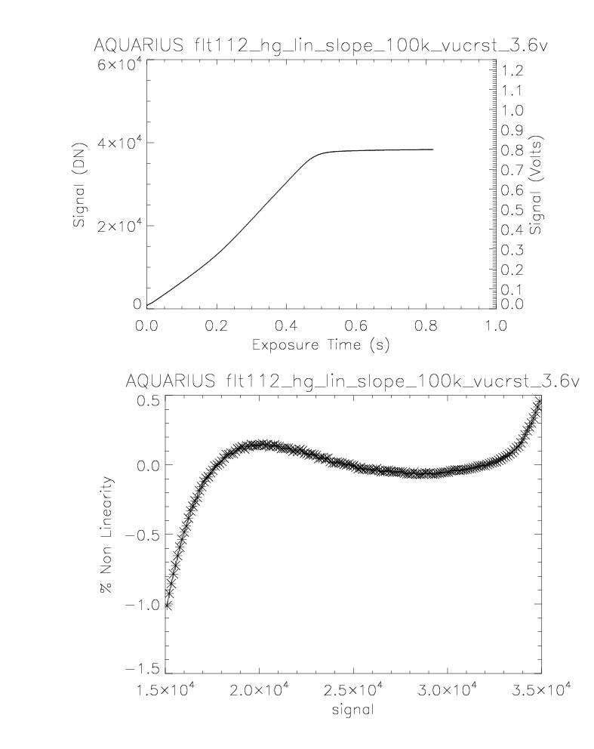
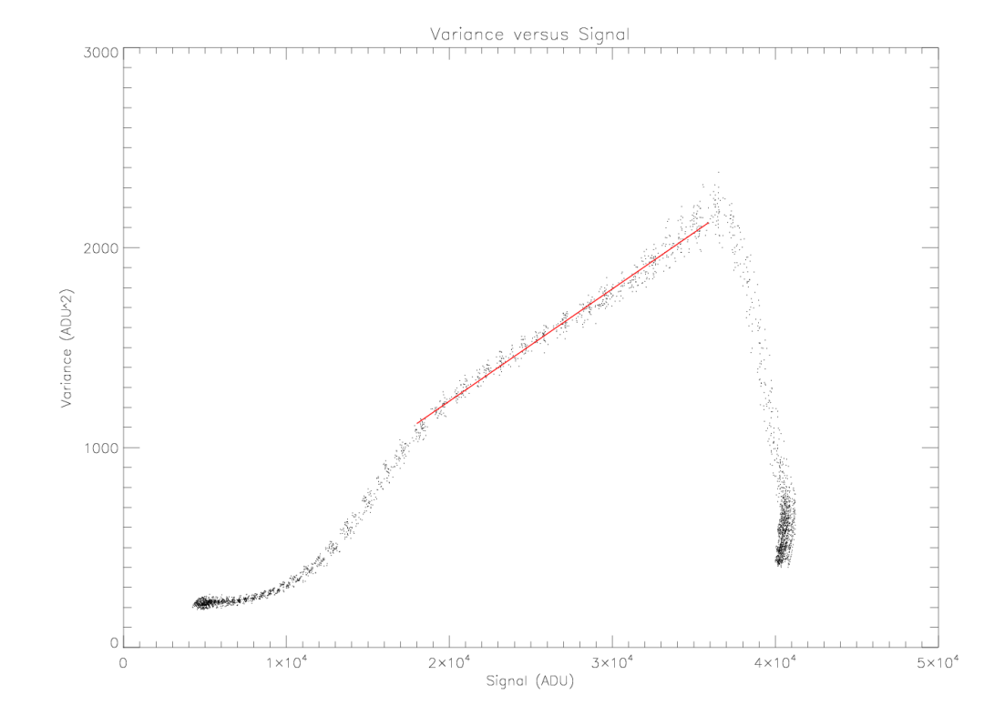
Suspect Number 3, Gain + Linearity
INNOCENT - Linearity and Gain nominal, as per design values

Slide 11
Suspect Number 4 - Quantum Efficiency ?
Instrument + Detector QE ~ 20 %
(6 optical elements, and calculated for 3 filters)
Seems low by factor of x 2 but not low enough
to explain loss in sensitivity
Instrument throughput (without detector) measured
Using pyro-electric detector ~ 50% (low)
Implies New detector QE > 40% (nominal)
INNOCENT – Quantum Efficiency nominal, as per design values
“I never guess. It is a shocking habit — destructive to the logical faculty” – The Sign of Four

Slide 12
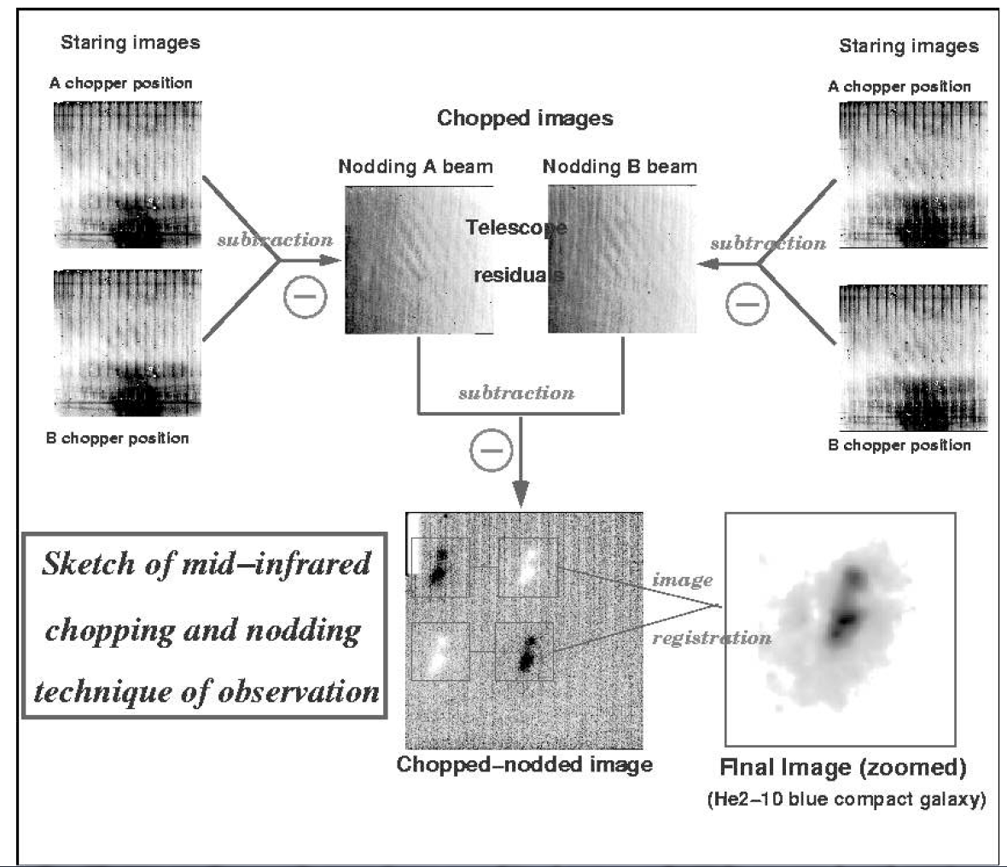
Typical operation - Evidence
Move secondary mirror
Chop faster than background
Fluctuations – cancels out.
Move telescope
Optical path not same in both
Chop positions – Nod to
remove residuals.

Slide 13
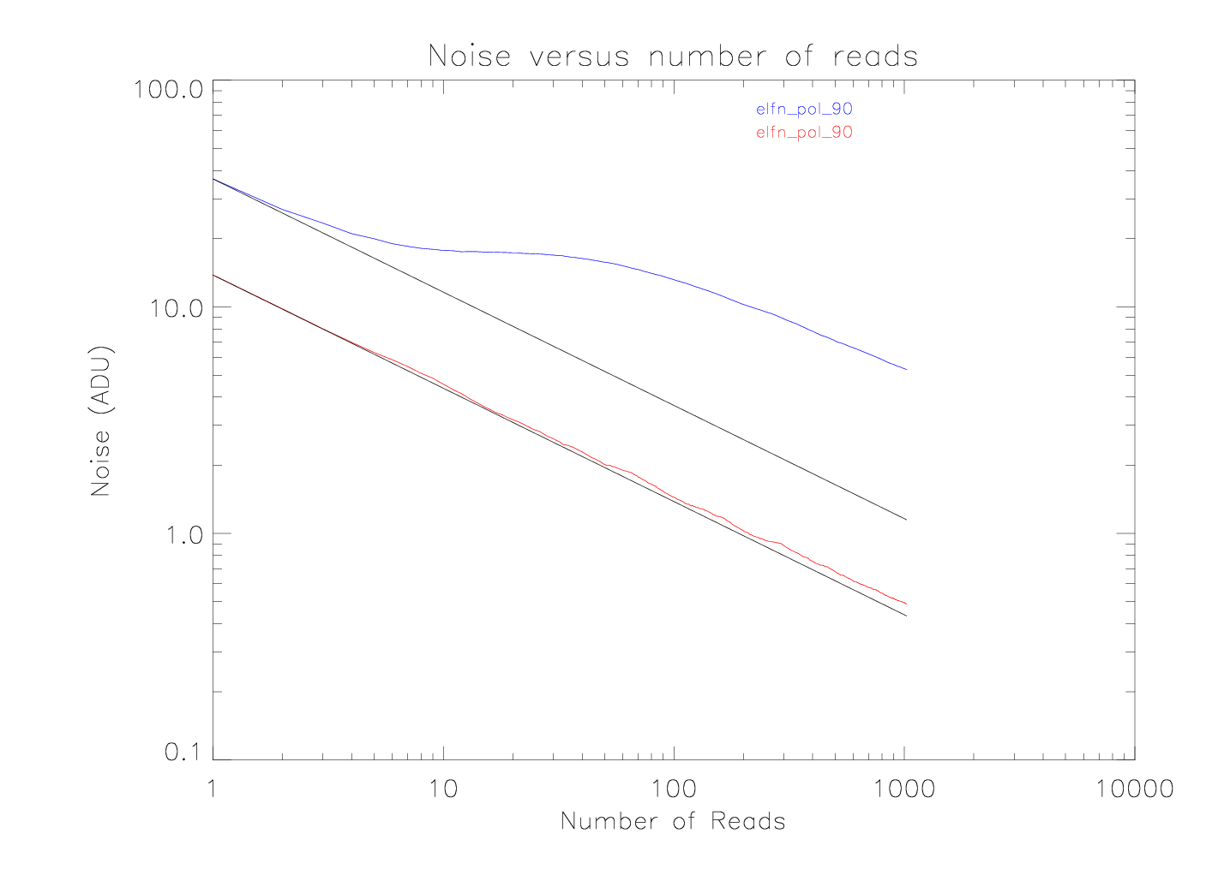
A big clue !
Shot Noise Regime
Actual
Read Noise Regime
Theory
“Any truth is better than indefinite doubt” - The Yellow Face

Slide 14
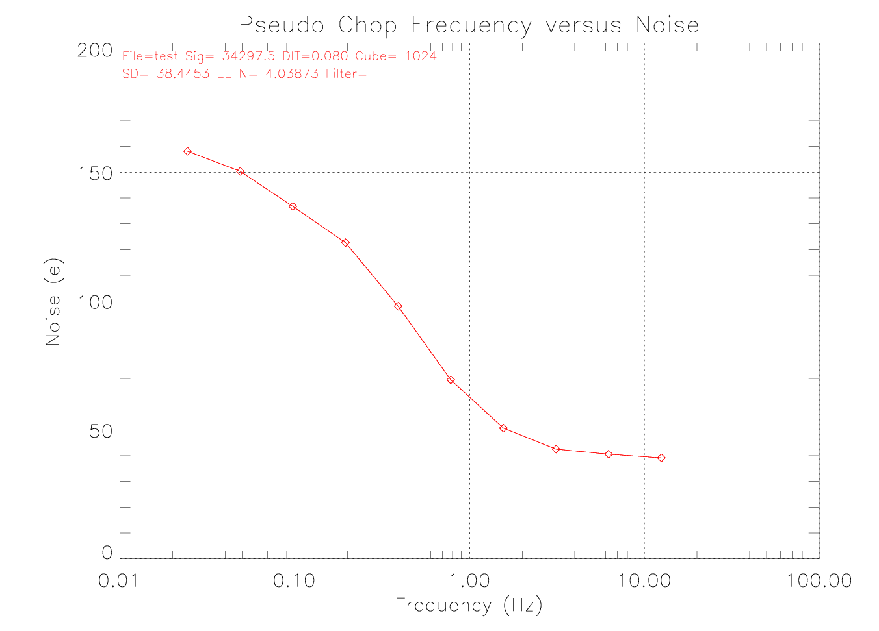

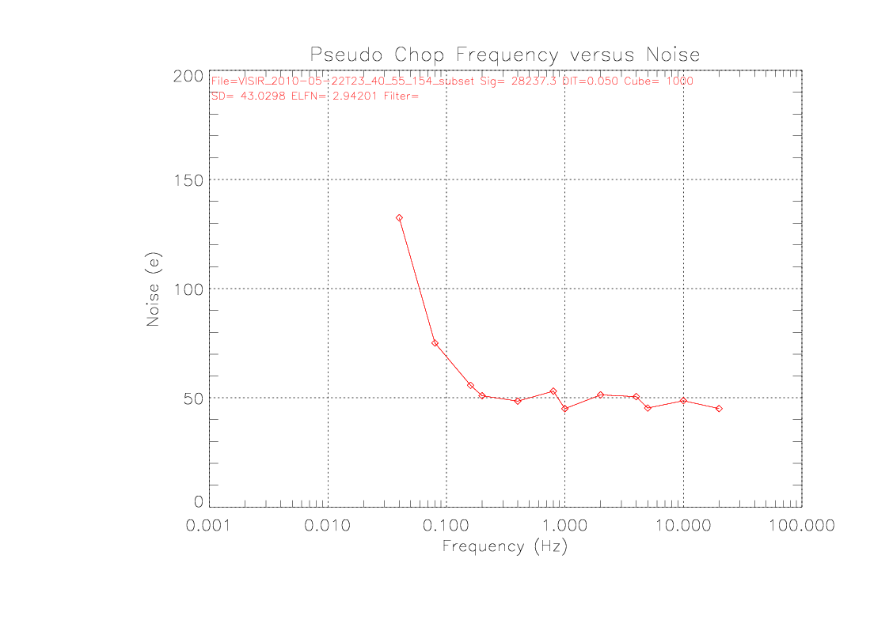

ELFN as a function of chop frequency
Difference of 500 Sums
OLD VISIR detector
We have a suspect – “Mr. ELFN”
Sum of 500 differences
0.25 Hz
0.25 Hz

Slide 15
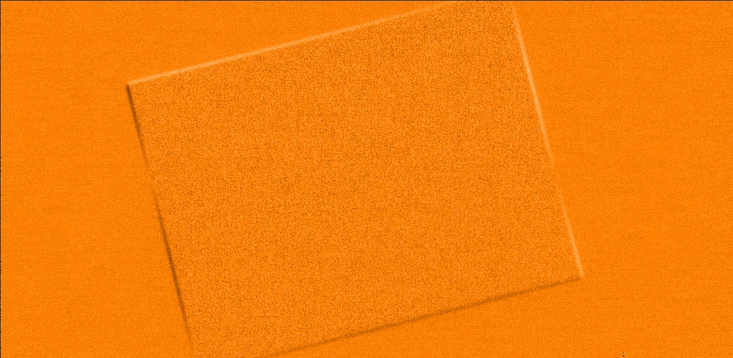
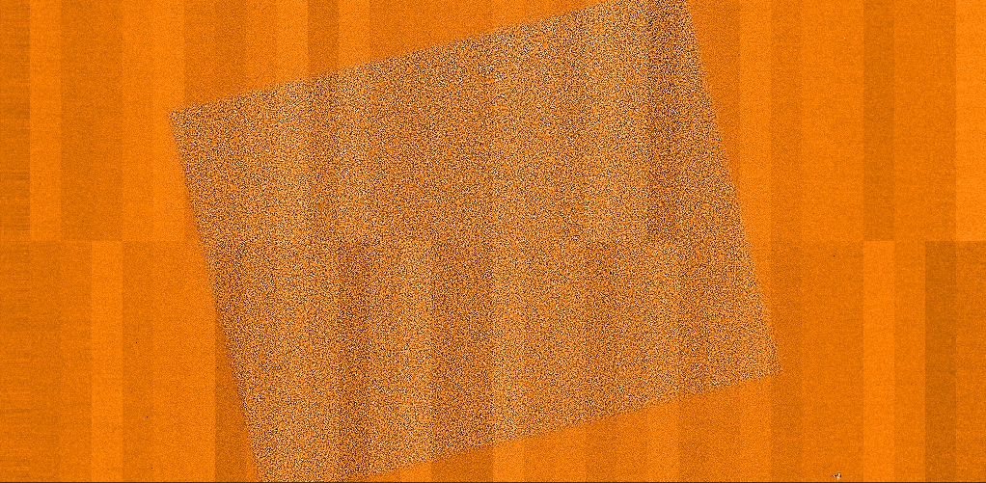
Visual Evidence
2000 frame data sequence, chopped at low and high frequencies
Difference of sums – low frequency noise
Sum of differences – high frequency noise

Slide 16
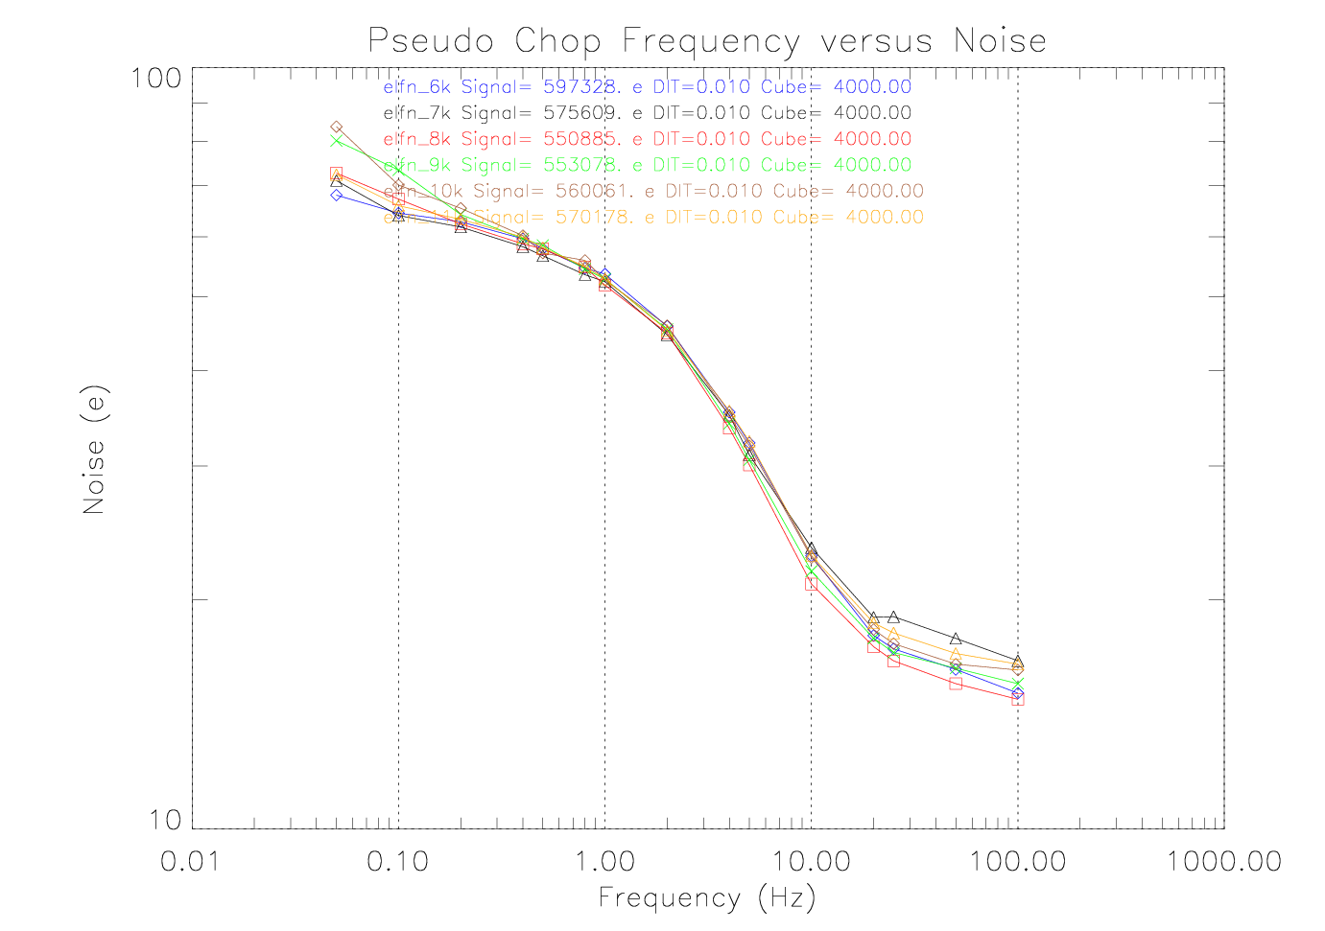
More evidence - ELFN with detector temperature
No change seen with detector temperature
"Data! Data! Data!“, "I can't make bricks without clay.“ - The Adventure of the Copper Beeches

Slide 17
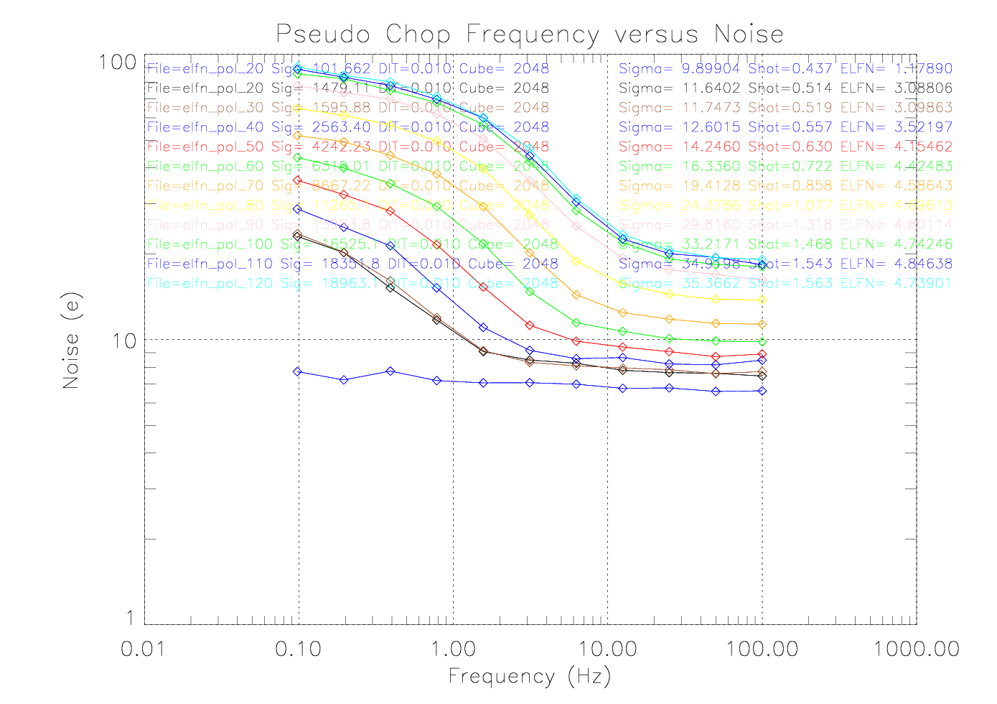
More Evidence - ELFN with increasing flux
Increasing flux shifts frequency “knee” higher
Very important piece of evidence
'It has long been an axiom of mine that the little things are infinitely the most important.‘ – A case of Identity

Slide 18
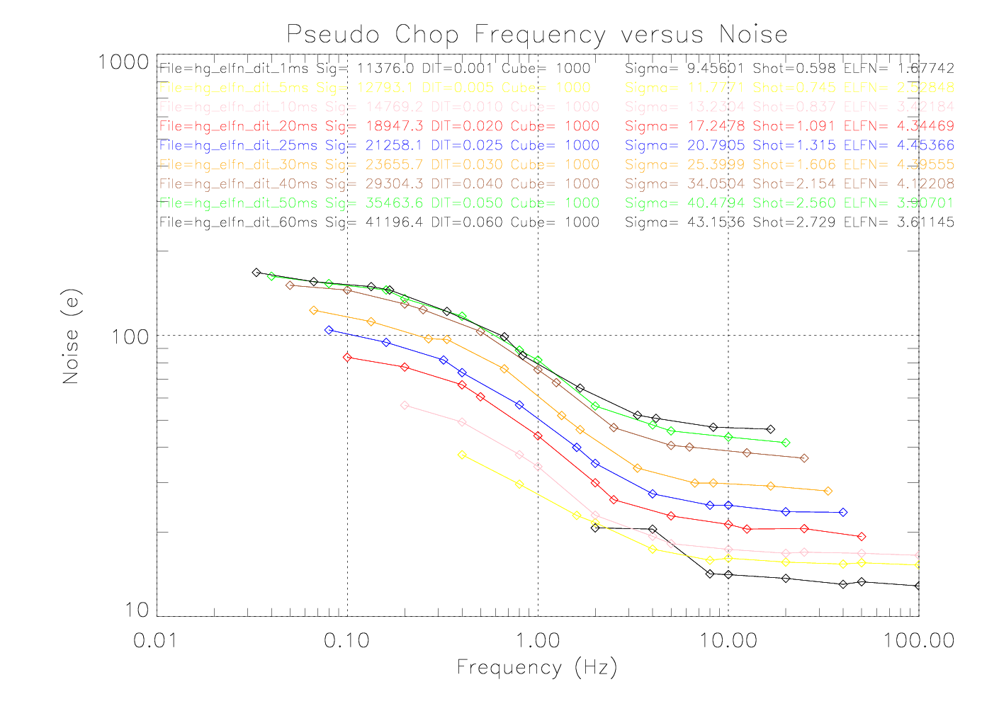
More Evidence – ELFN with integration time
Increasing integration time shifts
frequency “knee” lower

Slide 19
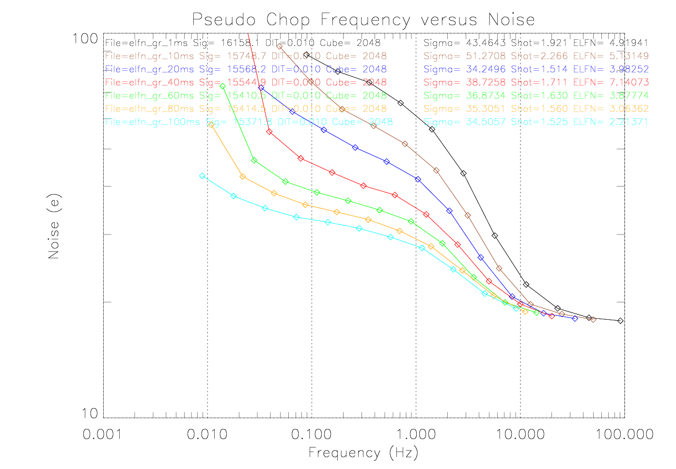
More Evidence – De-correlation of ELFN
Increase dead-time between frames

Slide 20
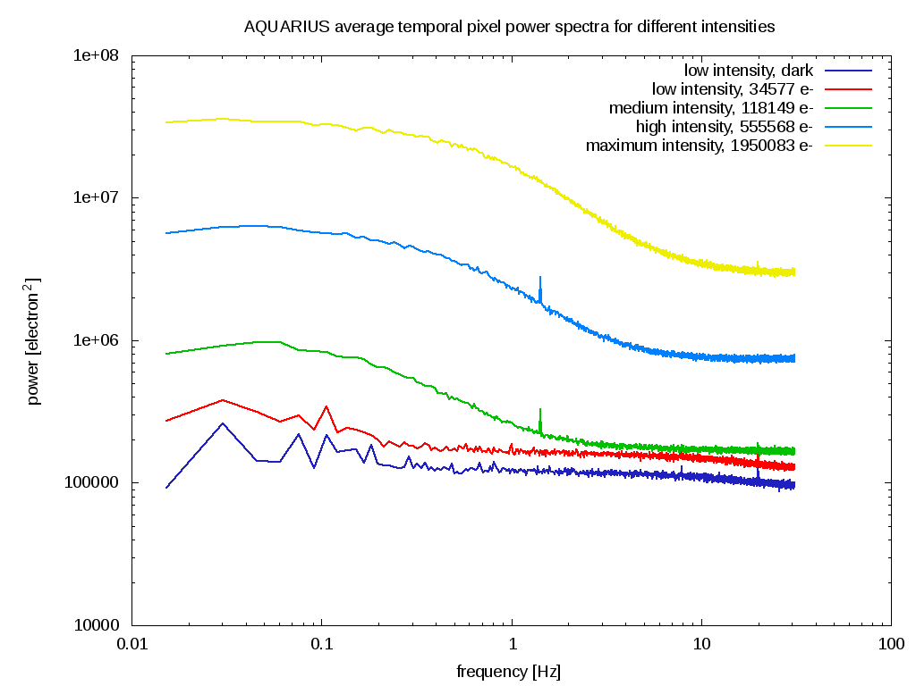
Sum up of evidence – power spectrum format
Different flux levels
No ELFN in Dark pixels
Unit cell noise level

Slide 21
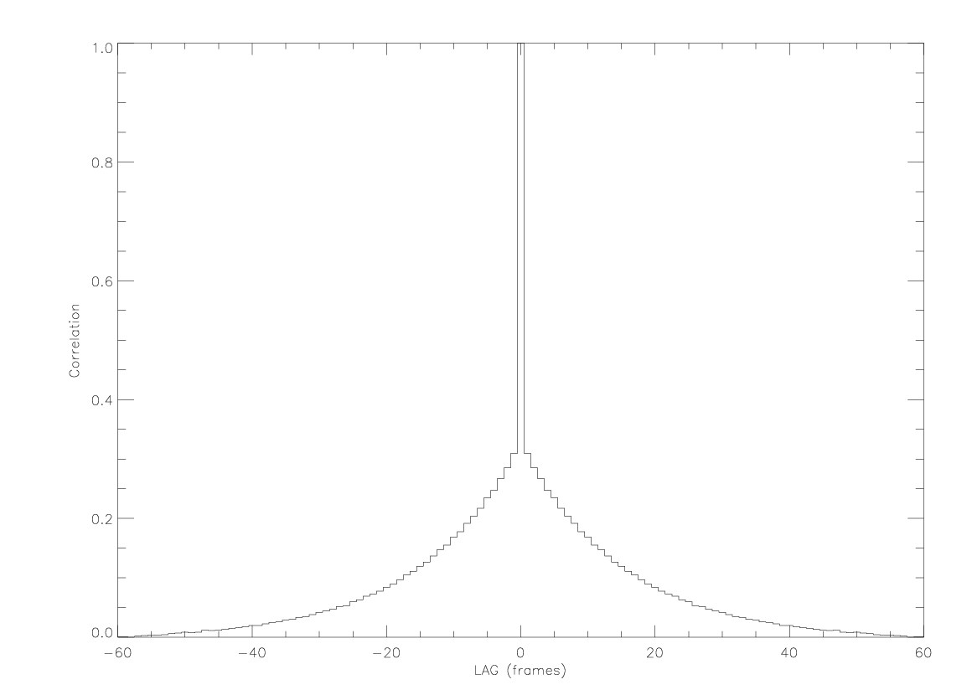
Change line of questioning - temporal correlation
Auto-correlation versus frame lag
Put flux on detector
Take a cube of 1024 frames
Find temporal auto-correlation for N pixels
Average N calculations and plot
'Having gathered these facts, Watson, I smoked several pipes over them, trying to separate those which were crucial from others which were merely incidental.' - The Crooked Man

Slide 22
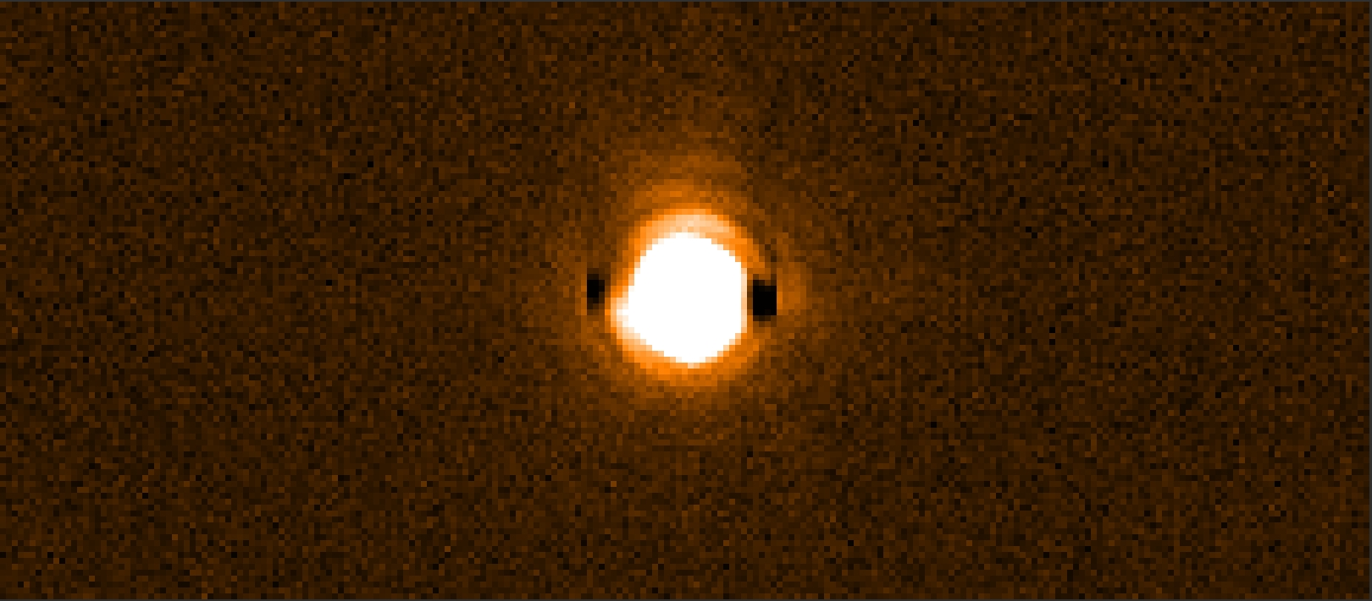
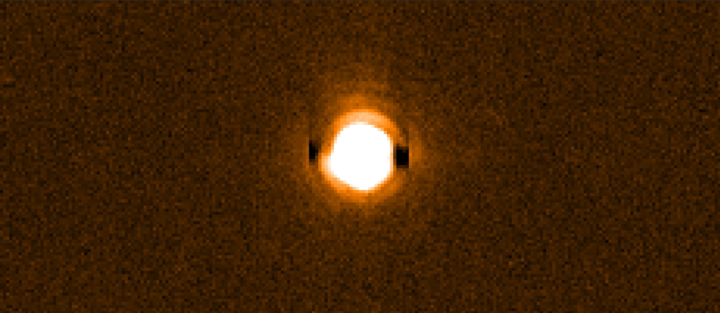
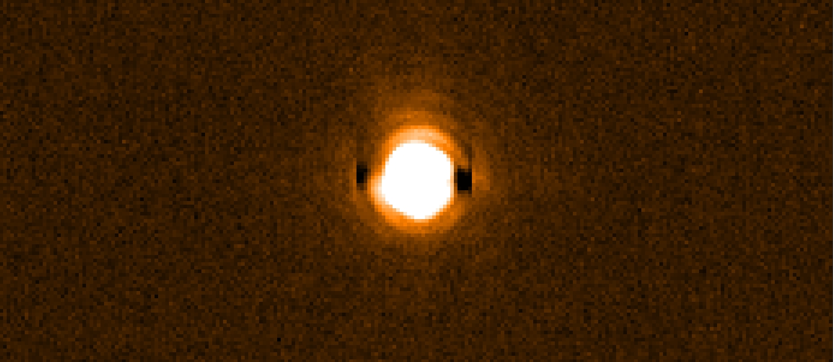
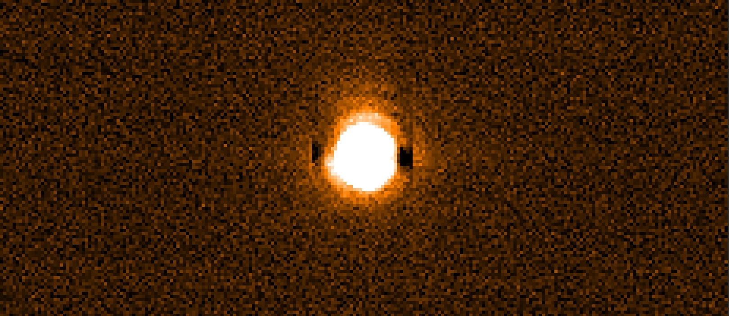
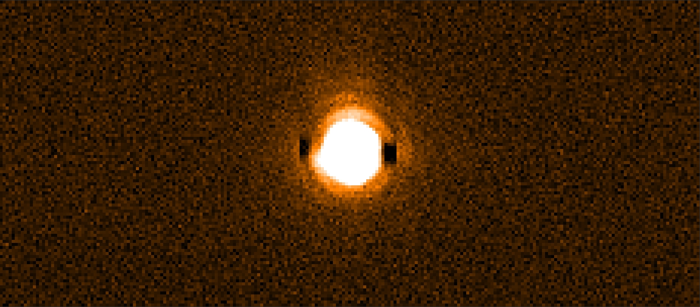
“The denouement” – real chopping with noise
Chop frequency = 10 Hz, sigma = 1.24 DN
Chop frequency = 1 Hz, sigma = 3 DN
Chop frequency = 2 Hz, sigma = 2.26 DN
Chop frequency = 15 Hz, sigma = 1.11 DN
Chop frequency = 5 Hz, sigma = 1.44 DN
“know a conjurer gets no credit when once he has explained his trick” – A study in scarlet

Slide 23
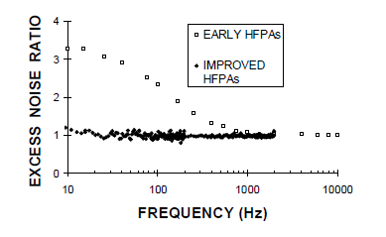
Past Crime - Excess Low Frequency Noise (ELFN)
Stapelbroek (inventor) reports noise versus frequency issues – 1990s
'There is nothing new under the sun. It has all been done before.‘ - A Study in Scarlet

Slide 24
The prosecution’s summing up remarks
New IBC detector suffers from Excess Low Frequency Noise (ELFN).
Origin of noise is definitely the Si:As material –(Probable issues
with Blocking Layer)
Cannot be seen in DARK images, therefore CDS not helpful.
ELFN always there, seen in past generation of detectors,
but not noticed because of high chop rates.
ELFN is a function of flux and integration time.

Slide 25
“Get out of jail cards”
Optimise detector operational parameters, minimise flux, longer integration times
(not always possible for wide band imaging, okay for spectrometer)
Increase chopping frequency of secondary mirror (> 1 metre diameter, ~ 50 kg mass
Operational limit is 5 Hz, typically used at 0.25 Hz)
New detector manufacturing run to fix problems – after modeling and detailed
understanding of problem

Slide 26
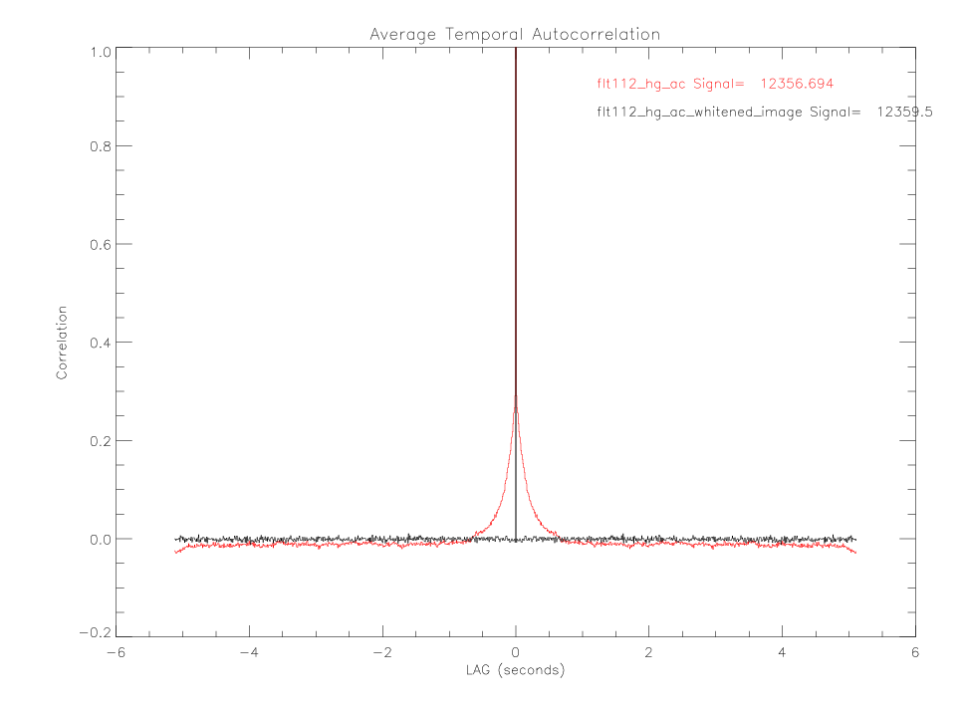
Time off for good behaviour – “Whitening”
Image temporal de-correlation :-
Possible to de-convolve image with
temporal function to “whiten” image cubes
However simple universal whitening function
does not improve SNR
Probably due to separate ELFN for each pixel
Raw data must be stored (300 Mbytes/second, 1 hour exposures are typical)
Huge processing power – x 2 FFTs to do whitening in real time
Observed O = Intrinsic I convolved in time domain by a Kernel K
O = I ⊗ K
Kernel can be retrieved from AC then data can be deconvolved such that
I = F⁻¹(F(O )/F(K))
(F is the Fourier transform
F⁻¹ is the inverse Fourier transform)
before
after

Slide 27
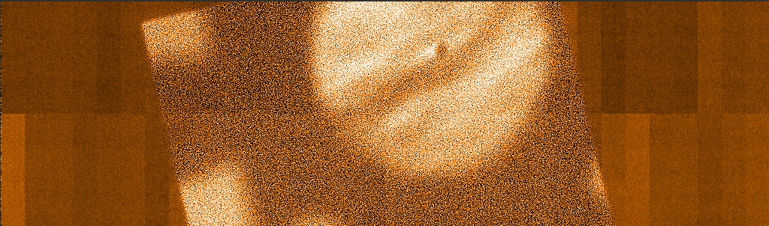
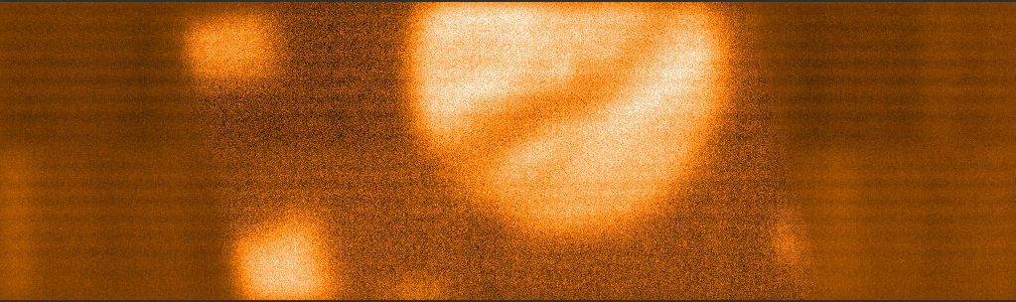
Drift scan/jittering
More Time off for good behaviour
Original data cube – Noise ~ 10.9 DN
Jittered data cube – Noise ~ 3.2 DN

Slide 28
SDW2013
Special thanks to :-
Sherlock Holmes
(and Sir Arthur Conan Doyle)
The ESO NGC team for the great controller
and most especially Gert Finger

