Slide 1
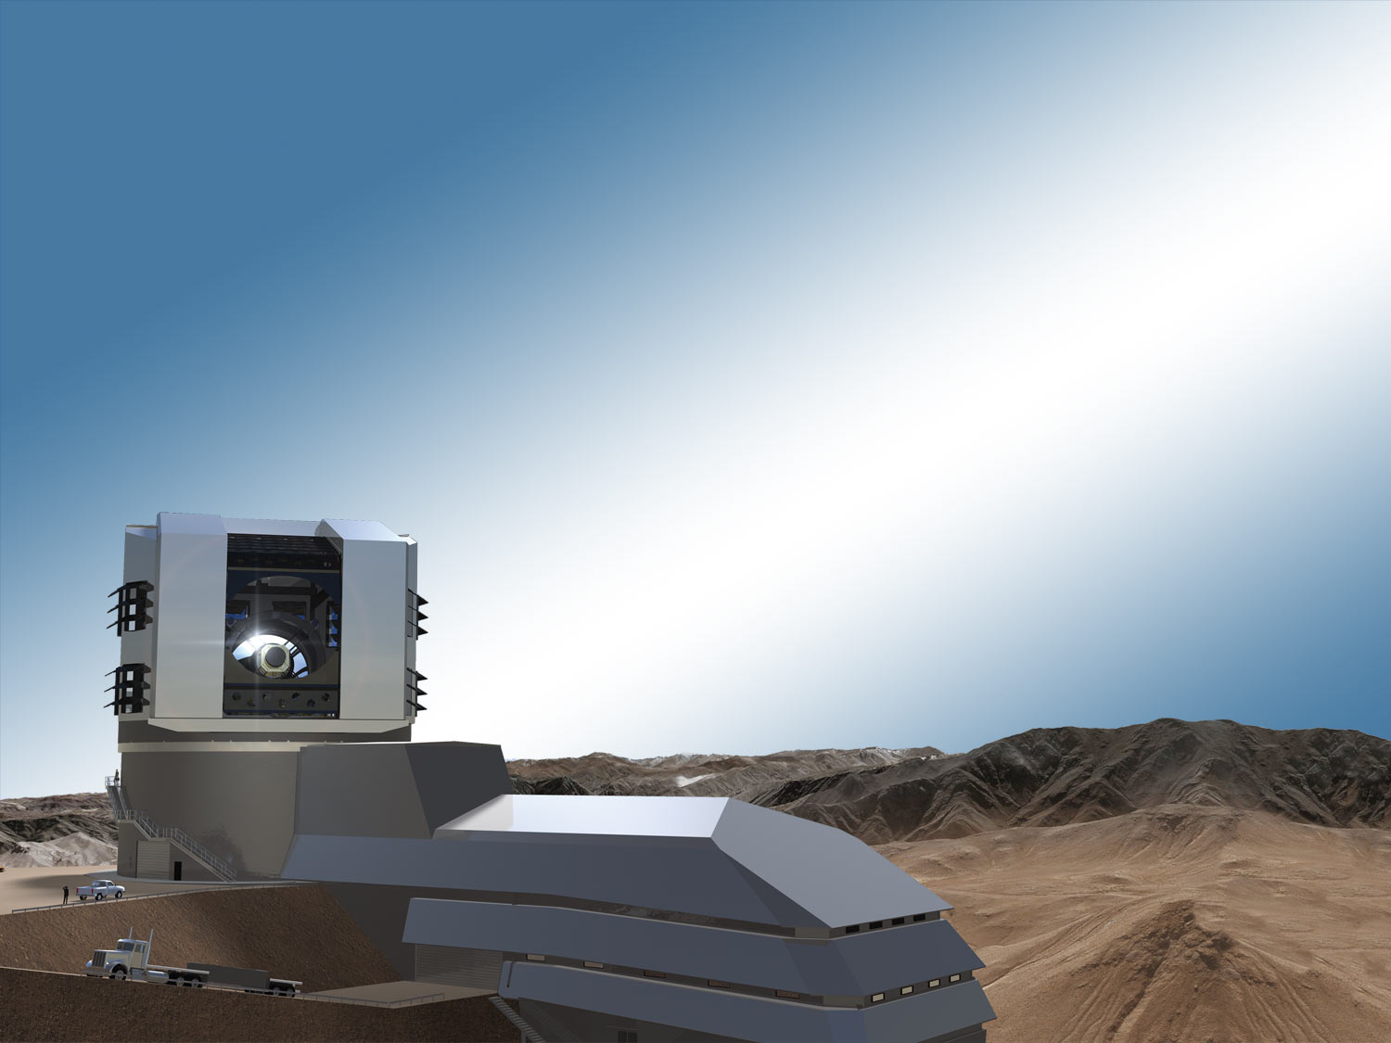
Sensor Risk Mitigation: Identifying and Retiring Sensor Related Risks to Science
Peter Doherty
Harvard University – Physics
Large Synoptic Survey Telescope
Scientific Detector Workshop
Florence, Italy
October 11, 2013

Slide 2
Acknowledgements
The work presented here involved many people:
Harvard:
Peter Doherty
Christopher Stubbs
Amali Vaz
BNL:
Paul O’Connor
Ivan Kotov
James Frank
Dajun Huang
Andrei Nomerotski
UC Davis:
Tony Tyson
SLAC:
Kirk Gilmore
Andy Rasmussen
LPNHE/IN2P3:
Pierre Antilogus
Pierre Astier
And others whom I have no doubt forgotten.

Slide 3
What does Science Risk Mitigation Mean?
The scientific instruments we build are intended for one thing:
To deliver the information our clients, the scientific community,
need in order to make the measurements they want and to
make those measurement to the required precision.
Science risk is the risk that our instrumentation will fail to deliver that information to the requisite precision making it impossible for our clients to make their measurements.
Risk mitigation is the process of identifying those aspects of the instrument that may cause risk to the science and finding a way to either eliminate or compensate for them.

Slide 4
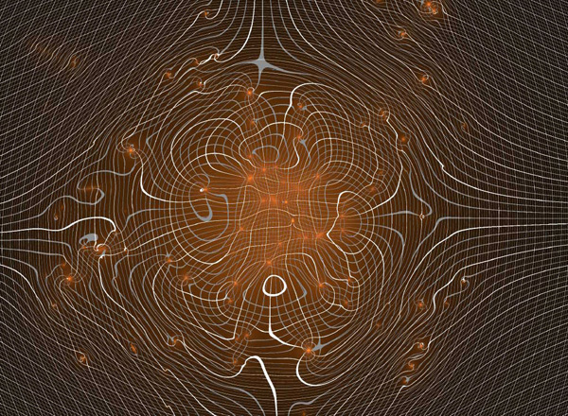
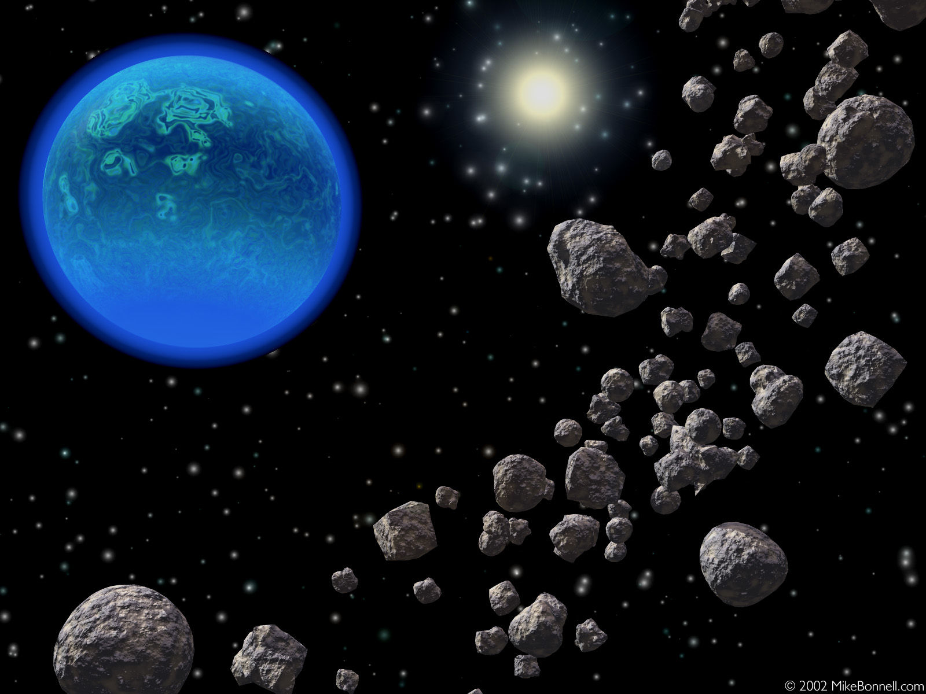
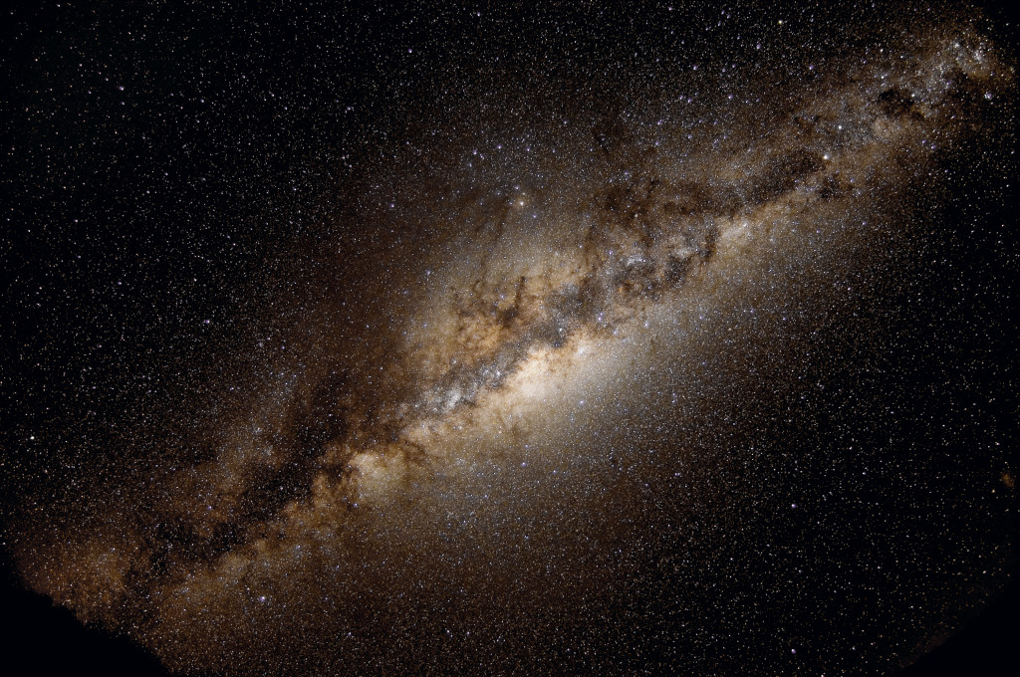
An Example:
What are Some LSST Science Goals?
Dark Matter and Energy (Strong and Weak Lensing)
Requires excellent image quality, control of PSF shape,
and deep summed images…Photometric redshifts
require better than 1% photometric precision.
Solar System Science
Requires accurate absolute astrometry to link motion
vectors.
Galactic Structure
The separation of stellar populations also drives the
requirements on photometric precision; proper motions
and parallax measurements drive the requirements
on relative astrometry.
Many more science goals with similar requirements.

Slide 5
How Can Sensor Effects Produce Science Risk?
Anything that undermines the Photometric or Astrometric precision of the instrument has the potential to place the delivered science at risk.
Typical detector specifications address some features in a naïve way:
Astrometric precision is assumed based on pixel size and orientation,
  physical stability, CTE, etc
Photometric precision is assumed based on stability and uniformity
  of QE, read noise, CTE, etc.
Both are dependent on our ability to map the incoming signal to the
generated digital representation.

Slide 6
Known Sensor “Features”
CCDs are known to have a variety of features, and we have thought that we
understand them. A partial list includes:
  Non-uniform Quantum Efficiency across the device
  Gain variation from amplifier to amplifier
  Fixed Pattern noise
  Fixed Pattern ‘QE’ variations (‘tree rings’)
  Residual Image
  Edge effects (bright or dark)
  Etc.
New thick, fully depleted, high resistivity CCDs present new challenges:
  Non-linearity of photon transfer curves
  Charge diffusion from conversion location to collection site
  Etc.
That’s OK. All of these flat field out, right?

Slide 7
Known Sensor “Features”
CCDs are known to have a variety of features, and we have thought that we
understand them. A partial list includes:
  Non-uniform Quantum Efficiency across the device
  Gain variation from amplifier to amplifier
  Fixed Pattern noise
  Fixed Pattern ‘QE’ variations (‘tree rings’)
  Residual Image
  Edge effects (bright or dark)
  Etc.
New thick, fully depleted, high resistivity CCDs present new challenges:
  Non-linearity of photon transfer curves
  Charge diffusion from conversion location to collection site
  Etc.
That’s OK. All of these flat field out, right? No, they do not.

Slide 8
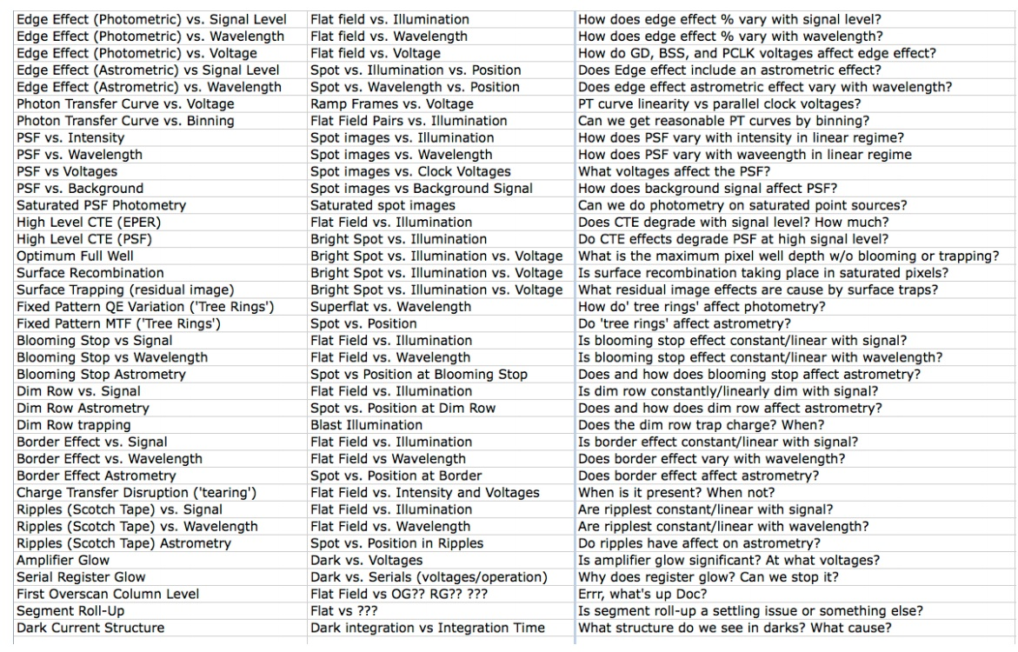
Photometric and Astrometric “Features”:
Effects that LSST collaboration has studied

Slide 9
Charge Displacement in Thick Fully-Depleted
High Resistivity CCD Sensors: Imaging Area
Many observed ‘photometric’ effects are actually due to charge displacement and therefore include an ‘astrometric’ effect as well
Devices have tall and skinny pixels : 10x10x100 um
Long travel distance from conversion point to collection point allows for charge
diffusion and for charge displacement due to electric fields lateral to the drift direction

Slide 10
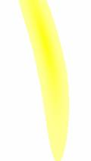

Charge Displacement : Edge Effects due to Lateral Electric Fields
Potentials outside of imaging area can affect the direction of charge travel by creating electric fields lateral to the electron drift direction.
guard drain +30V
P1
P2
P3
P1
P2
P3
P1
bur. chan.
δx
E║
E┴
window
-70V
δx = μE║t_{dr}
δx/d = E║/E┴

Slide 11
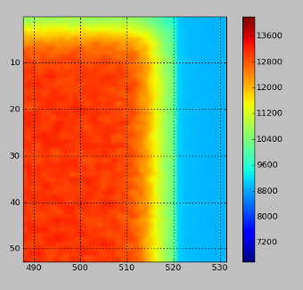
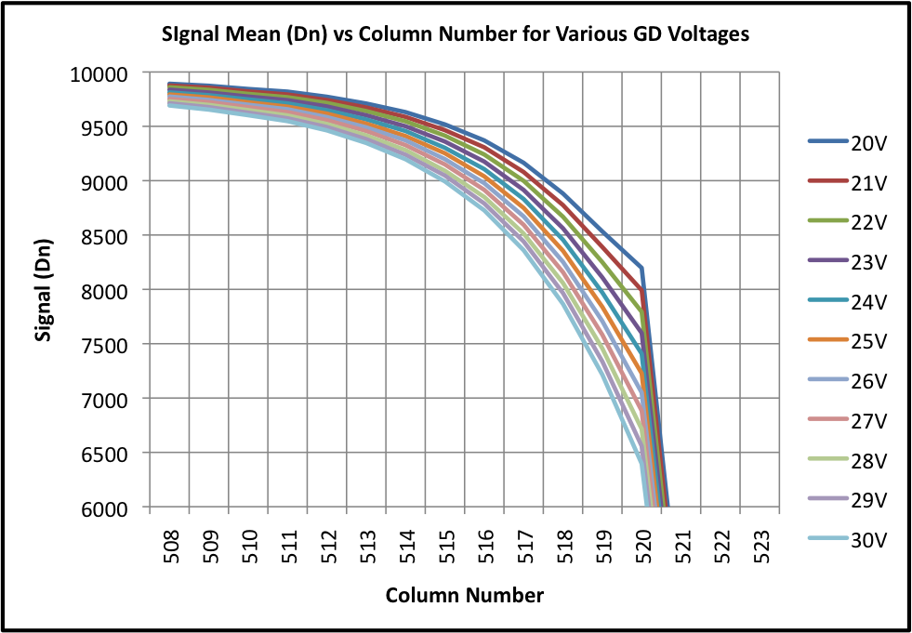
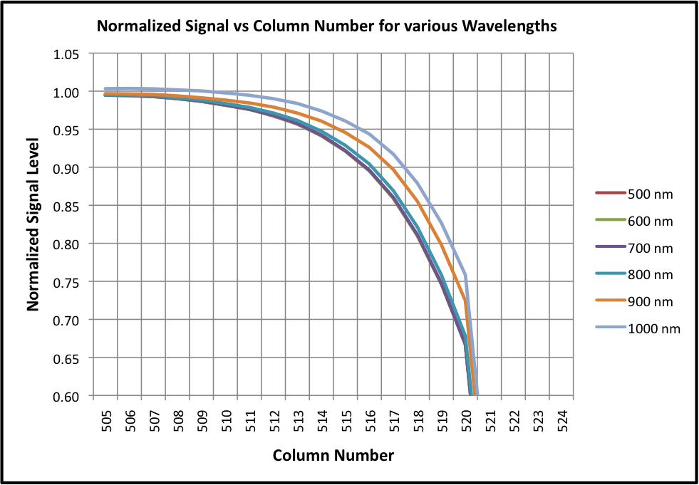
Charge Displacement : Photometric Effects at Edge of Imaging Area
A roll off in ‘sensitivity’ is observed at the edges of the device. This is not due to a variation in quantum efficiency, but to lateral electric fields.
Effect is largely independent of exposure level, but IS dependent on the guard drain voltage and the wavelength of incoming photons.
OVERSCAN

Slide 12
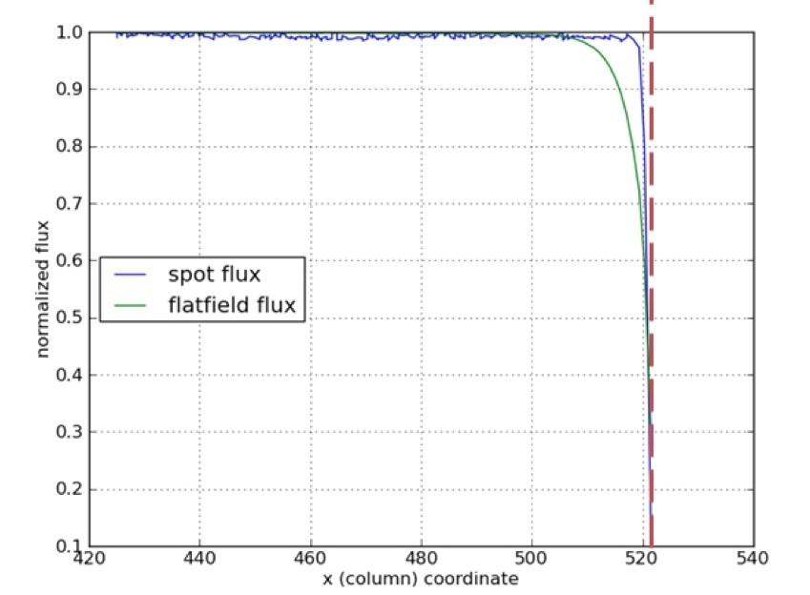
Edge Effects Caused by Lateral Fields
Scanned Spots- measure (x,y,Φ) & PSF
Astrometric effects of the edge ‘roll-off’ were studied by focusing a small spot on the imager and stepping the image across the device and off the edge.
Flux, position, and ellipticity were then measured for each spot image.
The most important thing to note with these data is that the measured flux in the spots *does not* match the measured flux in the flat field images.

Slide 13
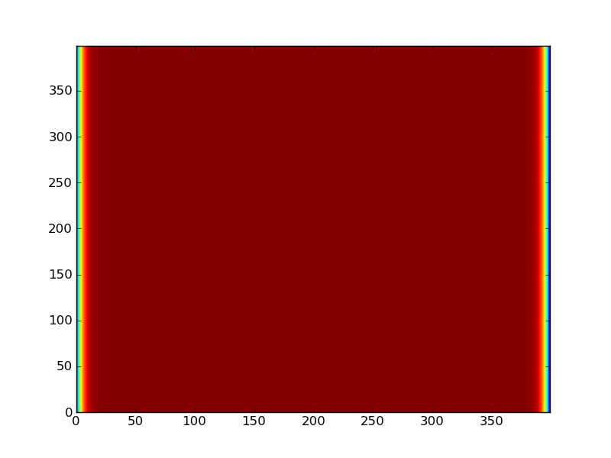
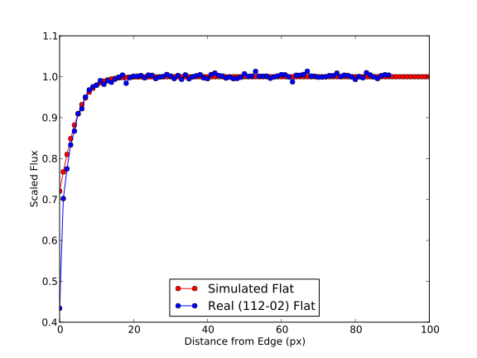
Simulation of charge deflection in flat field images. Real and Simulated Roll-off Profiles
Original
Warped
We have created simulated flat fields and warped them with a prescription that matches the response seen in ‘real’ data.
The plot at the right shows the edge roll off in the real and simulated data.

Slide 14
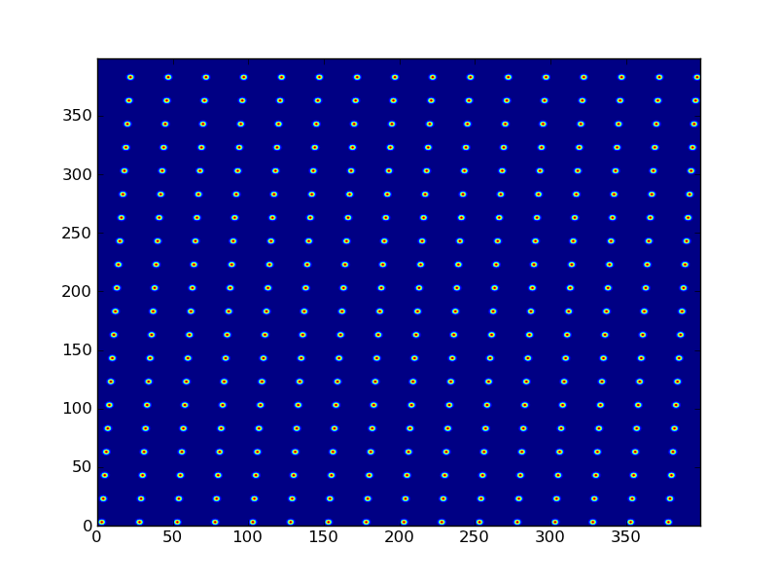

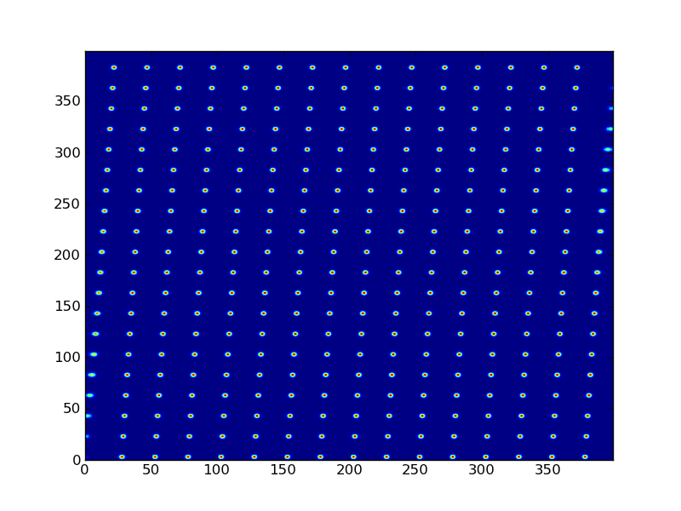
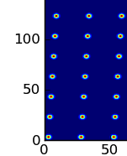
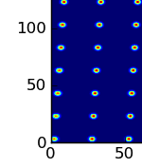
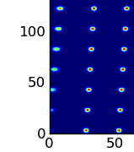
Sample Simulated Images: “Stars”
Original
Warped
Exaggerated
(to make more obvious)

Slide 15
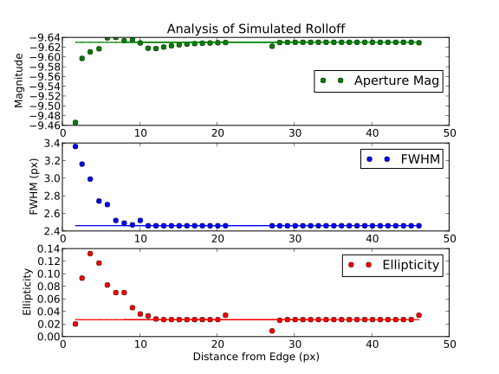
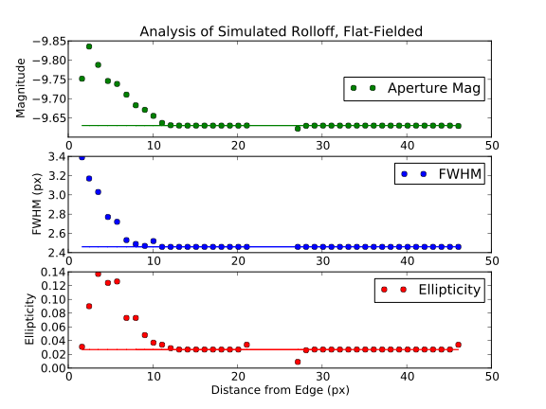
Edge Effects: Photometric and Astrometric
Charge deflection causes errors in the FWHM and ellipticity of the ‘stars’ well before the magnitude is reduced
Further errors are then introduced by inappropriate flat-fielding. ‘Corrected’ magnitude is exaggerated.
Correction algorithms are complicated by the wavelength dependence of the effect, making absolute correction difficult without a priori knowledge of source spectrum.
Presently, mitigation strategy is simply to exclude affected columns from data analysis.

Slide 16
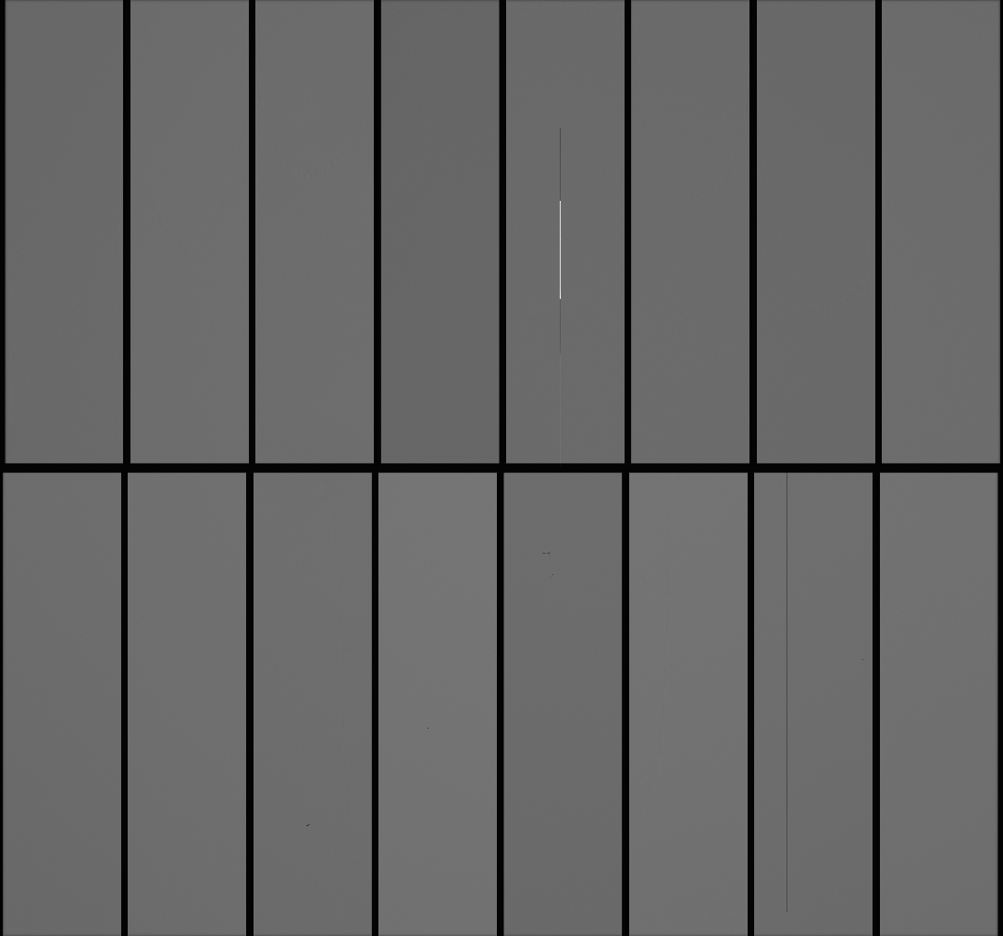
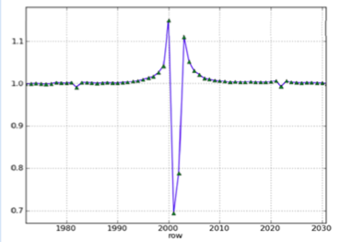
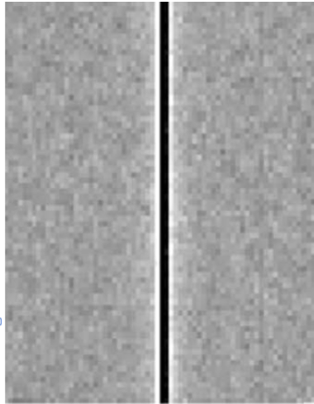
Blooming Stop Structure in LSST Prototypes
LSST prototype CCDs included a channel stop at the dividing line between the upper and lower halves of the image array to prevent ‘bloomed’ charge from affecting more than one segment of the CCD.
This produces charge deflection and redistribution. Deflected charge is collected in adjacent rows.

Slide 17
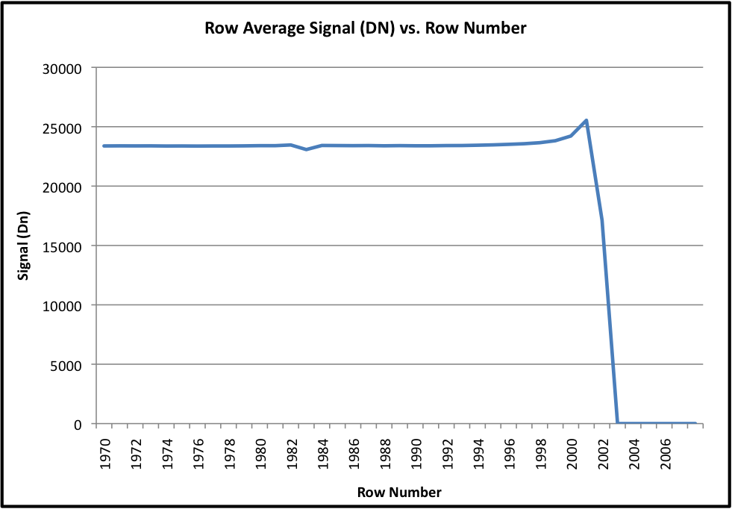
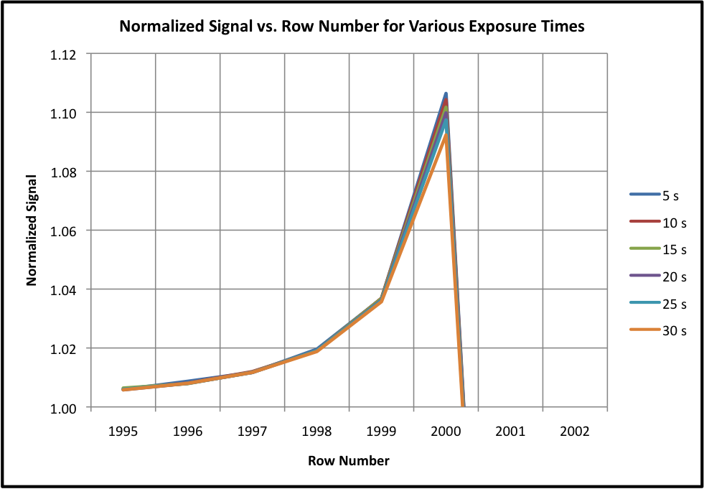
Blooming Stop Charge Displacement
Blooming Stop causes charge to be displaced from the last row in the segment. The ‘missing’ charge is redistributed in the adjacent rows.
The effect is somewhat dependent on both signal level and wavelength and so it is NOT a purely photometric effect that will ‘flat field out’.

Slide 18
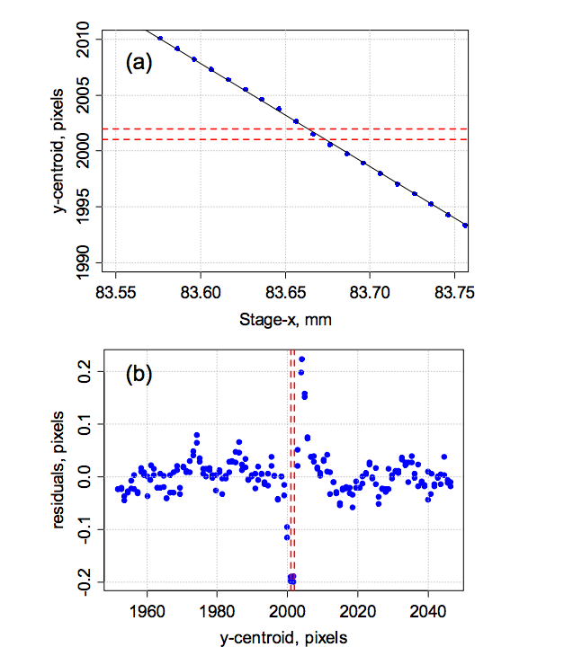
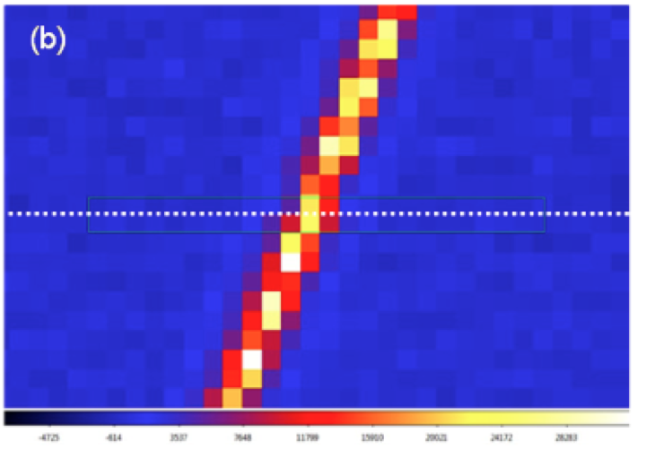
Blooming Stop Astrometric Effects
Spot scan tests have been performed across the blooming stop area
Charge displacement is observed, producing astrometric errors on either side of the mid-sensor blooming stop.
Mitigation strategy is either removal of feature from design or exclusion of the affected rows from data analysis.

Slide 19
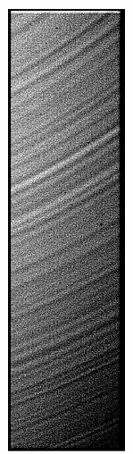
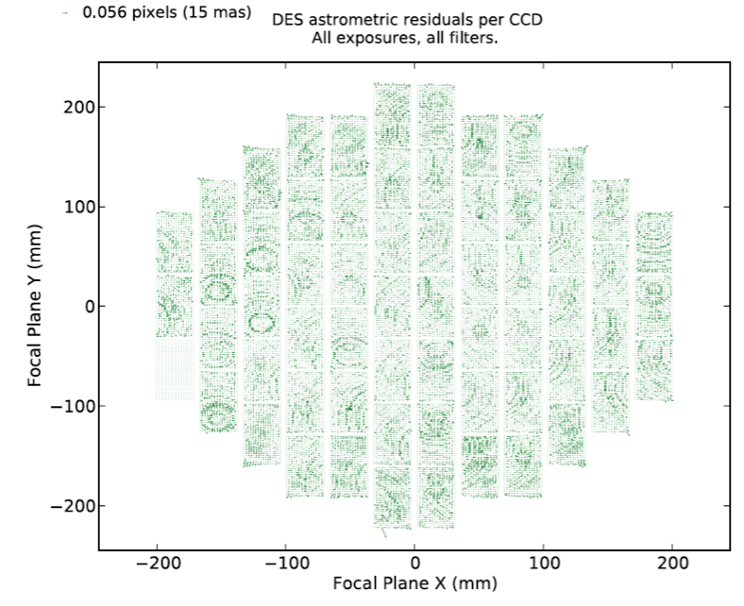
“Tree Rings”: A purely Photometric Effect?
A well known effect is referred to as ‘tree rings’: a pattern observed in flat field images that is often considered a QE or ‘effective pixel size’ variation.
Effect is thought to be caused by resistivity variation due to doping inhomogeneities in the boule from which the silicon wafer is cut.
Flat field correction does not account for astrometric effects caused by these resistivity variations
Practically, astrometric effects can be determined only using on-sky data.
Only mitigation strategy prior to operation is to attempt to select silicon wafers with minimal resistivity variation.

Slide 20
Sensor PSF effects: charge correlation
pixel pitch
10μm
P1
P2
P3
P1
P2
P3
P1
P2
P3
P1
bur. chan.
Si thickness
d=100μm
E┴
Electric field of stored charge in pixels with high signal counteracts E┴. Barrier between columns higher than between rows ➔ signal-dependent correlation along columns.
window
-70V
Notes:
There’s one more subtle effect that these thick CCDs exhibit that was not anticipated. As charge builds up in the buried channel on pixels with high sigal levels, it produces an electric field that partially cancels the drift field locally. That repulsive potential may be strong enough to deflect incoming charge to neighbor pixels. The potential barriers that confine charge within columns is stronger than that keeping them in the rows, so as signal charge builds up it progressively correlates along the column direction. This is shown in the next slide.

Slide 21
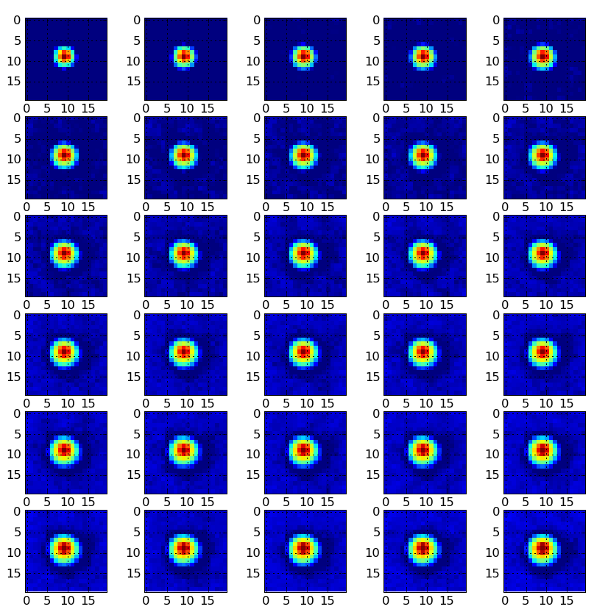
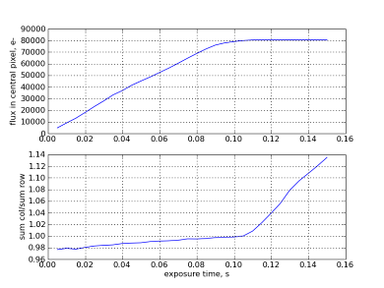
Spot profile vs. intensity: correlation-induced broadening (Bigger = Fatter) ?
Flux central pixel
PSF size FWHM
y/x aspect ratio
SRD ellipticity maximum
Pierre Antilogus will discuss this effect in his talk.
Notes:
Here we see point source images at a range of signal level. As the flux in the central pixel grows, the spot FWHM increases and becomes elliptical. The implication is that the weak lensing pipelines will have to parametize the PSF not only by its position on the focal plane but by the flux as well.

Slide 22
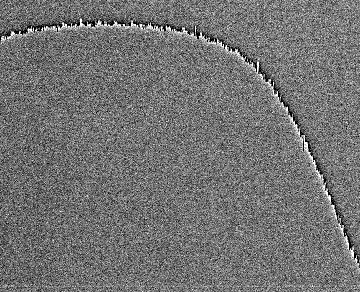
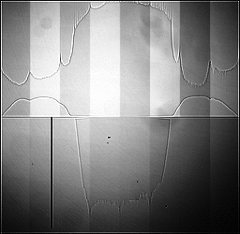
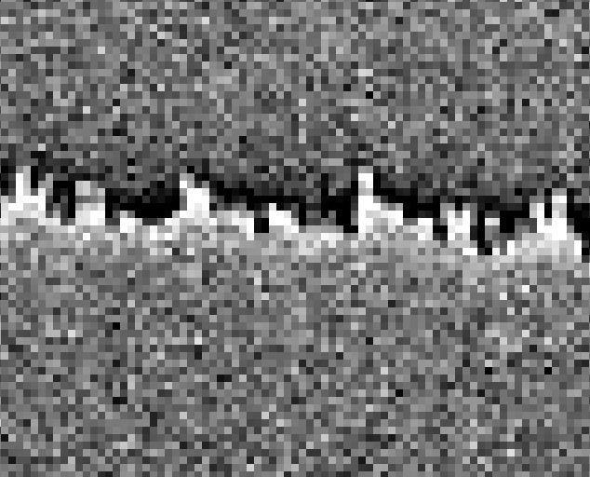
Charge Redistribution Caused by the Depletion of Holes in the Channel Stops?
Images acquired with some prototype LSST CCDs have sometimes shown an effect which has been dubbed ‘tearing’ for the visual look of the resulting data. An image that displays the effect is shown below.

Slide 23
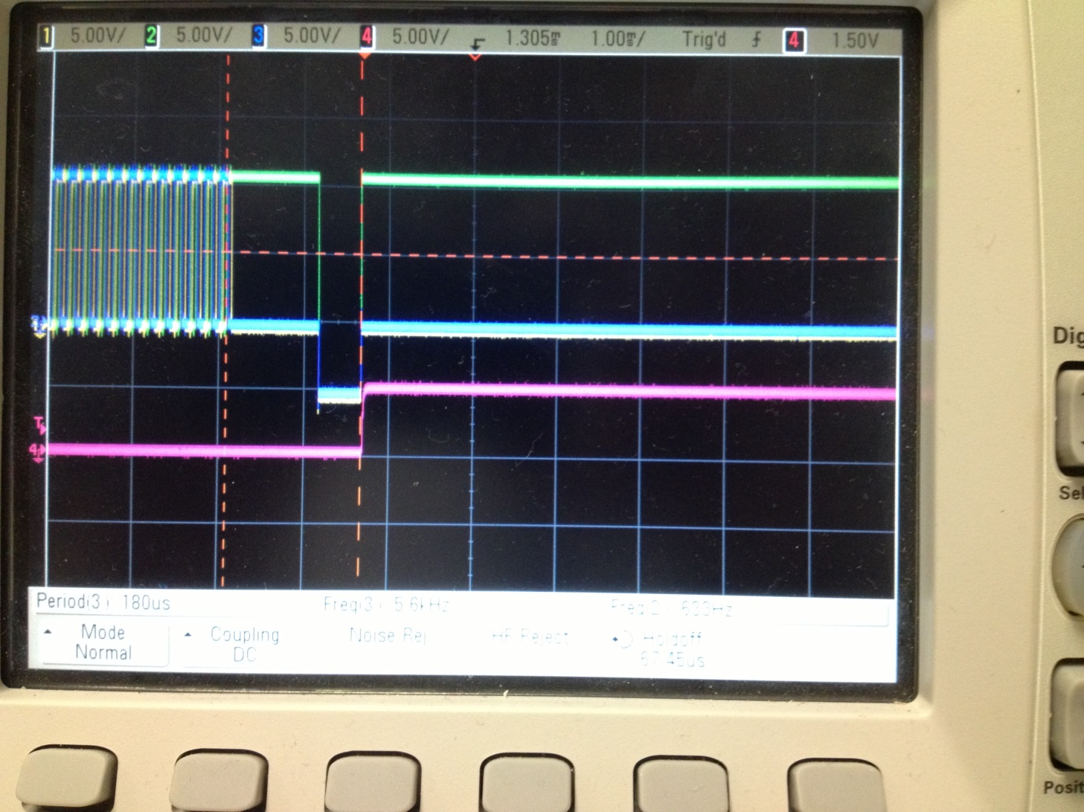
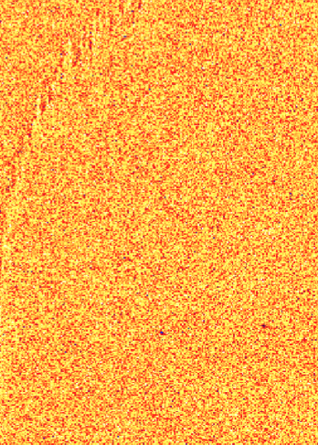
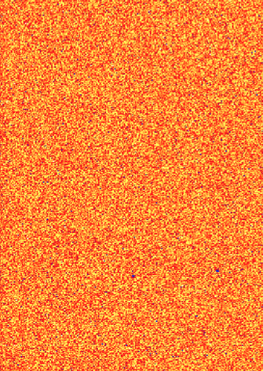
Elimination of effect by hole flush prior to exposure and readout?
When run in non-inverted mode, the holes can be swept down the channels tops, creating a gradient along the channels stops. It is thought that this potential gradient on the channel stops generates a field that disrupts charge transfer.
By inserting a brief period of surface inversion prior to exposure, we flood the surface with holes and provide holes to bring channel stops back into balance.
Effect visible
Effect gone

Slide 24
Conclusion
The LSST project has identified a number of sensor features that either fall outside of typical CCD specifications or that behave somewhat differently in the new generation of thick, high resistivity, fully depleted detectors.
The project has performed extensive testing on many of these features and that work continues. Risk mitigation strategies have been identified in each case, and those strategies continue to evolve.
Through this work, the sensor development team has greatly reduced the risk that the sensors (once considered to be the highest risk part of the entire LSST project) pose to project completion, schedule, cost, and delivered science.

Slide 25
End of Presentation

