Slide 1
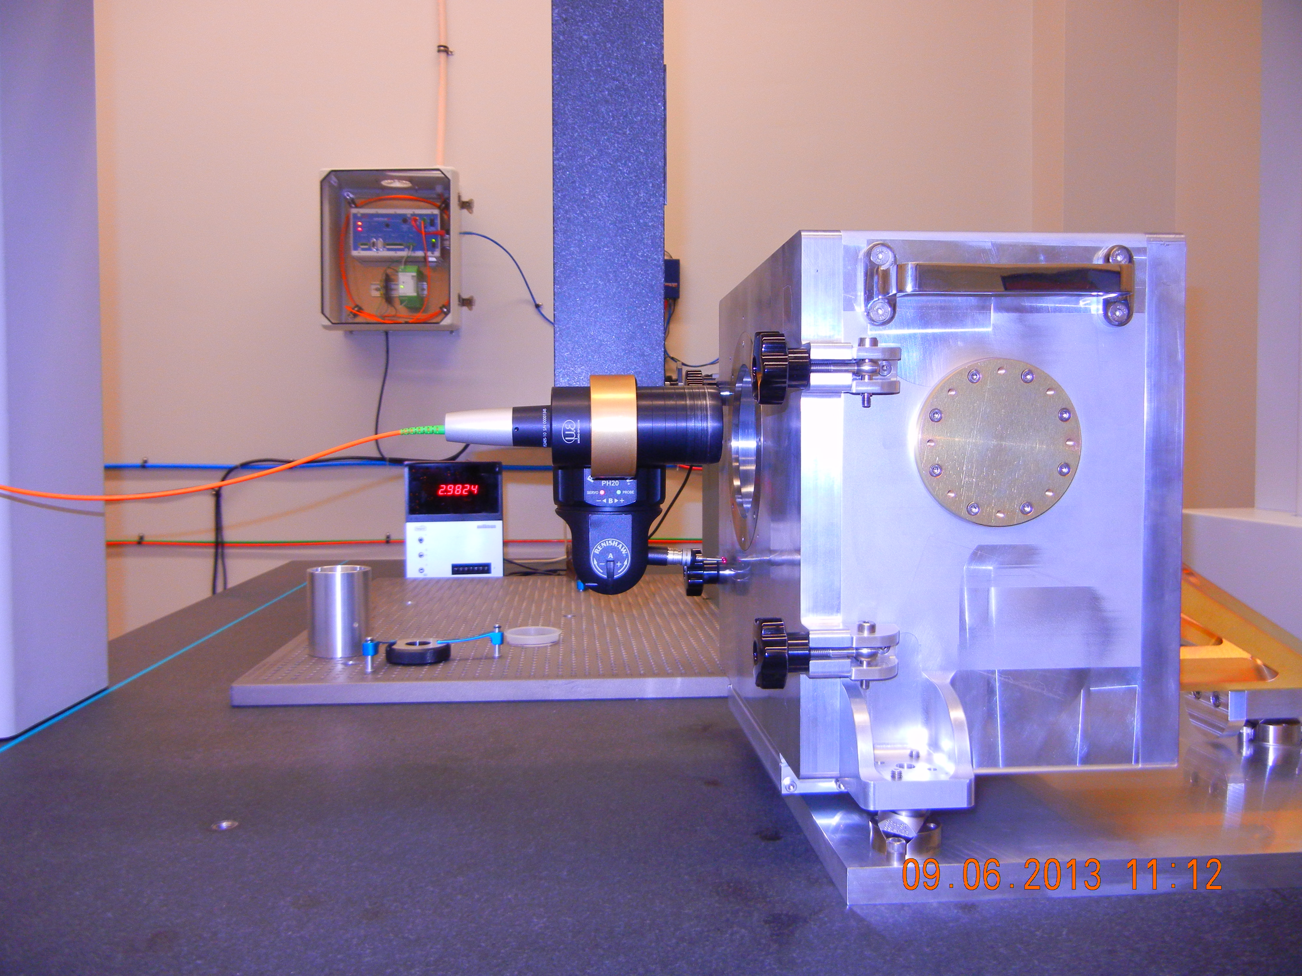
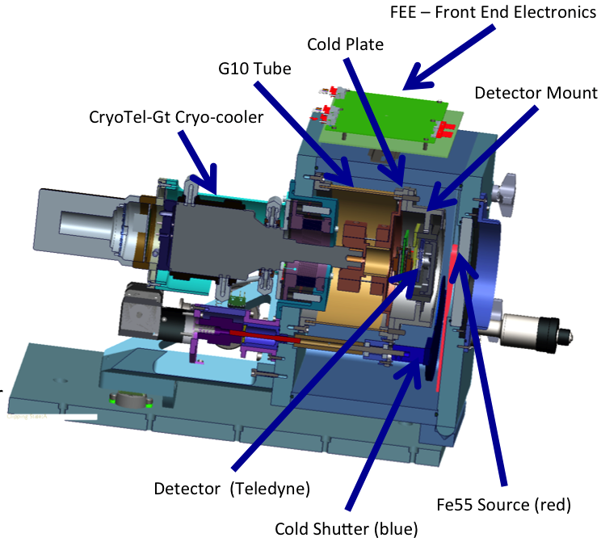
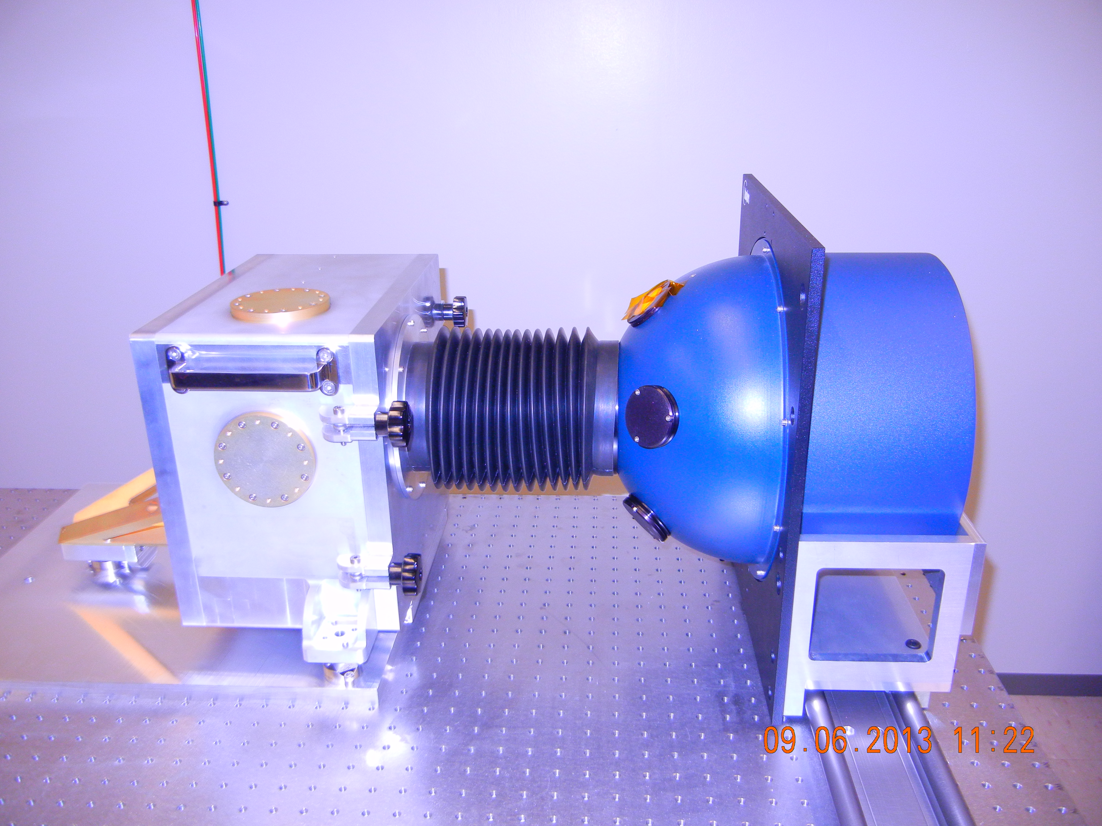
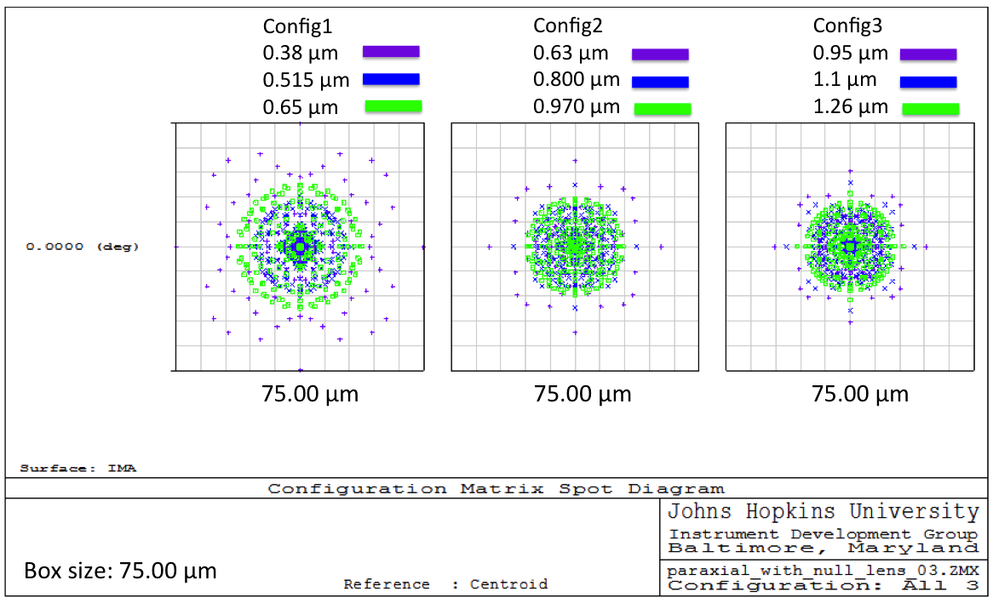
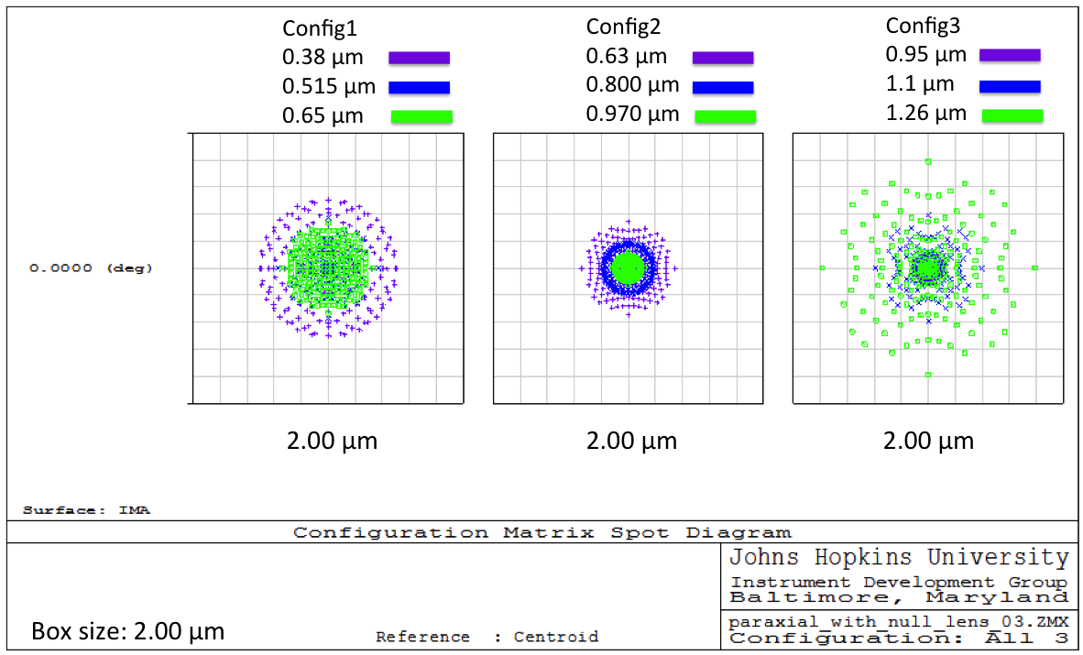
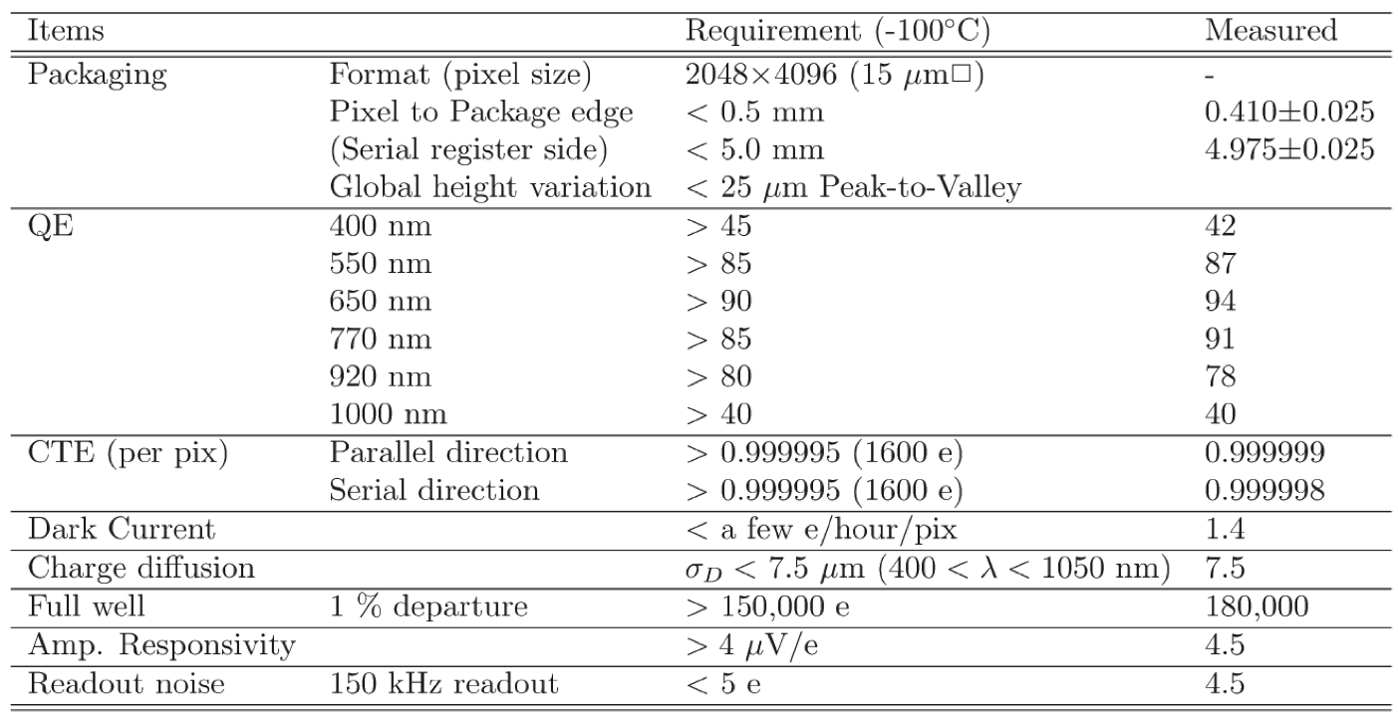
DETECTOR CHARACTERIZATION FOR THE SuMiRe PRIME FOCUS SPECTROGRAPH (PFS)
Murdock Hart , Robert H. Barkhouser, and Stephen A. Smee
Department of Physics and Astronomy, Johns Hopkins University, Baltimore, MD, 21218
PFS Spectrograph
Detector Coplanarity
4 identical spectrographs consisting of 3 channels each
Each receiving 600 fibers from the 2400 at the prime focus
3800 Å – 6500 Å
6300 Å – 9700 Å
9500 Å – 12600 Å
Vacuum Schmidt cameras for each channel
Fast ƒ/1.1 focal ratio
1.1” @ ƒ/1.0 projects to 54 μm at focal plane ~4 pixels
Visible channels use Hamamatsu 2k x 4k 15 μm pixel full-depleted CCDs
Each channel will use one pair
Red and blue optimized chips
170 K operating temperature
Near Infrared Channel uses Teledyne H4RG-15 HgCdTe 4k x 4k 15 μm pixel
110 k operating temperature
Test Cryostat
Wenzel XO-Orbit 87 CMM
Micro-Epsilon confocalDT 2405 white light confocal microscope
Coplanarity / topography measurements
Sub-pixel illumination
Charge diffusion
Charge transfer efficiency
Persistence / reciprocity
Flat Fielding
Measure / characterize detectors at cryogenic temperatures
Further evaluation of cryo-cooler active damping system
Test prototype camera electronics
Pre-amp board
Front End Electronics (FEE)
Back End Electronics (BEE)
Labsphere LRS-12Z integrating sphere
Horiba ihr320 monochromator
Newport optical bench
Photon transfer curve
Read noise
Gain
Full well
Linearity
Charge transfer efficiency
Extended pixel edge response
Quantum efficiency
Fe55 x-ray source
Gain
Charge transfer efficiency
Charge diffusion
Sub-Pixel Illumination
Mitutoyo 10x infinity corrected NIR objective
Mitutoyo infinity corrected tube lens
20 μm pinhole
CCD Specifications
Zemax spot diagrams showing the ability of the sub pixel illuminator to image a spot through a 13 mm thick vacuum window. On the Left shows that the addition of the vacuum window degrades the spot size to nearly 75 μm in diameter. On the right shows that with the addition of a null lens we are able to image a spot 2 μm in diameter.
Hyper Suprime-Cam (HSC) detector specifications

