Slide 1
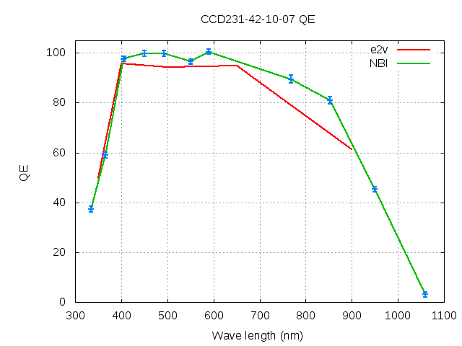
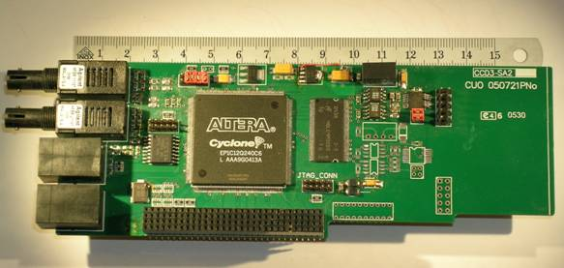
Test and Characterisation of the e2v CCD231-42 and the
NBI Generation 3 Array Controller
Graham C. Cox, Anton N. Sørenson, Preben Nørregaard,
Jeppe Andersen & Louise D. Nielsen
The poster is in two parts:
The first section gives details of the testing of the some specific
parameters of this version of the e2v CCD231-42
The second part described the new NBI generation 3 array controller
Measured Quantum Efficiency Curve
Sequencer Board

Slide 2
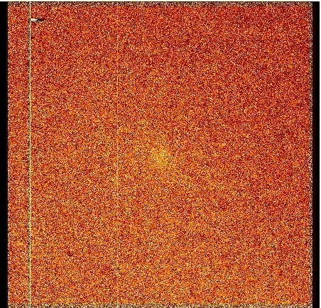
CCD Test and Measurements
At the NOT we desired a CCD with good quantum efficiency, minimal fringing in the red and low charge diffusion in the blue. Describe is the testing and characterisation, using the NBI generation 3 array controller, of the slightly experimental e2v CCD231-42 combining deep depleted silicon with their multi-2 AR coating and fringe suppression process.
Image illuminated by a 830nm laser
Measured Quantum Efficiency Curve

Slide 3
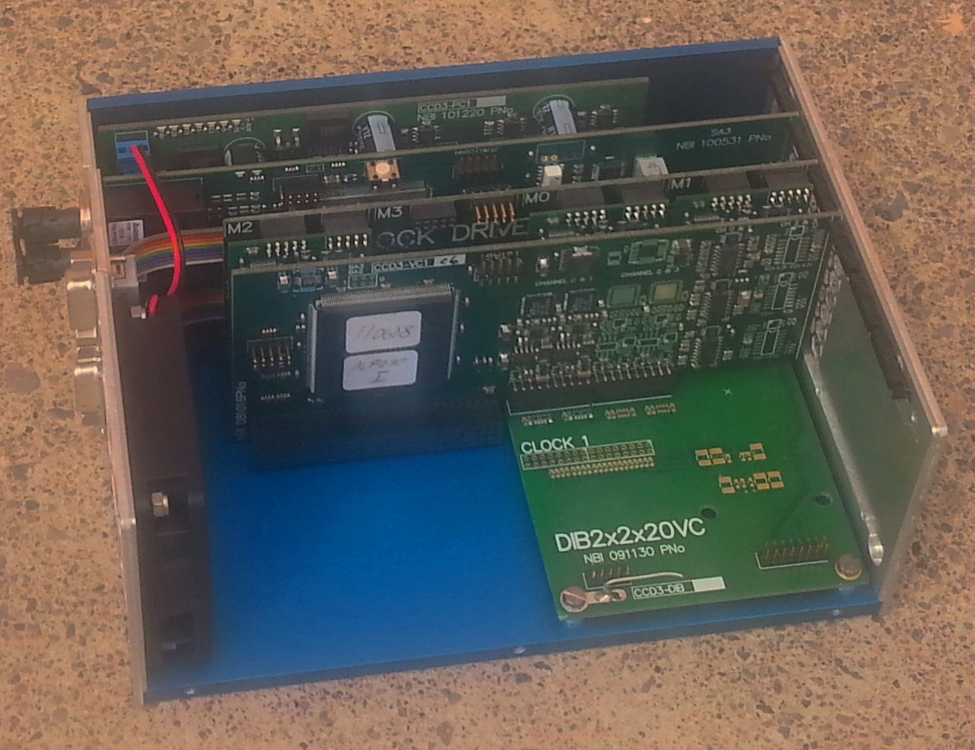
The NBI generation 3 array controller is the new all digital unit developed in Copenhagen. The controller concepts and data acquisition system 'ccd3comm' are described.
The controller, for example uses digital correlated double sampling and digitally derived clock waveforms.
The acquisition system provides a complete interface for the controller, including status and image windows and a simple console interface for commands.

