Slide 1
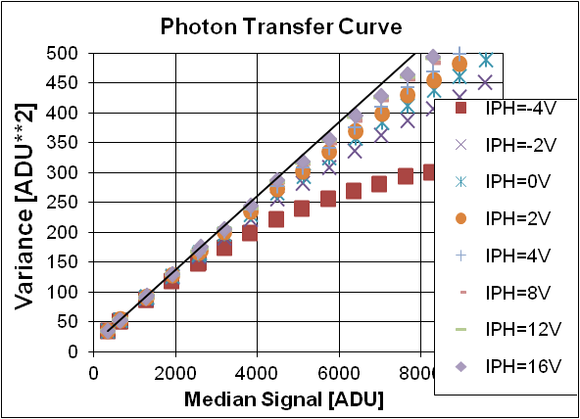
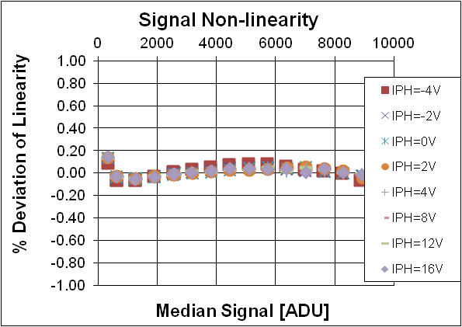
THE CCD RIDDLE REVISTED:
SIGNAL VERSUS TIME – LINEAR
SIGNAL VERSUS VARIANCE – NON-LINEAR
Mark Downing, Peter Sinclaire.
European Southern Observatory ESO (http://www.eso.org)
But CCDs are suppose to be near perfect compared to …..

Slide 2
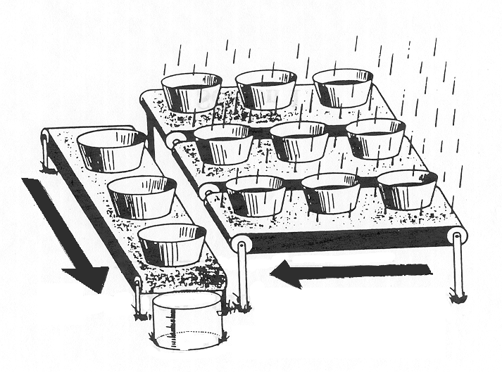
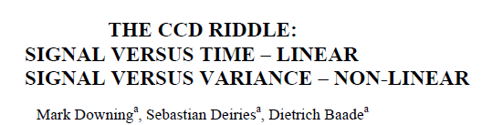
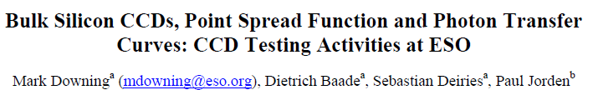
Previous results concluded….
“Sharing of electrons” between pixels that increase as more electrons are collected

Slide 3
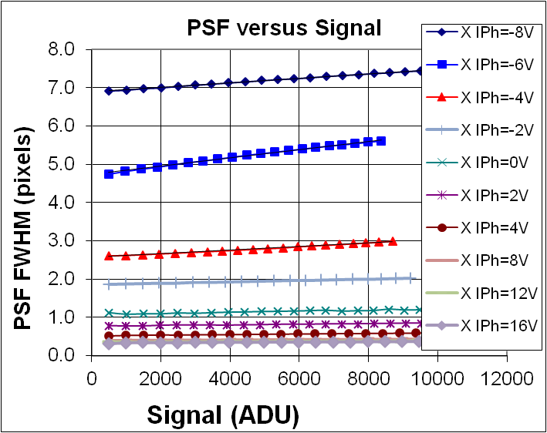
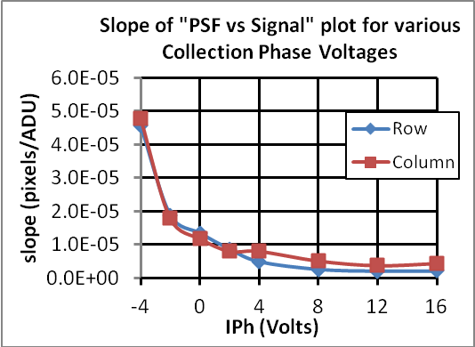
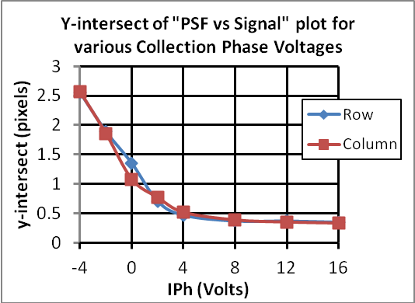
More evidence gathered…PSF
PSF linearly degrades with signal.
Both value and change with signal improve as 1/collection phase voltage.
Y-intersect
Slope

Slide 4
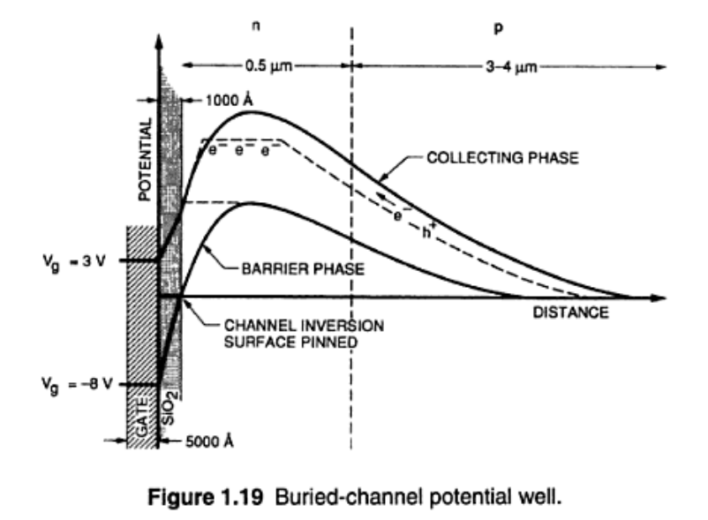
Mechanism behind “Charge Sharing” between Pixels
Undepleted Region
400nm
Pixel
Collection Phase
CCD
Front side
Electric
Field Extent

Slide 5
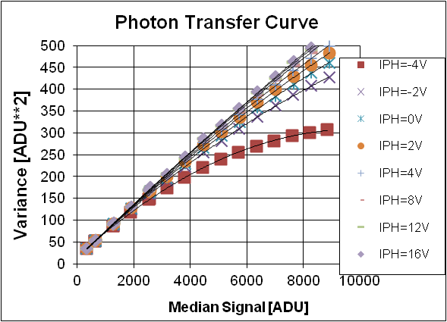
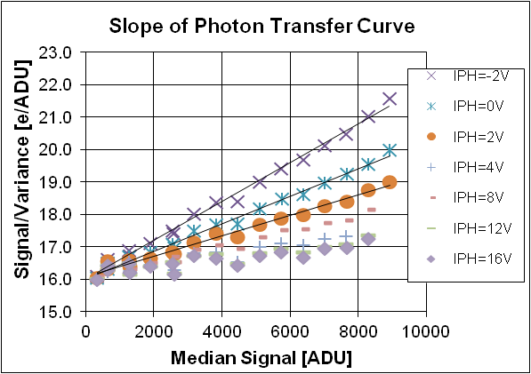
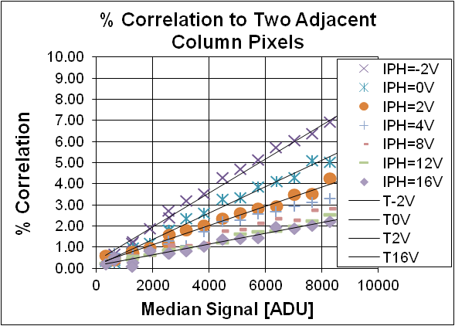
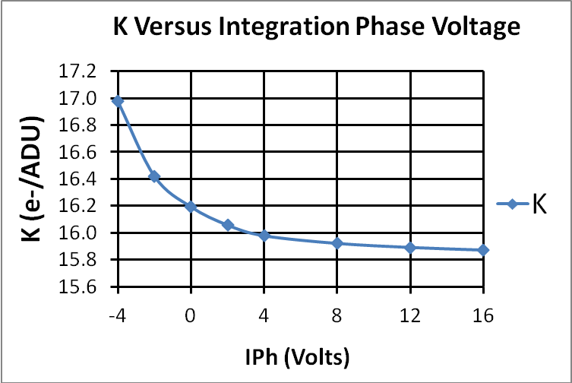
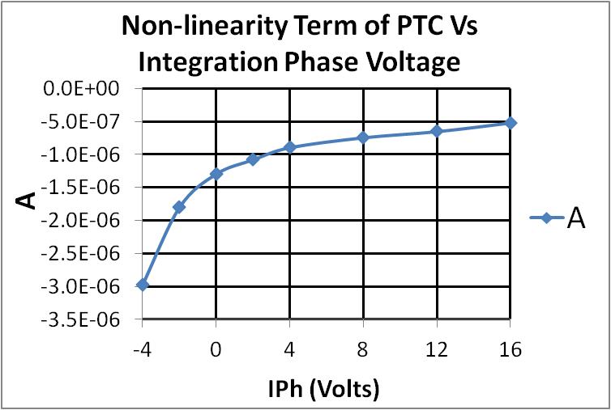
100% agreement between non-linearity in PTC and correlation between pixels
Slope
Both slope and signal² term
vary with 1/collection phase voltage.
Both slope and correlation between pixels vary linearly with signal
Slope
Signal² term

Slide 6
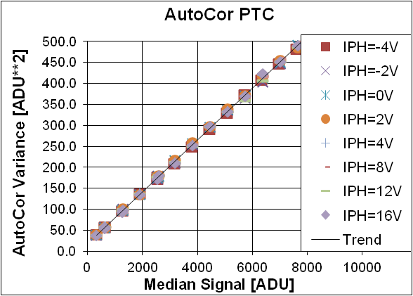
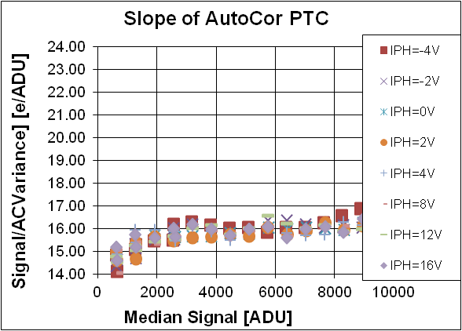
PTC can be 100% corrected for correlation between pixels by using autocorrelation variance
– most accurate method to determine gain

Slide 7
On going……
Confirm that the effect can be predicted by taking two flat fields and by using autocorrelation to calculate the correlation and thus determine the PSF Vs Signal. Corrections can then be applied to image data.
Consult the experts to better understand the cause of the effect and hopefully find a solution.

Slide 8
Thank You

