Slide 1
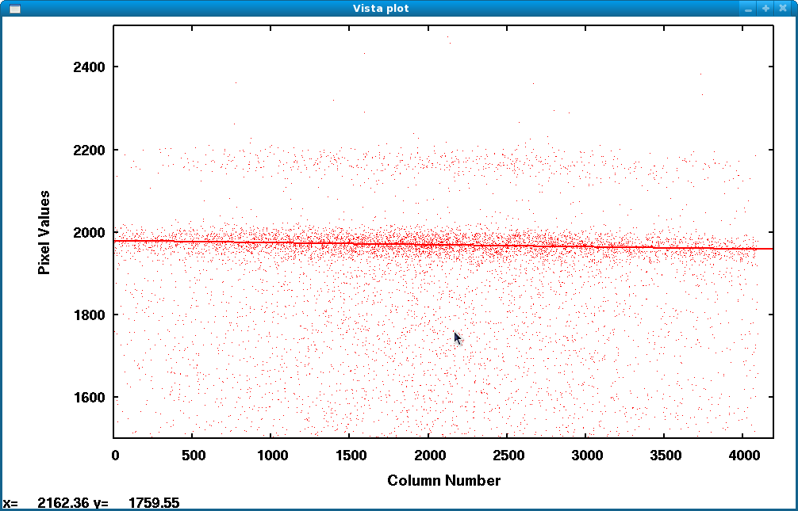
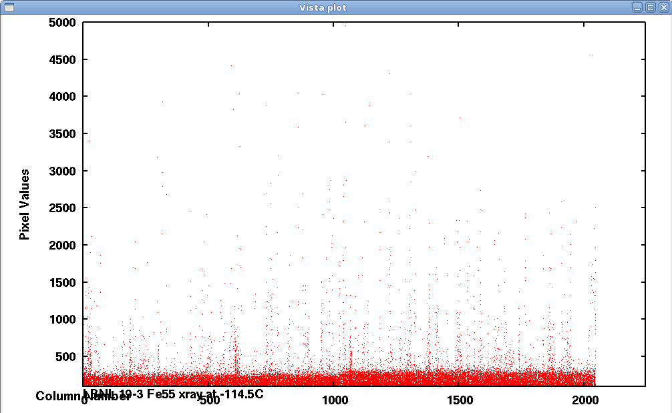
A new CTE Measurement Method (L11)
Mingzhi Wei
UCO/Lick Observatory, University of California, Santa Cruz, USA
Chinese National Astronomical Observatories, Beijing, China
There are three reasons we want to develop a new CTE measurement method:
1. Charge diffusion of thick back illuminated high-resistivity CCD
2. For Nod and shuffle type observing we need CCDs with excellent CTE.
We need a way to measure CTE more sensitively and accurately
3. We want to know the CTE at different light levels.
X-ray plot of Regular CCD X-ray plot of Thick back illuminated high-resistivity CCD

Slide 2
Test results with the new CTE measurement
CTE vs. Light level
Figure 2-1c Serial CTE vs. light level of Homamatsu CCD
Figure 2-2c Vertical CTE of our Hamamatsu test CCD with different light levels

Slide 3
Serial Charge Pumping
Figure 2-4 A flat field exposure with 5000 times of serial charge pumping of 36 pixels forward and 36 reverse

