Slide 1
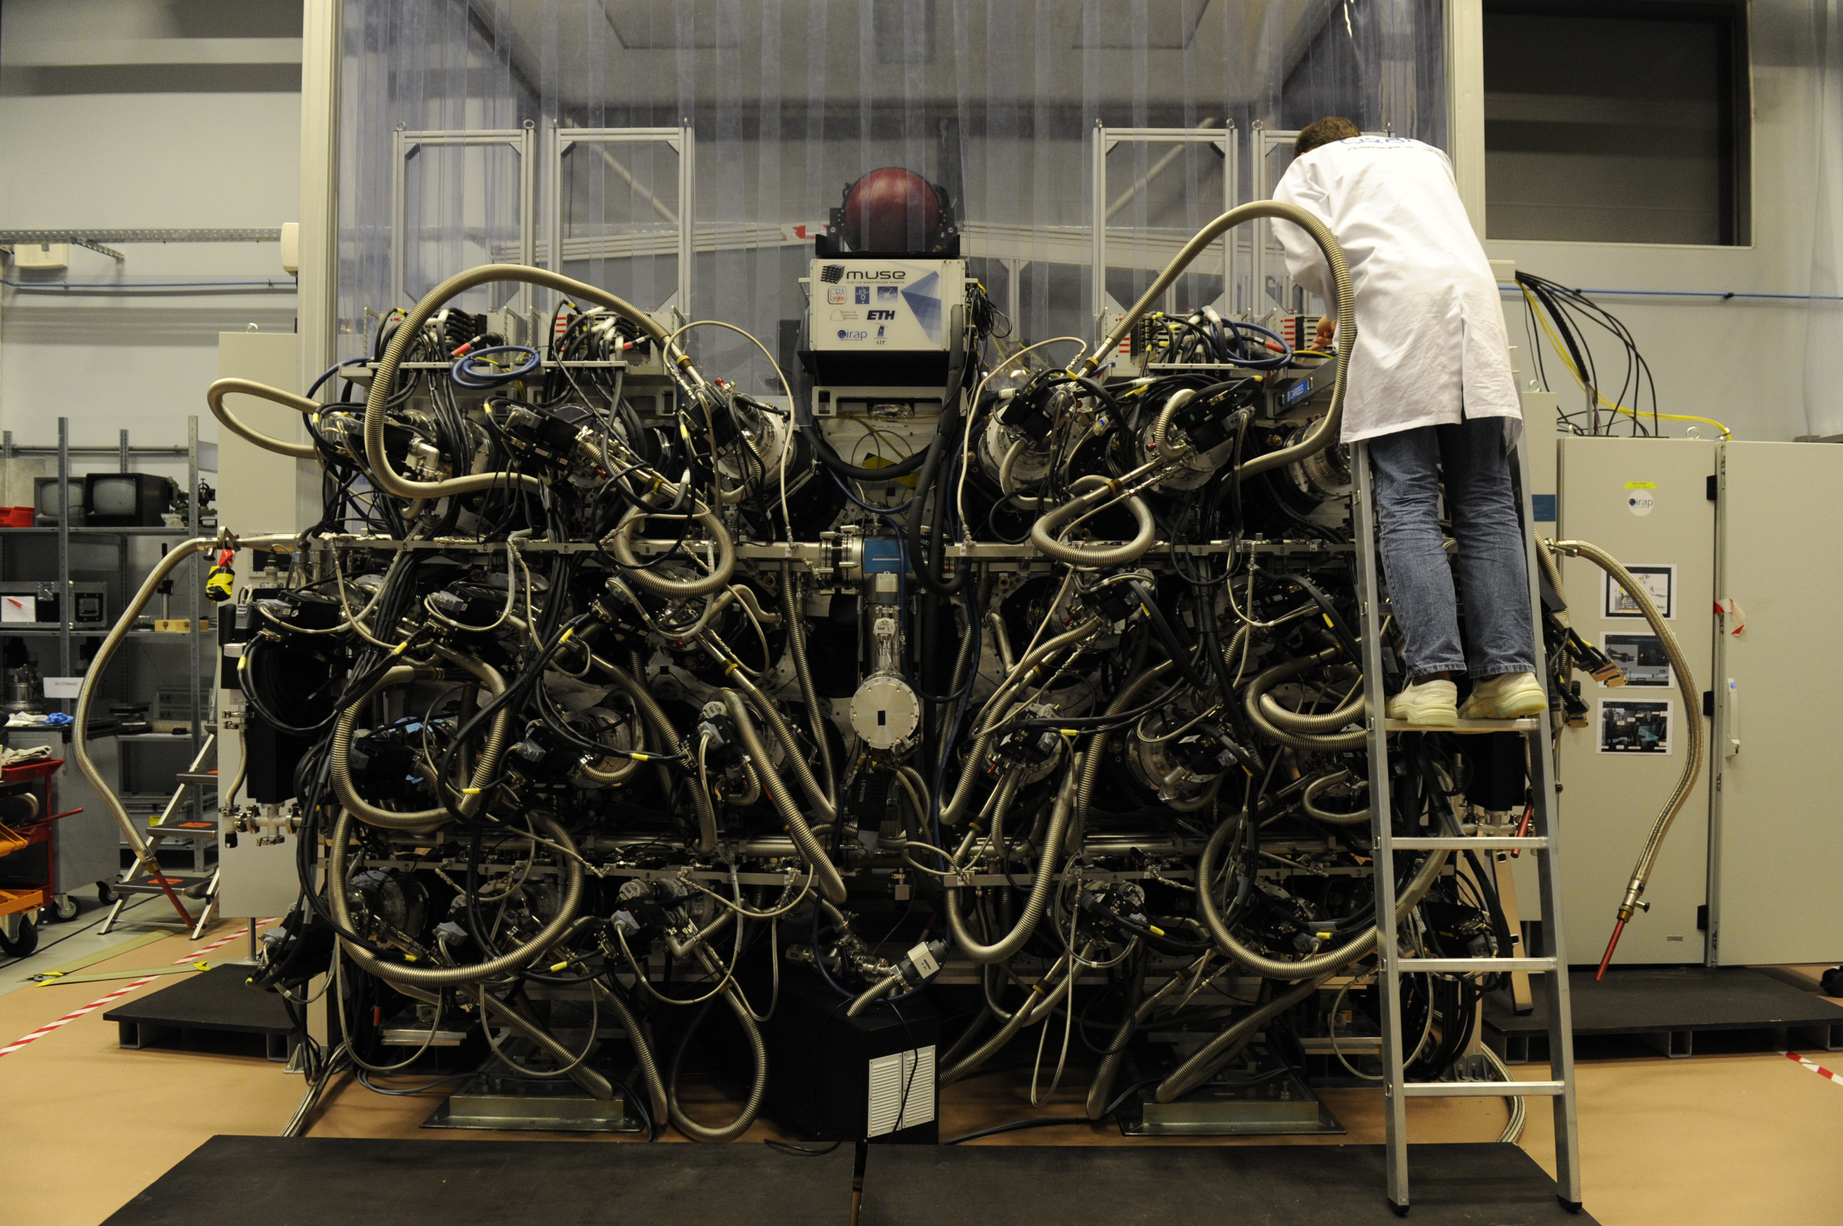



Serial Acceptance Testing of 24 Detectors for
Andreas Kelzª
J.-L. Lizon^{b}, R. Bacon^{c}(P.I.), M. Accardo^{b}, L. Capoani^{c}, S. Deiries^{b}, C. Dupuy^{b}, T. Fechnerª, T. Jahnª, A. Jarno^{c}, M. Loupias^{c}, A. Pecontal^{c}, L. Piqueras^{c}, R. Reiss^{b}, J. Richard^{c}, G. Rupprecht^{b}, M. Srivastava^{(a)}, O. Streicherª, P. Weilbacherª
a) Leibniz-Institut für Astrophysik Potsdam (AIP)
b) European Southern Observatory (ESO)
c) Centre de Recherche Astronomique de Lyon (CRAL)
„Scientific Detector Workshop“, Florence, 7th - 11th Oct. 2013
Supported by grant no. 05A11BA2

Slide 2


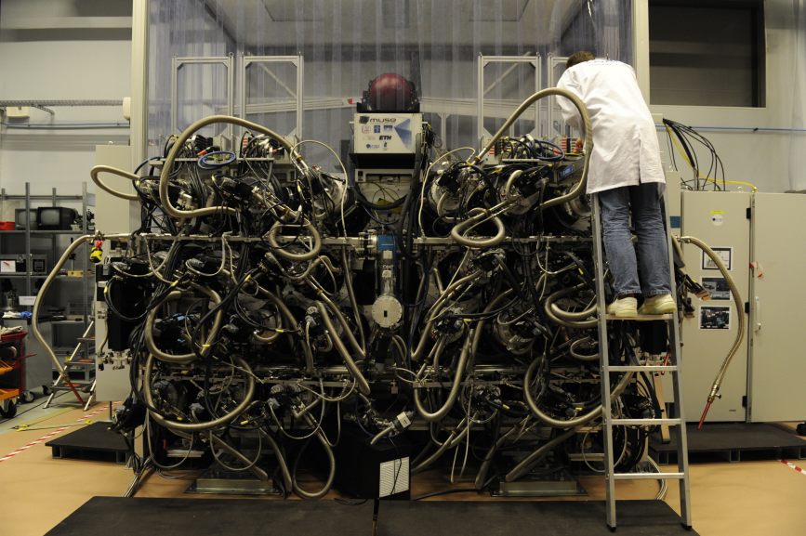
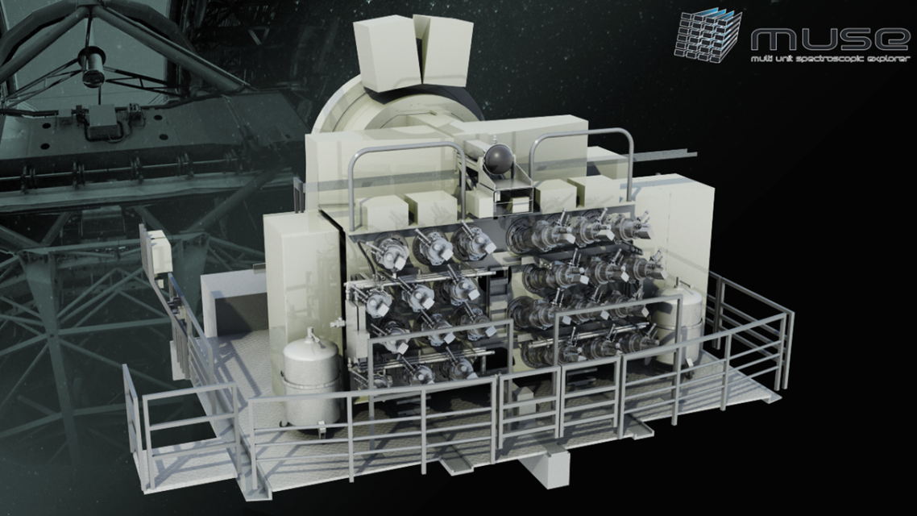
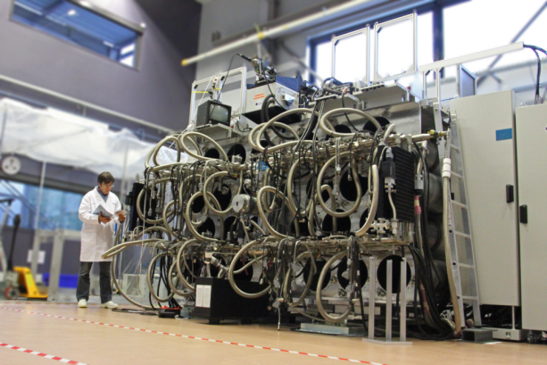


MUSE overview
MUSE, a second-generation VLT 3D-spectrograph
Field of View: 60 x 60 acrseconds
Spatial resolution: 0.2 arcseconds
Spatial elements: 60,000
Spectral range: 465nm – 930nm
24 spectrographs with detector systems
Adaptive Optics enhanced mode
The MUSE consortium:
(P.I.: R. Bacon, CRAL)

Slide 3
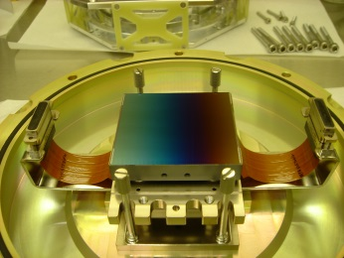
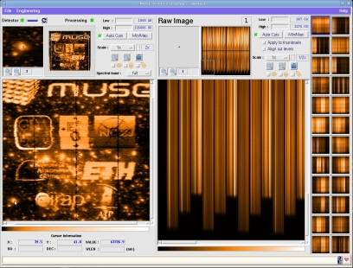
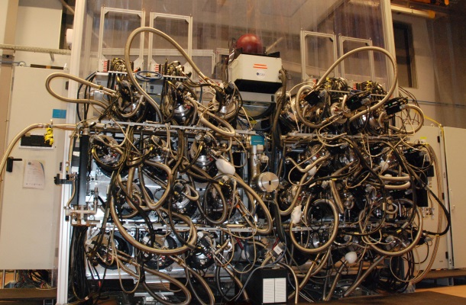

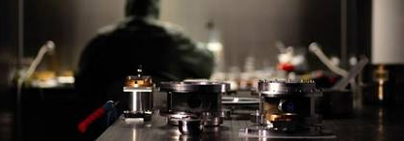
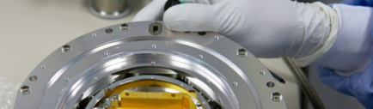
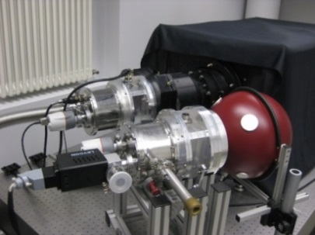
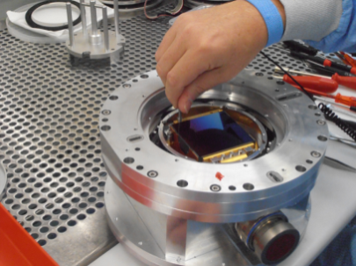
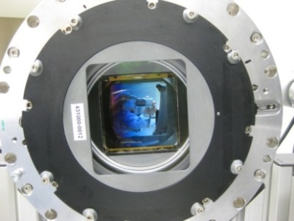
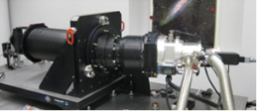
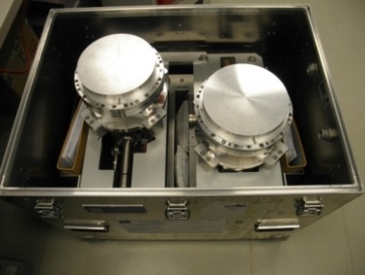
MUSE detector system: AIT process
CCD231
4k x 4k, 15 μm
1) design @ ESO
8) Operating-SW by LATT,
DR-SW by AIP & CRAL
7) Integration & perfomance
verification @ CRAL.
Vacuum- and cryo-
system by ESO
Production cycle of 24 MUSE detector heads
2) head mechanical
assembly @ AIP
3) chip integration &
alignment @ ESO
6) Acceptance test at spectrograph @ AIP
4) CCD character-
isation @ ESO
5) transport to AIP

Slide 4
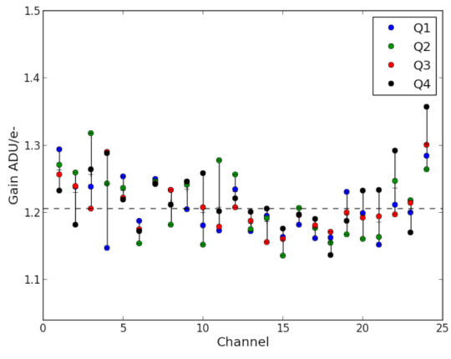
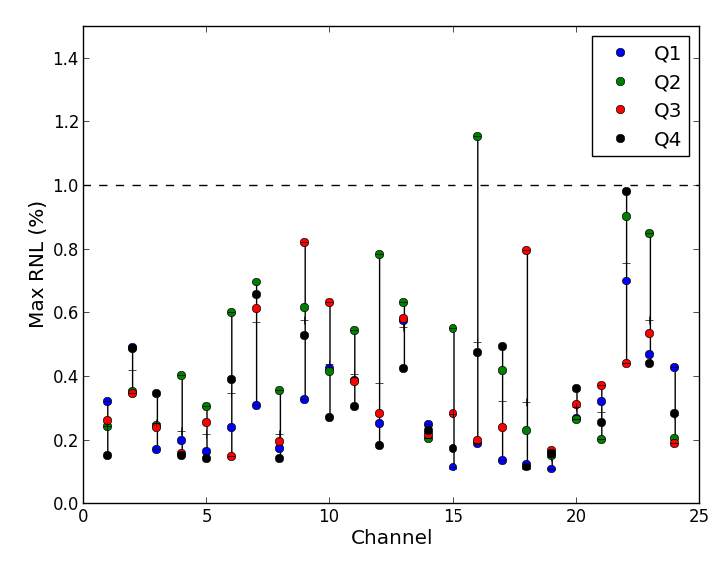
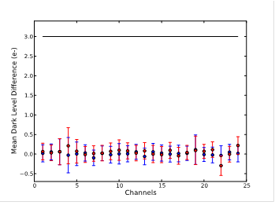
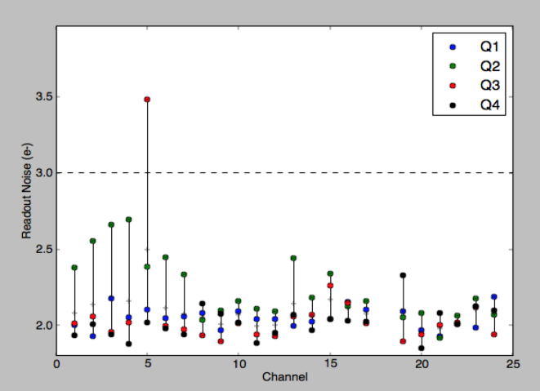
Performance of 24 detectors
(from VLT-TRE-MUS-1379 technical report to ESO)
Non-linearity:
0.3 %
Dark current:
1.1 e-/hour
Gain: 1.2 ADU/e-
Figure 1: Gain values for all quadrants and all channels. The dashed line displays the median value.
Figure 2: Maximum relative non-linearity for the 4 quadrants of each channel.
Figure 3: Measured dark current for the 24 channels. The dash line shows the specification.
Readnoise @ load
Readnoise @ quite
mean: 2.1 e-
Remanence:
<0.05 e-
Figure 4: Measured remanence level for each channel after medium (blue) and high (red) saturation.
Figure 5: Readout noise for all channels. The mean value and peak-to-peak variation for the 4 quadrants are plotted. The dashed line displays the specification.
Figure 6: Read-out noise measurement performed after shutting down all external electrical sources, except NGCs.

Slide 5

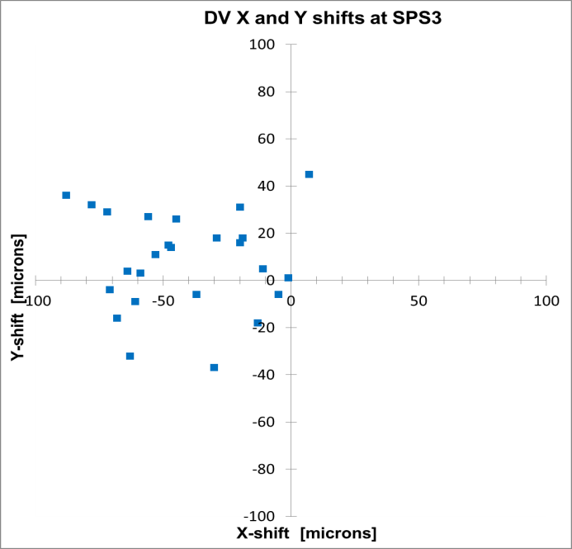
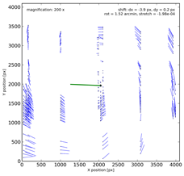
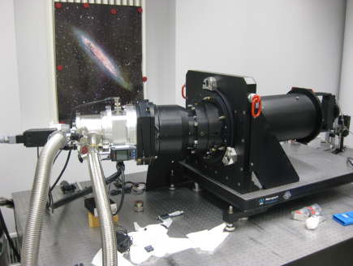
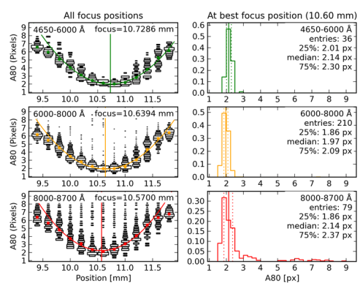
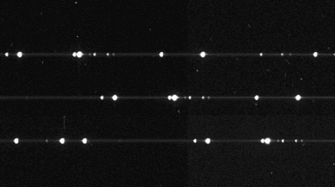
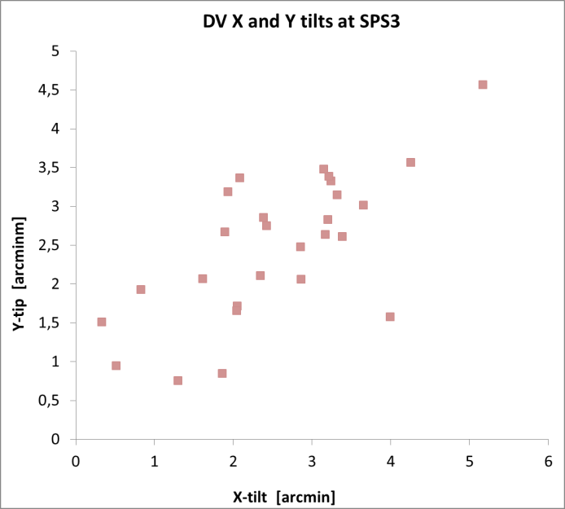
Acceptance test with spectrograph
Fig 10: example of detector shift and rotation measured across the CCD.
Fig 12: relative x and y shifts (top) and tilts (bottom) for all CCDs with allowed margins (green box).
Fig 11: spectrograph focus curves and image quality histograms in three-colours.

