Slide 1
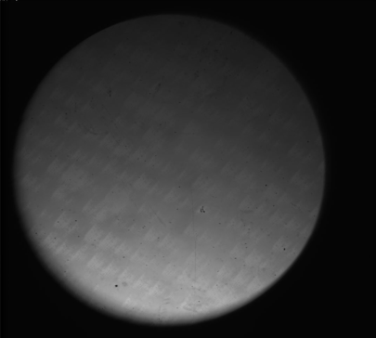
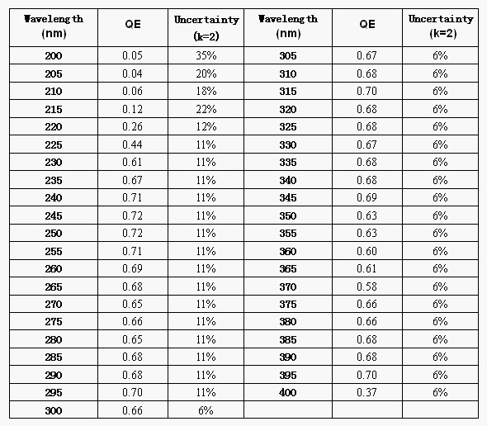
Quantum Efficiency Calibration of CCD on UV Band
Qian Song, Zhiwei Feng, Yangbing Liu
Chinese National Astronomical Observatories
Pinhole image on 245nm
Setup of the UV calibration system
Three tests of QE with an E2V 42-70 UV enhanced CCD.
stability of the light source

