Slide 1
X-ray Analysis of Fully Depleted Thick CCDs with Small Pixel Size Ivan Kotov Brookhaven National Laboratory SDW2013, October 2013

Slide 2
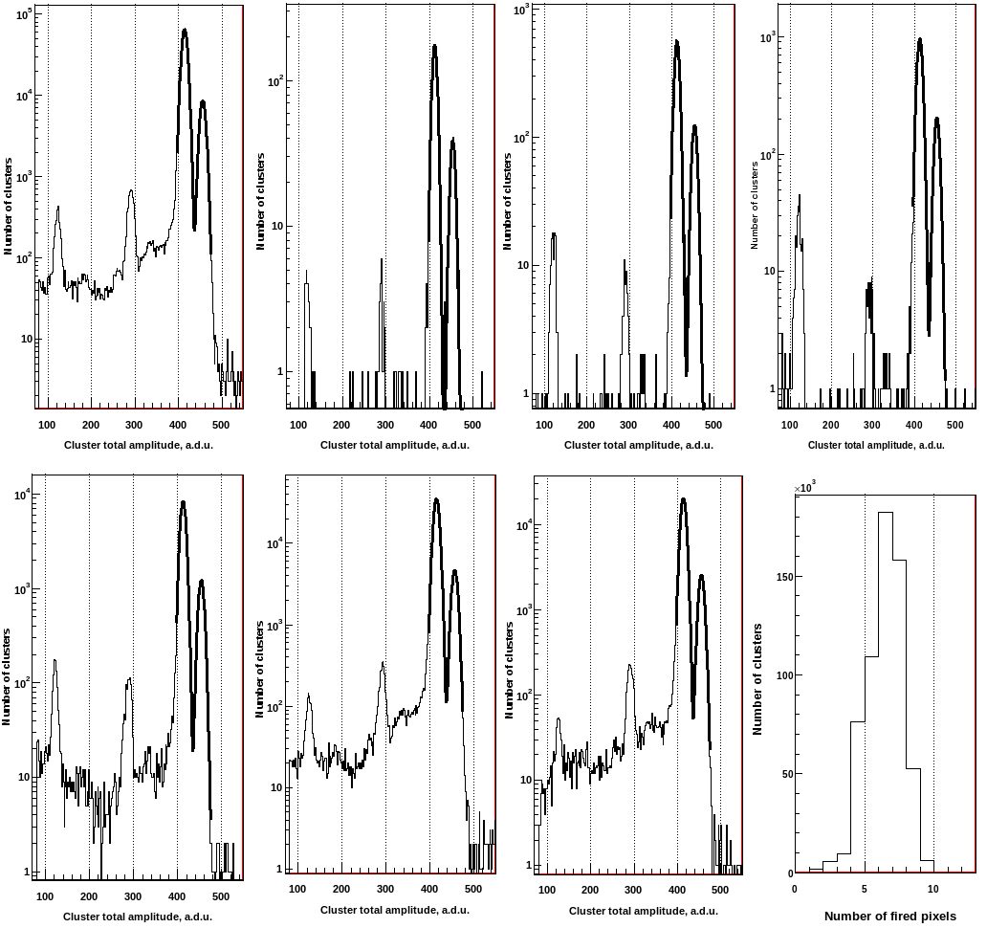
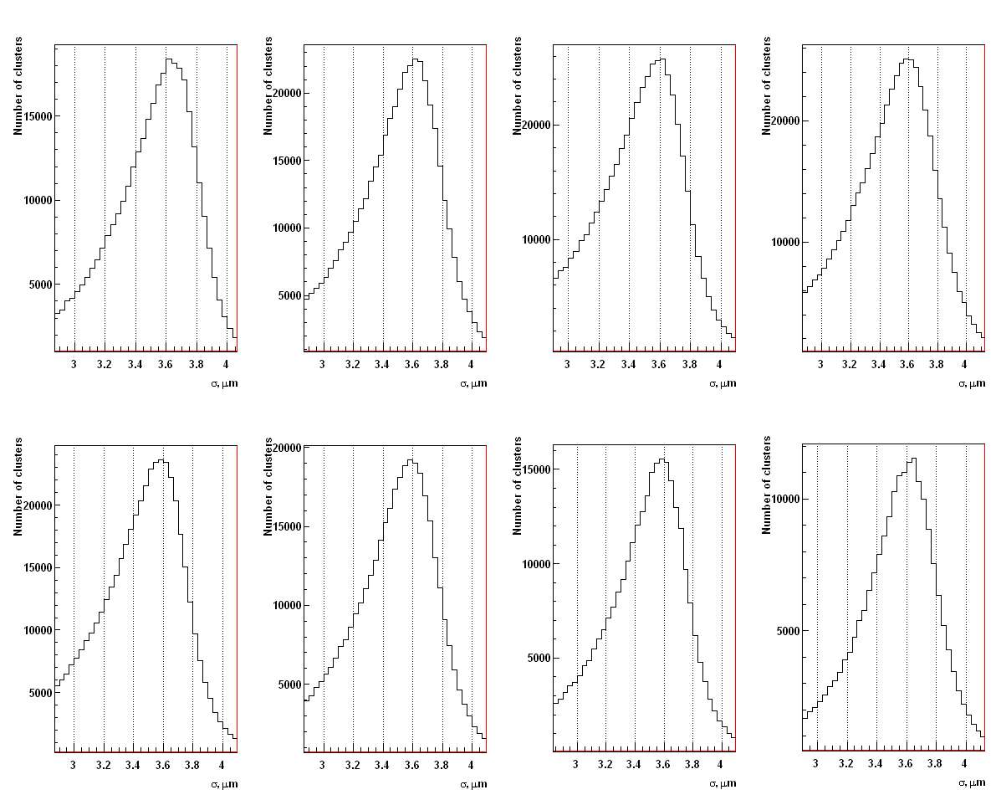
⁵⁵Fe data

Slide 3
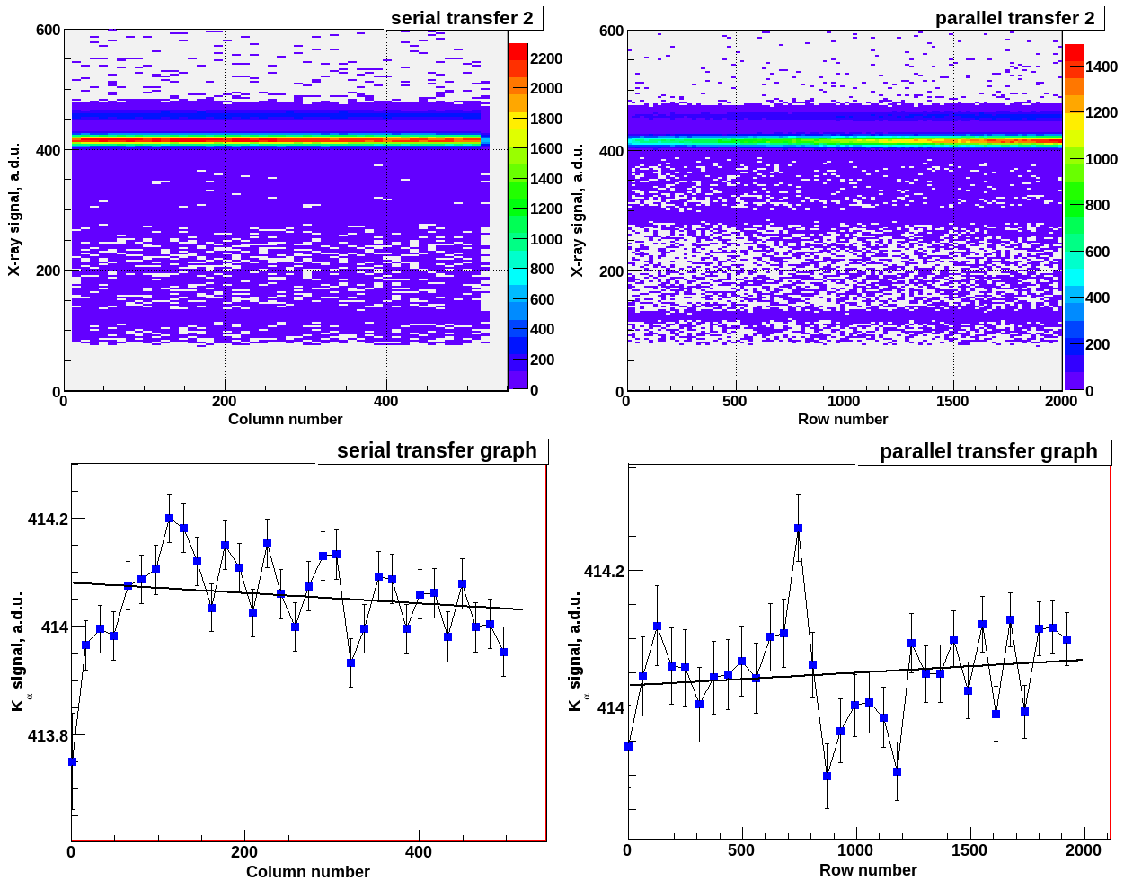
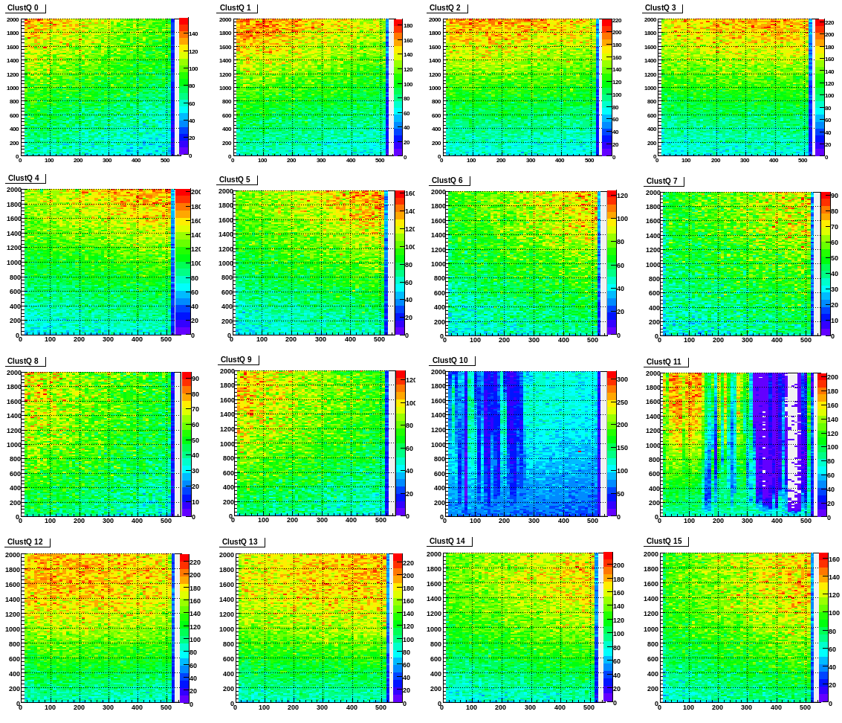
CTE measurements & defect diagnostics

