Slide 1
Super-hot pixels, hot pixels and DSNU on Hawaii-2RG detector
Crouzet Pierre-Elie, Jerome Caron, Thibault Viale

Slide 2
Outlines
Context
Test set up
H2RG cosmetic at low temperature (82K-145K)
  Hot pixel evolution with temperature
  DSNU with exposure time
H2RG cosmetic at high temperature (150K-170K)
  Switching pixel
  Super hot pixel

Slide 3
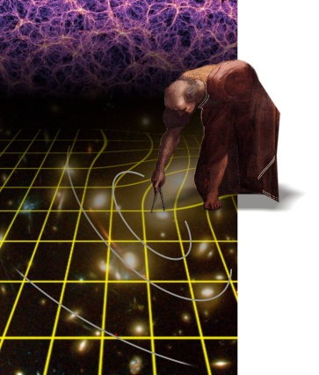
Context
Euclid
  2 instruments:
    VIS channel: 36 CCDs 4k x4k, 550-900 nm imager
    NISP channel: 16 H2-RG (large focal plane), 2k x2k, 1.0-2.0 um photo-spectrometer at < 100K
CarbonSat (Carbon Monitoring Satellite)
  Investigation/probing the use of the H2-RG detector operated at high temperature (130K-170K) in fast mode and with increased bias voltages Vreset
  Dedicated tests have been performed at ESTEC to investigate the detector performance
Subject of the talk: cosmetic of H2RG detector after dark measurement at low and high temperature and impact on calibration/operability

Slide 4
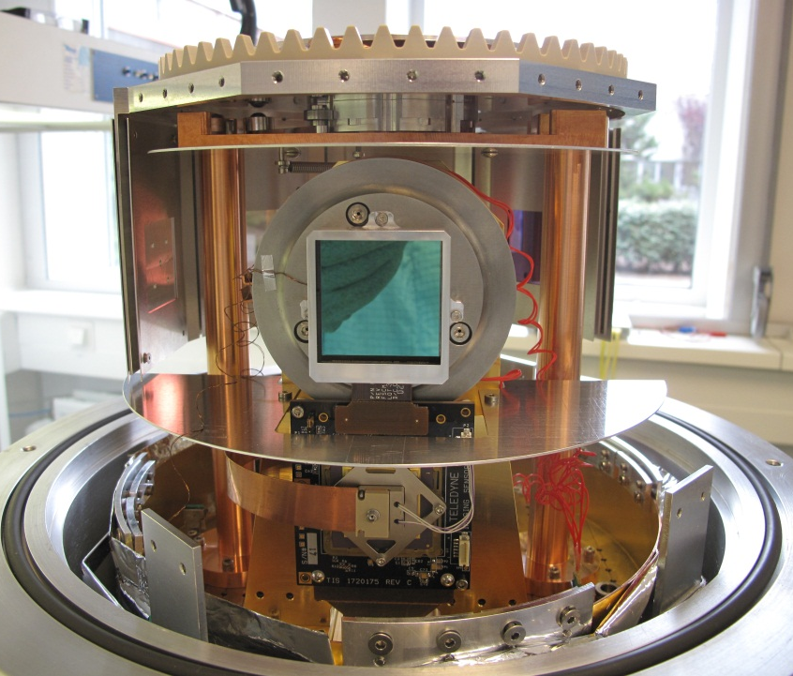
Test set up
H2RG:
  2.5um cut-off,
  engineering model
  2048*2048 pixels
  18um pixel pitch
Cryogenic SIDECAR readout electronic
Independent temperature control of the detector+SIDECAR at mk stability level
  From 82K till 170K
JADE2 card located at room temperature

Slide 5
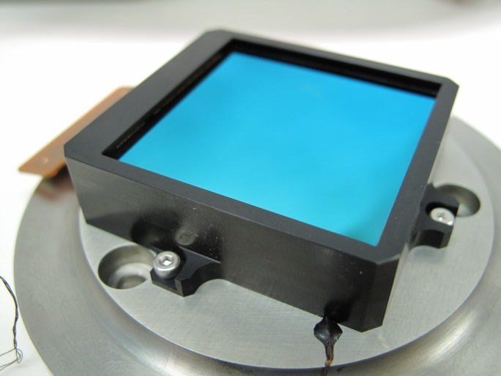
Outlines
H2RG cosmetic at low temperature (82K-145K)
  Hot pixel evolution with temperature
  DSNU with exposure time

Slide 6
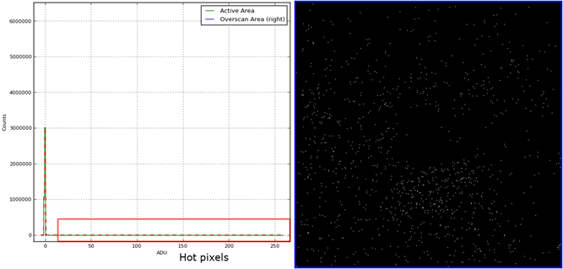
Hot pixel in the dark current frames
Map of dark current obtained from fit per pixel of 50 ramps of 100 up the ramp frames
  Hot pixel defined with a fixed threshold of 2.7 standard deviation of the mean distribution of dark current values
Example at 82K
Associated map of hot pixels

Slide 7
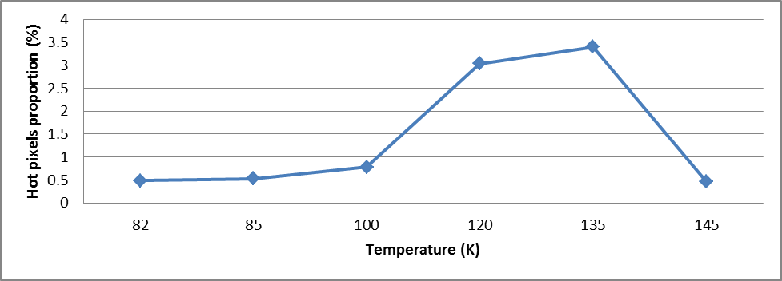

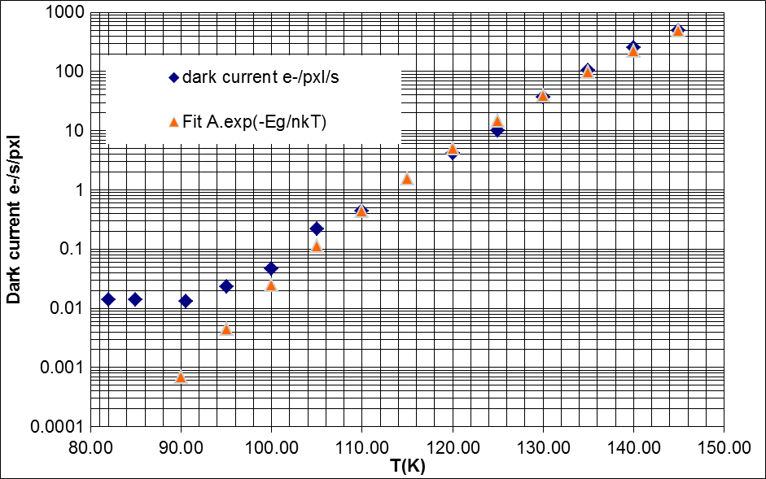
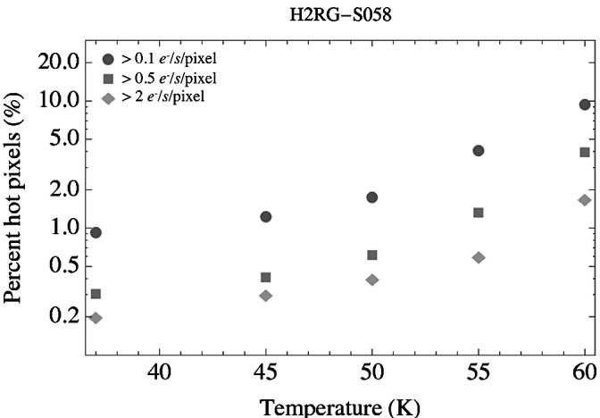
Evolution with the temperature
2 regimes:
  Below 100K plateau
  Increase of 0.6%/10K after 100K
Same behavior on dark current evolution
  Hot pixel thermally activated
Euclid SCA operational temperature <100K
Behaviour at 145K?
Complementary to the analyze for a H2RG 5um cut off for JWST in 2011 (B.Rausher PASP: 123-953-957)
≈ 2 times more every 6K

Slide 8
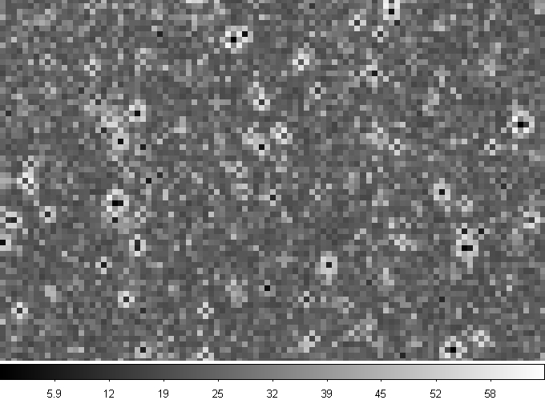
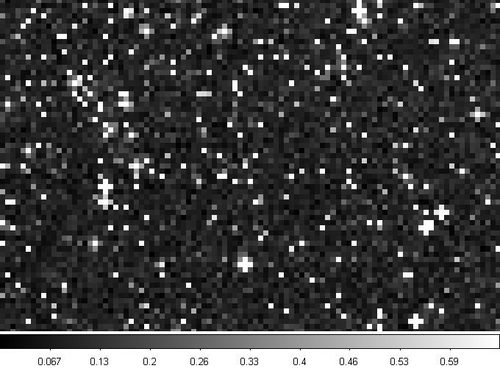
Behaviour at 145K
Dark current map at 145K
Dark current map at 100K
Hot pixel at high temperature (>145K) have a nearly null slope and therefore are not anymore counted as hot pixel

Slide 9
Summary
Hot pixel thermally activated after 100K
Euclid H2RG operational temperature <100K
  The lowest proportion of hot pixel → better for calibration and operability for science
Behavior at 145K only due to hot pixel seen as dead/bad pixels

Slide 10
DSNU with exposure time

Slide 11
DSNU definition and data
DSNU definition
  For each pixel i of the array at a given integration time t
    DSNU(i)=(S(i)-median)/median
    With S(i): signal of the pixel i
    Median: median value of the pixel over the entire array
  Temporal evolution of the DSNU
Same dark current up the ramp data
Dsub-Vreset=250mV

Slide 12
DSNU with exposure time
Over the entire array
  At T=125K
  Temperature stable at mK level
  22% of DSNU in 1000s
  At T=90.5K
  Temperature stable at mK level
  11% of DNSU in 1000s
-Different temporal behavior
for different temperature

Slide 13
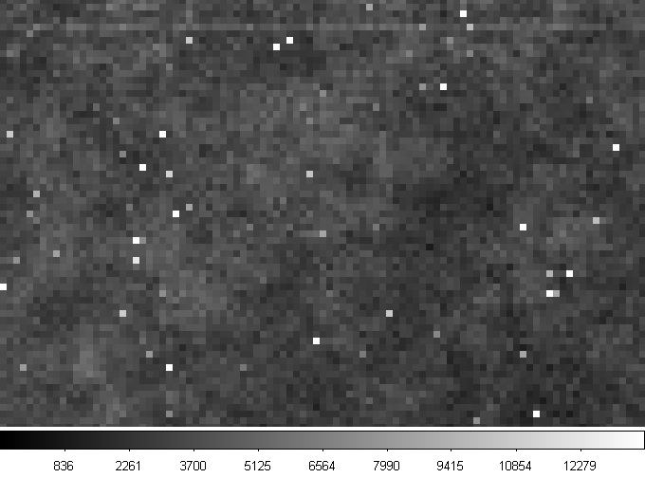
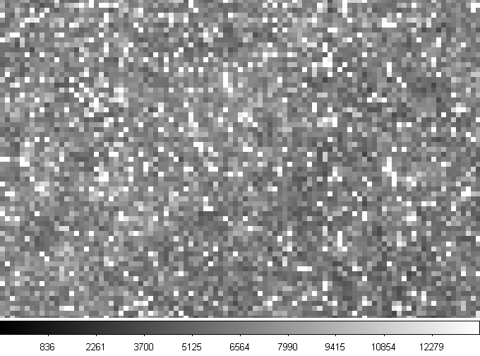
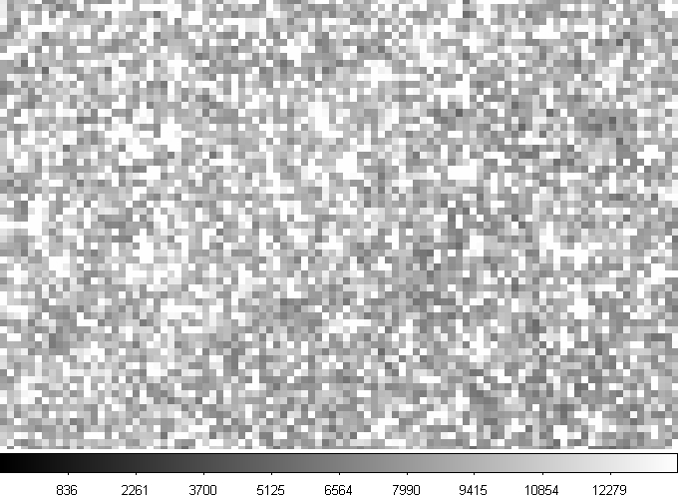
Frame evolution
T=125K
Same scale
Frame1
Frame 50 at t=2100s
Increasing of DSNU
Decreasing of DSNU
Increasing then decreasing of DSNU due to high amount of hot pixel or saturated pixel
no contrast anymore between good/hot pixels
Frame 100 at t=4200s

Slide 14
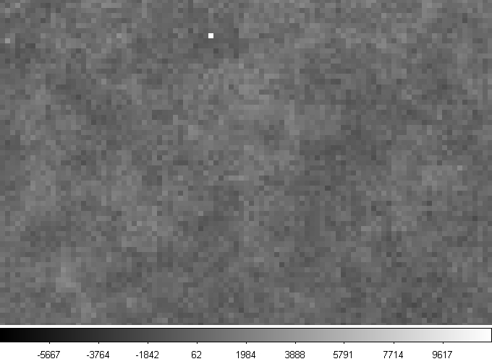
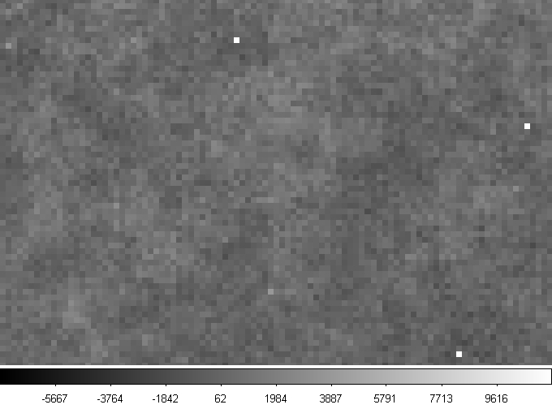

Frame evolution
T=90.5K
Same scale
frame1
Frame 50 at t=530s
Increasing of DSNU due to slow increase of hot pixel with time
Frame 100 at t=1060s

Slide 15
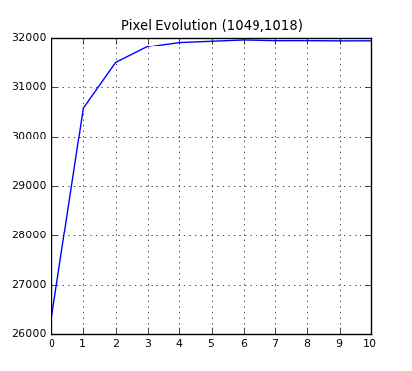
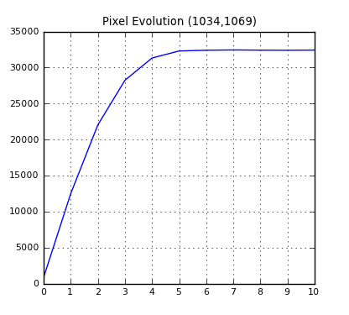
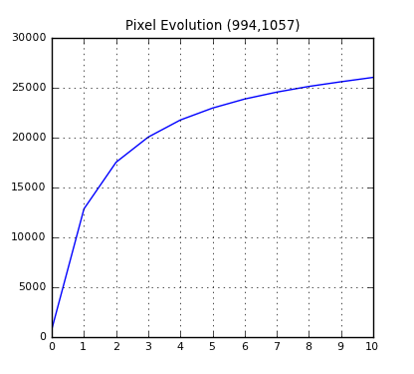
Signal (adu)
Some pixel become hot with the integration time with a RC behavior
frame1
Signal (adu)
-Evolution at some month/year interval if new RC pixel are created
-Explanation of RC behavior?
Value at frame 50
Frame 50 at t=530s
Signal (adu)
Value at frame 100
Frame 100 at t=1060s
Frame number (/10)

Slide 16
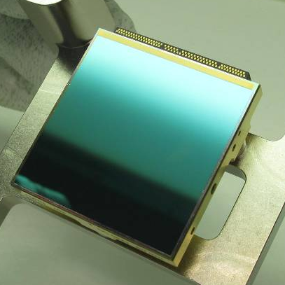
Outlines and data
H2RG cosmetic at high temperature (150K-170K)
  Switching pixel
  Super hot pixel
Data recorded at 5Mhz with the JADE2 card
  Integrating down (adu decrease with signal)

Slide 17
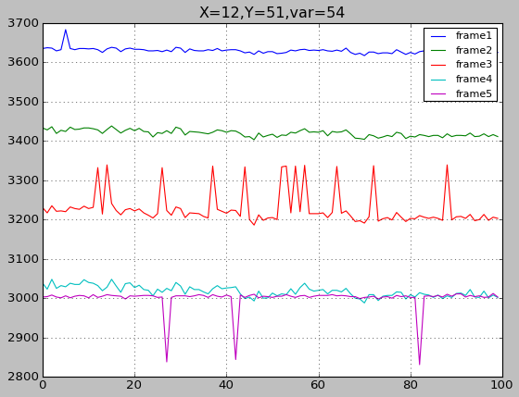
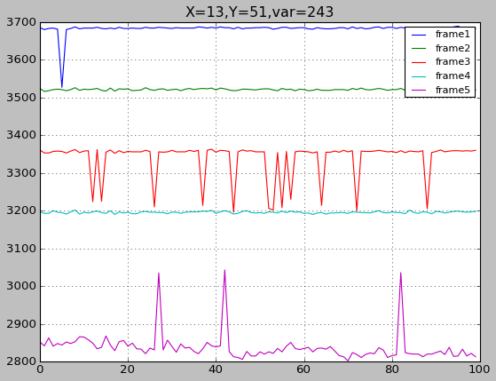
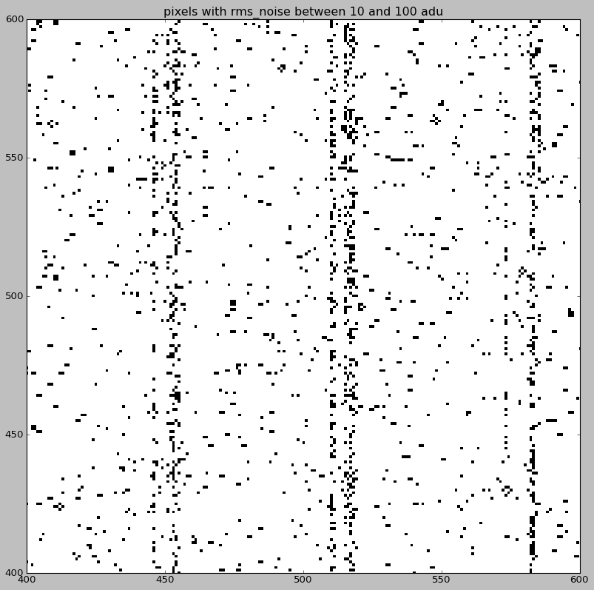
H2RG cosmetic at high temperature (170K)
Switching pixels
  100 ramps and 5 frames per ramp
  Dsub-Vreset of 1V
  Signal fluctuations exactly compensated by the signal fluctuations of one of the two adjacent pixels located on the same line (to the left or the right).
  Patterns repeat over the whole array, with a periodicity of 64 pixels (width of the area read-out by one of the 32 output amplifiers).
  biases tuning problem?
biases tuning of the detector/SIDECAR at 170K especially at 5Mhz not easy task: news biases to tune compare to the “standard” 100Khz

Slide 18




Super Hot pixel
Family of pixels already saturated in the first frame acquired immediately after reset surrounded by bright pixels
At 150K the super-hot pixels
  Isolated or in groups of 2 or 3 aligned along the same line
  These preceding bright pixels have a higher signal level than the background but still respond to light.
  Counting the super-hot pixels (≈0.5%) and theirs impacted neighbors (≈ 0.5%) number of defective pixels of ≈ 1%.
150K (raw frame)
170K (raw frame)
At 170K the super-hot pixels
  By groups of 1, 2 or 3 aligned along the same line,
  Surrounded by more bright pixels, typically 4 for one isolated super- hot pixel
  Number of pixels of ≈ 8%.
-Bias tuning problem + IPC +diffusion?
-Temperature behavior at high temperature creating hot structure
-Operability problem

Slide 19
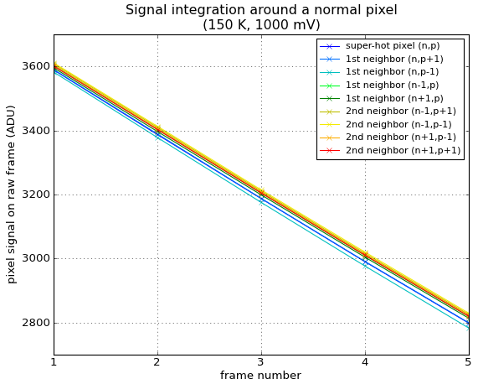
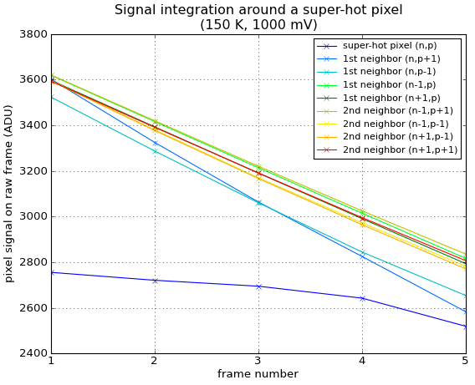
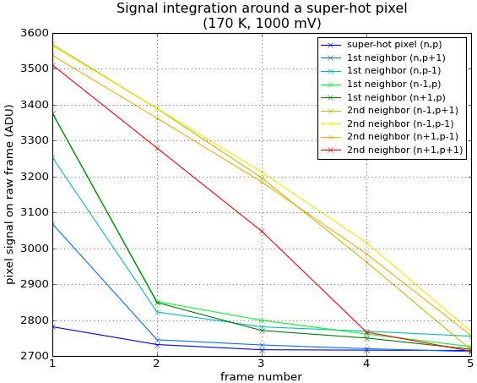
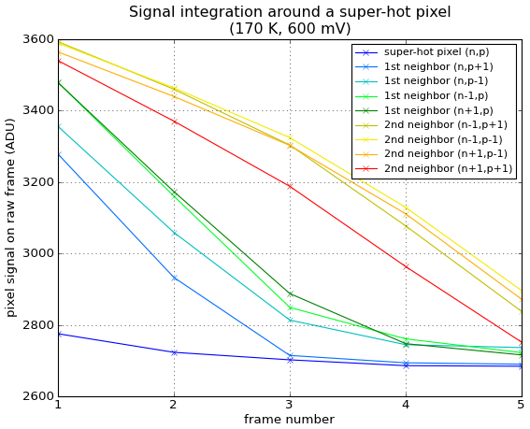
Super Hot pixel
Signal evolution with time
Bias effect:
  1V bias : neighbor pixels quicker affected than 600mV

Slide 20
Conclusion
In the context of the Euclid and CarbonSat tests from 82K till 170K on the HAWAII-2RG detector have been performed.
The hot pixel evolution with the temperature suggest hot pixel thermally activated. Temperature <100K better for calibration and science for Euclid
DSNU evolution with the exposure time shows RC pixel behaviour which need to be explained
At high temperature (150K-170K) the detector exhibits:
  Switching pixels
  Super-hot pixels
  → The behaviour of the H2RG detector at high temperature (>150K) needs to be more understood and biases properly

Slide 21
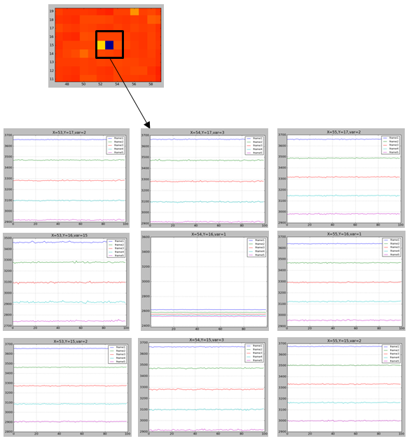
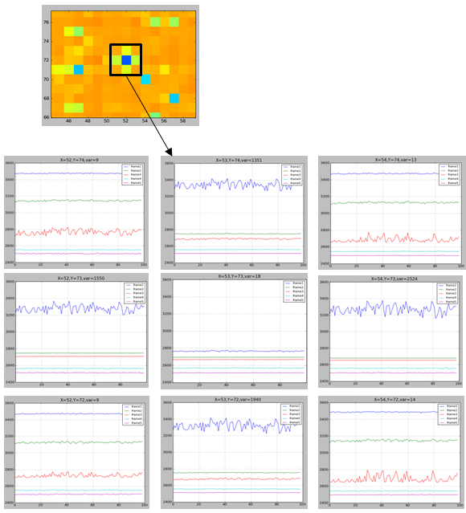
Super Hot pixel
Temporal evolution
Signal decrease that is almost two times larger than the normal response.
The additional signal could be interpreted as coming from excess electrons flowing from the central super-hot pixel.
150K
170K

