Slide 1

Characterization of a Large Format HgCdTe on Silicon Focal Plane Array
B. Hanold, J. Lee, D. Figer – Rochester Institute of Technology
L. Mears, J. Bangs, E. Corrales, J. Getty, C. Keasler, M. Mitani – Raytheon Vision Systems

Slide 2
Outline
Project overview
Device design
Test setup
Characterization results
Going forward

Slide 3
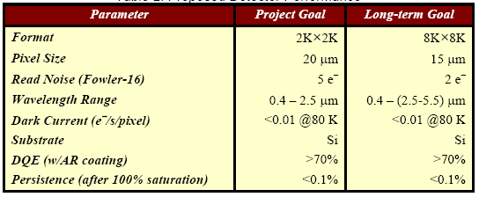
Project Overview
HgCdTe detector cost can be reduced by using Si substrate instead of CZT
Project will develop low cost infrared detectors for astronomy with long term goal of producing larger arrays enabled by using larger Si wafer
Project goal is to fabricate 2K x 2K MBE HgCdTe/Si detectors with competitive performance
Work is being funded by NSF and NASA to develop large format HgCdTe/Si detectors in collaboration with Raytheon Vision Systems (RVS)

Slide 4
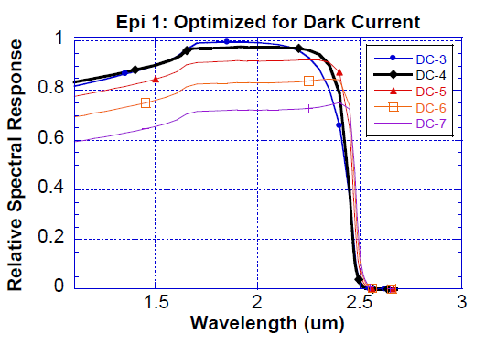
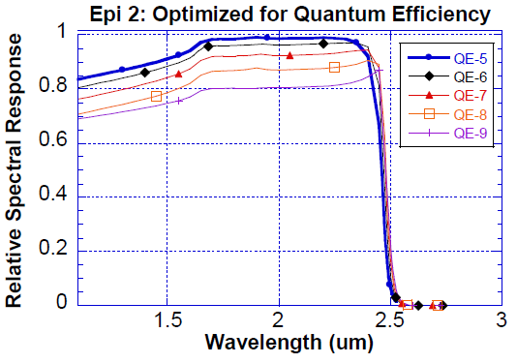
Device Design Drivers
Dark current and quantum efficiency identified as drivers for HgCdTe/Si design improvements
Multiple pixel designs need to be tested
Large amount of testing required to select optimal design

Slide 5
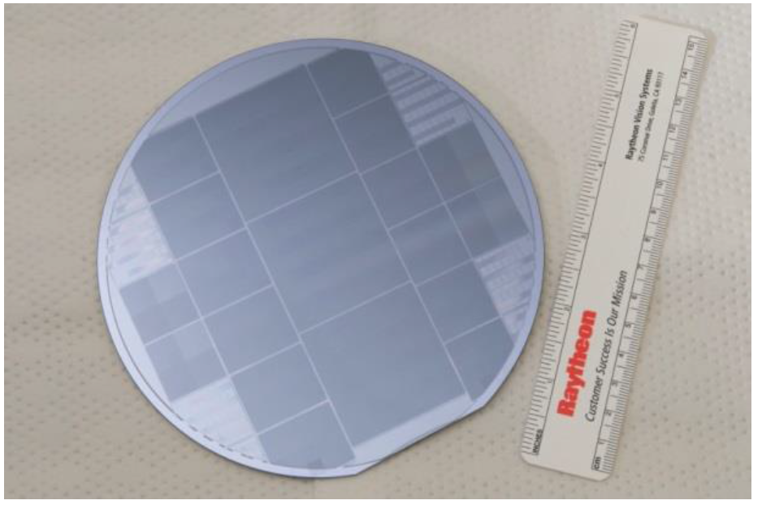
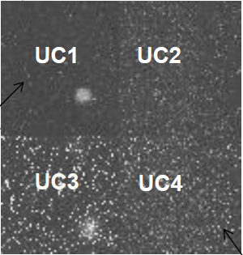
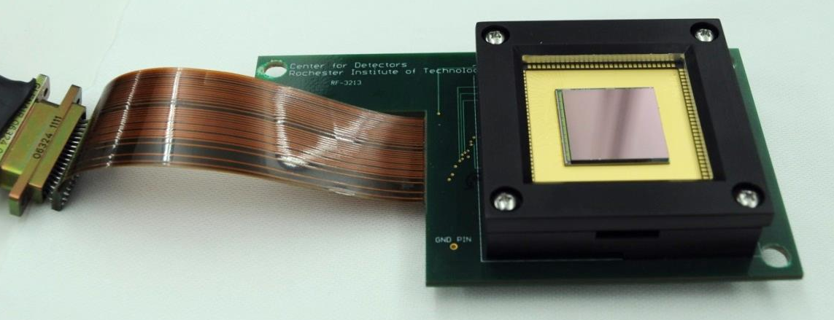
Variable Unit Cell (VUC) Devices
4 1K x 1K variable unit cell detector die
1K x 1K die fabricated with 4 unit cell designs
Design allows direct comparison of detector characteristics
VUC detector speeds design selection and allows more time for optimization

Slide 6
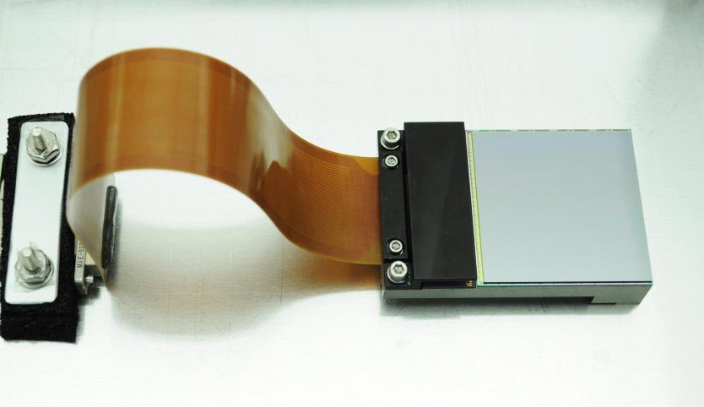
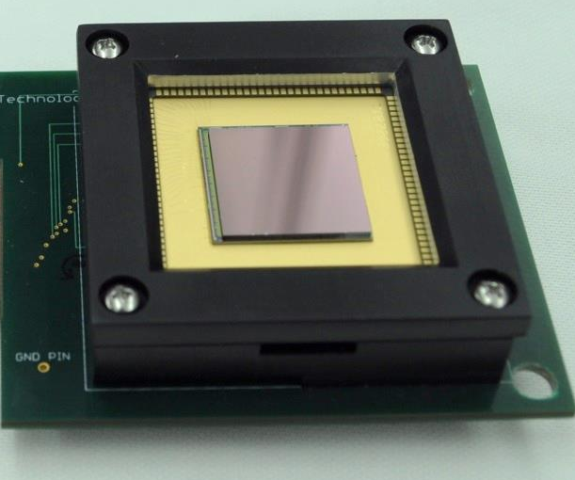
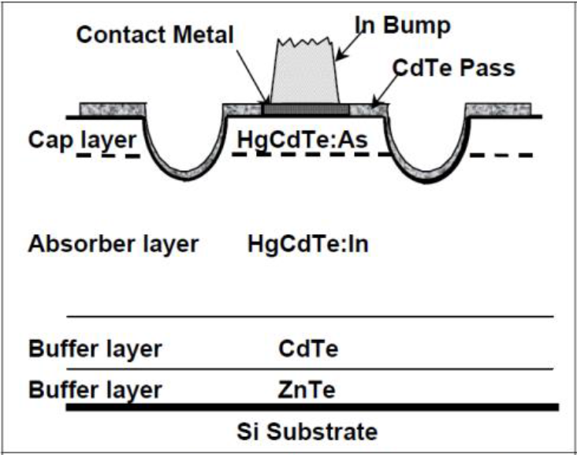
Detectors To Date
CfD received 4 detectors from RVS:
  SN: 9A, 14, V1, and V2
All bonded to Virgo ROICs
Current progress:
  Characterization of 2K x 2K HgCdTe/Si (SN: 14)
  Characterization of 1K x 1K HgCdTe/Si (SN: V1)

Slide 7
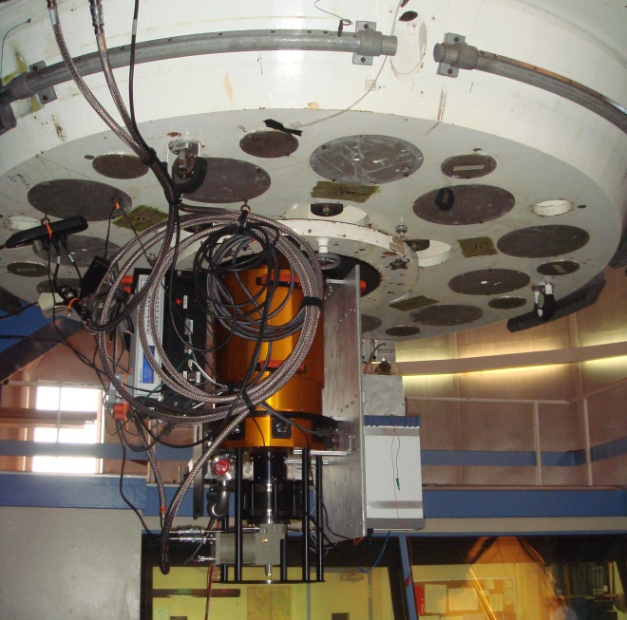
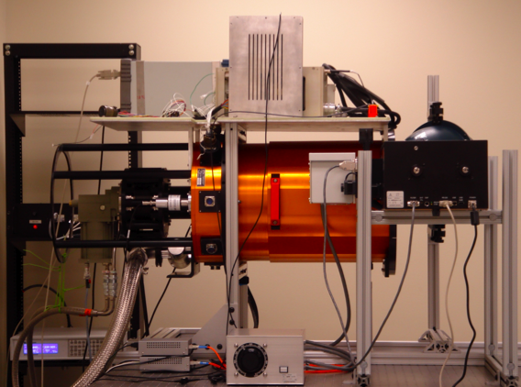
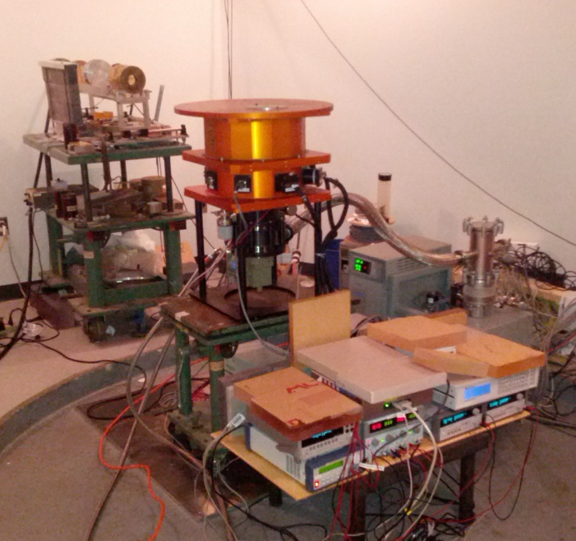
Rochester Imaging Detector Laboratory (RIDL) in The Center for Detectors (CfD)
Test Results for an Array-Based GM_APD Detector Before and After Irradiation
K. Kolb’s Poster L10
3 cryogenic test systems
Computing cluster for data acquisition and reduction running automated test suite
Test systems integrate with telescope for on-sky evaluation of detectors
Test systems have been designed and used for radiation testing

Slide 8
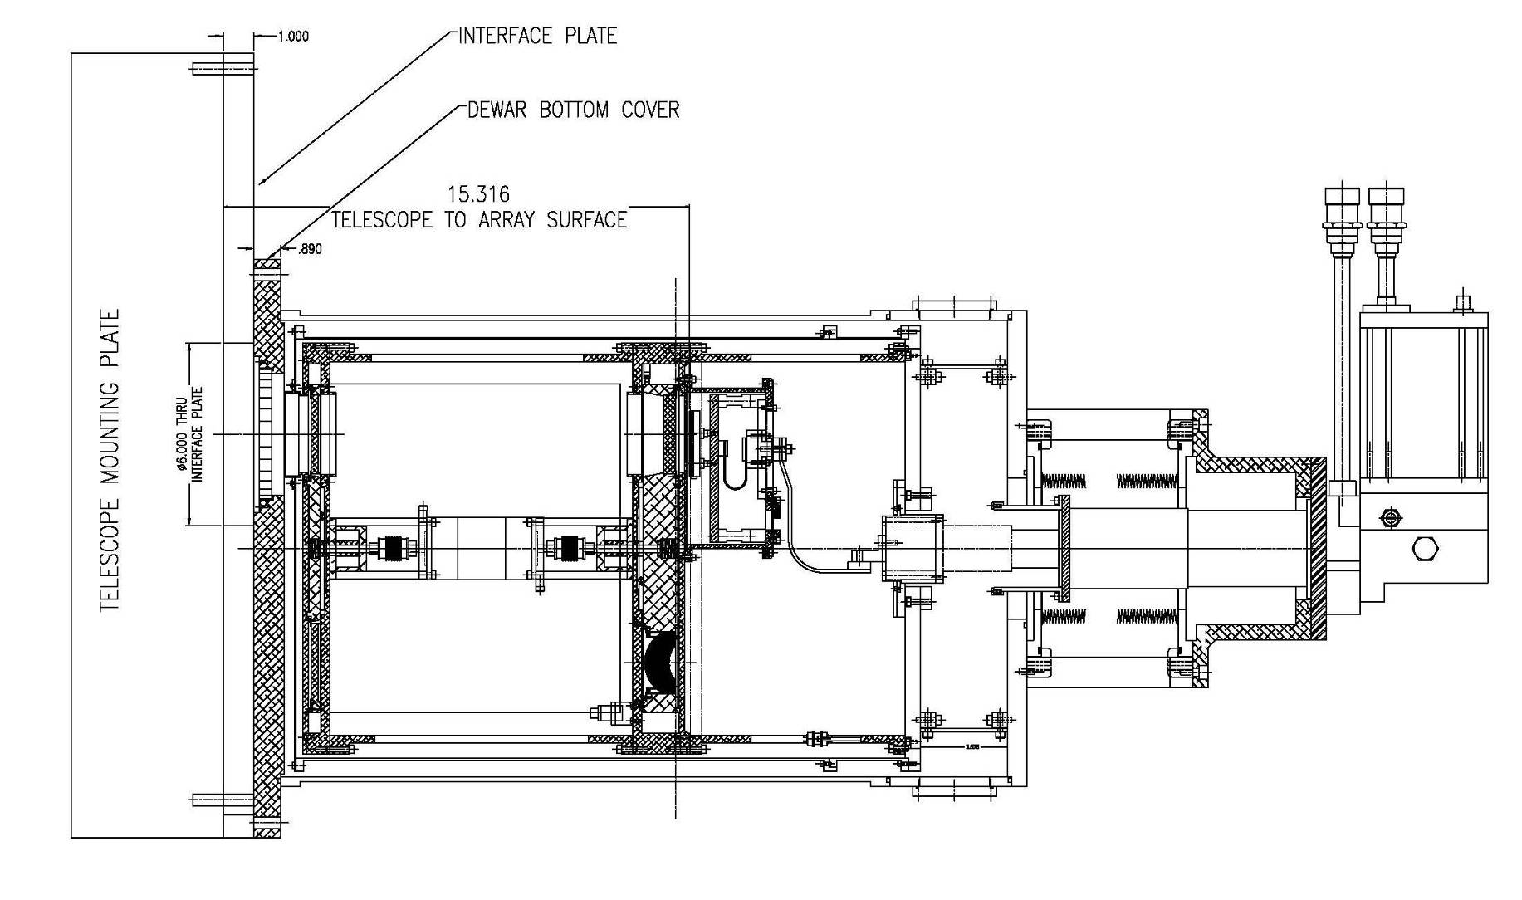
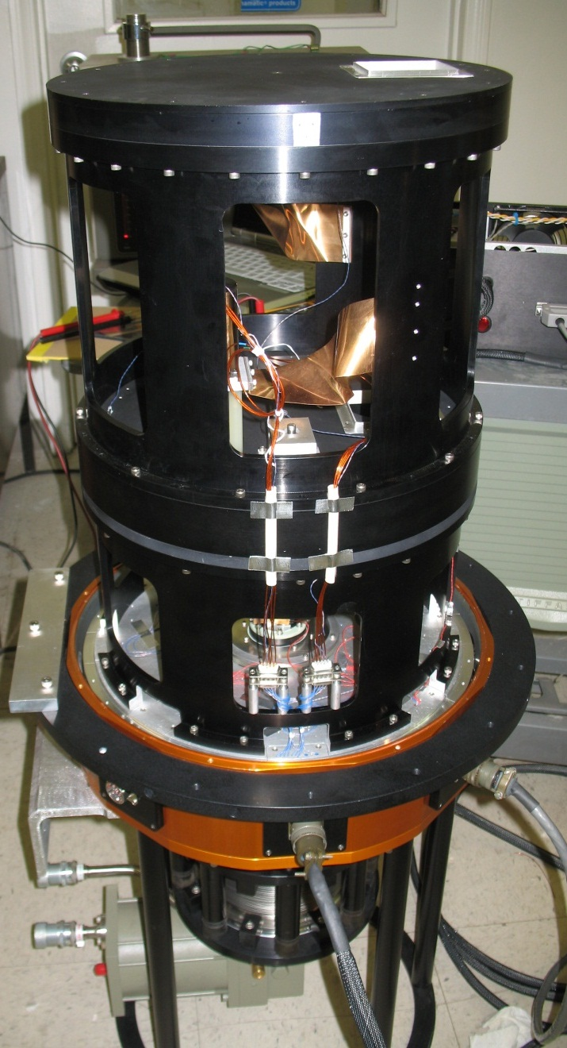
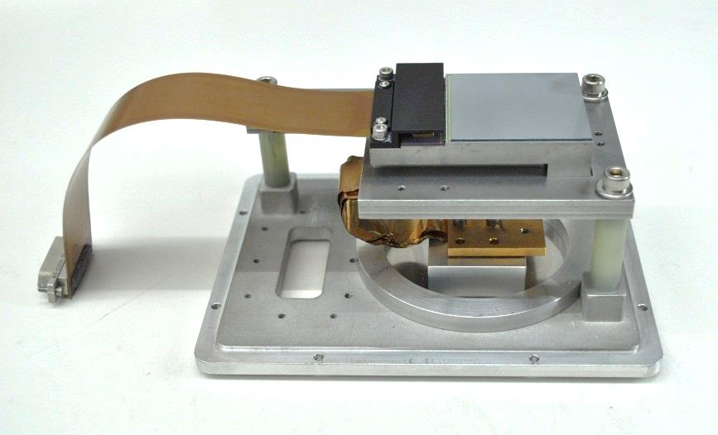
Cryostat Detail
Outer Case
Detector Enclosure
Cold Plate
Filter Wheel
Electrical Connectors

Slide 9
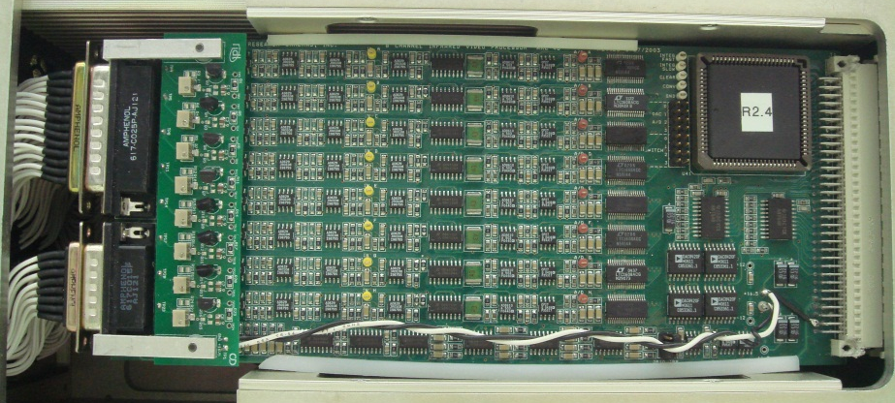
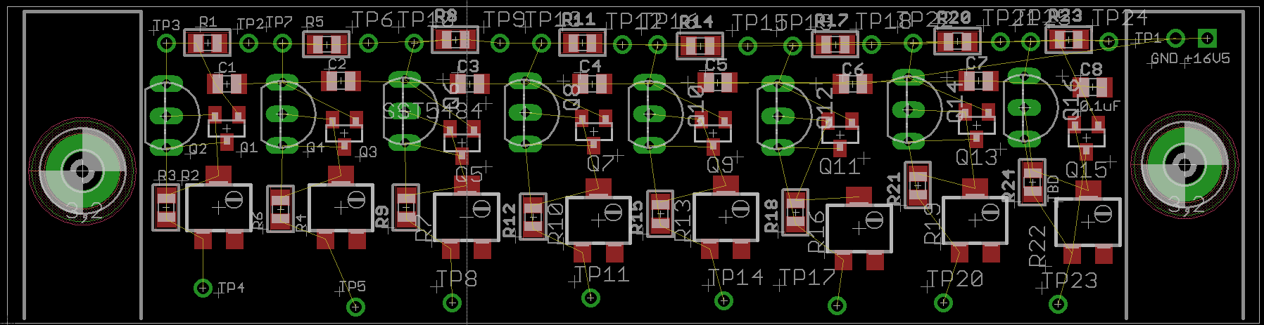
Detector Control Electronics
ARC Gen III controller used to operate the detectors
Mezzanine current source board designed for output buffer current supply
~7e⁻ CDS noise - includes cabling
Noise not increased significantly with addition of current source circuit
Through Hole JFET
SMT JFET
Potentiometer
SMT resistor

Slide 10
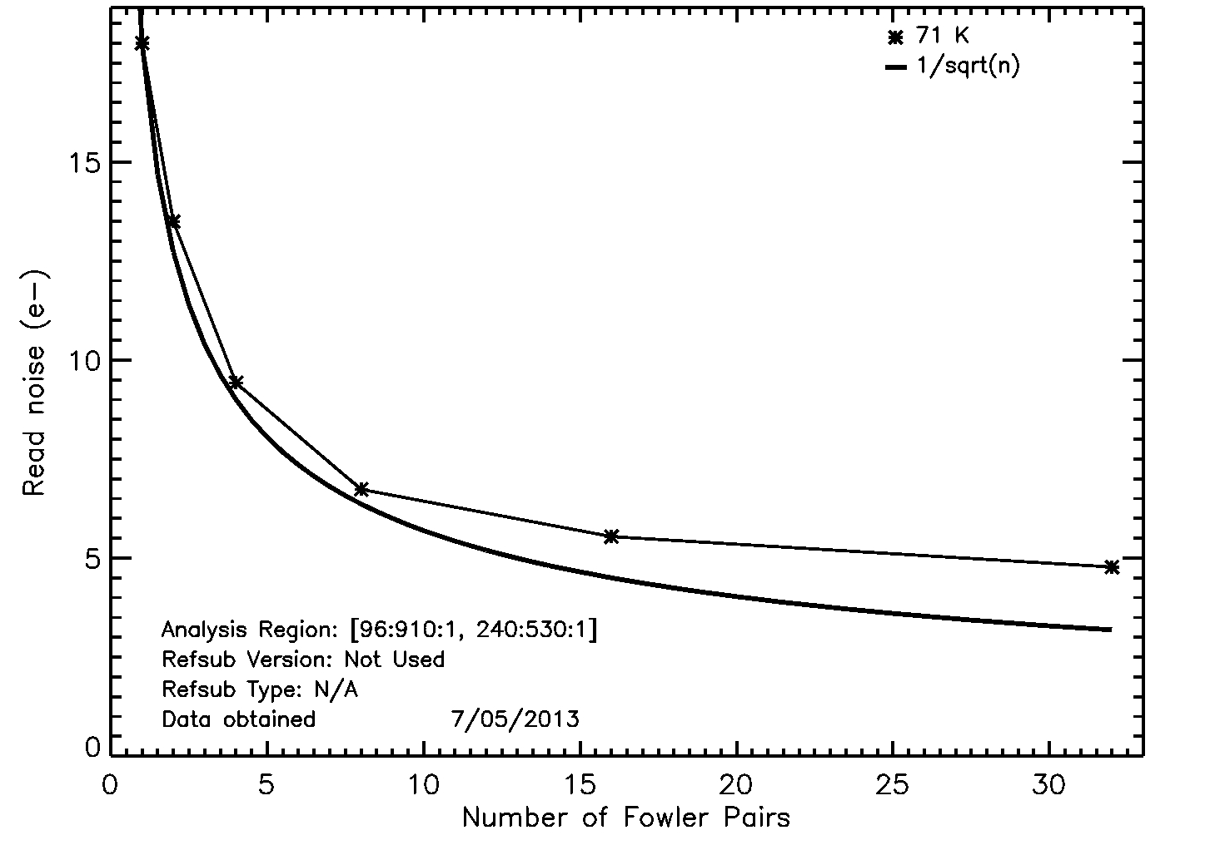
Virgo-14 Read Noise
18 e⁻ read noise CDS
5.5 e⁻ read noise Fowler-16
Noise may be improved with bias noise reduction

Slide 11
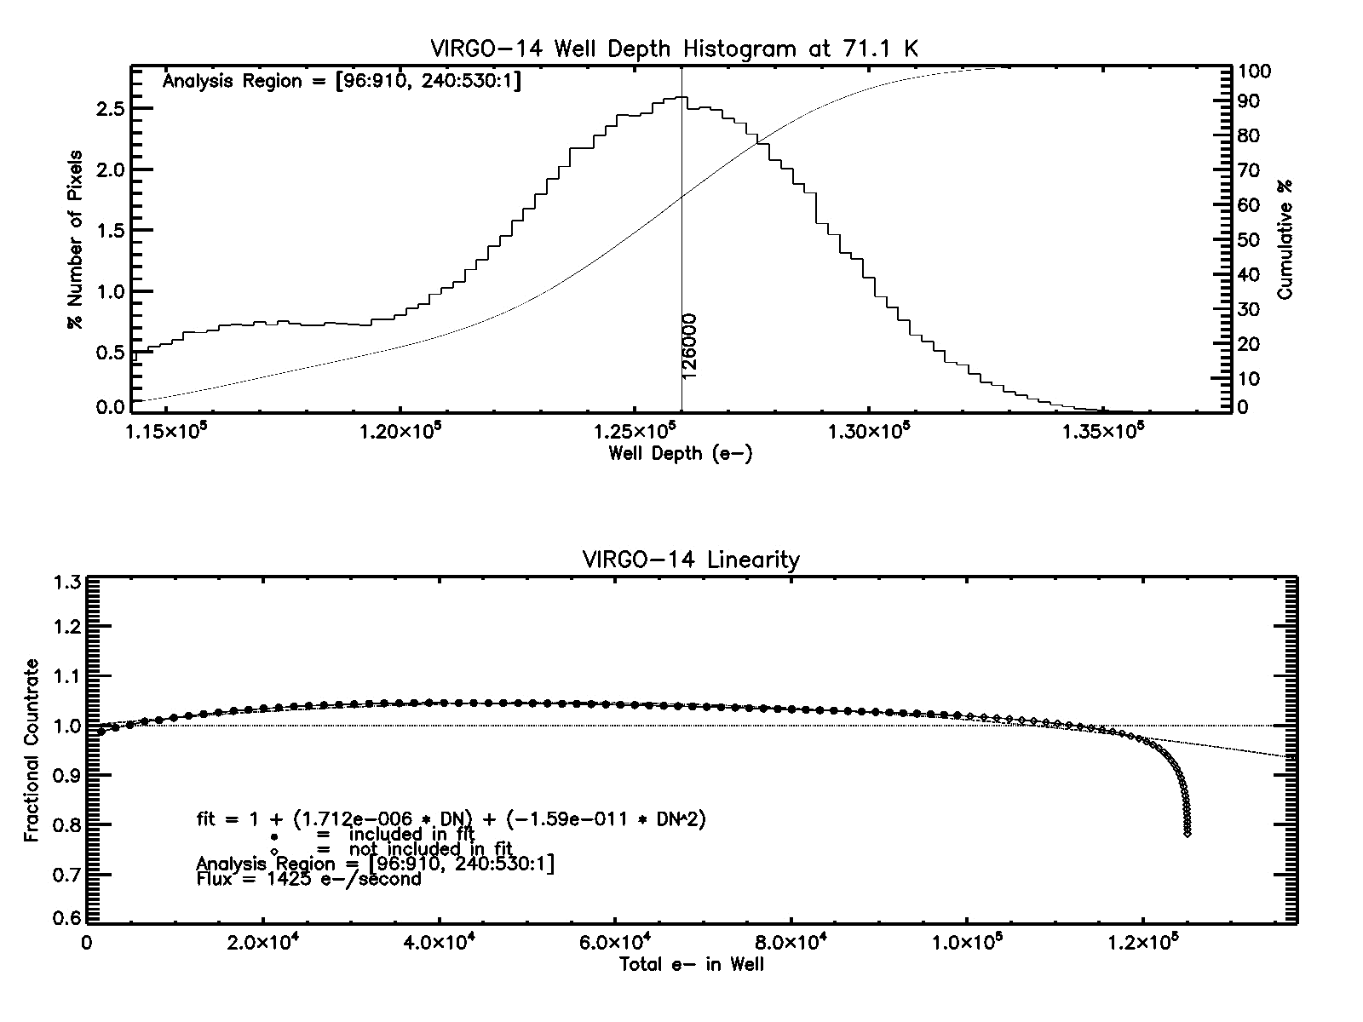
Virgo-14 Well Depth, Non-linearity, and Gain
Well depth: 126 K e⁻
Non-linearity terms:
  a = 1.712E-6
  b = -1.59E-11

Slide 12
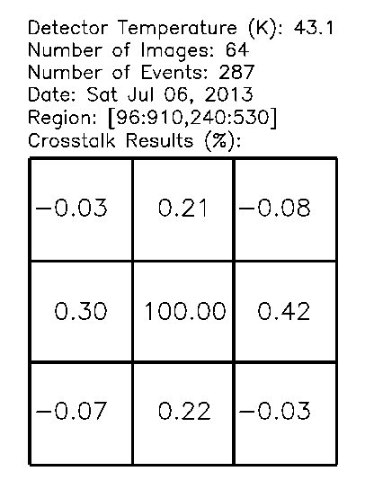
Virgo-14 Crosstalk
H2RG-015-5.0µm
VIRGO-14-4.9µm
SB304-008-5.0µm
Asymmetric crosstalk due to incomplete settling
Crosstalk measured using cosmic rays in dark exposures
3 x 3 grid shows crosstalk in nearest neighbors around central hit
Results given in percentage of hit signal

Slide 13
Virgo-14 Dark Current
.02 e⁻/s/pixel
Virgo-14 produced for a previous RVS project
Device being used as benchmark to compare future devices against
Currently measuring QE and validating 4.9 µm cut-off

Slide 14
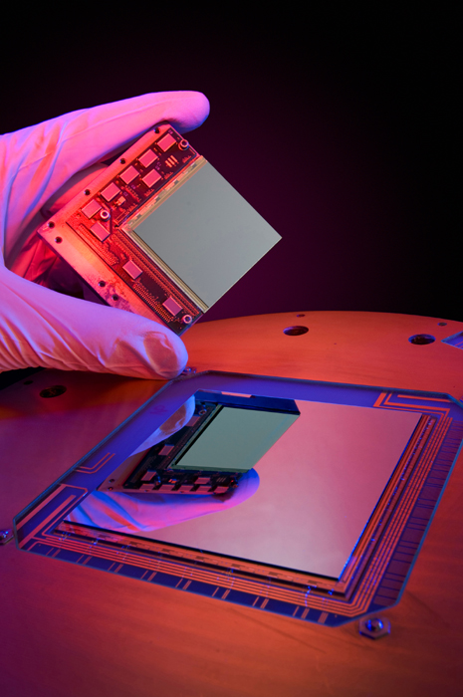
Going Forward
Project Milestones:
  Characterize VUC detectors
  Characterize substrate removed VUC detectors
  Select pixel design using VUC detector performance
  Fabricate and characterize 2K x 2K substrate removed MBE HgCdTe/Si device
Long term goals for MBE HgCdTe/Si process:
  Scale design to 4K x 4K and 8K x 8K
  Reduce pixel pitch

Slide 15


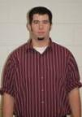
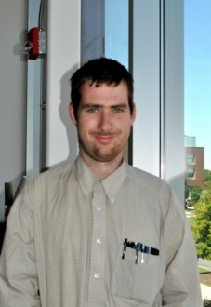
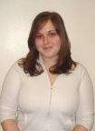
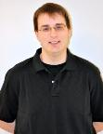
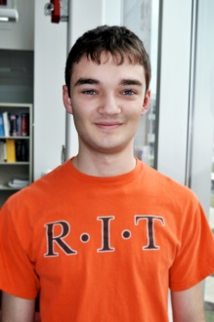
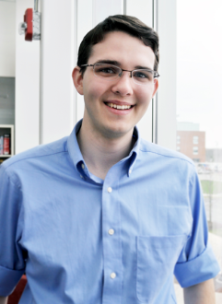
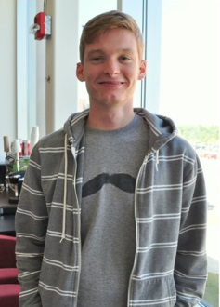
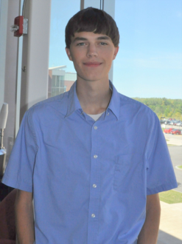
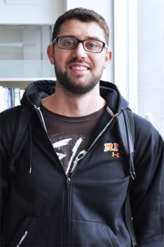
CfD Personnel
Don Figer
Joong Lee
Brandon Hanold
Iain Marcuson
Kim Kolb
P.I.
Engineer
Engineer
Engineer
PhD, IS
Matt Davis
Mike Every
Jon Zimmermann
Zach Mink
Kenneth Bean
Mike Shaw
MS, EE
BS, Physics
MS, EE
BS, EE
BS, ME
BS, EET
Notes:
15

Slide 16
Thank you for your attention.
Questions?

