Slide 1
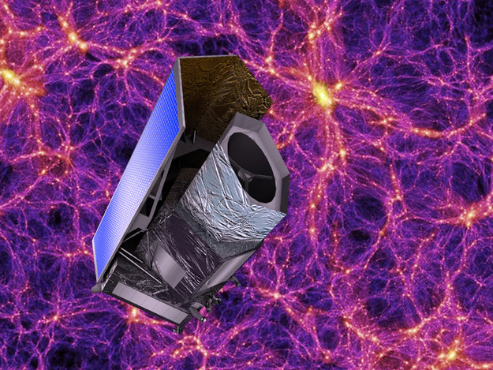
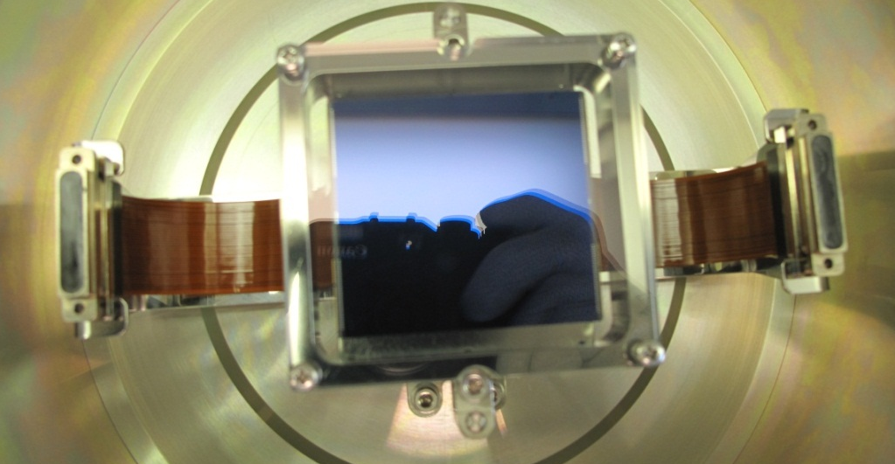
Characterisation of CCDs for the EUCLID VIS channel
Peter Verhoeve, Thibaut Prod’homme, Nathalie Boudin
Payload Technology Validation Section
Future Missions Preparation Office
Directorate of Science and Robotic Exploration of the European Space Agency

Slide 2
OUTLINE
The EUCLID mission and our role
EUCLID VIS CCD description
Pre-irradiation Characterisation
Irradiation and post-irradiation characterisation
Tests to come
Summary

Slide 3
Euclid (ref. [1]) : ESA mission to map the geometry of the dark Universe
Using two cosmological probes, namely Weak Lensing and Baryonic Acoustic Oscillations
1.2m diameter telescope with two focal plane instruments provided by the Euclid Mission Consortium:
Near-infrared spectrometer-photometer (NISP) (ref. [2]),
Visual imager (VIS) (ref. [3]) :
  will be used to measure the shapes of galaxies in one single wide visual band (550-920 nm)
  focal plane array of 36 back-illuminated CCDs (4k×4k pixels each) with 0.101 arcsec pixel platescale, giving a geometric field of 0.55 deg²
With the weak lensing technique, the mass distribution of the lensing structures can be traced back
Originally baselined CCDs were e2v CCD203-82.
Following the results from a dedicated CCD devices.
EUCLID
ESA survey mission to map the geometry of the
dark Universe
Using two cosmological probes:
Weak Lensing + Baryonic Acoustic Oscillations
launch 2020, L2 orbit, 6yr nominal mission
1.2m diameter telescope with two focal plane instruments provided by the Euclid Mission Consortium:
  Near-infrared spectrometer-photometer (NISP),
  Visual imager (VIS):
    will be used to measure the shapes of galaxies in one single wide visual band (550-920 nm)
    focal plane array of 36 back-illuminated CCDs (4k×4k pixels each) with 0.1 arcsec pixel plate scale, for a geometric field of 0.55 deg²
With the weak lensing technique, the mass distribution of the lensing structures can be traced back
Euclid requires the accuracy with which the shape of the galaxies is to be measured is 1%.
The radiation damage effects will compromise this accuracy, and thus need to be characterized.

Slide 4
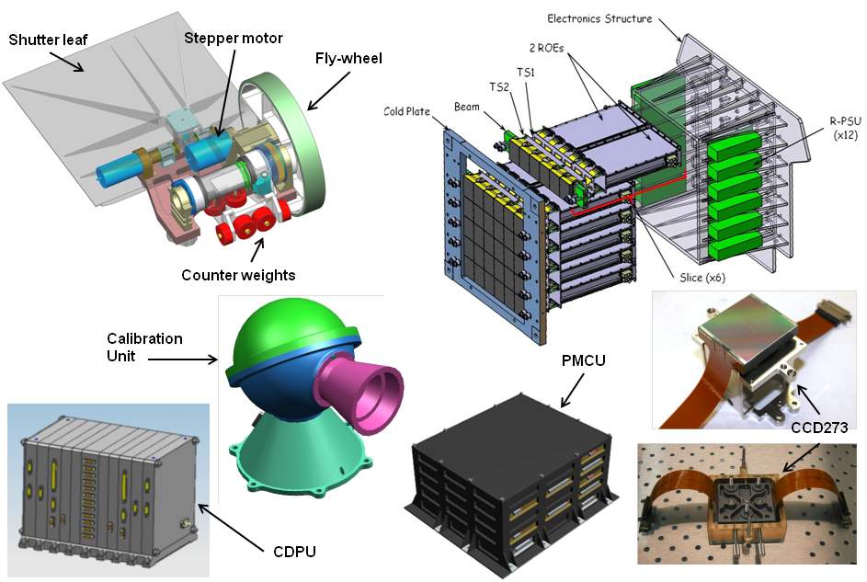
The EUCLID VIS intrument
Courtesy EUCLID Consortium/VIS

Slide 5
Motivation
ESA has run a contract for the pre-development of the CCDs during the EUCLID definition phase and ESA is responsible for the procurement of the flight CCDs for the EUCLID VIS instrument
A CCD test bench was developed in the Payload Technology Validation section (old SRE-FI) during the pre-development phase in support of the definition phase
The ESA Euclid project team uses now the now fully operational facility to:
    - verify other test results produced in the flight production phase
    - support the EUCLID VIS consortium in case of issues.
This work:
  Characterise a representative CCD, pre- and post- proton-irradiation
  In particular, try to quantify the change in the measured shape of galaxies due to radiation damage
  Compare with/feed into simulations and corrective models

Slide 6
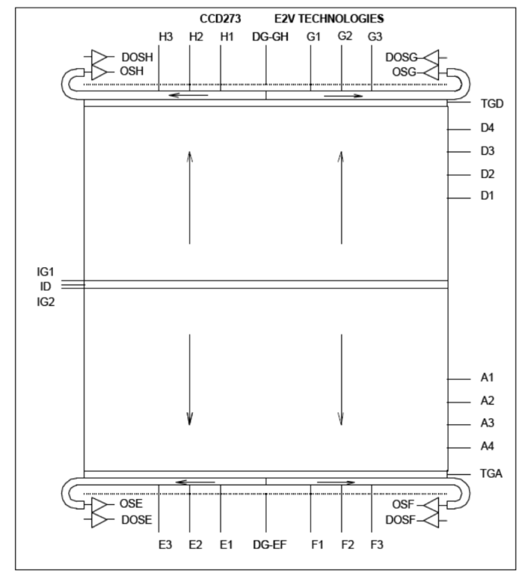

CCD description: CCD273
The CCD273 is developed for EUCLID-VIS based on existing CCD203 (e2v Technologies)
4kx4k format (5x5 cm²)
12x12 micron pixel size
4 high-responsivity, low-noise read-out circuits
high-res silicon, back-thinned to 40 micron
Thin gate dielectric process
Image section split in two, with charge injection structure in the middle
Reduced register width for rad-hardness
AR coated
SiC package
Specification:
Amp responsivity 6-8 µV/e-
Read noise <3.6 e-rms @70 kHz
FWC >175ke-
CTI <5e-6
Dark signal <6e-4 e-/s/pixel @ 153K

Slide 7
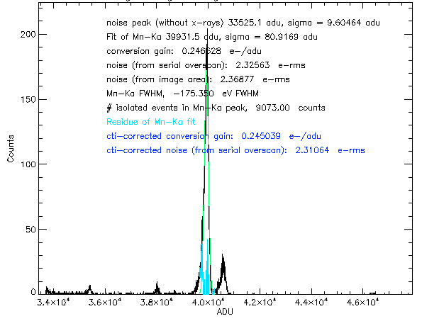
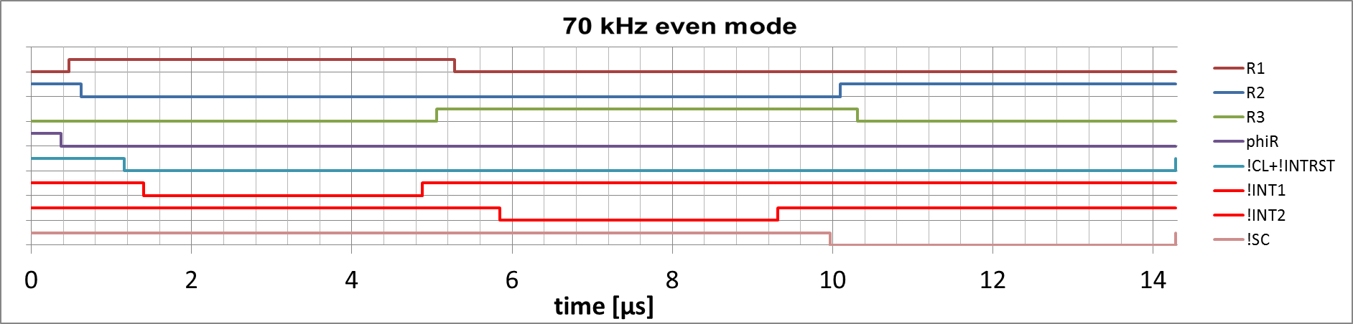
Noise and conversion gain
DN to electron conversion from 55Fe spectra (Mn-Ka 5.9 keV yields 1580 e- @153K)
CDS (Dual Slope Integration), 3.4 µs integration time
70 kHz pixel rate (14.3 µs pixel time)

Slide 8
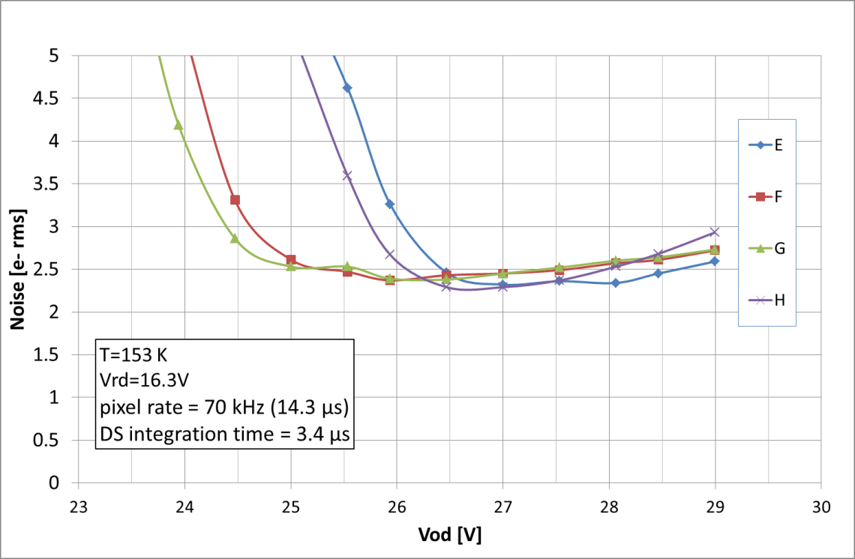
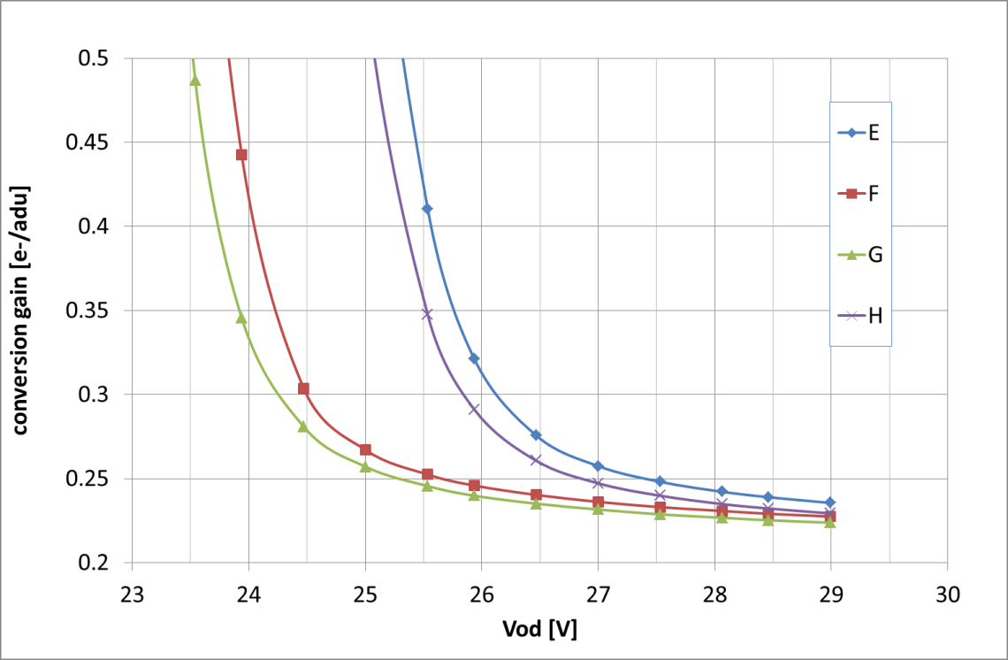
Noise and conversion gain
Noise 2.5 e- rms @ Vod =27.0 V, 70 kHz pixel rate
For all 4 amplifiers

Slide 9
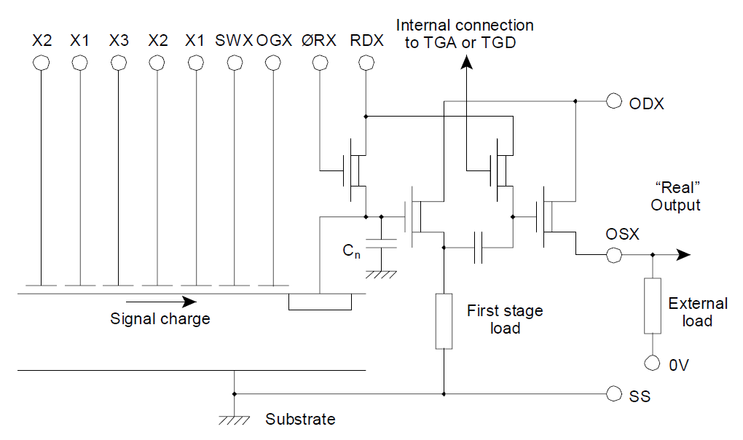
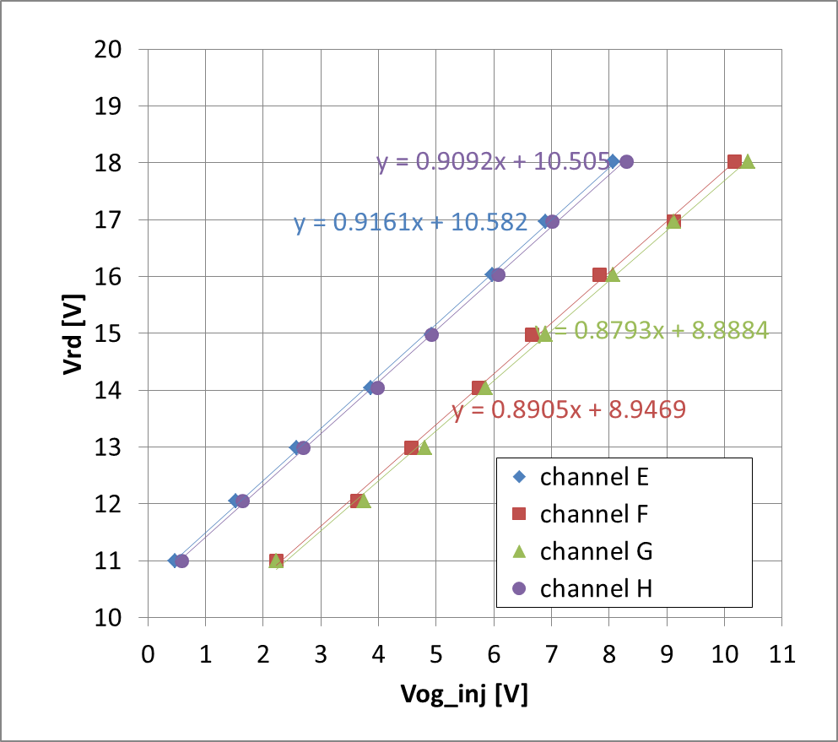
Channel parameter
~1.7 V difference in channel parameter between left and right EH: 10.6V
FG: 8.9V
Resistivity = 0.90
The cause of the variation of the channel potential has been traced and eliminated @e2v

Slide 10
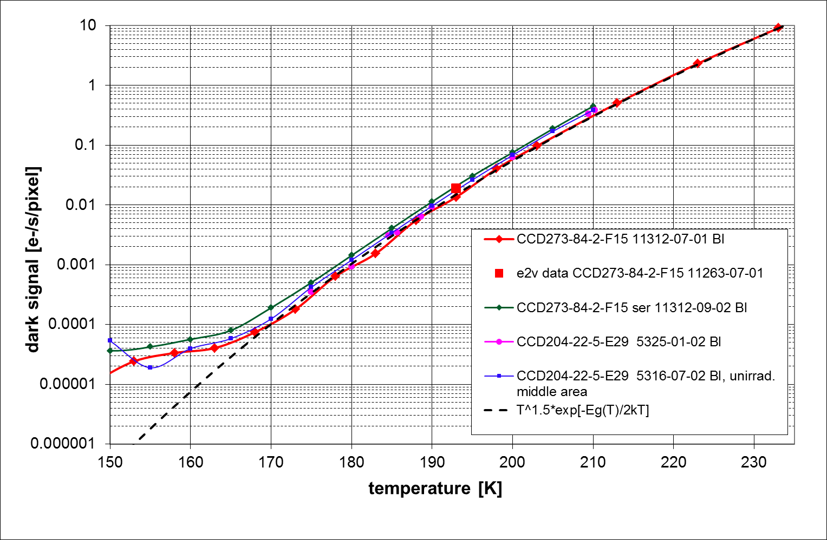
Dark current
Measured with:
  - 10x line binning
  - 0-3000s integration time
Thermal down to 170K
<10⁻⁴ e-/s/pixel @ 153K

Slide 11
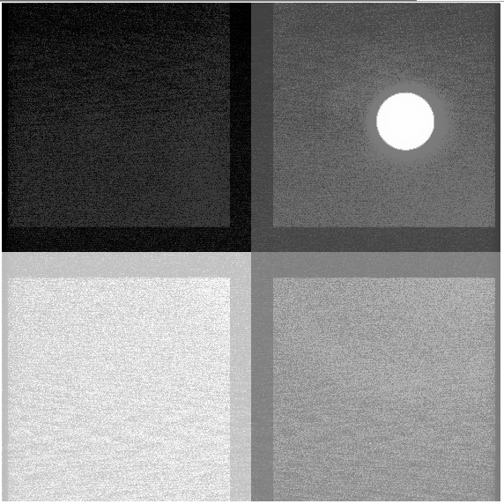
Set-up for monochromatic illumination
(uniform or spot)
Adjust.
Slit Δλ=
2-20nm
grating
Monochromator
λ=200-1060nm
Program-
mable
shutter
Light source
(Xe, 100 W)
Light tight enclosure
Straylight
screen
CCD
Dewar
Integrating
Sphere
Oriel 70401
RD1 movable
Abs. int. mapping
RD2 fixed
Rel. int. monitor
AR coated
Fused silica
window
Source
aperture
aperture
Photodiode
CCD

Slide 12
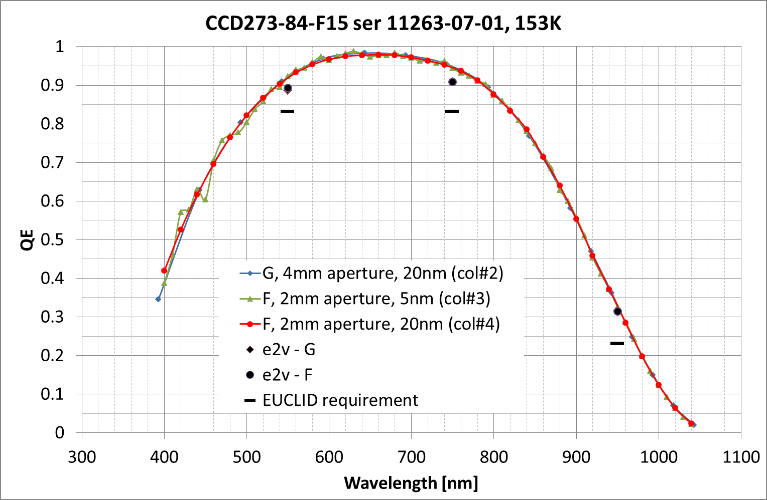
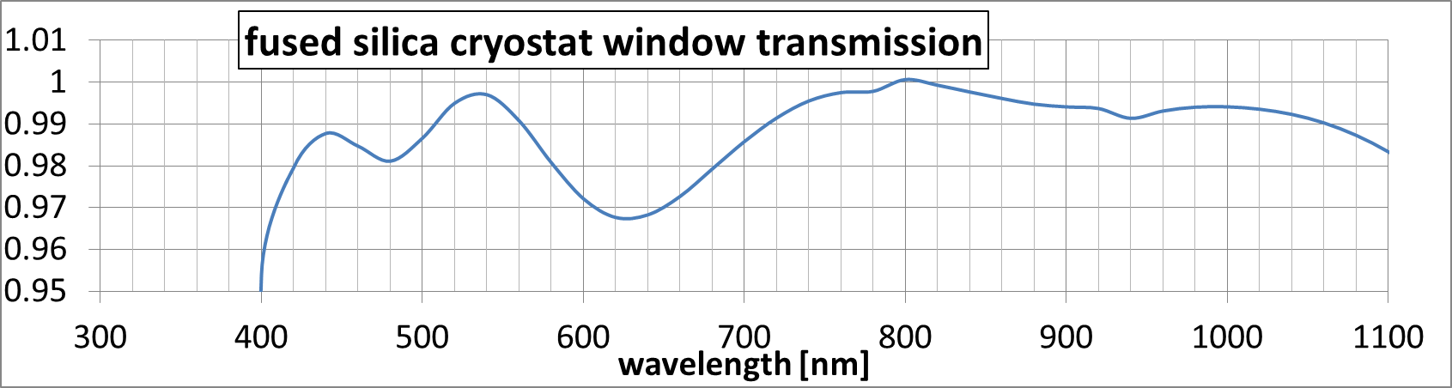
Quantum Efficiency
Measured QE ~3% above e2v measurements
Estimated uncertainty ~3%

Slide 13
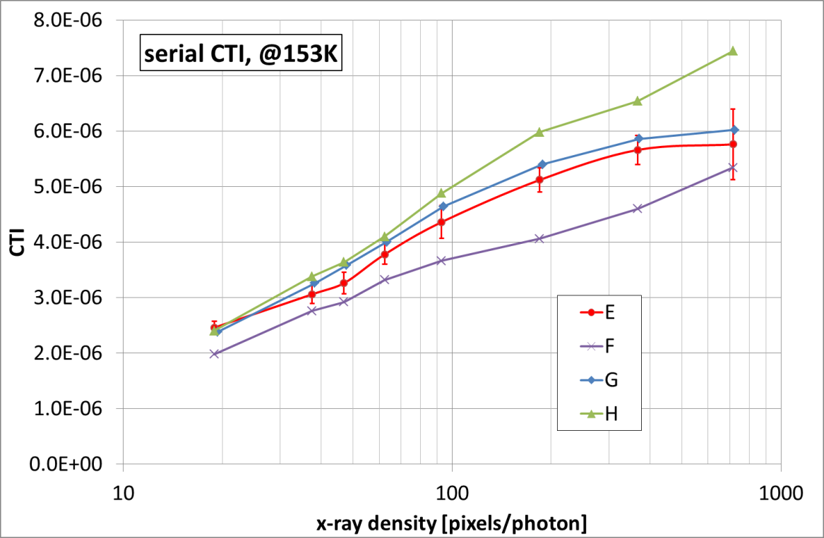
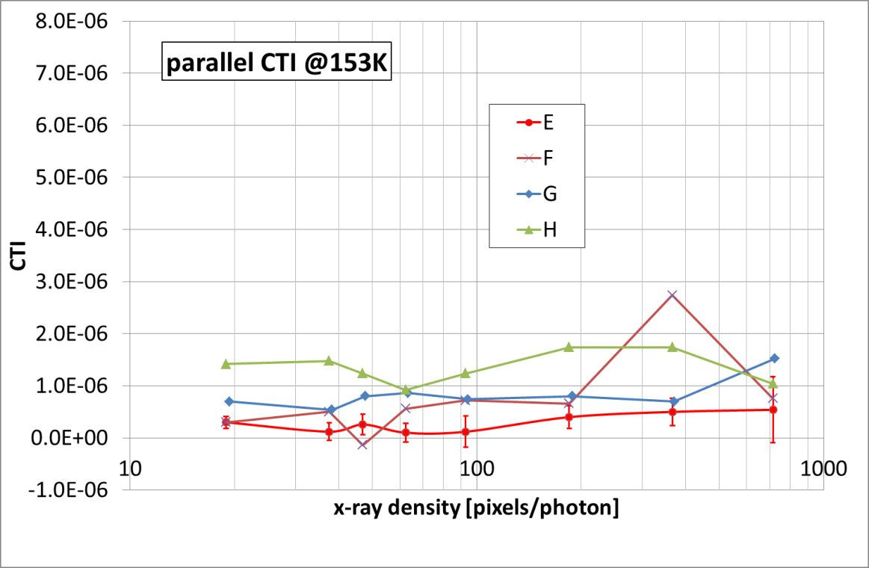
Charge transfer inefficiency (CTI)
from x-ray illumination (55Fe, 5.9 keV):
CTI at 153K
@ T=153K, 80 pixels/photon:
serial CTI =4.0ˑ10⁻⁶ parallel CTI =~1.0ˑ10⁻⁶

Slide 14
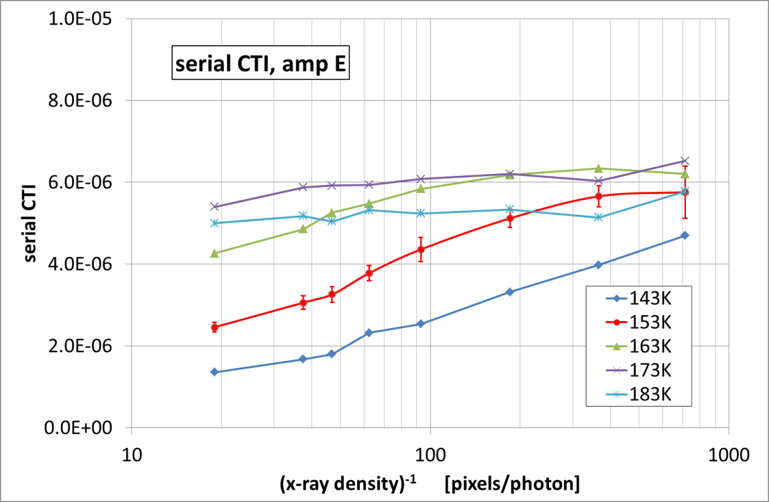
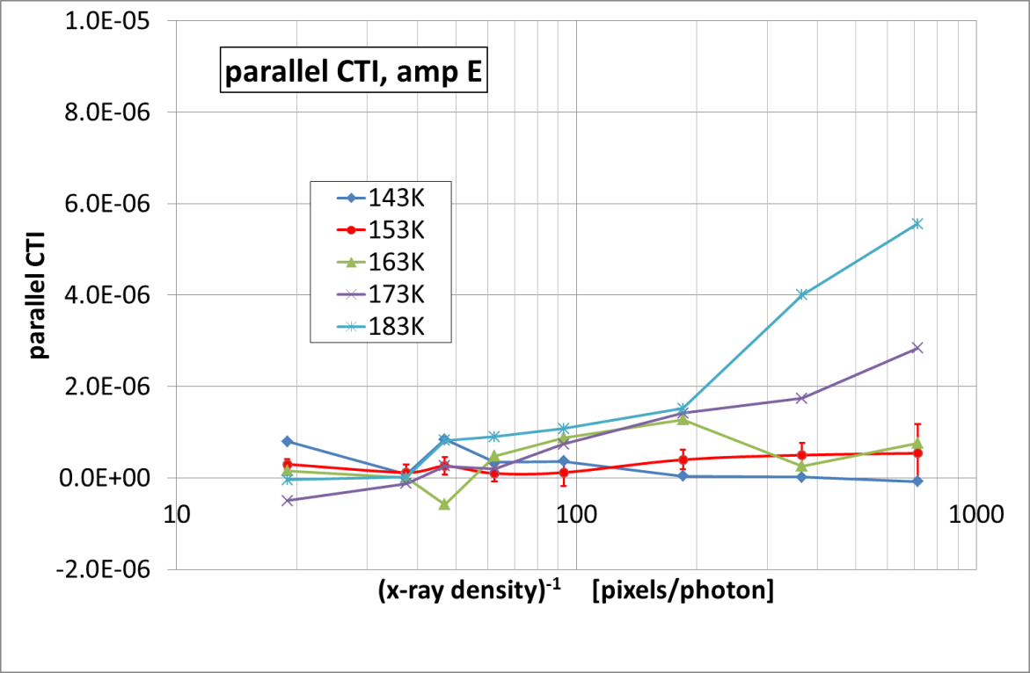
Charge transfer inefficiency (CTI)
from x-ray illumination (55Fe, 5.9 keV):
CTI vs temperature
@ 80 pixels/photon:
serial CTI: better at lower T parallel CTI: no measurable T dependence

Slide 15
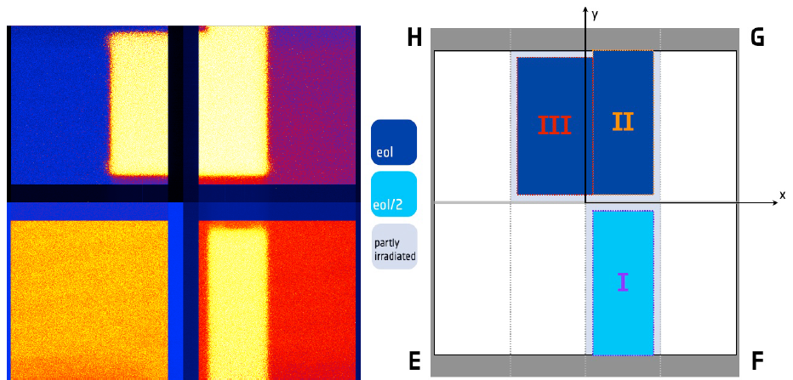
Proton Irradiation at the KVI accelerator
Groningen, Netherlands
CCD at ambient temperature, unbiased
10 MeV protons, flux 9.0 10⁶ p+ cm⁻² s⁻¹
1st illumination: Region I: 2.40 10⁹ p+ cm⁻².
2nd illumination: Region II+III: 4.80 10⁹ p+ cm⁻² (= predicted EUCLID EOL dose)
Dark image at 243K

Slide 16
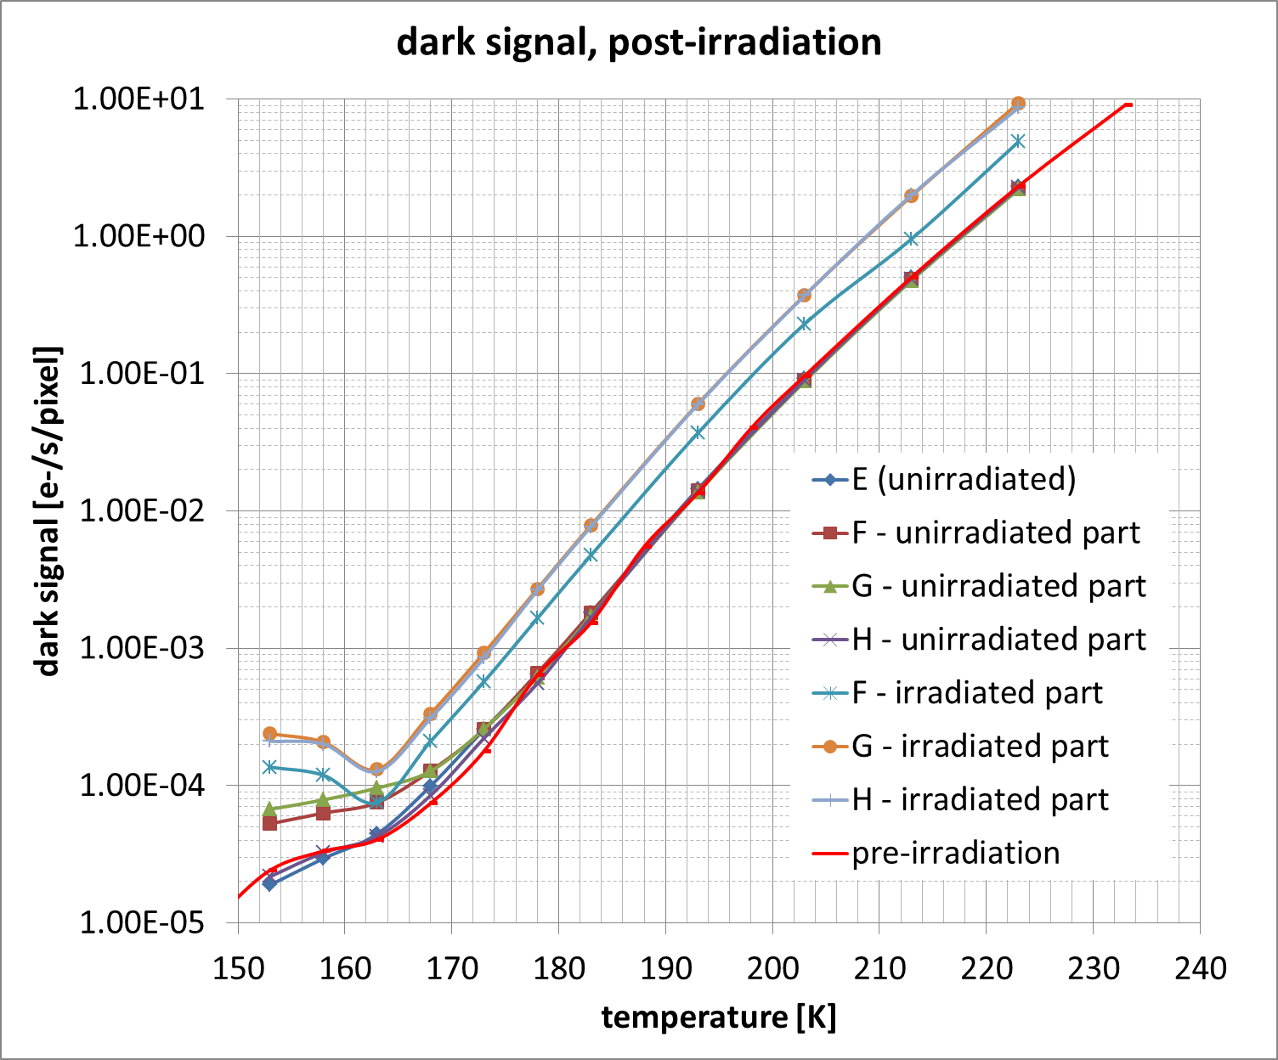
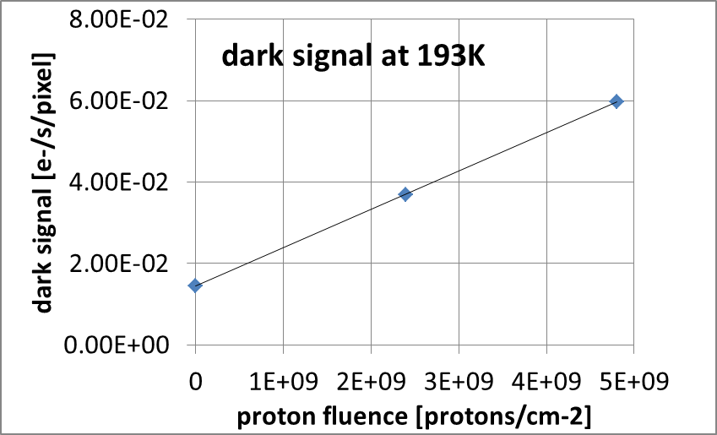
Dark signal, post-irradiation

Slide 17
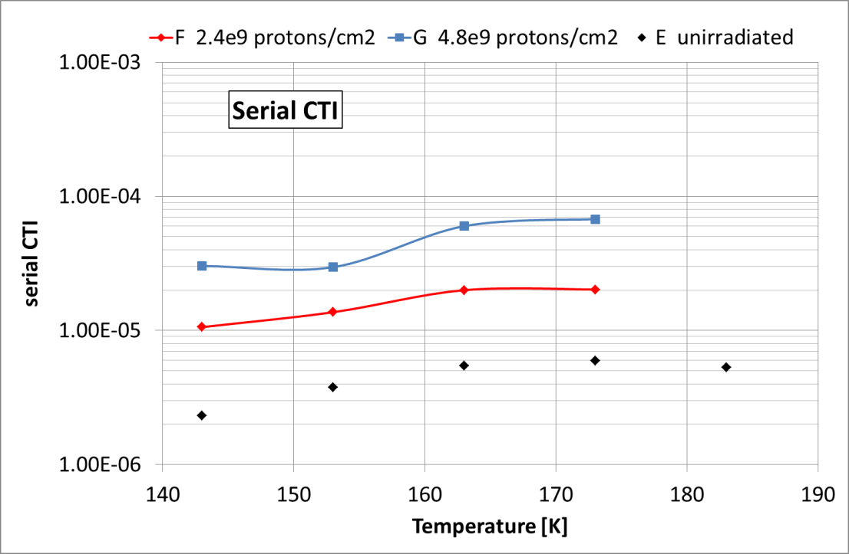
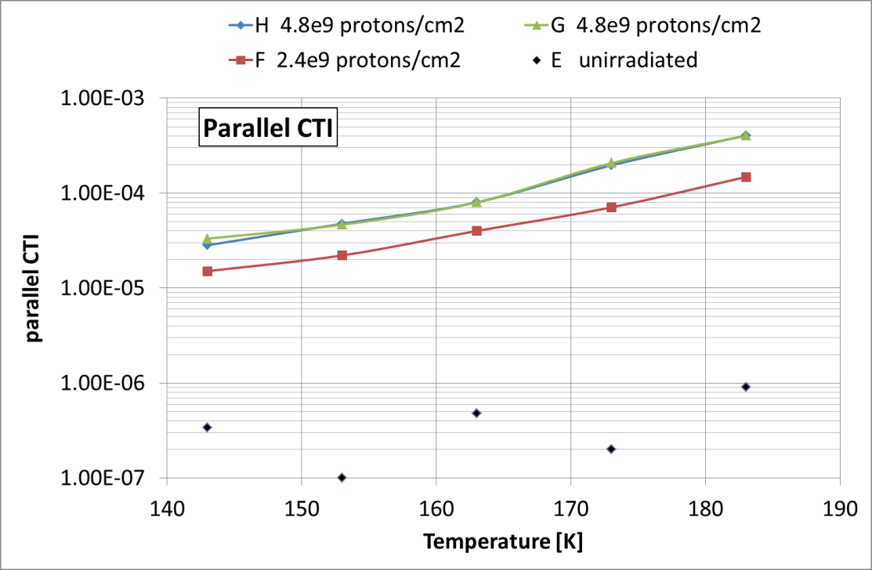
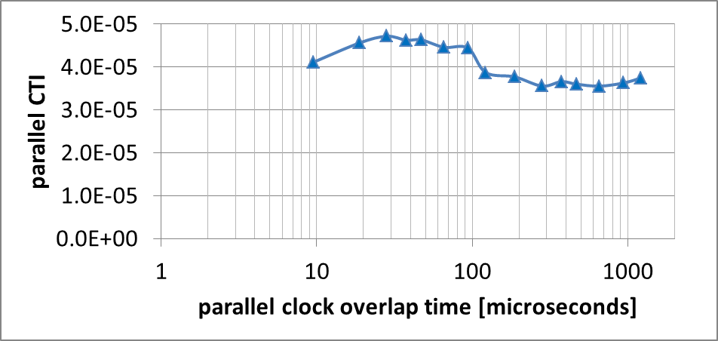
Charge transfer inefficiency (CTI)
from x-ray illumination (55Fe, 5.9 keV)
Post-irradiation
Optimum temperature ~150K
(EUCLID ~153K)
Cf N. Murray, Proc. of SPIE Vol. 8453 845317-2

Slide 18
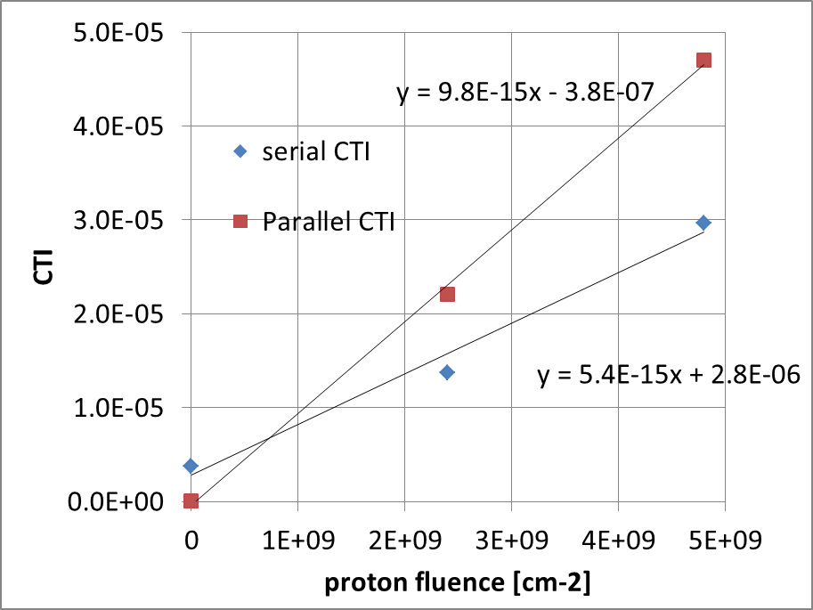
Charge transfer inefficiency (CTI)
Radiation Damage constants
Radiation damage constants
(@ 153K, 70 kHz, ~70 pixels/5.9keV photon)
ΔCTI/(10 MeV proton fluence) =
Serial: 5.4e-15
Parallel: 9.8e-15
Cf CEI, OU (FI, @160K, 200 kHz):
Serial: 3.9e-15
Parallel: 11.0e-15

Slide 19
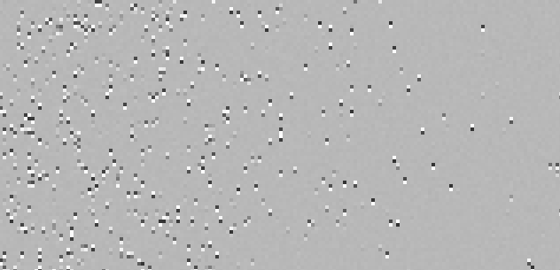
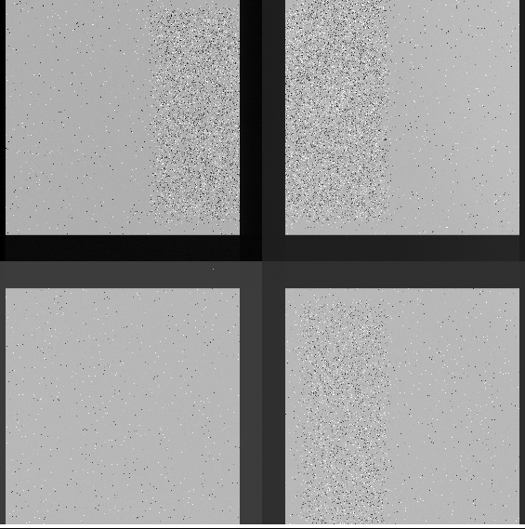
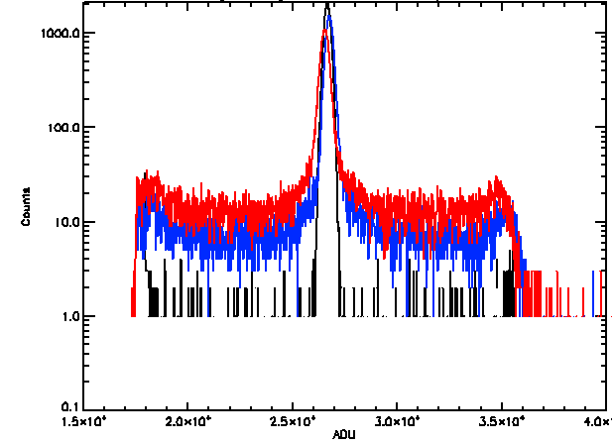
Trap Pumping
Flat field illumination ~4500 e-
Followed by ~4000 pairs of forward and backward line shifts reveals traps
Proposed as in orbit calibration tool for EUCLID-VIS
(N. Murray, Proc. of SPIE Vol. 8453 845317-2)

Slide 20
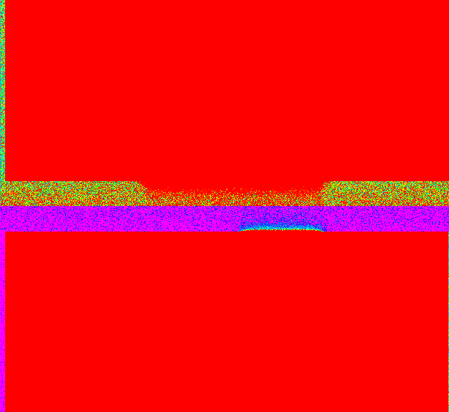
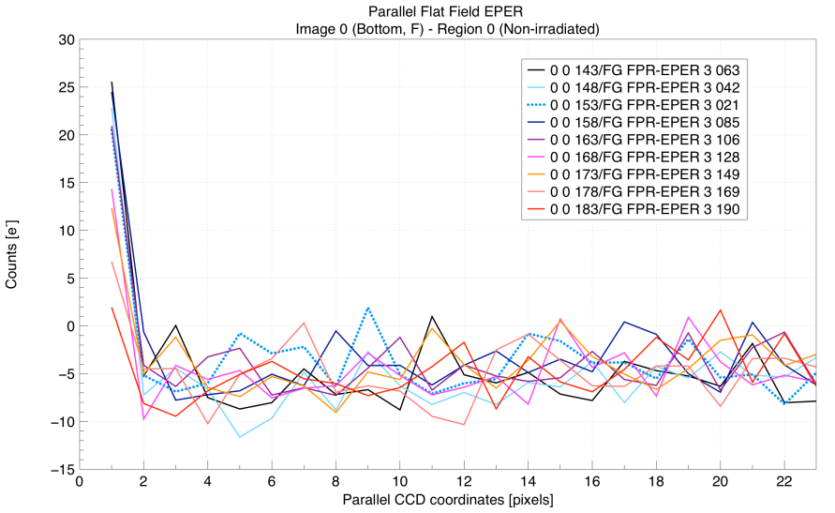
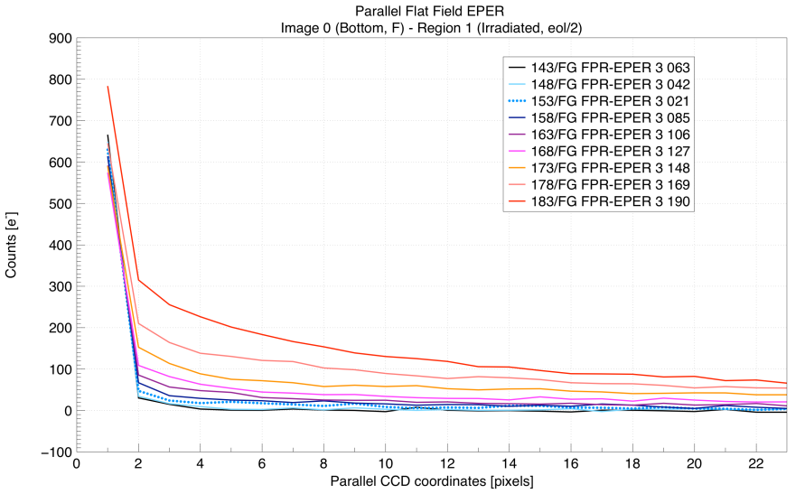
CTI from Extended Pixel Edge Response
(EPER) at uniform illumination
EPER data to be used for comparison with charge loss models
T

Slide 21
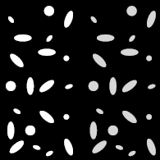
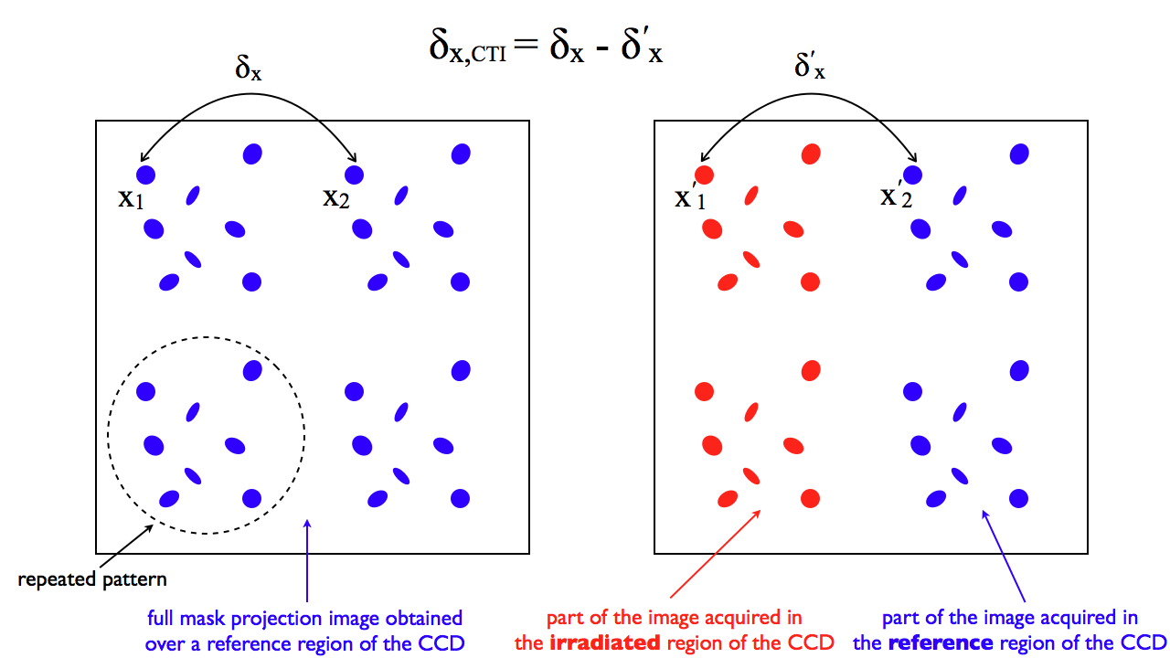
Next step: the ultimate experiment for EUCLID
Project a sky scene of stars and Galaxies on different sections of the CCD
Measure the shape of the galaxies in EUCLID observables
Determine the change in shape for different levels of irradiation

Slide 22
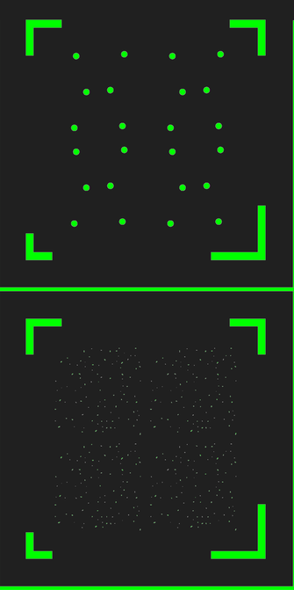

Next step: the ultimate experiment
Lithographic mask
Bright stars + galaxies
Galaxies in different shapes, sizes and orientations
~400 galaxies and 24 stars
Average distance between objects ~100 pixels
Mask just arrived
Testing in next few months
5x5mm

Slide 23
Summary
We have characterised a EUCLID prototype back-illuminated CCD273
We have irradiated this CCD with 10 MeV protons up to the expected End Of Life Dose of 4.8e9 protons/cm²
The observed increase in Charge Transfer Inefficiency (5.9 keV photons, ~60 pixels/photon) corresponds to:
  1.0e-5 per 1e9 protons/cm² for parallel transfer
  0.5e-5 per 1e9 protons/cm² for serial transfer
  In good agreement with results on a front-illuminated device (Centre for Electronic Imaging, Open University, UK)
Next step is to measure the radiation induced changes in the shape of projected elliptical galaxies (in EUCLID observables)

