Slide 1
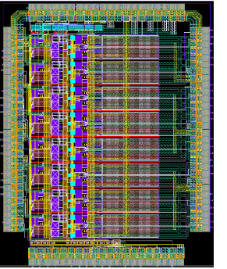
ASICs development (expensive and long )
&
ASICs production (cheap and quick)
Example : ASPIC
(CCD signal processing)

Slide 2
ASPIC I (2007-2008) : test ideas / validate concept :
2 different CDS implementations ( Clamp and sample & Dual slope integration )
Demonstrate Xtalk between channels at ~ 10⁻⁴ level (usual xtalk ~ % level in ASICs)
Qualify simulation ( DSI not so trivial to enter , equivalent model … )
“No features / no real programmable functionalities “ / test the basic
R&D started in late winter 2007 , end of the chip characterization/study summer 2008 . ( 18 months), 1.2 FTE ASIC designer (3 involved), 5 FTE test/req (controller FPGA based + qualification setup allowing fraction of electron / 10⁻⁵ xtalk study + feedback to design )
Prototype cost : 25 chips for ~10 k€, total cost (with FTE) ~ 450 k€ / 600 k$
ASPIC II (2008-2009) : implement a chip close to final configuration / specification
better noise ➔ at 550 kHz readout : 4.8 μV (-100º C) / 5.9 μV (room T) – gain 6
add key functionalities (programmable gain & integration time )
R&D started fall 2008 , chip “qualified” December 2009 : same time/20% less FTE
ASPIC III (2012-2013) : Final requirements & full functionalities
include electronic / CCD diagnostic capabilities ( imbedded ASIC designer with CCD guys)
Extend the ASIC config to # CCD ( gain 1.6 – 6.6 , integration 250 ns – 4 μs )
same time ( started sep 2012) / same cost : we just received the chip .
ASPIC Production estimate :
1000 chips ( 8000 video channels ) : 50 € per chip/ < 7 € per video channel
3900 chips ( 31 k video channels) : 25 € per chip / < 3.5 € per video channel
+ full development cost (and time) ~ 1.5 M$ .

