Slide 1

DCDS for roundtable
Paul Jorden
10 Oct 2013
Scientific Detector Workshop, Florence
e2v Matthew Bastable and others
RAL Matthew Clapp and others

Slide 2
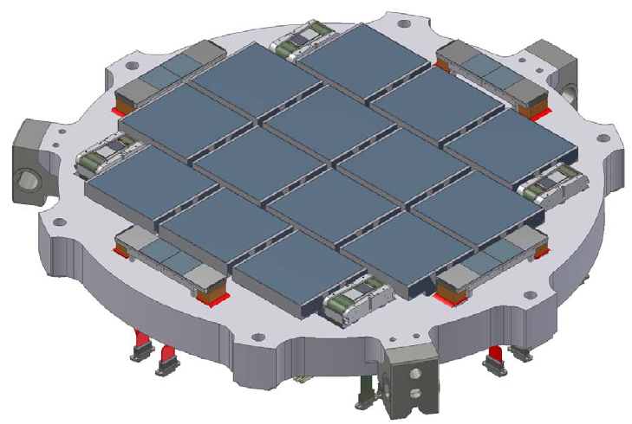
The motivation
Integrated Focal Plane Electronics
  Readout electronics for large focal plane arrays
  Prototyping a test systems using DCDS.
Digital Correlated Double Sampling (DCDS)
  Moves a significant proportion of the signal processing into the digital domain
  Minimise complexity and size of analogue electronics
JPAS focal plane 224 signal channels

Slide 3
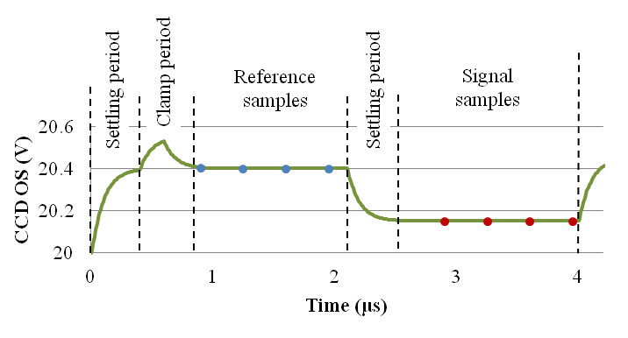
DCDS Processing
Limited to sampling the settled output voltage
Sample frequency/pixel frequency > 14
  16-bit accuracy
  System bandwidth at ADC nyquist frequency
  10% clamp period

Slide 4
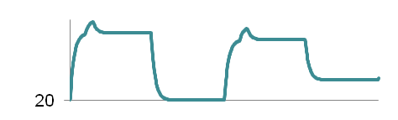
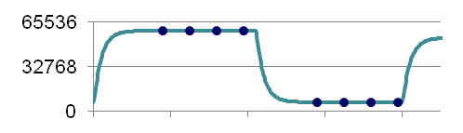
Video Chain
Digital Correlated Double Sampling (DCDS)
Analogue
Digital
CCD
Video signal conditioning
OS
OversamplingADC
DCDS
Video Data
DOS
DC restore
Anti-alias filter
Single ended to differential
Remove reset feed-through
Digital low pass filter
Correlated double sampling
ADC output (ADU)
Reference samples (r_{i})
CCD OS
20V
Signal samples (s_{i})

Slide 5
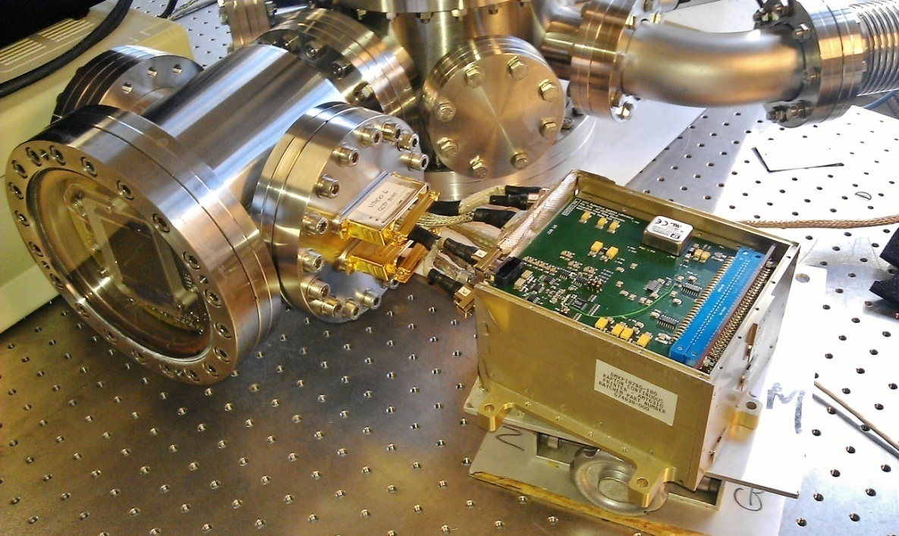
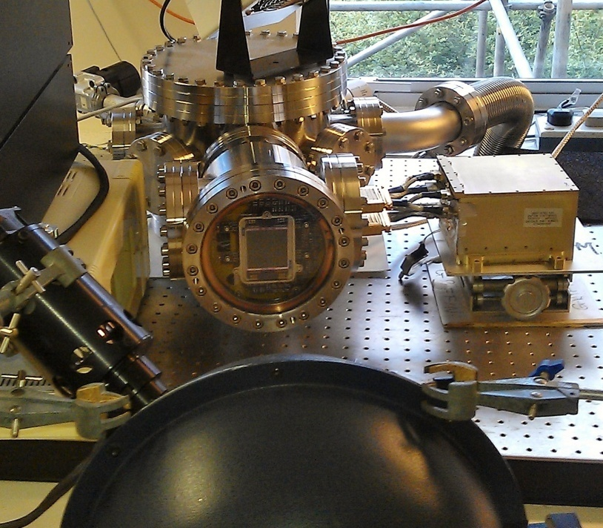
DCDS Prototype
DCDS
Video Card
CCD203
SDO CEB

Slide 6
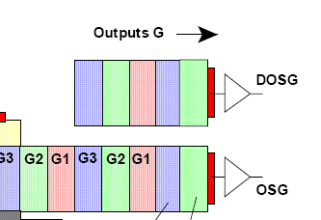
Concept for J-PAS
Use differential signals for best common-mode noise rejection
Get √2 noise increase
Use DCDS for optimal noise of system
  100 MHZ sampling frequency; 500 kHz pixel rate
  DCDS better than analogue CDS and recovers some of the loss of differential mode.
References
Clapp SPIE 2012, 8453-49 DCDS
Jorden et al. SPIE 2012, 8453-20. J-PAS

