Slide 1
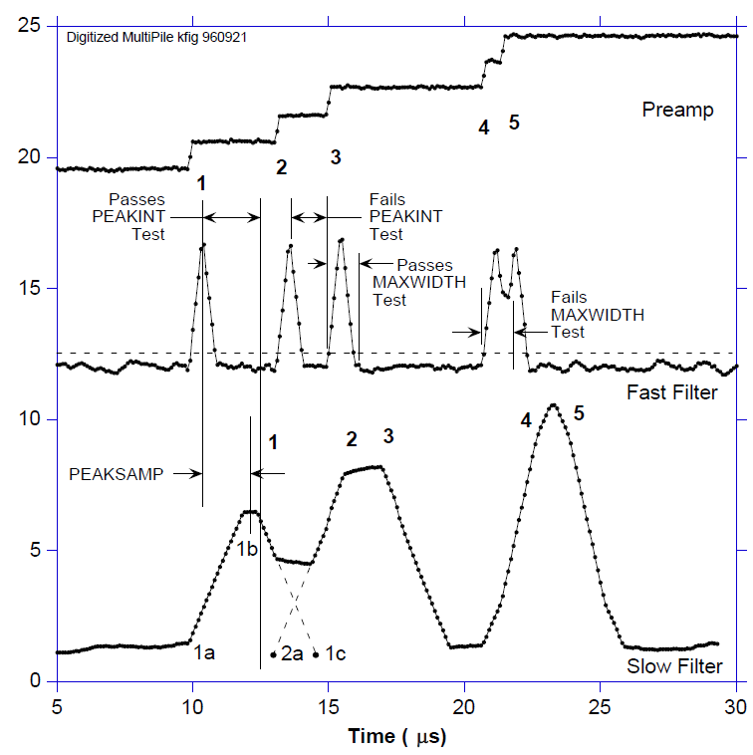
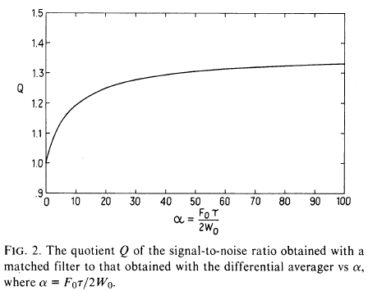
DCDS pros and cons
Paul O’Connor 10/10/13
“Digital CDS” is a special case of digital filtering, which has been used for a long time in a wide range of research instrumentation to approach optimal filtering, or to apply multiple filters to the same digitized waveform, or to implement time-adaptive filters:
  W. Cleland, E. Stern, “Signal processing considerations for liquid ionization calorimeters in a high rate environment”, Nucl. Instrum. Methods A338, 467(1994)
  W. Warburton et al., “Digital pulse processing: new possibilities in nuclear spectroscopy”, Appl. Rad.Isotopes 53(4), 913 (2000)
It is well established that the simple differential averager (SDA) is the optimal filter for detecting a step signal in the presence of white noise;
  D. Hegyi, A. Burrows, AJ85(10), 1980
  G. Hopkinson, D. Lumb, J. Phys. E15,1214(1982)
When 1/f noise is significant, the shape of the optimal filter changes but SDA remains near-optimal.
The SDA is easily implemented in the analog domain (dual-slope integrator).
DCDS advantage only when noise is non-white and pixel rate is low.
πt_{p}f_{c}/2
1

Slide 2
Experimental study
A nice study of DCDS was done at RAL and reported in last year’s SPIE meeting:
  M. Clapp, “Development of a test system for the characterisation of DCDS CCD readout techniques”, Proc. of SPIE Vol. 8453, 84531D (2012)
where it is shown that:
  For 16-bit system minimum sampling frequency is 14X pixel frequency
  Measurements of the e2V CCD203 at 100kpix/s and 60MSa/s using a variety of weight functions showed no improvement over equal-weighted samples (same as SDA)
Assertion:
  Highly-oversampled DCDS systems incur power dissipation penalty compared to analog CDS.
increasingly unequal weights →

Slide 3
