Slide 1
Focal Plane Electronics Round Table
Scientific Detector Workshop 2013
Florence, Italy
10 October 2013
Greg Bredthauer
Semiconductor Technology Associates, Inc.
27122 Paseo Espada, Suite 1004
San Juan Capistrano, CA 92675
(949) 481-1595 | greg.bredthauer@sta-inc.net

Slide 2
ADC Evolution
Controller | Year | ADC | Sample Rate (MHz) | Bits | Noise (LSB RMS) | Power (mW / Ch) | Notes
FlexCam | 2006 | AD9824 | 30 | 14 | 2.0 | 153 | Analog CDS
Firefly | 2007 | LTC2208 | 130 | 16 | 2.9 | 1500
Tapestry | 2008 | LTC2208 | 130 | 16 | 2.9 | 1500
CCTapestry | 2009 | ADS5562 | 80 | 16 | 1.4 | 865
Aura | 2009 | LTC2262 | 150 | 14 | 1.2 | 149
Reflex | 2010 | AD9268 | 125 | 16 | 2.3 | 375 | Dual
Reflex B | 2011 | AD9650 | 105 | 16 | 1.5 | 328 | Dual
Archon | 2012 | ADS5263 | 100 | 16 | 1.0 | 355 | Quad
 | 2013 | AD7960 | 5 | 18 | 1.1 | 46 | SAR

Slide 3
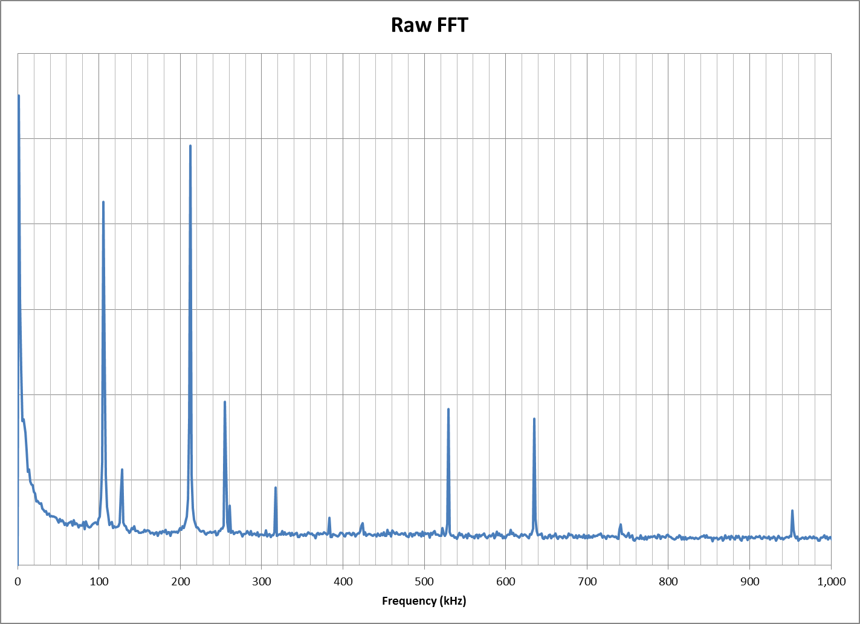
Diagnostics

Slide 4
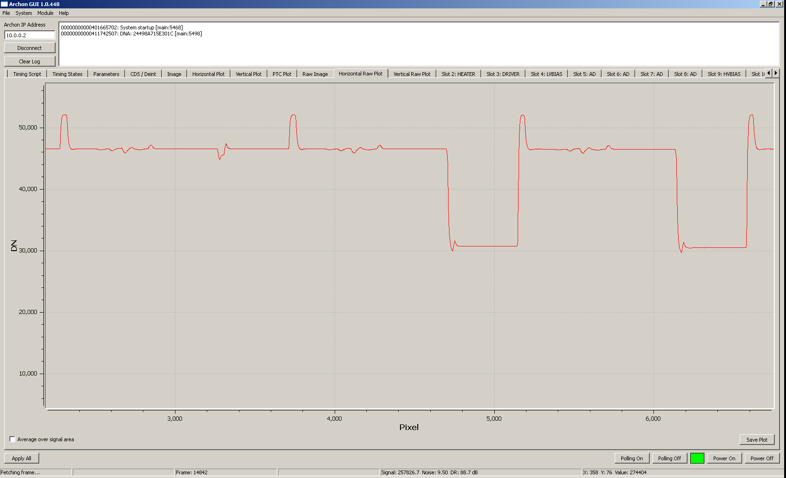
Analytic Possibilities

Slide 5
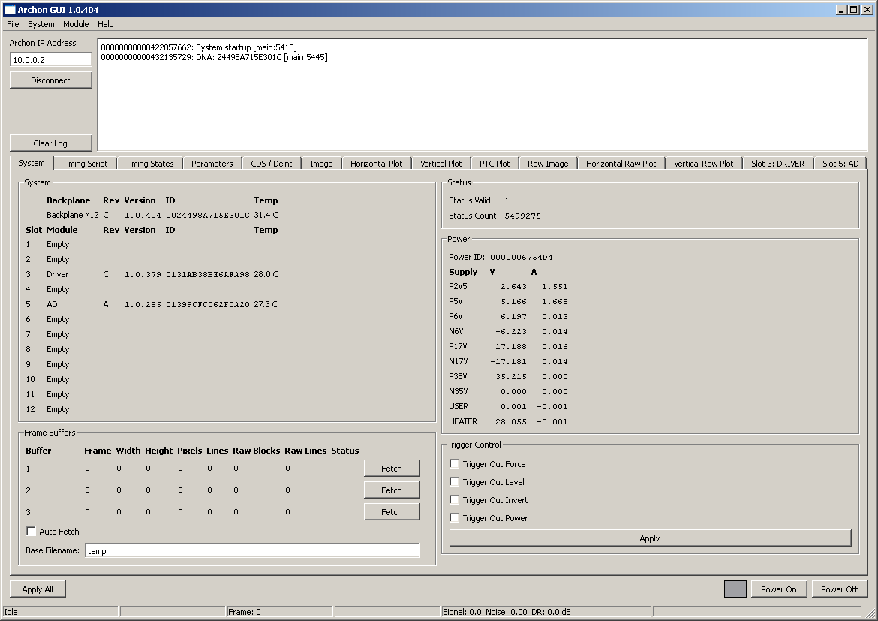
More Diagnostics

Slide 6
Digital CDS Experience
High sampling rates let you see subtle features
(How fast is the CCD output settling? Is it ringing?)
For higher frequencies (1 MHz), every extra sample averaged lowers noise, close to theory
For lower frequencies (100 kHz), balance with 1/f noise – samples prefer to be close to SW transition
Higher analog bandwidth gives faster settling, easier to avoid subtle non-linearities
ADC power falls with sample rate – use lower frequencies in production after tuning

