Slide 1
Digital Correlated Double Sampling for ZTF
Roger Smith and Stephen Kaye California Institute of Technology

Slide 2
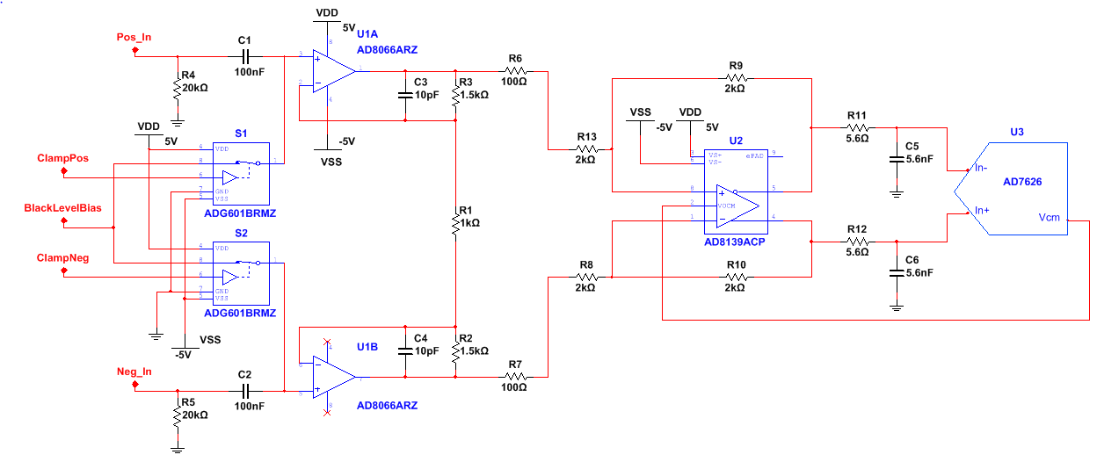
Digital CDS is very simple
Vacuum Interface Board, in Dewar
Part of Single Board CCD controller, outside telescope beam.
Twinax cable
Preamp in dewar
Simple Postamp-ADC
Serial register
Coadder
Virtex 5 FPGA
USB2
Commercial fiber optic USB extender.
Serial register
Coadder
4ch * 1 Mpixel/s * 32 bit
= 128 mbit/s
USB2 is rated at 400mbit/s.
Is 10 MHz sampling adequate at 1 Mpixel/s ?
If so, successive approximation ADC can have excellent 16 bit performance, size, power.

Slide 3
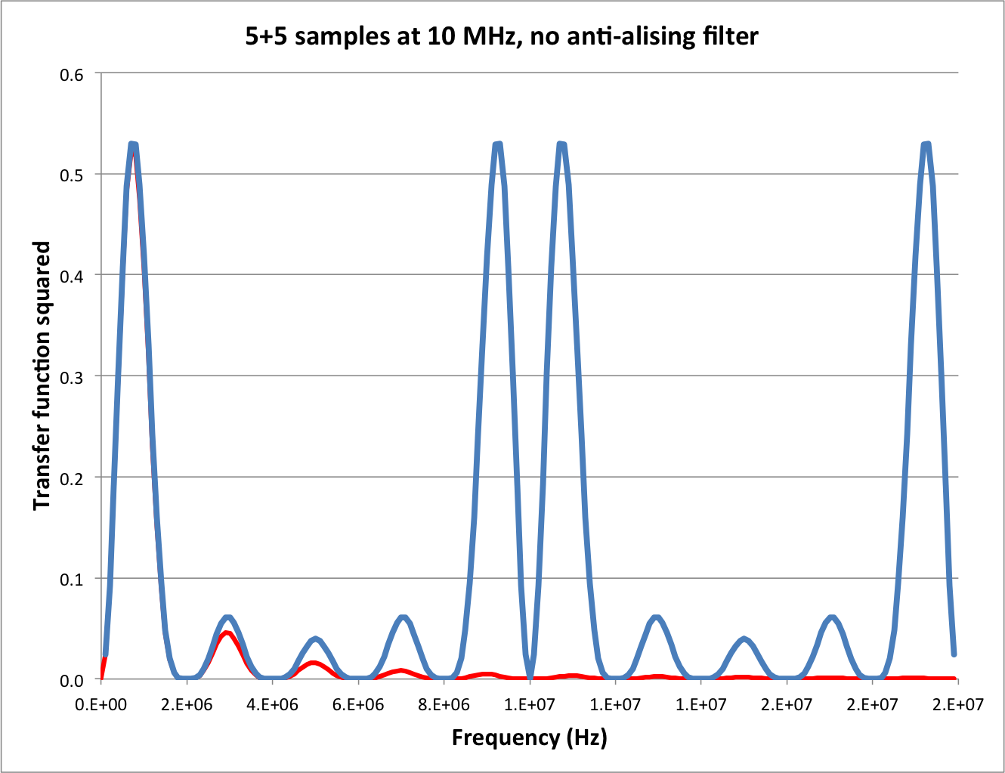
Transfer function², no filter
Aliases
Passband
Dual slope integrator
Nyquist

Slide 4
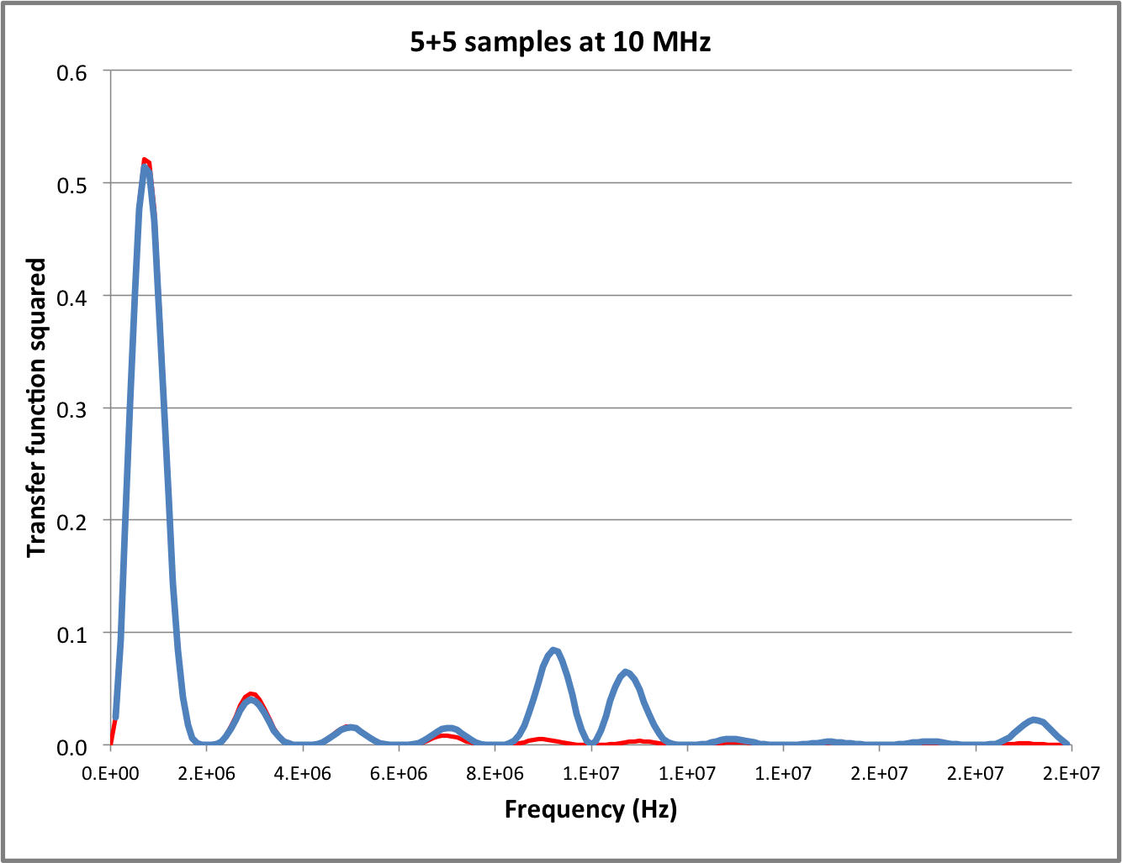
Transfer function², 1 pole anti-aliasing
1 Pole Filter at f_{c} = 4Mhz
Is not good enough
Significant aliased power remains

Slide 5
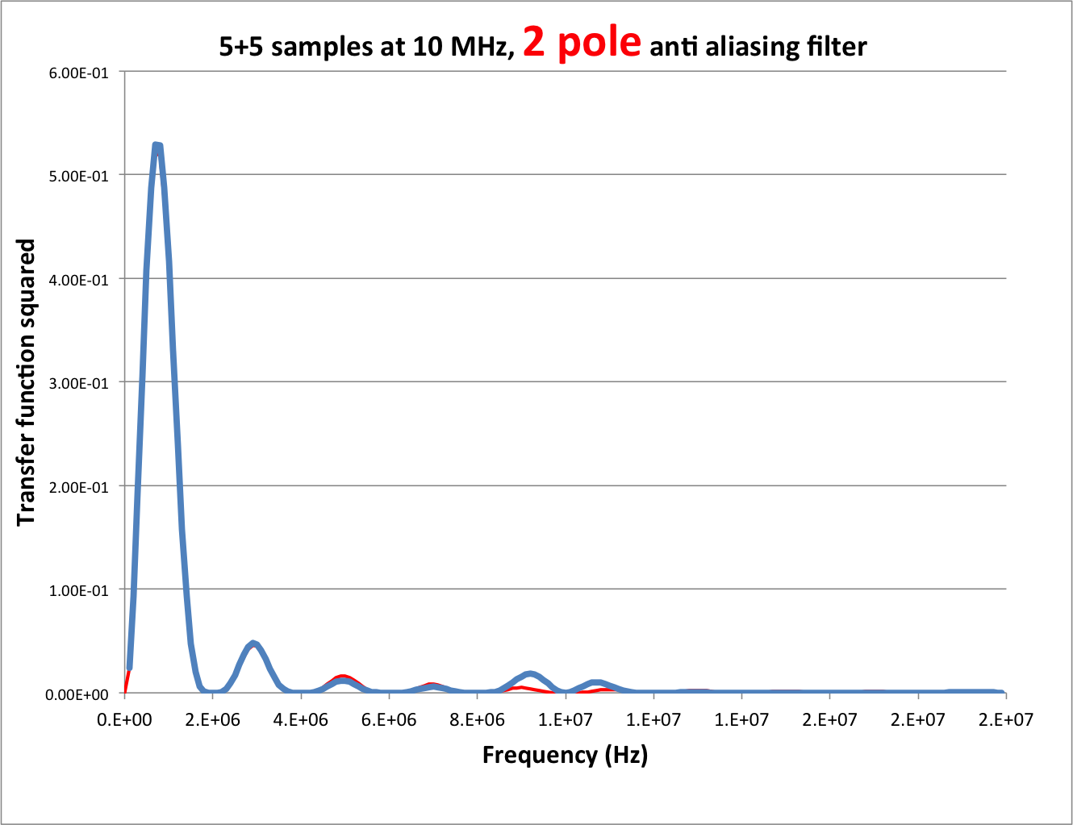
5+5
Read noise voltage only 1% more than dual slope integration.

Slide 6
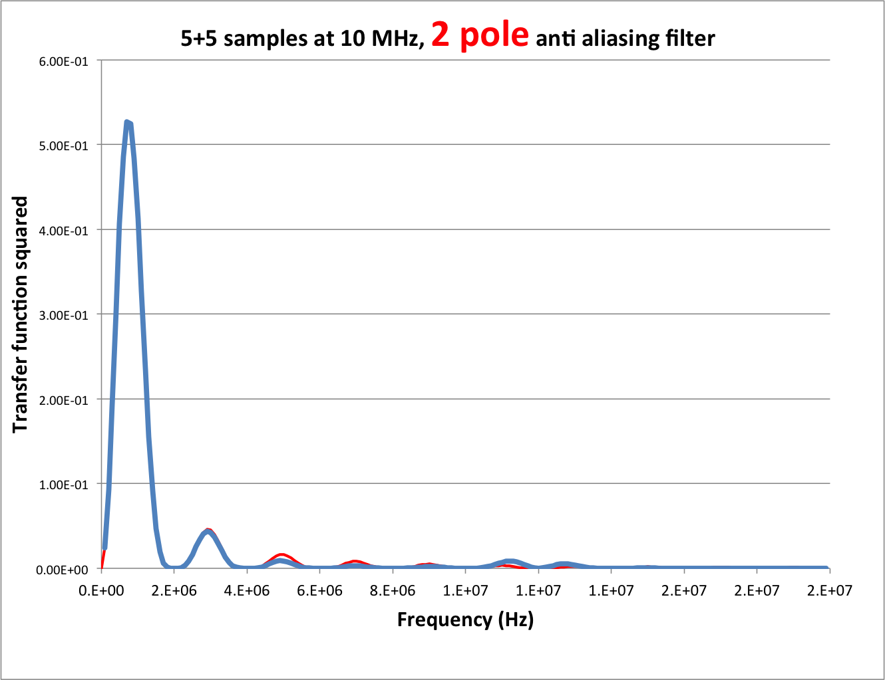
6+6

Slide 7
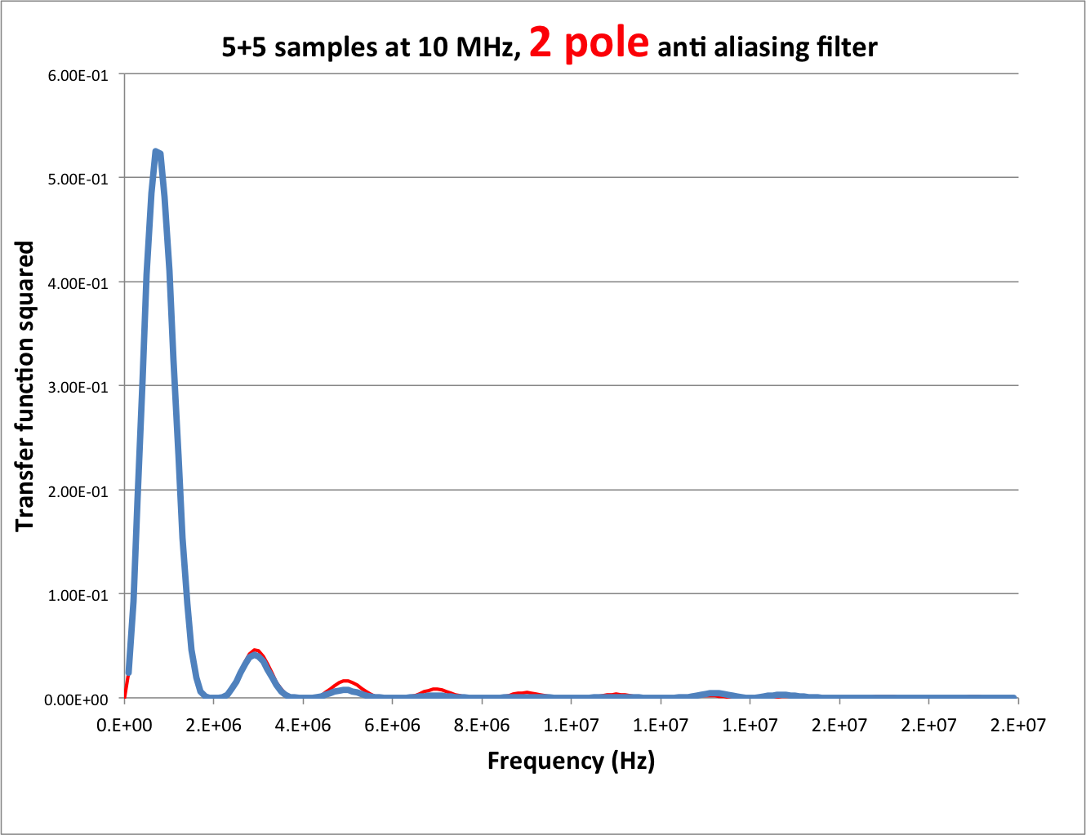
7+7

Slide 8
Backup slides

Slide 9
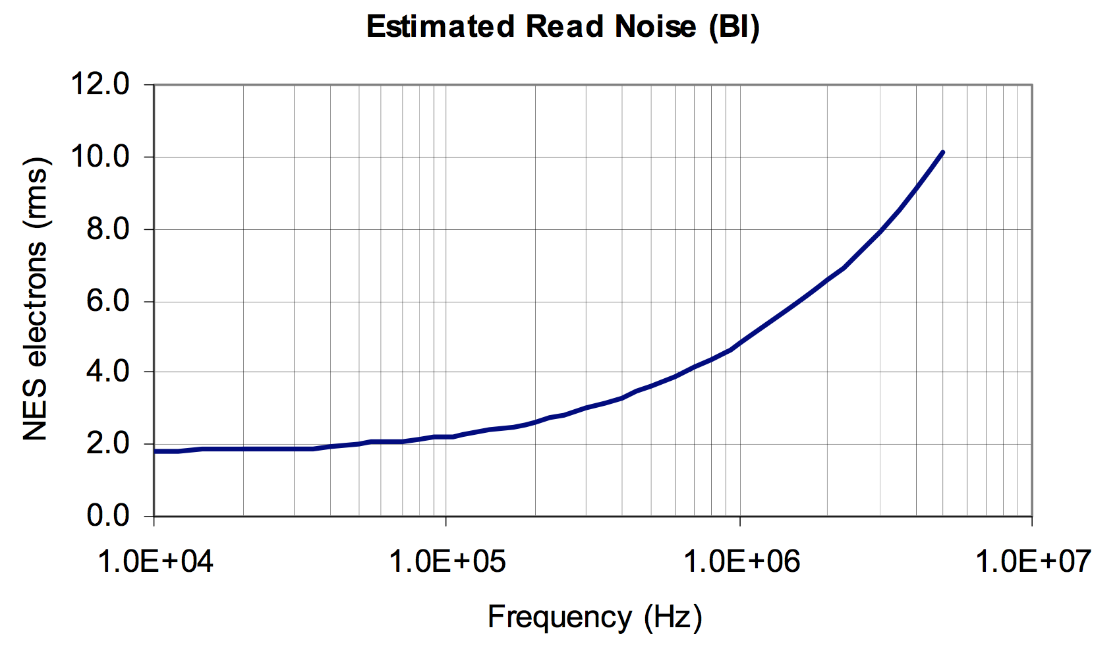
E2v CCD231-C6: “typical” noise
Gain for 300,000 e- full well → 4.6 e-/ADU
>9e- noise per sample = 1.95 ADU
Quantization degrades noise
by √(1+0.5/1.95²)-1 = 3 %
Can reduce by choosing higher filter cut-off or lower e-/ADU
F_{c} = 4MHz

