Slide 1
Theoretical Comparison
of CCD Video Processors
Dr. Simon Tulloch
University of Sheffield

Slide 2
Reset and clock-feedtrough
noise
Reset (or Reference) pedestal
The video
processor
measures
this step size
Reset event
Charge dump
Reset event
Signal pedestal

Slide 3

Correlated double sampler, Method 1:
Dual Slope Integrator (differential averager)
R
RD
OD
Reset switch
Integrator
Pre-Amplifier
Inverting Amplifier
RC=τ
_{OS}
.
-1
Computer Bus
_{R}
_{C}
OS
ADC
(1 sample
Per pixel)
CCD
R_{L}
Input Switch
Polarity Switch
3 switches minimum
3 op-amps minimum
(in practice another switch is needed to vary gain
of pre-amp if more than one pixel speed
is required)
= time between reference
and signal measurement windows
= width of measurement windows
(in general ~40% of pixel time)

Slide 4

Correlated double sampler, Method 2:
Clamp and Sample
R
RD
OD
Bandwidth-
Limiting
(f_{3dB} ~2 x f_{pix})
Pre-Amplifier
Hi-impedance
buffer
.
.
Computer Bus
S
-
+
ADC
(1 sample
Per pixel)
OS
H
R_{L}
LP
CCD
Clamp switch
Sample/Hold switch
2 switches minimum
3 op-amps minimum
(in practice another switch is needed to vary 3dB
point of input pre-amp if more than one pixel speed
is required)
= time between release of
Clamp and activation of Hold

Slide 5

slope
For the CCD231 the values are:
=Gaussian white noise 15nV Hz^{-0.5}
=flicker noise corner 150kHz

Slide 6
At high pixel rates
we are dominated by
Gaussian white noise
At low pixel rates
we are dominated by
flicker noise

Slide 7
Correlated double sampler: Digital version (DCDS)
R
RD
OD
Bandwidth-
limiting
Pre-Amplifier
f_{3dB}
f_{ADC} ≥ 2.0 x f_{3dB}
.
Computer Bus
OS
ADC
(Multiple samples
Per pixel)
CCD
R_{L}
LP
Hardware simpler (at least on the analogue side).
This then allows digital synthesis of Dual Slope,
Clamp/Sample or other types of CDS.
No high-speed analogue switches required.

Slide 8
Digital Synthesis : some examples
Dual Slope integrator (= Differential Averager)
Reset pedestal weights= +1
Signal pedestal weights = -1

Slide 9

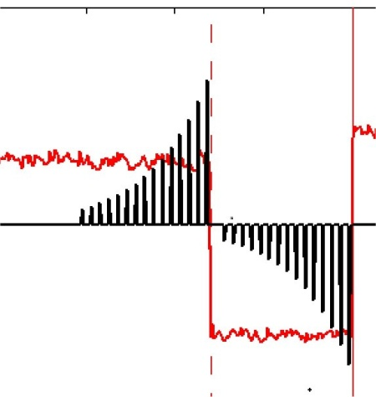


Simplest possible DCDS with analogue prefilter
Clamp & Sample
Digital Synthesis : some examples
Two ways to
do this.
Pre-filter synthesised digitally

Slide 10
Note that if prefilter is too narrow the Point Spread Function can suffer
δ pixel
Trailing pixel
Note: read noise “switched off” to make effect clearer
ref
sig
ref
sig
Infinite bandwidth
ref
sig
ref
sig
-ve signal
“leakage”
Upper 3dB too low
ref
sig
ref
sig
+ve signal
“leakage”
Lower 3dB too high

Slide 11
If the previous pixel waveforms are CDS processed using the Clamp&Sample technique we get:
Infinite bandwidth:
Perfect pixel delta function.
At bias
Upper 3dB too low:
Following pixel is
below bias
Below bias
Lower 3dB too high:
Following pixel is
above bias
Above bias

Slide 12
Video bandwidth required, purely from PSF considerations:
Clamp&Sample should have
analogue bandwidth >2.6 F_{pix}
Dual Slope should have
analogue bandwidth >6 F_{pix}

Slide 13
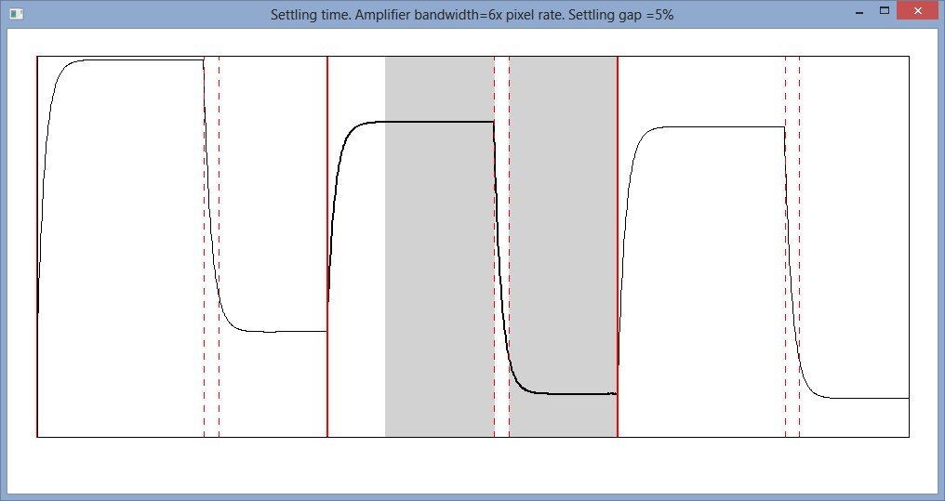
The bandwidth of 6x pixel rate required to give good PSF
also gives reasonable signal settling within 5% of pixel time.

Slide 14
Various digital CDS techniques now
compared using a novel time-domain model
of the E2V CCD231 output amplifier.
Synthetic MOSFET noise waveform: “Virtual CCD oscilloscope”

Slide 15



Build complex array
f
Real amplitudes
Imaginary amplitudes
FFT
{200,000 point FFT
takes 6ms on a PC}
t
Real amplitudes
Imaginary amplitudes
The real part is our MOSFET noise waveform

Slide 16

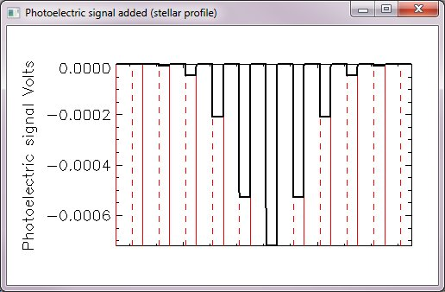
Next add:
Reset noise pedestals.
Signal pedestals.
and bandwidth limit:
Add AC-coupling
Bandwidth limit the pre-amp
=CCD sensitivity μV/e-
=MOSFET Source follower gain (0.55 typ.)
( V_{RESET} ~ 250μV for CCD231)

Slide 17
The synthetic CCD waveforms were then analysed using the standard CDS techniques.
(floating point arithmetic with ≥ 200 samples per pixel )
Results compared the analytic models and E2V data sheet

Slide 18
E2V data-sheet values are based on Clamp&Sample CDS
with 0.4T_{pix} between the two samples and a pre-filter
bandwidth=2.f_{pix}
This analytic model suggests that Dual-
slope integration should give read noise as low as 1.3e⁻ RMS (Controller noise not considered here)

Slide 19
Mirrored
Gaussian
Mirrored
Exponential
Hamming
Window
(speculative)
1-Hamming
Window
(speculative)

Slide 20
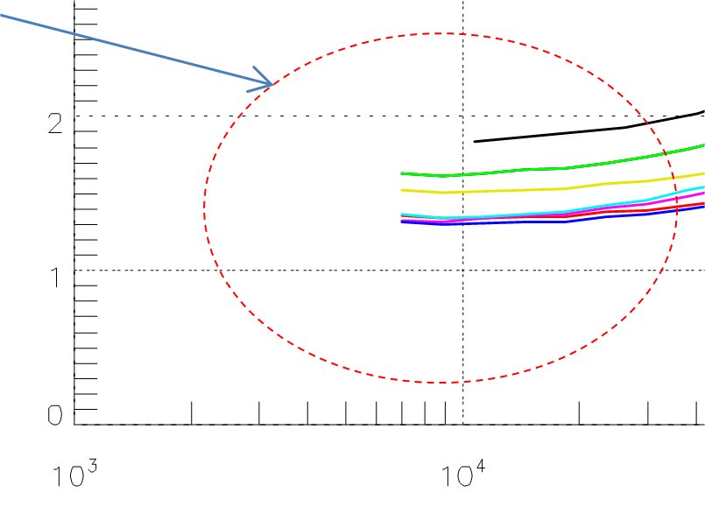
Differential Averager
(Dual Slope Integrator)
is the best all-round
performer.
Clamp&Sample
is the poorest
performer at all
pixel rates
Mirrored Gaussian
and mirrored
exponential methods
give tiny advantage at
low-signal end
Mirrored
exponential
Dual
Slope
Notes.
f_{3dB}=8MHz in all cases.
Time resolution
of model=50ns.
AC coupled with
lower 3dB point at 30Hz.

Slide 21

For σ>>1 this method is equivalent to the
Dual-Slope method
5% settling time
5% settling time
20% clocking
time

Slide 22
For Z=0 this method is equivalent to the
Dual-Slope method

Slide 23

So fine tuning the Mirrored Gaussian
weights gives only a tiny improvement and then only at very-low pixel rates

Slide 24
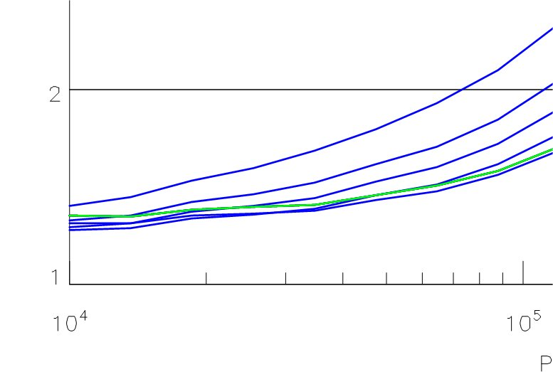

So fine tuning the Mirrored Exponential
weights gives only a tiny improvement and then only at very-low
pixel rates
Z=0 (equivalent to dual slope integrator)
Z ≤ 2

Slide 25
Up to now the waveforms have been heavily oversampled (f_{ADC} > 200f_{pix}) and all arithmetic has been floating point.
Practical implementation of digital CDS :
- Account for more practical (i.e. lower) ADC frequencies
- Account for quantisation noise.
These are now included in the model…

Slide 26
Nyquist tells us
That f_{ADC} > 2.f_{3dB}
Is there any advantage
to running the ADC
even faster?
[f_{3dB}= analogue bandwidth]

Slide 27
Small improvement
can be gained from
oversampling.
Diminishing returns
for f_{ADC} > 5.f_{3dB}
oversampling factors

Slide 29
Same true for mirrored
exponential method
Again, diminishing returns
for f_{ADC} > 5.f_{3dB}

Slide 30

Quantisation noise
Analogue CDS processor with a single ADC sample per pixel will have a quantisation noise of 12^{-0.5}=0.29 ADU. This adds in quadrature with the read noise.
Quantisation Noise

Slide 31
Now we quantise the synthetic CCD waveform and repeat the noise analysis
Focus in on one
pixel frequency and
two oversampling factors.
Note: the “granularity “ of the quantised
waveform is proportional to the inverse gain
of the system i.e. the e⁻/ADU in the image.

Slide 32

Pixel rate = 50kHz
Analogue Bandwidth (f_{3dB})=500kHz
CDS Method = Diff. Averager
f_{ADC} = 20. f_{3dB}
f_{ADC} = 10. f_{3dB}
The sample averaging will give floating point results.
We can thus get sub-ADU resolution from our ADC.

Slide 33
In conclusion:
DCDS reduces analogue component count and removes the need
for analogue switches.
Analogue bandwidth in a DCDS system needs to be at least 6x pixel rate from
PSF considerations.
3) ADC frequency needs to be at least 2x analogue bandwidth (as Nyquist would suggest).
A small reduction in noise can be achieved if this is increased to 5x.
Read-noise improvements are minimal if the ADC frequency is raised further.
4) Fancy DCDS weighting schemes offer insignificant improvements.
The differential averager is the best all-round performer when
implemented either digitally or with analogue circuitry.
In DCDS quantisation noise is greatly reduced which gives an effective
improvement to ADC resolution and a corresponding increase
in dynamic range.
The CCD231 should be capable of 1.3e- read noise with a zero-noise
controller (using a Differential Averager). This implies that even
with the root-2 noise hit from a differential signal chain the CCD231 should
still have an intrinsic noise floor below 2e⁻.

Slide 34
If manufacturers could reduce corner frequency……………
1e⁻ @ 50kHz

Slide 35
Thank you!
Extended version of this presentation, together
with noise-model IDL software available at :
www.qucam.com

