Slide 1
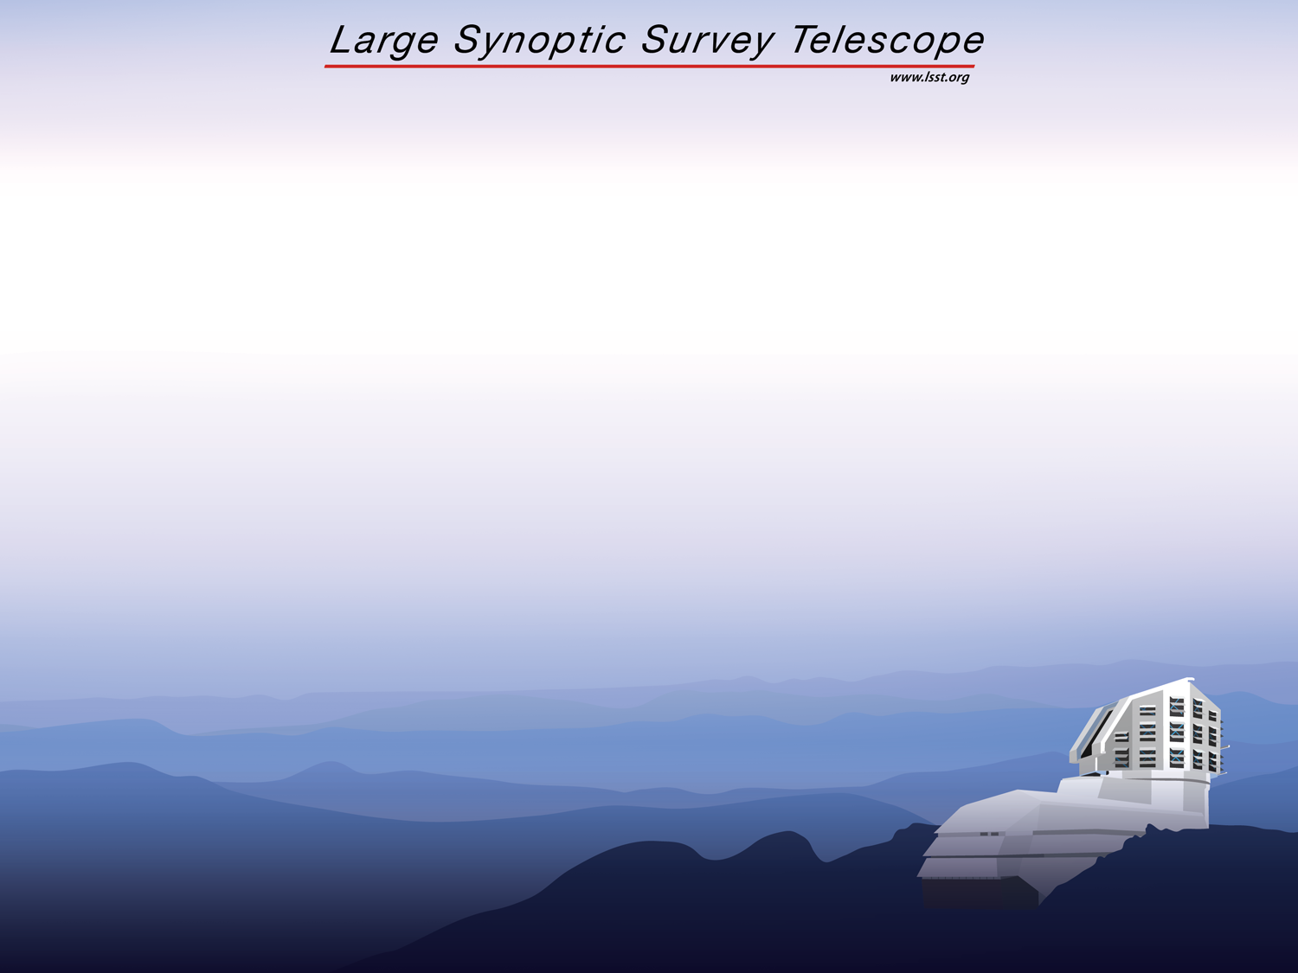
System Tests of LSST Integrated Readout Chain
Paul O’Connor for the LSST Science Raft Collaboration
Brookhaven National Laboratory, Upton, NY
Laboratoire de Physique Nucléaire et des Hautes Energies, Paris
Harvard University, Cambridge, MA
University of Pennsylvania, Philadelphia, PA
SLAC National Laboratory, Menlo Park CA
Scientific Detector Workshop 2013

Slide 2
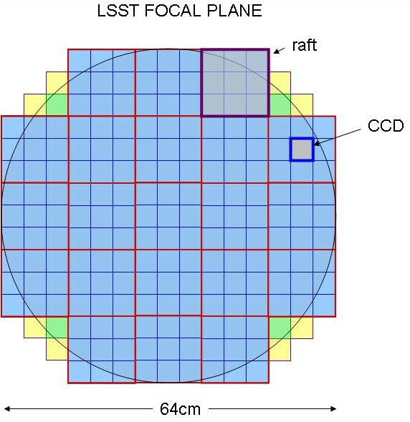
LSST science focal plane
3.5° (64cm) diam.
3×10⁹, 0.2” (10μm) pixels
189 4K × 4K CCDs
Fuly-butted mosaic (90% fill factor)
Beam geometry limits camera radial extent
2 sec readout
WFS
guider

Slide 3
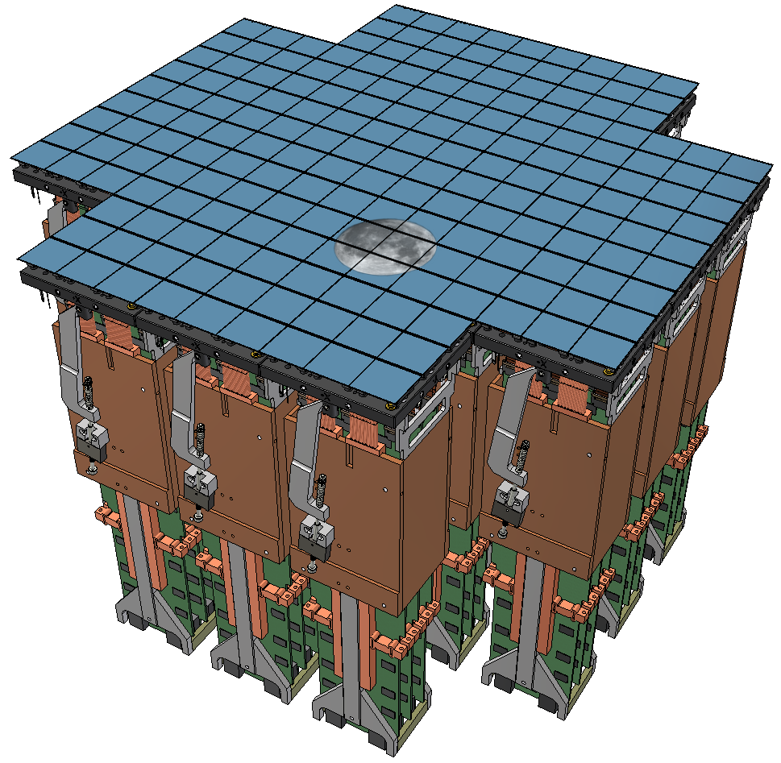
The problem
Electronics to control CCDs and process an aggregate of 1.5Gpixels/s must fit into 1/6m³ behind the focal plane
Inclusive of thermal and mechanical FPA support
Everything in cryostat

Slide 4
The solution
A modular system of 21 “raft towers”.
Each is an autonomous, fully-testable 12K x 12K imager.
Roughly the same size and power envelope as a 16-channel SDSU controller.
Keys to compactness and low power:
  Shortest possible CCD-electronics interconnect length
  Analog CDS
  ASIC-based clock, bias, and video processing

Slide 5
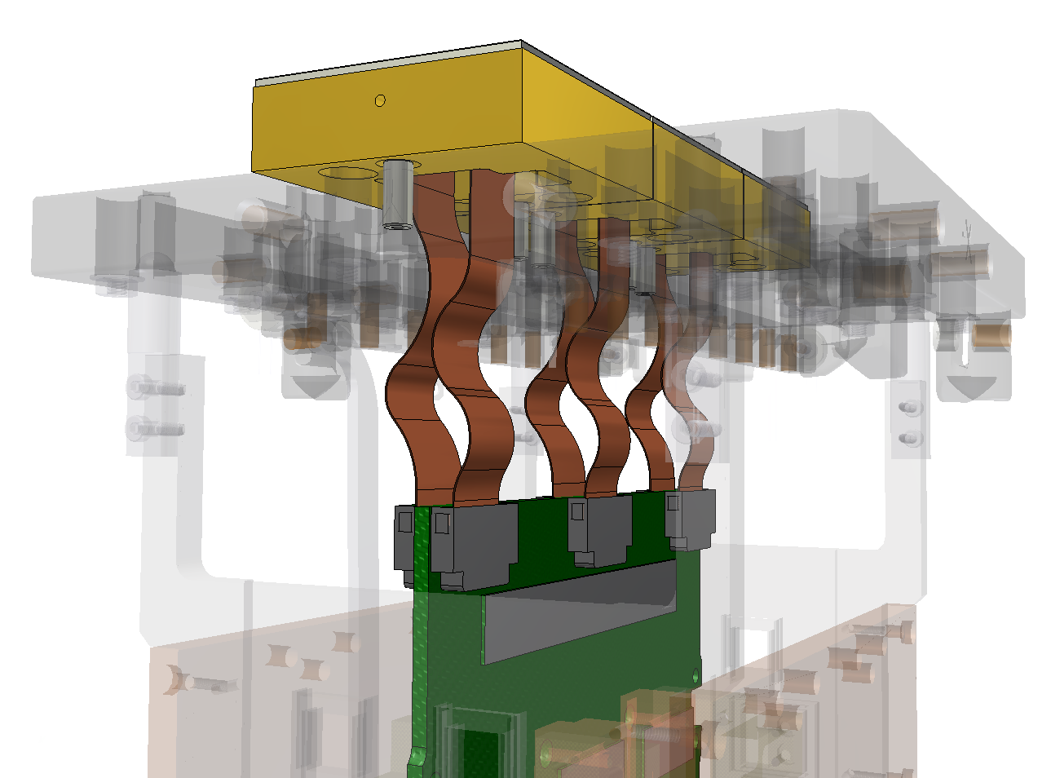
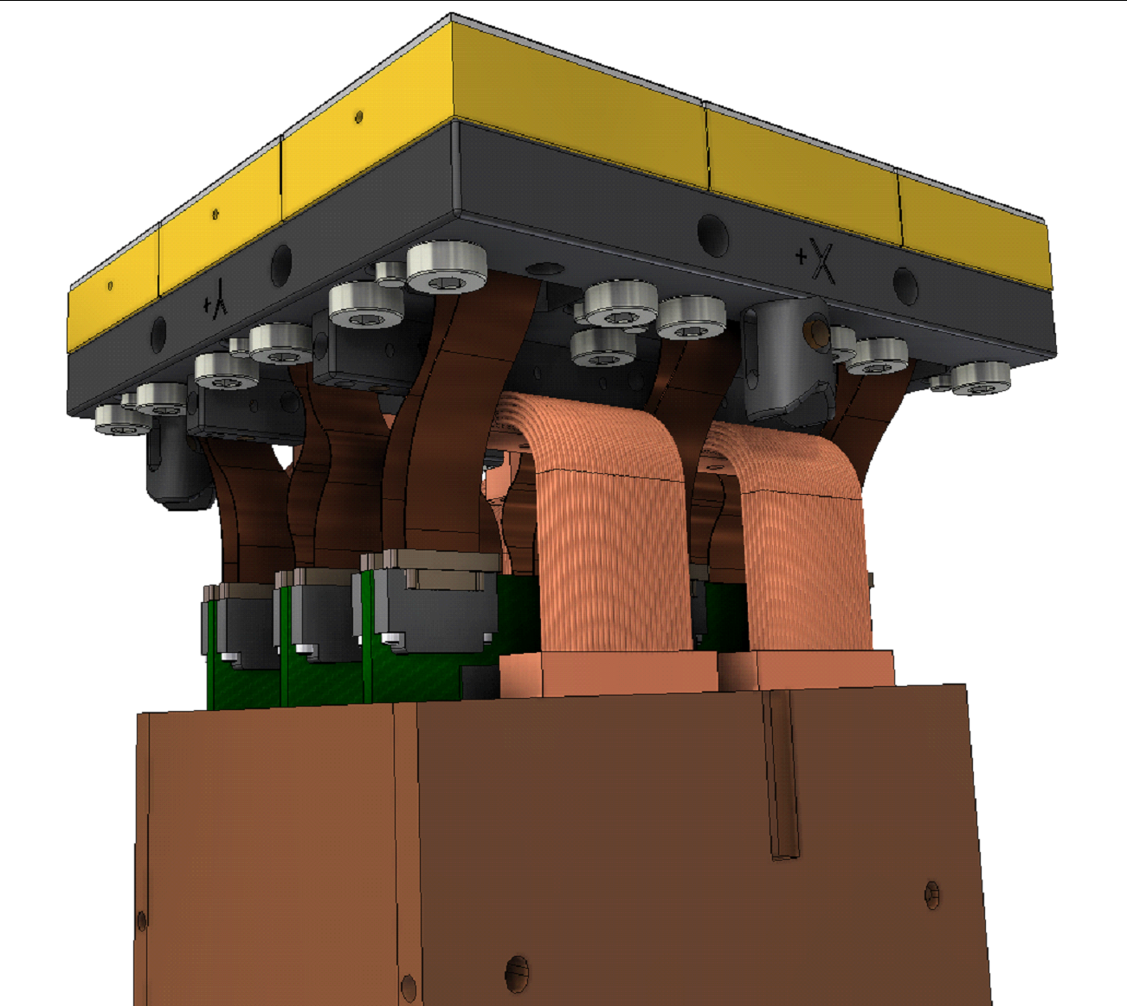
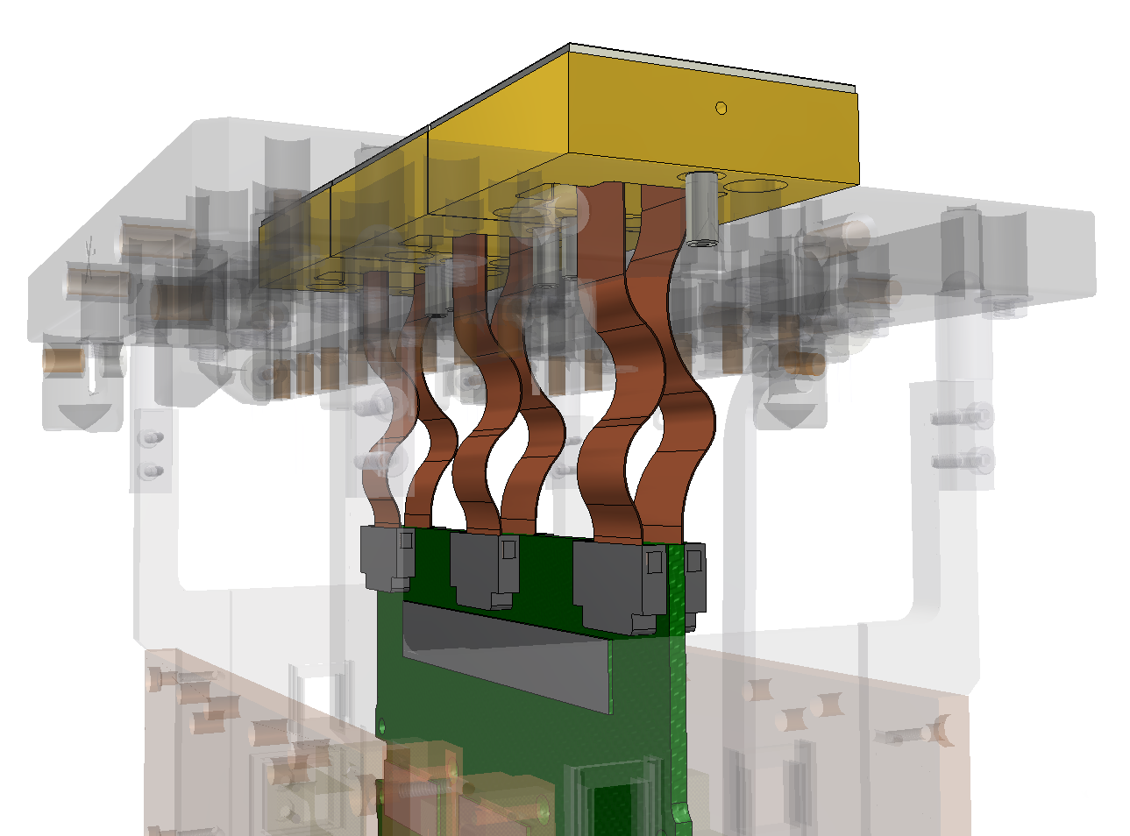
Numerology
UNIT | # Units | #CCDs | #Video Chan.
CAMERA | 1 | 189 | 3024
RAFT | 21 | 9 | 144
REB | 63 | 3 | 48
ASIC | 378 | ½ | 8
2020
2014
2013
2010

Slide 6
Raft tower electronics
3X RAFT ELECTRONICS BOARDS (REBs)
9-CCD
array
video
Preamp/DSI
ASIC
OS-video
144
ADC
0.5MHz
Digital data
LVCMOS
50Mb/s
ASPIC
18b
Clocks
72
clock/bias
timing engine,
configuration
I/O
Clock/Bias
ASIC
FPGA
Timing
14 LVDS
3.125 Gb/s mini-SAS
Bias
135
Clock/command
200MHz
CABAC
diagnostic
Bias, clk readback
ADC
80MHz
DAC
12b
slow control/monitoring
heaters
Heater current
DAC
SPI
RTDs
Temp sense
48
ADC
Power
conditioning
Power
+40A,+18A,+9A,+5D
Voltage/current/board temp readback
ADC
Notes:
48 low level single ended video inputs, 144 LVCMOS single ended, 10V clocks

Slide 7
Data acquisition, firmware, software
Firmware structure on FPGA
FPGA on REB hosts
  timing state machines (one per CCD)
  ASIC configuration and monitoring
  data encoding
  video and command interface (3.125Gbps custom protocol with virtual channels)
copper-to-optical
ATCA-based server
Each board contains a 10-G Ethernet with 9 nodes of RCE
  Dual-core (A-9) ARM processor (@ 1 GHZ)
  1 GByte of DDR3 RAM
  More than 250 DSP tiles
  Memory subsystem has > 6 GBytes/sec of I/O capacity
  Real-Time kernel or LINUX
  Full TCP/IP stack
RCE’s host all Server software

Slide 8
Raft electronics key requirements
CCD bias | Provide programmable voltages for all CCD biases, except back depletion voltage
CCD clocking | Provide switches and programmable rail voltages/slew rate for all CCD clocks
Sequencer | Timing generator for CCD clocks, CDS switches, ADCs. Independent state machines for each CCD.
Video processing | CDS by dual slope integration for 48 video channels Pixel rate 545kpix/s Noise <9e- Crosstalk <0.2% Nonlinearity < 2%, 1 – 90ke- Max signal 175ke-
Data acquisition | 18b sampling, 48 channels @545kpix/s Serialize with ECC. No frame buffer on REB 3.125Gbps Cu link to optical TX/RX
Slow controls and monitoring | Configure ASICs Monitor board and CCD temperatures, P/S current and voltage Read serial ID chip CCD protection
Special diagnostic port | Read back CCD bias voltages 80MSa/s ADC to monitor CCD clocks via mux on CABAC
Environmental | Vacuum operation; -40C coldsink.; low outgassing; power ≤ 350mW/chan

Slide 9
raft electronics board (REB)
103
420

Slide 10
raft electronics board (REB)
CCD current sources
ASPIC
CABAC
buffers, ADCs
voltage regulators and references
FADC

Slide 11
raft electronics board (REB)
STRIPE 3
STRIPE 2
STRIPE 1
Each stripe services one CCD

Slide 12
raft electronics board (REB)
Thermal path
KEEPOUTS FOR HEATSINK

Slide 13
raft electronics board (REB)
CCD current sources
ASPIC
CABAC
buffers, ADCs
voltage regulators and references
FADC

Slide 14
raft electronics board (REB)
STRIPE 1 POPULATED
CCD current sources
ASPIC
CABAC
buffers, ADCs
voltage regulators and references
FPGA
daughterboard
Power
CCD
connector
HS serial I/O
Board temperature monitor
Supply current and voltage monitor
Test connector

Slide 15
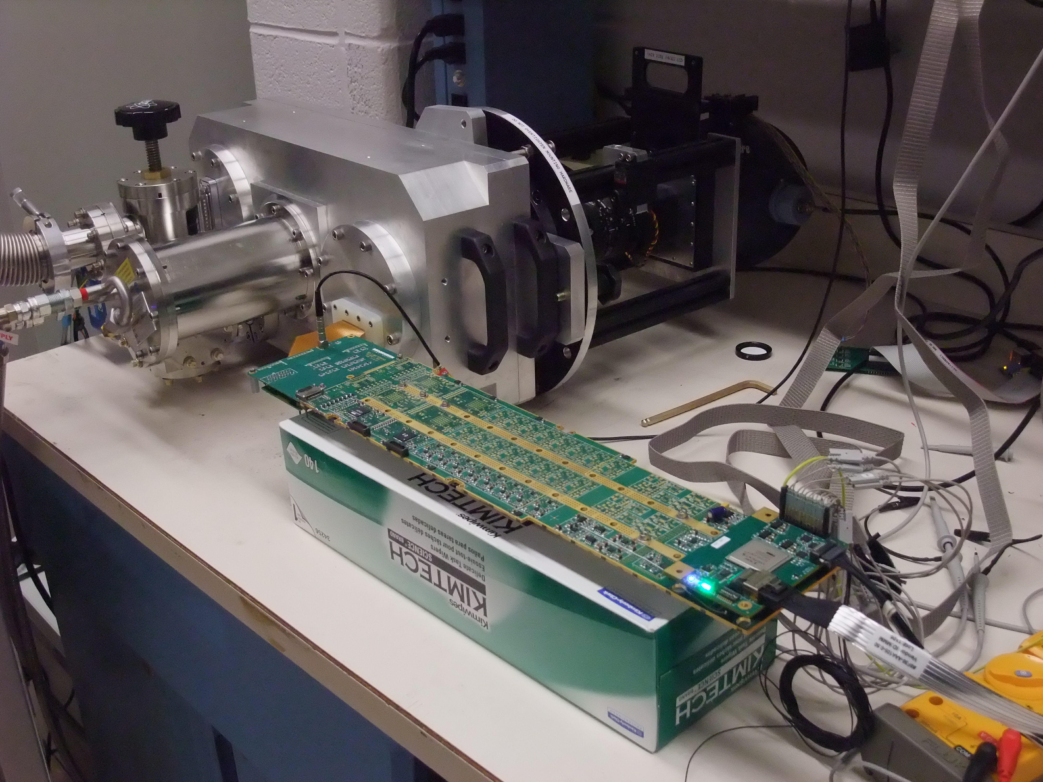
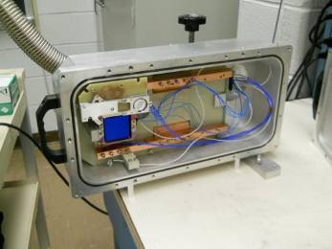
Single-CCD imaging setup
REB with 1 stripe populated
Small cryostat with engineering-grade 4Kx4K pre-production sensor
Full DAQ system ➔

Slide 16
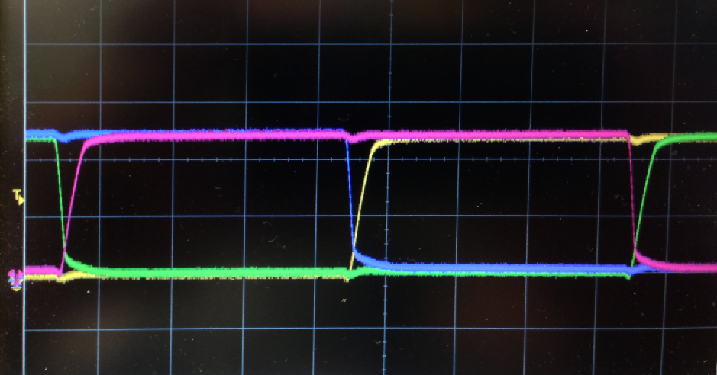
waveforms
Pixel
500ns/div
Yellow: OS 100mV/div
Magenta: ASPIC out 200mV/div
Green: S3 2V/div
Blue: Reset gate 2V/div
Parallel clocks
5V/div
5μs/div

Slide 17
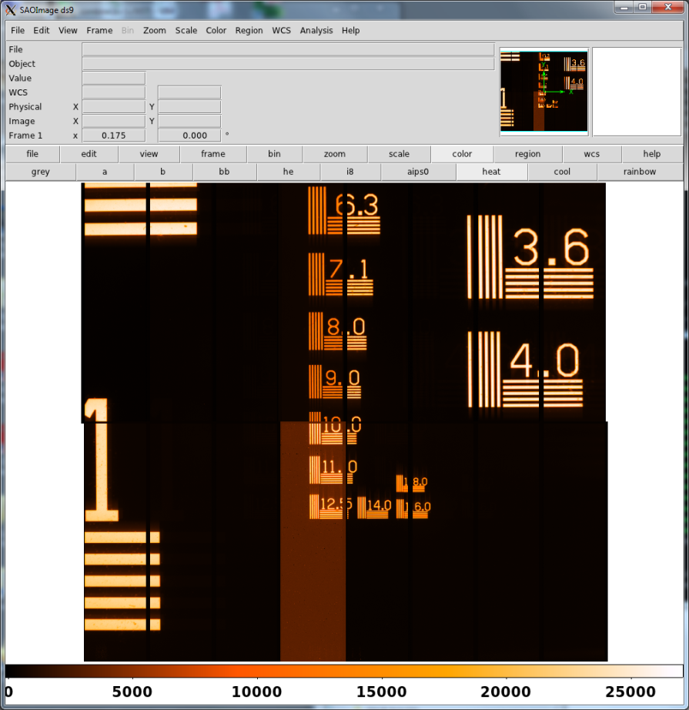
target image
8000 e-
650nm

Slide 18
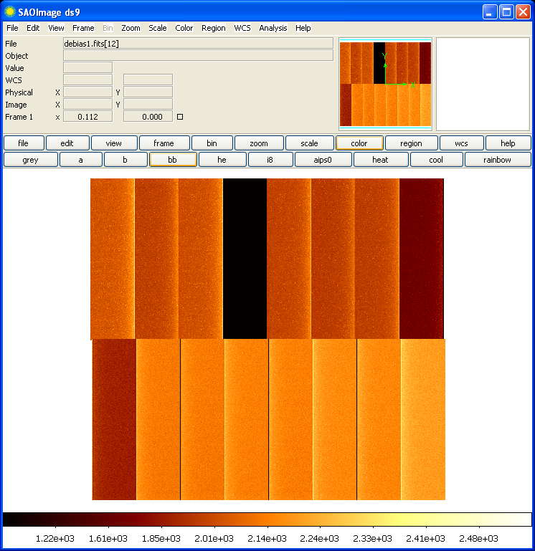
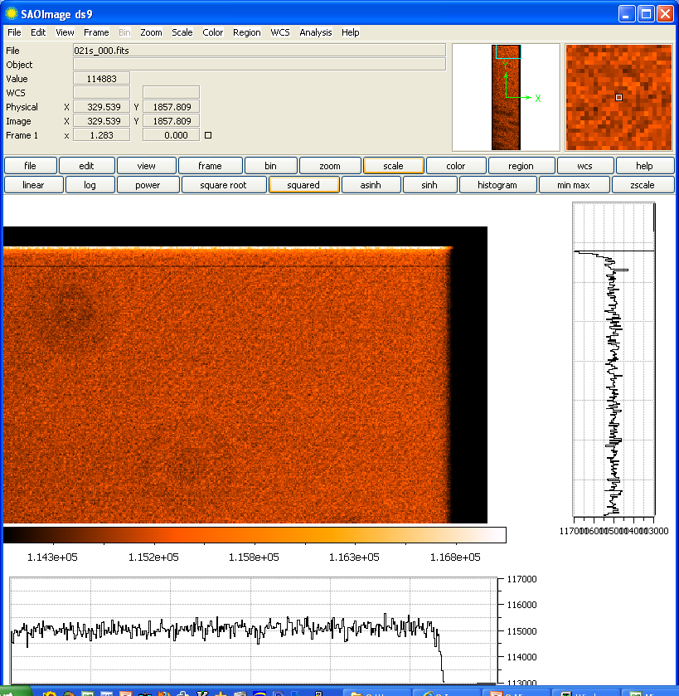
Bias and flatfield
Bias
650nm flat
8000 e-
650nm

Slide 19
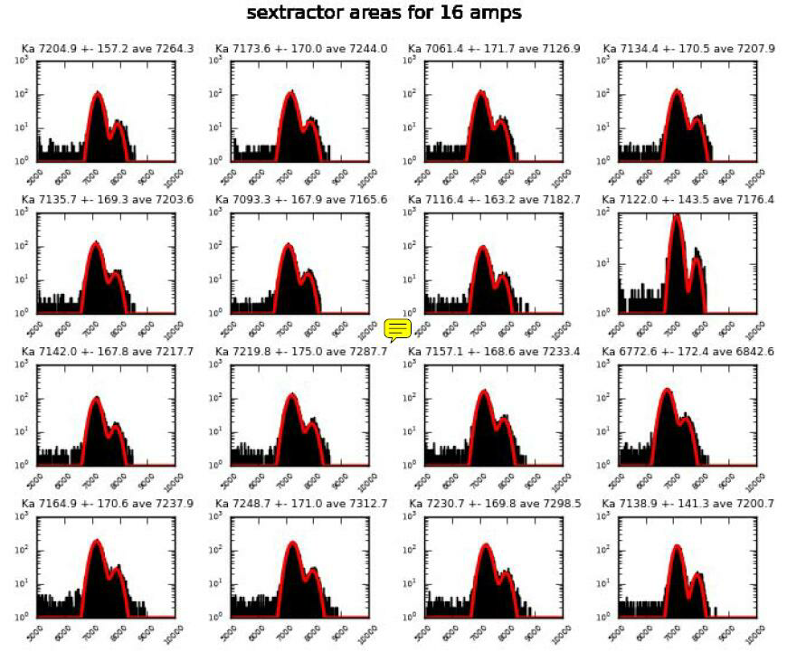
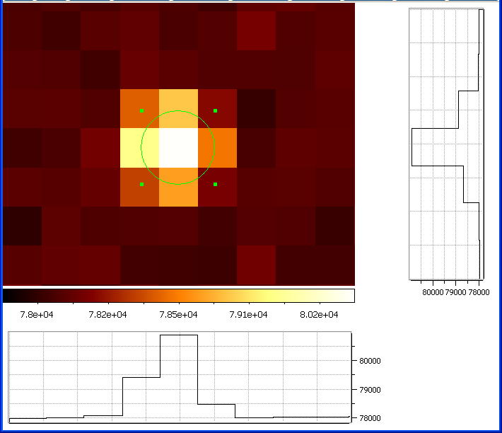
⁵⁵Fe xrays, -50V substrate bias
Spectra with Kα, Kβ peaks
Single cluster (zoom)
σ=4μm
.188’’ FWHM
Gain dispersion 1.5%

Slide 20
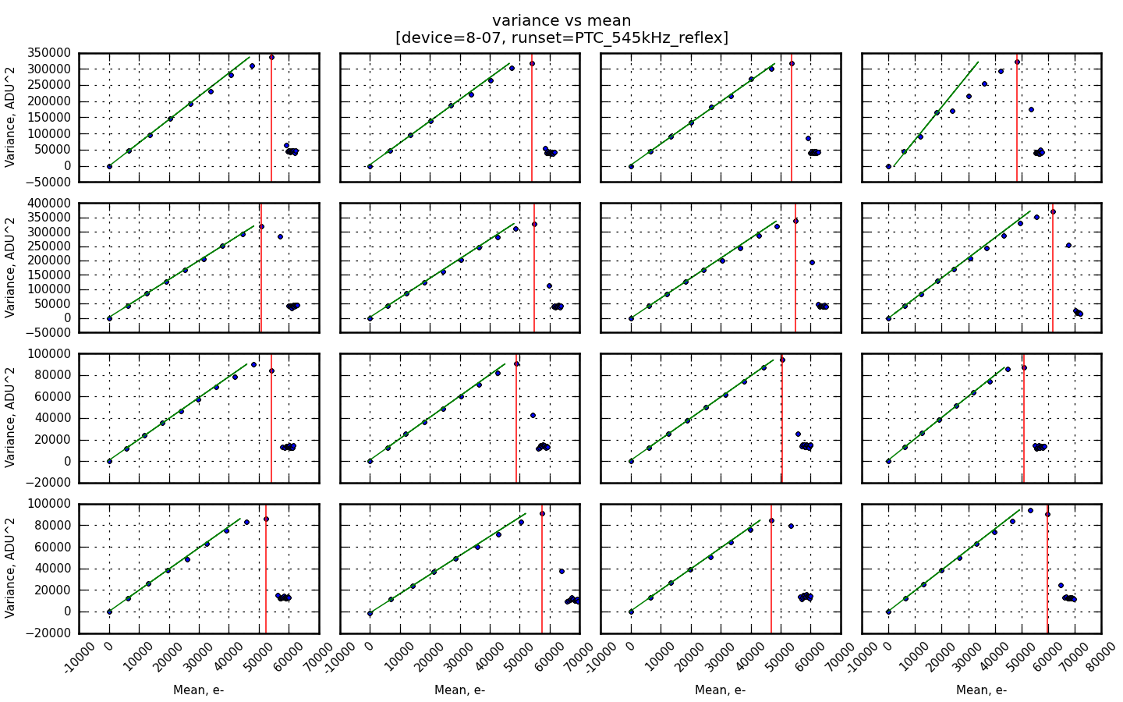
photon transfer
NEEDS UPDATING
Full well capacity of CCD is ~140ke-; dynamic range of REB1 limited to ~ 60-80ke⁻ withcurrent gain setup

Slide 21
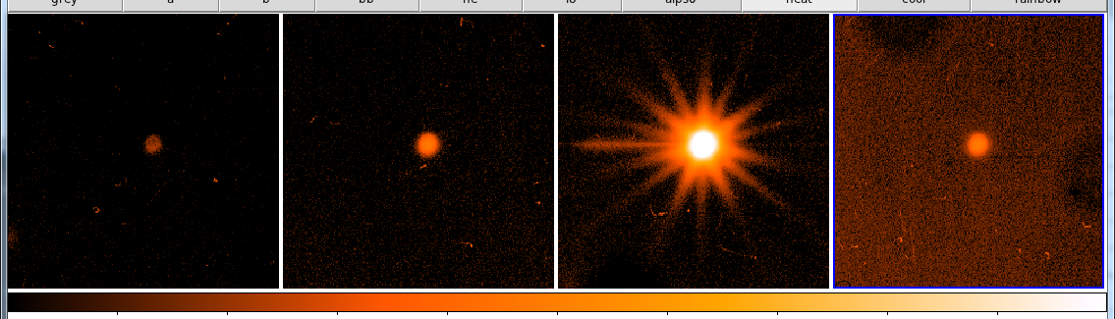
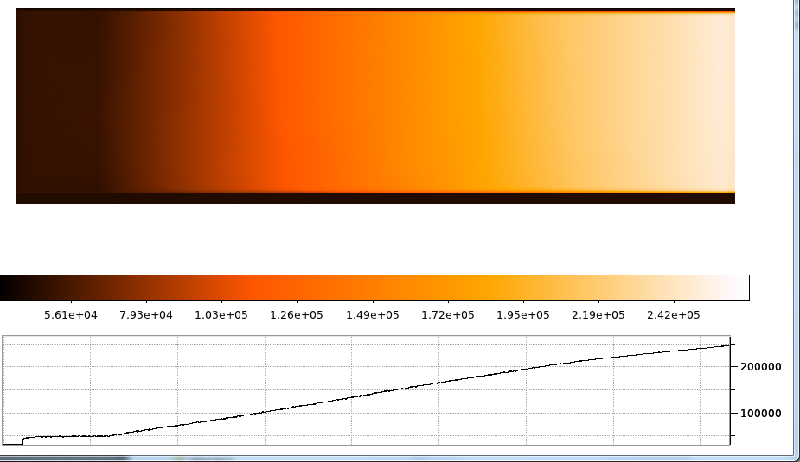
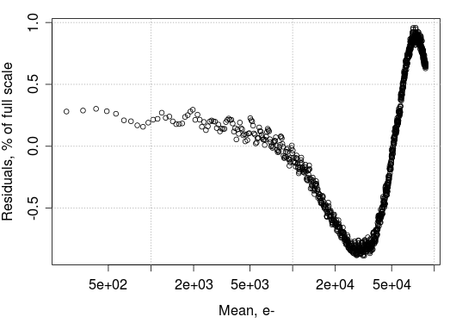
Noise, crosstalk, nonlinearity
480kpix/s
aggressor channel
victims
segment
* REB noise is 1.5 -2.2 e-
* REB xtalk is ≤ 0.04%

Slide 22
Electronics power dissipation
Source | Peak power dissipation, W
 | Per REB | Per channel
CCD current source | 4.21 | .088
Video ASIC | 1.20 | .025
Clock/bias ASIC | 2.52 | .053
ADC differential buffer/driver | 0.31 | .0065
ADC | 0.36 | .0075
Power Regulators | 6.63 | .138
Control FPGA | 1.50 | .031
TOTAL Electronics Power | 16.73 | 0.349
Measured (on single-stripe REB)
Expose | 6.98W
Readout | 8.96W
Ave(LSST cadence) ~ 7W
30% power common
≈.35W/chan for fully-populated REB ✓

Slide 23
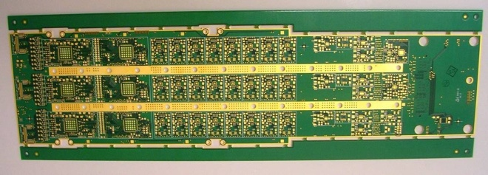

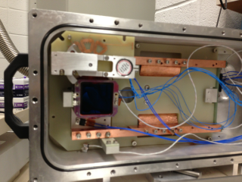
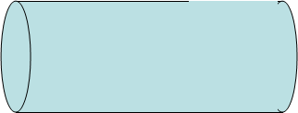

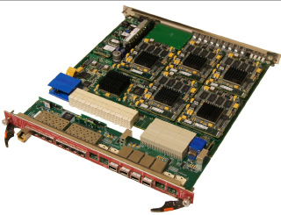
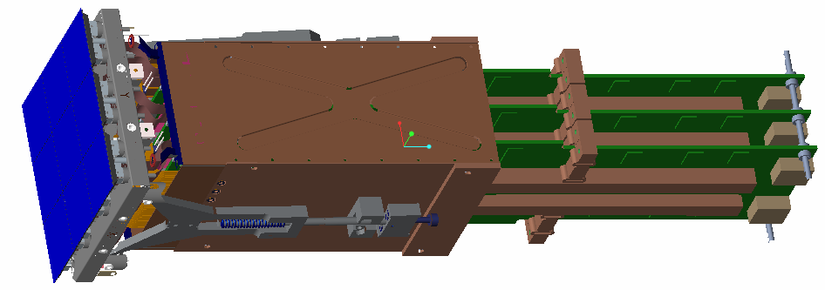


Next steps
1 REB only
Pulser/
Emulator
25°
-100°
25°C
1 REB warm + 1 CCD
1 REB + 1 CCD in cryostat
-40°
VAC-OTM
-100°
1 REB + 3 CCDs in cryostat
-40°
VAC-OTM
-100°C
Full RTM: 9 CCDs, 3 REBs
VAC-OTM
-100°
-40°
TCM

Slide 24
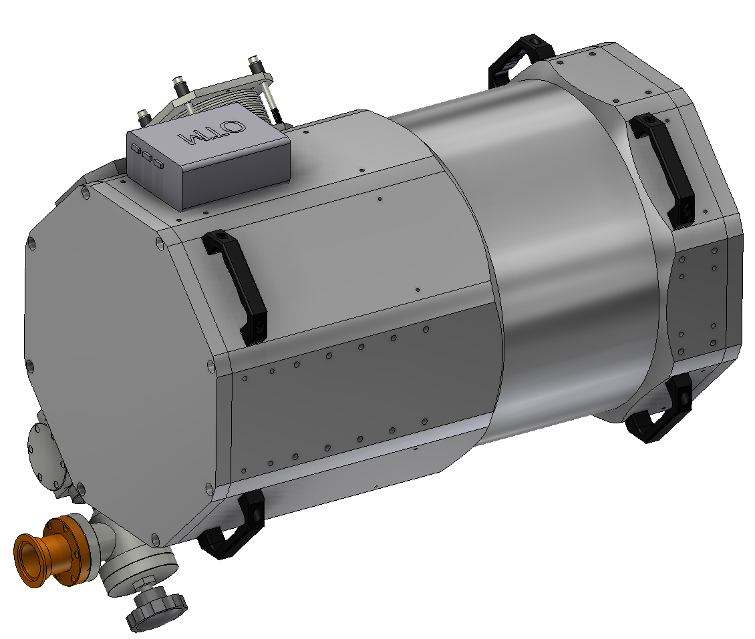
raft test cryostat

Slide 25
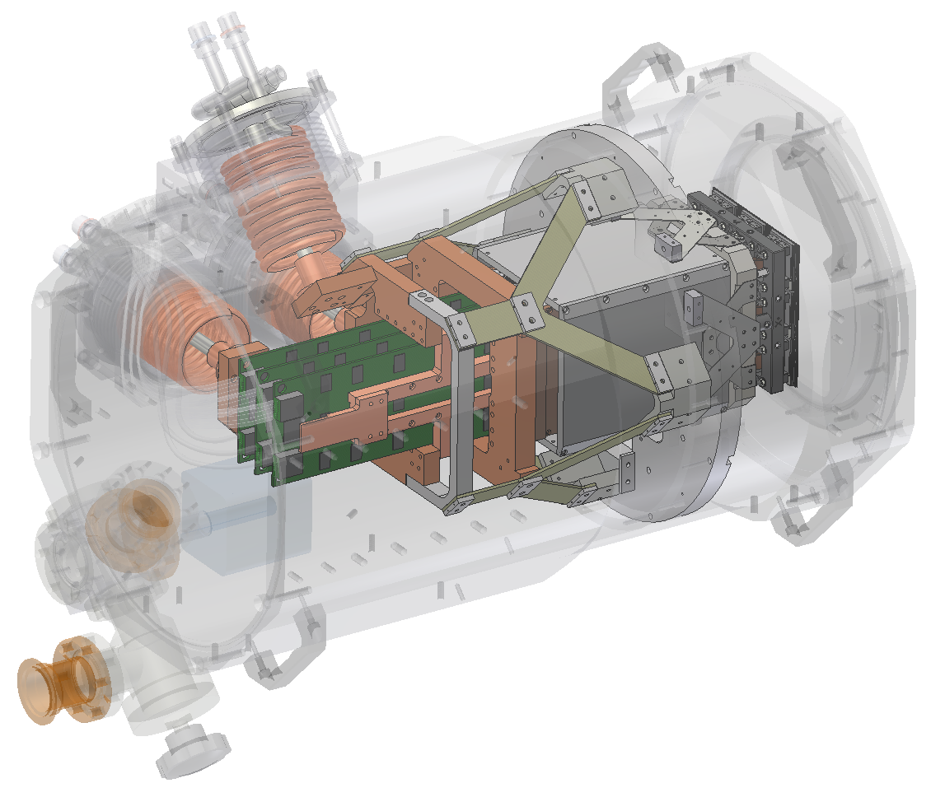
mechanics and thermal

Slide 26
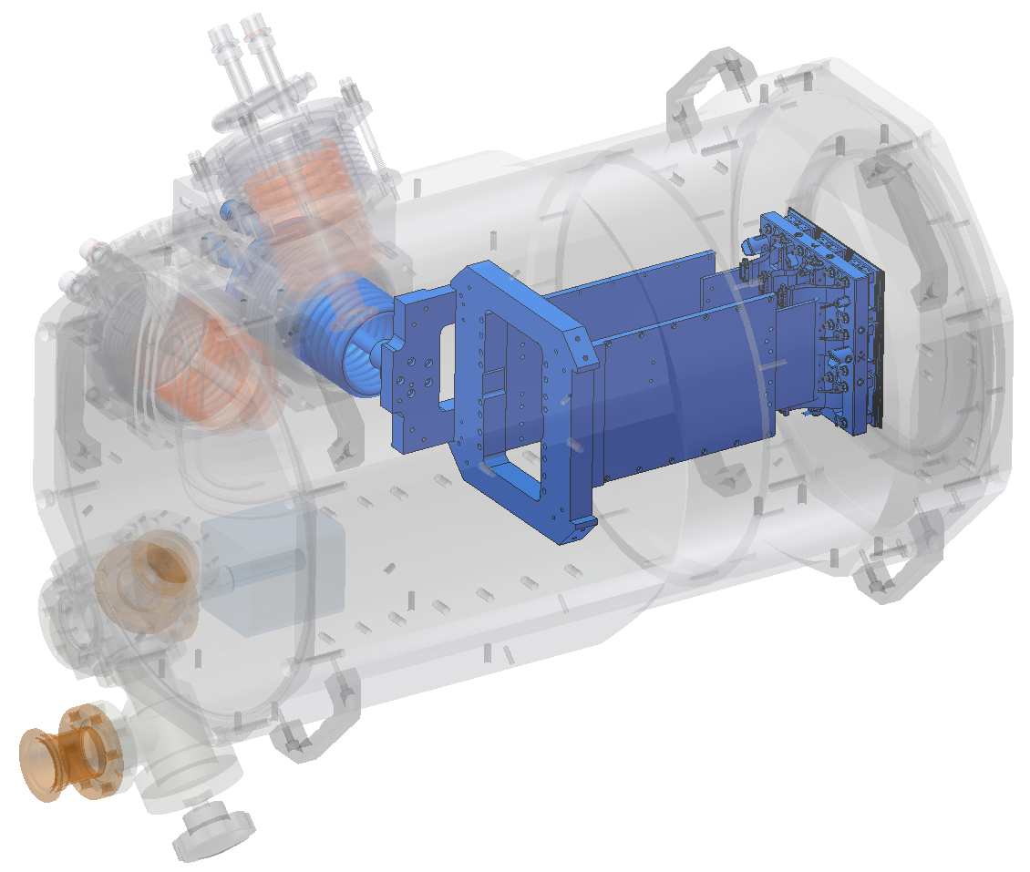
CCD cooling

Slide 27
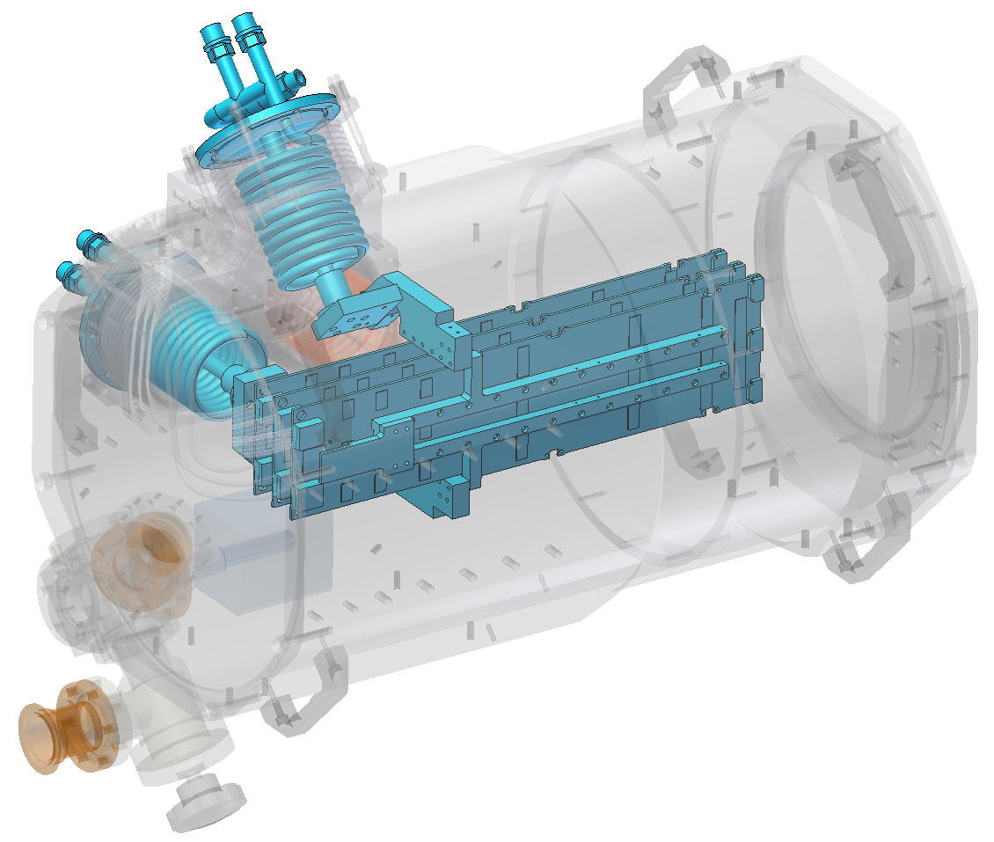
electronics cooling

Slide 28
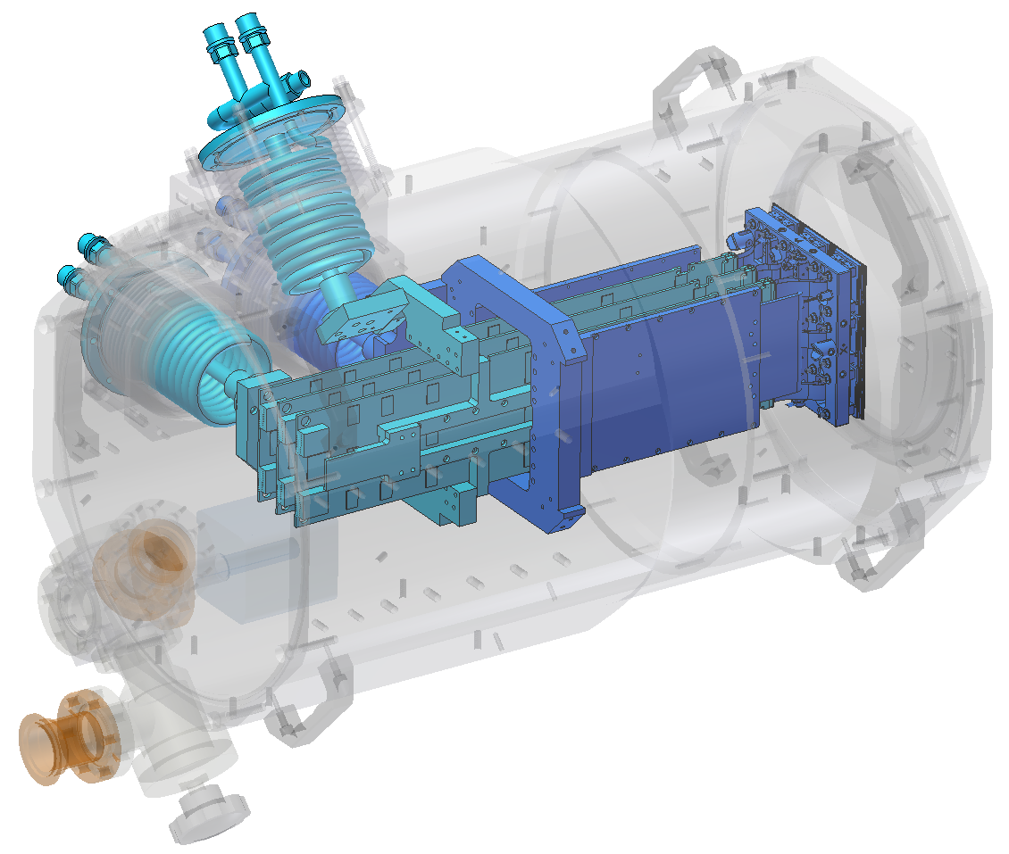
cooling

Slide 29
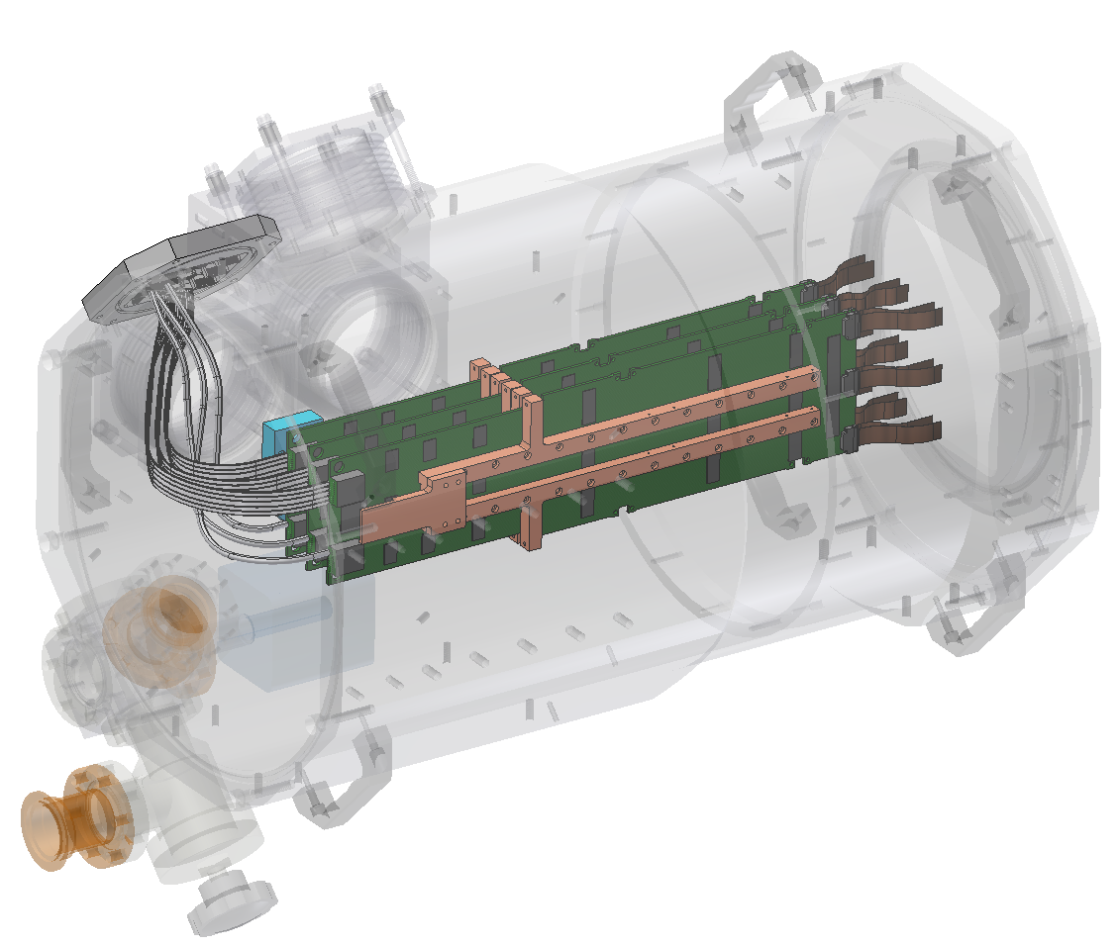
electronics

Slide 30
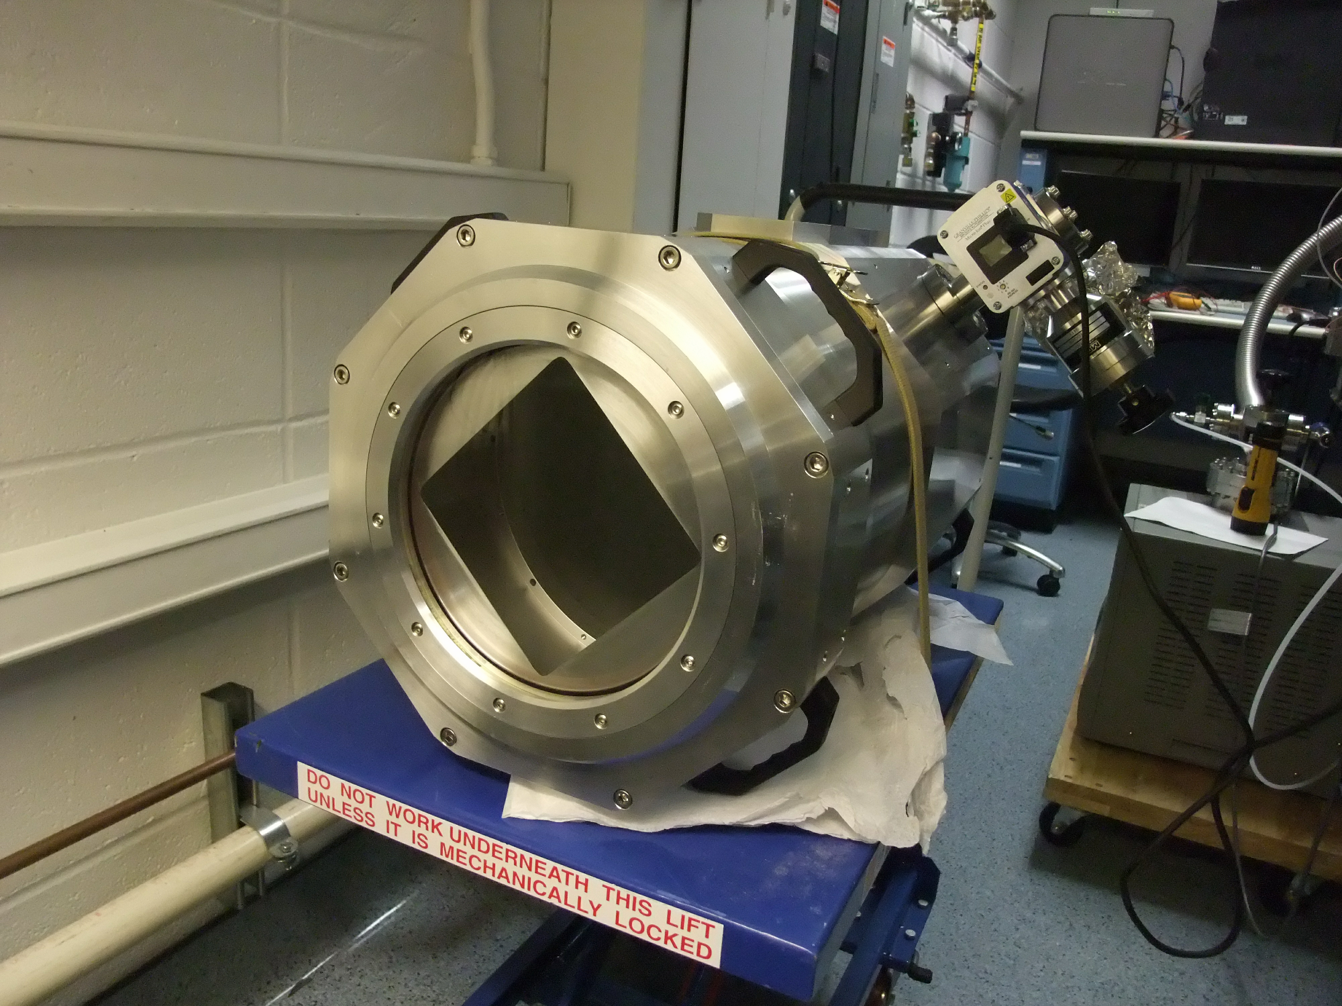
vacuum enclosure under test

Slide 31
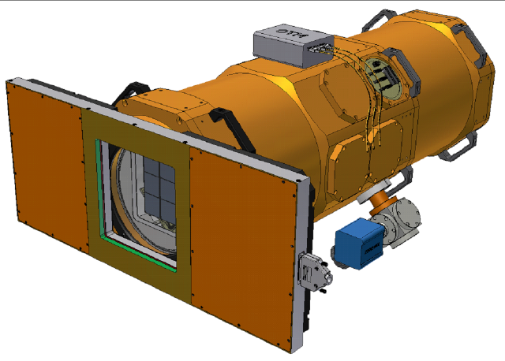
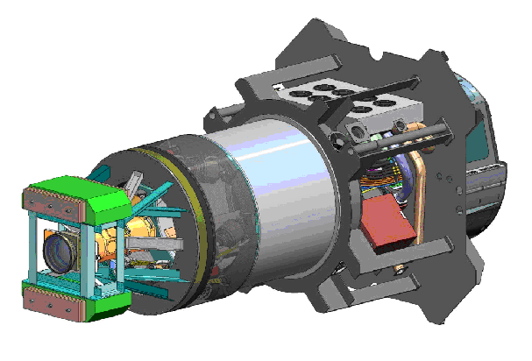
proposed LSST commissioning camera (ComCam)
Raft test cryostat with 9 engineering-grade CCDs, full electronics and DAQ, LN2 cooling, shutter, corrector + filters
Installed on camera hexapod/rotator at LSST 3-mirror focus prior to full Camera readiness
30 arcmin field on-axis
Early commissioning studies

Slide 32
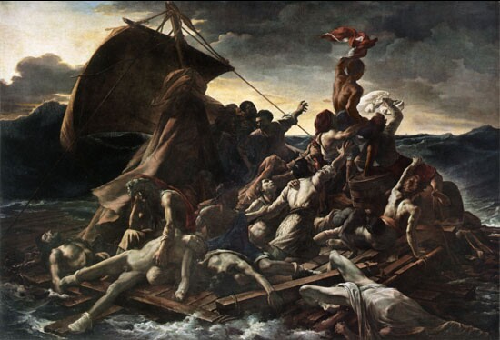
LSST raft development team
I can see land…

Slide 33
acknowledgements
This presentation has been co-authored by employees of Brookhaven Science Associates, LLC. Portions of this work are supported by the Department of Energy under contract DE-AC02-98CH10886 with Brookhaven National Laboratory. LSST project activities are supported in part by the National Science Foundation through Governing Cooperative Agreement 0809409 managed by the Association of Universities for Research in Astronomy (AURA), and the Department of Energy under contract DE-AC02-76-SFO0515 with the SLAC National Accelerator Laboratory. Additional LSST funding comes from private donations, grants to universities, and in-kind support from LSSTC Institutional Members.

Slide 34

shameless plug
http://www.bnl.gov/cosmo2013/

Slide 35
BACKUP

Slide 36
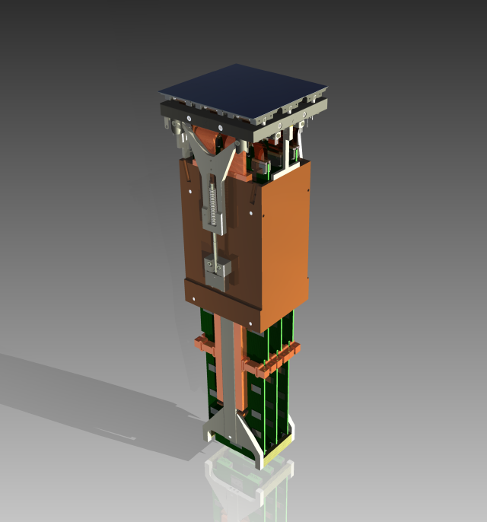
Raft Tower Module
Complete 144-Mpixel imager
Support sensors mechanically to meet strict coplanarity and piston tolerances
Thermal management of sensors and electronics
Protect sensor surfaces from condensable contamination
Provide bias, timing, and control signals for CCD operation
Low noise analog signal processing
Digitizing, multiplexing of pixel data
Diagnostics and slow controls
CCDs
raft baseplate
V-grooves for kinematic mount
housing (cold mass)
pre-tensioning arm
electronics cooling bars
FEE boards
Optimized for
Compactness
Low power

Slide 37
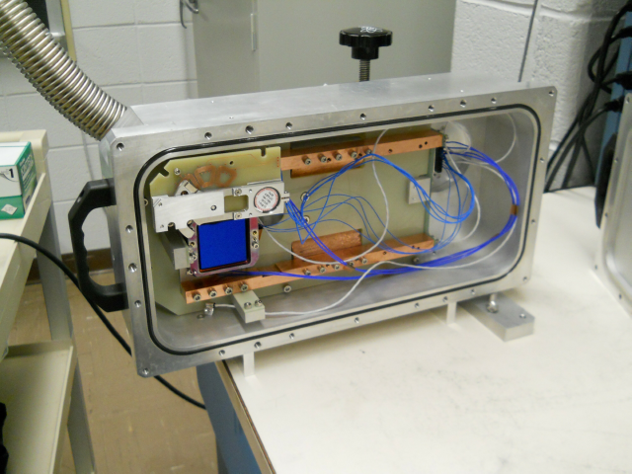
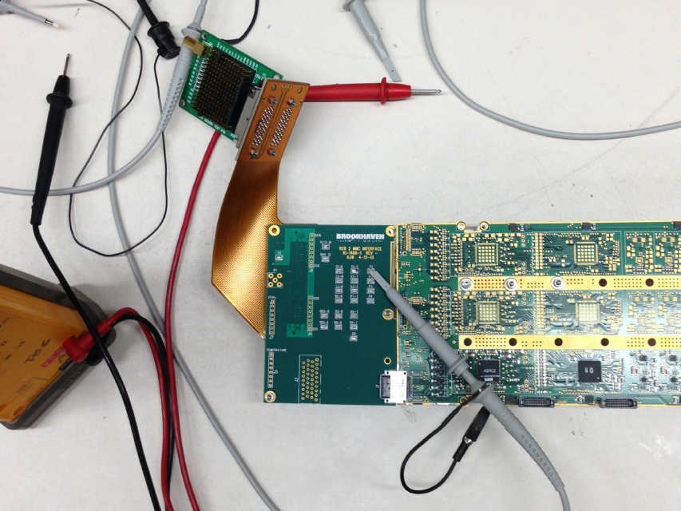
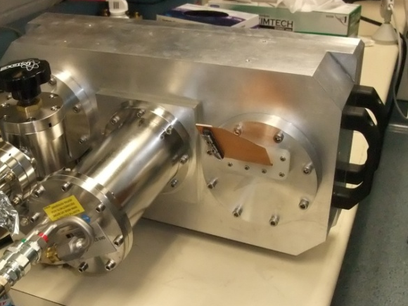
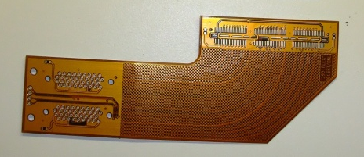
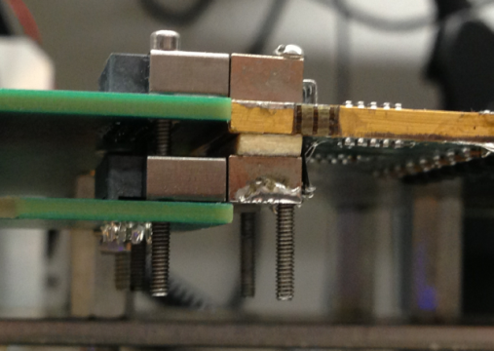
REB + CCD test bench components
Multimode cryostat with CCD, xray source, thermal control and monitoring
REB with adapter PCB and through-vacuum rigidflex cable

Slide 38
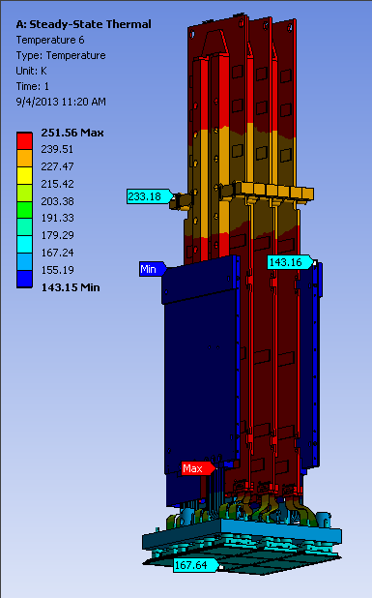
Robust FEA Model: Complete RTM Assembly
Nominal thermal loads from: electronics, radiation from L3, conduction through materials, etc.
Expected thermal contact at all interfaces
Raft rim heaters at 1.0 Watts each (slightly less than ½ max)
Cryoplate at 143K
ColdPlate at 233K

