Slide 1
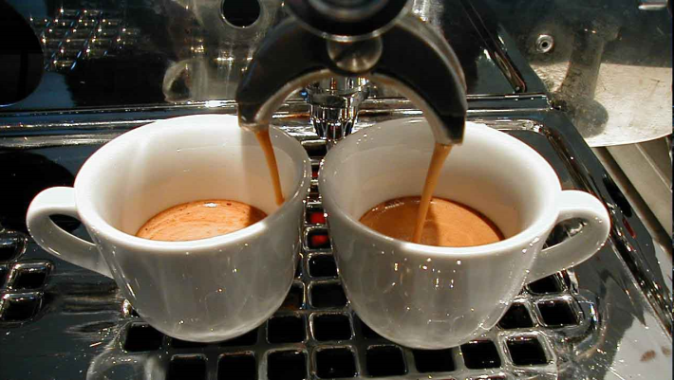
ESPRESSO Olaf Iwert, ESO

Slide 2
Istituto Nazionale Espresso Italiano:
Necessary portion of ground coffee 7 g ± 0,5
• Exit temperature of water from the unit 88°C ± 2°C
• Temperature of the drink in the cup 67°C ± 3°C
• Entry water pressure 9 bar ± 1
• Percolation time 25 seconds ± 2,5 seconds
• Viscosity at 45°C > 1,5 mPa s
• Total fat > 2 mg/ml
• Caffeine < 100 mg/cup
• Millilitres in the cup (including foam) 25 ml ± 2,5

Slide 3
The ESPRESSO Detector System (Stability)
and first results of the ultra-stable cryostat

Slide 4
It’s all about:
Centroid Stability at Nanometer Level
(Spectrograph, exoplanet search,
~ 10 cm/sec radial velocity precision)

Slide 5


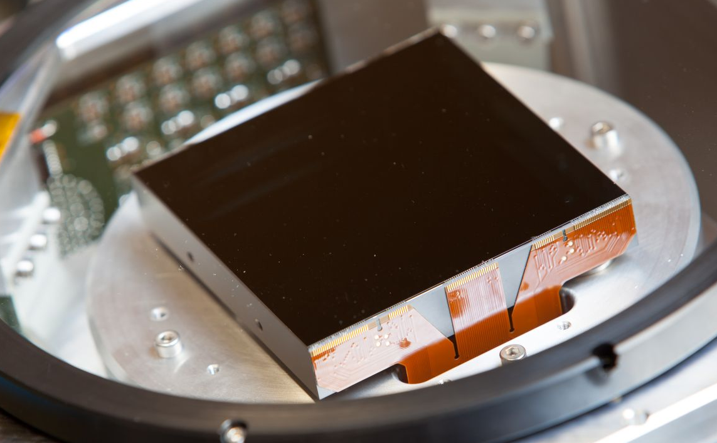
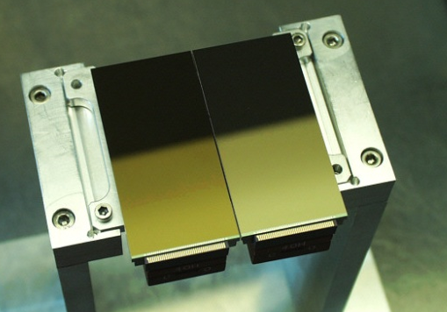
< 5nm Centroid Stability
HARPS Mosaic
ESPRESSO 9K x 9K Monolithic CCD

