Slide 1

The Millikelvin Challenge—Cryogenic Control with Industrial PLCs
Roland Reiss, Sebastian Deiries

Slide 2
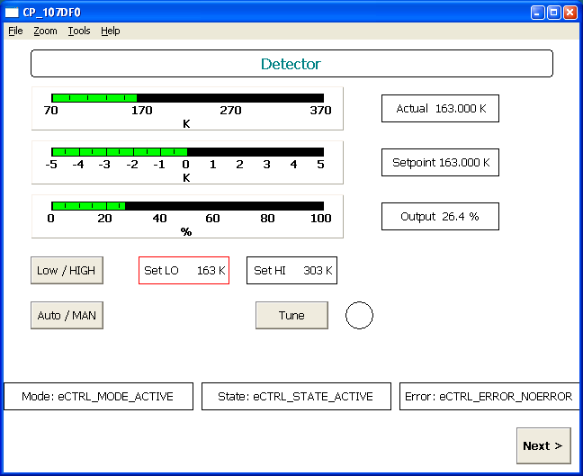
Cryogenic Controller
Beckhoff Programmable Logic Control (PLC)
  EtherCAT field bus (100Mbit/s)
  24 bit analog input modules
  24V/4A PWM outputs
Features
  Precision temperature measurement
  Graphical User Interface
Sensors
  PT100..PT1000 RTDs
  LakeShore Cernox RTDs
  LakeShore DT-670 Si diodes
  Edwards WRG (vacuum)

Slide 3
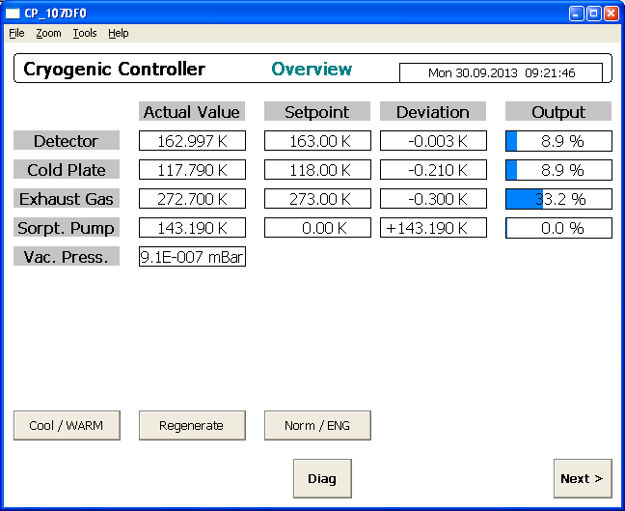
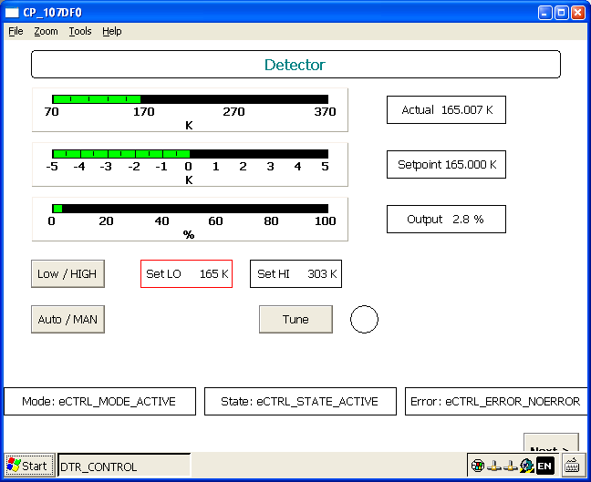
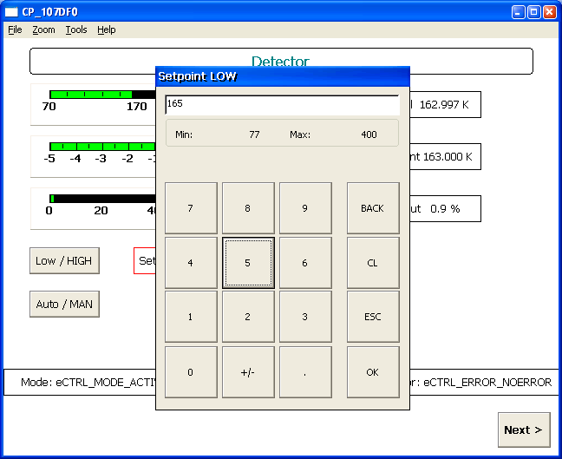
Graphical User Interface

Slide 4

Cryogenic Controller

Slide 5
Performance
Temperature resolution
  PT100: 10mK
  Cernox: <1mK (at 160K)
Temperature accuracy
  Only limited by vendor calibration data
Control loop stability
  ± 5mK pp

