Slide 1




Theoretical Framework, Simulation Results and Plans for an ASIC to Implement Weighted Multiple Sampling in Scientific CCDs
Dani Guzmán, Cristóbal Alessandri, Ángel Abusleme, Diego Ávila, Marcelo Guarini, Enrique Álvarez, Hernán Campillo, Alexandra Gallyas, Christian Oberli
Pontificia Universidad Católica (PUC) Astro-Engineering Center Integrated Circuits Group
Santiago, CHILE

Slide 2
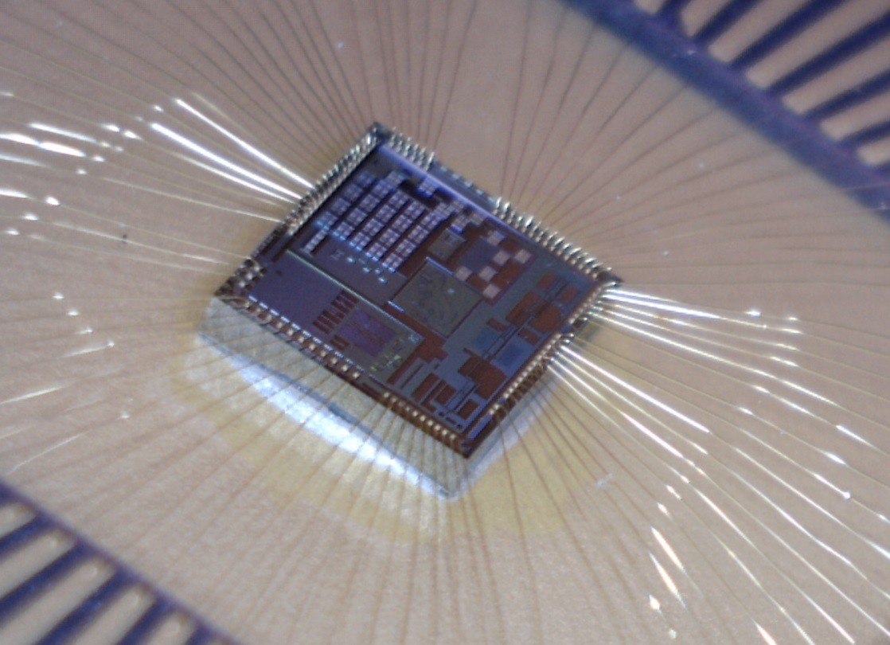
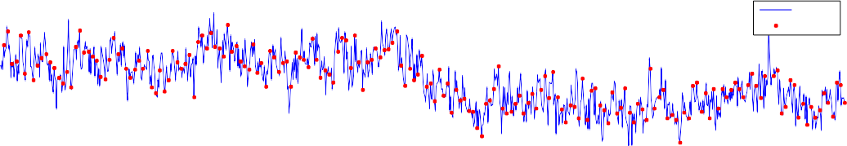


ASIC & Weighted Multiple Sampling
100
CCD output
Output Samples
50
Level [ _{μ}V]
0
-50
-100
-150
-200
0
10
20
30
40
50
time [_{μ}s]
60
70
80
90
100
0.04
Filter coefficients
Averaging filter
Optimal filter 0.02
0
-0.02
Coefficient
-0.04
0
20
40
60
80
100
Sample
120
140
160
180
200
●
Mixed signal chip designed at PUC
●
Framework developed for particle physics calorimeters
Adapted to CCD readout:
an analytical method to determine weighting coefficients by noise minimization
Reduces noise floor due to Flicker noise, for slow pixel times
In agreement with published results
1 poly – 6 metal 180 nm CMOS process.
Die size: 2.742mm × 2.84mm.
ASIC for CCD to be designed to include:
–
●
●
●
–
Preamps ADCs
Clock drivers
–
●
–
To work cryogenically
●
●
–
Gach (PASP 2003)
Clapp (SPIE 2012)
–

Slide 3
