Slide 1
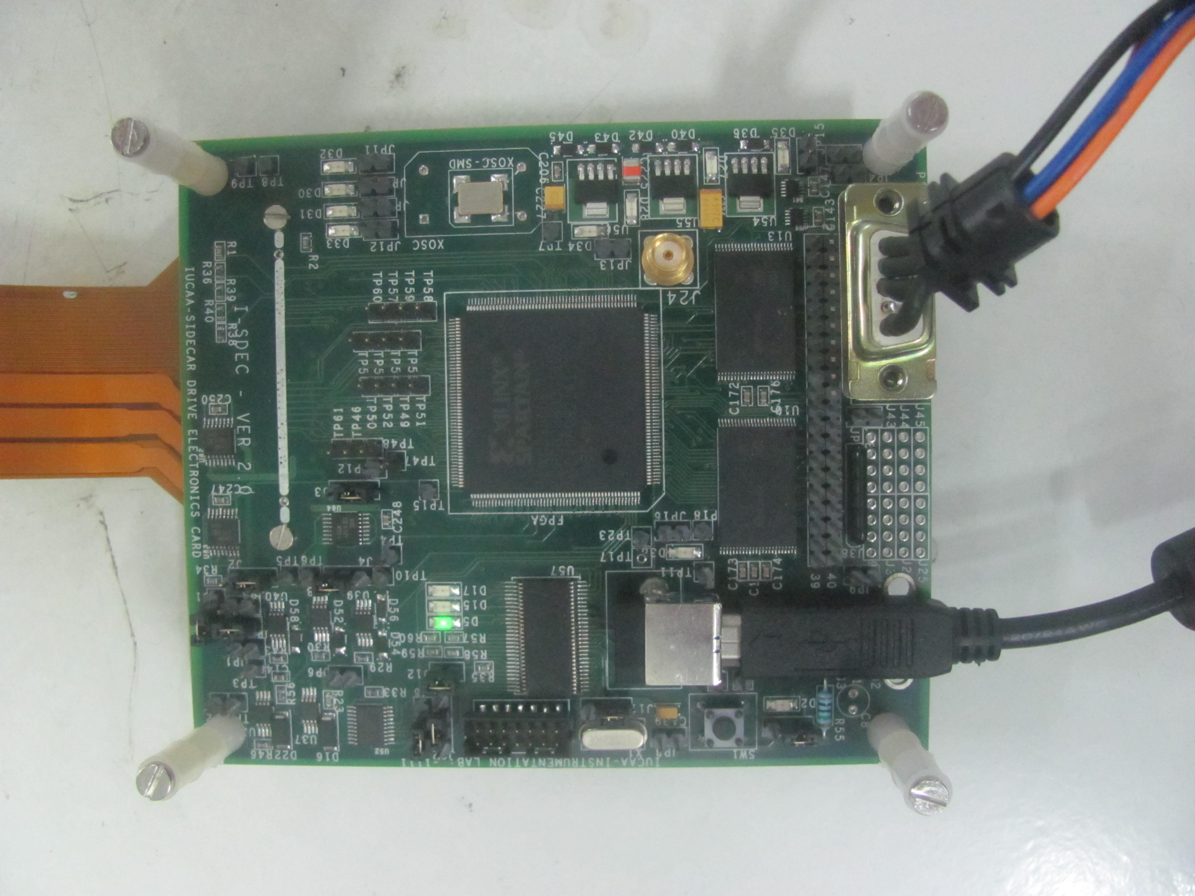
IUCAA SIDECAR DRIVE ELECTRONICS CONTROLLER (ISDEC) for Teledyne H2RG DETECTOR Inter-University Centre for Astronomy and Astrophysics, Pune, INDIA
On board 2 GB NAND memory
SMA connector for external clock / sync
D Connector for 5 volt DC voltage in
USB controller chip
USB connector
Spartan-III FPGA as a main controller

Slide 2
IUCAA SIDECAR DRIVE ELECTRONICS CONTROLLER (ISDEC) for Teledyne H2RG DETECTOR
Ready to use complete package
Spartan III-E based card, designed to work at -40 deg
Compatible with firmware supplied by Teledyne
Supports 50 to 500 KHz pixel rates, work on new (Differential Multi Accumulate) readout modes in progress
Linux based software, one for Configuration and one for Acquisition / Exposure.
System RN 1-2 electrons with SIDECAR ASIC Pre Amps inputs grounded
Current and planned Users : RSS-NIR for SALT, CIRCE instrument for GTC, RoboAO at Palomar, OIWFS for TMT and more …..

Slide 3
IUCAA SIDECAR DRIVE ELECTRONICS CONTROLLER (ISDEC) for Teledyne H2RG DETECTOR
THANK YOU
For more information please come and have a look at my poster which is located at R6.

