Slide 1
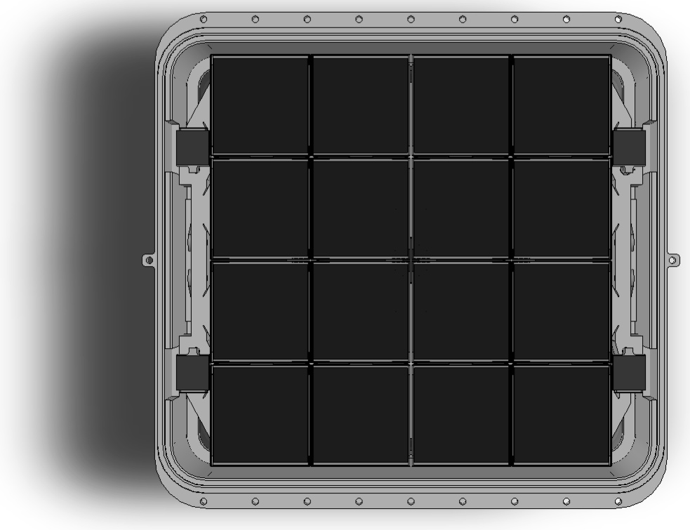
Differential Signal Path for 64 ch ZTF Mosaic
Roger Smith and Stephen Kaye
California Institute of Technology

Slide 2
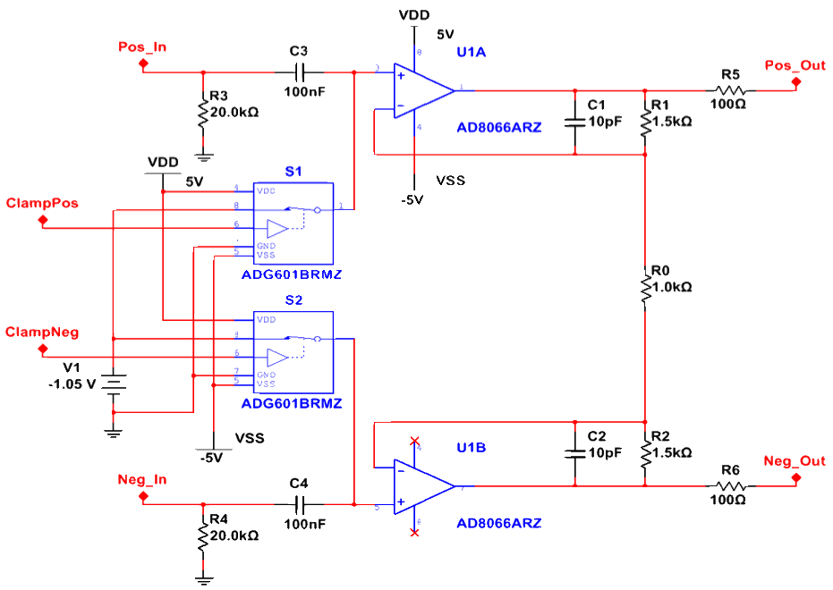
Differential preamp is line driver
e2v 231-C6:
Signal out
Electronics outside telescope beam
Commercial Twinax
Dummy out
Pros of differential
Video cross talk reduced
→ negligible ?
Less susceptible to interference.
These become common mode errors which are rejected:
  Bias noise
  Ground differentials
  Reset feedthrough
  Clock feedthrough
  Clamp control feedthrough.
  AC coupler drift
    → clamp once per line.
Cons
CCD noise is incurred twice.
CCD output power is doubled.

Slide 3
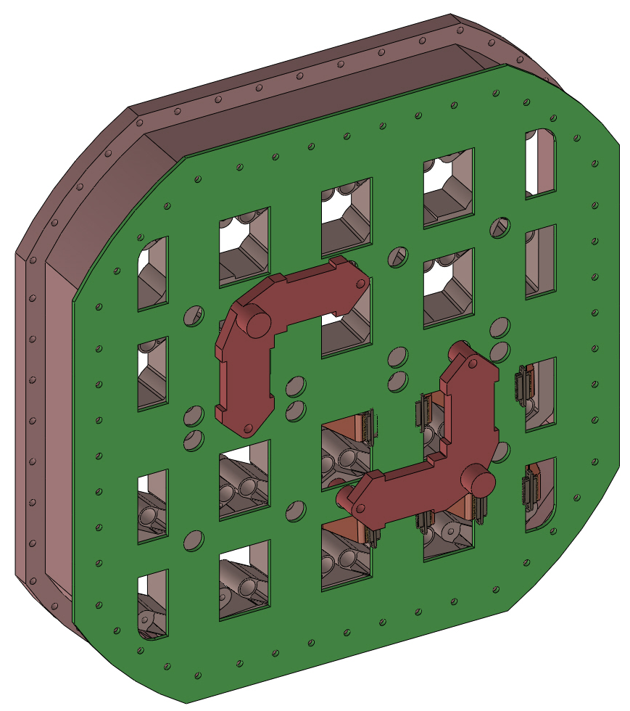
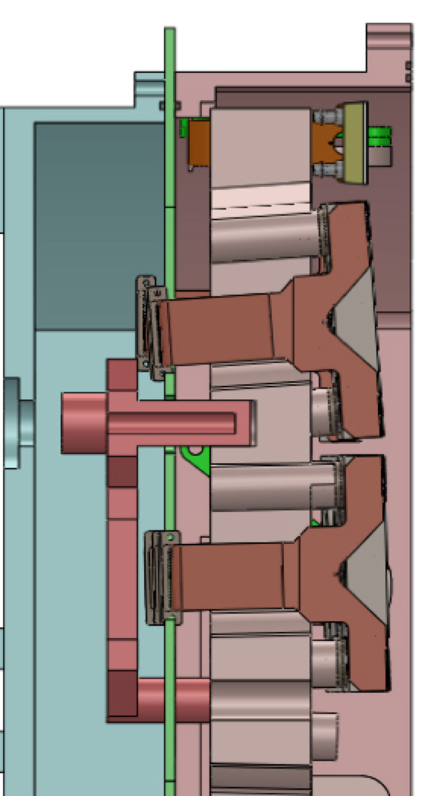
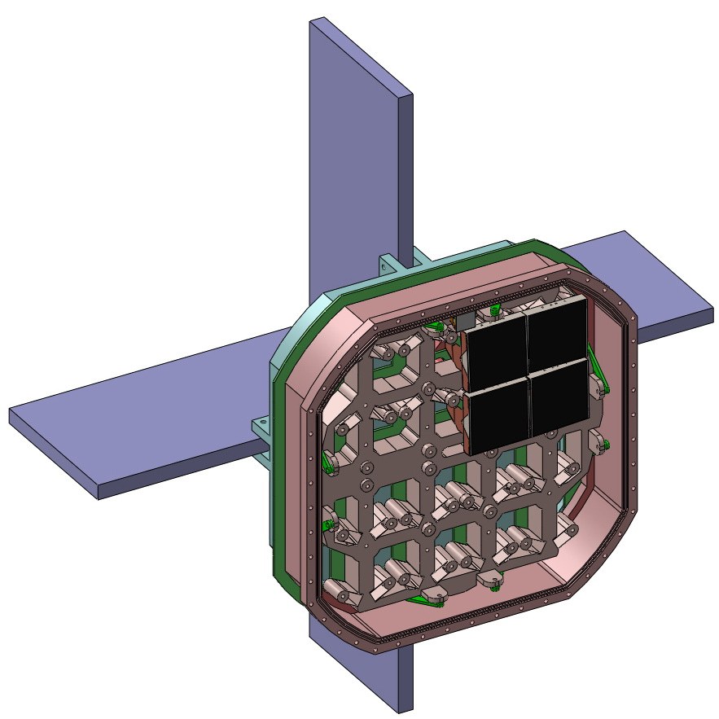
No hand wiring
COTS cables
to electronics outside beam
Samtec ERDP-049 twinax 32 pair
Glenair 177-710 shielded 100 pin
Vacuum Interface Board
1/8” thick PCB carries preamps
Trapped between two O-rings
    in side wall and back cover.
Signals routed on internal layers.
Outer layers are isolated, in contact with case: conduct heat from preamps.
Eliminates hermetic connectors.
COTS cables connect directly to edges: all custom wiring in PCB.
A
A-A
A

