Slide 1



KMTNet Posters
L19 Camera Design
L21 Electronics

Slide 2
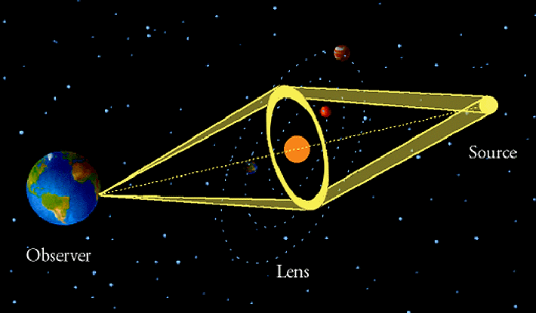
Geometry of Microlensing

Slide 3
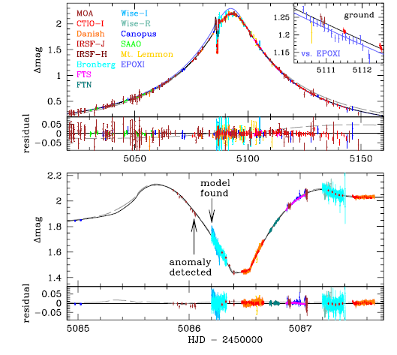

Slide 4
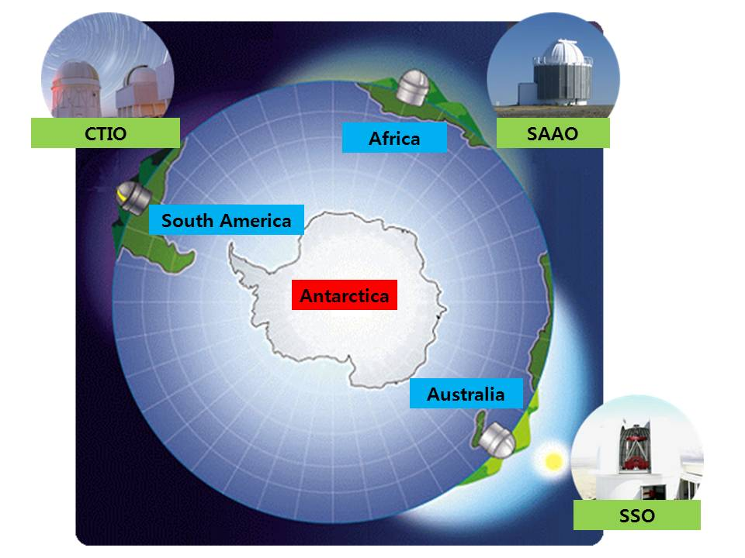
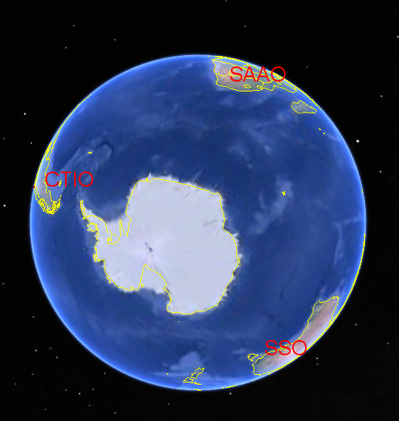
The Projetct

Slide 5
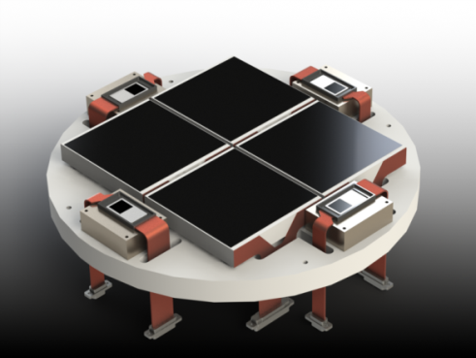
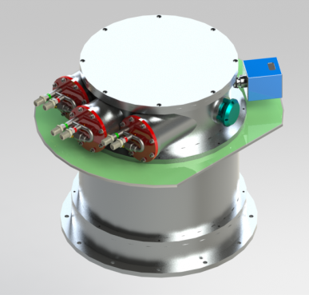
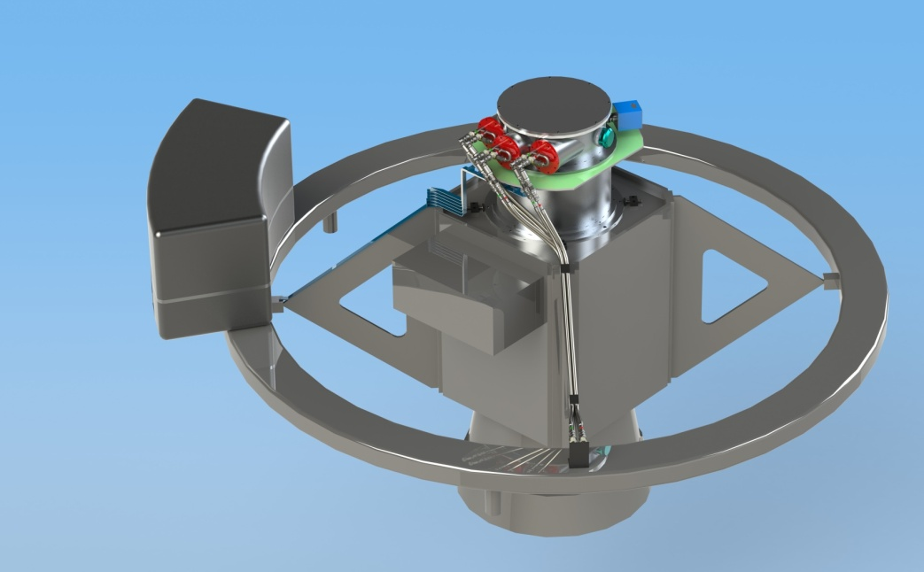
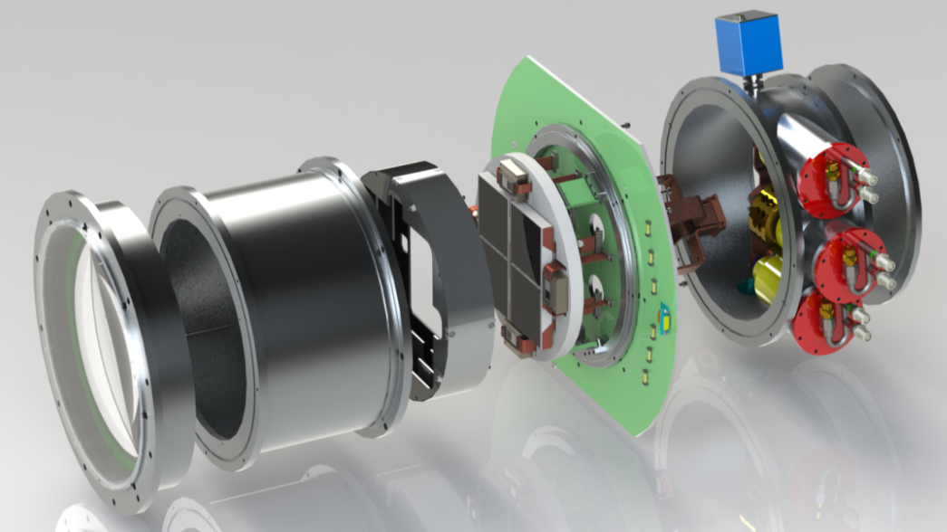
Camera System
4 Element Prime Focus Corrector
4x 9k x 9k 10 micron CCDs
4x 1k x 1k Guide CCDs
Closed Cycle Cooling System

Slide 6
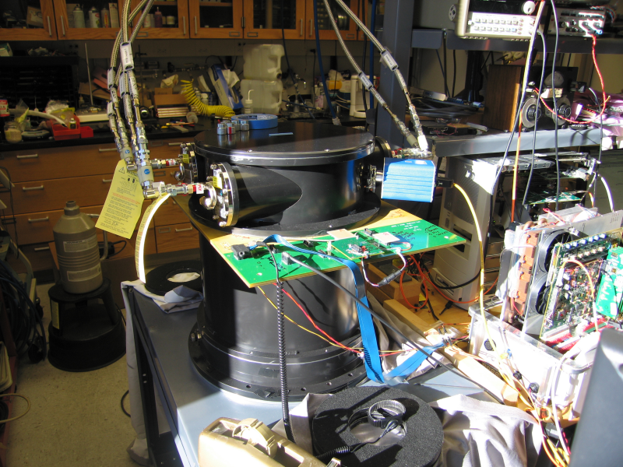
Renderings are neat, Labs are not.

