Slide 1
Cabling Design for a
CCD231 based camera
Dr. Simon Tulloch
University of Sheffield

Slide 2
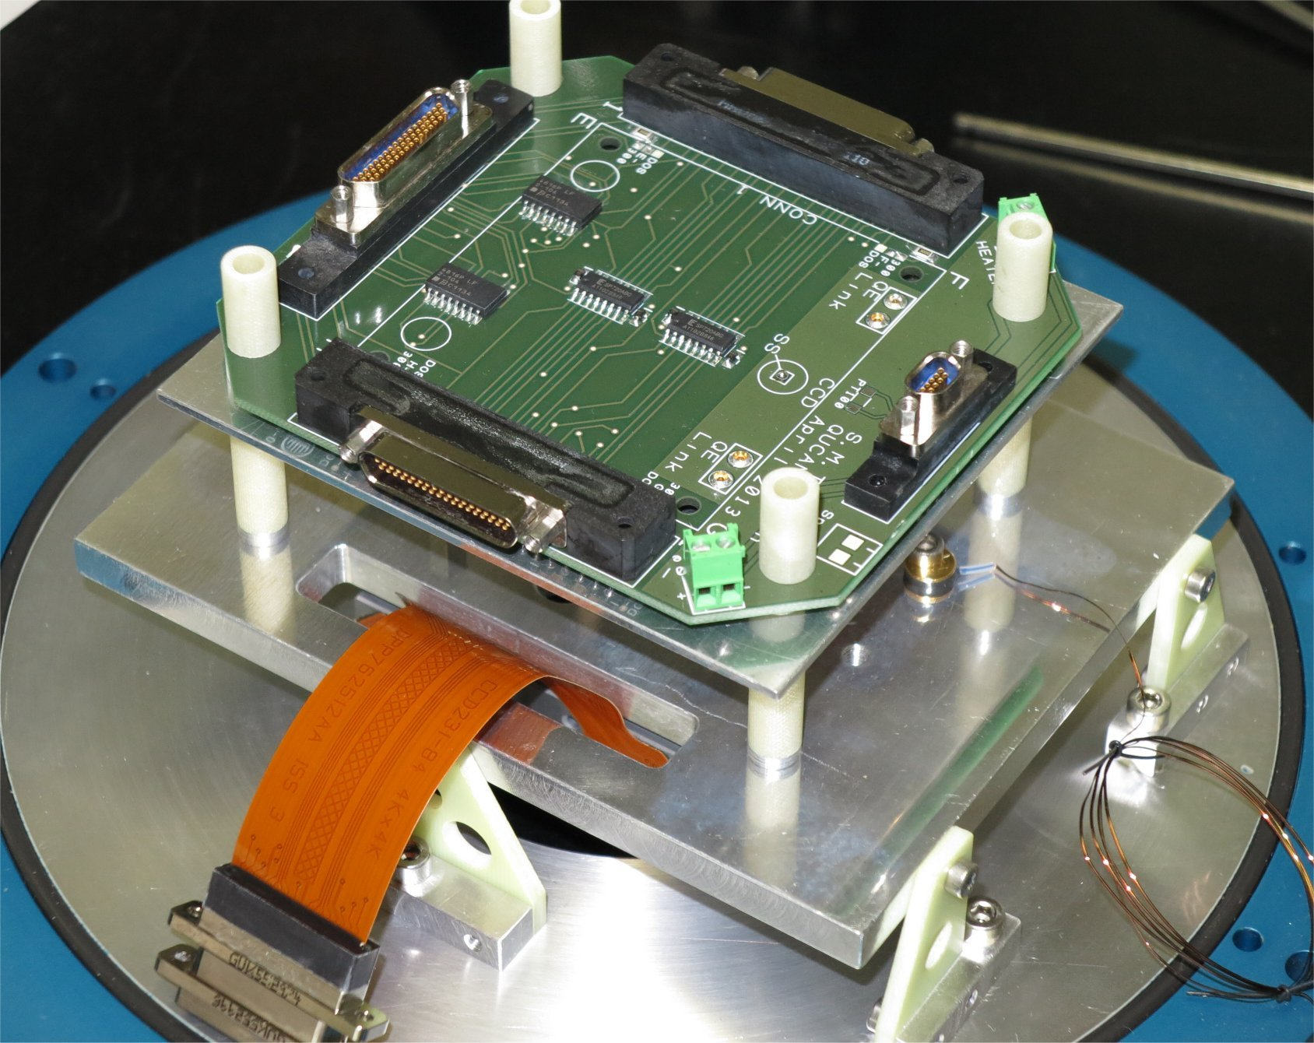
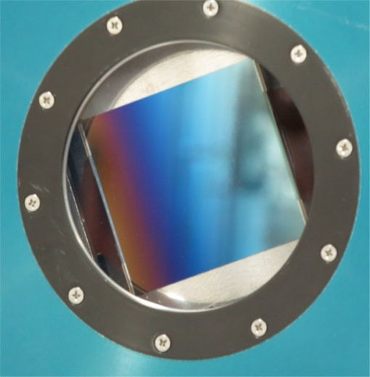
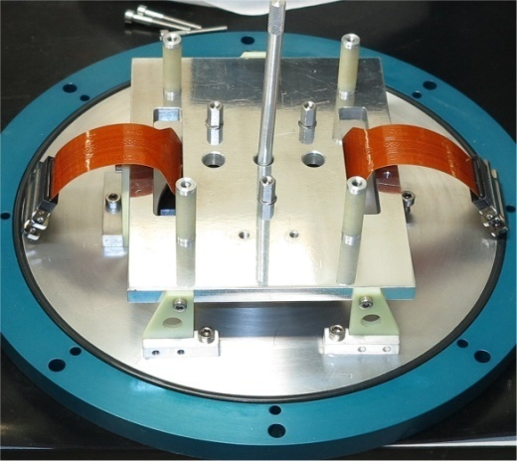
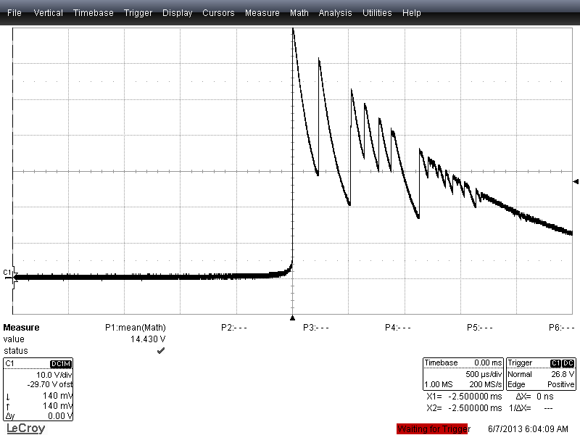
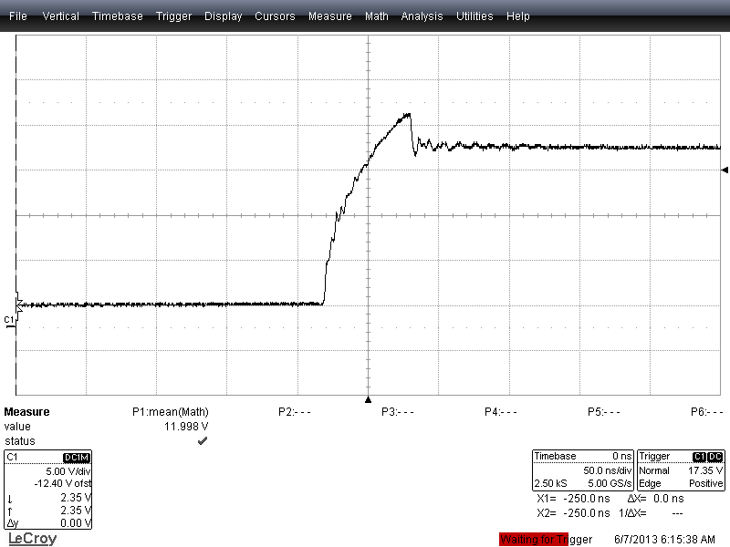
CCD231 Camera
Cryostat Head Board
E2V CCD231
graded AR coating.
SP720
Very poor EMI environment
in lab. PCB has option
to use differential video.
Raw ESD
17V
70V
With SP720
protection
circuitry
60ns

Slide 3
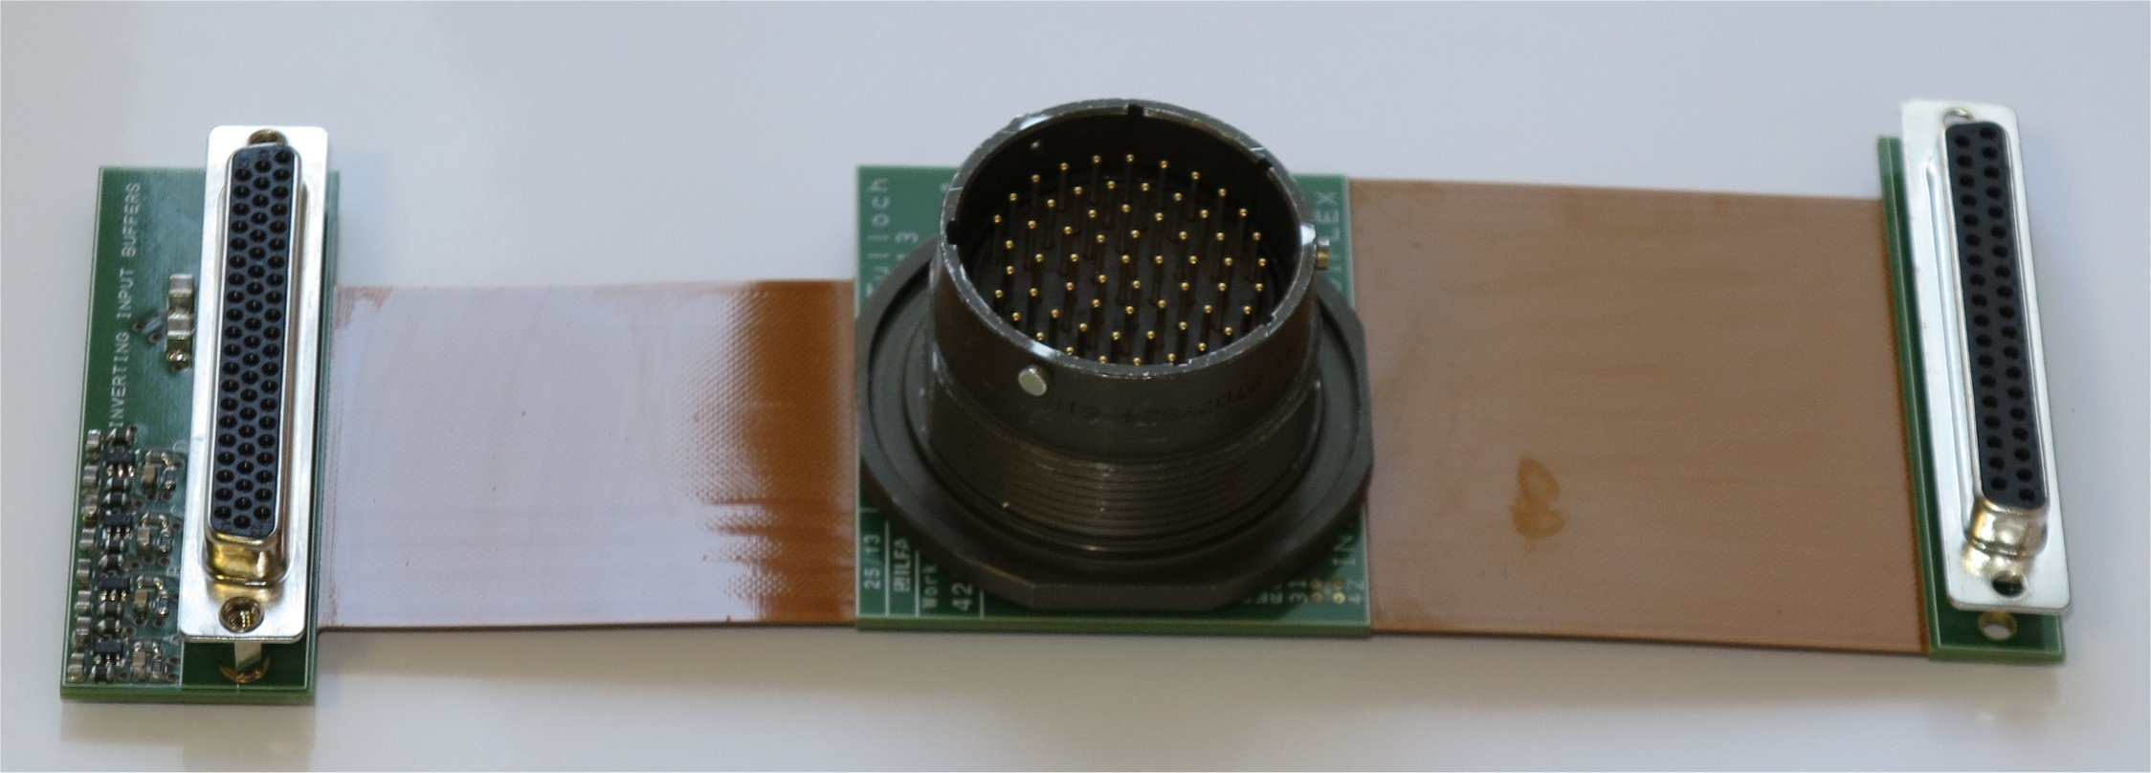
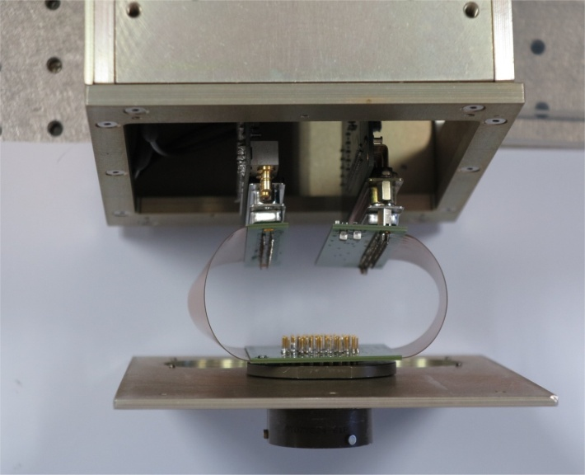
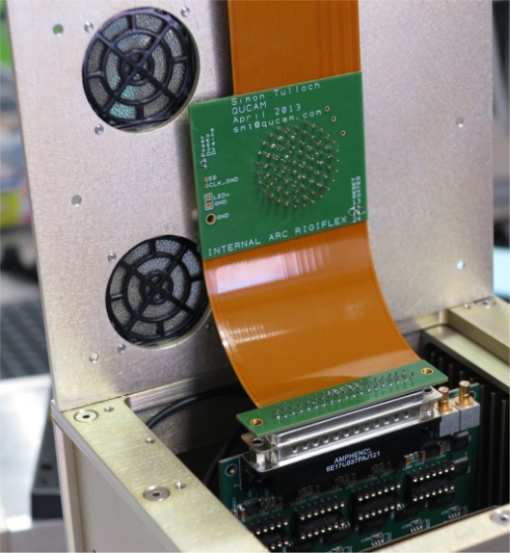
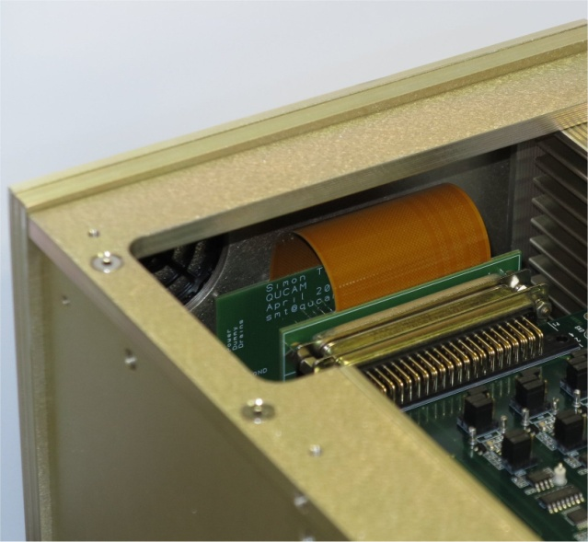
Controller cabling : 6-layer rigiflex
Biases
Clocks
Pre-amp power
Differential video
(segmented sheathes)
Buffer op-amps for inverting inputs (controller video board has only 1k input impedance on inverting inputs) .
ARC Controller.
Installation process.

Slide 4
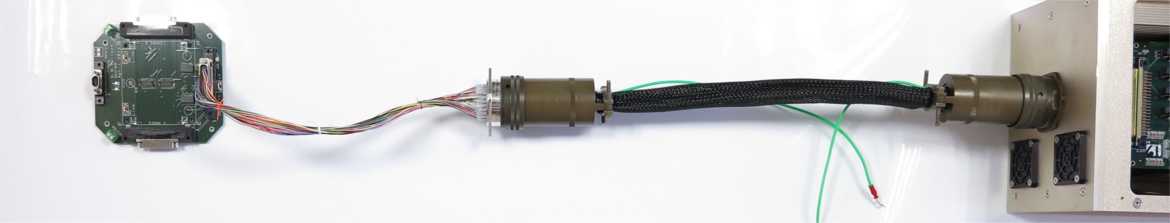
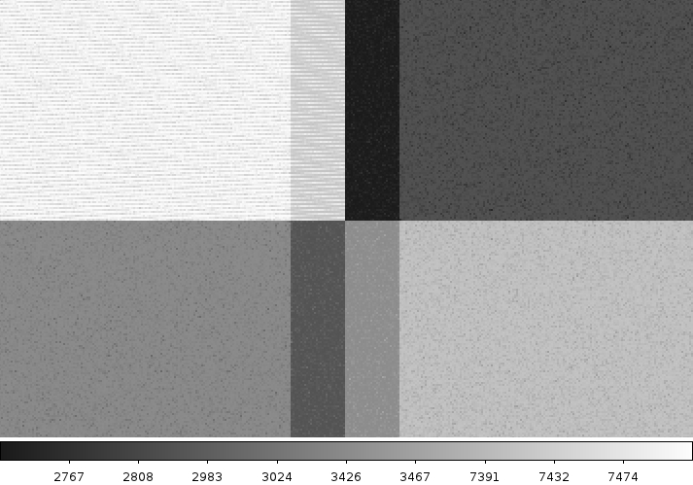
Complete assembly. Gives approx. 2MHz video bandwidth
150kpix/s bias (with some light leakage)
5e- RMS
20 e- RMS
overscan
overscan
Differential
Single ended.
Centre of a
quad-readout image.
Upper-left quadrant
used in single-ended
mode, others in
differential
5e- RMS
5e- RMS
overscan
overscan
Differential
Differential

