Slide 1
DECam low level data acquisition
Camera Built for the Dark Energy Survey (DES)
LBNL fully depleted, back side illuminated, 250 um thick
62 2x4K LBNL science
8 2x2K focus
4 2x2K guiding
520 Mpix - 1.2 GB image
17 secs readout (140 amplifiers)

Slide 2
DECam low level data acquisition
SISPI
OCS
(console)
SISPI
GCS
SISPI
PSL
tcp/ip
science
guider
science
science
science
focus
panview-1
(readout1)
panview-g
(readout2)
panview-3
(readout3)
panview-4
(readout4)
panview-5
(readout5)
panview-f
(readout6)
fiber optics
crate1
crate2
crate3
Monsoon
bkp1
Monsoon
bkpg
Monsoon
bkp3
Monsoon
bkp4
Monsoon
bkp5
Monsoon
bkpf
clk, sync
18 ccds
4
ccds
18
ccds
8
ccds
18
ccds
8
ccds

Slide 3
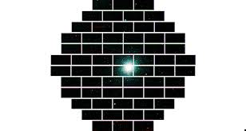
DECam low level data acquisition
BKP3
BKPG
BKP1
BKP4
BKPF
BKP4

