Slide 1

Wide-Band Spice Model of the High-Speed and High-Voltage Transformers for the CCD220
Jorge Romero
University of Málaga (http://www.uma.es)
Javier Reyes (Presenter), Mark Downing
European Southern Observatory, ESO (http://www.eso.org)
Spice Model of the High-Voltage Transformers for the CCD220
Scientific Detector Workshop 2013. 7-11 October 2013. Florence, Italy

Slide 2
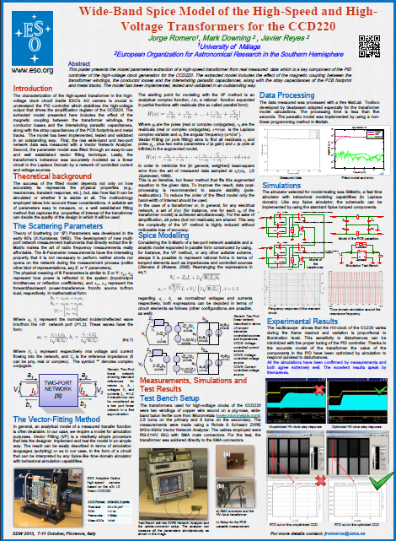
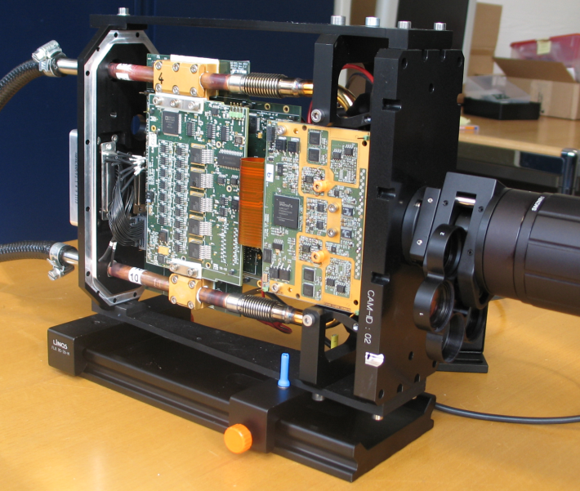
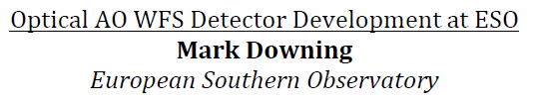
ESO Adaptive Optics Camera
CCD220 is and EMCCD
High-Voltage clock key element for electron multiplication
At the core of the high-voltage clock there is a high-speed transformer
High-Voltage PID controller
MOSFET switching at the primary of the transformer
PID controller
Peak Detector
Peak Detector
Spice Model of the High-Voltage Transformers for the CCD220
Scientific Detector Workshop 2013. 7-11 October 2013. Florence, Italy

Slide 3
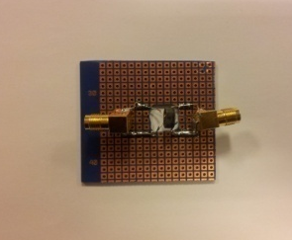
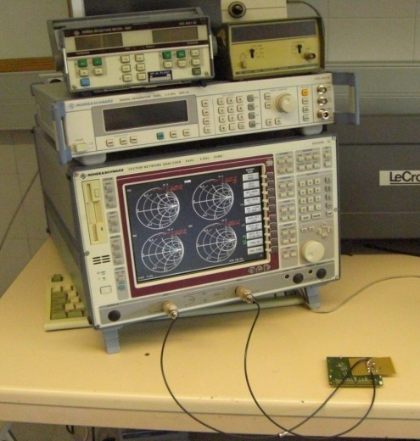
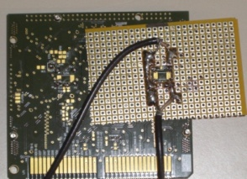
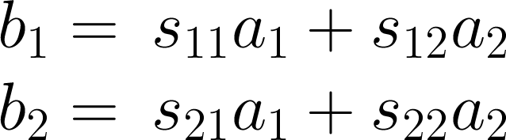
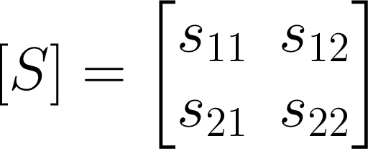
Measurement and Vector Fitting
The S-Parameter measurements have the interesting property that it is not necessary to perform neither shorts nor opens on the network during the measurement process (unlike other kind of representations, say Z or Y parameters)
One can translate S parameter to Z or Y parameters
a₁
a₂
TWO-PORT
NETWORK
[S]
V₁
I₁
I₂
V₂
b₁
b₂
Spice Model of the High-Voltage Transformers for the CCD220
Scientific Detector Workshop 2013. 7-11 October 2013. Florence, Italy

Slide 4
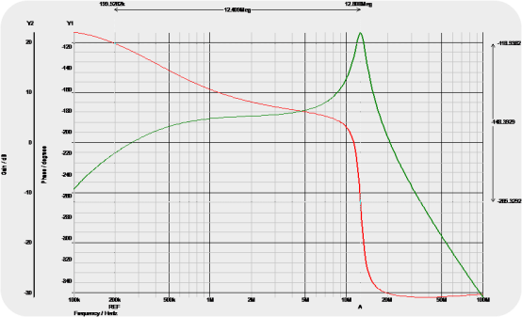
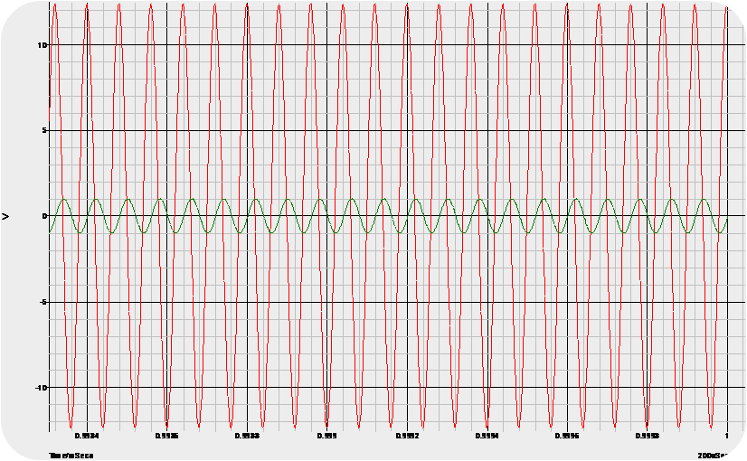
Very accurate modelling
The extracted model includes:
The effect of the magnetic coupling between the transformer windings
The conductor losses
The interwinding parasitic capacitances
The stray capacitances of the PCB footprint and metal tracks
Peak Detector
Model of the transformer
Peak Detector
Frequency-response of the resonant circuit.
The Spice model
The transformer’s behaviour was accurately modeled as a linear circuit in the Laplace Domain by a network of controlled current and voltage sources.
Time-domain simulation around the resonance frequency
Fine tuning of the
PID parameters possible
10 October 2013
4
Spice Model of the High-Voltage Transformers for the CCD220
Scientific Detector Workshop 2013. 7-11 October 2013. Florence, Italy

Slide 5
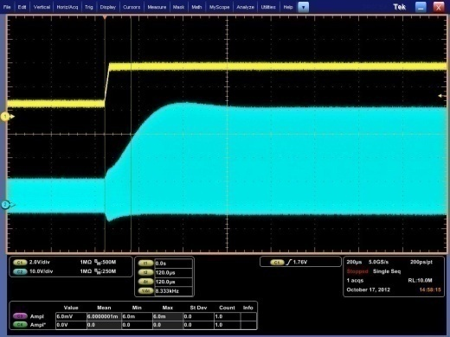
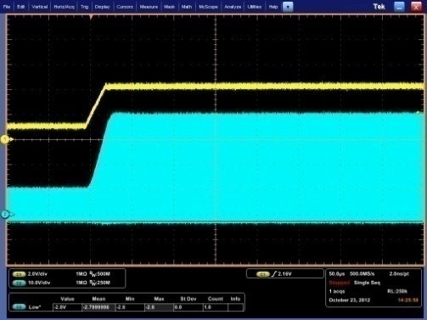
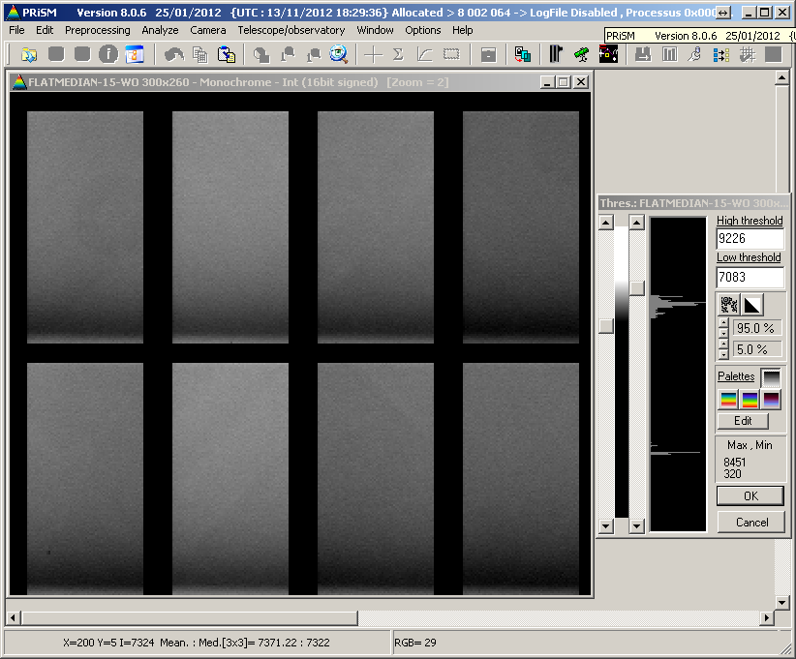
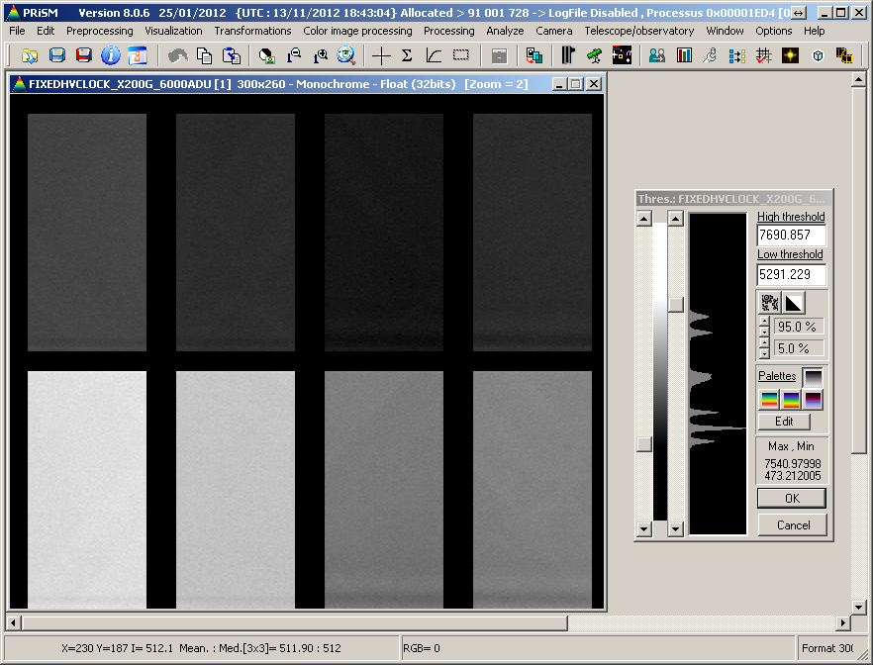


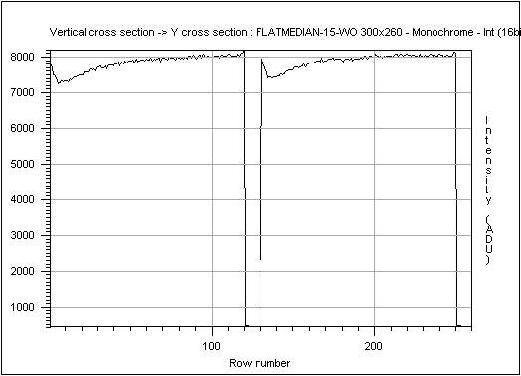
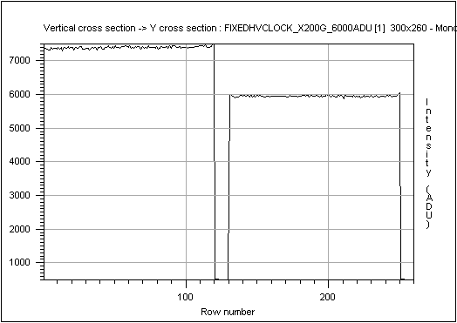
Experimental Results
The oscilloscope shows that the HV-clock of the CC220 varies during the frame readout and variation is proportional to illumination level. This sensitivity to disturbances can be minimized with the proper tuning of the PID controller. Thanks to the accurate model of the transformer the value of the components in the PID have been optimized by simulation to respond quickest to disturbances.
All the simulations have been confirmed by measurements and both agree extremely well. The excellent results speak by themselves.
Unoptimized HV-clock step response
Optimized HV-clock step response
RTD cut on the unoptimized CCD
RTD cut on the optimized CCD
Spice Model of the High-Voltage Transformers for the CCD220
Scientific Detector Workshop 2013. 7-11 October 2013. Florence, Italy

Slide 6
Thanks to Jorge Romero and the University of Malaga for this outstanding work

