Slide 1
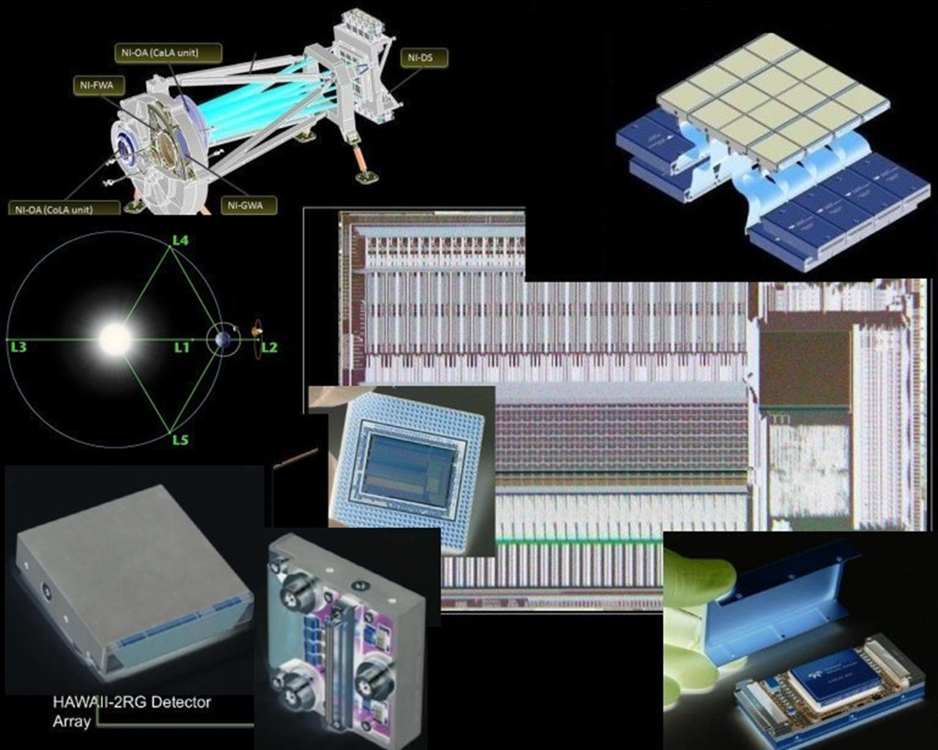
Control System for the Euclid-NISP Mission
IR Focal Plane
F. Bortoletto, C. Bonoli, M. D’Alessandro,
L. Corcione, S. Ligori
On Behalf of NISP Team, EC, ASI, INAF
DWG 07-11 October 2013 F. Bortoletto on behalf of NISP team, EC, ASI, INAF Page : 1

Slide 2
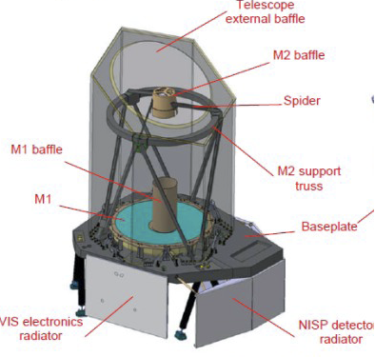
EUCLID COSMOLOGICAL SURVEY
Mission Heritage :
DUNE : VIS/NIR
DARK MATTER by
WEAK LENSING SURVEY
    Imaging/Photometry
    Photo-Z
SPACE : NIR
BAO by 3D Spectroscopic SURVEY
DMD Spectroscopy/ BAO
Imaging
EUCLID : 3x Combined Modes For 15K Deg² and 40 Deg² Coverage for
Wide and Deep Survey, 1.2m Collecting Area
VIS: Weak-Lensing (550÷900 nm), Psiz=0.1”, 36 4Kx4K CCD, FOV 0.79x0.71 Deg² ,24.5 M_{AB}
NIP: Weak-Lensing / BAO (920÷2000 nm), Psiz=0.3”, 16 2Kx2K H2RG2.3, FOV 0.76x0.72 Deg²
3x Bands Photometry/Photo-Z (Y, J, H) ,24 M_{AB}
NIS: BAO (1100÷2000 nm), R250 2x Bands Slitless Spectroscopy
Same IR
Focal Plane
DWG 07-11 October 2013 F. Bortoletto on behalf of NISP team, EC, ASI, INAF Page : 2

Slide 3
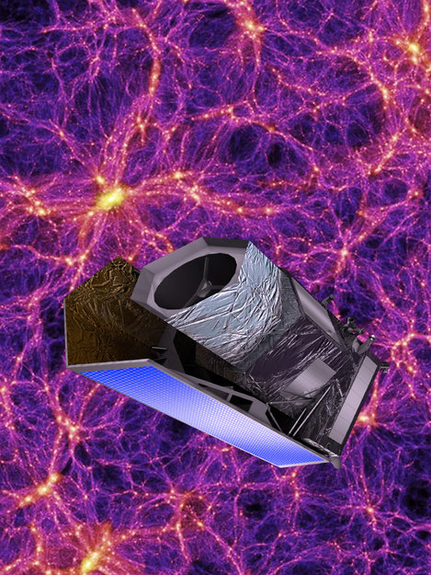
Euclid Key Milestones
SELECTION 5 Oct 2011
GO-AHEAD 22 Jun 2012
PAYLOAD SELECTION
(Astrium) Jun 2013
IPDR Jan 2014
FM DELIVERY Jul 016
LAUNCH ~ 2020
6 YEARS SURVEY
DWG 07-11 October 2013 F. Bortoletto on behalf of NISP team, EC, ASI, INAF Page : 3

Slide 4
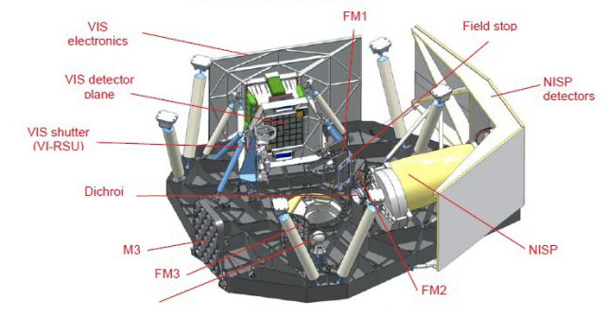
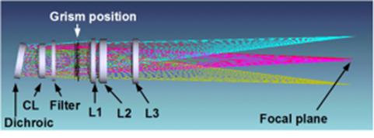
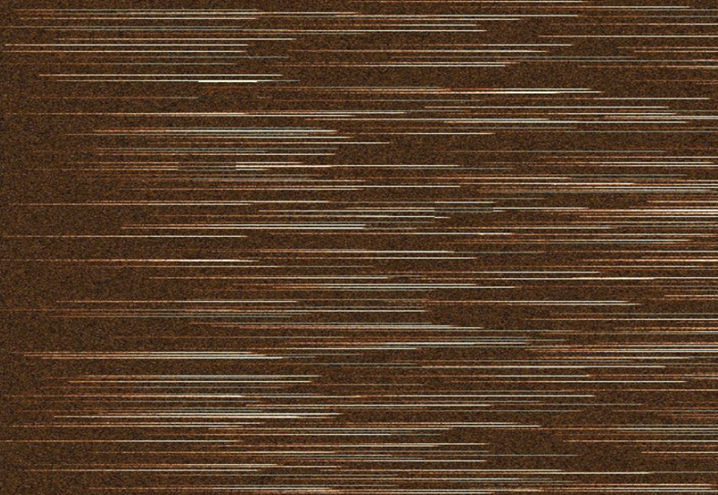
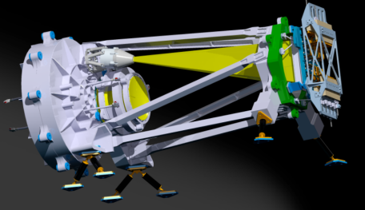
The Euclid NISP Instrument
The Near Infrared Opto-Mechanical Assembly
(NIOMA) Optical Design
The NIOMA Structure @ 120÷135 K°
aXeSIM Simulated Slit-Less Frame
DWG 13-15 October 2013 F. Bortoletto on behalf of NISP team, EC and ASI Page : 4

Slide 5
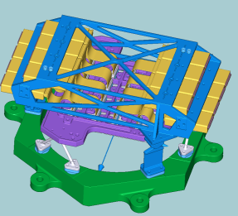
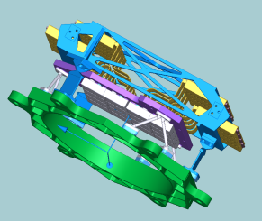
    NISP Focal Plane System
135K ASIC Thermal Conductive Interface
On Al
FLEXI- WIRES
(ESA/NASA)
16 H2RG DETECTORS @ <98K
(provided by ESA/NASA)
95K H2RG Thermal Conductive Interface
On MOLYBDENUM plate
ASIC Sidecar @140K
(ESA/NASA)
SiC Flange
DWG 07-11 October 2013 F. Bortoletto on behalf of NISP team, EC, ASI, INAF Page : 5

Slide 6
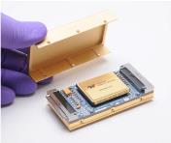
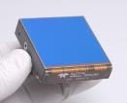

    NISP Focal Plane System
NI-SCS (Sensor Chip System) : 16x H2RG Sensor chip with Moly Package + Flexi-Wire + SIDECAR ASIC Package Triplets
+ +
  NISP Specific Detectors (2.3 µ Cut-Off) Provided to the consortium by ESA (Development & Qualification Phase) & NASA (Flight + Spares Phase)
  Good performances measured on the first batch of detectors produced by TIS with samples already matching Euclid Specs.
  Requirements on ‘total’ noise, pixel-operability still under revision following test results
DWG 07-11 October 2013 F. Bortoletto on behalf of NISP team, EC, ASI, INAF Page : 6

Slide 7
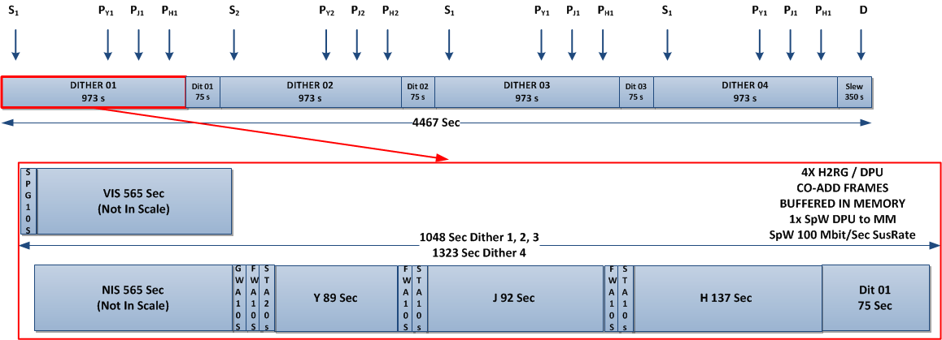
Survey Strategy
Data Products :
19 Cycles/Day
4x Dithers/Cycle
TOTAL/cycle = 1.33 Gbytes
TOTAL/day = 25.420 Gbytes = 203.4 Gbit/day
Assigned telemetry = 240 Gbit/day
Assumed Lossless Compression Factor 2
1x Compressed Image / Exposure
1x Compressed Q.Fact / Exposure
Test/Debug. Modes Allowing
Intermediate Data Down-Loading
DWG 13-15 October 2013 F. Bortoletto on behalf of NISP team, EC and ASI Page : 7

Slide 8
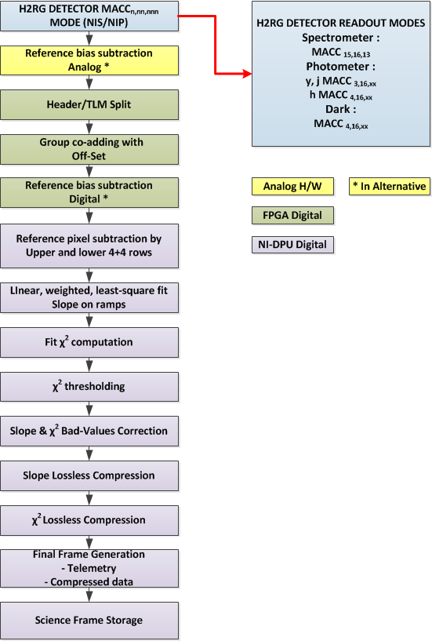
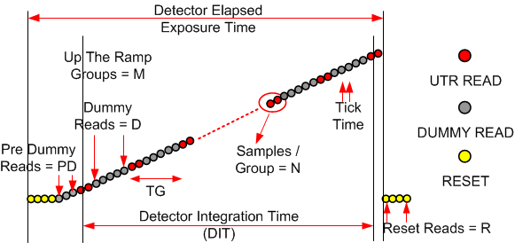
Science Data On-Board Pipe-Line
All readouts are performed in Multi-Accumulation (MACC) mode with different numbers of groups, samples/group and drops to match exposure time and noise requirements. :
No deglitching on-board
Quality indicator function for spectro & photo mode
Weighted least square fit processing for spectro & photo mode
 | Group # | Samples/ Group # | Tot. Noise RMS
Spectro-mode | >15 | 16 | 9
Photo-mode | 3÷8 | 16 | 7
SCIENCE DATA PIPELINE

Slide 9
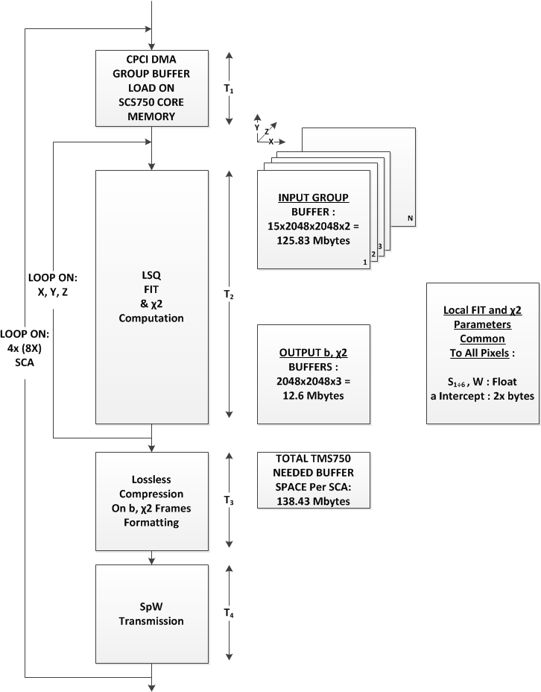
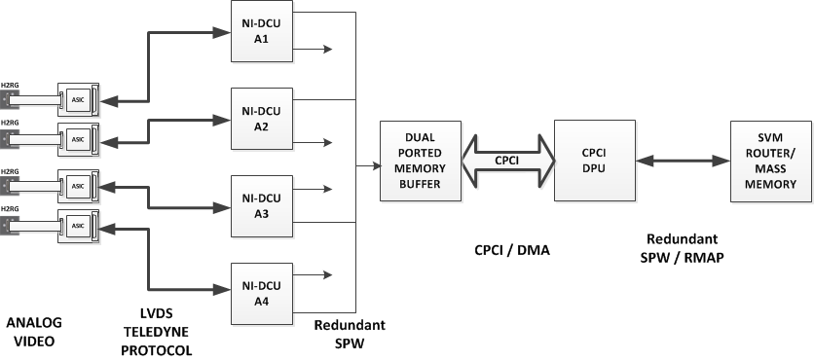
From Processing Req. To HW
Dual-Ported Transit Memory on Groups is required for Test & Debug and to optimally use PPC cache
Dual-Ported Memory size dimensioned on MACC parameters, processing flow and redundancy requirements
Redundacy option requires one DPU can process 4x or 8x triplets data
It can be done :
  Increasing Clock (400 > 800 Mhz
  Changing Algorithm
  Changing MACC sequence
MAXWELL board (256 Mbytes)
can optimally process 1x SCA MACC at a time
DWG 13-15 October 2013 F. Bortoletto on behalf of NISP team, EC and ASI Page : 9

Slide 10
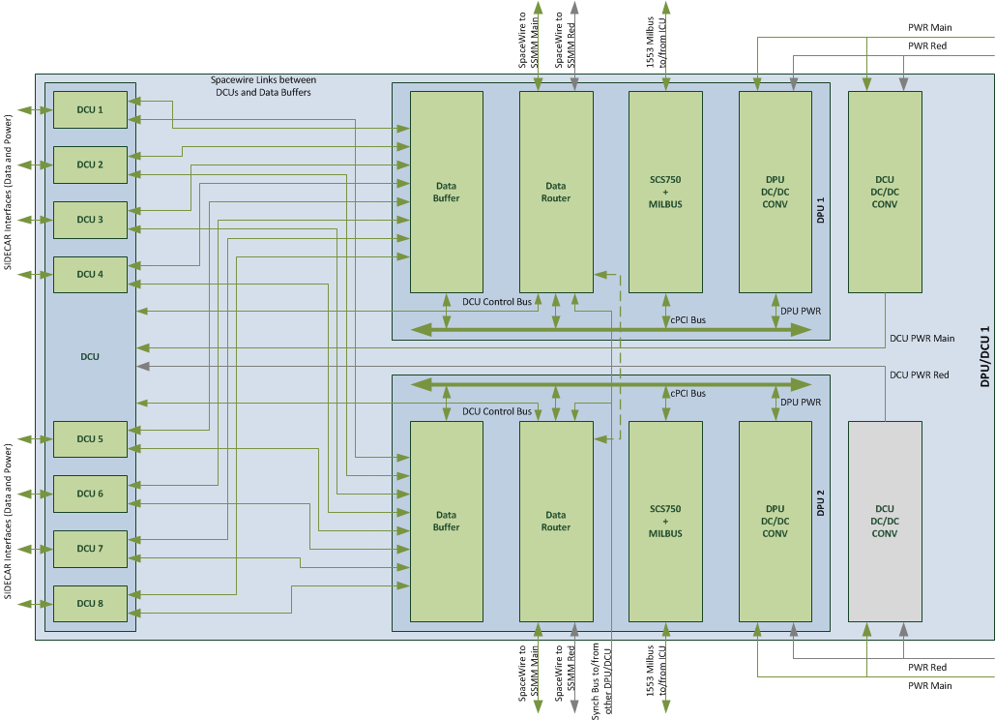
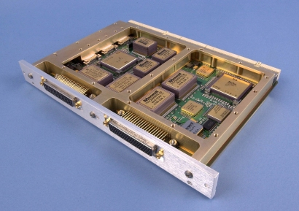
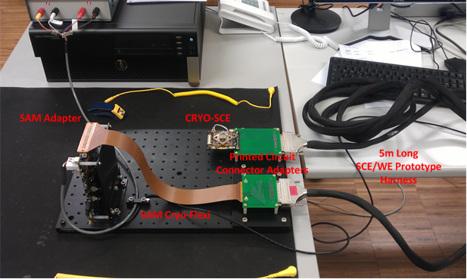
Present WE Architecture: 1 From 2x Units
DPM
SPW
DPU
P.SUP
L
INK
DCU
SPW
Triplets 1-4
1x Triplet/DCU
Triplets 5-8
1553
DWG 07-11 October 2013 F. Bortoletto on behalf of NISP team, EC, ASI, INAF Page : 10

Slide 11
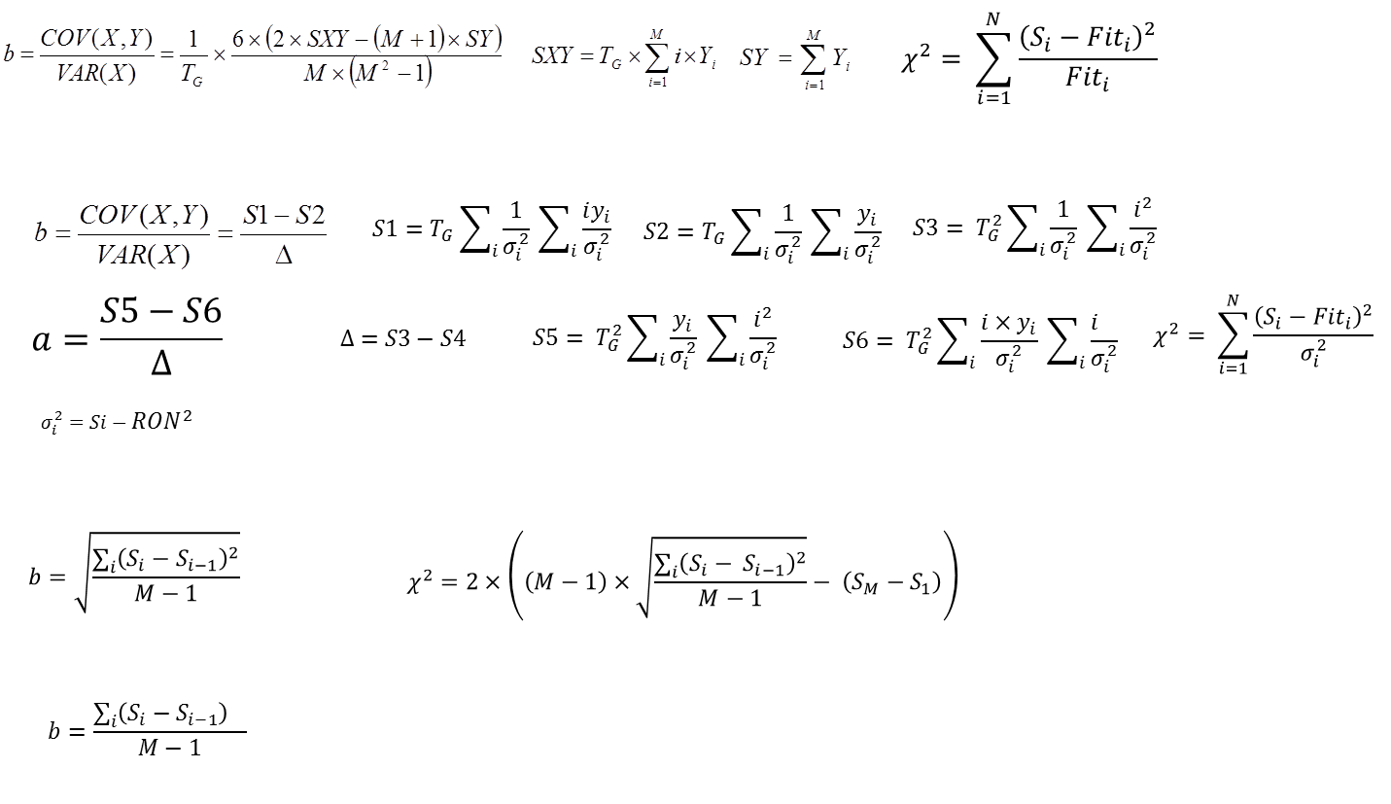
On-Board Processing Fit Algorithms
Simplified Least-Square Fit on Signal Samples :
Weighted/Unweighted Least-Square Fit on Signal Samples :
Weighted/Unweighted Least-Square Fit on Signal Samples Derivative :
Weighted/Unweighted Mean on Signal Samples Derivative :
DWG 07-11 October 2013 F. Bortoletto on behalf of NISP team, EC, ASI, INAF Page : 11

Slide 12





































































    Algorithms Simulation Analysis
AxeSYM Image template
Multy-Accumulation Data-Cube
Final cosmic hits map
DWG 07-11 October 2013 F. Bortoletto on behalf of NISP team, EC, ASI, INAF Page : 12

Slide 13
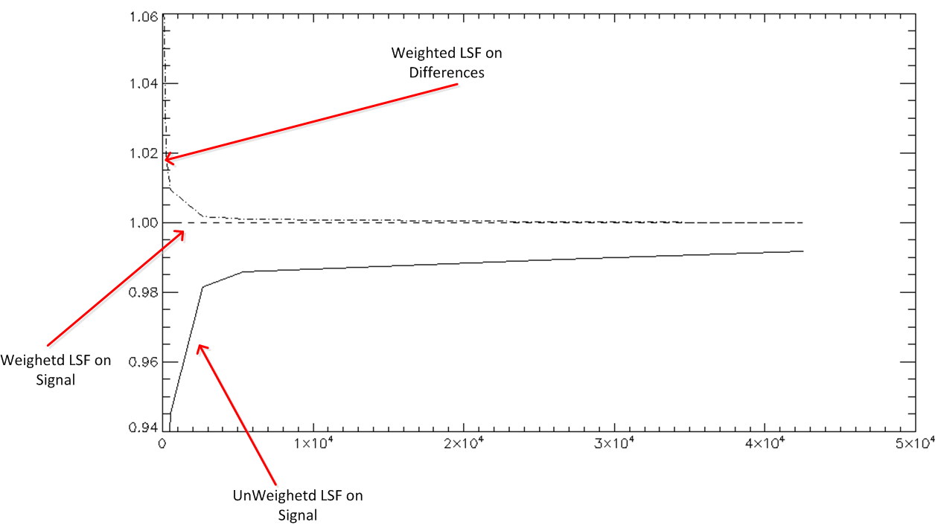
Algorithms Simulation Analysis
Algorithms tested with MACC data produced by IDL simulators :
Comp. Slope/
Real Slope
e⁻
DWG 07-11 October 2013 F. Bortoletto on behalf of NISP team, EC, ASI, INAF Page : 13

Slide 14
Results: Algorithm Speed Tests On Real HW
Processing Time
Computational time for the different algorithms. Simplified real-time version was tested on CPCI Maxwell board both at 400 and 800 Mhz and recently tested on a VME Motorola 5100 at 400 Mhz, same PPC750 processor and same VxWorks OS.
MODE | COMPUTATIONAL TIME ON PENTIUM (s) | Motorola 5100 @ 400 Mhz (s)
Simplified Least-Square Fit on Signal Co-Added Ramp | 6 | 122
Weighted Least-Square Fit on Signal Co-Added Ramp Floating Point Version | 14 | 235
Weighted Least-Square Fit on Signal Co-Added Ramp Integer Version | 8
Un-Weighted Least-Square Fit on Co-Added Ramp Derivative | 4 | 95
Weighted Least-Square Fit on Co-Added Ramp Derivative | 5 | 114
Average of Co-Added Ramp Derivative | 4 | 93
Lossless Compression for slope and chi2 frames | 1.2 | 5
Upper and lower reference pixel correction | 0.26 | 0.5
Computational time for the different algorithms developed in a Pentium and currently under test in a Motorola 5100 board.
Base is MACC 15,16,13 case and 4 H2RG detectors (2048x2048 pixels). About 600 Sec CPU time required per dither (dither time 1048 Sec)
Dimensioning of Redundant Dual Ported
Memory Buffer for 1x Dither Buffering :
First 3 dithers
Spectro, 16 groups: 1.07 Gbyte
Photo, 3 groups Y and 4 in J and H: 0.738 Gbyte
Ending 4th dither
Dark in photo mode: 0.268 Gbyte
For a total of 2.07 Gbyte of data.
 | Runs on the same data set (s) | Runs on different data sets (s)
Weighted Least-Square Fit on Signal Co-Added Ramp Floating Point Version | 240.13±0.14 | 240.13±0.42
DWG 07-11 October 2013 F. Bortoletto on behalf of NISP team, EC, ASI, INAF Page : 14

Slide 15
Control System for the Euclid-NISP Mission
IR Focal Plane
THANKS FOR THE ATTENTION
F. Bortoletto, C. Bonoli, M. D’Alessandro,
L. Corcione, S. Ligori
On Behalf of NISP Team, EC, ASI, INAF
DWG 07-11 October 2013 F. Bortoletto on behalf of NISP team, EC, ASI, INAF Page : 15

