Slide 1
In situ testing of detector controllers
Roger Smith
Caltech
2013-10-10

Slide 2
The need
Many “detector problems” are actually controller failures.
High channel counts make testing expensive:
  32 channels are common for NIR detectors
  Many CCD cameras are high channel count mosaics.
How to test with minimal human intervention?
This talk is an attempt to share some useful ideas rather than to be a comprehensive diagnostics manual.
Will focus on automated noise and DNL tests

Slide 3
Example problems
ADC DNL (e.g. missing codes)
Excess readout noise or bias drift (banding)
  Component failure (rare; usually bypass capacitors)
  Noisy power supplies
  Noisy bias voltages.
  ADC or DAC reference voltage drift.
  Bad grounding/shielding
Clock failures (wiring, connectors?)
Supply filtering failure; especially bypass caps.
Conducted interference (from AC outlet) or in shields (from telescope)
Non-Linearity, usually clipping, signal offsets.

Slide 4
SENSORY OVERLOAD ???
…..Let’s focus on noise and ADC DNL

Slide 5
Simplified block diagram
Clk DAC
Clock
Clk DAC
Bias
Bias DAC
Host
Disk
Detector
AC coupler (for CCDs)
ADC
Data Link
Optical Fiber
Preamp
Noise BW control
Power supplies
Network
RFI shield

Slide 6
What test equipment ?
Typical scope input ~ few mV (20Mhz BW limit)
CCD output noise ~ 3e- * 5µV/e- = 15µV
To see the noise and signals of interest we need
Low input referred noise and differential probe.
Same passband as the CDS processor
Samples to be synchronized to pixels.
  (Interference that is same on every pixel is benign)
→ Controller is its own oscilloscope!

Slide 7
Data link and pixel sorting
Clk DAC
Clock
Clk DAC
Bias
Bias DAC
Host
Disk
AC coupler (for CCDs)
ADC
Artificial Data
Optical Fiber
Preamp
Noise BW control
Power supplies
Network
RFI shield

Slide 8
Will discuss ADC testing later…
Clk DAC
Clock
Clk DAC
Bias
Bias DAC
Host
Disk
AC coupler (for CCDs)
ADC
Data Link
Optical Fiber
Preamp
Noise BW control
Power supplies
Network
RFI shield

Slide 9
Permanent integrator reset
Clk DAC
Clock
Clk DAC
Bias
Bias DAC
Host
Disk
AC coupler (for CCDs)
ADC
Data Link
Optical Fiber
Preamp
Noise BW control
Power supplies
Network
RFI shield

Slide 10
Permanent (black level) clamp
Clk DAC
Clock
Clk DAC
Bias
Bias DAC
Host
Disk
AC coupler (for CCDs)
ADC
Data Link
Optical Fiber
Preamp
Noise BW control
Power supplies
Network
RFI shield

Slide 11
Shorted input – loopback connector
Clk DAC
Clock
Clk DAC
Bias
Bias DAC
Host
Disk
AC coupler (for CCDs)
ADC
Data Link
Optical Fiber
Preamp
Noise BW control
Power supplies
Network
RFI shield

Slide 12
Bias loopback at connector or mount
Clk DAC
Clock
Clk DAC
Bias
Bias DAC
Host
Short
Disk
AC coupler (for CCDs)
ADC
Data Link
Optical Fiber
Preamp
Noise BW control
Power supplies
Network
RFI shield

Slide 13
Bias DAC test
Clk DAC
Clock
Clk DAC
Bias
Bias DAC
Host
Disk
AC coupler (for CCDs)
ADC
Data Link
Optical Fiber
Preamp
Noise BW control
Power supplies
Network
RFI shield

Slide 14
Clock loopback – stationary low
Clk DAC
Clock
Clk DAC
Bias
Bias DAC
Host
Disk
AC coupler (for CCDs)
ADC
Data Link
Optical Fiber
Preamp
Noise BW control
Power supplies
Network
RFI shield

Slide 15
Clock loopback – stationary high
Clk DAC
Clock
Clk DAC
Bias
Bias DAC
Host
Disk
AC coupler (for CCDs)
ADC
Data Link
Optical Fiber
Preamp
Noise BW control
Power supplies
Network
RFI shield

Slide 16
Clock loopback – stationary high
Clk DAC
Clock
Clk DAC
Bias
Bias DAC
Host
Disk
AC coupler (for CCDs)
ADC
Data Link
Optical Fiber
Preamp
Noise BW control
Power supplies
Network
RFI shield

Slide 17
Power Supply loopback
Clk DAC
Clock
Clk DAC
Bias
Bias DAC
Host
Disk
AC coupler (for CCDs)
ADC
Data Link
Optical Fiber
Preamp
Noise BW control
Power supplies
Network
RFI shield

Slide 18
Shield loopback -- make connection near detector if possible
Clk DAC
Clock
Clk DAC
Bias
Bias DAC
Host
Disk
AC coupler (for CCDs)
ADC
Data Link
Optical Fiber
Preamp
Noise BW control
Power supplies
Network
RFI shield

Slide 19
CCD Reset feedthru → switching threshold
Clk DAC
Clock
Clk DAC
Bias
Bias DAC
Host
Disk
Detector
AC coupler (for CCDs)
ADC
Data Link
Optical Fiber
Preamp
Noise BW control
Power supplies
Network
RFI shield

Slide 20
ADC DNL

Slide 21
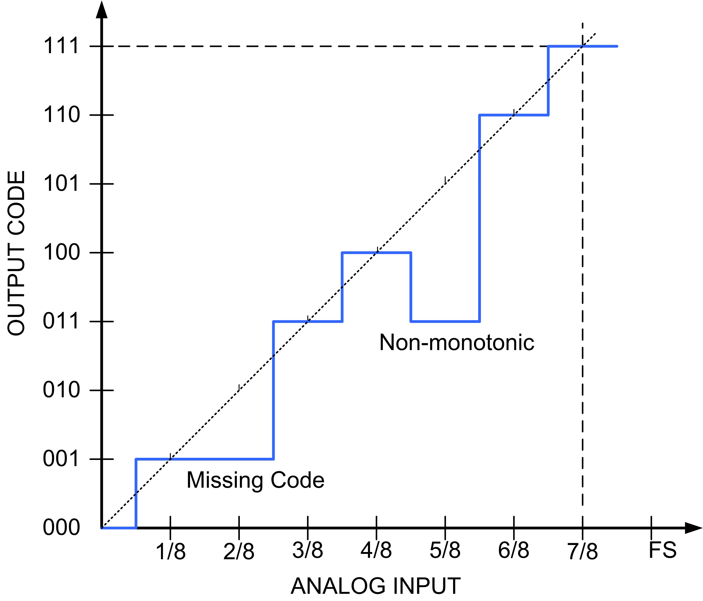
What is Differential Non-Linearity?
Variation in voltage delta corresponding to one output code, usually expressed in fraction of nominal.
+1ADU implies that code represents twice the usual input range
Poor DNL can suppress or exaggerate noise depending on signal level.
Common causes:
Differences between analog and digital ground at ADC.
Pixel synchronous transient on ADC supply or reference.
Inductance in bypass cap leads; self inductance.
Reference or signal source impedance too high at bit rate.

Slide 22
How to measure DNL?
Too hard to scan input voltage to look for thresholds directly (noise, drift), so instead…
Generate input signal with smooth histogram
  flat is good but not required.
Make histogram of raw data. Must be totally unprocessed.
Counts per bin are proportional to voltage delta represented by each code.
  Works just as well in the presence of noise !
  Need enough data for statistical errors to be negligible compared to fixed pattern.
    Eg: 1000samples_per_bin * 2¹⁶ bins * 3µs/sample = 196 sec.

Slide 23
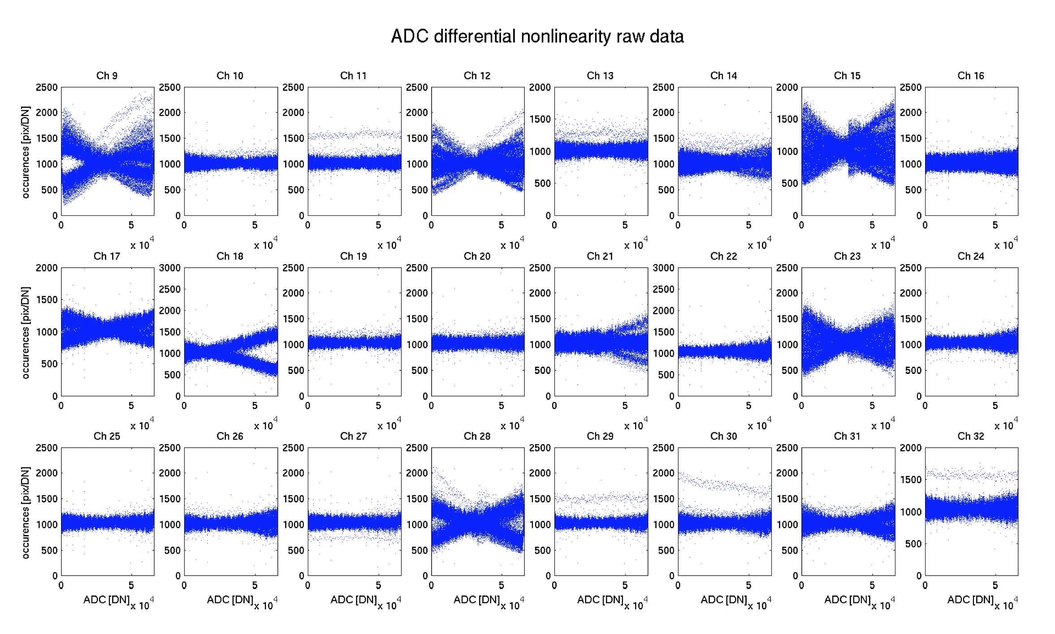
Measure all channels at once

Slide 24
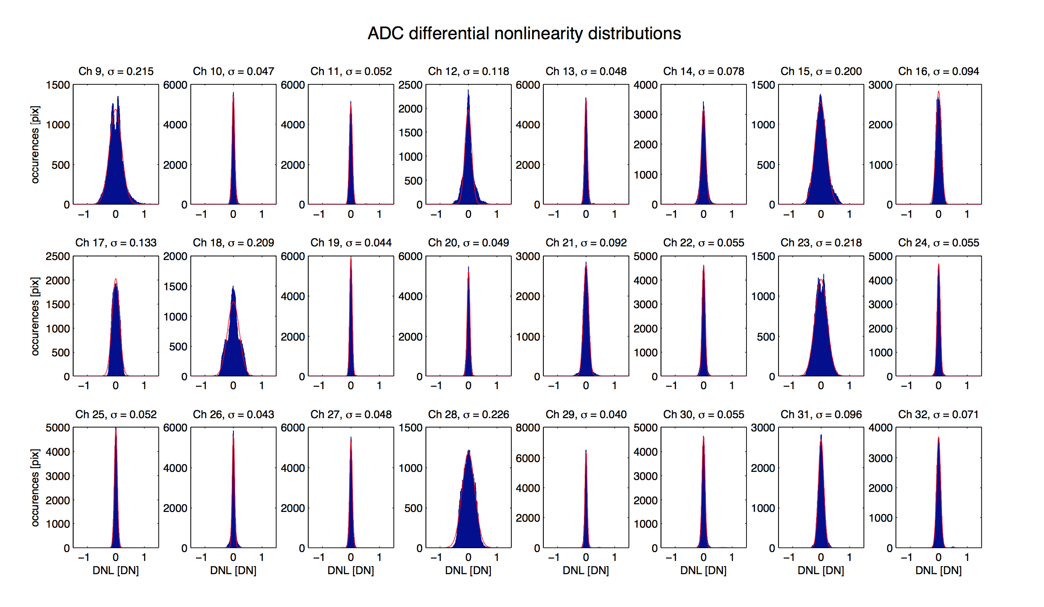
Histograms of DNL errors
All these are acceptable, but performance varies greatly…..

Slide 25
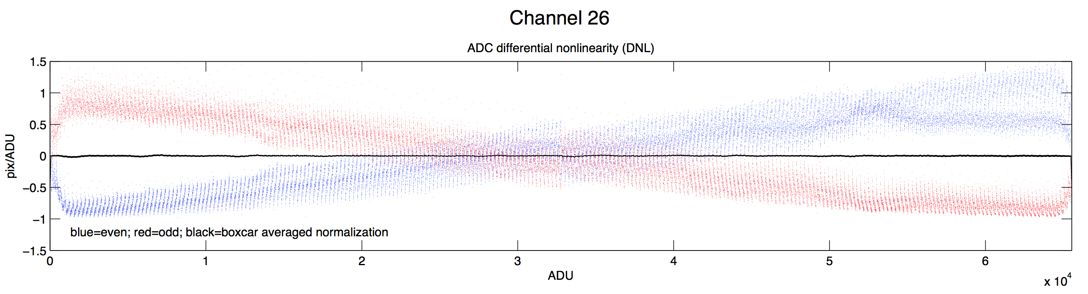
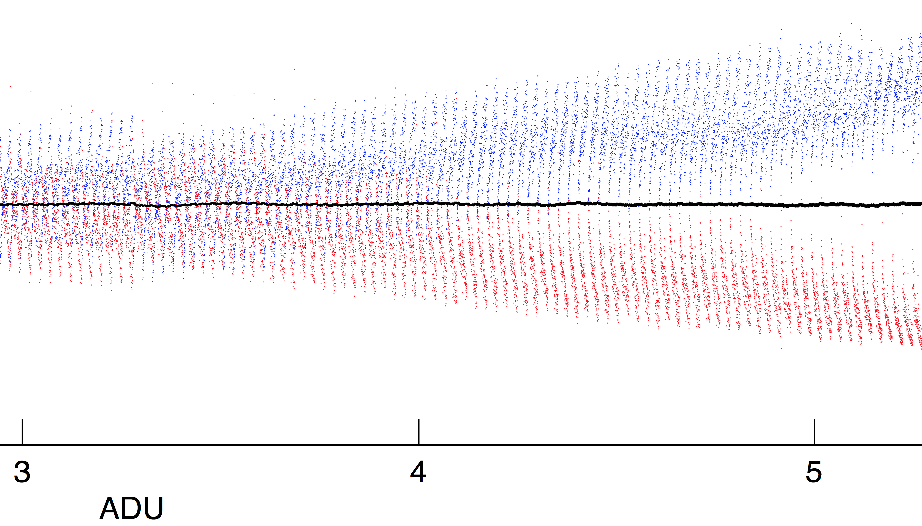
Zooming in on poor ADC

Slide 26
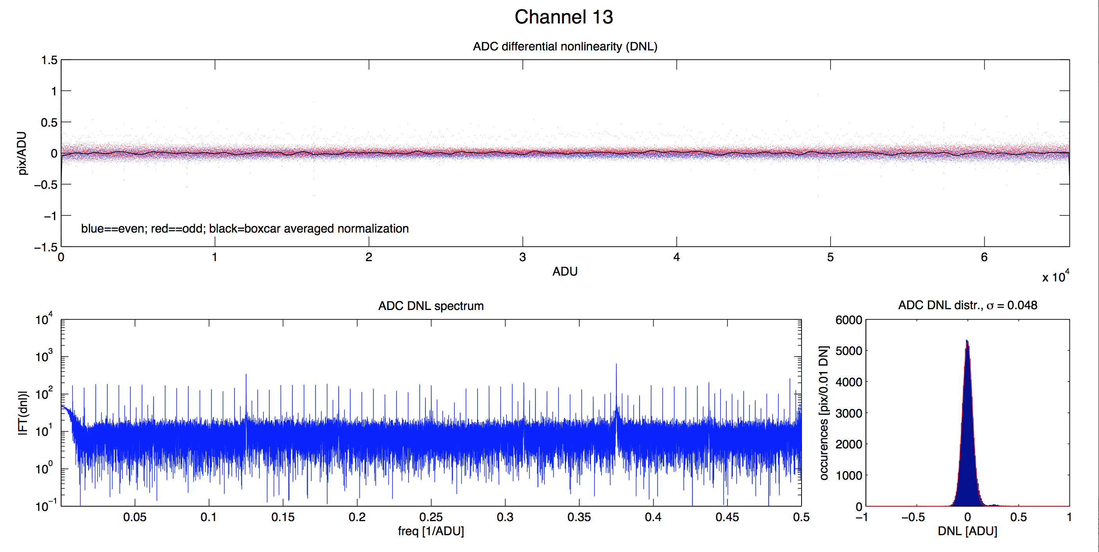
Excellent ADC
Fourier Transform of DNL errors reveals that they occur at binary transitions as expected.
Histogram of DNL errors

Slide 27
Rasterize histogram to see details

Slide 28
Rasterize histogram to see details

Slide 29
Rasterize histogram to see details

Slide 30
Rasterize histogram to see details

Slide 31
Making flat input histogram with CCD
Erase with shutter closed then read CCD with shutter open to generate linear signal ramp
  Read noise, shot noise and flat field irregularities are ok.
Adjust signal and/or line time so full well reached at end end of readout.
Combine histograms from multiple images. Need ~65 megapixels per output amplifier so ~ 1000 counts DAC code (assuming 16 bit ADC).

Slide 32
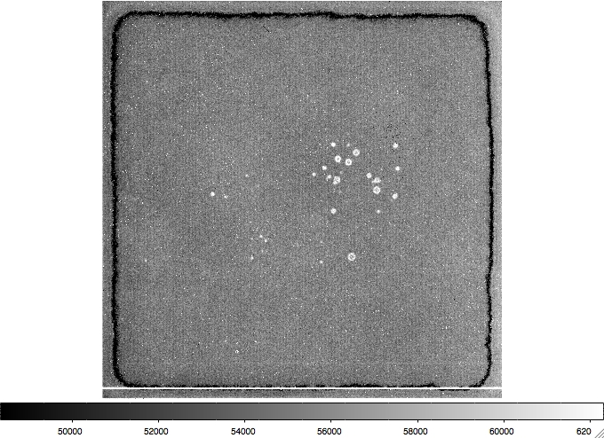
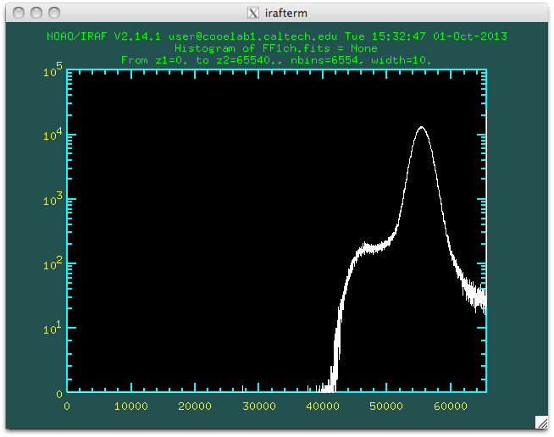
Generating flat input histogram with CMOS mux
Use unsubtracted data (not CDS)…
Pixel offsets are normally distributed with typically ~3000 ADU FWHM.
Mean can be shifted by input offset DAC.

Slide 33
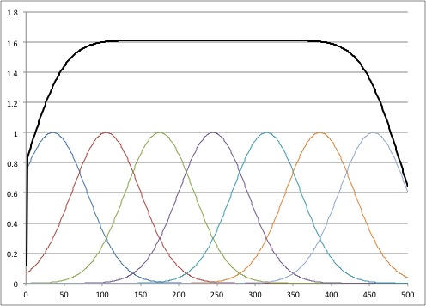
Overlapped gaussians → flat top
In our NIR detector controllers (ARC Inc), the input offset DAC produces shift in mean ~130 ADU at ADC for 1 count at DAC. This is safely less than 1500 ADU FWHM
Gaussian distributions separated by less than FWHM produce flat top when combined.
Model:
Perfect gaussians with uniform offsets

Slide 34
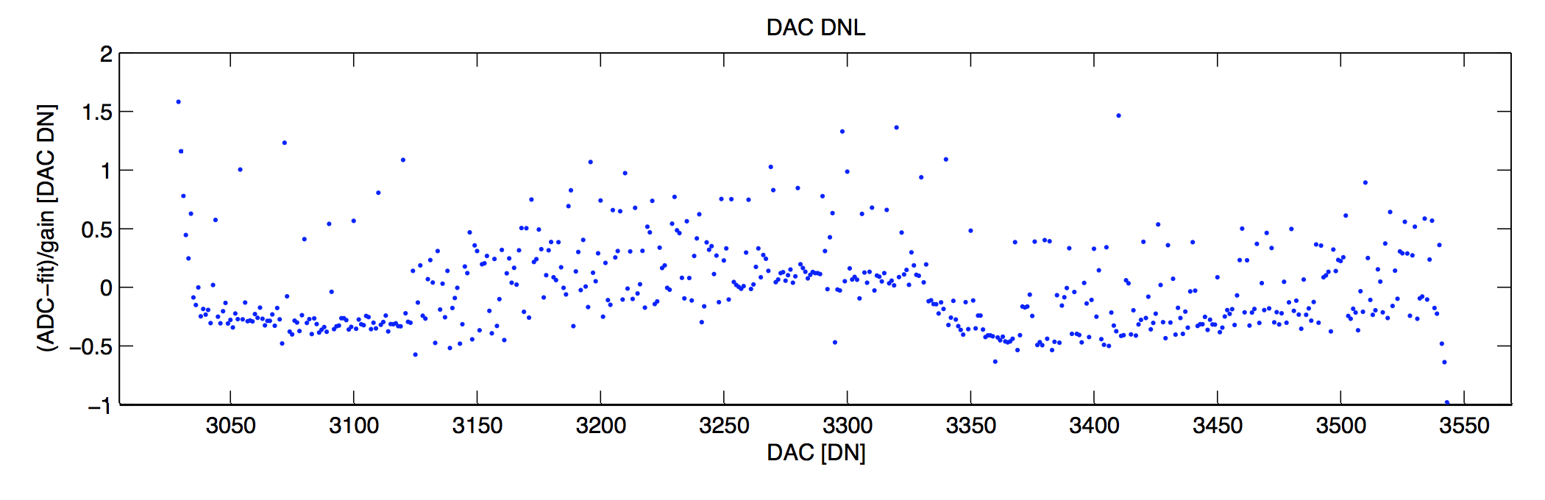
DAC DNL is also measured
DAC DNL creates low frequency ripples in ADC histogram at predictable periodicty given by number of ADC counts produced by one DAC count.
Smooth and normalize the ADC histogram to remove this small effect.
The shift in ADC mean measures the input offset DAC’s DNL.

Slide 35
Many topics not covered
Noise power spectrum measurement.
Banding and drift.
Fixed patterns; line start transient
Interference (moving patterns)
Timing jitter
Clipping levels; dynamic range.
DAC range
Bias and clock stability
Gain stability
Linearity
Crosstalk

Slide 36
Additional SLIDES

Slide 37
Vital signs – CCD in the dark
Cosmic rays and overscan edges?
Reset and clock feedthroughs normal?
Serial and parallel clocks connected?
  Inter-phase coupling
  Clock capacitance
  Resistance from one side of CCD to other
Finding CCD reset threshold.
Source follower gain and output impedance.
Source follower DC output level.
Internal AC coupler switch threshold

Slide 38
Vital signs – CMOS mux, in the dark
Linecheck & frame check
Output offset normal?
Output offset response to load current setting biases
Mux gain (change Vreset)
Unsubstracted image with permanent reset.
  Map of source follower offsets makes recognizable pattern.
What if its not working? How to check signal continuity to detector?

