Slide 1
Scientific Detector Workshop
October 10, 2013
Driving, conditioning and signal acquisition
Prototype ASIC for Large Format NIR/SWIR
Detector Array
B.Dupont, Peng Gao, B.Dierickx,
G.Verbruggen, S.Gielis, R.Valvekens

Slide 2
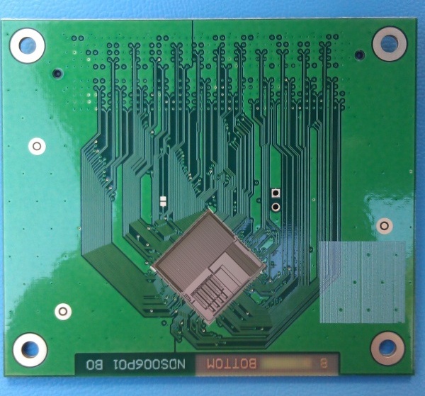
status
Development in two phases:
Prototype ASIC (2013)
Final product design (2014-2015)
Device is just back from foundry:
Tests will go on until jan 2014

Slide 3
Outline
Motivation and technical challenges
Design for Radiation hardness and Cryogenic temperature
Circuit design
Test setup
Conclusions

Slide 4
Outline
Motivation and technical challenges
Design for Radiation hardness and Cryogenic temperature
Circuit design
Test setup
Conclusions

Slide 5
A signal conditionning ASIC
This development aims at providing the community with
a signal conditioning ASIC
Tailored to imagers (especially IR sensor)
Versatile
With a wide operating temperature range
Taking in consideration multiple IR detector manufacturers specificities
Able to drive multi-sensor systems
Notes:
During the passed presentation, we have heard many smart detector designs and techniques to tolerance the radiation effect. But after all, to have to good imager, data acquisition and
In EU there are many very good IR sensor companies, they are all in

Slide 6
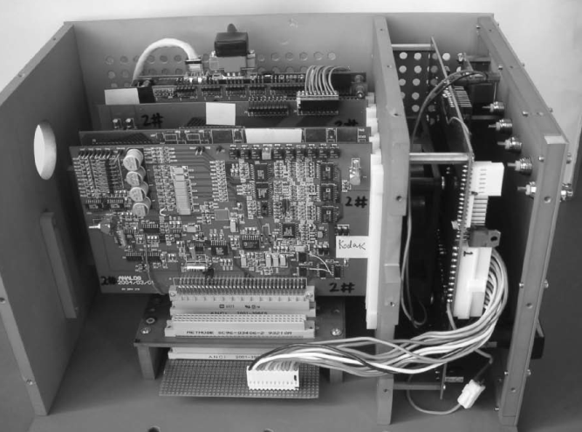
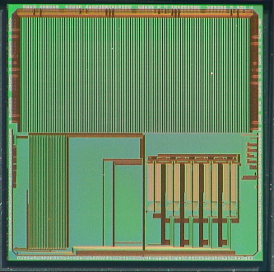
Why an ASIC ?
Data acquisition and control system for IR imagers
[Z.Zhao.SDA’05]
Analog domain
Signal conditioning
Analog to digital converter
Regulated power supply
Bias voltage/current references
Digital domain
Digital control core
Memory & Clock
Data Communication
Notes:
During the passed presentation, we have heard many smart detector designs and techniques to tolerance the radiation effect. But after all, to have to good imager, data acquisition and
In EU there are many very good IR sensor companies, they are all in

Slide 7
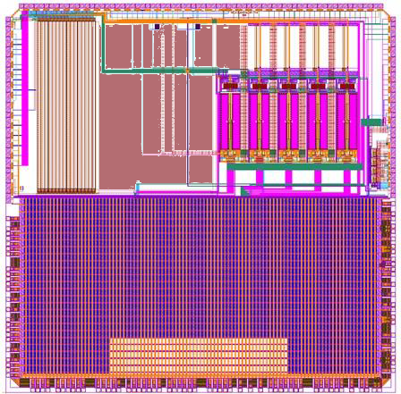
A mixed mode ASIC

Slide 8
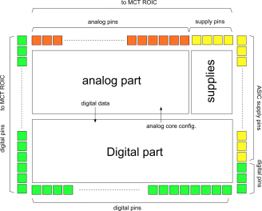
Challenging specifications
Analog domain
Function | No. | specifications
LDO | 4 | 1.3-3.4 [V], 100mA max. supply current
Analog inputs | 16
Preamplifier / CDS / Offset cancellation | 4 | 5 gains, 25uV RMS noise 8 bits Offset removal
16-bit ADC | 4 | Successive approximation with bits calibration Target DNL < 1,5 LSB
ROIC bias and Reference voltages | 16 | 10 bits, rail to rail operation
ROIC health monitoring | 4 | Resistors / differential voltage monitoring 16 bits
Internal reference | 1 | 1.2V Bandgap
Temperature sensor | 1

Slide 9
Challenging specifications
Digital domain
Master clock | 0 – 200 MHz
System level protocol | 2 – 200 Mbit/s Space Wire
ROIC digital control | 32
Scheduler time granularity | 10M updates/s
Sequence nesting depth | 8
ROIC monitoring and trigger inputs | 8
ROIC programming channel | 1 SPI

Slide 10
Environmental constraints
Challenging design for:
Cryogenic temperature (77K)
… but not only: operates from 77K to room temperature
Radiation tolerance in space (designed up to 1Mrad TID, 60MeVcm² /mg SEU)
High reliability
Scalalibility

Slide 11
Outline
Motivation and technical challenges
Design for Radiation hardness and Cryogenic temperature
Circuit design and simulation
Test setup
Conclusions and future work

Slide 12
Radiation hardness
Radiation hardness is a concern for:
Synthetized digital logic
Analog custom designed cells

Slide 13
Radiation hardness: digital design
The project uses DARE Library
Developed by IMEC
Designed up to Mrad, used in flight models
DARE180 (UMC 0.18um 1P6M CMOS)
Radiation Hard Standard Cells, SRAM, I/O cells, PLL
Intrinsic protection against Latch up and TID
Flip-flop protected against SEU
Allows custom mixed-signal design

Slide 14
Radiation hardness: digital design
Beyond library, circuit topology is rad hard:
Redundancy
Hamming Codes
Parity check
Safe FSMs
Watchdog Timers
Notes:
All FSMs and other random logic are implemented using HIT flip-flops. Additionally all logic is monitored by watchdog timers, resetting the logic when an operation needs more time than expected. All state machines will be implemented as safe state machines. This means that any change in the state due to an SEE-effect will not result in a blocked state machine.

Slide 15
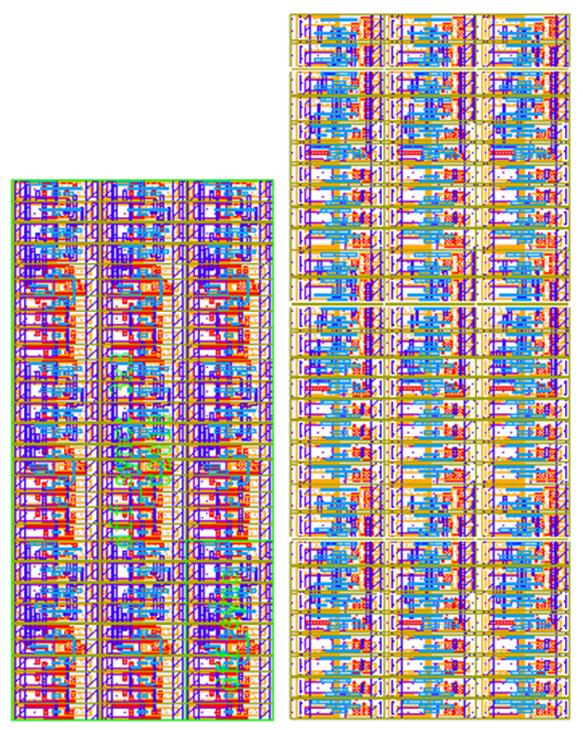
Radiation hardness: analog design
Caeleste uses its own radhard library
Analog and High Voltage logic standard cells
Full custom tactical cells
Prevention for:
Single Event
Total dose
Layout using Caeleste’s standard library (left) and the same in the fully radiation hard library (right)
Notes:
Logic, analog, fully custom designed,. Mega rad TID tested. Port matching by extract view form digital part. Vector driven simulation. (vector form digital partners)

Slide 16
Design for low temperature
Analog and digital flow require different approach on modeling and design strategy for cryogenic temperature:
Synthetized digital logic:
Validation of key blocks (such as SRAM)
A derating of speed, power, etc. of the library
Analog custom design:
Active and passive component

Slide 17
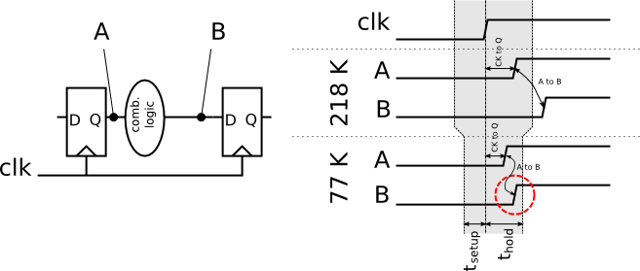
Cryogenic digital design
The DARE library has never been used at 77K
The logic becomes faster. However one must take care of set-up and hold time violation.
The library models have be adapted, based on a model characterized at 218K
Other components like SRAM are also to be validated still

Slide 18
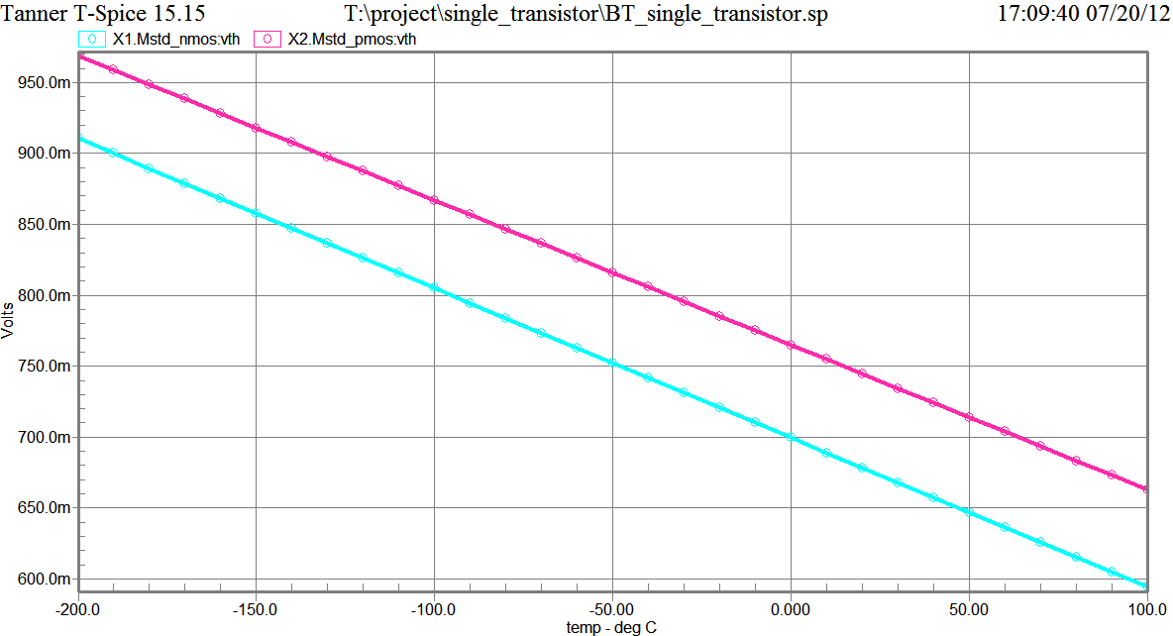
Cryogenic analog design
MOSFET modeling
V_{th}: increase
Mobility: increase
MOS switch: low R_{on}
Careful choice of passive components
High doped non silicide poly Resistor for stability
MIM capacitors

Slide 19
Outline
Motivation and technical challenges
Design for Radiation hardness and Cryogenic temperature
Circuit design
Test setup
Conclusions
Notes:
Why design this ASIC ,,,,, of….

Slide 20
Analog section

Slide 21
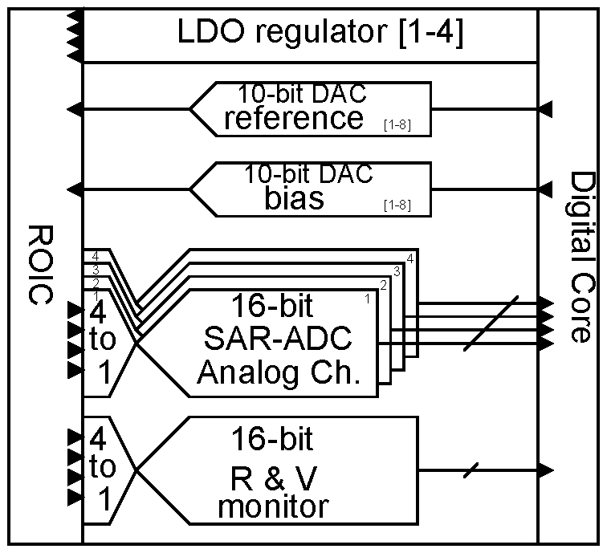
Analog section

Slide 22
LDO
LDO
Programmable output
Stability: PM>60°
Output current 0-100mA
Bandgap
1.2V
77K-300K

Slide 23
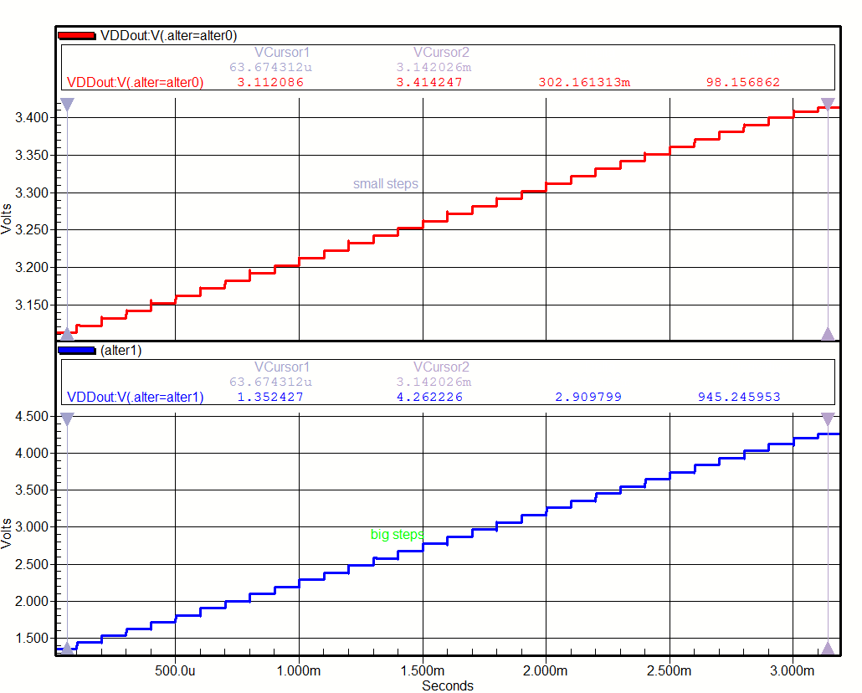
LDO: tunning range
Fine / coarse
Tuning
Extended
Range:
1,3…4,2V

Slide 24
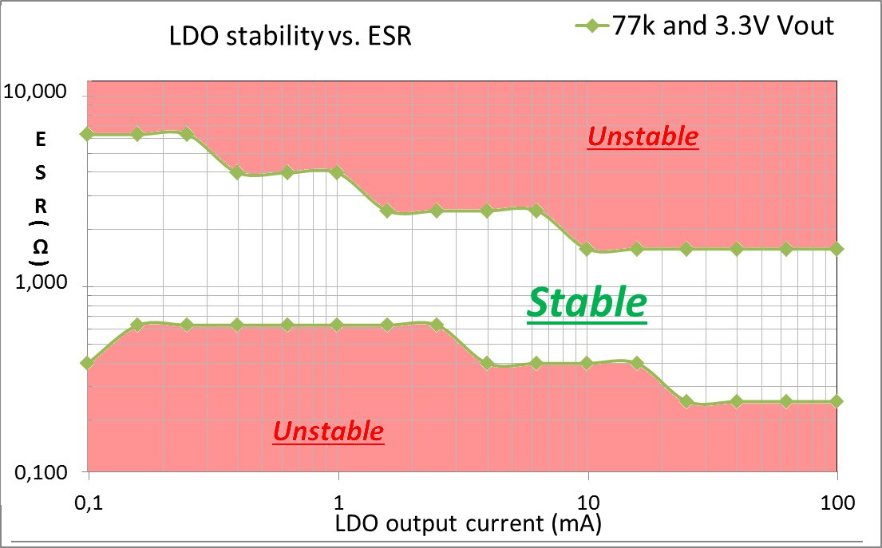
LDO: stability

Slide 25
Conversion channel
One ADC addressed 4 analog inputs in prototype ASIC
CDS
Bypassable
Preamplifier (PA)
Programmable gain from 0-30dB in 6dB step
Offset cancellation
Single to differential

Slide 26
ADC
16-bit, 50-200kHz, fully differential SAR ADC
Feedback DAC 11 MSBs capacitive and 5 LSBs resistive
Low offset comparator: auto zero
A calibration scheme is available

Slide 27
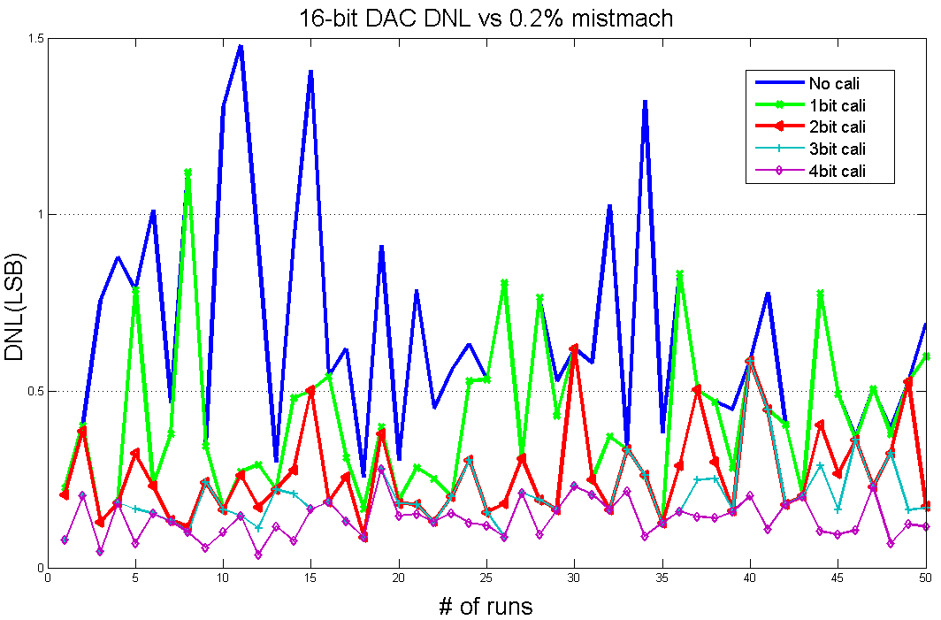
ADC: model driven design
Effect of mismatch calibration on DNL

Slide 28
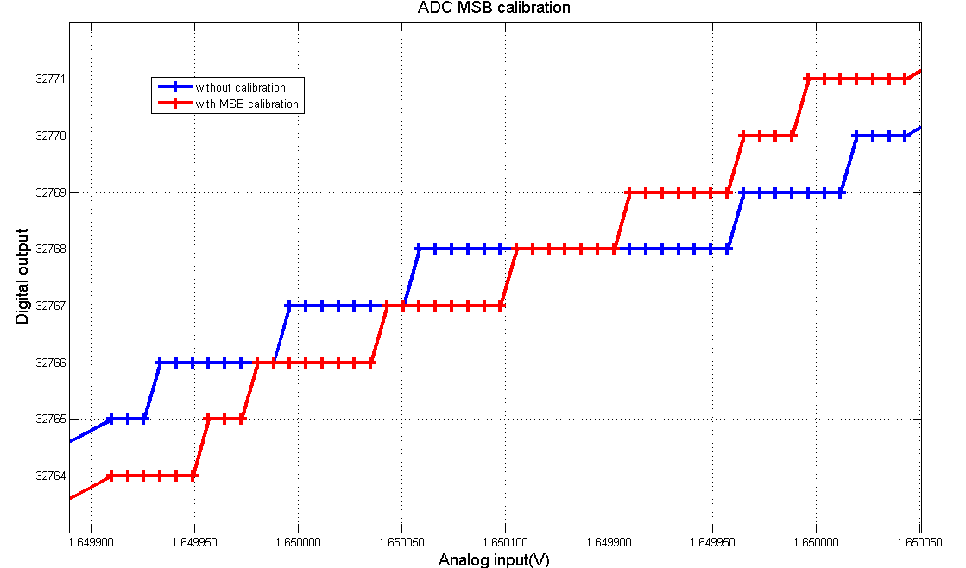
ADC: design verification
Full analog simulation:
Effect of calibration on linearity
Notes:
Full page pics. One pic!

Slide 29
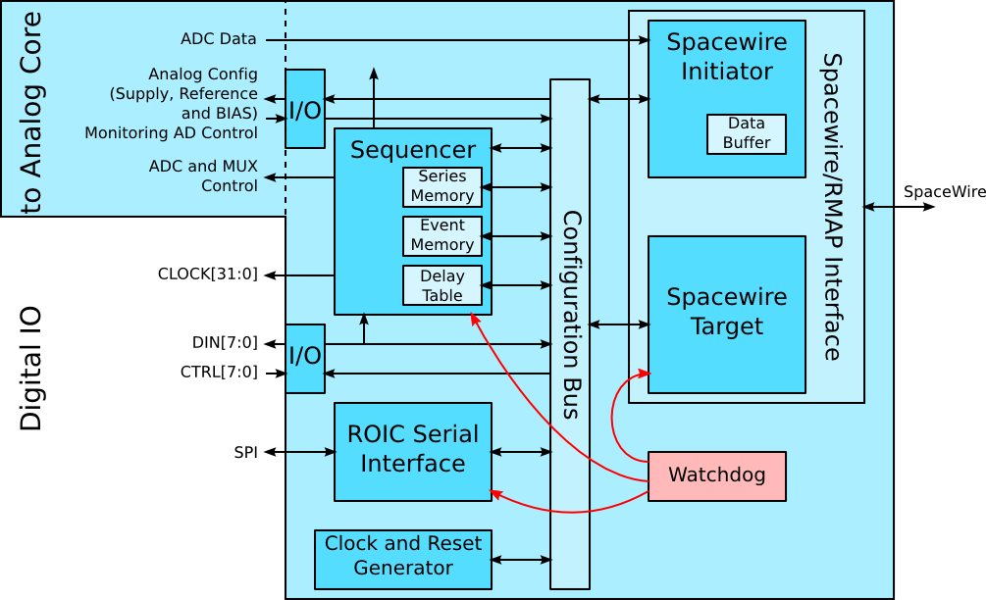
Digital design

Slide 30
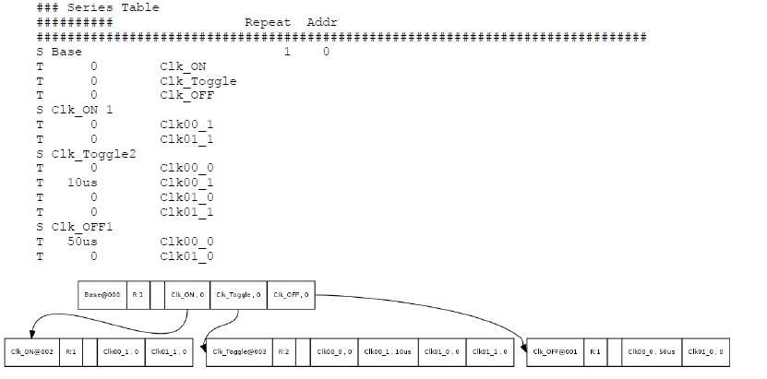
Digital design

Slide 31
Outline
Motivation and technical challenges
Design for Radiation hardness and Cryogenic temperature
Circuit design
Test setup
Conclusions and future work

Slide 32
Test setup
Unified design for:
Room temperature board
Cryogenic temperature

Slide 33
Outline
Motivation and technical challenges
Design for Radiation hardness and Cryogenic temperature
Circuit design and simulation
Test and measurements
Conclusions and future work

Slide 34
Conclusions
Fully custom design high performance mixed signal ASIC
From cryogenic(77K) to room temperature
Radiation hard for TD and SE
Highly flexible for ROICs
programmable sequencer
programmability and large dynamic ranges in analog circuits
Beyond IR imagers
Notes:
Full page pics. One pic!

Slide 35
Next steps ?
Testing!
Larger Asic with multiple channels (32 to 64)
Faster ADCs are under development (up to 12MSamples /s with reduced resolution)
More discussion with instrument builders and IR sensor manufacturers for further enhancements
Irradiation testing and deeper temperature testing
Notes:
Full page pics. One pic!

Slide 36
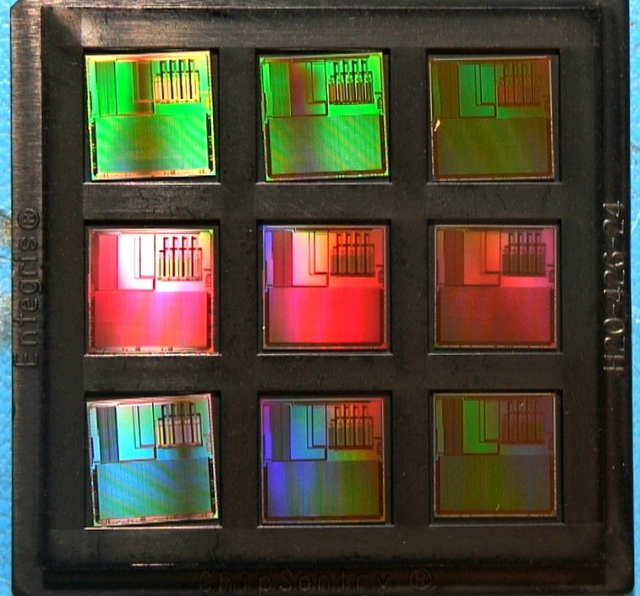
Thank you!

