Slide 1

A compact, low power digital CDS CCD readout system.
Armin Karcher
SDW 2013

Slide 2
Overview
Motivation
System Design Goals
System Architecture Overview
  Video Hardware Architecture
  Bias voltages
  Clocking Hardware Architecture
  Timing Generation
  Software
  System Design Choices
Details on the Video Signal Chain
Performance overview

Slide 3

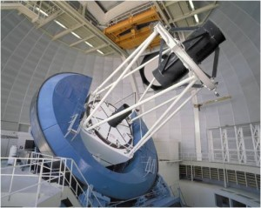
Background
DESI is a robotic actuated, fiber fed spectrograph system for the Mayall 4m telescope.
It consists of 5000 fibers, feeding 10 spectrographs with 3 cameras each.
CCD readout electronicis designed for the DESI spectrographs is described here.
The goal is to have a workable system early on to be able to use the same hardware and most of the same software during testing,commissioning and operations.

Slide 4
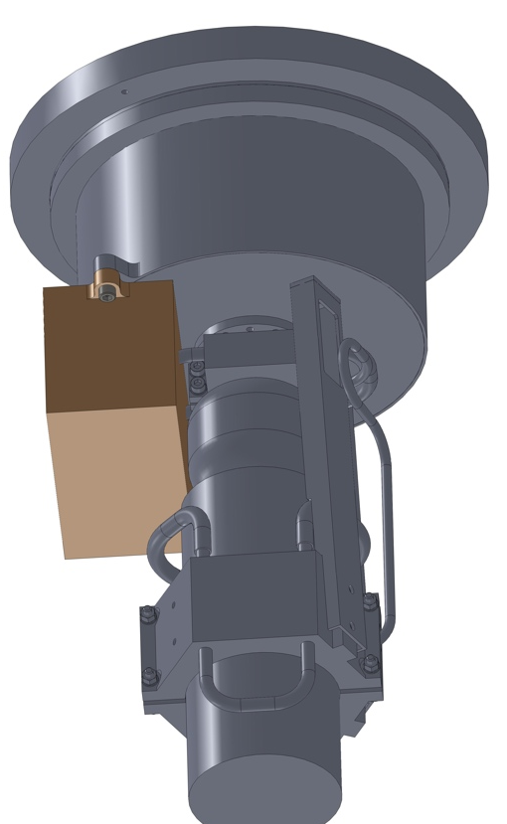
Hardware Requirements
Low Noise
Compact / Low Power
Flexible
  P type and N type CCDs
  3 and 4 phase clocking
Commercial interface
  TCP/IP over Ethernet

Slide 5
Video Architecture
CCD
Pre
Amp
PGA
Buffer
ADC
6.4 Gb/s
Digital CDS
High analog bandwidth
Flexible averaging time
Few analog components
High speed 16 bit ADC (100MHz)
Large data bandwidth to FPGA
Offset
DAC
FPGA

Slide 6
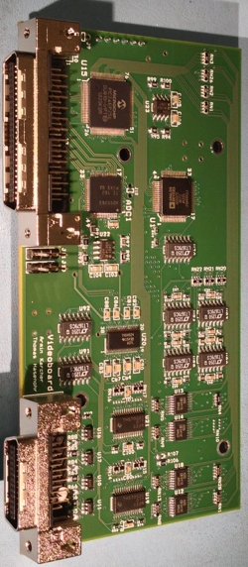
Bias Architecture
Bias
DAC
Buffer
Enable
32 channel 16-bit DAC for on-board and CCD bias voltages.
Bi-polar DAC, +/-15V and 0V to +/- 30V buffers.
On board jumpers configure polarity for n- or p-channel CCDs.
Rail-to-rail buffers allow single supply positive or negative operation.
Non inverting buffer allows filtering using low voltage capacitors.
MCU with 32 analog inputs controls DAC and reads buffered voltages prior to enabling outputs.

Slide 7
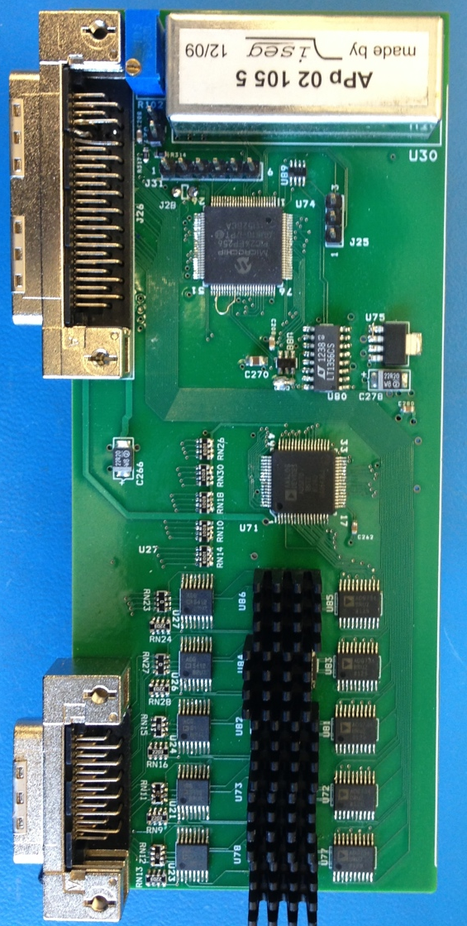
Clocking Architecture
40 channel 16 bit DAC for 20 clock voltages.
High speed, low voltage switches.
High slew rate amplifiers with gain drive CCD clocks.
Enable and voltage read-back by on-board MCU.
All timing is directly driven by FPGA (LVTTL).
High voltage for CCD depletion is generated on-board.
  Ramping and clamping controlled by MCU

Slide 8
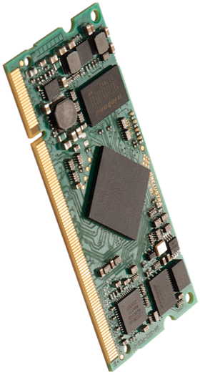
FPGA Board
Commercial board reduces routing effort
Includes DRAM, FLASH, Power, Ethernet phy
Ultra compact SO-DIMM form factor
Upgrade path to new, pin-out compatible boards with next generation FPGAs
Uses MicroBlaze soft-core@100MHz for PC communication.
State machine reads timing table from internal memory and generates clocks, reads ADC data, and transmits CDS data to Micro Blaze.

Slide 9
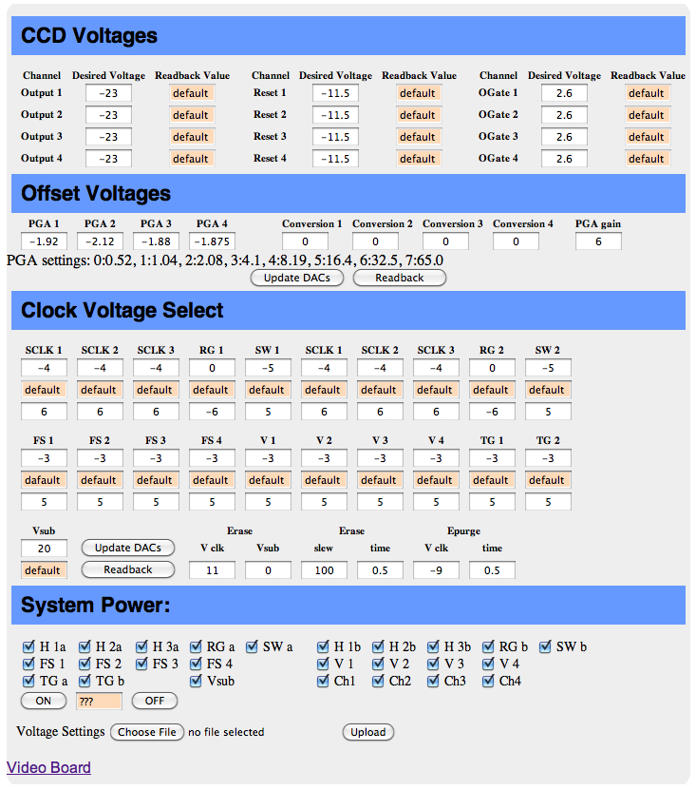
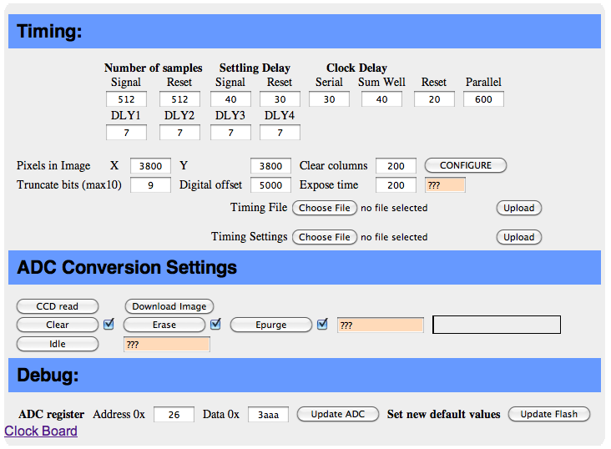
Software
User Interface is web based.
No PC software is needed.
All configuration files are stored on the controller in flash.
Images can be acquired/read out by sending requests from the browser or any user program.
Image files are sent in fits format.

Slide 10
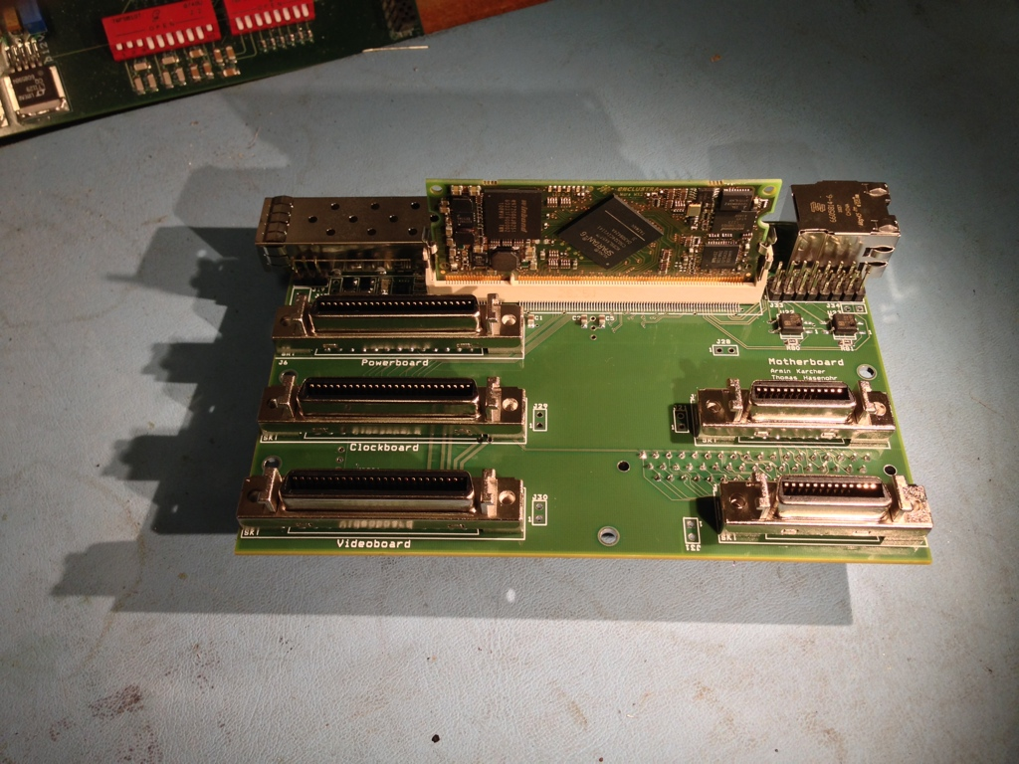
System Choices
Commercial FPGA board, upgradeable, reduced engineering, incorporates many system components.
Single FPGA makes firmware simpler, reduces complexity of other boards.
Web based GUI eliminates need for client software.
Ethernet interface uses commercial routing and PC interface components
Direct LVTTL switching of clocks eliminates need for high speed backplane protocols.
MCU on daughter boards incorporates ADC, mux, individual voltage enable. Increases flexibility while reducing backplane signals and component count.
Single ended low noise input eliminates need for external video drivers.

Slide 11
Video Architecture (cont.)
THS7002
THS4524
ADS5263
CCD
Pre
Amp
FPGA
PGA
Buffer
ADC
DC restore uses clamp or resistor
Offset
DAC
8 channels 800mb/s
Input has a choice of resistor or switched clamp
Pre-amp and PGA run off +/-15V supply to give maximum headroom.
Dual offset DACs allow independent adjustment of single ended and ADC zero points.
End to end bandwidth >25MHz guarantees fast settling, beneficial for both slow and fast read rates.

Slide 12
Video Architecture (cont.)
THS7002
THS4524
ADS5263
CCD
Pre
Amp
FPGA
PGA
Buffer
ADC
DC restore uses clamp or resistor
Offset
DAC
8 channels 800mb/s
100Mhz ADC allows 10ns time granularity.
Low voltage (3.3V) ADC reduces power consumption.
Low component count allows for compact design.
Easily converted to a differential input with external pre-amp.
Jumpers allow for differential signal inversion for n-channel CCDs

Slide 13
Digital CDS
8 channels 800mb/s
ADS5263
Spartan 6
FPGA
ADC
Simple approach to DCDS was chosen.
A programmable number of Reset and Signal samples are added in two 26bit accumulators.
The difference is right shifted by a programmable number of bits and 16 bits are read-out.
A digital gain can be chosen by setting the shift number.
This allows simple tuning of settling and averaging times.
More complex approaches may now be investigated after fully understanding the current system performance.

Slide 14
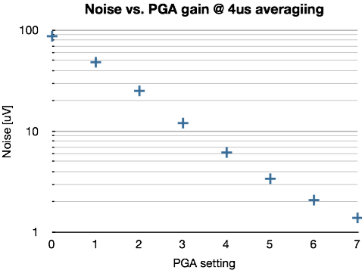
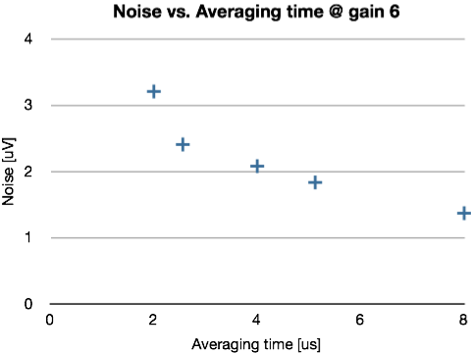
Performance without CCD
Input sensitivity is adjustable from 60uV/ADU to 0.6uV/ADU
Single ended input can be directly attached to CCD output.
1.7nV/rt Hz and 0.9pA/rt Hz input referred noise make buffer Jfets unnecessary.
Noise is below 1e- or 1.2 ADU for gain 6 @ 100kHz.
For lower gain noise does not improve below 0.6 ADU.
1e- LBNL std. CCD
1e- LBNL std. CCD

Slide 15
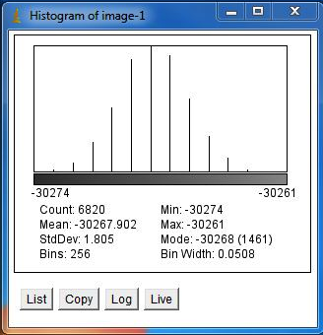
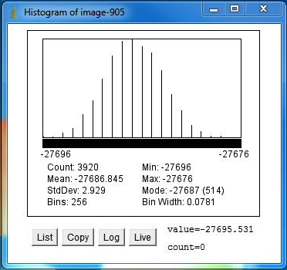
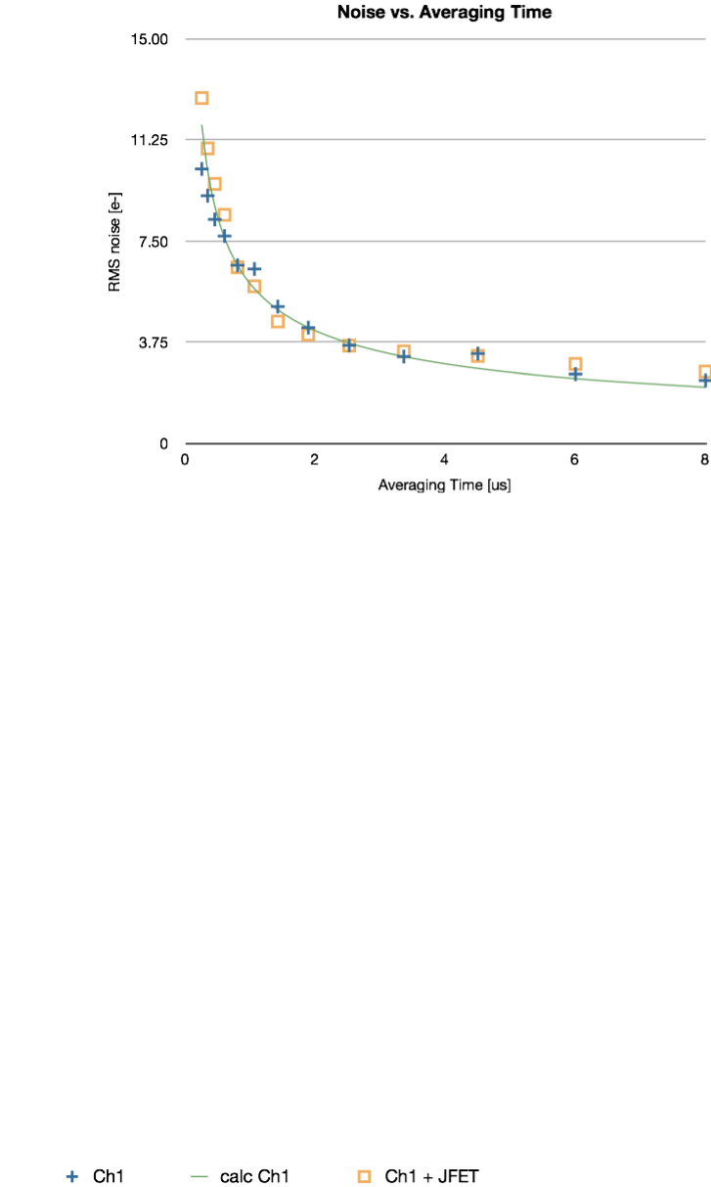
Performance with LBNL CCDs
Performance is identical to the best we have seen on this CCD with the ARC Gen2 system.
Newer low capacitance output transistors bring down noise.
Lowest achieved noise in test system:
  1.76 e- @ 100kHz
  1.59 e- @ 50kHz
Readout without CCD
Original LBNL CCD

Slide 16
Issues and Changes
A second revision was designed to improve packaging density and fix minor problems.
DAC outputs were too noisy, large RC filter implemented for clocks and bias voltages.
Rail to rail single supply OpAmps were used for higher voltage bias drivers, eliminating second supply and reducing power.
A clamp for DC restore was added to eliminate drift in flat field exposures.
A power supply board with low noise switching supplies was incorporated to reduce the need for external supplies.
Two optically isolated outputs were added for external devices such as shutters.

Slide 17
Questions

